Slide 1
Graphics 2
06-02408
Level 2
10 credits in Semester 2
Professor Ela Claridge

Slide 2
Aims
Further develop the concepts and terminology of computer graphics
Develop understanding of key representations and techniques of computer graphics
Develop skills in applying computer graphics techniques to construction and viewing problems

Slide 3
On completion of this module, you should be able to
Design wire-frame representations of 3-dimensional objects
Define matrices for 3-dimensional transformations
Explain and design algorithms for viewing and projection of 3-dimensional objects using transformation matrices
Apply the relevant concepts of linear algebra and geometry to the design of computer graphics algorithms (e.g. vector and matrix operations and trigonometry)
Explain and design raster conversion algorithms
Explain image representations and colour models

Slide 4
“There is particular criticism of specialised video games and effects courses. In 2009, just 12% of graduates from video games courses found jobs in the sector within six months of graduating. Employers in the games industry say graduates of these courses have poor technical skills in areas such as maths and programming, and lack management skills.”

Slide 5
Hope, managing director of the visual effects firm Double Negative, said: "In Harry Potter [and the Half Blood Prince], the opening sequence has Death Eaters flying across the river Thames, destroying the [Millennium] bridge between St Paul's and the Tate Modern.
"The way you create that is people who understand computational fluid dynamics, they know how water moves. They take the physics that's used in modelling rivers and the flow of water and apply that in our world. People doing it need an artistic sensibility as well. An understanding of maths and science is fundamental to many of the disciplines in our industry."

Slide 6
Teaching and learning
“What” and “Why” parts: topic introduction, theoretical underpinnings of the methods used in the practical work
“How” part: Practical work using Matlab or any software of your choice (e.g. Povray, Java 3D, DirectX, etc) (unassessed)

Slide 7

Teaching and learning
Traditional lectures
Exercises related to the taught topics (unassessed)
Several tutorial-style lectures
“How” part: Practical work using Matlab or Povray (unassessed)
“Why” part: theoretical underpinnings of the methods used in the practical work

Slide 8
Teaching
Traditional
Conventional lectures - 2 hrs/week for most of the semester
Tutorial-style lectures - step by step solution to a 3-dimensional viewing problem
Practical exercise in construction and viewing of 3-dimensional wire-frame objects (unassessed)

Slide 9
Syllabus
Traditional
3D constructive graphics
Coordinate systems
Object & scene design - primitives, attributes and data structures
Graphics transformations in 3D: translation, scaling, rotation, composite transformations
3D viewing
2D raster graphics
Algorithms for efficient drawing of lines and curves

Slide 10

Syllabus (cont)
Traditional
Animation
Images and colour
Rendering (light, reflectance, shading)
Image representations
Colour models
Image enhancement

Slide 11
Syllabus
Object construction
  Vertex and surface tables
  Sweep functions
  Height maps
Rendering
  Surface colour
  Lights
  Reflectance
  Shading
  Simple texture mapping
  Lines and circles
Coordinate systems
Vectors and matrices + operations
3D transformations (T,S,R)
Delunay triangulation
Light, spectra and colour
Colour spaces
Normal vectors
Physics of light reflectance
  Cosine law, Snell law
  Surface properties
Interpolation

Slide 12
Syllabus (cont.)
Viewing and projection
  Camera positioning
  View definition
  View projection
  Hidden surface removal
Animation
  Object movement
  Camera movement
  Path definition
  Making movies
Transformation matrices
Combined transformations
  Matrix multiplication
Transformations of coordinate
systems
Transformations (as above)
Lines
  Parametric equations
  Bresenham’s algorithms
2D and 3D splines
In-betweening
Double buffering
Hidden surface removal

Slide 13
Syllabus (cont.)
Digital images
  Handling colour
  Image enhancement
Overview of selected advanced topics
  Ray tracing
  Particle animation
  Morphing
Further colour spaces
Colour conversion
Colour map manipulation
Image smoothing and sharpening

Slide 14
Teaching materials
Books
Handouts
On-line exercises and solutions

Slide 15
Recommended Books
Computer Graphics, Hearn D & Baker M, 1997.
3D Computer Graphics, Watt, A, 2000.

Slide 16
Practical work option: Matlab
Scientific programming environment
Interpreted language
Support for 2D and 3D graphics
Available for Windows, Mac, Linux

Slide 17
Matlab
Tutorials
http://www.cyclismo.org/tutorial/matlab/
  Work through the tutorial should take you 2-3 hours.
Matlab Help
  Have a look at the “Programming” and “Graphics” sections

Slide 18
Matlab
Tutorials
http://www.cyclismo.org/tutorial/matlab/
  Work through the tutorial should take you 2-3 hours.
http://web.mit.edu/6.094/www/lecnotes/lec1.ppt
  Ignore first five pages which have information relevant to the MIT course
Matlab Help
  Have a look at the “Programming” and “Graphics” sections

Slide 19
Vectors
Colours, Positions and Directions are represented using vectors e.g.
  rgb [1, 1, 1]
  translate [0, 0, 1]

Slide 20
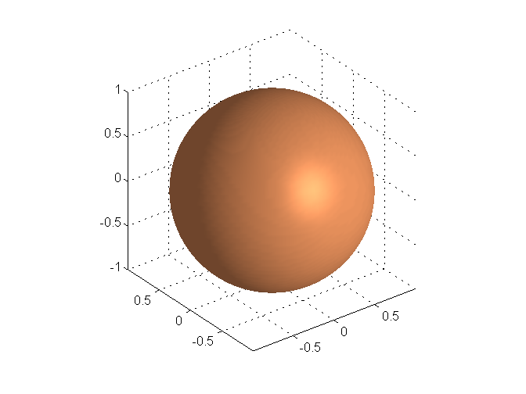
Simple Objects
A few basic shapes are provided, e.g. a unit sphere is simply generated by
  S =sphere;
Material properties can be included within the object description e.g.
  S = sphere;
  material shiny;

Slide 21
Camera Positioning
The following is an example of a simple set-up :
camproj('perspective');
campos([xp,yp,zp]);
camup(up_vector);
camtarget([xp;yp;zp]+target_vector);
drawnow
There are other options you can use for modelling a camera. We will discuss camera modelling in more detail in later lectures

Slide 22
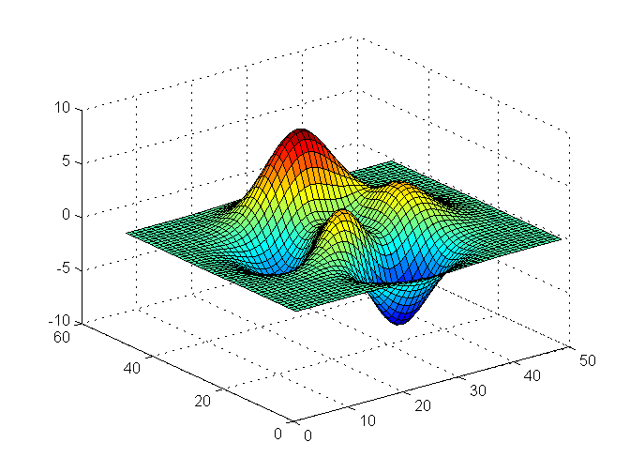
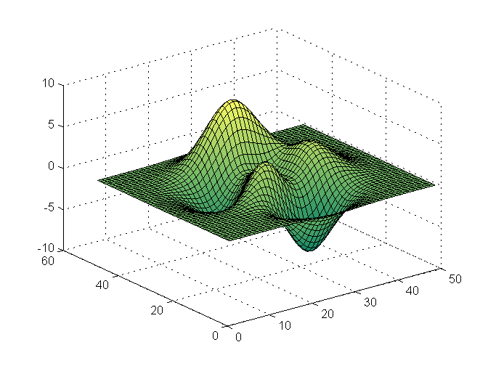
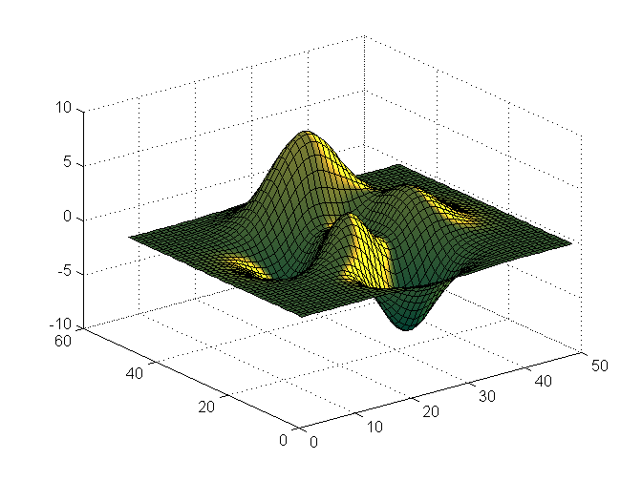
Light Source
For any object to be rendered visible, we require at least one light source or emissive object
h = surf(peaks);
colormap(spring);
set(h,'FaceLighting','phong', 'FaceColor','interp’,'AmbientStrength',0.5)
light('Position',[1 0 0], 'Style','infinite‘,’Color’,[1 1 0]);

Slide 23
Comments
Comments can be included like this
  figure;
  hold on %this is a single line comment
  %{
  % the whole section commented out
  for i=1:N
  plot(X,Y,’r’);
  end
  %}

Slide 24
Assessment
1.5 hr examination (100%)
The role of the exercises

