Slide 1
2. DEFINING OBJECTS:
3D REPRESENTATIONS
Coordinate systems
Surface representations
Polygon tables
Volumetric representations - overview
Constructive Solid Geometry
Oct-trees

Slide 2
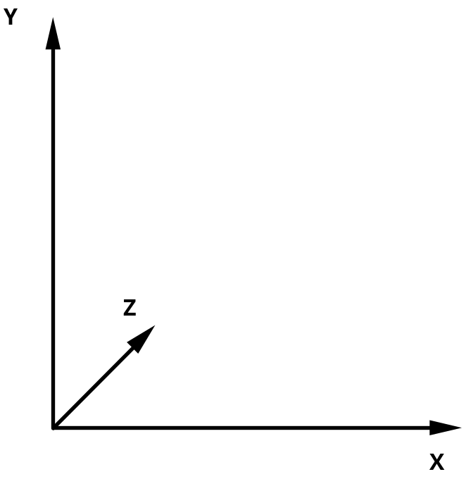
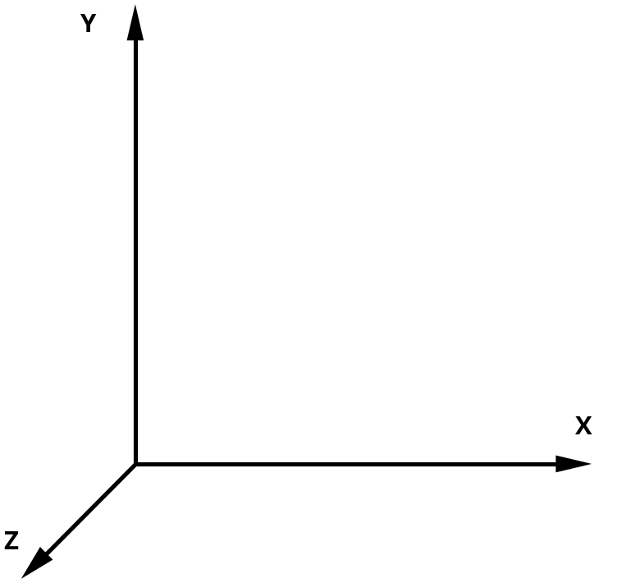
3-Dimensional coordinate systems
Cartesian left handed Cartesian right handed
Z axis goes "into" the page Z axis goes "out" of the page

Slide 3
In this course we use right-handed coordinate system

Slide 4
Right-handed coordinate system
Y
Screen
X
Z

Slide 5
Right-handed coordinate system layouts
Z
Y
X
Z-up
Typically used in design
Y-up
Typically used in display / animation

Slide 6
Right-handed coordinate system layouts
Z
Y
Y
Z
X
X
Z-up
Typically used in design
Y-up
Typically used in display / animation

Slide 7
Two classes of 3D representations
Surface
Solid

Slide 8
Surface representations
Polygon surfaces

Slide 9
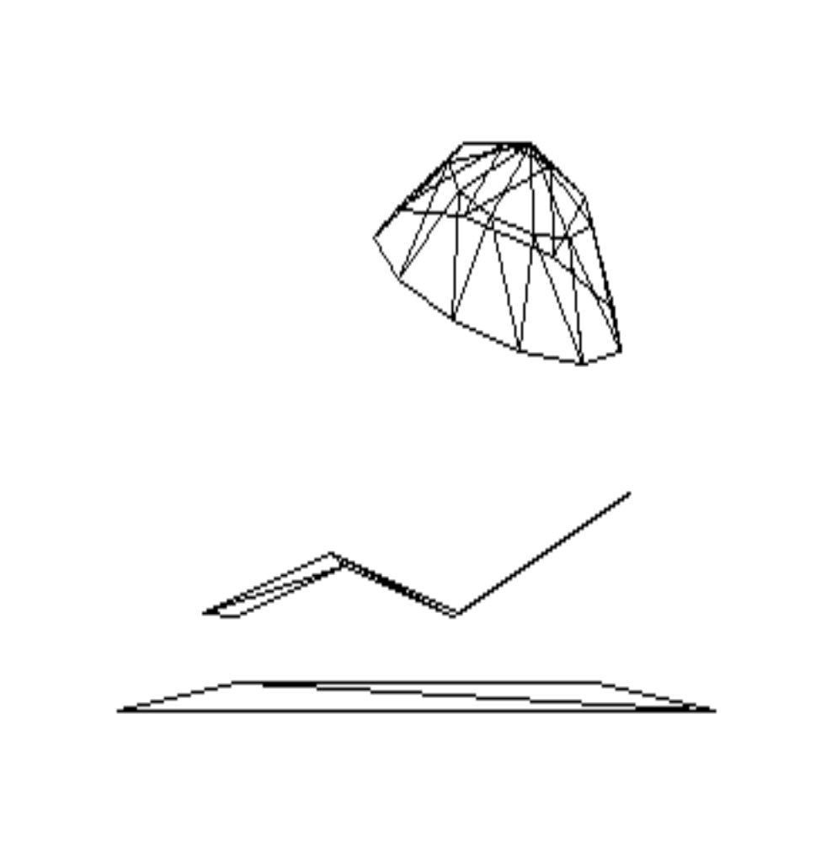
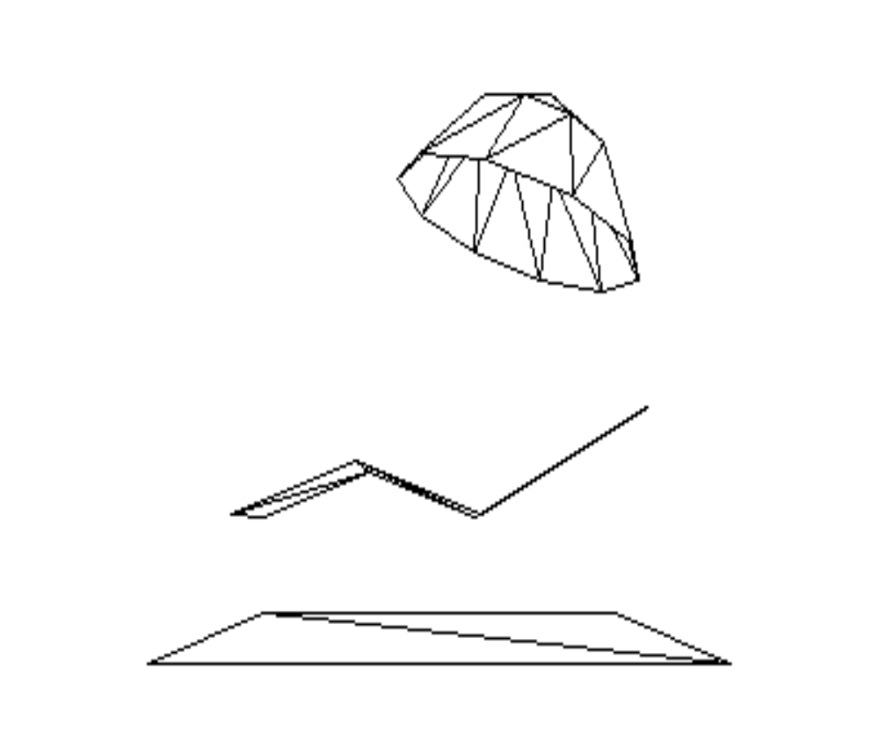
Succession of models
Wireframe Surface patch

Slide 10
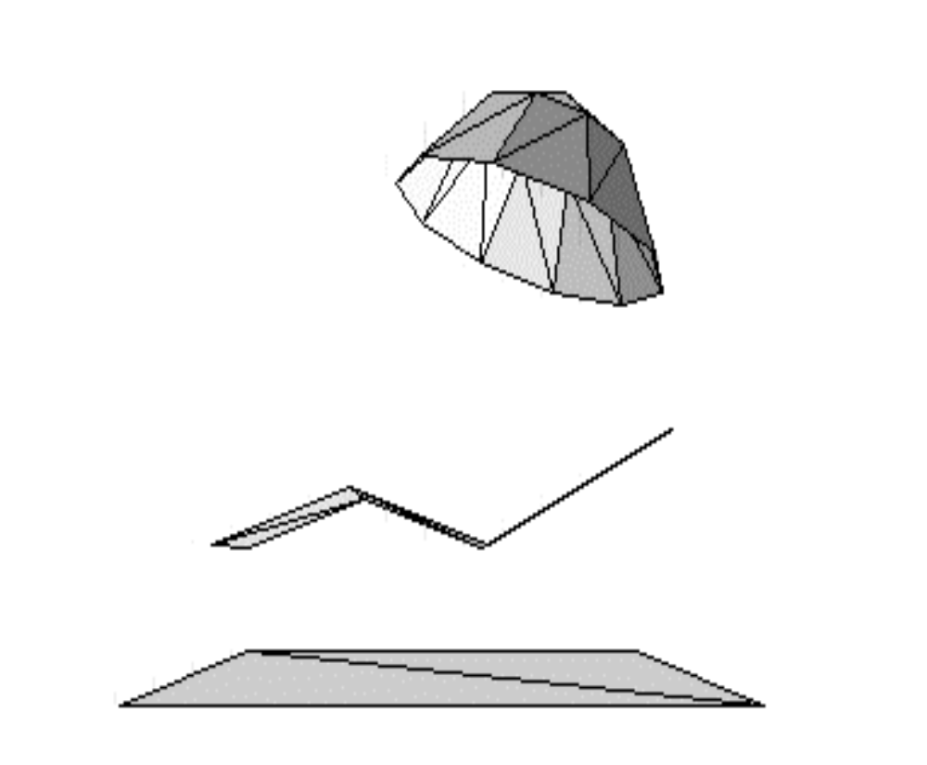
Surface patch Surface shading

Slide 11
Surface representation
Surface
Vertex
Edge

Slide 12
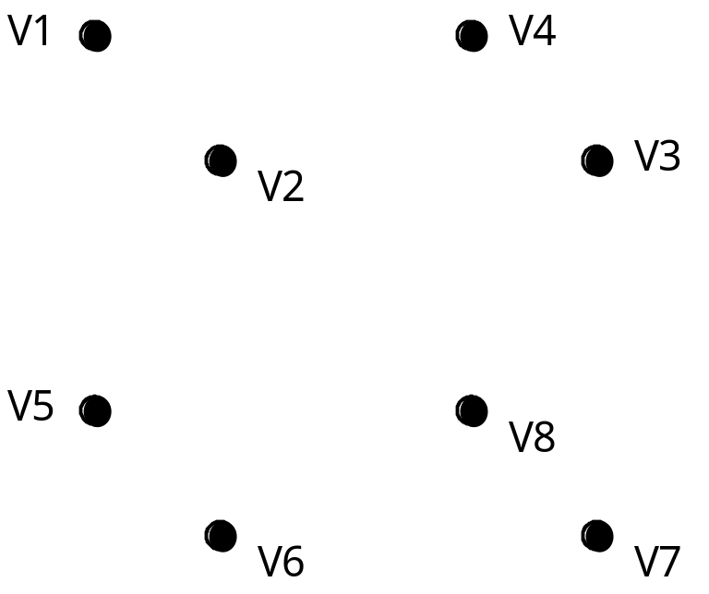
Vertices

Slide 13
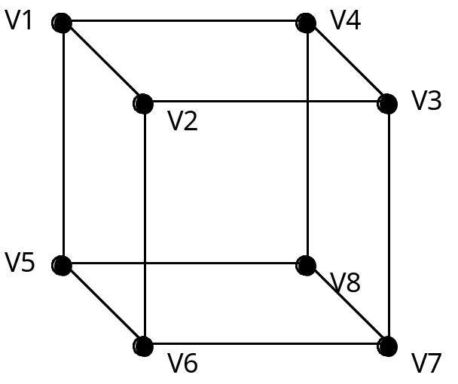
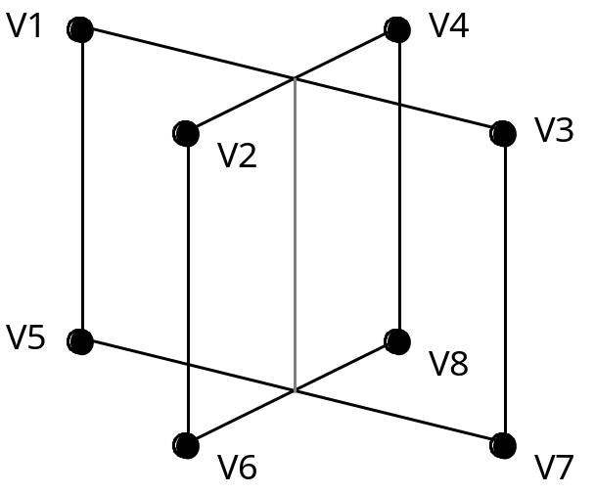
Wire-frame
How many surfaces?

Slide 14
Surface
V1
V4
V1
V4
V3
V3
V2
V2
V2
V2
V5
V5
V8
V8
V6
V7
V6
V7

Slide 15
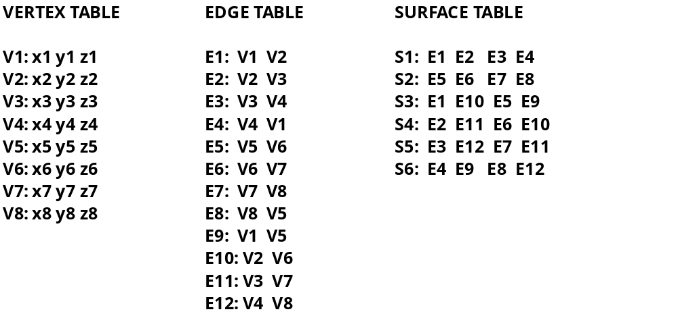
Surface (Boundary) representation
S1: V1 V2 V3 V4
S2: V5 V8 V7 V6
S3: V1 V5 V6 V2
S4: V2 V6 V7 V3
S5: V3 V7 V8 V4
S6: V1 V4 V8 V5

Slide 16
From vertices to surface patches
When constructing a surface patch,
does it matter
in what order we traverse the vertices?

Slide 17
YES
“In-s and Out-s” of triangles
Outside
(front-facing)
1
Inside
Right-hand rule
2
0

Slide 18
Exercise
VERTEX TABLE
SURFACE TABLE
V1: x1 y1 z1
V2: x2 y2 z2
V3: x3 y3 z3
V4: x4 y4 z4
V5: x5 y5 z5
V6: x6 y6 z6
V7: x7 y7 z7
V8: x8 y8 z8

Slide 19
Surface representations
Surface patches

Slide 20
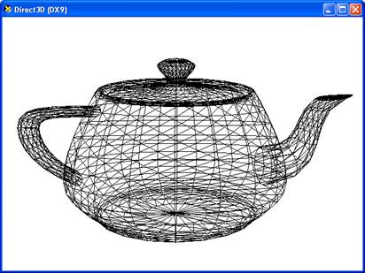
Surface representation: Utah teapot
Source: http://www.codesampler.com/d3dbook/chapter_05/chapter_05.htm
Vertex table:
http://www.sjbaker.org/wiki/index.php?title=The_History_of_The_Teapot#The_Teapot_DataSet

Slide 21
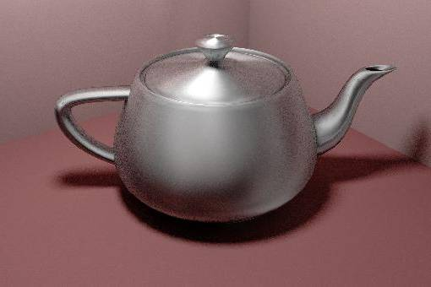
Source: http://www.graphics.cornell.edu/~westin/gallery/teapot.jpg

Slide 22
How to generate surface patches?
Delaunay triangulation

Slide 23
Delaunay triangulation
Given a set P of points in a plane, create a triangular mesh DT(P) such that no point in P is inside the circumcircle of any triangle in DT(P).
Delaunay triangulations maximize the minimum angle of all the angles of the triangles in the triangulation.
D
Convex Hull
D
D
?
C
C
C
A
A
A
B
B
B

Slide 24
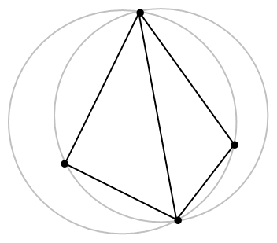
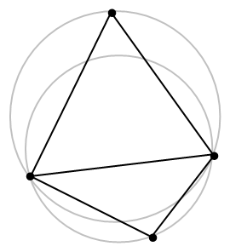
Delaunay triangulation
D
D
C
C
A
A
B
B

Slide 25
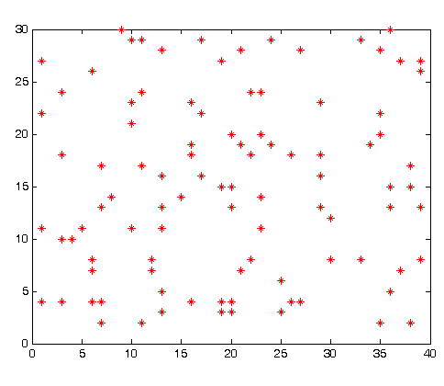
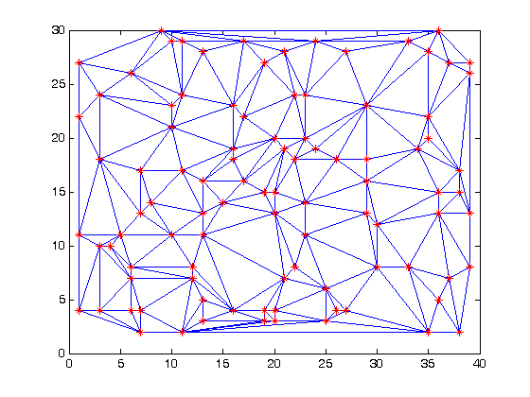
Delaunay triangulation: an example

Slide 26
Consistency checking
Every vertex is listed as an endpoint of at least two edges (lines)
Every surface (polygon) is closed
Each surface has at least one shared edge

Slide 27
Representations for solids - overview
Constructive Solid Geometry (CSG)
Octrees

Slide 28
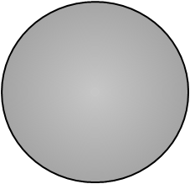
Volumetric Modules
Constructive Solid Geometry
Primitives
Box
Wedge
Cylinder
Sphere

Slide 29
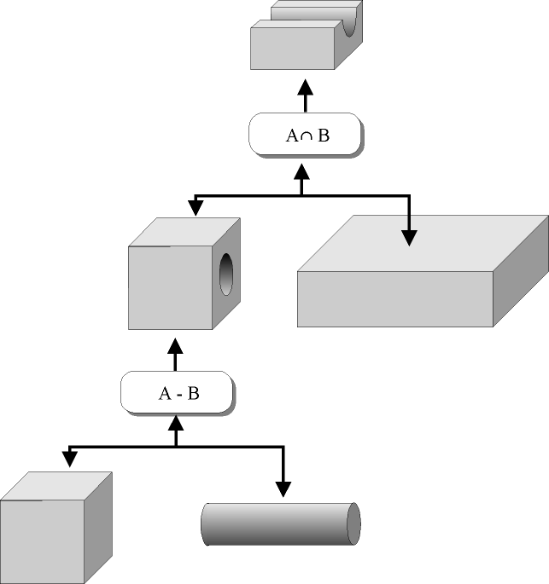
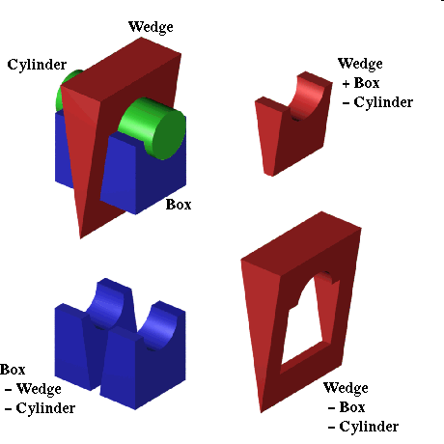
Volumetric Modules
Constructive Solid Geometry

Slide 30
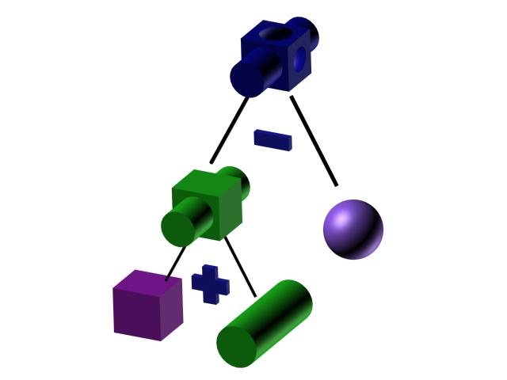
Constructive solid geometry
Source: http://groups.csail.mit.edu/graphics/classes/6.837/F98/talecture/

Slide 31
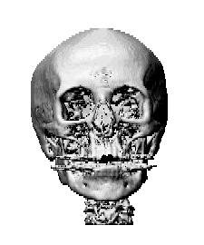
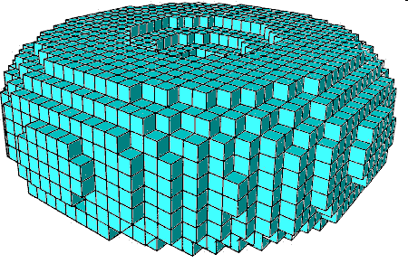
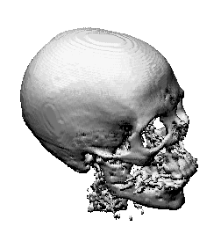
Volumetric Models
Voxels (Volume elements/Volumetric pixels)

Slide 32
Quadtrees
0
1
0
1
2
3
3
2
0
1
2
3
0
1
3
2
0
1
2
3

Slide 33
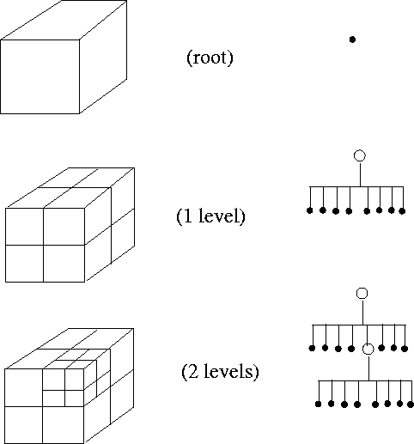
Octrees

Slide 34
Further reading
Surface modelling
http://www.geometry.caltech.edu/pubs.html
http://groups.csail.mit.edu/graphics/classes/6.837/F98/talecture
http://escience.anu.edu.au/lecture/cg/surfaceModeling/index.en.html
Mesh triangulation (including Delaunay)
http://www.cs.berkeley.edu/~jrs/mesh/
http://www.visionbib.com/bibliography/describe436.html

Slide 35
Key concepts for surface representation in Java
PointArray
LineArray
TriangleArray
QuadArray
LineStripArray
TriangleStripArray
TriangleFanArray
See http://java.sun.com/developer/onlineTraining/java3d/j3d_tutorial_ch2.pdf (especially from p. 2-25, 2.5.2 Subclasses of GeometryArray)

Slide 36
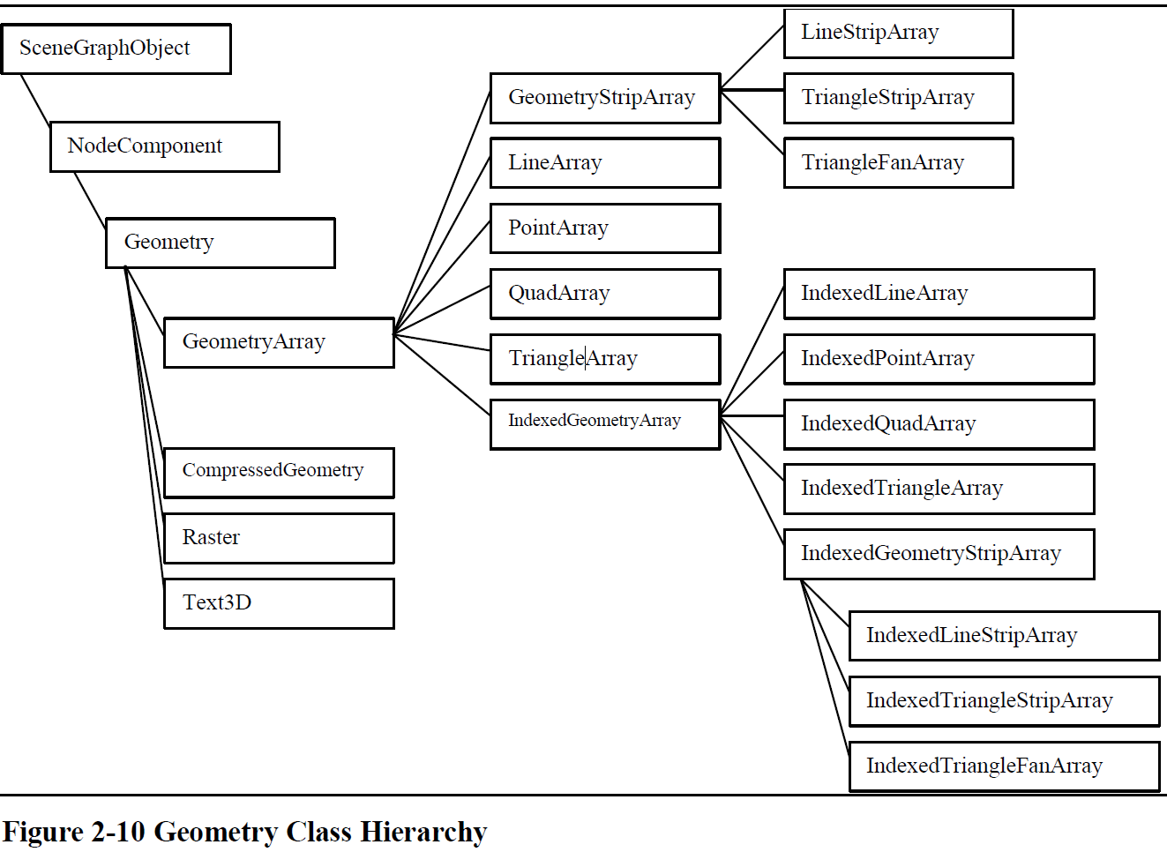

Slide 37
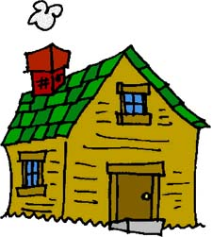
Homework
1. Define Surface Representation (i.e. Vertex Table and Surface Table) for a pyramid with a triangular base. When specifying the Surface Table ensure that when the cut-out below is folded into the pyramid the triangle surfaces face correctly “in” and “out”. Labels v1-v6 are vertex numbers, to be used in the construction of the Tables.
v3
v1
v5
v2
v4
v6

Slide 38
Homework
Study matrix and vector operations. Tutorial is on-line at
  www.cs.bham.ac.uk/~exc/Teaching/Graphics/Mathematical_tools.pdf
Do exercises in “Matrix and vector arithmetics”
  www.cs.bham.ac.uk/~exc/Teaching/Graphics/
Solutions on-line next week

Slide 39
Matlab exercise
  Define a simple cube, display and manipulate. The outline of the Matlab code is in file www.cs.bham.ac.uk/~exc/Teaching/Graphics/ex1_simple_cube.m
Reminder about Matlab tutorials
http://www.cyclismo.org/tutorial/matlab/
  Work through the tutorial should take you 2-3 hours.
http://www.cs.bham.ac.uk/~exc/Teaching/Graphics/Matlab_tutorial.pdf
Matlab Help
  Have a look at the “Programming” and “Graphics” sections

Slide 40
Next lecture
Sweep functions
Height maps
Elementary transformations

