Slide 1
DEFINING OBJECTS - 3D REPRESENTATIONS
3D surface representation - continued
Sweep functions
Elementary 3D transformations
Translation
Scaling
Rotation

Slide 2
Surface representations
Object triangulation

Slide 3
Sweep representations
Define shape
Define sweep path

Slide 4
Sweep representations

Slide 5
Sweep representations
Define sweep path
Define shape

Slide 6
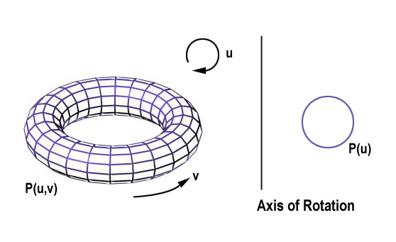
Sweep representations
Source: http://groups.csail.mit.edu/graphics/classes/6.837/F98/talecture/

Slide 7
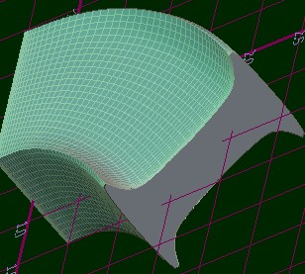
Sweep representations
Source: http://www.h-dm.com/resources/CADZilla/manual/multi_section_sweep.jpg

Slide 8
Sweep functions: implementation
3D Transformations – quick revision

Slide 9
Basic transformations
Translation (shift)
Scaling
Rotation

Slide 10
Translation
D’
Y
D
C’
A’
A
C
B’
x’ = x + Tx
y’ = y + Ty
z’ = z + Tz
T = [Tx Ty Tz]
B
Z
X

Slide 11
Scaling about the origin
D’
A’
C’
Y
x’ = x * Sx
y’ = y * Sy
z’ = z * Sz
S > 1 - enlarge
0 < S < 1 - reduce
S < 0 - mirror
D
C
B’
A
S = [Sx Sy Sz]
B
Z
X

Slide 12
Rotation in the right-handed coordinate system
  Positive angle of rotation is counter-clockwise when the axis about which it occurs points toward the observer

Slide 13
Positive angle of rotation for Z axis
Z axis points at the observer
Y
Anti-clockwise
X

Slide 14
Rotation about Z axis
Y
x' = x·cos ϕ - y·sin ϕ
y' = x·sin ϕ + y·cos ϕ
z' = z
C
B
D
D’
A
C’
X
A’
Z
B’
Positive angle

Slide 15
Rotation about X axis
Y
D
C
A
Z
A’
B
y' = y·cos ϕ - z·sin ϕ
z' = y·sin ϕ + z·cos ϕ
x' = x
D’
C’
X
B’
Positive angle

Slide 16
Rotation about Y axis
D
D’
Y
B’
z' = z·cosϕ - x·sinϕ
x' = z·sinϕ + x·cosϕ
y' = y
C
C’
A
A’
B
Z
X
Positive angle

Slide 17
Rotation
Axis of rotation is Direction of positive rotation is
X from Y to Z
Y from Z to X
Z from X to Y

Slide 18
Rotation about any fixed point
1. Translate the object so that the rotation axis coincides with the parallel coordinate axis
2. Perform the specified rotation
3. Translate the object so that the rotation axis is moved back to its original position

Slide 19
Matrix representation
Homogeneous coordinates
Common notation for ALL transformations
Common computational mechanism for ALL transformations
Simple mechanism for combining a number of transformations => computational efficiency

Slide 20
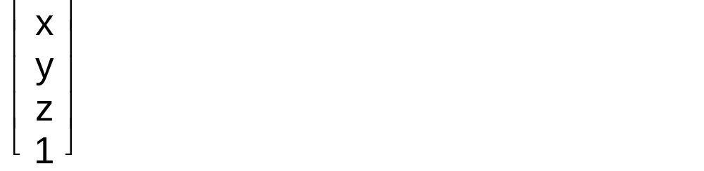
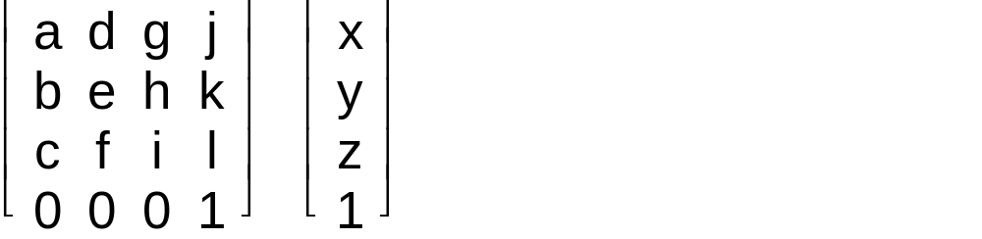
Homogeneous coordinates
Point P = (x, y, z ) represented by a vector
P = = [x y z 1]^{T}
Transformations
  All represented by a 4 x 4 matrix M
M =

Slide 21
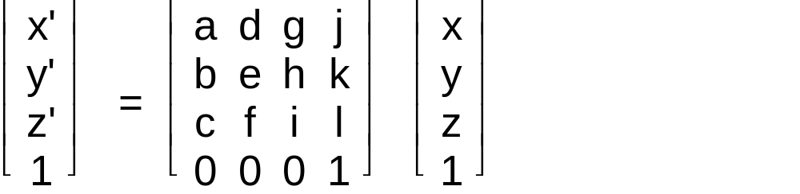
Point transformation in homogeneous coordinates
Implemented by matrix multiplication
  P’ = M · P

Slide 22
Transformation matrices for elementary transformations
4 x 4 matrix
Homogeneous coordinates
Translation, scaling, rotation and perspective projection, all defined through matrices
See this website for a nice explanation of homogeneous coordinates: http://www.devmaster.net/forums/showthread.php?t=2092

Slide 23
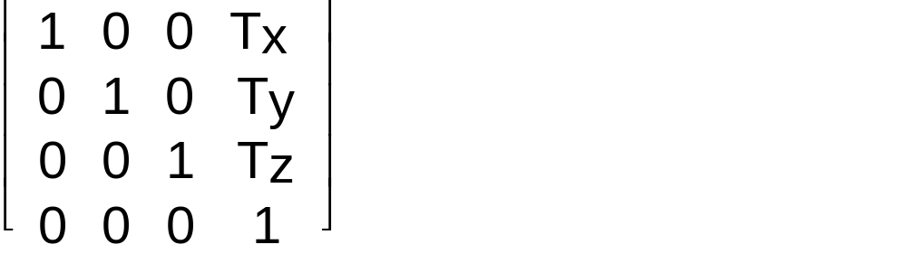
Translation
x’ = x + Tx
y’ = y + Ty
z’ = z + Tz
T =

Slide 24
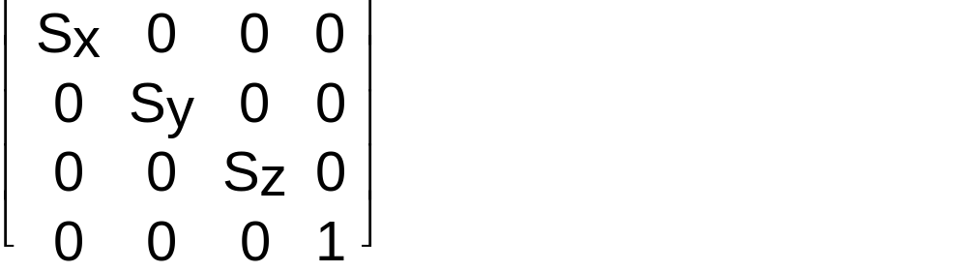
Scaling
x’ = Sx * x
y’ = Sy * y
z’ = Sz * z
S =

Slide 25
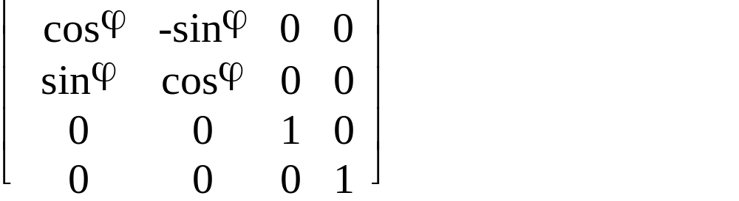
Rotation about Z axis
x' = x·cos ϕ - y·sin ϕ
y' = x·sin ϕ + y·cos ϕ
z' = z
Rz =

Slide 26
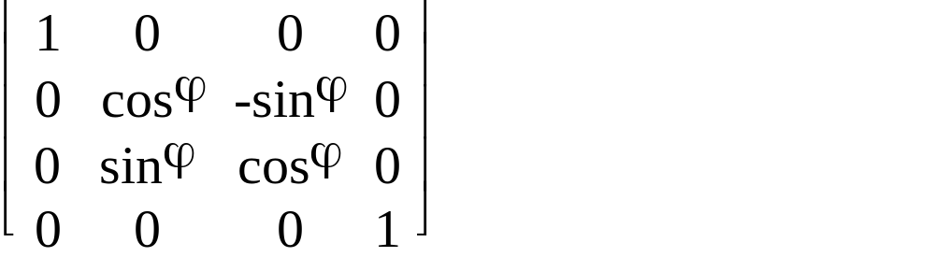
Rotation about X axis
y' = y·cos ϕ - z·sin ϕ
z' = y·sin ϕ + z·cos ϕ
x' = x
Rx =

Slide 27
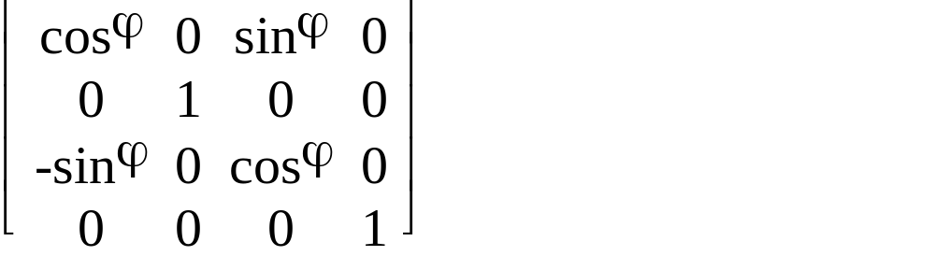
Rotation about Y axis
z' = z·cosϕ - x·sinϕ
x' = z·sinϕ + x·cosϕ
y' = y
Ry =

Slide 28
Key concepts for 3D transformations in Java
Class:
Transform3D
Example methods
setTranslation, setRotation, set Scale
SetTransform
rotX, rotY, rotZ
transform
mul

Slide 29
End of revision

Slide 30
Sweep functions: implementation
Translational sweep
  Define a shape as a polygon vertex table
  Define a sweep path as a sequence of translation vectors
  Translate the shape, continue building a vertex table
  Define a surface table
T1
T2

Slide 31

% Define a crossection of a unit cube in the YZ plane
crossection=[0 0 0 1
0 1 0 1
0 1 1 1
0 0 1 1];
K=4;
% Define a sweep path (relative displacement vectors)
path=[0 0 0
1 0 0
2 0 0];
% Create a vertex table
for n=1:N
Tm=makehgtform('translate',path(:,n));
i1=K*(n-1)+1; % current start index to array V
i2=K*(n-1)+K; % current end index to array V
V(:,i1:i2)=Tm*C;
end

Slide 32
% Generate vertex table for all the side-faces
for n=1:K:K*(N-1)
for k=1:K
F((n-1)+k,1)=(n-1)+k;
F((n-1)+k,2)=n+K+k-1;
F((n-1)+k,3)=n+K+k;
F((n-1)+k,4)=(n-1)+k+1;
F((n-1)+k,5)=F((n-1)+k,1);
end
end
% ... And for the end faces
for k=1:K
EndFaces(1,:)=[1:K];
EndFaces(2,:)=[K*N:-1:K*(N-1)+1];
end

Slide 33
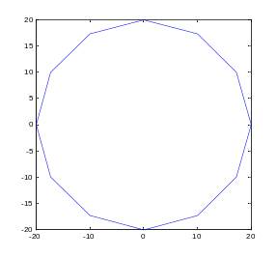
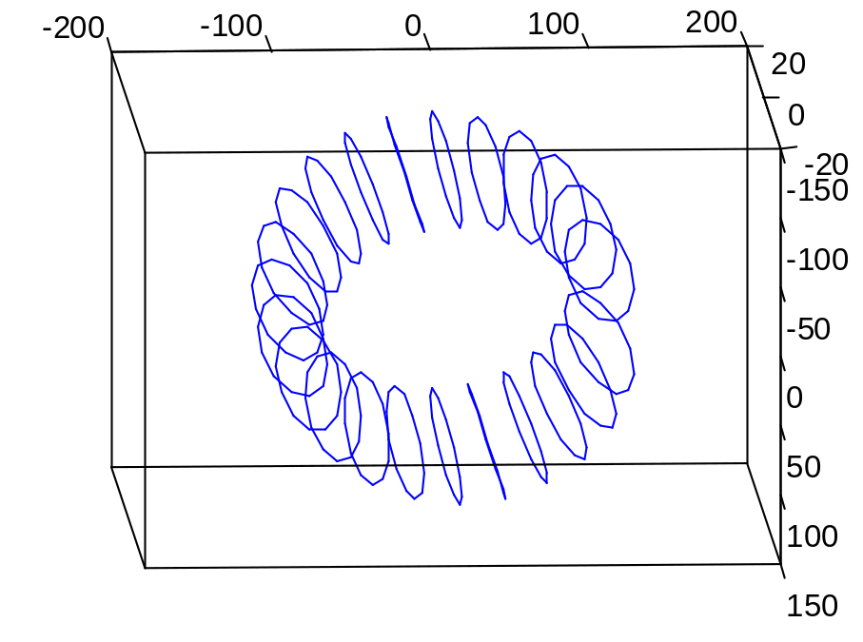
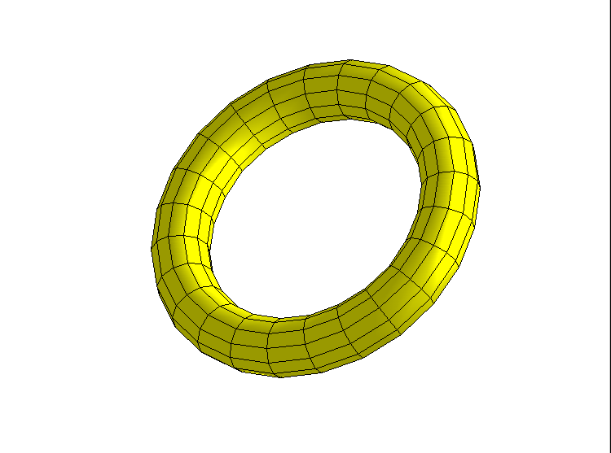
Sweep functions: implementation
Rotational sweep
  Define a shape as a polygon vertex table
  Define a sweep path as a sequence of rotations
  Rotate the shape, continue building a vertex table
  Define a surface table

Slide 34
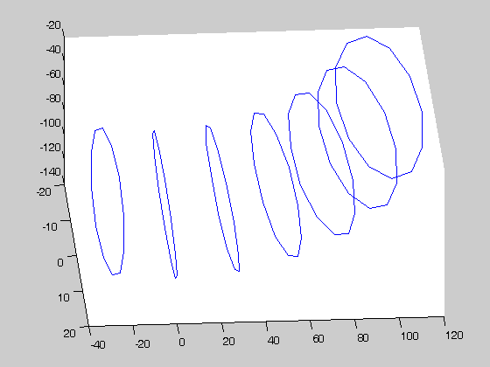
%% Generate a crossection in 3D (homogeneous coords)
% Simple circle equation
for k=1:K
C(k,1)=rK*cosd((k-1)*alphaK);
C(k,2)=rK*sind((k-1)*alphaK);
C(k,3)=0;
C(k,4)=1;
end
%% Generate torus
% Define 3D transformation matrices
Tm=makehgtform('translate',[rN 0 0]); % Translation
Ry=makehgtform('yrotate',alphaN*pi/180);
% Rotation about Y axis
% Translate the crossection Ctemp (only once)
V(:,1:K)=Tm*C;

Slide 35
% Generate vertices
% Rotate the crossection about
% axis Y
for n=K:K:K*N
V(:,n+1:n+K)=Ry* V(:,1:K);
end
% Generate face table (pointers to vertices, not vertices themselves)
for n=1:K:K*N
for k=1:K
F((n-1)+k,1)=(n-1)+k;
F((n-1)+k,2)=(n-1)+k+1;
F((n-1)+k,3)= n+K+k;
F((n-1)+k,4)= n+K+k-1;
end
end

Slide 36
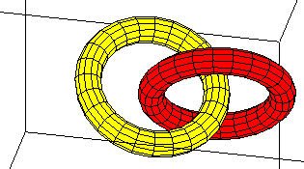

Slide 37
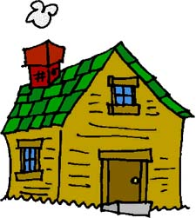
Homework
Suggest a simple way of applying a transformation defined by a matrix M to a large set of N 3-dimensional vertices in homogeneous coordinates.
Explain how you would define a surface table for a sphere using a sweep function. Specify precisely the shape and the sweep path.
For adventureous: Using a sweep function define an egg shape (NOT an ellipsoid!)

Slide 38
Matlab exercise
  Extend the code in ‘ex2_torus.m’ to define and display five linked toruses in different colours. You will also need file ‘torus.m’ which is a function generating the face and the vertex table for a torus. Matlab code for both functions is in file www.cs.bham.ac.uk/~exc/Teaching/Graphics/ex2_torus.zip
  Write Matlab code to generate a surface table for a sphere using a sweep function.
Reminder about Matlab tutorials
http://www.cyclismo.org/tutorial/matlab/
  Work through the tutorial should take you 2-3 hours.
http://www.cs.bham.ac.uk/~exc/Teaching/Graphics/Matlab_tutorial.pdf
  Ignore first five slides which have information relevant to the MIT course
Matlab Help
  Have a look at the “Programming” and “Graphics” sections

Slide 39
Next lecture
Height maps
Parametric surfaces

