Slide 1
DEFINING OBJECTS - 3D REPRESENTATIONS
3D surface representation - continued
Height maps
Parametric surfaces

Slide 2
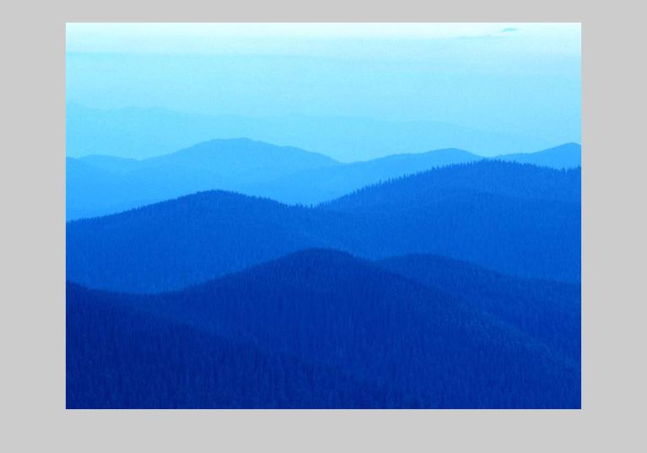
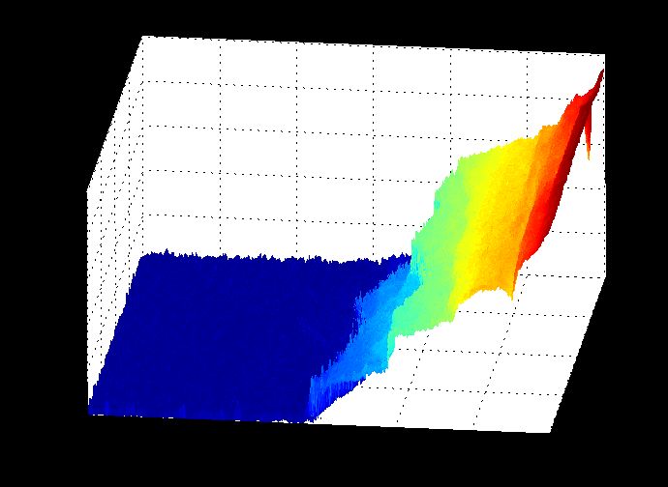
Heightmaps from bitmaps

Slide 3
Heightmaps from bitmaps
Bitmap – image data
  Rectangular grid X ^{x} Y of values
  Value in the bitmap corresponds to height (Z) in the heightmap
  Image rendered using normally the Painter algorithm (see later lectures)
230 230 230 229 225
212 223 222 219 226
215 218 220 222 220
203 201 210 225 215
124 146 169 187 196
72 83 100 108 114
58 68 69 63 70
43 50 56 63 63
40 39 42 50 44
49 45 49 47 46
40 46 40 37 41

Slide 4
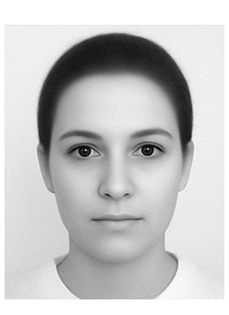
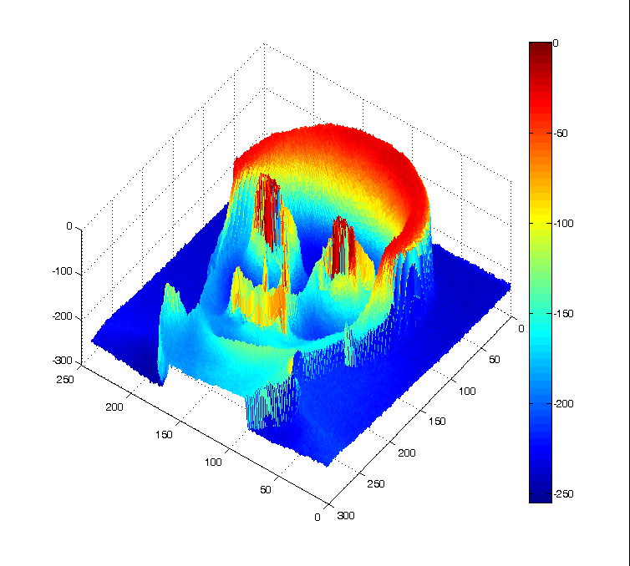
Heightmaps from bitmaps

Slide 5
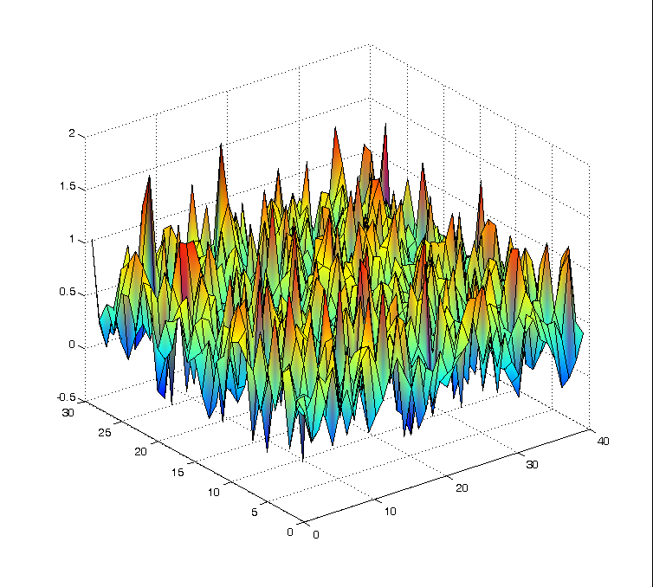
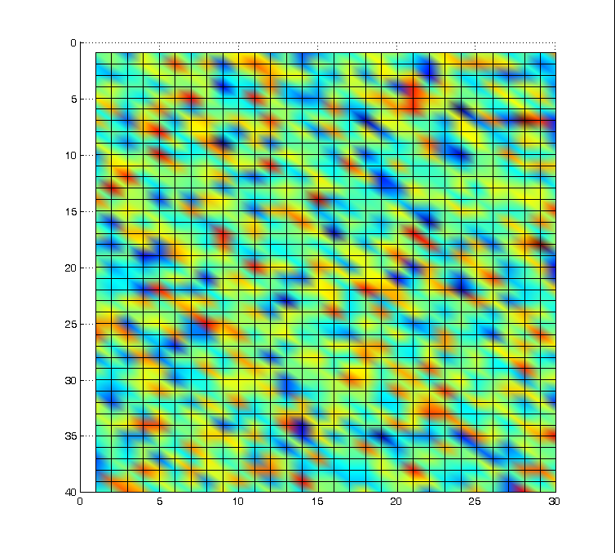
Heightmaps using random number generation

Slide 6
Heightmaps using random number generation
Bitmap – contents created using random number generation
  Rectangular grid X ^{x} Y of values
  Value in the bitmap corresponds to height (Z) in the heightmap
  Image rendered using normally the Painter algorithm (see later lectures)
  grid=zeros(Nx,Ny);
  for xi=1:Nx
  for yi=1:Ny
  grid(xi,yi)=gmin+(gmax-gmin)*rand(); % Uniform distribution
  grid(xi,yi)=0.5+sqrt(0.1)*randn(); % Normal distribution
  end
  end

Slide 7
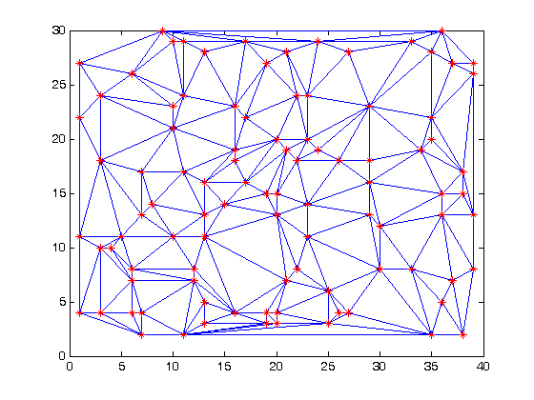
Delaunay triangulation
For the data points defined by vertices x and y, Delaunay triangulation returns a set of triangles such that no data points are contained in any triangle's circumscribed circle.
For overview of Delunay triangulation see http://www.cs.berkeley.edu/~jrs/meshpapers/BernEppstein.pdf

Slide 8
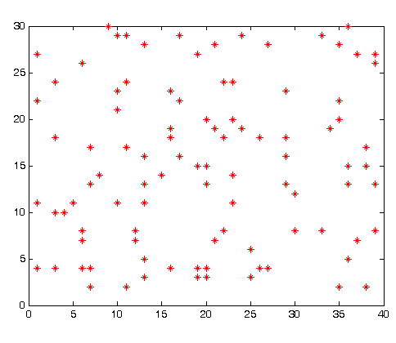
Delaunay triangulation
Generate points (vertices) at random locations on a rectangular grid
At each point generate random height
Delunay triangulation creates triangles by connecting the nearest three vertices. The lines between the vertices must not intersect.
This generates triangular faces.

Slide 9
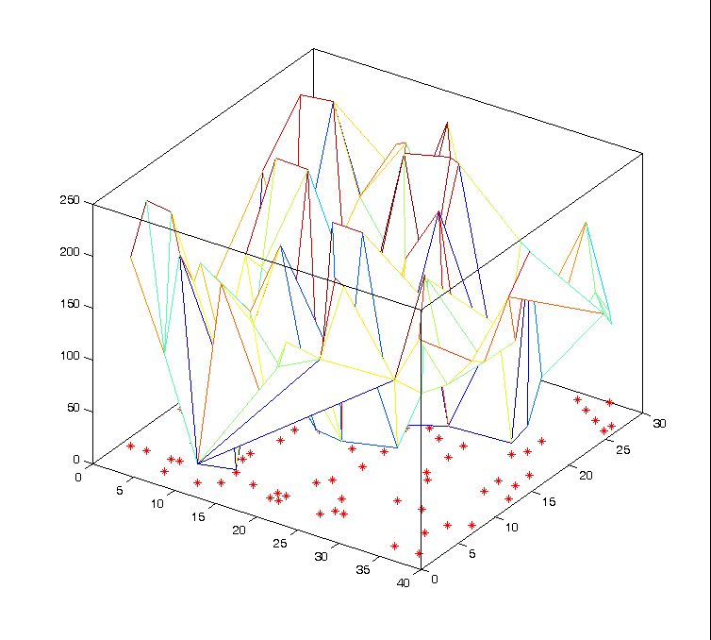
Delaunay triangulation
Display the surfaces

Slide 10
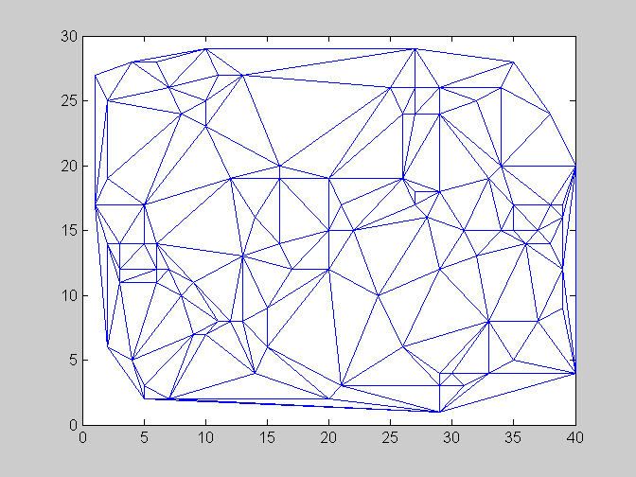
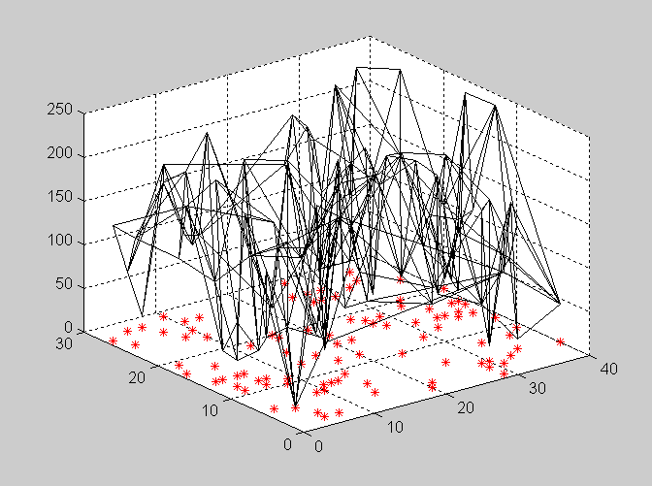
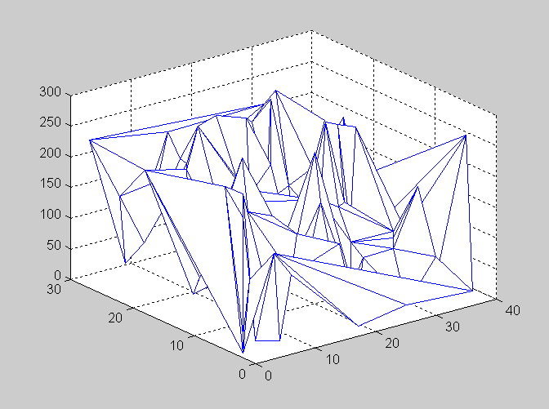
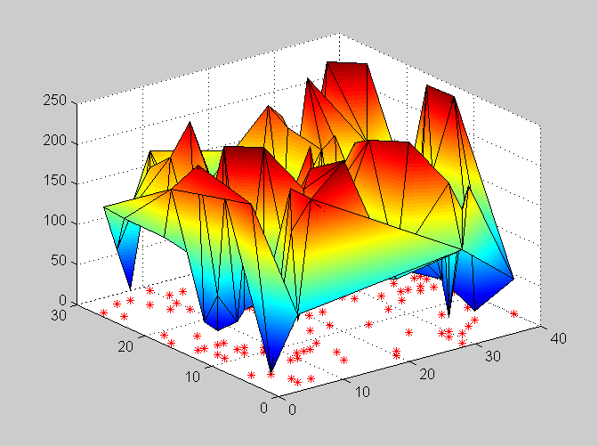
1. Delunay triangulation on a plane.
Heights are defined at the intersections
2. Wireframe representation
3. Application of hidden surface removal
4. Application of height colouring for the surfaces

Slide 11
Curved surfaces (and lines)
The generation of 3D curved lines and surfaces
  An input set of mathematical functions
  A set of user-specified data points (splines, discussed later)
Curve and surface equations
  Nonparametric
  Parametric
Quadric Surfaces
  Sphere
  Ellipsoid
  Torus

Slide 12
Parametric equations
x(u)
P(u) = y(u)
z(u)
u is the parameter
x(u), y(u) and z(u) are functions of the parameter u which generate x, y and z coordinates of the curve or surface P.

Slide 13
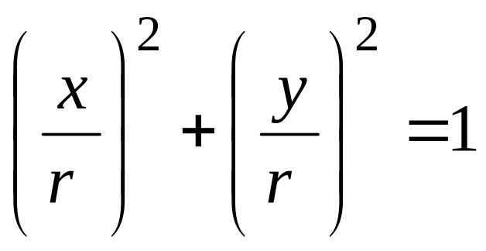
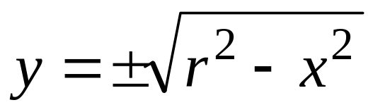
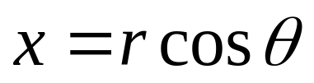
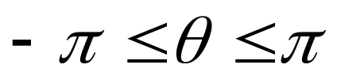
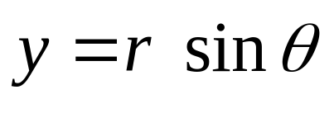
Curve equations - circle
Canonical form
Generative form
Parameter
Parameter
Parametric form

Slide 14
Generating a circle in Matlab
Nphi=30;
Dphi=pi/Nphi;
R=2;
phi=(-pi : Dphi : pi);
for i=1:length( phi )
X(i)=R*cos( phi(i) );
Y(i)=R*sin( phi(i) );
end
plot( X, Y);

Slide 15
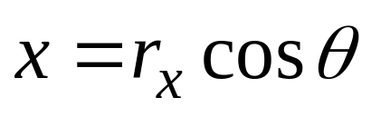
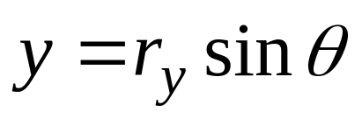
Examples of parametric equations: curves
Circle
Ellipse

Slide 16
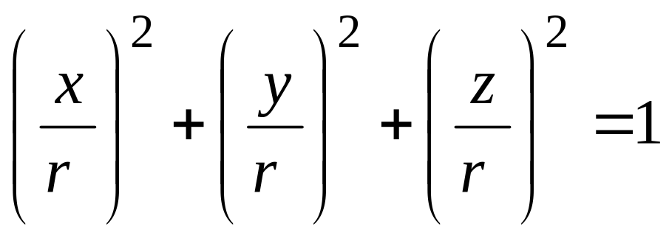
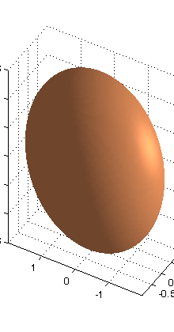
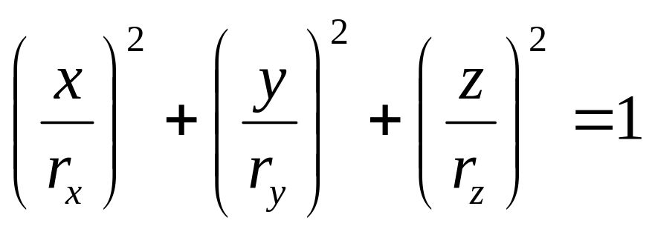
Quadric Surfaces: canonical form
Sphere
Ellipsoid

Slide 17
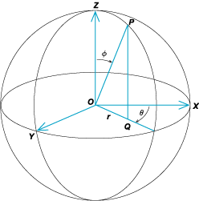
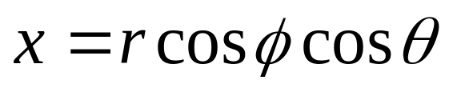
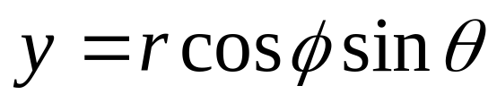
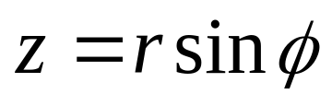
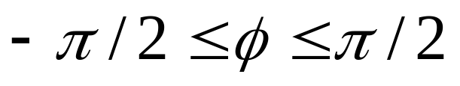
Spherical coordinates

Slide 18
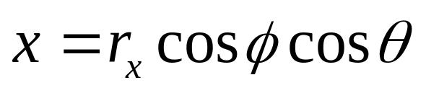
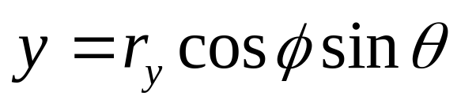
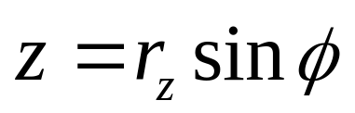
Quadric Surfaces
Parameters
Sphere
Ellipsoid

Slide 19
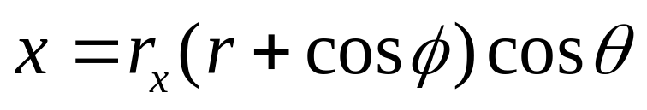
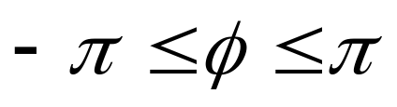
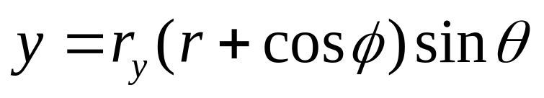
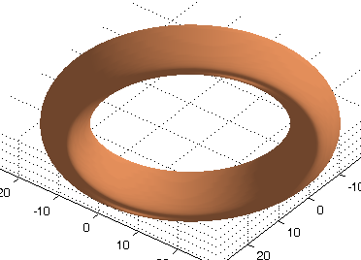
Quadric Surfaces
Torus

Slide 20
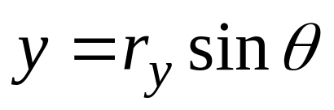
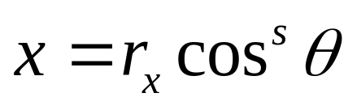
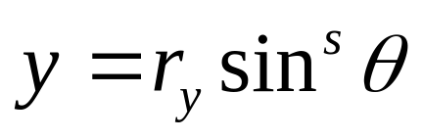
Superquadrics
A generalization of the quadric representations
  Incorporate additional parameters into the quadric equations
  The number of additional parameters used is equal to the dimension of the object.
Ellipse
Superellipse

Slide 21
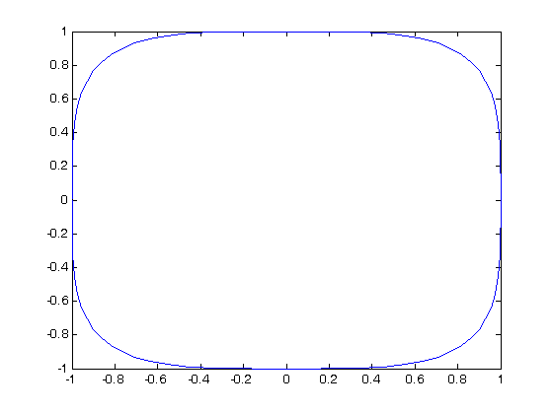
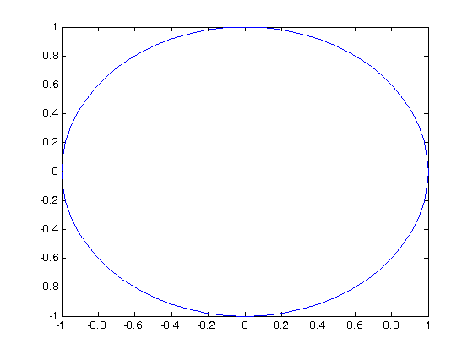
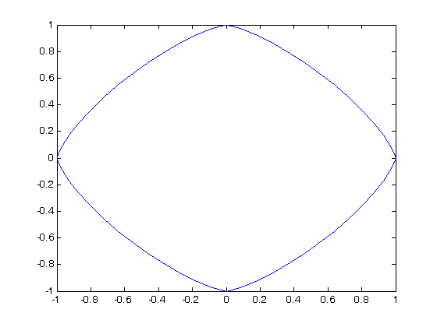
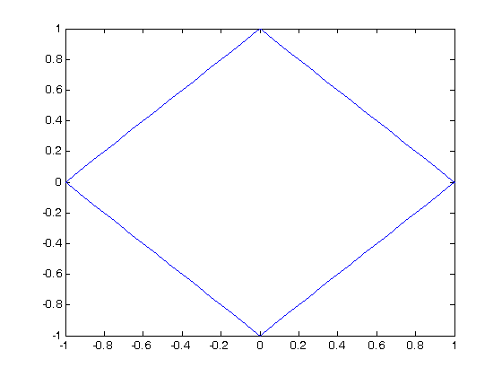
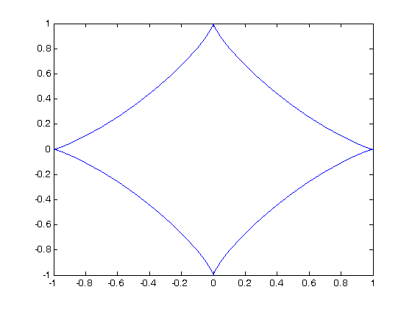
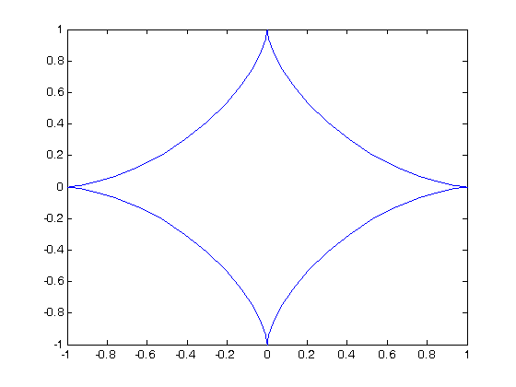
Superellipses
S=0.5
S=1.0
S=1.5
S=2.0
S=2.5
S=3.0

Slide 22
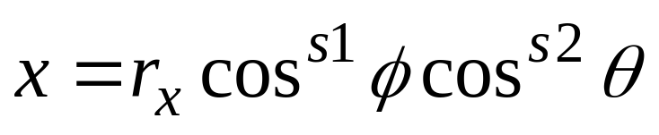
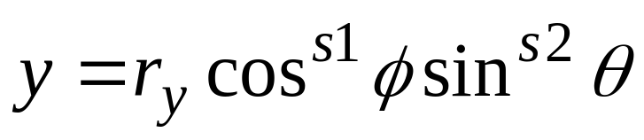
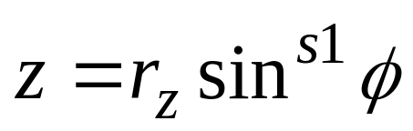
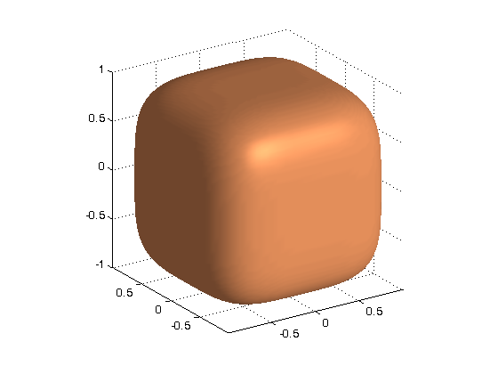
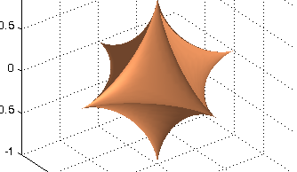
Superquadrics
Superellipsoid
S1=S2=0.5
S1=S2=3.0

Slide 23
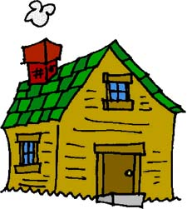
Homework
Explore the range of superellipses by further modifying parameter s
Explore the range of superellipsoids by modifying parameters s1 and s2
Relevant Matlab code is at ex3_surffaces.zip

Slide 24
Next lecture
Surface rendering - overview

