Slide 1
Object rendering
Overview
Scene
Object
Camera
Light
Objects
Geometry
Colour
Microstructure

Slide 2

Rendering: setting up the scene
Given
  Object surfaces
  Light sources
  Camera
Compute
  Colour of each pixel on the screen
  This is colour that bounces off the surface point and goes in the direction of the camera (viewer)

Slide 3
Object
Geometry
  Structure
  Surface orientation (normal vectors)
Microstructure
  Shiny
  Matt
  Textured
Colour
Transparency
√

Slide 4
Light
Location
  w.r.t object
  w.r.t. camera
Sources
  Ambient
  Directional: diffuse
  Directional: point source
  Divergence
Colour

Slide 5
Camera
Position w.r.t. object
Direction of view
Angle of view
Tilt (up-vector)
Magnification (zoom)
Projection (parallel / perspective)
Camera viewing
Projection

Slide 6
Relationships between the entities
Camera
Object
 | Position | View | Proj.
Position | X | X
Direction |  | X
Colour
 | Orient. | Microstr | Colour
Position | X |  | X
Direction | X | X | X
Colour |  |  | X
Light
Light
Camera
 | Position | View | Proj.
Orient | X | X | X
Microstr
Colour
Object

Slide 7
Topics for the next lectures
Surface orientation – normal vectors
Lighting
Surface shading algorithms
Colour and colour representations
Revision of the above
Viewing and projections

Slide 8
Normal vectors
What they are
How to compute them

Slide 9
Normal vectors
Normal vector = vector perpendicular to the face
N
N
N
N
(x,y,z)
(x,y,z)
(x,y,z)
(x,y,z)
(x,y,z)
Flat surface patch
Curved surfaces

Slide 10
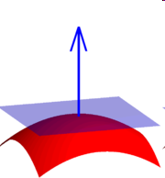
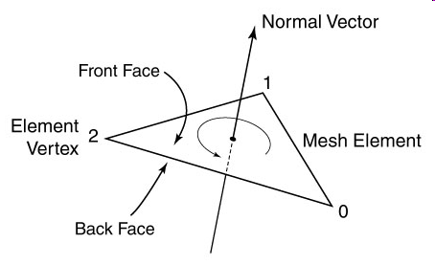
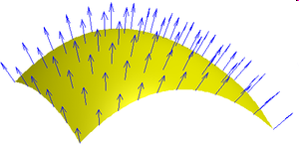
Normal vectors
Flat surface patch
Curved surfaces

Slide 11
Surface normal vectors - uses
Surface visibility (→ hidden surface removal)
Surface shading
Surface texture

Slide 12
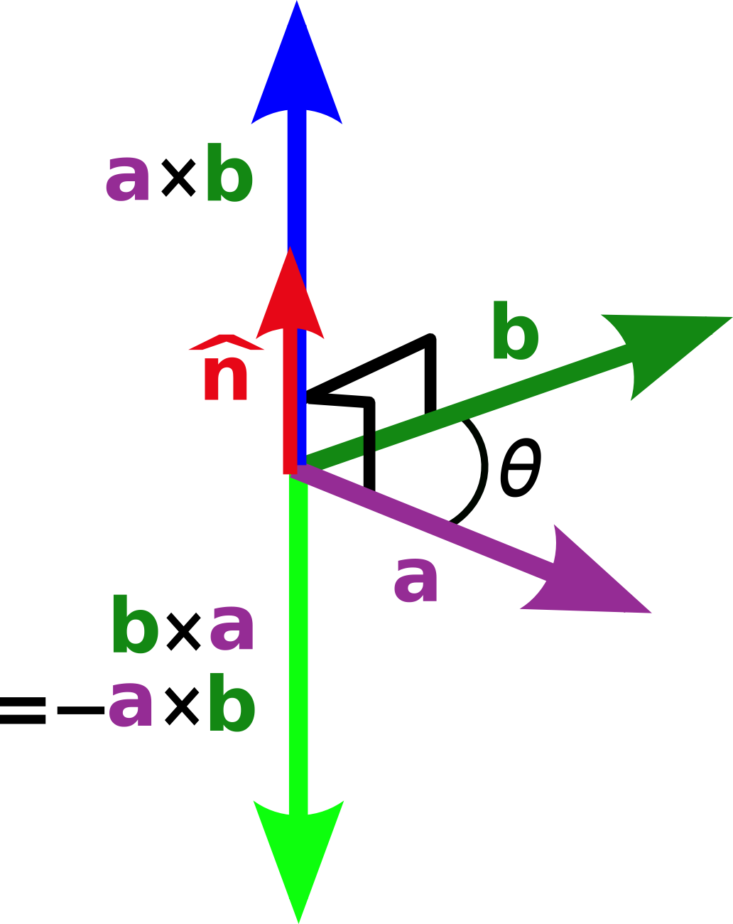
Normal vectors
Computing normal vectors
  A cross-product of two vectors is a vector perpendicular (orthogonal, normal) to both input vectors
  if n = a ^{x} b, n ⊥ a and n ⊥ b
Cross product is NOT commutative:
  a ^{x} b ≠ b ^{x} a
  although both cross-products are orthogonal to a and b

Slide 13
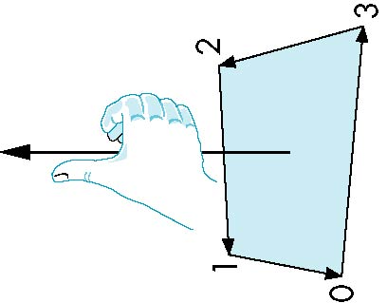
“In-s and Out-s” of triangles
3
4
2
Outside
Inside
1
2
3
1
Right-hand rule
Unit 2

Slide 14
Normal vectors
E1 ^{x} E2
E2
E2 ^{x} E1
E1 ^{x} E2
E1
E2
E1

Slide 15
Normal vectors
V8
Front face
E1=V2 – V1
E2=V3 – V2
N1=E1 ^{x} E2
V7
V4
V3
E4
N2
E2
V5
E3
V6
Back face
E3=V5 – V6
E4=V8 – V5
N2=E3 ^{x} E4
V1
E1
V2
N1

Slide 16
Computing cross product
V3
Front face
E1=V2 – V1
E2=V3 – V2
N1=E1 ^{x} E2
E2
V1
E1
V2
N1

Slide 17
Computing cross-product
E1=V2 – V1
E2=V3 – V2
N1=E1 ^{x} E2 =
Unit vectors
1_{x} 1_{y} 1_{z}
x₂ – x₁ y₂ – y₁ z₂ – z₁ =
x₃ – x₂ y₃ – y₂ z₃ – z₂
1_{x} (y₂ – y₁)(z₃ – z₂) – (y₃ – y₂)(z₂ – z₁) +
1_{y} (x₃ – x₂)(z₂ – z₁) – (x₂ – x₁)(z₃ – z₂) +
1_{z} (x₂ – x₁)(y₃ – y₂) – (x₃ – x₂)(y₂ – y₁)

Slide 18
Normal vectors
Y
Left-handed coordinate system
sign(N1_{Z}) = - sign(Z)
Facing towards the viewer:
- front face
sign(N2_{Z}) = sign(Z)
Facing away from the viewer
- back face
N2
Z
N1
X

Slide 19
Normal vectors
Y
Right-handed coordinate system
sign(N1_{Z}) = sign(Z)
Facing towards the viewer:
- front face
sign(N2_{Z}) = - sign(Z)
Facing away from the viewer
- back face
N2
X
N1
Z

Slide 20
Surface visibility from surface normal
E1=V2 – V1
E2=V3 – V2
N1=E1 ^{x} E2 =
Unit vectors
1_{x} 1_{y} 1_{z}
x₂ – x₁ y₂ – y₁ z₂ – z₁ =
x₃ – x₂ y₃ – y₂ z₃ – z₂
1_{x} (y₂ – y₁)(z₃ – z₂) – (y₃ – y₂)(z₂ – z₁) +
1_{y} (x₃ – x₂)(z₂ – z₁) – (x₂ – x₁)(z₃ – z₂) +
1_{z} (x₂ – x₁)(y₃ – y₂) – (x₃ – x₂)(y₂ – y₁)
N_{z}

Slide 21
Surface visibility from surface normal
In a right-handed coordinate system a surface visible to the viewer will have positive value of z-coordinate of the normal vector: N_{Z}>0
Render only the visible surfaces facing the viewer

Slide 22
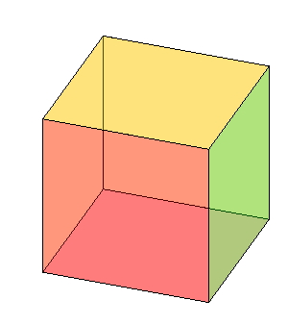
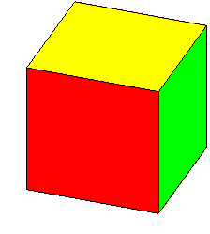
Example
Vertices
V1 0 0 0
V2 0 1 0
V3 0 1 1
V4 0 0 1
V5 1 0 0
V6 1 1 0
V7 1 1 1
V8 1 0 1
2
6
Y
3
7
Z
1
X
5
4
8
Faces
sign N_{z}
2
6
F1 1 2 6 5 +
F2 5 6 7 8 +
F3 3 4 8 7 -
F4 1 4 3 2 -
F5 1 5 8 4 -
F6 2 3 7 6 +
3
7
5
4
8

Slide 23

Homework
In the cube defined by homogeneous vertices in the vertex table V and faces in the face table F, demonstrate that face F2 is visible and face F4 is not visible in the right-handed coordinate system.
Given the same vertex table V and the face table F, would it be the case in the left-handed coordinate system?
Vertices
V1 0.00 0.00 0.00 1.00
V2 0.00 1.00 0.00 1.00
V3 -0.26 1.00 0.97 1.00
V4 -0.26 0.00 0.97 1.00
V5 0.97 0.00 0.26 1.00
V6 0.97 1.00 0.26 1.00
V7 0.71 1.00 1.22 1.00
V8 0.71 0.00 1.22 1.00
Faces
F1 1 2 6 5
F2 5 6 7 8
F3 3 4 8 7
F4 1 4 3 2
F5 1 5 8 4
F6 2 3 7 6

Slide 24
0.00 0.00 0.00 1.00
0.00 1.00 0.00 1.00
-0.26 1.00 0.97 1.00
-0.26 0.00 0.97 1.00
0.97 0.00 0.26 1.00
0.97 1.00 0.26 1.00
0.71 1.00 1.22 1.00
0.71 0.00 1.22 1.00
F2
E1 = V6-V5 = [ 0 1 0 ]
E2 = V7-V6 = [ -0.26 0 0.97 ]
E1 x E2 = [ 0.97 0 0.26 ]
F4
E1 = V4-V1 = [ -0.26 0 0.97 ]
E2 = V3-V4 = [ 0 1 0 ]
E1 x E2 = [ -0.97 0 -0.26 ]

Slide 25
Next lecture
Illumination and shading

Slide 26
Credits
http://www.absoluteastronomy.com/topics/Surface_normal
http://commons.wikimedia.org/wiki/File:Crossproduct.png

