Slide 1
Implementing a virtual camera
Defining a camera
Implementing a virtual snapshot
- Coordinate system transformations
- Viewing projections
Practical exercise

Slide 2
Virtual camera - definitions
View up-direction
Yw
Direction of gaze
Zw
U
View plane
N
Xw
Viewing
distance
View Reference Point (VRP)
Eye position
V
Handedness axis

Slide 3
Virtual camera - definitions
Yw
View up-direction
Xw
U
Viewing
distance
Zw
View plane
N
V
Handedness axis
Direction of gaze
View Reference Point (VRP)
Eye position

Slide 4
Creating a view of the scene – an outline
Create vertex tables (3D) for an object in the World coordinate system.
Define the (3D) Viewing (camera) coordinate system.
Change the 3D coordinates of the object from the World system to the Viewing system.
Create (2D) perspective projection of the object.
Plot the 2D vertices, edges and surfaces.

Slide 5
Creating a view of the scene – an outline
Create vertex tables for an object in the World coordinate system.
Define the Viewing (camera) coordinate system by computing its axes (vectors V, U and N) from VRP and the Target point.
Change the coordinates of the object from the World system to the Viewing system. This done by finding transformation which aligns the axes of the Viewing system (V,U,N) with the axes of the World system (X,Y,Z). Create the combined transformation matrix for these transformations.
Create the perspective projection matrix (from the viewing distance D) and combine with the matrix calculated in (3) above.
Transform all the object vertices through the combined matrix calculated in (4).
Calculate the homogeneous coordinates of the points transformed in (5), so that the last (fourth) coordinate for each point is 1. As a check see that the z coordinate of each point is equal to D, the viewing distance.
Plot the 2D vertices, edges and surfaces.

Slide 6
2. Define the camera coordinate system
36
U
V
VRP
N
Target
12
20

Slide 7

2. Define the camera coordinate system
Y_{w}
6
2
X_{w}
2
2
6
8
Z_{w}

Slide 8

2. Define the camera coordinate system
36
U
VRP
V
N
Target
12
20

Slide 9
2. Define the camera coordinate system
36
U
V
VRP
N
Target
12
20

Slide 10
2. The camera coordinate system
Define N
  N=TP-VRP
Define a temporary “up-vector”
  U₀=[0 1 0]
Compute the handedness vector
  V=U₀ x N
Compute the correct up-vector
  U=N x V

Slide 11
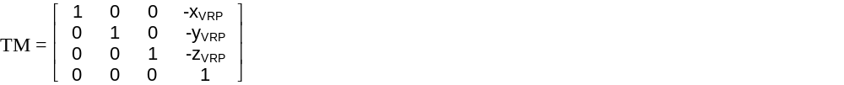
3. Coordinate system transformation
3.1.
Define a matrix to translate the centre of the Camera system to the centre of the World system

Slide 12
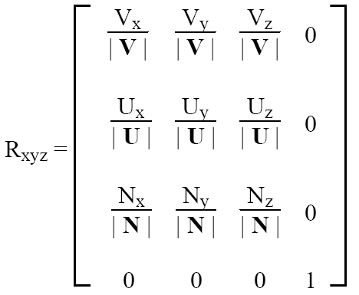
3. Coordinate system transformation
3.2
Define a matrix to align the axes of the Camera system with the axes of the World system

Slide 13
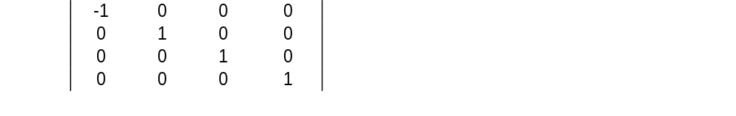
3. Coordinate system transformation
3.3.
Define a matrix to convert from the right-handed World coordinate system to the left-handed Camera coordinate system (scaling by -1 w.r.t. X)
SM

Slide 14

W – world coordinate system
C – camera coordinate system
Y
U
VRP
V
N
X
Z

Slide 15

Translate the origin of C to the origin of W
Y
U
VRP
V
X
X
Z
N

Slide 16

Align the axes U and N of C to the axes Y and Z of W by rotation ...
Y
U
VRP
V
X
X
Z
N

Slide 17

... Align the axes U and N of C to the axes Y and Z of W by rotation ...
Y
U
V
VRP
X
X
N
Z

Slide 18

... Align the axes U and N of C to the axes Y and Z of W by rotation
Y
Z
N
U
X
V
VRP

Slide 19
Align the axis V of C to the axis X of W by axis “flipping” (scaling x-coordinate by -1)
Y
Z
N
U
V
VRP
X

Slide 20
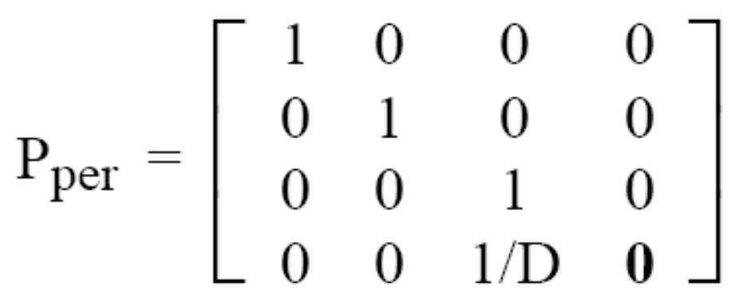
4. Perspective projection
Define a perspective projection matrix with Centre of Projection (COP) at the centre of the coordinate system and the viewing plane at the distance D
Perspective projections are covered in unit ‘Viewing transformations’

Slide 21
5. Transform the object vertices
Vertices defined in a N x 4 matrix P
Compute the combined transformation matrix
  CM = SM * P_{per} * R_{xyz} * TM
Apply the combined transformation matrix to the vertices
  P’ = CM * P
Composite transformations are covered in unit ‘Composite transformations’

Slide 22

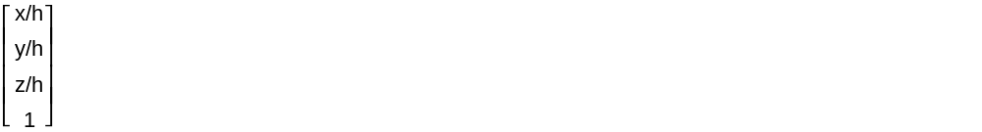
6. Homogeneous coordinates
Perspective projection makes the vertices P’ non-homogeneous.
Make them homogenous by dividing the coordinate vector of each vertex by its fourth (homogeneous) component
P’=
P’’= / h =

Slide 23
7. Plot the 2D points
The ‘z’ coordinate for all the homogeneous vertices should be equal D
Plot the object in 2D, using only (x,y) coordinates of the homogenous vertices, and the object’s surface table

Slide 24

Homework
See the class exercise “Big N”

