Slide 1
Viewing Transformations
Viewing parameters
Viewing projections
- Parallel
- Parallel orthographic projection
- Parallel oblique projection

Slide 2
Viewing transformations
Viewing transformations are concerned with projecting 3D objects onto 2D surfaces (display screen, printed page, etc)

Slide 3
Virtual camera - definitions
Yw
View up-direction
Xw
U
Viewing
distance
Zw
View plane
N
V
Handedness axis
Direction of gaze
View Reference Point (VRP)
Eye position

Slide 4
Virtual camera
Yw
Zw
View up-direction
U
Xw
Viewing
distance
View plane
N
V
Handedness axis
Direction of gaze
View Reference Point (VRP)
Eye position

Slide 5
Viewing projections
Parallel
  centre of projection in the infinity
  the projection lines are parallel
Projection / VIEW plane
Projection lines
Y
X
Z

Slide 6
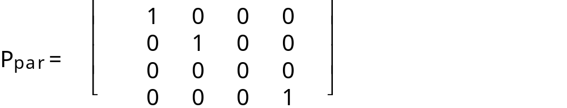
Parallel orthographic projection
Projection lines perpendicular to the projection plane
Transformation matrix
x_{p} = x
y_{p} = y

Slide 7
Parallel oblique projection
Projection lines parallel, but not perpendicular to the projection plane
Projection lines
Projection plane
Y
X
Z

Slide 8
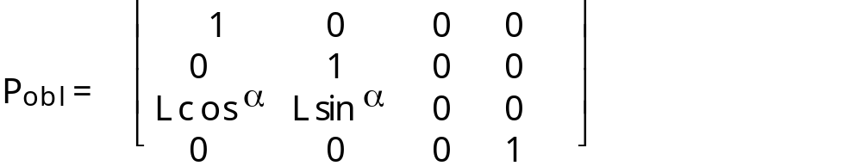
Parallel oblique projection
Y
Matrix
L sin
α
P'
L
P( 0,0 -1)
α
Z
L cos
α
X

Slide 9
Parallel projections
Preserve relative dimensions of the objects
Do not give realistic appearance

Slide 10
Perspective projections
The projection lines meet in one or more projection centre(s)
Y
X
COP
(Centre of Projection)
Z

Slide 11
Perspective projections
COP can be placed at:
  at the negative part of the Z (N) viewing axis, with the viewing plane at COP
  at the centre of the viewing coordinate system, with the viewing plane at the positive part of the Z (N) viewing axis

Slide 12
COP at the centre of the viewing coordinate system
COP is at the centre of the viewing coordinate system (Z_{COP} = 0)
Projection plane is on the positive part of the Z (N) axis
Projection plane is at distance D from the COP
Y
P
P'
COP
Z
D

Slide 13
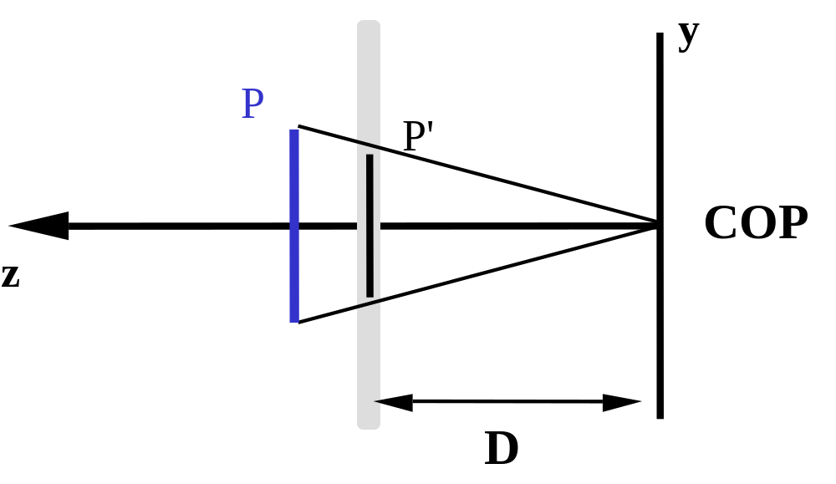
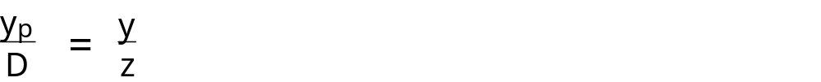
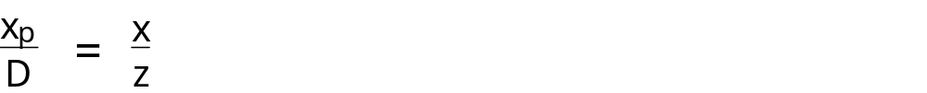
P = (x, y, z)
P' = (x_{p}, y_{p}, D )

Slide 14
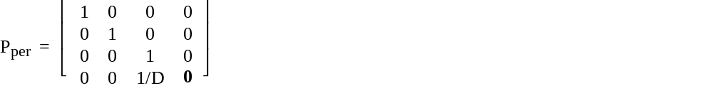
Transformation matrix
Example point transformation

Slide 15
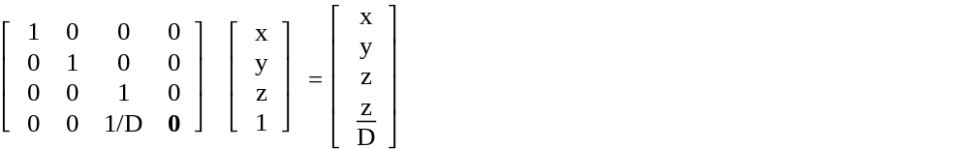
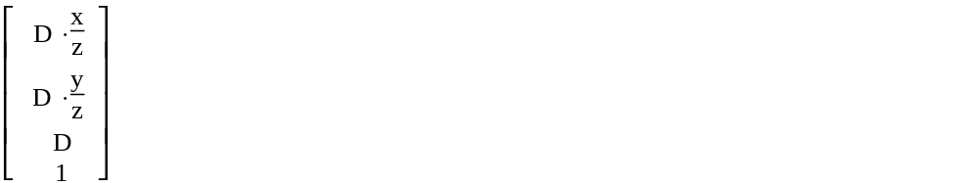
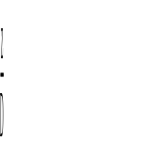
Non-homogeneous coordinates
This vector is not in the homogeneous coordinate system.
Convert to the homogenous coordinates by dividing all the components of the vector by the last term:

Slide 16
Projection plane at the centre of the viewing coordinate system
COP is on the negative part of the z axis (ZCOP = -D)
Projection plane is at the centre of the viewing coordinate system
Projection plane is at distance D from the COP
Y
P
P'
COP
Z
D

Slide 17
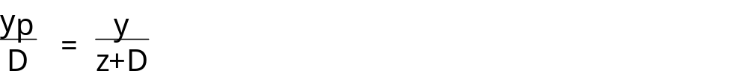
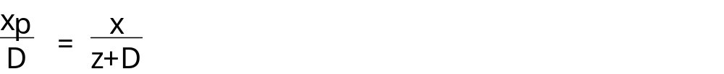
y
P
P'
COP
z
P = (x, y, z)
P' = (x_{p}, y_{p}, 0 )
D

Slide 18
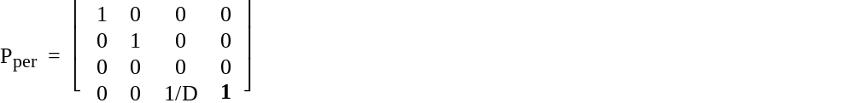
Transformation matrix
Example point transformation

Slide 19
Perspective projections
do not preserve relative dimensions
give realistic appearance

Slide 20
Clipping
Used to restrict the depth of the projected scene
Back clipping plane
Front clipping plane
View plane

Slide 21
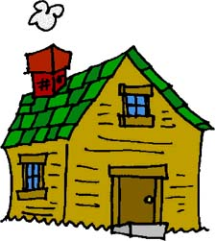
Homework
Define a cube of edge length 10. Place it such that its front bottom right corner is at location (-3, -2, 12).
Compute the perspective projection of the cube when the COP is at (0,0, -20) and the projection plane is at the centre of the coordinate system.
Compute the perspective projection of the cube when the COP is at (0,0, -10) and the projection plane is at the centre of the coordinate system.
Compute the perspective projection of the cube when the COP is at (0,0, 10) and the projection plane is at the centre of the coordinate system.
Place the front bottom right corner of the cube at location (-3, 0, 5). Compute the perspective projection of the cube when the COP is at (0,0, -10) and the projection plane is at the centre of the coordinate system.

Slide 22
Next lecture
Animation

