Slide 1
Computer Animation
Creating animation sequences
path specification
object definition
key frames
in-betweening
Displaying animation sequences
raster animation
Parametric equations in animation

Slide 2
Displaying animation sequences
Movies work by fooling our eyes
A sequence of static images presented in a quick succession appears as continuous flow

Slide 3
Why animation works
The eye cannot register images faster than approximately 50 frames per second
(30 is just about adequate)
If a gap in the projection occurs, the eye seems to perform spatial interpolation over the gap

Slide 4
Steps of a simple computer animation
1. Creating animation sequences
  object definition
  path specification (for an object, a camera or a segment)
  key frames
  in-betweening
2. Displaying the sequences
  raster animation
  colour-table animation

Slide 5
CREATING ANIMATION SEQUENCES

Slide 6
Path specification
Impression of movement can be created for two basic situations, or for their combination:
  static object, moving camera
  static camera, moving object
The path defines the sequence of locations (for either the camera or the object) for the consecutive time frames
Examples

Slide 7
Static object, moving camera
Time
F1
F5
F2
F4
F3

Slide 8
Static object, moving camera
The path specifies the spatial coordinates along which the camera moves
The path is usually specified for a single point, e.g. the VRP

Slide 9
Static object, moving camera
During movement, the target point in the World coordinate system can
  remain the same (e.g. when walking or flying around the object to see it from all directions);
  change (e.g. standing in one location and looking round, or moving along a given path and showing the view seen by the observer while moving).

Slide 10
Static object, moving camera
Target point
VRP
Time
F1
F5
F2
F4
F3

Slide 11
Static object, moving camera
Target point
VRP

Slide 12
Static camera, moving object
F1
F2
F3
F4

Slide 13
Static camera, moving object
Path specifying the object movement has to be defined
The path is defined as the spatial coordinates along which the object moves

Slide 14
Static camera, moving object
Objects and their parts are defined in a local coordinate system
Animation path is defined in the World coordinate system
The path is specified for a single point, e.g. the centre of the object's local coordinate system
Coordinates of the actual points describing the object are calculated afterwards

Slide 15
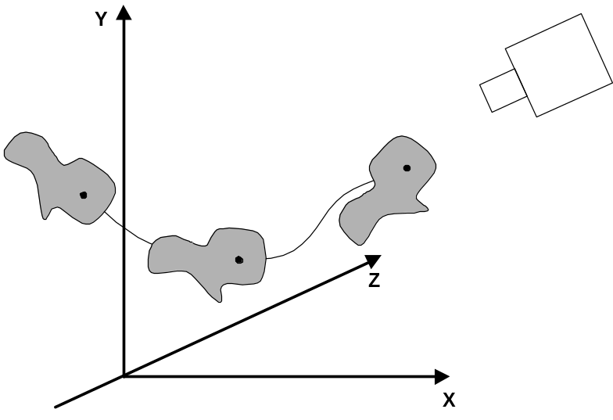
It is important to remember that when the object moves along the path, not only its position changes, but also its orientation
Y
Z
X

Slide 16
Rotate
Y
Z
X

Slide 17
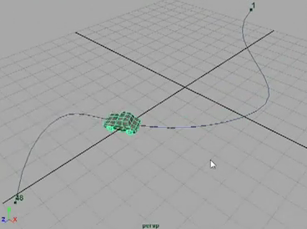
Example of path specification
http://www.ideepix.nl/ARIL/3D/maya/?show=31

Slide 18
Object definition
In simple manual systems, the objects can be simply the artist drawings
In computer-generated animations, models are used

Slide 19
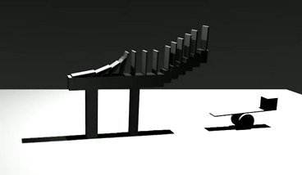
Models can be ...
Rigid (i.e. they have no moving parts)
http://www.youtube.com/watch?v=pMmFWlZNkWU

Slide 20

Models can be ...
Articulated (subparts are rigid, but movement is allowed between the sub-parts)
http://www.youtube.com/watch?v=MR0BU7g43p0

Slide 21
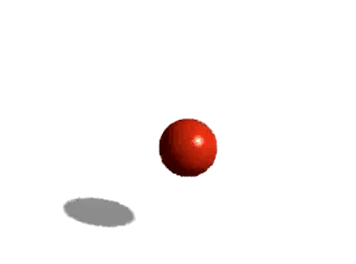
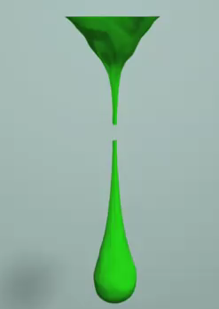
Models can be ...
Dynamic (using physical laws to simulate the motion)
http://www.youtube.com/watch?v=ih-sqwHEx7A&NR=1
    http://www.youtube.com/watch?v=moGZi1kim-8

Slide 22

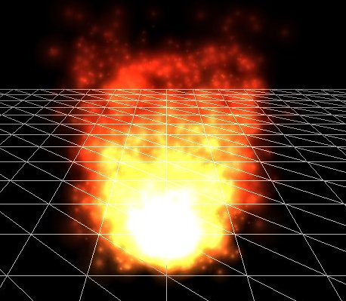
Models can be ...
Particle based (animating individual particles using the statistics of behaviour)
http://vimeo.com/6305219
Source: Wikipedia
http://www.cgarena.com/freestuff/tutorials/maya/firevideo/fire.html

Slide 23
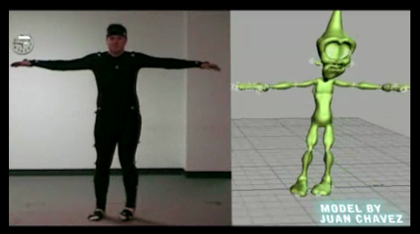
Models can be ...
Behaviour based (e.g. based on behaviour of real people or animals)
http://www.youtube.com/watch?v=DcLJ8aDq74g&feature=related

Slide 24
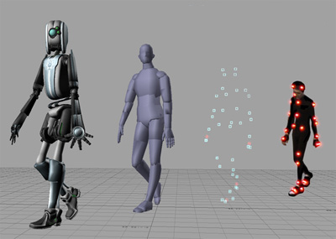
Behaviour-based (motion capture)
Source: Wikipedia

Slide 25
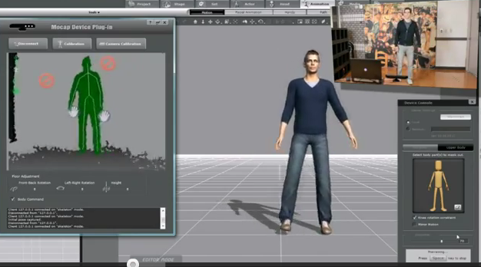
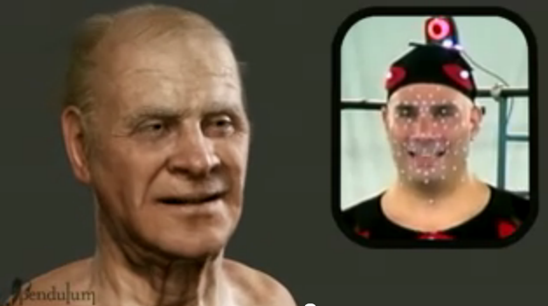
http://www.youtube.com/watch?v=4ysV-6tnE00
http://www.youtube.com/watch?v=o_7CfWlkqm8

Slide 26
Rigid objects
Simple rigid objects can be defined in terms of
  polygon tables (3D)
  basic shapes such as line segments, circles, splines etc. (2D)
Rigid body animation is an extension of the three-dimensional viewing

Slide 27
Computer Animation
Creating animation sequences
object definition
path specification
key frames
in-betweening
Displaying animation sequences
raster animation
Parametric equations in animation

Slide 28
Models can be
Rigid (i.e. they have no moving parts)
Articulated (subparts are rigid, but movement is allowed between the sub-parts)
Dynamic (using physical laws to simulate the motion)
Particle based (animating individual particles using the statistics of behaviour)
Behaviour based (e.g. based on behaviour of real animals)

Slide 29
KEY FRAMES AND IN-BETWEENING

Slide 30
Rigid body animation
Rigid body animation uses standard 3D transformations
At least 30 frames per second to achieve smooth animation
Computing each frame would take too long

Slide 31
Key frames
Compute first a small number of key frames
Interpolate the remaining frames in-between these key frames (in-betweening)
Key frames can be computed
  at equal time intervals
  according to some other rules
  for example when the direction of the path changes rapidly

Slide 32
In-betweening
The simplest method of in-betweening is linear interpolation
Interpolation is normally applied to the projected object points

Slide 33
1
1’
3’
3
added point
2’
2
Key frame k
Halfway frame
Key frame k+1

Slide 35
In-betweening - example
Given coordinates of a 2D point
  key frame n: (x_{n},y_{n})
  key frame n+1: (x_{n+1},y_{n+1})
  time interval between the two key frames: 1/10 second
To get smooth animation, needs at least 30 frames per second
Solution: insert at least further 2 frames between the given two key frames

Slide 36
In-betweening - parametric equations
Parametric equations – a flexible tool for interpolation
Example for line segment between two points, (x_{n},y_{n}) and (x_{n+1},y_{n+1})
  calculate points in between the two given points
  x_{i} = x_{n} + t (x_{n+1} - x_{n})
  y_{i} = y_{n} + t (y_{n+1} - y_{n})
  t is the parameter which always changes between 0 and 1
  when t = 0, we get x_{n}
  when t = 1 we get x_{n+1}
  for 0 < t < 1 we get the points in between

Slide 37
In-betweening - parametric equations
The only thing to decide is the number steps between point n and point n+1
This allows us to set the value of Δt , which is 1 divided by the number of steps
For example, for 10 steps, Δt = 1/10 = 0.1
This formula works also for points in 3D

Slide 38
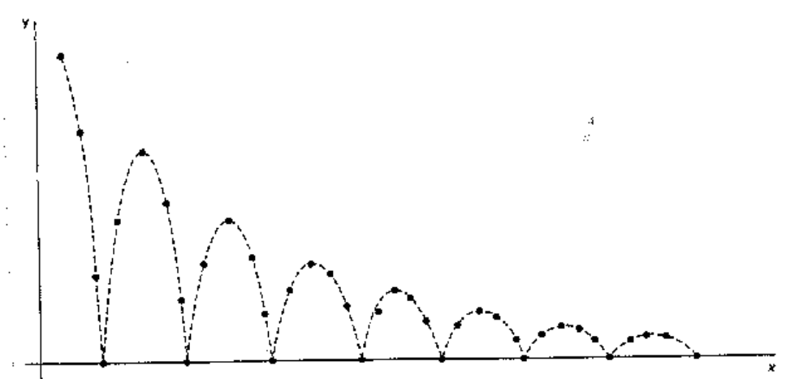
In-betweening
Linear interpolation will not always produce realistic results.
Example: an animation of a bouncing ball where the best in-betweening can be achieved by dynamic animation

Slide 39
In-betweening
In-betweening should use interpolation based on the nature of the path, for example:
  straight path linear interpolation
  circular path angular interpolation
  irregular path linear interpolation
  spline
For in-betweening use parametric representation of lines and curves, e.g.
  line segment
  circle
  Bezier curve

Slide 40

Examples
Bouncing Ball
  Basic animation
    http://www.youtube.com/watch?v=ih-sqwHEx7A&NR=1
  Story 1
    http://www.youtube.com/watch?v=-rnbylVH4tM&NR=1
  Story 2
    http://www.youtube.com/watch?v=yyRUrDUHLPo&feature=related

Slide 41
RASTER BASED ANIMATION

Slide 42
Raster animation
This is the most common animation technique
Frames are create off-line and copied very fast from the off-screen memory to the frame buffer
Copying usually done with bitBLT-type operations
Copying can be applied to
  complete frames
  only parts of the frame which contain some movement

Slide 43
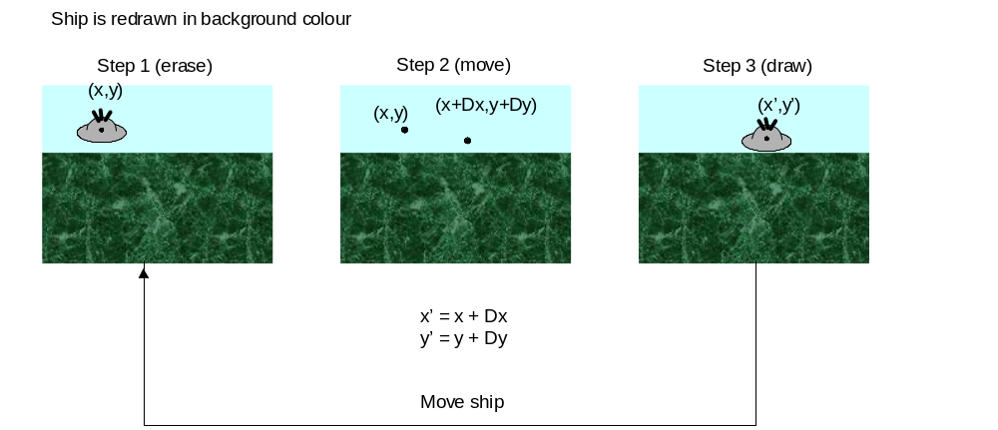
Examples

Slide 44
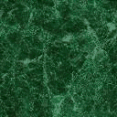

Slide 45
Raster animation - procedures
A part of the frame in the frame buffer needs to be erased
The static part of the frame is re-projected as a whole, and the animated part is over-projected.

Slide 46

Example of raster animation
http://www.youtube.com/watch?v=9mpr6WaTsfU

Slide 47
BitBLT
Bit BLock Transfer
Copying rectangles of images
  From one part of the screen to another
  From off-screen images to on-screen images
  Implemented on video cards – hence very fast
Automatic rescaling if rectangles are of different size
BitBLT often includes logic operations (NOT, XOR etc)

Slide 48
BitBLT
Java methods implementing BitBLT
Graphics.copyArea( )
  To move image from one part of the screen to another
Graphics.drawImage
  To copy between off-screen images, or off-screen and on-screen images
java.awt.Robot.createScreenCapture
  Capture the screen as an Image

Slide 49
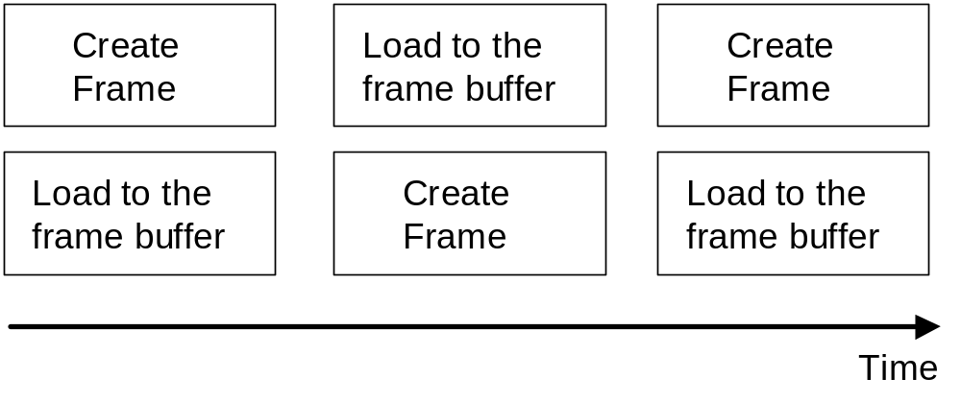
Double buffering
Used to achieve smooth animation
The next frame of animation is computed to an off-screen buffer at the same time when the current frame is transferred to the frame buffer.

Slide 50
Double buffering
Java methods implementing double buffering
  createBufferStrategy( )

Slide 51
Colour-table animations
Simple 2D animations can be easily implemented using colour lookup table.

Slide 52
Displaying animation sequences
Animations frames can be
  pre-computed in advance and pre-loaded in memory
  computed in real time (e.g. movement of the cursor)

Slide 53
Next lecture
Efficient algorithms for line and circle

