Slide 1
Raster conversion algorithms for line and circle
Introduction
- Pixel addressing
- Primitives and attributes
Line drawing algorithms
- DDA
- Bresehnam
Circle generating algorithms
- Direct method
- Bresenham algorithm

Slide 2
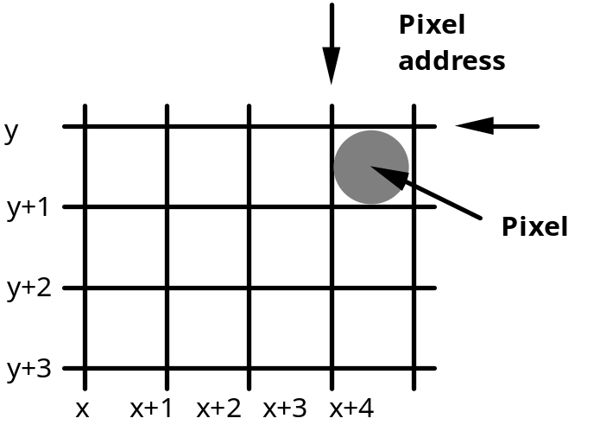
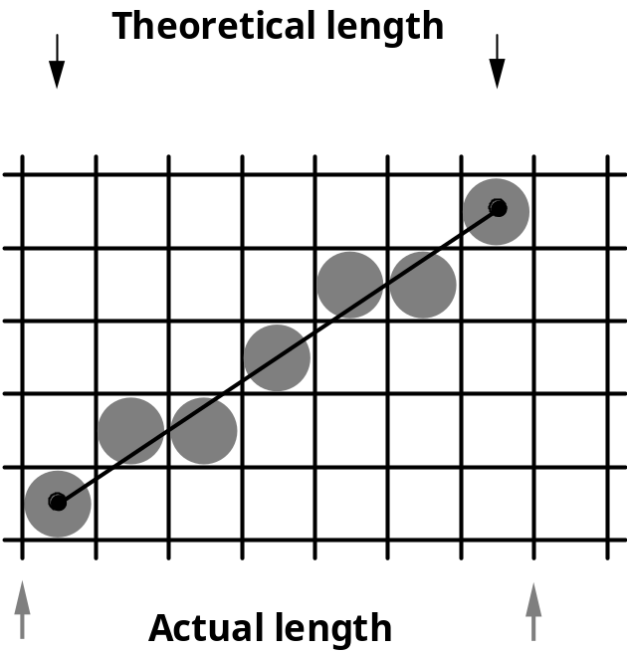
Pixel addressing in raster graphics

Slide 3
Raster conversion algorithms: requirements
visual accuracy
spatial accuracy
speed

Slide 4
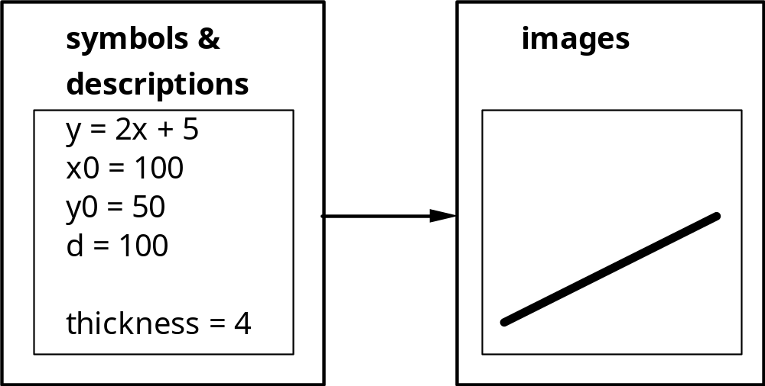
Line (segment) drawing algorithms

Slide 5
Line – raster representation

Slide 6
Simple line equation
y = mx + b
m = slope (gradient)
b= intercept with y axis
b
m = Δy / Δx

Slide 7
Line gradient (slope)
m = Δy / Δx
m =∞
|m| > 1, m > 0
m = 1
|m| < 1, m > 0
m = 0
m = -1

Slide 8
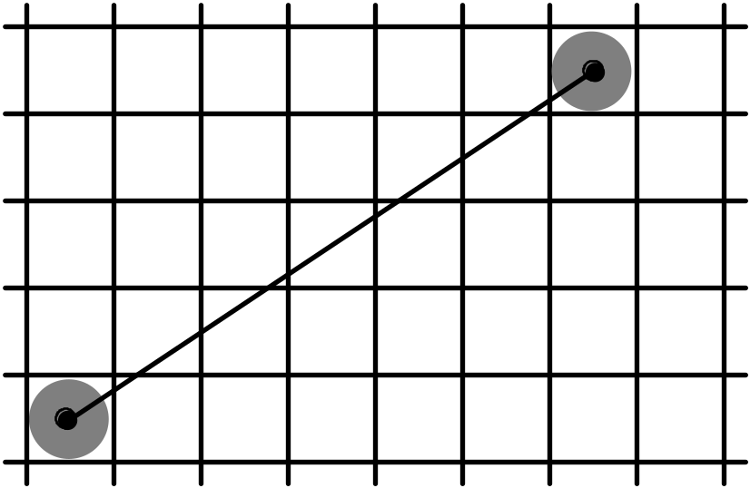
DDA (digital differential algorithm)

Slide 9
DDA ( Digital Differential Algorithm )
|m| < 1, m > 0

Slide 10
DDA ( Digital Differential Algorithm )
|m| > 1, m > 0

Slide 11
DDA ( Digital Differential Algorithm )
|m| > 1, m > 0

Slide 12
DDA ( Digital Differential Algorithm )
Derivation

Slide 13
DDA ( Digital Differential Algorithm )
Derivation

Slide 14
Bresenham's line algorithm
y = mx + b
y = mx + b
y = m(x+1) + b
d2
y
d1
x
x+1

Slide 15
Bresenham's line algorithm
y = mx + b
y = mx + b
y = m(x+1) + b
d2
y
d1
x
x+1

Slide 16
Bresenham's line algorithm (slope ≤ 1)
input line endpoints, (x₀,y₀) and (x_{n}, y_{n})
calculate Δx = x_{n} - x₀ and Δy = y_{n} - y₀
calculate parameter p₁ = 2 Δy - Δx
set pixel at position (x₀,y₀)
repeat the following steps until (x_{n}, y_{n}) is reached:
if p_{i} < 0
set the next pixel at position (x_{i} +1, y_{i} )
calculate new p_{i+1} = p_{i} + 2 Δy
if p_{i} ≥ 0
set the next pixel at position (x_{i} +1, y_{i} + 1 )
calculate new p_{i+1} = p_{i} + 2(Δy - Δx)
For derivation see http://www.cs.bham.ac.uk/~exc/Teaching/Graphics/Bresenham_derivation.pdf

Slide 17
Circle generating algorithms
Direct
Polar coordinate based
Bresenham’s

Slide 18
Direct circle algorithm
Cartesian coordinates
Circle equation:
  ( x - x_{c} )² + ( y - y_{c} )² = r²
Step along x axis from x_{c} - r to x_{c} + r and calculate
  y = y_{c} ± √ r² - ( x - x_{c} )²

Slide 19
Polar coordinates
Polar coordinate equation (parametric, w.r.t. ϕ)
x = x_{c} + r cosϕ
y = y_{c} + r sinϕ
step through values of ϕ from 0 to 2π

Slide 20
Optimisation and speed-up
Symmetry of a circle can be used
Calculations of point coordinates only for a first one-eighth of a circle
Assumes (x_{c},y_{c})=(0,0)
(-x,y)
(x,y)
(-y,x)
(y,x)
(-y,-x)
(y,-x)
(-x,-y)
(x,-y)

Slide 21
Bresenham’s circle algorithm
Assumes centre at (0,0)
Initialisation
Input radius r
Plot a point at x₀=0, y₀=r
Set k = 0
Calculate the initial value of the decision parameter
p₀ = 3 - 2r

Slide 22
While x < y
if p_{k} < 0
p_{k+1} = p_{k} + 4x_{k} + 6
x_{k+1} = x + 1
y_{k+1} = y_{k}
else
p_{k+1} = p_{k} + 4(x_{k} – y_{k} ) + 10
x_{k+1} = x_{k} + 1
y_{k+1} = y_{k} – 1
plot point at (x_{k+1} , y_{k+1})
increment k

Slide 23
5. Determine symmetry points in the other seven octants and plot points
6. Repeat steps 4 and 5 until x ≥ y

Slide 24
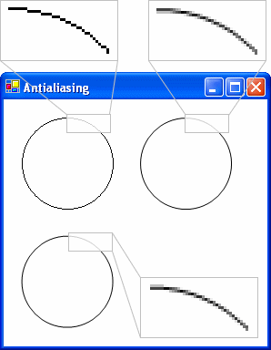
Antialiasing
The technique of minimizing the distortion artifacts arising due to representing smooth and continuous entities (fonts, lines, curves) on a discrete (pixelated) display.

Slide 25
Antialiasing – an example algorithm
Xiaolin Wu. An Efficient Antialiasing Technique. Computer Graphics, Volume 25, Number 4, July 1991.
Good image quality and high computational efficiency.
Assumptions:
  Word length n bits.
  2m intensity levels, m < n.

Slide 26
Antialiasing algorithm for 0 ≤ slope ≤ 1
setpixel(x0, y0, I);
setpixel(x1, y1, I);
D = 0;
d = integer_part(slope * 2^n + 0.5);
x0 = x0 + 1; x1 = x1 - 1;
while (x0 < x1) {
D = D + d;
if (D overflowed) {
y0 = y0 + 1; y1 = y1 - 1;
}
setpixel(x0, y0, D / 2^(n-m));
setpixel(x1, y1, same intensity);
setpixel(x0, y1+1, complement of that intensity);
setpixel(x1, y1-1, again the complement);
x0 = x0 + 1; x1 = x1 - 1;
}

Slide 27
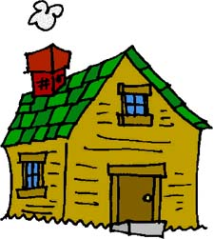
Homework
Implement the Bresenham’s circle algorithm for a circle with a centre at an arbitrary position (x_{c}, y_{c}).
Using Bresenham’s circle algorithm generate circle with centre at (-10,10) and radius r=40
Extend the Bresenham’s line algorithm for lines at an arbitrary slope
Extend the Bresenham’s line algorithm to draw lines of arbitrary thickness (the original algorithm generates lines of nominal thickness of 1)
Implement an algorithm for drawing anti-aliased lines

Slide 28
Homework
Implement the Bresenham’s circle algorithm for a circle with a centre at an arbitrary position (x_{c}, y_{c}).
Generate circle with centre at (-10,10) and radius r=40
Extend the Bresenham’s line algorithm for lines at an arbitrary slope
Extend the Bresenham’s line algorithm to draw lines of arbitrary thickness (the original algorithm generates lines of nominal thickness of 1)
Implement an algorithm for drawing anti-aliased lines

Slide 29
Next lecture
Splines and spline surfaces

