Slide 1

ELECTION ROUND

Slide 2
GENERAL DESCRIPTION
The java program handle an elections round ,choosing an winning party that have most of the votes voted by the citizen on different kalpis.
Each party have candidates that choosed by the user from the existing citizens.
As an action after adding all the entities ,the program asking all of the citizens who can vote ,who they want to vote to and adding their vote to the kalpi and to the party.

Slide 3
USERS
There are 1 type of user in Election Round
Electoral Commission - it is collecting all the votes of voters, of each kalpi in the country which is voting to some political party , and update all of it .when it is over , it is calculate the sum of all votes out of all the kalpis , the political party with most of the votes is winning the elections.

Slide 4
ENTITIES
Citizen – a person live in the elections's country , can vote in the elections if he is 18+
Kalpi – includes all the citizen who can vote who have been added to there depends on the user
Political party – the voters choose between them who to vote to , and the party who get most of the votes win the elections .depends on the user it can have many citizens who is chosen to be candidate of this party if the space is available.
Candidate – a citizen who is choosed to represent an existing political party ,and can vote like a normal citizen.
Soldier – citizen that can carry a weapon and depends on if he is sick on corona votes in different kalpis.
Citizen with corona virus – can vote only to a special kalpi who fits his situation depends on how many days he is sick.
Kalpi corona idf – special kalpi , that only soldiers who sick in corona assigned to vote in.

Slide 5
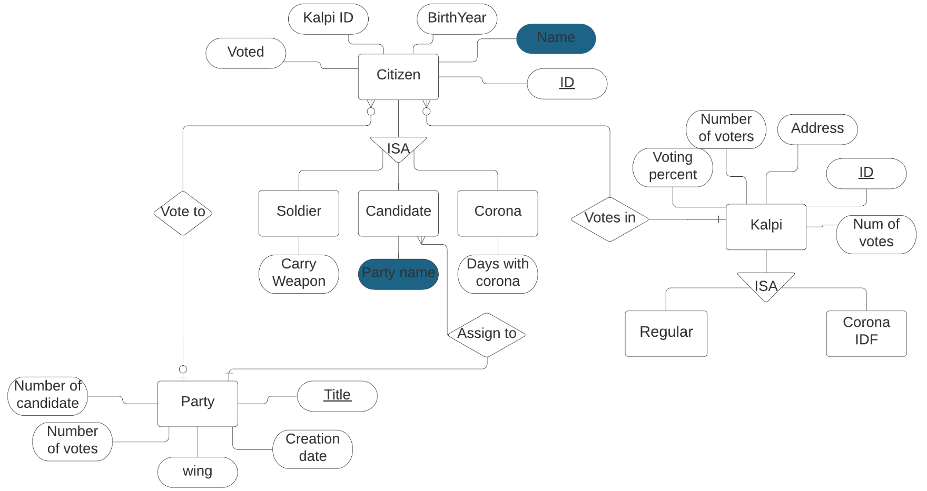

Slide 6
TABLES
Mark the primary keys with an underline.
Mark the foreign keys with an asterisk (*) and state which other table it references.
Party: ( Title, Creation date , wing , number of candidate , number of votes ).
Citizen: (CID, Name, Birthyear , KalpiID* , Voted ).
* References Kalpi.
Vote to : CID(Citizen) , Title.
Soldier : (CID*,Carry weapon ).
* References Citizen.
Candidate : (CID*, Party name** ).
* References Citizen.
**References Party.
Assign to : CID(Candidate) , Title.
Corona : (CID*, Days with corona ).
* References Citizen.
Kalpi : (KID, Address, Number of voters, Voting percent ,Number of votes ).
Regular Kalpi : (KID*).
* References Kalpi.
Corona IDF Kalpi: (KID*).
* References Kalpi.
Vote in : CID(Citizen),KID.

Slide 7
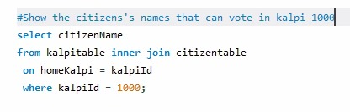
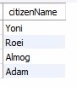
SELECT EXAMPLE

Slide 8
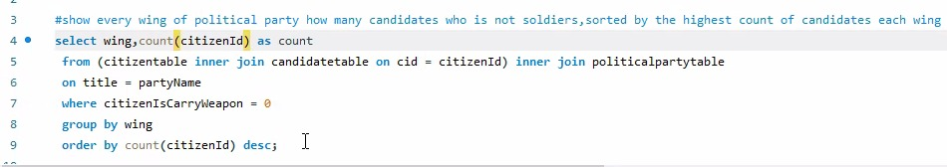

SELECT EXAMPLE

