Slide 1
Chord Lord Android game (Java)
Project Video Link:
https://www.youtube.com/watch?v=Eb-rzKuGtPQ

Slide 2
Game purpose and audience
Game Goal
An educational and simple game designed to teach the playing and hearing of chords while developing musical hearing in a pleasant user experience.
Audience:
Beginner and advanced musicians, music lovers and anyone who wants to develop their musical hearing, the app is designed for children and adults alike

Slide 3
Screen Diagram - UML
Activity 1
Main
Activity 2
Choose Instrument
Activity 3
Choose Difficulty
Activity 4
Choose Scale
Activity 5
Game Screen
Activity 6
Game Score
Activity 7
Leaderboards
GameInfo Class
Class for game logic
Answer Button
extends Button
Activity 9
Learn Guitar
Activity 8
Learn Instrument
Activity 11
Chord Screen
Custom Grid Layout
extends GridLayout
Activity 10
Learn Piano
Score Item
Model for leaderboard
Save score to device storage

Slide 4
Game Screens

Slide 5
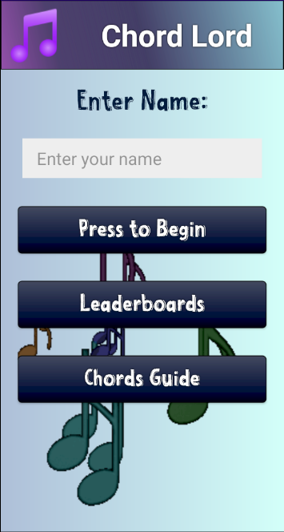
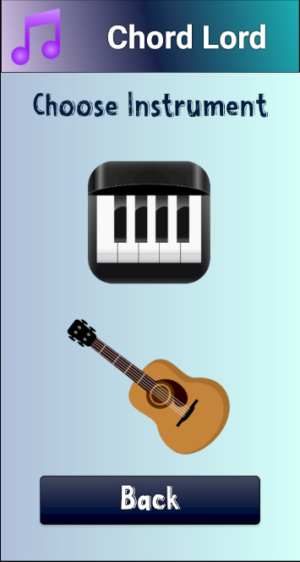
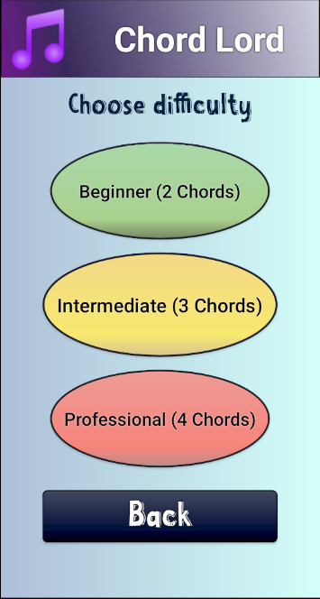
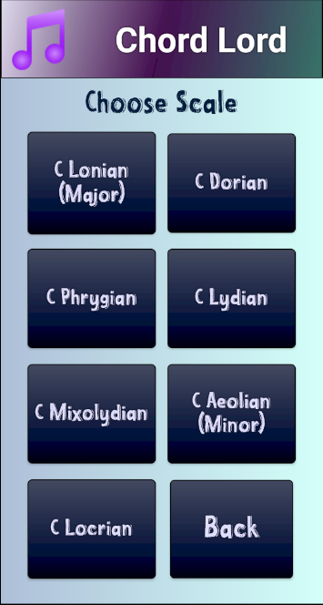
Screen 1 - Main screen:
Designed to navigate between the various game options and enter players' names.
Screen 2 - Selecting Musical Instruments:
Allow the player to select a musical instrument, guitar or piano.
Screen 3 - Difficulty Selection:
Allows the player to select the initial difficulty level of the game.
Screen 4 - Scale Selection:
Allows the player to select the relevant scale he wants to play.

Slide 6
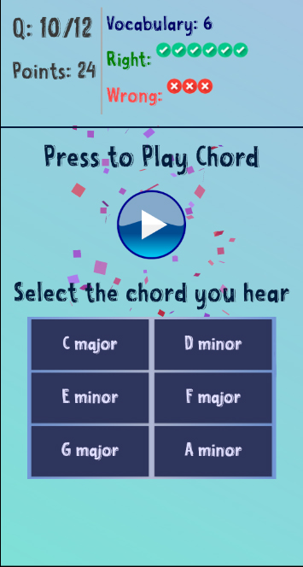
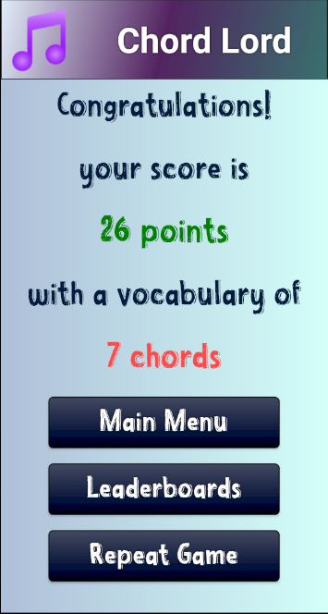
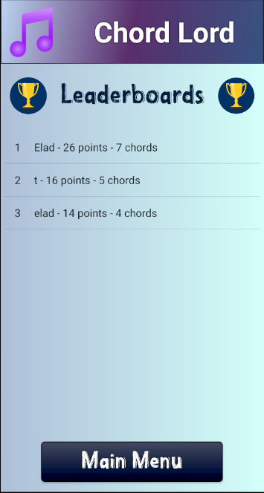
Screen 5 - Game screen:
A screen in which chords varying according to the scale and instruments chosen by the user will be played. The player will have to choose the chord he heard, with every 2 correct answers adding a chord from the scale to the answer database.
Screen 6 - Score screen:
Will appear at the end of the game. A screen with the number of points and chords that the user was able to achieve.
Contains a transition to the main menu, the achievements board, and the option to start the game again.
Screen 7 – Leader Board:
Contains the table of records of the game leaders, including - rank, name, score, number of chords.
Screen 8 - Chords Practice:
A screen beyond the study area that allows the player to select a musical instrument, guitar or piano that he will want to practice before he starts playing the real game.

Slide 7
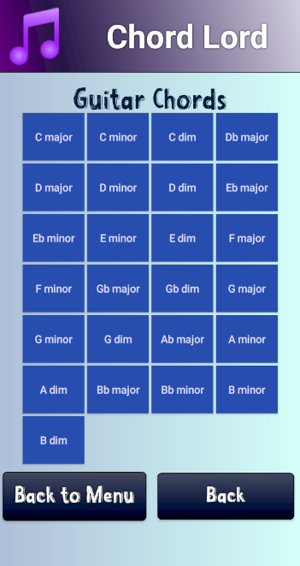
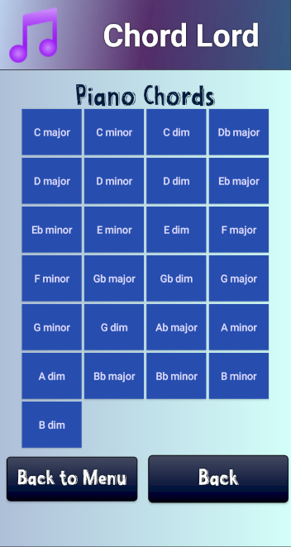
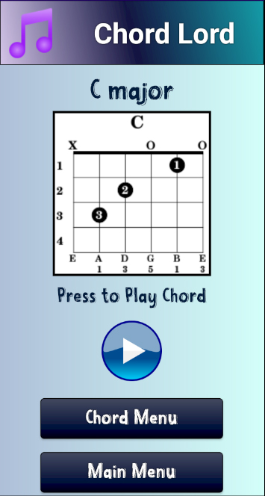
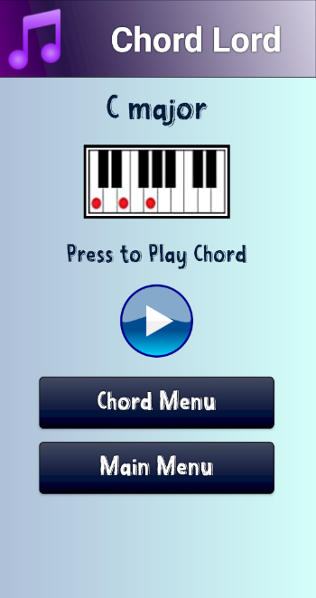
Screens 9-10 - Chord Screens:
These screens will show the user all the existing chords in the game.
For guitar or piano.
Screen 11 - Chords screen:
This screen will show the user how to play the chord, and how the chord sounds.

Slide 8
Development, technologies and special features
Serialization: Using the Gson class to store complex objects in the device memory.
Animation: Dynamic color-changing backgrounds, touch-responsive image objects (size and color), "breathable" buttons.
Font localization: The app has several languages, and each language has its own custom font.
XML Shapes: Button design, gradient colors, dynamic (and animated) top banner.
Custom Layout: A custom layout component that inherits from Grid and handles the arrangement of answer buttons.
Custom Button: The AnswerButton object that inherits from Button with additional functionality.
Gif Drawable: Use the Gif-Drawable class to implement Gif animations on the various screens.
Study pages: contain over 50 different variations of chords and musical instruments, a lot of work has been done in collecting and organizing the study material - the pages are created dynamically.
Record table: includes reading and writing to the device memory, and viewing the data using ListView.

