Slide 1
Conflict-Based Search for
Optimal Multi-Agent Pathfinding
Sharon, Stern, Felner & Sturtevant — AIJ 2015
Nimrod Netzer • Elad Damti • Kfir Dahan
Bar-Ilan University | Search in AI Course | June 2026
Heuristic Search Course Project

Slide 2
What is Multi-Agent Path Finding?
Nimrod Netzer
• k agents on a graph, each with a start and a goal location
• Agents move one step per timestep, or wait in place
• Objective: minimize Sum of Costs (SOC) = total steps by all agents
• Constraint: no two agents at the same vertex or edge at the same time
Real-World Applications
• Amazon warehouse robots (Kiva systems)
• Airport ground traffic control
• Railway scheduling and video game AI
Formal Definition
• Graph G=(V,E), agents A={1..k}, starts s_i, goals g_i
• Optimal MAPF is NP-hard in the general case

Slide 3
Why is MAPF Hard? (Joint A* Fails)
Nimrod Netzer
• Naive approach: search the joint state space of all agents
• Joint state space size = |V|^k (exponential in number of agents)
State Space Explosion
• 2 agents × 5 vertices → 25 joint states
• 10 agents × 5 vertices → 9,765,625 joint states
• 30 agents on a 20×20 grid → completely infeasible
Joint A* limitations
• Runs out of memory before finding solution
• Even optimal A* cannot handle large instances
CBS Solution
• Avoid the joint space entirely — plan each agent separately
• Only resolve conflicts when they actually occur

Slide 4
Conflict Types in MAPF
Nimrod Netzer
Vertex Conflict
• Two agents occupy the same vertex at the same timestep
Edge Conflict (Swap)
• Two agents traverse the same edge in opposite directions simultaneously
Following Conflict
• Agent i follows agent j along the same edge
Cycle Conflict
• A group of agents forms a cycle of dependencies
Swapping Conflict
• Two agents exchange positions across consecutive timesteps
• CBS detects the first conflict found and branches on it

Slide 5
Conflict-Based Search — Two-Level Algorithm
Elad Damti
High Level — Constraint Tree (CT)
• Binary tree where each node holds a set of constraints
• Best-first search: always expand the node with lowest total cost
• Branch when a conflict is found: add constraint to one agent
Low Level — Time-Space A* (TSA*)
• Plan each agent individually, respecting its constraint set
• State = (vertex v, timestep t)
• Heuristic = Manhattan distance (admissible)
Key Insight
• CBS avoids joint state space — agents plan independently
• Conflicts are resolved lazily: only when they appear
• Guaranteed to find the optimal solution (complete + optimal)

Slide 6
Low Level: Time-Space A* (TSA*)
Elad Damti
• State = (vertex v, timestep t) — time is part of the state
• Successor states: move to adjacent vertex OR wait in place
Constraint Checking
• Vertex constraint: (agent i, vertex v, time t) → skip state (v,t)
• Edge constraint: (agent i, edge v1→v2, time t) → skip transition
Admissible Heuristic
• Manhattan distance from v to goal (ignores constraints)
• Never overestimates → TSA* is optimal for each agent
Result
• Returns the shortest path for one agent that satisfies all its constraints
• If no path exists → CT node is pruned (infeasible branch)

Slide 7
CBS Algorithm — Step by Step
Elad Damti
• Step 1: Plan each agent independently → root CT node
• Step 2: Find the first conflict among all agent paths
• Step 3: If no conflict → DONE, return optimal solution
• Step 4: Create 2 child CT nodes:
→ Left child: agent i is forbidden from vertex v at time t
→ Right child: agent j is forbidden from vertex v at time t
• Step 5: Replan the constrained agent with TSA*
• Step 6: Add both children to the open list (by cost)
• Step 7: Pop cheapest CT node → go to Step 2
Optimality Guarantee
• Best-first search + optimal low level → first complete solution is globally optimal

Slide 8
Our Implementation — Python 3
Elad Damti
Module Structure
• graph.py — 20×20 grid, 4-connected, obstacle support
• tsa_star.py — Time-Space A*, vertex + edge constraints [Nimrod]
• conflict.py — Vertex & edge conflict detection [Elad]
• cbs.py — Constraint Tree, best-first search [Elad]
• benchmark.py / joint_astar.py — Joint-State-Space A* baseline, instance runner [Kfir]
Implementation Choices
• First conflict found is resolved (not prioritized by type)
• Agents stay at goal after arrival (path extended with waits)
• Time limit: 30s reproduction, 15s extension
Validation
• Tested on hand-verified 3-agent examples
• All paths checked to be conflict-free before reporting success

Slide 9
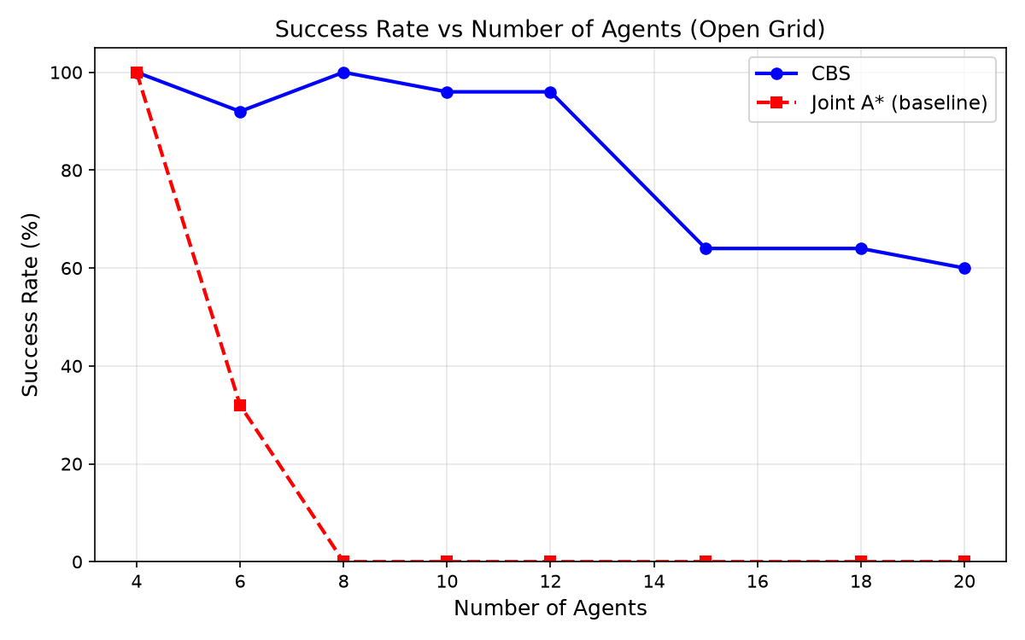
Reproduction Results — Success Rate vs. Agents
Kfir Dahan
CBS vs. Joint-State-Space A* baseline | 25 instances per count | 20×20 open grid | CBS: 30s limit, Joint A*: 5s limit

Slide 10
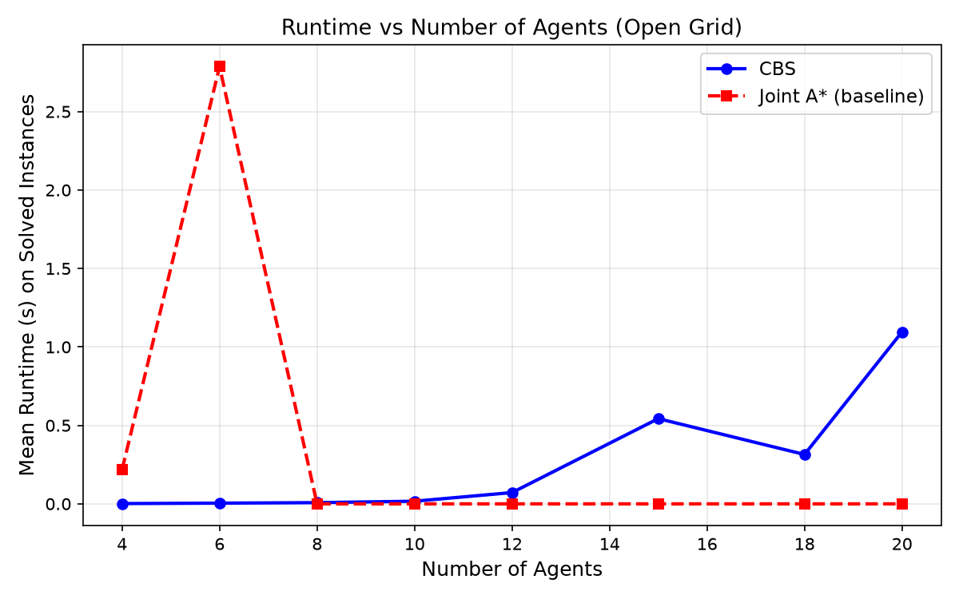
Reproduction Results — Runtime Comparison
Kfir Dahan
CBS runtime grows with agents but remains tractable | Joint A* baseline fails completely (0% success) from 8 agents onward

Slide 11
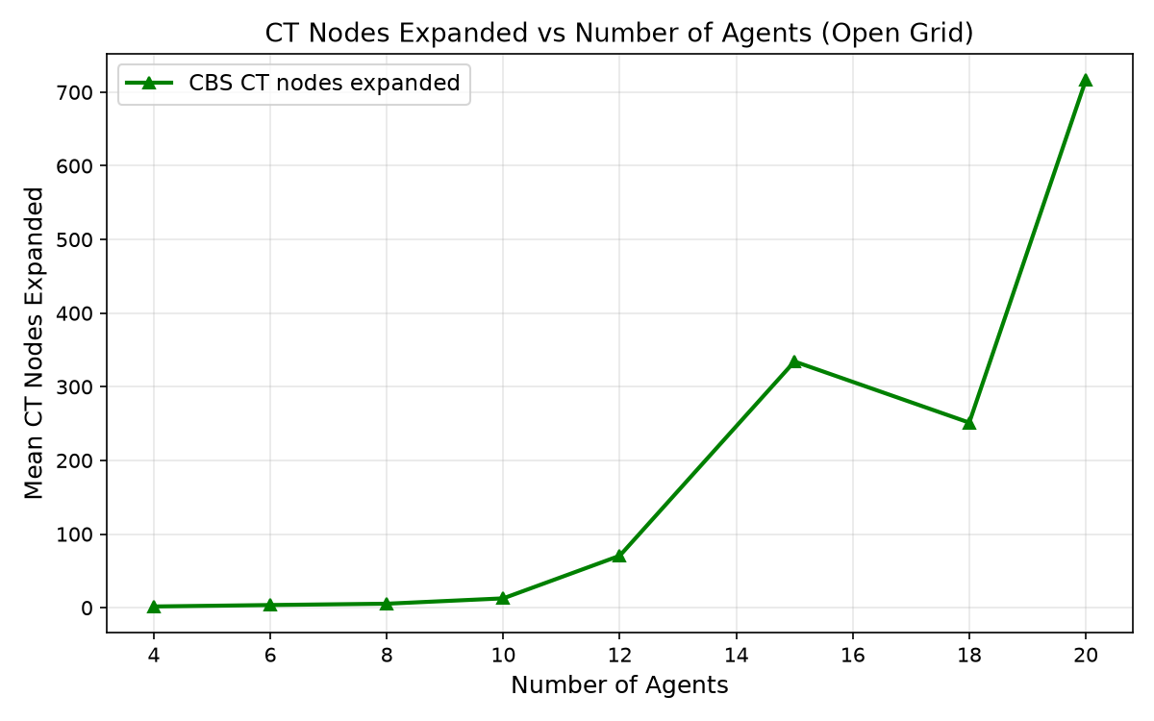
Reproduction Results — Constraint Tree Growth
Kfir Dahan
CT nodes expanded grows exponentially with agent count — reflects increasing conflict resolution work

Slide 12
Extension: Map Topology Study
Kfir Dahan
Research Question
• Does map structure affect CBS performance, and why?
Two Map Types Compared
• Open grid: 20×20, 10% random obstacles (sparse, many paths)
• Warehouse grid: structured shelf rows + narrow corridors (bottlenecks)
Experimental Setup
• Tested agent counts from 4 to 20 agents (4, 6, 8, 10, 12, 15, 18, 20)
• 25 instances per agent count per map type
• 15-second time limit per instance
Hypothesis
• Bottleneck maps force agents onto same paths → more conflicts → deeper CT trees

Slide 13
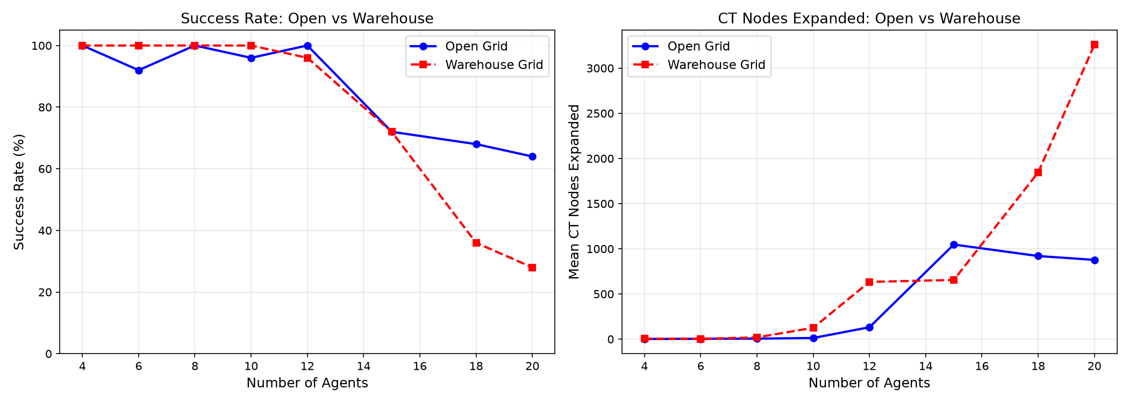
Extension Results — Open Grid vs. Warehouse
Kfir Dahan
Warehouse maps show significantly lower success rate — confirming bottleneck hypothesis

Slide 14
Key Findings
Kfir Dahan
Finding 1: CBS Works
• Finds optimal, conflict-free solutions — Joint A* fails completely (0%) from 8 agents onward
• 100% success rate at 4 agents; drops gracefully with scale
Finding 2: Map Topology Matters
• Warehouse maps (bottlenecks) are significantly harder for CBS
• More conflicts → deeper CT trees → exponentially more search
• Practical insight: CBS deployment depends on environment structure
Finding 3: Python CBS is Efficient
• 4-agent problems solved in under 2 millisecond
• 10-agent warehouse problems solved in 14 millisecond on average
Limitation
• Beyond 20 agents, CBS times out → motivates CBS improvements
• Conflict prioritization + high-level heuristics extend scalability

Slide 15
Conclusion
Nimrod Netzer
• CBS solves MAPF optimally by separating individual planning from conflict resolution
• Two-level structure avoids exponential joint state space
• Low level (TSA*) finds optimal single-agent paths under constraints
• High level (CT) resolves conflicts lazily — only when they occur
Our Contribution
• Full Python implementation validated against hand-verified examples
• Reproduced the main success rate trend from Sharon et al. 2015
• Extension: warehouse maps create 3.7× more CT expansions than open maps (20 agents)
Future Work
• Test CBS improvements (conflict prioritization, disjoint splitting)
• Scale to larger maps using the Moving AI benchmark library

Slide 16
Thank You
Conflict-Based Search for Optimal Multi-Agent Pathfinding
Questions?
Nimrod Netzer • Elad Damti • Kfir Dahan
Sharon, Stern, Felner & Sturtevant — Artificial Intelligence, 219, 40–66, 2015
Bar-Ilan University | Search in AI | June 2026

