Slide 1
Neuroevolution Network
Functional programming in concurrent and distributed systems
Lecturer: Dr. Yehoda Ben Shimol
Teaching Asistent: Mr. David Leon
By: Elad Sofer & Tom Kessous

Slide 2
Project Overview
Perform a learning mechanism in order to catch a running cat.
The learning process is being made via an evolutional neural network's algorithm.
In order to alleviate the calculations, the learning process is being distributed into 4 nodes. Each node has a population of genes which it responsible for it’s evolution
Fault tolerant system – in case a node falls, the system redistribute the workload between the live nodes.
Each node is consisted of several components:
Master Server – OTP gen server
Population FSM – OTP gen statem
Agents Pool – OTP gen servers
Agents supervisor – OTP Supervisor

Slide 3
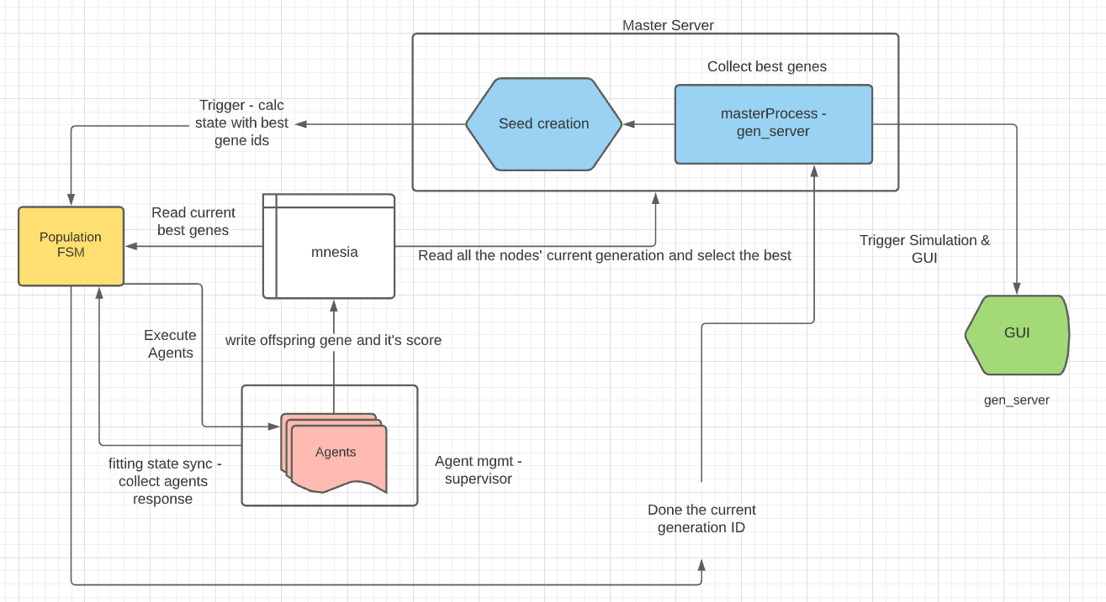
Project Design

Slide 4
Master Server
OTP Gen server.
Each master server has a type – king/regular.
The king master server
responsible for initialization of all nodes’ Mnesia DB, and initialize the system’s GUI,
Gather all the nodes’ genes population scores and select the best Offsprings for the next generation.
Trigger all the nodes’ FSM’s with the current generation.
In case of node down - the master changes the nodes’ PopulationFSM’s genes workload equally.
Regardless of the type, each master server is responsible for creating it’s Population FSM gen server.

Slide 5
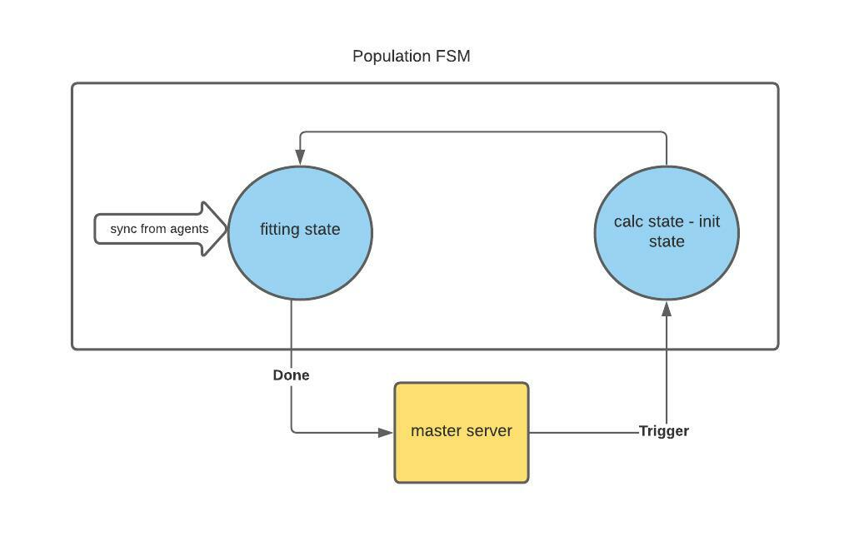
PopulationFSM
OTP Gen statem – The server reports to the king master server. It is which is responsible for the evolution of an entire population. A population is a set of genes which is being evolved during the learning process
Maintain and resize the agents pool – in case a node is down, the workload changes. the population FSM call the supervisor to create more agents in order to adapt its new workload.
Responsible for creating the agents’ pool via creating an agents managment

Slide 6
Population FSM States
Calc mode - the FSM starts in a calc mode, and waits for a trigger from the king master sever. when the trigger received it orders to start the evolution process via commanding all it's agents' pool to deliver an offspring and deliver its score. afterwards it transfer to fitting state.
Fitting state - in the fitting state, the FSM waits until all the agents' pool sends a sync message, letting it know it finished to create an offspring and a score. Each agent inserts the result to the DB. After all agents finished, it sends a done atom to the king master server and move to calc state, waiting for the king master to trigger again

Slide 7
Agent
OTP Gen server.
responsible for executing an evolution single process using the phenotype, genotype and mutation generators.
Execute mutation on a genotype to produce an offspring and run a simulation upon that offspring via phenotype module.
Save the results to the DB and report to it’s FSM population server.

Slide 8
Agent Management
Supervisor OTP.
It responsible for creating the agents pool and make sure that Every agent is alive and able to perform it's tasks.
Each population FSM own a supervisor server.
In case an agent falls, the supervisor restarts it.

Slide 9
Neural Network Design
NN Utilities:
Mutation_gen – a module which obtain a gene and create an offspring
Genotype_gen – a module which creates the seed genes.
Phenotype_gen – a module which obtain a gene and create a vivid neural network. Each NN component is a independent process.
Genotypes tracking feature is included
The NN have several units:
Cortex
Sensor
Neuron
Actuator

Slide 10
Mnesia Data Base
Mnesia data base is perfectly fit for our needs:
Distributed.
Robust.
Reliable.
Fast real-time key-value lookup
High fault tolerance

Slide 11
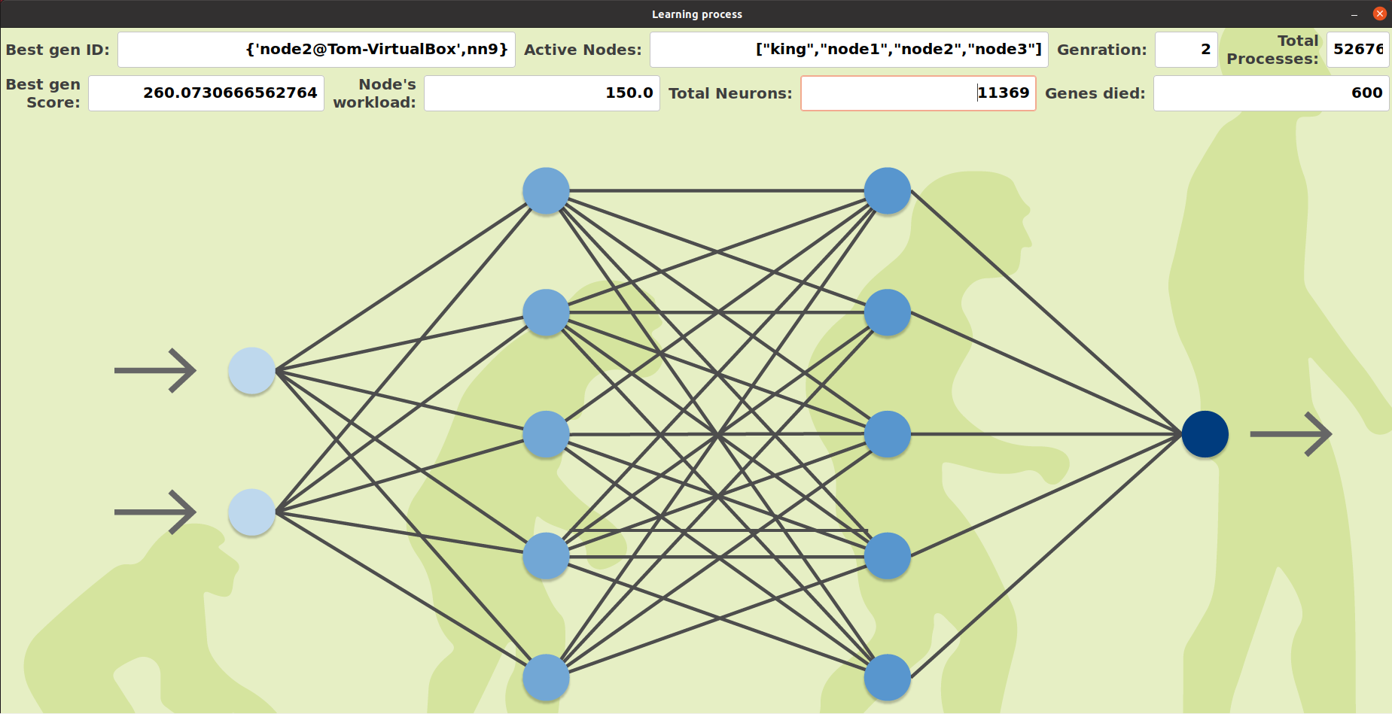
Real Time Learning GUI

Slide 12

Best Scored Simulation GUI

Slide 13
Challenges
Learning new field of evolutional neural networks from scratch.
Learn and adopt new technologies like gen_server, gen_statem, supervisor and wx object.
Working with unfamiliar distributed data base – mnesia.
The lack of a debugger.
Dealing with large number of processes and the communication between them using cross platform standardization.
Synchronizing all the nodes and agents.
Working with Git.

Slide 14
Conclusions
The simulation gets better as we increase the NN amount until we reach saturation.
The distributed computation is much faster than one node, moreover the scalability is much larger in a distributed system.
We learned a different approach to programing different from other “traditional languages”. Letting Erlang Virtual Machine a full control of the concurrency, saves thread management, using locking mechanism and more. Moreover, we believe that In a non concurrent language that project becomes very hard due to several limitations such as max thread limit and more.

Slide 15
Links
Youtube video - https://youtu.be/gjLjRERK-dA
Github repository - https://github.com/eladsofer879/ErlangNN

