Slide 1
Stability of coupled synchronous generators
Elad Venezian
Under the supervision of Prof. George Weiss

Slide 2
Introduction:
~150 years of electricity grid.
The electricity grid become more and more dependent on inverters.
The main power source of the electricity gird is the Synchronous Generator (SG).
This work discuss single generator connected to an infinite bus, and Two Identical Coupled SGs (TICSG).
The frequency stability concept.
TBD schemas of FOM and TICSG.

Slide 3
Agenda
TBD: agenda
Schemas for FOM and TICSG
Graphics
Getting ISE and classical model by phasors

Slide 4
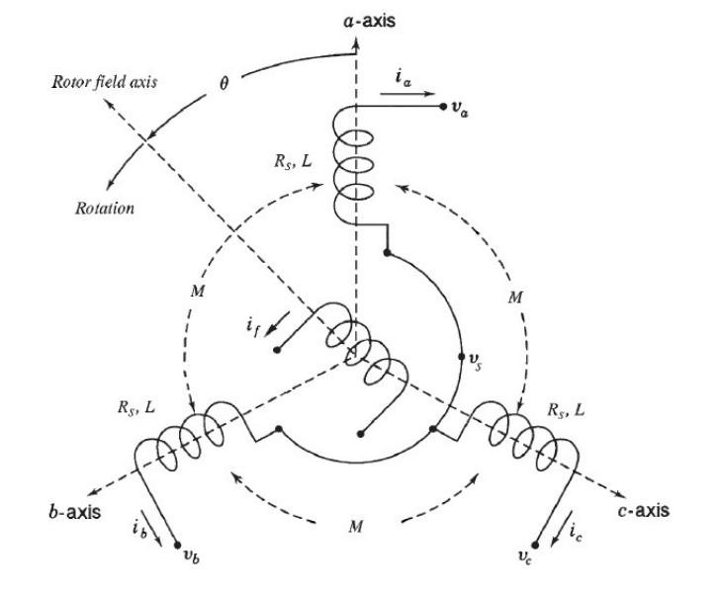
SG modeling:

Slide 5
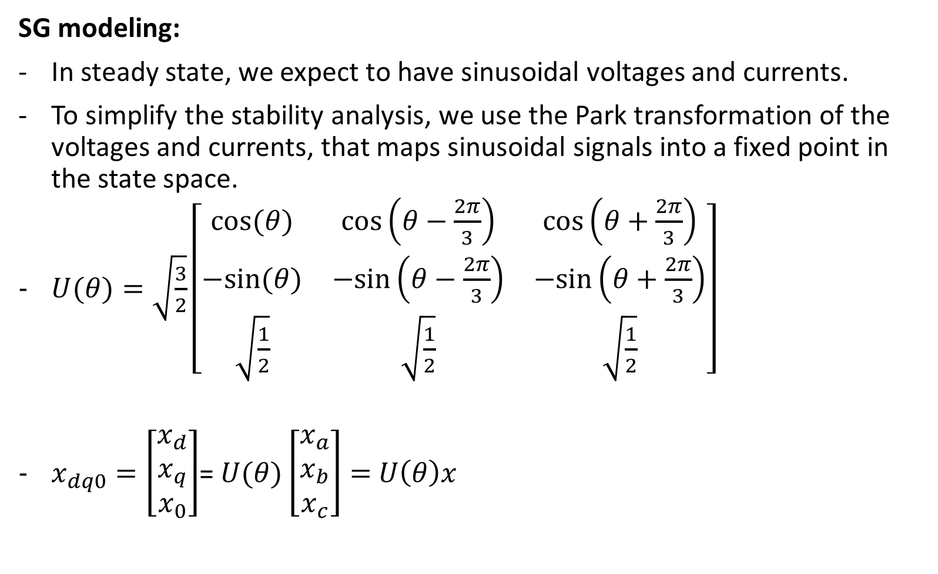
SG modeling:
In steady state, we expect to have sinusoidal voltages and currents.
To simplify the stability analysis, we use the Park transformation of the voltages and currents, that maps sinusoidal signals into a fixed point in the state space.
$U(θ)=\sqrt{\frac{3}{2}}\left[\begin{matrix}cos⁡(θ) & cos⁡\left(θ−\frac{2π}{3}\right) & cos⁡\left(θ+\frac{2π}{3}\right) \\ −sin⁡(θ) & −sin⁡\left(θ−\frac{2π}{3}\right) & −sin⁡\left(θ+\frac{2π}{3}\right) \\ \sqrt{\frac{1}{2}} & \sqrt{\frac{1}{2}} & \sqrt{\frac{1}{2}}\end{matrix}\right]$
$x_{dq0}=\left[\begin{matrix}x_{d} \\ x_{q} \\ x_{0}\end{matrix}\right]$= $U(θ)\left[\begin{matrix}x_{a} \\ x_{b} \\ x_{c}\end{matrix}\right]=$ $U\left(θ\right)x$

Slide 6

SG modeling:
Assuming constant $i_{f}$.
$$\frac{d}{dt}\left[\begin{matrix}L_{s}i_{d} \\ L_{s}i_{q} \\ Jω\end{matrix}\right]=\left[\begin{matrix}−R_{s} & ωL_{s} & 0 \\ −ωL_{s} & {−R}_{s} & −{mi}_{f} \\ 0 & {mi}_{f} & −D_{p}\end{matrix}\right]\left[\begin{matrix}i_{d} \\ i_{q} \\ ω\end{matrix}\right]+\left[\begin{matrix}{−V}_{d} \\ {−V}_{q} \\ T_{m}\end{matrix}\right]$$
This model depends on $θ$.
Prime mover torque is $T_{m}−D_{p}$ $ω$

Slide 7
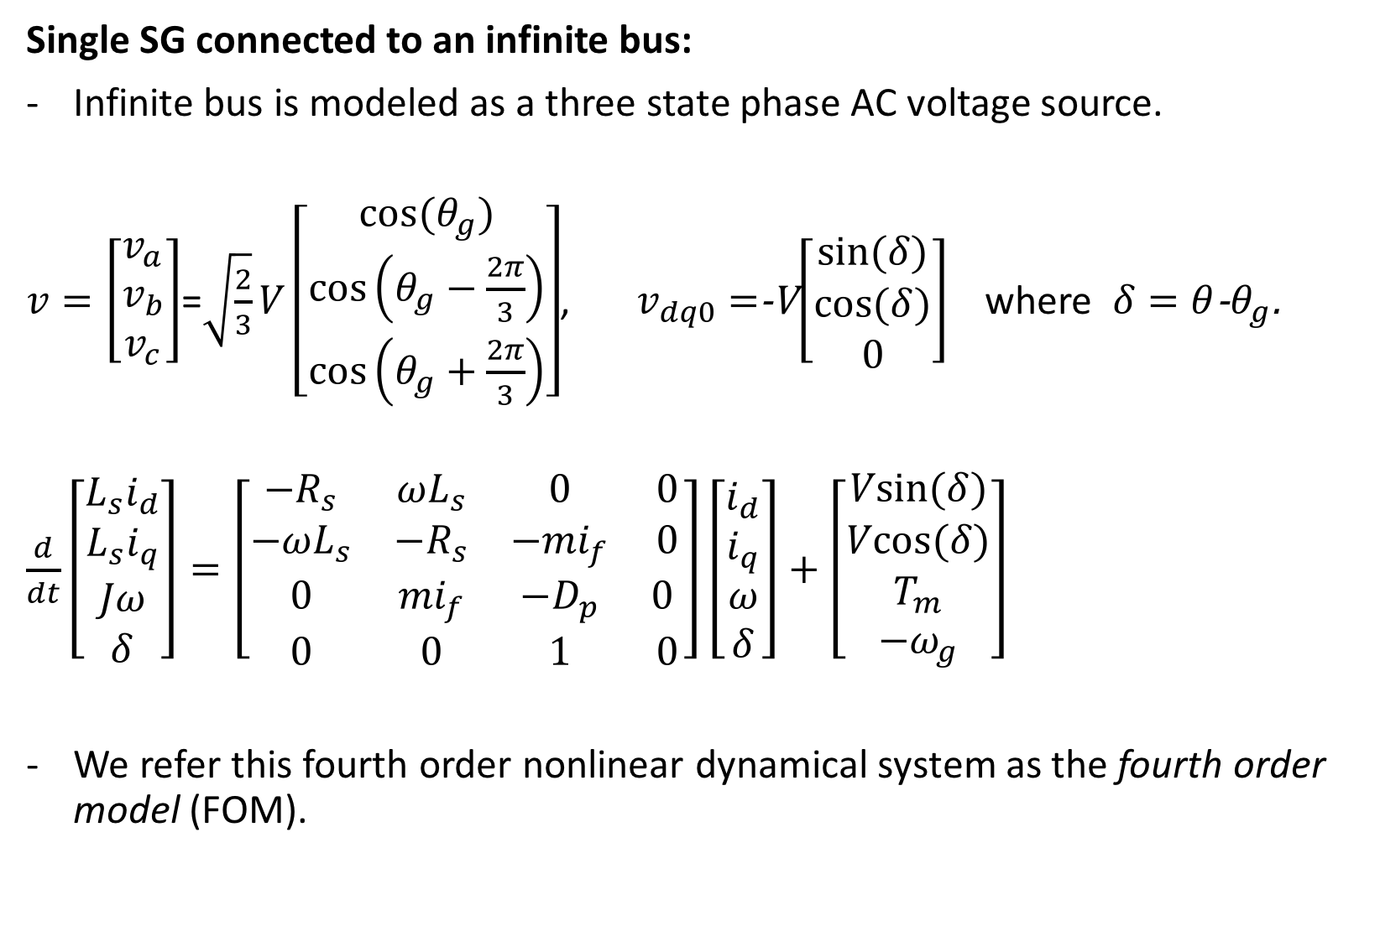
Single SG connected to an infinite bus:
Infinite bus is modeled as a three state phase AC voltage source.
$v=\left[\begin{matrix}v_{a} \\ v_{b} \\ v_{c}\end{matrix}\right]$=$\sqrt{\frac{2}{3}}V\left[\begin{matrix}cos⁡(θ_{g}) \\ cos⁡\left(θ_{g}−\frac{2π}{3}\right) \\ cos⁡\left(θ_{g}+\frac{2π}{3}\right)\end{matrix}\right]$, $v_{dq0}=$-V$\left[\begin{matrix}sin⁡(δ) \\ cos⁡(δ) \\ 0\end{matrix}\right]$ where $δ=θ$-$θ_{g}$.
$\frac{d}{dt}\left[\begin{matrix}L_{s}i_{d} \\ L_{s}i_{q} \\ Jω \\ δ\end{matrix}\right]=\left[\begin{matrix}−R_{s} & ωL_{s} & 0 & 0 \\ −ωL_{s} & {−R}_{s} & −{mi}_{f} & 0 \\ 0 & {mi}_{f} & −D_{p} & 0 \\ 0 & 0 & 1 & 0\end{matrix}\right]\left[\begin{matrix}i_{d} \\ i_{q} \\ ω \\ δ\end{matrix}\right]+\left[\begin{matrix}Vsin⁡(δ) \\ Vcos⁡(δ) \\ T_{m} \\ −ω_{g}\end{matrix}\right]$
We refer this fourth order nonlinear dynamical system as the fourth order model (FOM).

Slide 8
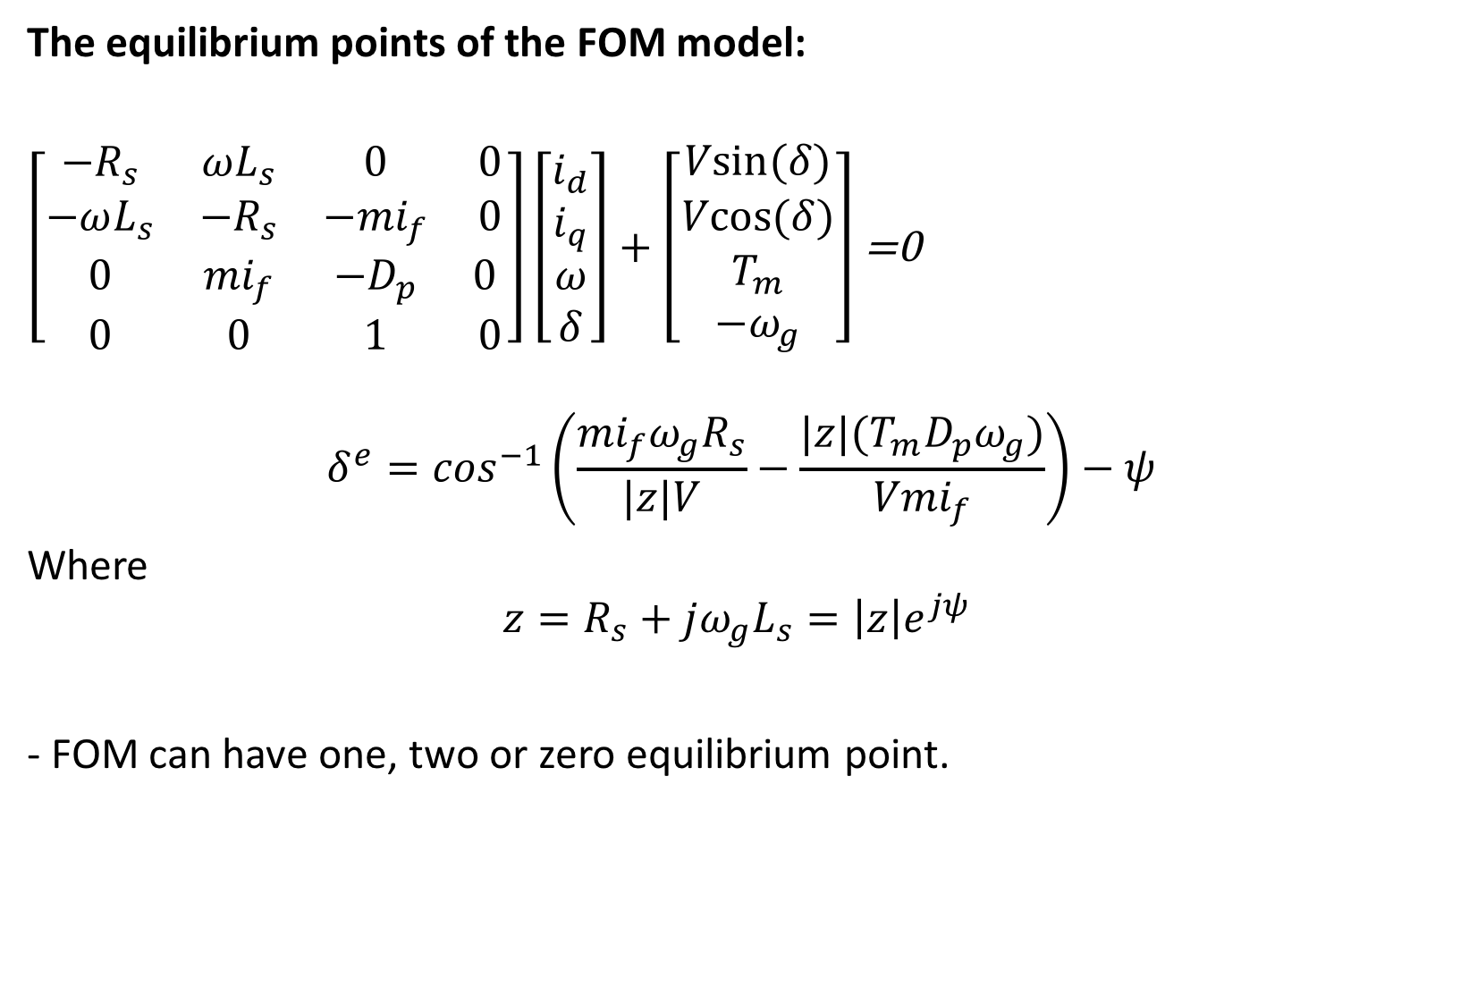
The equilibrium points of the FOM model:
$\left[\begin{matrix}−R_{s} & ωL_{s} & 0 & 0 \\ −ωL_{s} & {−R}_{s} & −{mi}_{f} & 0 \\ 0 & {mi}_{f} & −D_{p} & 0 \\ 0 & 0 & 1 & 0\end{matrix}\right]\left[\begin{matrix}i_{d} \\ i_{q} \\ ω \\ δ\end{matrix}\right]+\left[\begin{matrix}Vsin⁡(δ) \\ Vcos⁡(δ) \\ T_{m} \\ −ω_{g}\end{matrix}\right]$ =0
$$δ^{e}=\cos^{−1}\left(\frac{{mi}_{f}ω_{g}R_{s}}{|z|V}−\frac{|z|(T_{m}D_{p}ω_{g})}{{Vmi}_{f}}\right)−ψ$$
Where
$$z=R_{s}+jω_{g}L_{s}=\left|z\right|e^{jψ }$$
- FOM can have one, two or zero equilibrium point.

Slide 9
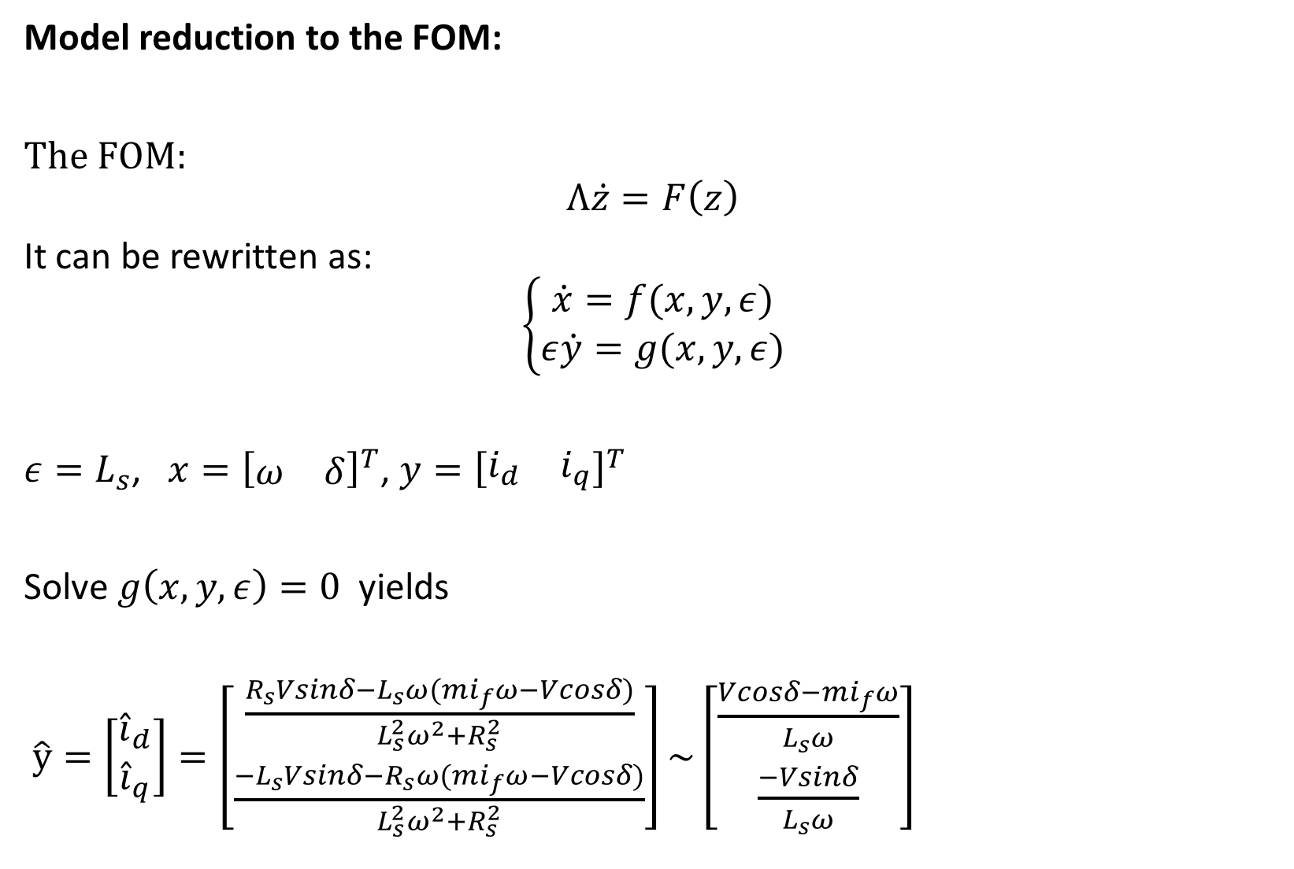
Model reduction to the FOM:
The FOM:
$$Λ\dot{z}=F\left(z\right)$$
It can be rewritten as:
$$\left\{\begin{matrix}\dot{x}=f(x,y,ε) \\ ε\dot{y}=g(x,y,ε)\end{matrix}\right.$$
$ε=L_{s}$, $x={\left[\begin{matrix}ω & δ\end{matrix}\right]}^{T}$, $y={\left[\begin{matrix}i_{d} & i_{q}\end{matrix}\right]}^{T}$
Solve $g\left(x,y,ε\right)=0$ yields
$\hat{y}=\left[\begin{matrix}{\hat{i}}_{d} \\ {\hat{i}}_{q}\end{matrix}\right]=\left[\begin{matrix}\frac{R_{s}Vsinδ−L_{s}ω(mi_{f}ω−Vcosδ)}{L_{s}^{2}ω^{2}+R_{s}^{2}} \\ \frac{{−L}_{s}Vsinδ−R_{s}ω(mi_{f}ω−Vcosδ)}{L_{s}^{2}ω^{2}+R_{s}^{2}}\end{matrix}\right]\sim \left[\begin{matrix}\frac{Vcosδ−mi_{f}ω}{L_{s}ω} \\ \frac{−Vsinδ}{L_{s}ω}\end{matrix}\right]$

Slide 10
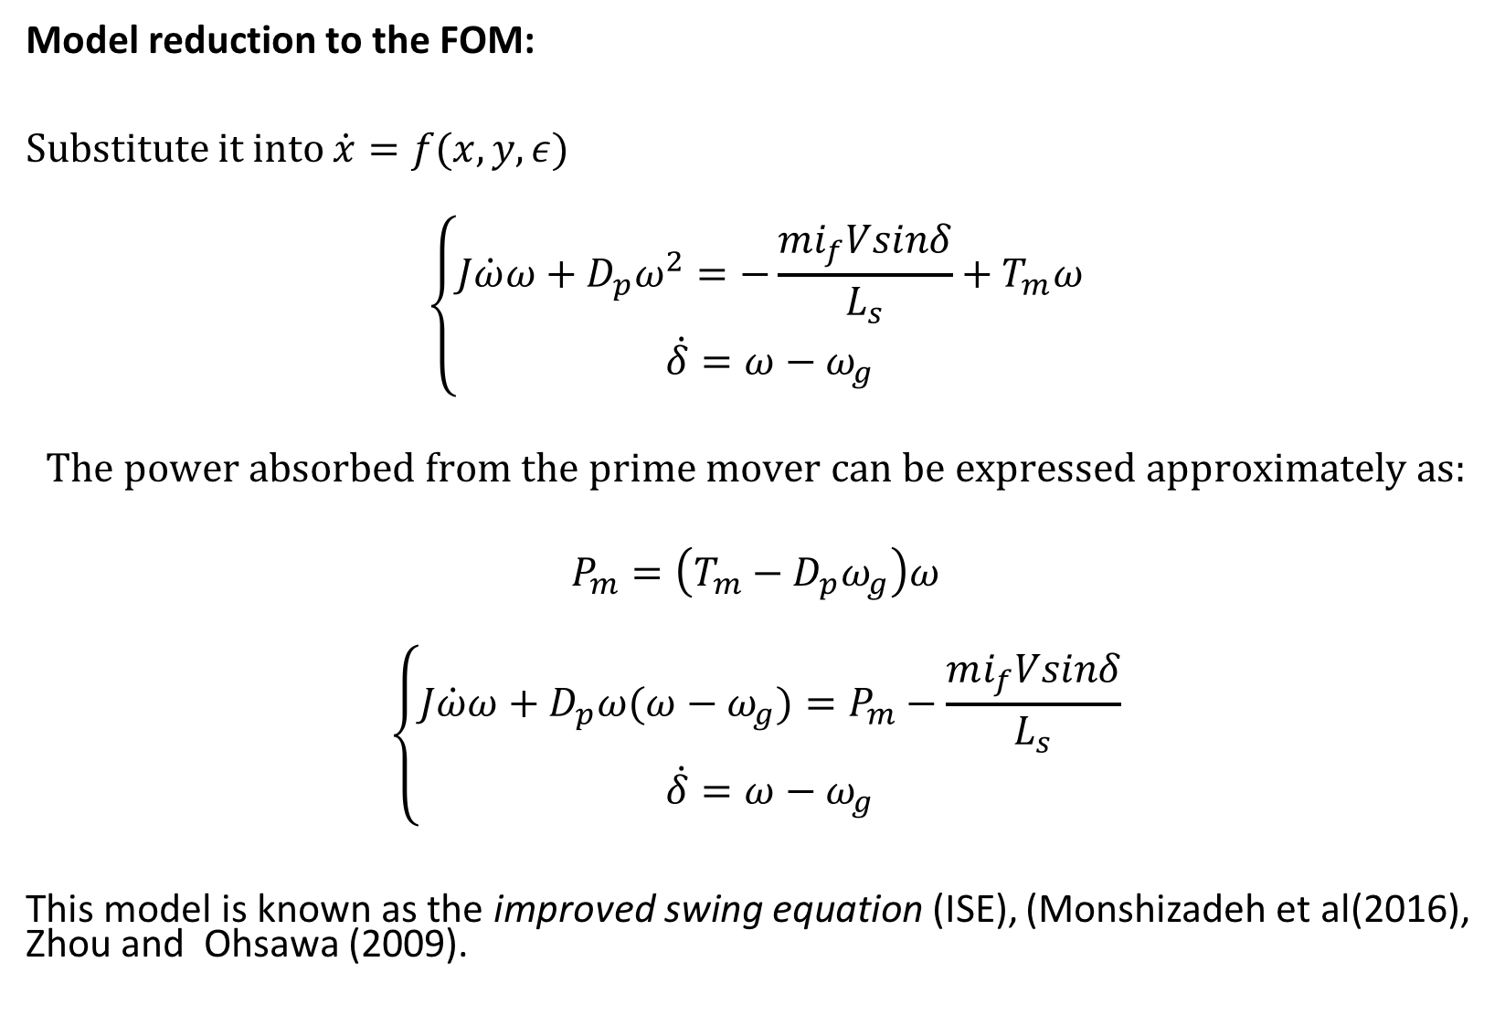
Model reduction to the FOM:
Substitute it into $\dot{x}=f(x,y,ε)$
$$\left\{\begin{matrix}J\dot{ω}ω+D_{p}ω^{2}=−\frac{mi_{f}Vsinδ}{L_{s}}+T_{m}ω \\ \dot{δ}=ω−ω_{g}\end{matrix}\right.$$
$$The power absorbed from the prime mover can be expressed approximately as:$$
$$P_{m}=\left(T_{m}−D_{p}ω_{g}\right)ω$$
$$\left\{\begin{matrix}J\dot{ω}ω+D_{p}ω(ω−ω_{g})=P_{m}−\frac{mi_{f}Vsinδ}{L_{s}} \\ \dot{δ}=ω−ω_{g}\end{matrix}\right.$$
This model is known as the improved swing equation (ISE), (Monshizadeh et al(2016), Zhou and Ohsawa (2009).

Slide 11
Simulations:
5 KW SG

Slide 12
Simulations:
1 MW SG

Slide 13
Simulations:
Non stable example

Slide 14
Simulations:
Different region of attraction

Slide 15
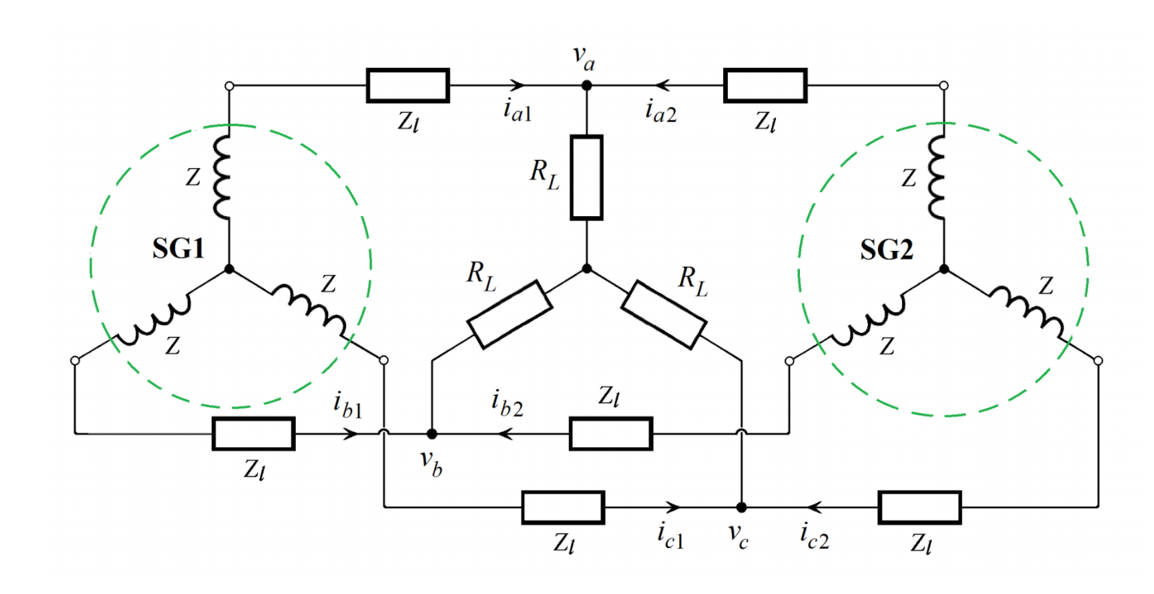

TICSG:
$Z_{l}$ can be added to $R_{s}$ and $L_{s}$.
Note that each SG vectors depends on different $θ$.
$U\left(θ_{1}\right)U^{−1} \left(θ_{2}\right)=\left[\begin{matrix}\cos\left(δ\right) & −\sin\left(δ\right) & 0 \\ \sin\left(δ\right) & \cos\left(δ\right) & 0 \\ 0 & 0 & 1\end{matrix}\right]$,
$x_{dq0\left(θ_{1}\right)}=U\left(θ_{1}\right)U^{−1}x_{dq0\left(θ_{2}\right)}$

Slide 16
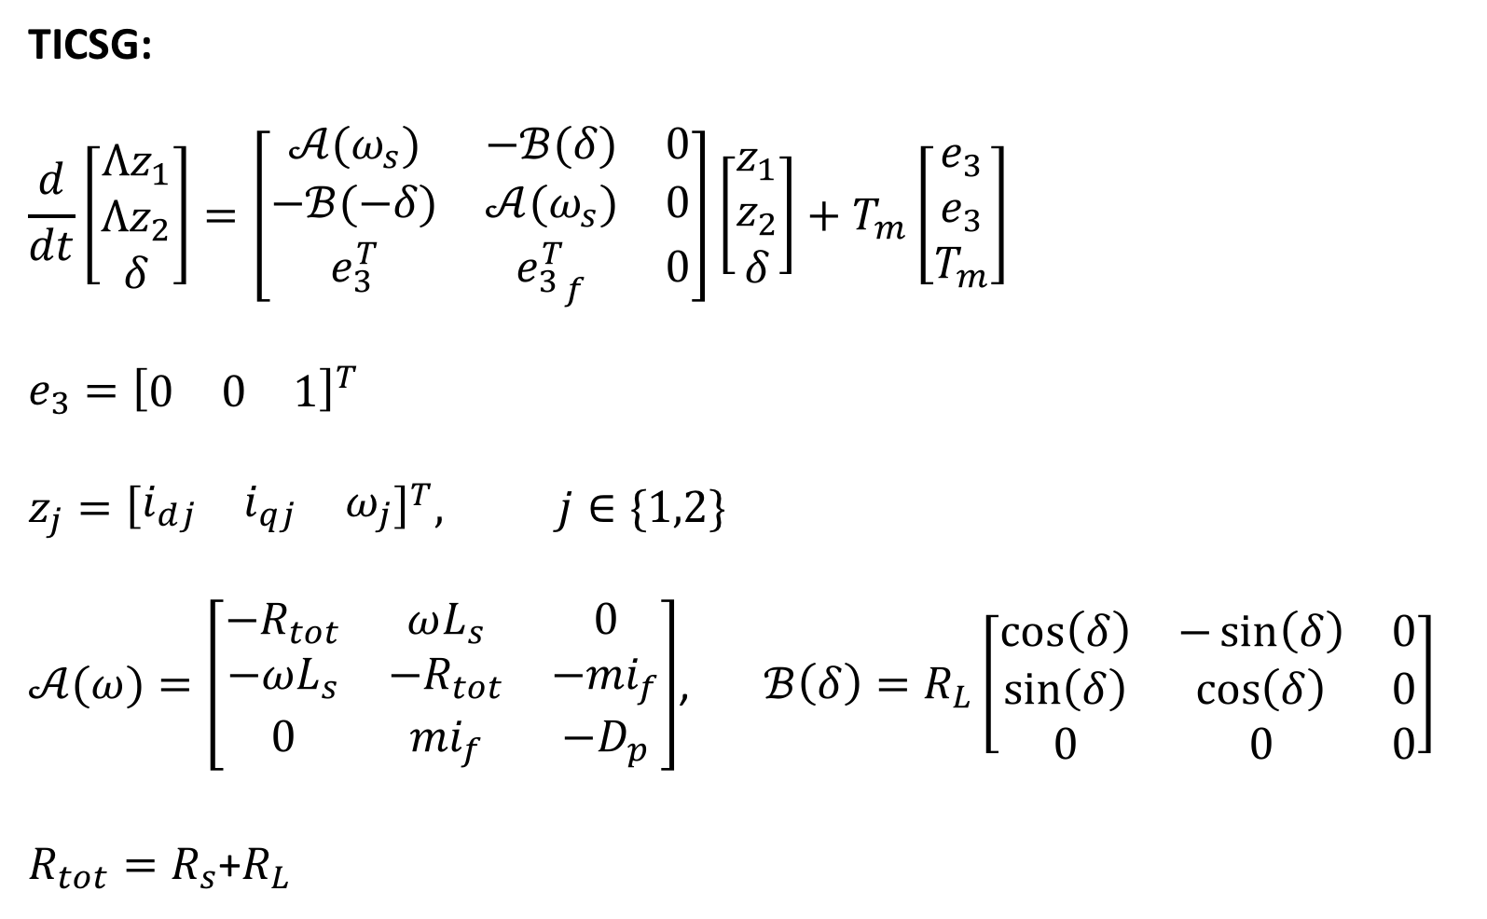
TICSG:
$$\frac{d}{dt}\left[\begin{matrix}Λz_{1} \\ Λz_{2} \\ δ\end{matrix}\right]=\left[\begin{matrix}𝒜(ω_{s}) & −ℬ(δ) & 0 \\ −ℬ(−δ) & 𝒜(ω_{s}) & 0 \\ e_{3}^{T} & {e_{3}^{T}}_{f} & 0\end{matrix}\right]\left[\begin{matrix}z_{1} \\ z_{2} \\ δ\end{matrix}\right]+T_{m}\left[\begin{matrix}e_{3} \\ e_{3} \\ T_{m}\end{matrix}\right]$$
$$e_{3}={\left[\begin{matrix}0 & 0 & 1\end{matrix}\right]}^{T}$$
$$z_{j}={\left[\begin{matrix}i_{dj} & i_{qj} & ω_{j}\end{matrix}\right]}^{T}, j∈\{1,2\}$$
$𝒜(ω)=\left[\begin{matrix}−R_{tot} & ωL_{s} & 0 \\ −ωL_{s} & {−R}_{tot} & −{mi}_{f} \\ 0 & {mi}_{f} & −D_{p}\end{matrix}\right]$, $ℬ\left(δ\right)=R_{L}\left[\begin{matrix}\cos\left(δ\right) & −\sin\left(δ\right) & 0 \\ \sin\left(δ\right) & \cos\left(δ\right) & 0 \\ 0 & 0 & 0\end{matrix}\right]$
$R_{tot}=R_{s}$+$R_{L}$

Slide 17
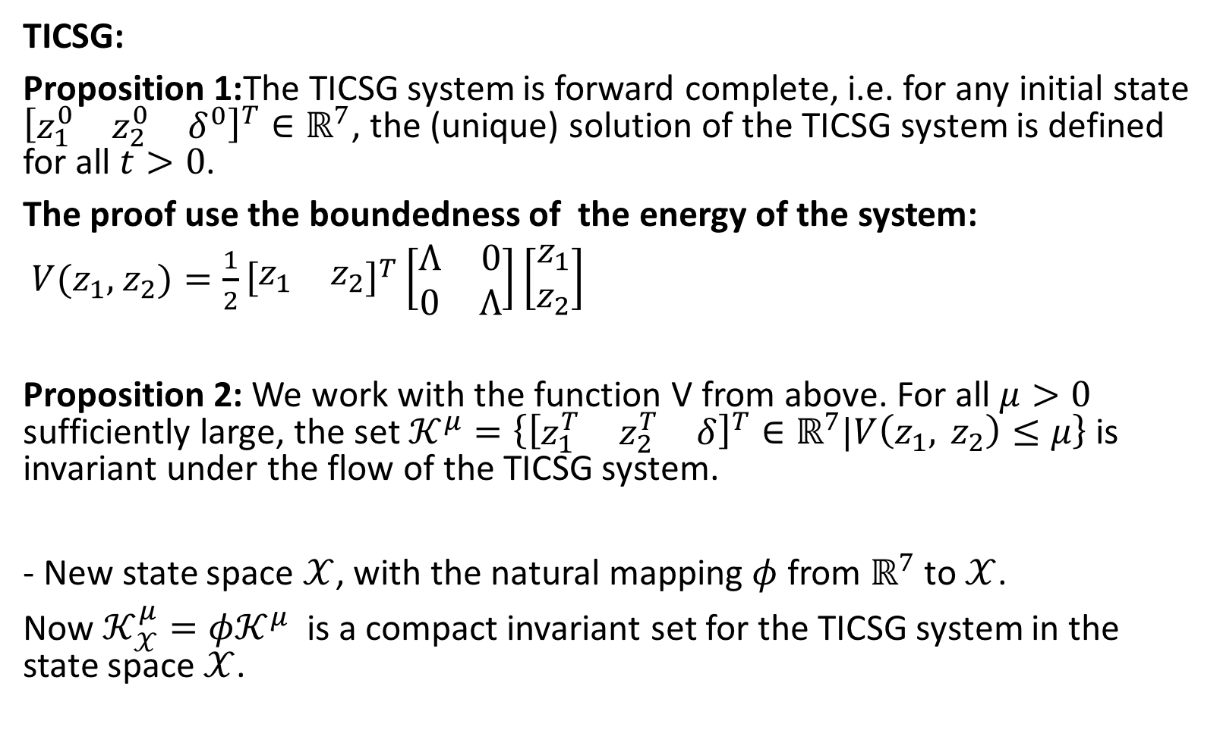
TICSG:
Proposition 1:The TICSG system is forward complete, i.e. for any initial state ${\left[\begin{matrix}z_{1}^{0} & z_{2}^{0} & δ^{0}\end{matrix}\right]}^{T}∈ℝ^{7}$, the (unique) solution of the TICSG system is defined for all $t>0$.
The proof use the boundedness of the energy of the system:
$V(z_{1},$ $z_{2})=\frac{1}{2}{\left[\begin{matrix}z_{1} & z_{2}\end{matrix}\right]}^{T}\left[\begin{matrix}Λ & 0 \\ 0 & Λ\end{matrix}\right]\left[\begin{matrix}z_{1} \\ z_{2}\end{matrix}\right]$
Proposition 2: We work with the function V from above. For all $μ>0$ sufficiently large, the set $𝒦^{μ}=\left\{{\left[\begin{matrix}z_{1}^{T} & z_{2}^{T} & δ\end{matrix}\right]}^{T}∈ℝ^{7}\text{|}V\left(z_{1}, z_{2}\right)≤μ\right\}$ is invariant under the flow of the TICSG system.
- New state space $𝒳$, with the natural mapping $φ$ from $ℝ^{7}$ to $𝒳$.
Now $𝒦_{𝒳}^{μ}=φ𝒦^{μ}$ is a compact invariant set for the TICSG system in the state space $𝒳$.

Slide 18
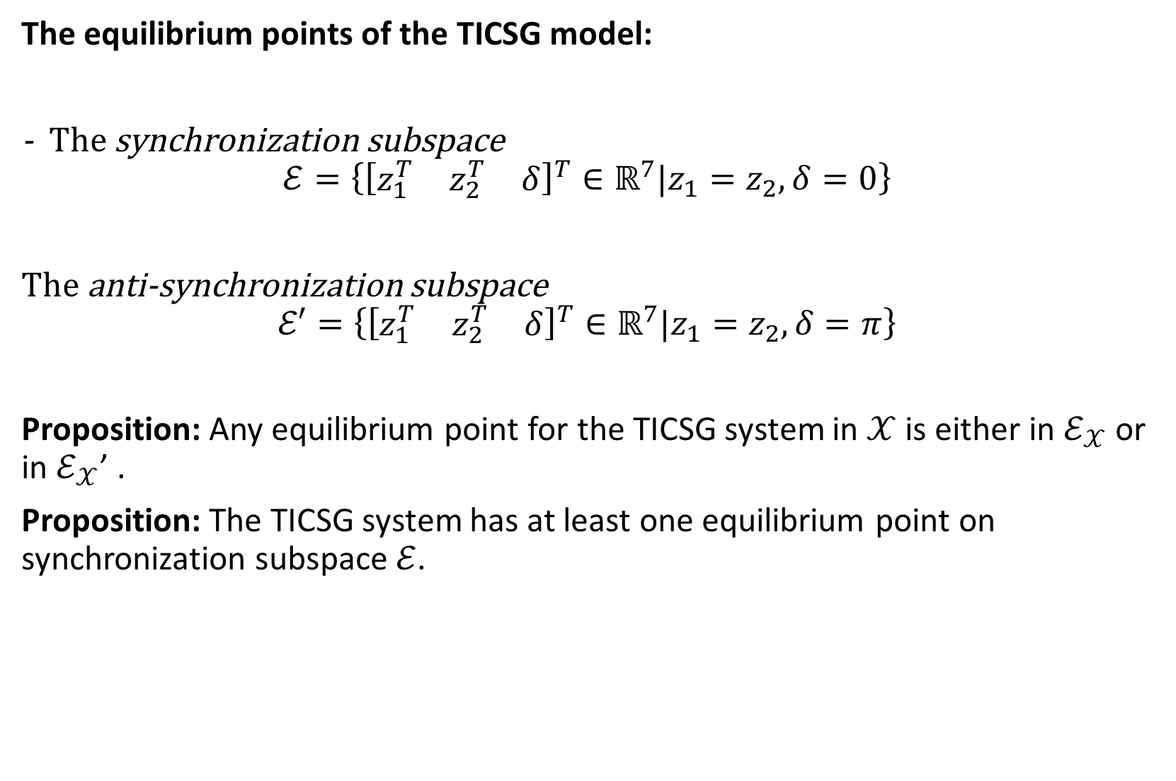
The equilibrium points of the TICSG model:
- The synchronization subspace
$$ℰ=\left\{{\left[\begin{matrix}z_{1}^{T} & z_{2}^{T} & δ\end{matrix}\right]}^{T}∈ℝ^{7}\text{|}z_{1}=z_{2}, δ=0\right\}$$
The anti-synchronization subspace
$$ℰ′=\left\{{\left[\begin{matrix}z_{1}^{T} & z_{2}^{T} & δ\end{matrix}\right]}^{T}∈ℝ^{7}\text{|}z_{1}=z_{2}, δ=π\right\}$$
Proposition: Any equilibrium point for the TICSG system in $𝒳$ is either in $ℰ_{𝒳}$ or in $ℰ_{𝒳}$’ .
Proposition: The TICSG system has at least one equilibrium point on synchronization subspace $ℰ$.

Slide 19

The stability of the TICSG system:
The TICSG system:
$$\tilde{Λ}\left[\begin{matrix}{\dot{z}}_{1} \\ {\dot{z}}_{2} \\ \dot{δ}\end{matrix}\right]=f\left(z_{1},z_{2},δ\right)$$
It can be rewritten as:
$$\dot{e}=F\left(e,x\right), \dot{x}=G\left(e,x\right)$$
$e=\left[\begin{matrix}z_{2}−z_{1} \\ δ\end{matrix}\right]$, $x=z_{1}+z_{2}$

Slide 20
The TICSG e,x model

Slide 21
Stability on the synchronization manifold

Slide 22
George proposition

Slide 23
Bayau definitions

Slide 24
Bayau Theorem

Slide 25
Bayau application

Slide 26
Simulation1

Slide 27
Simulation2

