Slide 1
Stability of coupled synchronous generators
Elad Venezian
Under the supervision of Prof. George Weiss

Slide 2
Introduction
~150 years of electricity grid.
The electricity grid become more and more dependent on inverters.
The main power source of the electricity gird is the Synchronous Generator (SG).
The frequency stability concept.
This work discuss single generator connected to an infinite bus, and Two Identical Coupled SGs (TICSG).

Slide 3
Agenda
One SG connected to an infinite bus.
Models.
Fourth order SG model.
The improved swing equation model.
The classic swing equation model.
Equilibrium points analysis.
Relation between the forth order model and the improved swing equation model.
Simulations
Two identical coupled SGs.

Slide 4
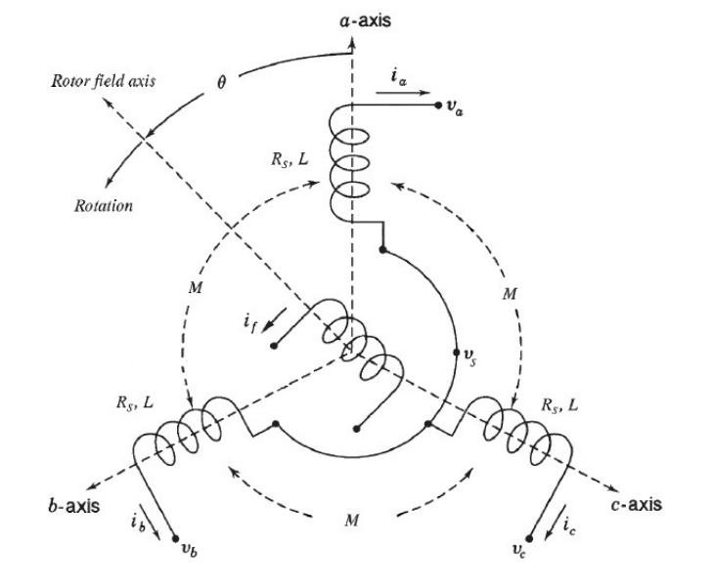
SG modeling

Slide 5
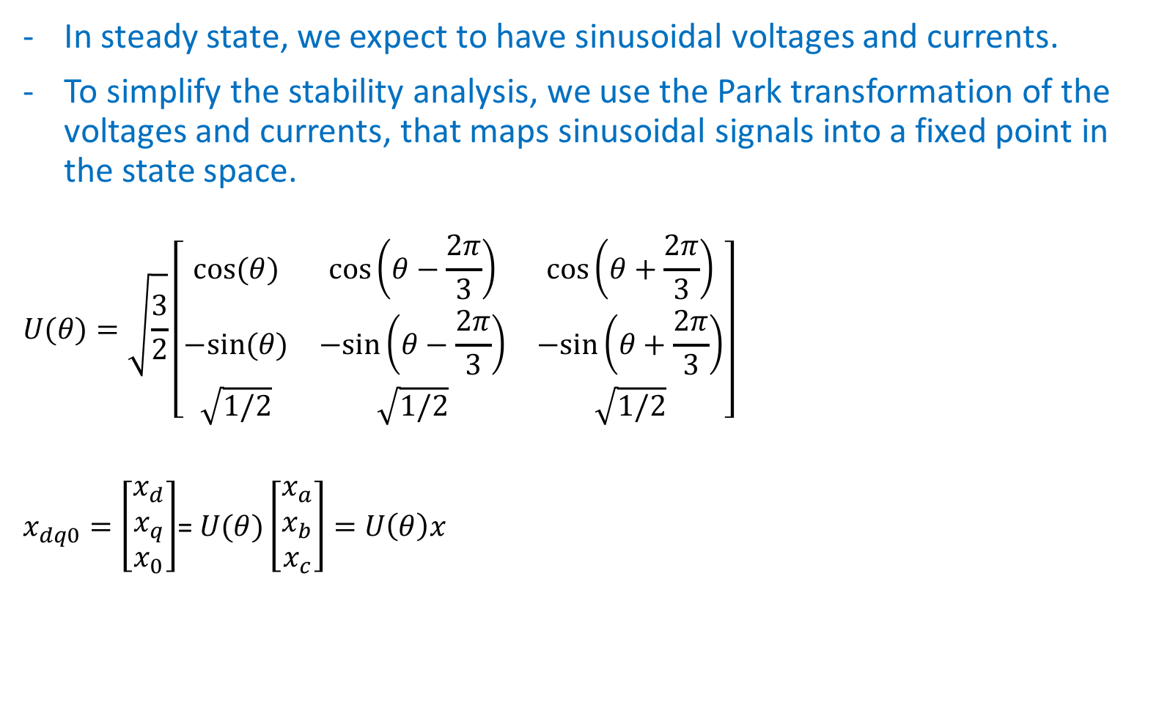
SG modeling
In steady state, we expect to have sinusoidal voltages and currents.
To simplify the stability analysis, we use the Park transformation of the voltages and currents, that maps sinusoidal signals into a fixed point in the state space.
$$U(θ)=\sqrt{\frac{3}{2}}\left[\begin{matrix}cos⁡(θ) & cos⁡\left(θ−\frac{2π}{3}\right) & cos⁡\left(θ+\frac{2π}{3}\right) \\ −sin⁡(θ) & −sin⁡\left(θ−\frac{2π}{3}\right) & −sin⁡\left(θ+\frac{2π}{3}\right) \\ \sqrt{1/2} & \sqrt{1/2} & \sqrt{1/2}\end{matrix}\right]$$
$x_{dq0}=\left[\begin{matrix}x_{d} \\ x_{q} \\ x_{0}\end{matrix}\right]$= $U(θ)\left[\begin{matrix}x_{a} \\ x_{b} \\ x_{c}\end{matrix}\right]=$ $U\left(θ\right)x$

Slide 6

SG modeling
Assuming constant $i_{f}$.
$$\frac{d}{dt}\left[\begin{matrix}L_{s}i_{d} \\ L_{s}i_{q} \\ Jω\end{matrix}\right]=\left[\begin{matrix}−R_{s} & ωL_{s} & 0 \\ −ωL_{s} & {−R}_{s} & −{mi}_{f} \\ 0 & {mi}_{f} & −D_{p}\end{matrix}\right]\left[\begin{matrix}i_{d} \\ i_{q} \\ ω\end{matrix}\right]+\left[\begin{matrix}{−V}_{d} \\ {−V}_{q} \\ T_{m}\end{matrix}\right]$$
This model depends on $θ$.
Prime mover torque is $T_{m}−D_{p}$ $ω$

Slide 7

The improved swing equation model
(Monshizadeh et al(2016), Zhou and Ohsawa (2009)
The mechanical dynamics of SG is:
$$J\dot{ω}+D_{p}\left(ω−ω_{g}\right)=T_{m}−T_{e}$$
Assuming that
$T_{m}=\frac{P_{m}}{ω}$ and $T_{e}=\frac{P_{e}}{ω}$
SG dynamics can be rewritten as:
$$Jω\dot{ω}+D_{p}ω\left(ω−ω_{g}\right)=P_{m}−P_{e}$$

Slide 8

The classical swing equation model
(Monshizadeh et al(2016), Machowski at el (2009)
Approximate:
$Jω ≈Jω_{g}≔M$ and $D_{p}ω ≈D_{p}ω_{g}≔A$
SG dynamics can be rewritten as:
$$M\dot{ω}+A\left(ω−ω_{g}\right)=P_{m}−P_{e}$$

Slide 9
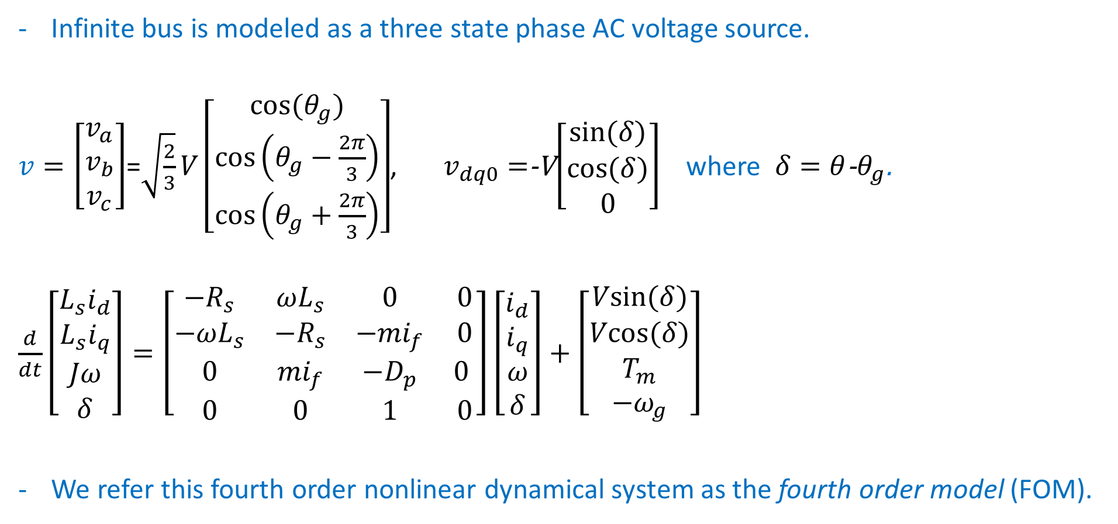
Single SG connected to an infinite bus:
Infinite bus is modeled as a three state phase AC voltage source.
$v=\left[\begin{matrix}v_{a} \\ v_{b} \\ v_{c}\end{matrix}\right]$=$\sqrt{\frac{2}{3}}V\left[\begin{matrix}cos⁡(θ_{g}) \\ cos⁡\left(θ_{g}−\frac{2π}{3}\right) \\ cos⁡\left(θ_{g}+\frac{2π}{3}\right)\end{matrix}\right]$, $v_{dq0}=$-V$\left[\begin{matrix}sin⁡(δ) \\ cos⁡(δ) \\ 0\end{matrix}\right]$ where $δ=θ$-$θ_{g}$.
$\frac{d}{dt}\left[\begin{matrix}L_{s}i_{d} \\ L_{s}i_{q} \\ Jω \\ δ\end{matrix}\right]=\left[\begin{matrix}−R_{s} & ωL_{s} & 0 & 0 \\ −ωL_{s} & {−R}_{s} & −{mi}_{f} & 0 \\ 0 & {mi}_{f} & −D_{p} & 0 \\ 0 & 0 & 1 & 0\end{matrix}\right]\left[\begin{matrix}i_{d} \\ i_{q} \\ ω \\ δ\end{matrix}\right]+\left[\begin{matrix}Vsin⁡(δ) \\ Vcos⁡(δ) \\ T_{m} \\ −ω_{g}\end{matrix}\right]$
We refer this fourth order nonlinear dynamical system as the fourth order model (FOM).

Slide 10

Single SG connected to an infinite bus: (ISE)
$P_{e}=\frac{VE}{L_{s}}\sin\left(δ\right)≔γ\sin\left(δ\right)$
$$\left\{\begin{matrix}Jω\dot{ω}+D_{p}ω\left(ω−ω_{g}\right)=P_{m}−γ\sin\left(δ\right) \\ \dot{δ}=ω−ω_{g}\end{matrix}\right.$$
We refer this fourth order nonlinear dynamical system as the Improved Swing Equation (ISE).
The classical model becomes:
$$\left\{\begin{matrix}M\dot{ω}+A\left(ω−ω_{g}\right)=P_{m}−γ\sin\left(δ\right) \\ \dot{δ}=ω−ω_{g}\end{matrix}\right.$$

Slide 11
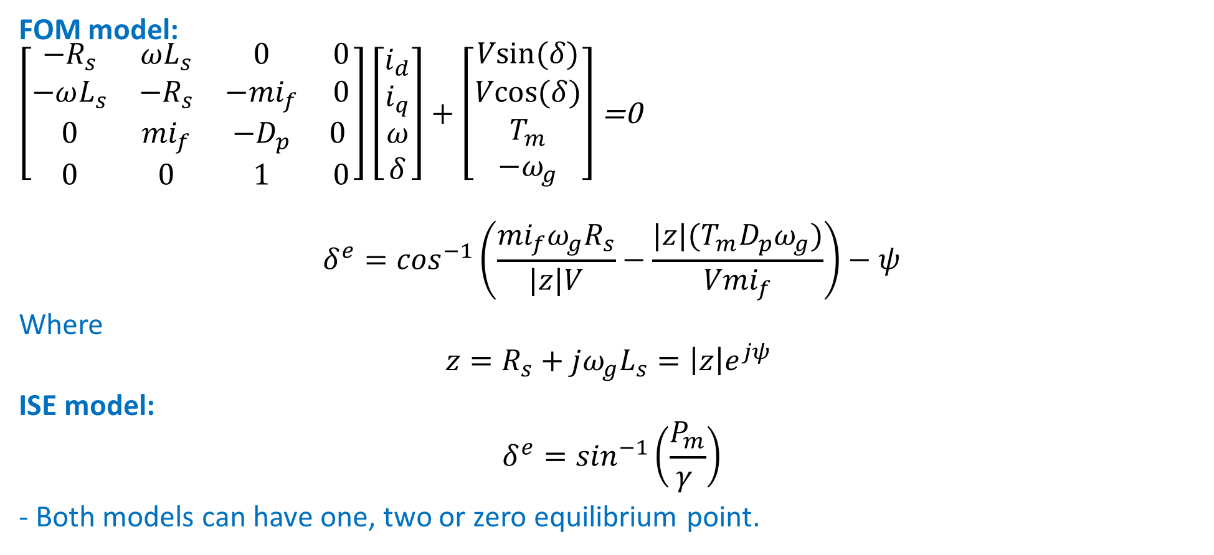
Equilibrium points
FOM model:
$\left[\begin{matrix}−R_{s} & ωL_{s} & 0 & 0 \\ −ωL_{s} & {−R}_{s} & −{mi}_{f} & 0 \\ 0 & {mi}_{f} & −D_{p} & 0 \\ 0 & 0 & 1 & 0\end{matrix}\right]\left[\begin{matrix}i_{d} \\ i_{q} \\ ω \\ δ\end{matrix}\right]+\left[\begin{matrix}Vsin⁡(δ) \\ Vcos⁡(δ) \\ T_{m} \\ −ω_{g}\end{matrix}\right]$ =0
$$δ^{e}=\cos^{−1}\left(\frac{{mi}_{f}ω_{g}R_{s}}{|z|V}−\frac{|z|(T_{m}D_{p}ω_{g})}{{Vmi}_{f}}\right)−ψ$$
Where
$$z=R_{s}+jω_{g}L_{s}=\left|z\right|e^{jψ }$$
ISE model:
$$δ^{e}=\sin^{−1}\left(\frac{P_{m}}{γ }\right)$$
- Both models can have one, two or zero equilibrium point.

Slide 12
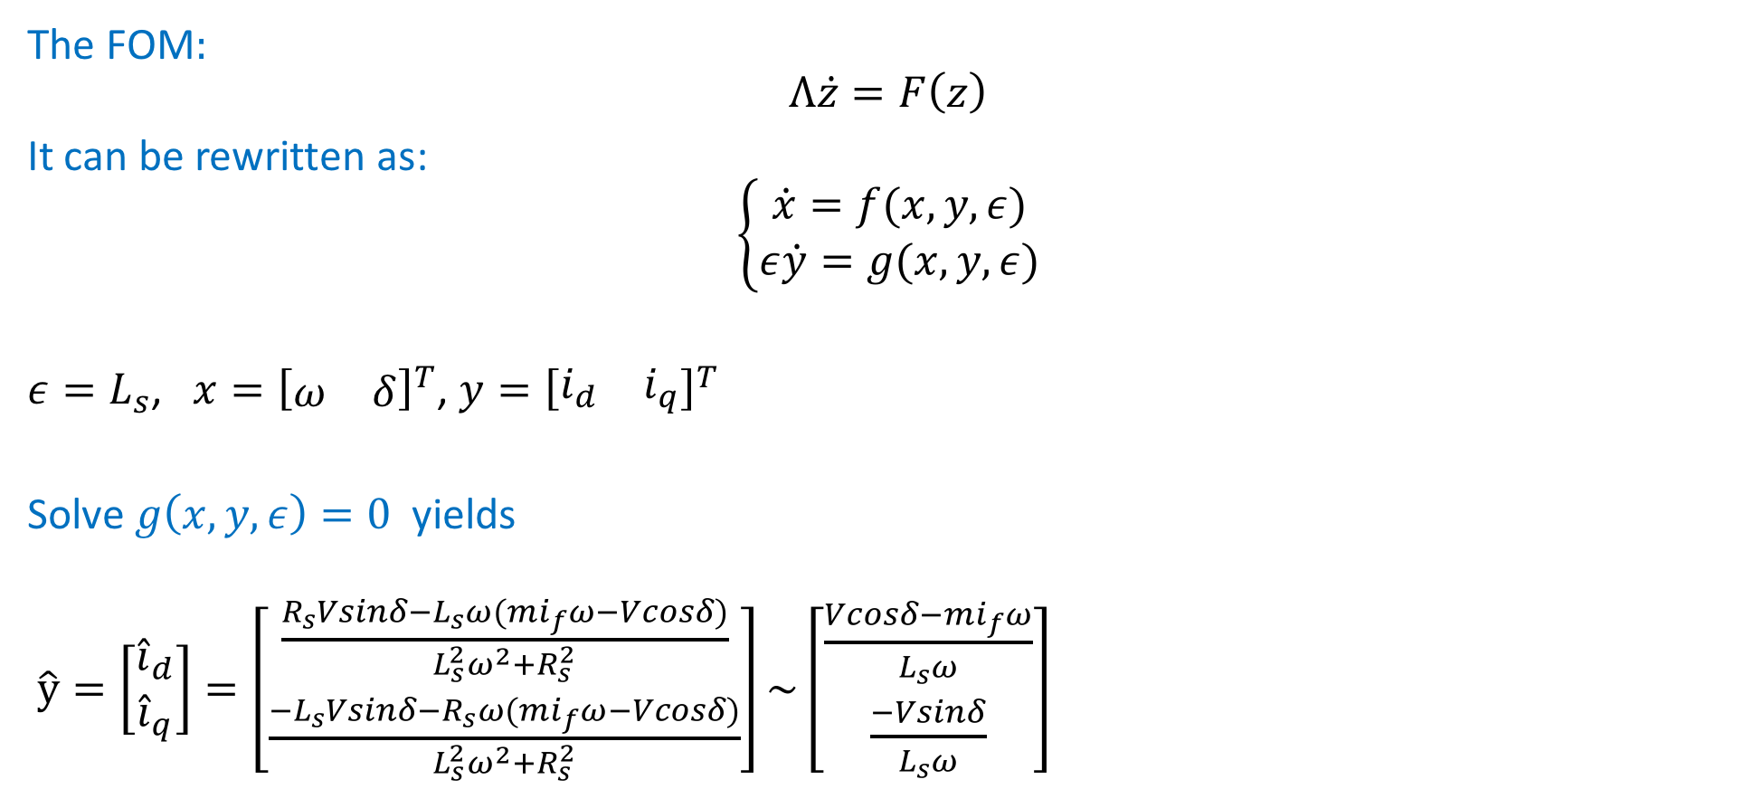
Model reduction
The FOM:
$$Λ\dot{z}=F\left(z\right)$$
It can be rewritten as:
$$\left\{\begin{matrix}\dot{x}=f(x,y,ε) \\ ε\dot{y}=g(x,y,ε)\end{matrix}\right.$$
$ε=L_{s}$, $x={\left[\begin{matrix}ω & δ\end{matrix}\right]}^{T}$, $y={\left[\begin{matrix}i_{d} & i_{q}\end{matrix}\right]}^{T}$
Solve $g\left(x,y,ε\right)=0$ yields
$\hat{y}=\left[\begin{matrix}{\hat{i}}_{d} \\ {\hat{i}}_{q}\end{matrix}\right]=\left[\begin{matrix}\frac{R_{s}Vsinδ−L_{s}ω(mi_{f}ω−Vcosδ)}{L_{s}^{2}ω^{2}+R_{s}^{2}} \\ \frac{{−L}_{s}Vsinδ−R_{s}ω(mi_{f}ω−Vcosδ)}{L_{s}^{2}ω^{2}+R_{s}^{2}}\end{matrix}\right]\sim \left[\begin{matrix}\frac{Vcosδ−mi_{f}ω}{L_{s}ω} \\ \frac{−Vsinδ}{L_{s}ω}\end{matrix}\right]$

Slide 13
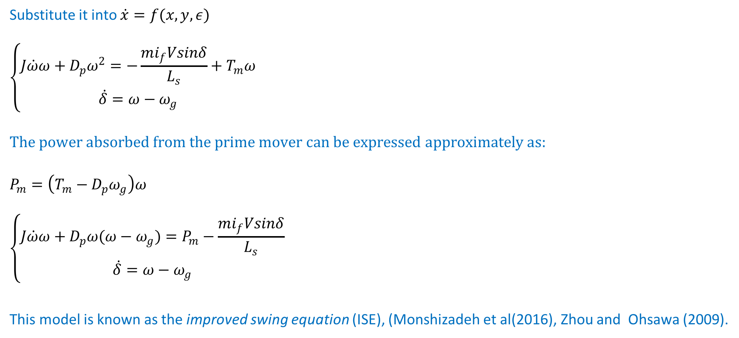
Model reduction
Substitute it into $\dot{x}=f(x,y,ε)$
$$\left\{\begin{matrix}J\dot{ω}ω+D_{p}ω^{2}=−\frac{mi_{f}Vsinδ}{L_{s}}+T_{m}ω \\ \dot{δ}=ω−ω_{g}\end{matrix}\right.$$
$$The power absorbed from the prime mover can be expressed approximately as:$$
$$P_{m}=\left(T_{m}−D_{p}ω_{g}\right)ω$$
$$\left\{\begin{matrix}J\dot{ω}ω+D_{p}ω(ω−ω_{g})=P_{m}−\frac{mi_{f}Vsinδ}{L_{s}} \\ \dot{δ}=ω−ω_{g}\end{matrix}\right.$$
This model is known as the improved swing equation (ISE), (Monshizadeh et al(2016), Zhou and Ohsawa (2009).

Slide 14
Simulations
5 KW SG

Slide 15
Simulations
1 MW SG

Slide 16
Simulations
Non stable example

Slide 17
Simulations
Different region of attraction

Slide 18
Two Identical Coupled SGs (TICSG).

Slide 19
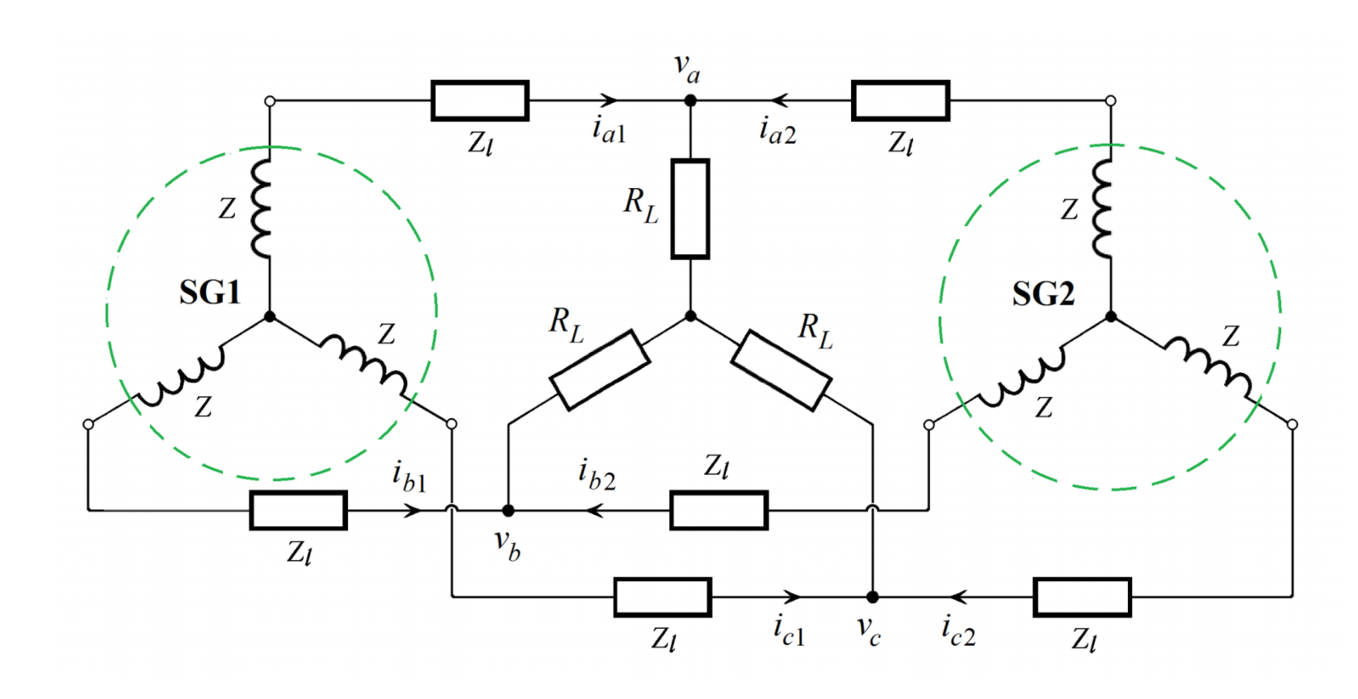

TICSG:
$Z_{l}$ can be added to $R_{s}$ and $L_{s}$.
Note that each SG vectors depends on different $θ$.
$U\left(θ_{1}\right)U^{−1} \left(θ_{2}\right)=\left[\begin{matrix}\cos\left(δ\right) & −\sin\left(δ\right) & 0 \\ \sin\left(δ\right) & \cos\left(δ\right) & 0 \\ 0 & 0 & 1\end{matrix}\right]$,
$x_{dq0\left(θ_{1}\right)}=U\left(θ_{1}\right)U^{−1}x_{dq0\left(θ_{2}\right)}$

Slide 20
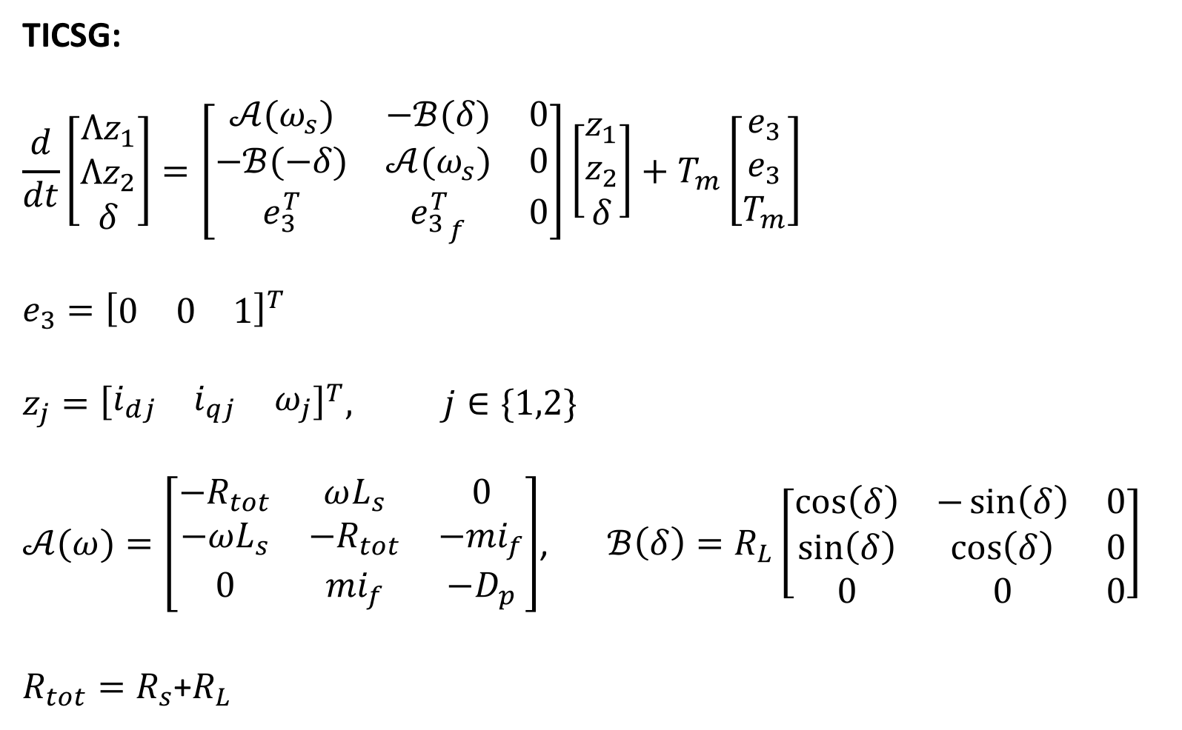
TICSG:
$$\frac{d}{dt}\left[\begin{matrix}Λz_{1} \\ Λz_{2} \\ δ\end{matrix}\right]=\left[\begin{matrix}𝒜(ω_{s}) & −ℬ(δ) & 0 \\ −ℬ(−δ) & 𝒜(ω_{s}) & 0 \\ e_{3}^{T} & {e_{3}^{T}}_{f} & 0\end{matrix}\right]\left[\begin{matrix}z_{1} \\ z_{2} \\ δ\end{matrix}\right]+T_{m}\left[\begin{matrix}e_{3} \\ e_{3} \\ T_{m}\end{matrix}\right]$$
$$e_{3}={\left[\begin{matrix}0 & 0 & 1\end{matrix}\right]}^{T}$$
$$z_{j}={\left[\begin{matrix}i_{dj} & i_{qj} & ω_{j}\end{matrix}\right]}^{T}, j∈\{1,2\}$$
$𝒜(ω)=\left[\begin{matrix}−R_{tot} & ωL_{s} & 0 \\ −ωL_{s} & {−R}_{tot} & −{mi}_{f} \\ 0 & {mi}_{f} & −D_{p}\end{matrix}\right]$, $ℬ\left(δ\right)=R_{L}\left[\begin{matrix}\cos\left(δ\right) & −\sin\left(δ\right) & 0 \\ \sin\left(δ\right) & \cos\left(δ\right) & 0 \\ 0 & 0 & 0\end{matrix}\right]$
$R_{tot}=R_{s}$+$R_{L}$

Slide 21
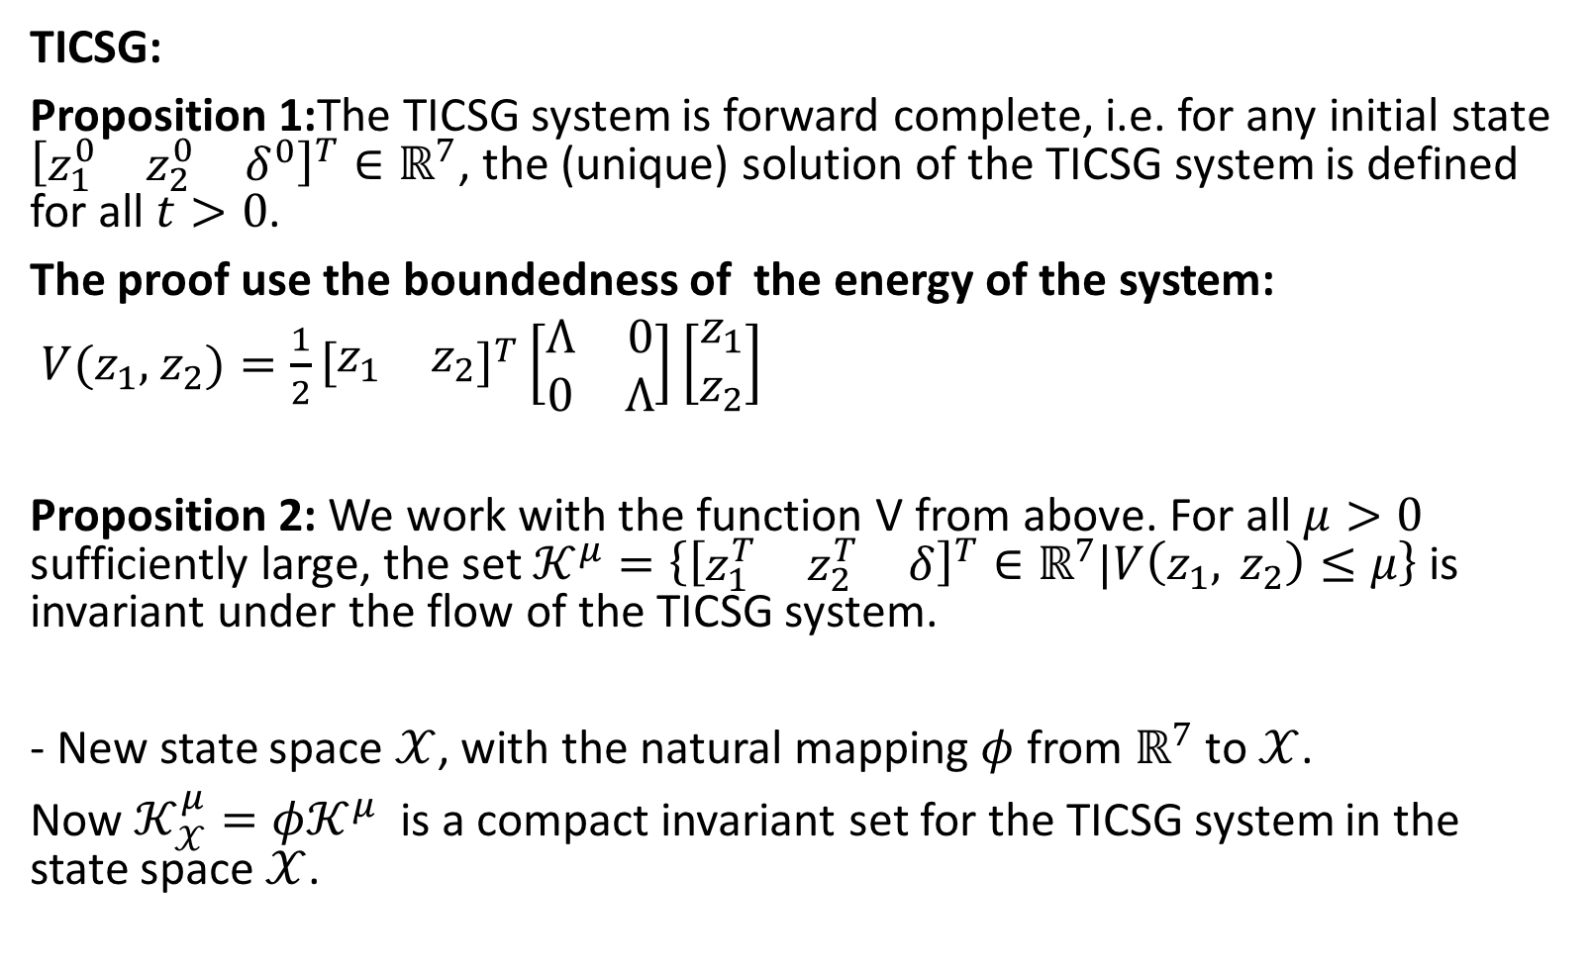
TICSG:
Proposition 1:The TICSG system is forward complete, i.e. for any initial state ${\left[\begin{matrix}z_{1}^{0} & z_{2}^{0} & δ^{0}\end{matrix}\right]}^{T}∈ℝ^{7}$, the (unique) solution of the TICSG system is defined for all $t>0$.
The proof use the boundedness of the energy of the system:
$V(z_{1},$ $z_{2})=\frac{1}{2}{\left[\begin{matrix}z_{1} & z_{2}\end{matrix}\right]}^{T}\left[\begin{matrix}Λ & 0 \\ 0 & Λ\end{matrix}\right]\left[\begin{matrix}z_{1} \\ z_{2}\end{matrix}\right]$
Proposition 2: We work with the function V from above. For all $μ>0$ sufficiently large, the set $𝒦^{μ}=\left\{{\left[\begin{matrix}z_{1}^{T} & z_{2}^{T} & δ\end{matrix}\right]}^{T}∈ℝ^{7}\text{|}V\left(z_{1}, z_{2}\right)≤μ\right\}$ is invariant under the flow of the TICSG system.
- New state space $𝒳$, with the natural mapping $φ$ from $ℝ^{7}$ to $𝒳$.
Now $𝒦_{𝒳}^{μ}=φ𝒦^{μ}$ is a compact invariant set for the TICSG system in the state space $𝒳$.

Slide 22
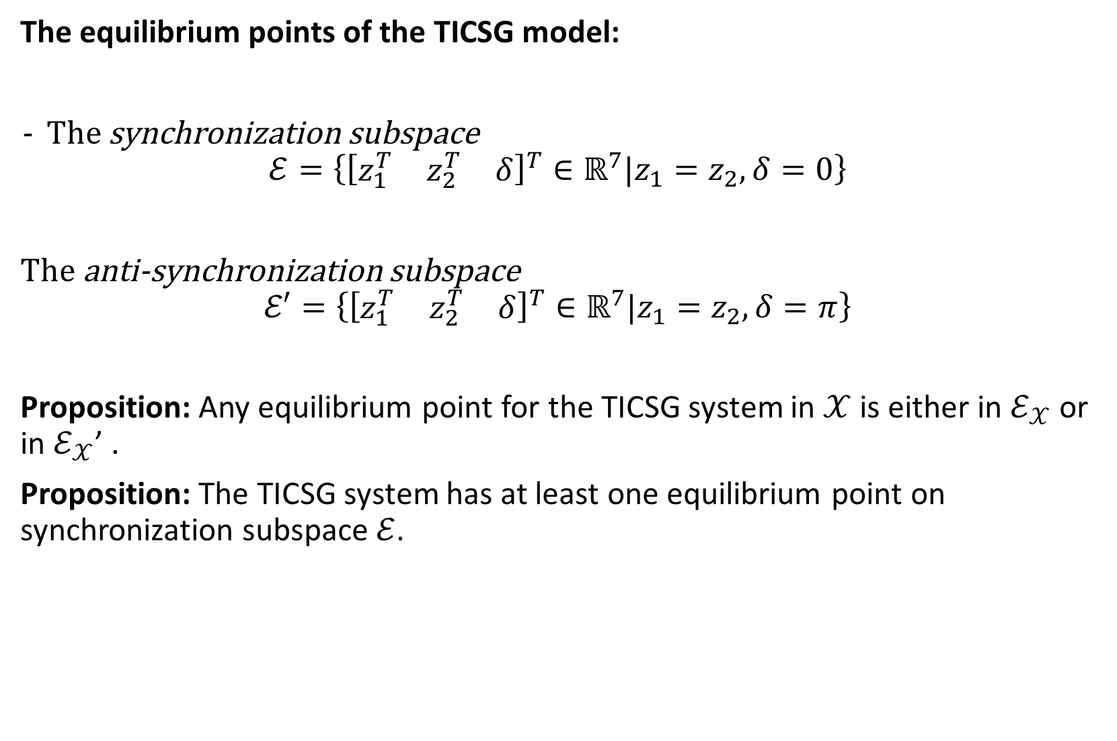
The equilibrium points of the TICSG model:
- The synchronization subspace
$$ℰ=\left\{{\left[\begin{matrix}z_{1}^{T} & z_{2}^{T} & δ\end{matrix}\right]}^{T}∈ℝ^{7}\text{|}z_{1}=z_{2}, δ=0\right\}$$
The anti-synchronization subspace
$$ℰ′=\left\{{\left[\begin{matrix}z_{1}^{T} & z_{2}^{T} & δ\end{matrix}\right]}^{T}∈ℝ^{7}\text{|}z_{1}=z_{2}, δ=π\right\}$$
Proposition: Any equilibrium point for the TICSG system in $𝒳$ is either in $ℰ_{𝒳}$ or in $ℰ_{𝒳}$’ .
Proposition: The TICSG system has at least one equilibrium point on synchronization subspace $ℰ$.

Slide 23

The stability of the TICSG system:
The TICSG system:
$$\tilde{Λ}\left[\begin{matrix}{\dot{z}}_{1} \\ {\dot{z}}_{2} \\ \dot{δ}\end{matrix}\right]=f\left(z_{1},z_{2},δ\right)$$
It can be rewritten as:
$$\dot{e}=F\left(e,x\right), \dot{x}=G\left(e,x\right)$$
$e=\left[\begin{matrix}z_{2}−z_{1} \\ δ\end{matrix}\right]$, $x=z_{1}+z_{2}$

