Slide 1
A warning about the use of reduced models of synchronous generators
Elad Venezian and George Weiss
School of EE, Tel Aviv University

Slide 2
Introduction
Approximately 150 years of electricity grid.
The electricity grid is more and more dependent on inverters.
The main power source of the electricity gird is the Synchronous Generator (SG).
The stability concept (in particular, frequency and voltage).
We discuss a single generator connected to an infinite bus. The question is its stability and the region of attraction of the stable equilibrium point.
Reduced model called improved swing equation has been proposed by Zhou and Ohsawa (2009) Monshizadeh et al (2016). We investigate its usefulness for stability analysis.

Slide 3
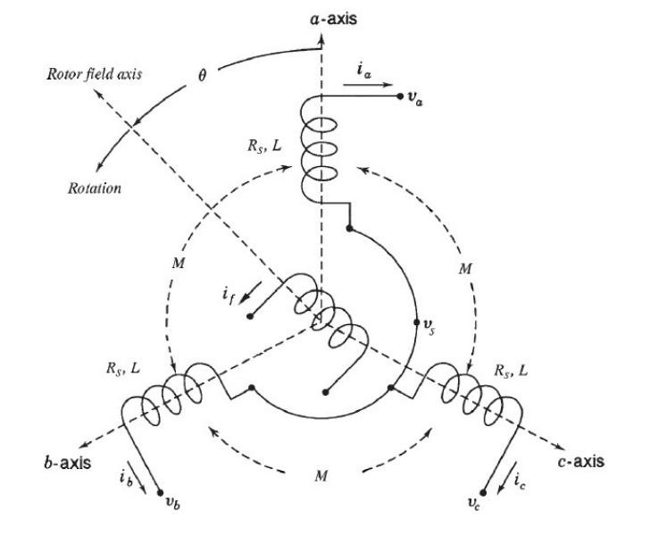
SG modeling

Slide 4
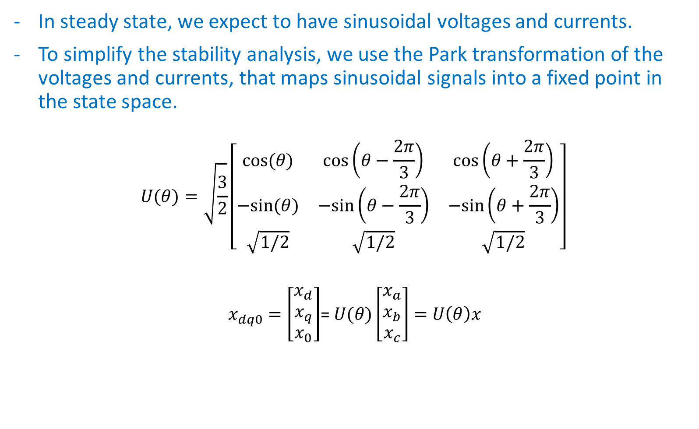
SG modeling
In steady state, we expect to have sinusoidal voltages and currents.
To simplify the stability analysis, we use the Park transformation of the voltages and currents, that maps sinusoidal signals into a fixed point in the state space.
$$U(θ)=\sqrt{\frac{3}{2}}\left[\begin{matrix}cos⁡(θ) & cos⁡\left(θ−\frac{2π}{3}\right) & cos⁡\left(θ+\frac{2π}{3}\right) \\ −sin⁡(θ) & −sin⁡\left(θ−\frac{2π}{3}\right) & −sin⁡\left(θ+\frac{2π}{3}\right) \\ \sqrt{1/2} & \sqrt{1/2} & \sqrt{1/2}\end{matrix}\right]$$
$x_{dq0}=\left[\begin{matrix}x_{d} \\ x_{q} \\ x_{0}\end{matrix}\right]$= $U(θ)\left[\begin{matrix}x_{a} \\ x_{b} \\ x_{c}\end{matrix}\right]=$ $U\left(θ\right)x$

Slide 5
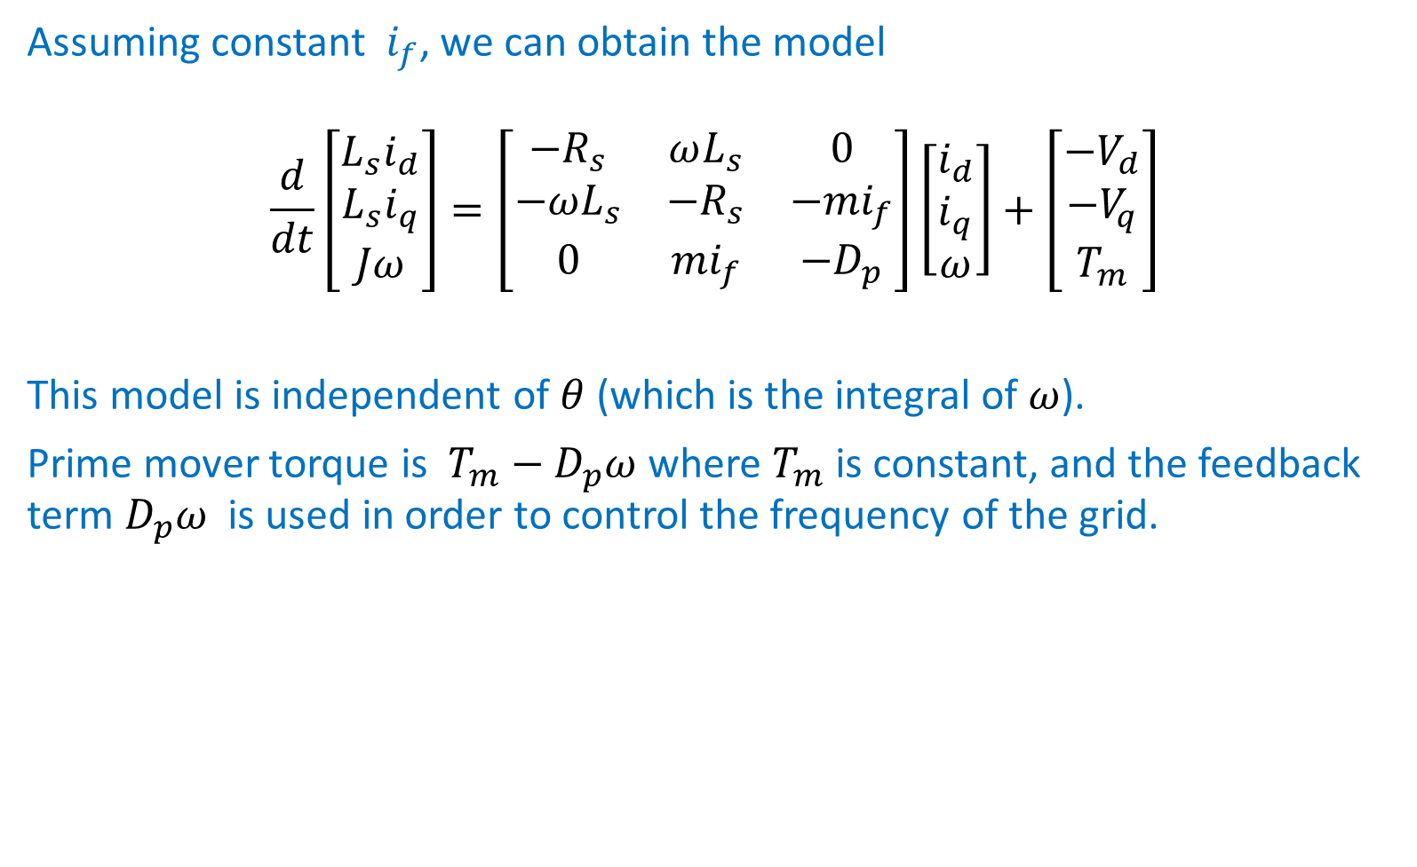
SG modeling
Assuming constant $i_{f}$, we can obtain the model
$$\frac{d}{dt}\left[\begin{matrix}L_{s}i_{d} \\ L_{s}i_{q} \\ Jω\end{matrix}\right]=\left[\begin{matrix}−R_{s} & ωL_{s} & 0 \\ −ωL_{s} & {−R}_{s} & −{mi}_{f} \\ 0 & {mi}_{f} & −D_{p}\end{matrix}\right]\left[\begin{matrix}i_{d} \\ i_{q} \\ ω\end{matrix}\right]+\left[\begin{matrix}{−V}_{d} \\ {−V}_{q} \\ T_{m}\end{matrix}\right]$$
This model is independent of $θ$ (which is the integral of $ω$).
Prime mover torque is $T_{m}−D_{p}ω$ where $T_{m}$ is constant, and the feedback term $D_{p}ω$ is used in order to control the frequency of the grid.

Slide 6
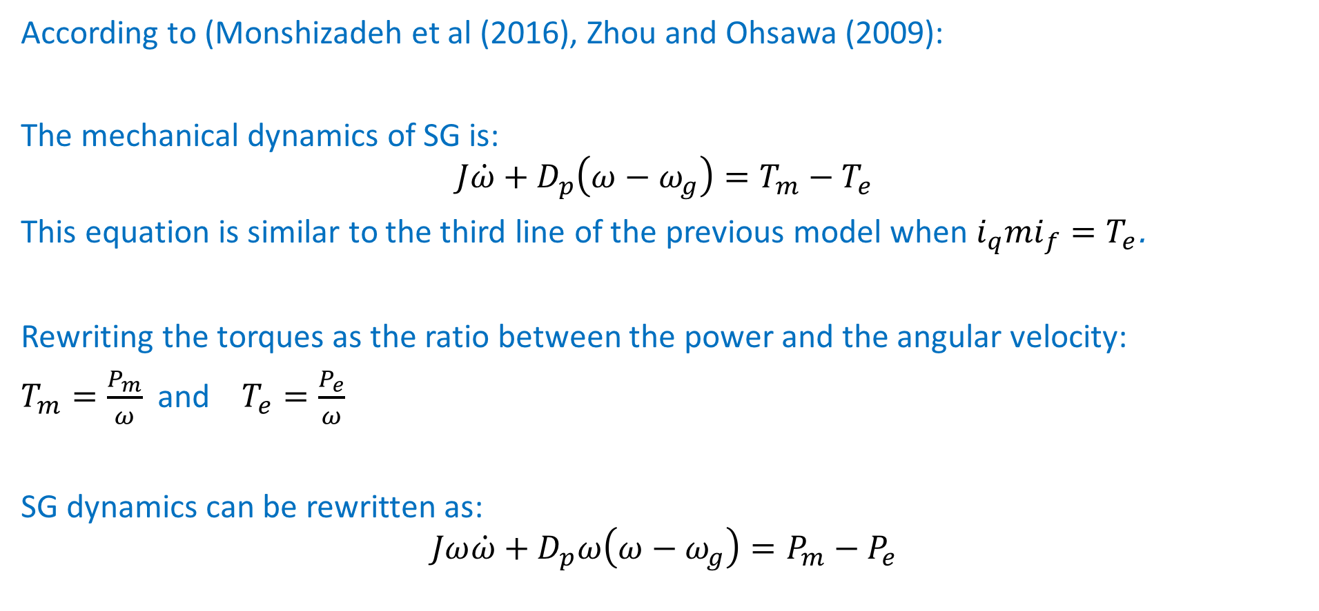
The improved swing equation model
According to (Monshizadeh et al (2016), Zhou and Ohsawa (2009):
The mechanical dynamics of SG is:
$$J\dot{ω}+D_{p}\left(ω−ω_{g}\right)=T_{m}−T_{e}$$
This equation is similar to the third line of the previous model when ${i_{q}mi}_{f}=T_{e}$.
Rewriting the torques as the ratio between the power and the angular velocity:
$T_{m}=\frac{P_{m}}{ω}$ and $T_{e}=\frac{P_{e}}{ω}$
SG dynamics can be rewritten as:
$$Jω\dot{ω}+D_{p}ω\left(ω−ω_{g}\right)=P_{m}−P_{e}$$

Slide 7
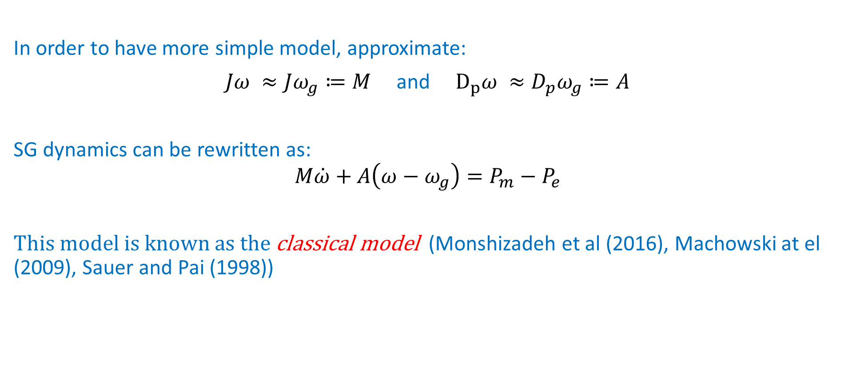
The classical swing equation model
In order to have more simple model, approximate:
$Jω ≈Jω_{g}≔M$ and $D_{p}ω ≈D_{p}ω_{g}≔A$
SG dynamics can be rewritten as:
$$M\dot{ω}+A\left(ω−ω_{g}\right)=P_{m}−P_{e}$$
This model is known as the classical model (Monshizadeh et al (2016), Machowski at el (2009), Sauer and Pai (1998))

Slide 8
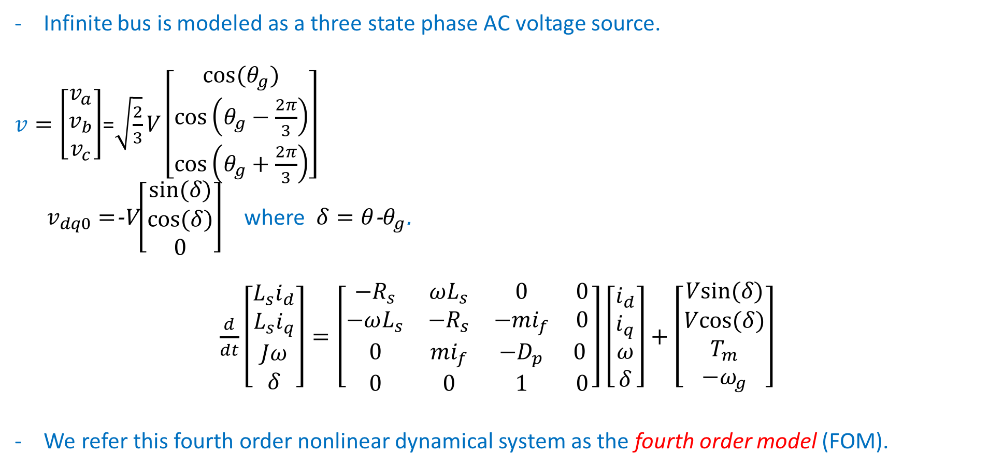
Single SG connected to an infinite bus:
Infinite bus is modeled as a three state phase AC voltage source.
$v=\left[\begin{matrix}v_{a} \\ v_{b} \\ v_{c}\end{matrix}\right]$=$\sqrt{\frac{2}{3}}V\left[\begin{matrix}cos⁡(θ_{g}) \\ cos⁡\left(θ_{g}−\frac{2π}{3}\right) \\ cos⁡\left(θ_{g}+\frac{2π}{3}\right)\end{matrix}\right]$
$v_{dq0}=$-V$\left[\begin{matrix}sin⁡(δ) \\ cos⁡(δ) \\ 0\end{matrix}\right]$ where $δ=θ$-$θ_{g}$.
$\frac{d}{dt}\left[\begin{matrix}L_{s}i_{d} \\ L_{s}i_{q} \\ Jω \\ δ\end{matrix}\right]=\left[\begin{matrix}−R_{s} & ωL_{s} & 0 & 0 \\ −ωL_{s} & {−R}_{s} & −{mi}_{f} & 0 \\ 0 & {mi}_{f} & −D_{p} & 0 \\ 0 & 0 & 1 & 0\end{matrix}\right]\left[\begin{matrix}i_{d} \\ i_{q} \\ ω \\ δ\end{matrix}\right]+\left[\begin{matrix}Vsin⁡(δ) \\ Vcos⁡(δ) \\ T_{m} \\ −ω_{g}\end{matrix}\right]$
We refer this fourth order nonlinear dynamical system as the fourth order model (FOM).

Slide 9
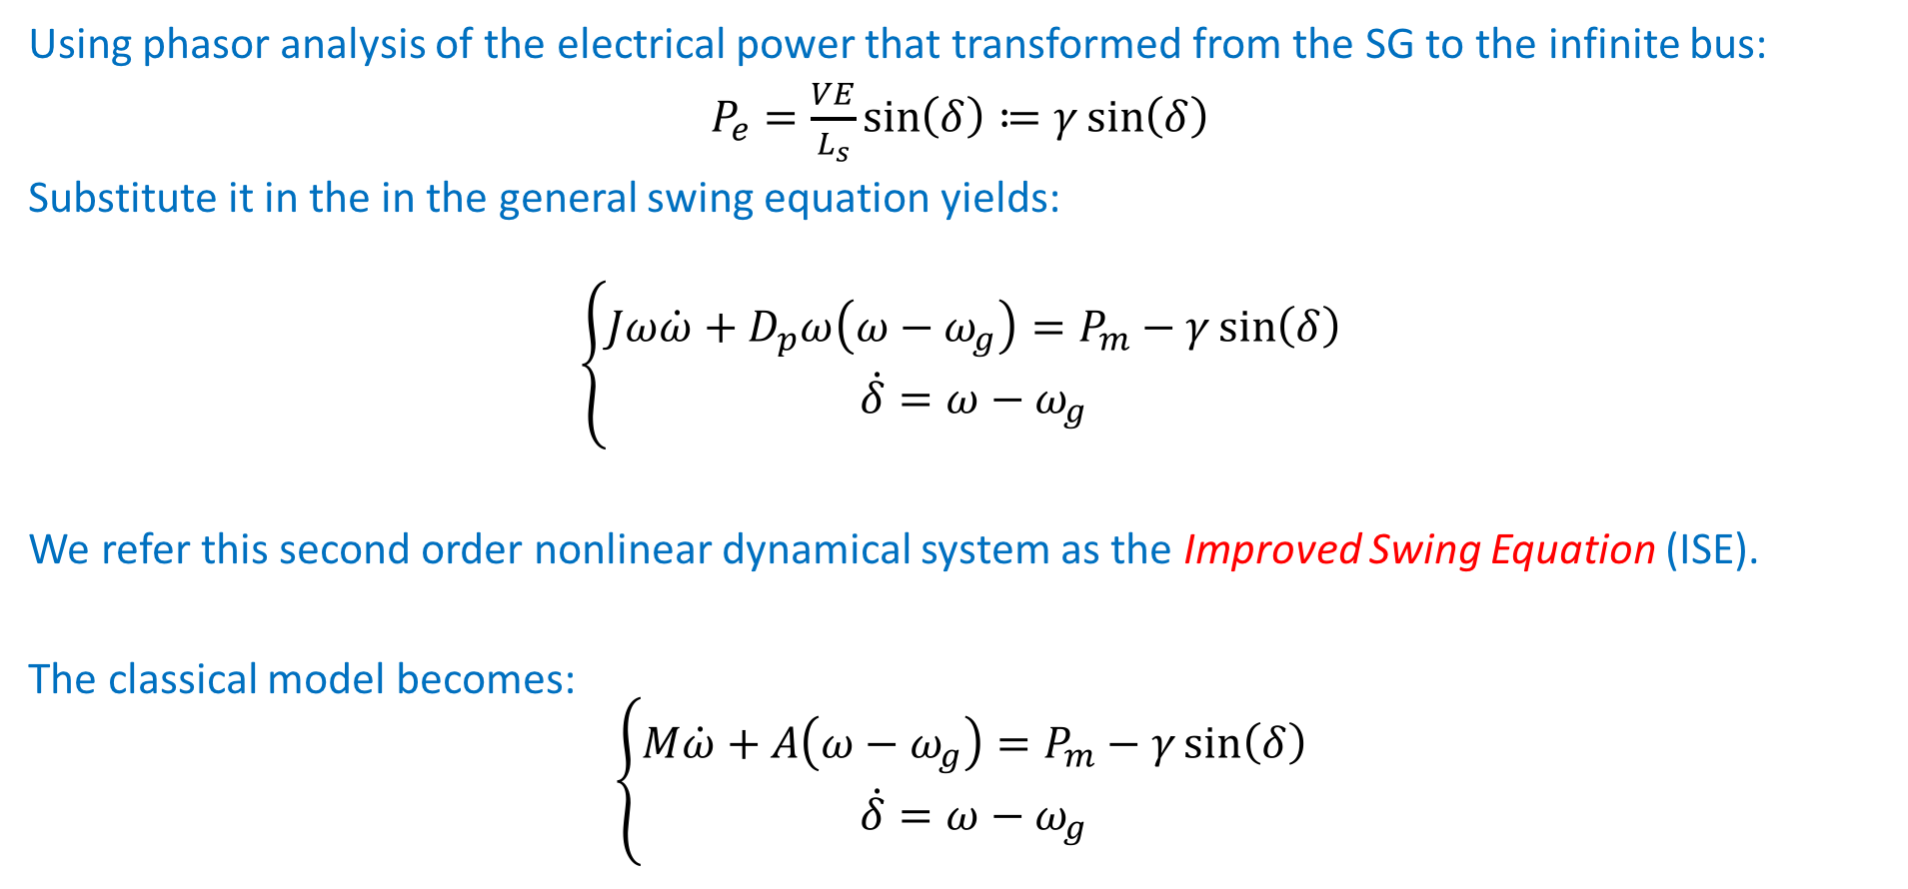
Single SG connected to an infinite bus: (ISE)
Using phasor analysis of the electrical power that transformed from the SG to the infinite bus:
$P_{e}=\frac{VE}{L_{s}}\sin\left(δ\right)≔γ\sin\left(δ\right)$
Substitute it in the in the general swing equation yields:
$$\left\{\begin{matrix}Jω\dot{ω}+D_{p}ω\left(ω−ω_{g}\right)=P_{m}−γ\sin\left(δ\right) \\ \dot{δ}=ω−ω_{g}\end{matrix}\right.$$
We refer this second order nonlinear dynamical system as the Improved Swing Equation (ISE).
The classical model becomes:
$$\left\{\begin{matrix}M\dot{ω}+A\left(ω−ω_{g}\right)=P_{m}−γ\sin\left(δ\right) \\ \dot{δ}=ω−ω_{g}\end{matrix}\right.$$

Slide 10
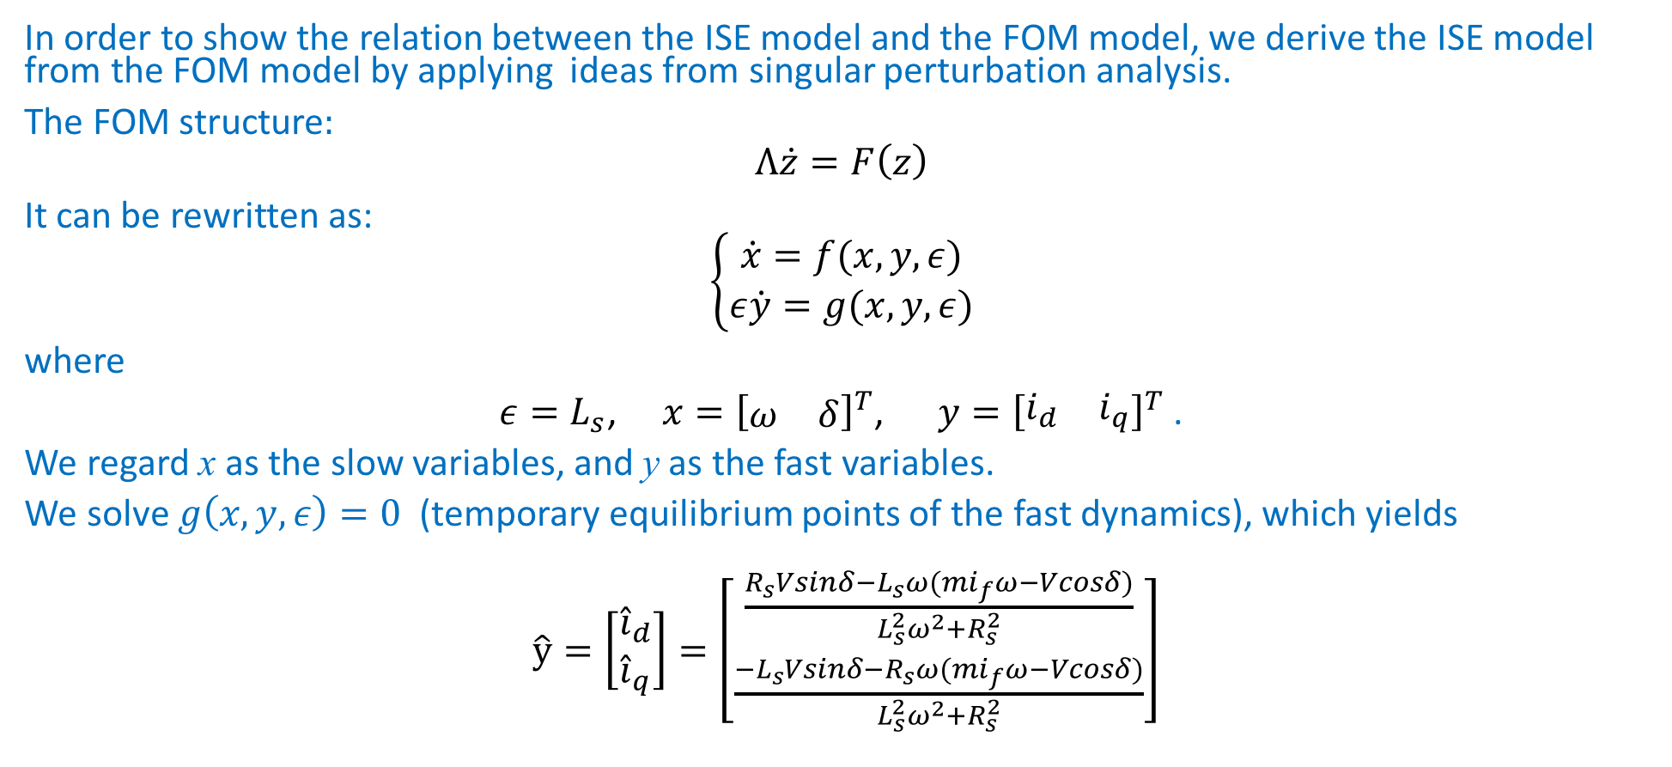
Model reduction
In order to show the relation between the ISE model and the FOM model, we derive the ISE model from the FOM model by applying ideas from singular perturbation analysis.
The FOM structure:
$$Λ\dot{z}=F\left(z\right)$$
It can be rewritten as:
$$\left\{\begin{matrix}\dot{x}=f(x,y,ε) \\ ε\dot{y}=g(x,y,ε)\end{matrix}\right.$$
where
$ε=L_{s}$, $x={\left[\begin{matrix}ω & δ\end{matrix}\right]}^{T}$, $y={\left[\begin{matrix}i_{d} & i_{q}\end{matrix}\right]}^{T}$ .
We regard x as the slow variables, and y as the fast variables.
We solve $g\left(x,y,ε\right)=0$ (temporary equilibrium points of the fast dynamics), which yields
$\hat{y}=\left[\begin{matrix}{\hat{i}}_{d} \\ {\hat{i}}_{q}\end{matrix}\right]=\left[\begin{matrix}\frac{R_{s}Vsinδ−L_{s}ω(mi_{f}ω−Vcosδ)}{L_{s}^{2}ω^{2}+R_{s}^{2}} \\ \frac{{−L}_{s}Vsinδ−R_{s}ω(mi_{f}ω−Vcosδ)}{L_{s}^{2}ω^{2}+R_{s}^{2}}\end{matrix}\right]$

Slide 11

Model reduction
In order to show the relation between the ISE model and the FOM model, we derive the ISE model from the FOM model by applying ideas from singular perturbation analysis.
The FOM structure:
$$Λ\dot{z}=F\left(z\right)$$
It can be rewritten as:
$$\left\{\begin{matrix}\dot{x}=f(x,y,ε) \\ ε\dot{y}=g(x,y,ε)\end{matrix}\right.$$
where
$ε=L_{s}$, $x={\left[\begin{matrix}ω & δ\end{matrix}\right]}^{T}$, $y={\left[\begin{matrix}i_{d} & i_{q}\end{matrix}\right]}^{T}$ .
We regard x as the slow variables, and y as the fast variables.
We solve $g\left(x,y,ε\right)=0$ (temporary equilibrium points of the fast dynamics), which yields
$\hat{y}=\left[\begin{matrix}{\hat{i}}_{d} \\ {\hat{i}}_{q}\end{matrix}\right]=\sim \left[\begin{matrix}\frac{Vcosδ−mi_{f}ω}{L_{s}ω} \\ \frac{−Vsinδ}{L_{s}ω}\end{matrix}\right]$

Slide 12
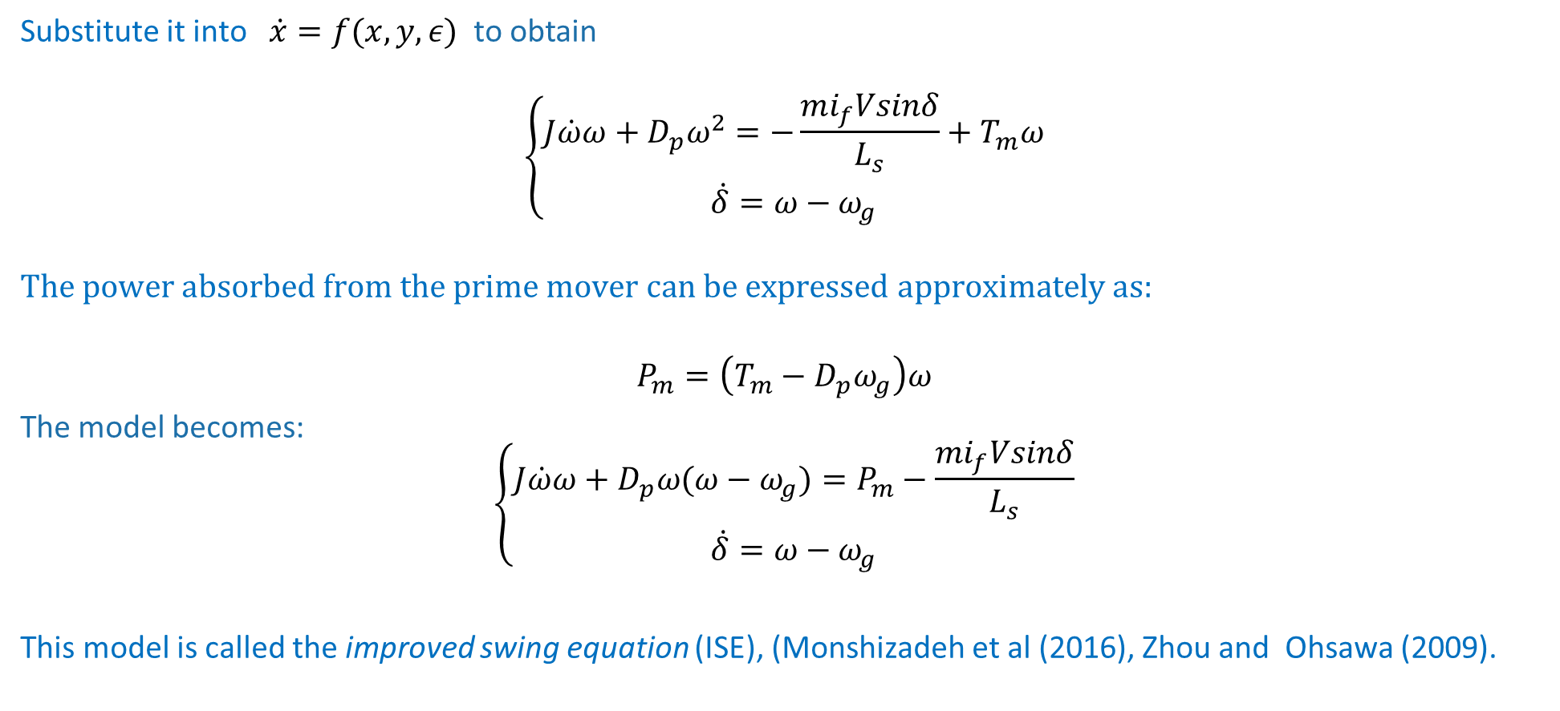
Model reduction
Substitute it into $\dot{x}=f(x,y,ε)$ to obtain
$$\left\{\begin{matrix}J\dot{ω}ω+D_{p}ω^{2}=−\frac{mi_{f}Vsinδ}{L_{s}}+T_{m}ω \\ \dot{δ}=ω−ω_{g}\end{matrix}\right.$$
$$The power absorbed from the prime mover can be expressed approximately as:$$
$$P_{m}=\left(T_{m}−D_{p}ω_{g}\right)ω$$
The model becomes:
$$\left\{\begin{matrix}J\dot{ω}ω+D_{p}ω(ω−ω_{g})=P_{m}−\frac{mi_{f}Vsinδ}{L_{s}} \\ \dot{δ}=ω−ω_{g}\end{matrix}\right.$$
This model is called the improved swing equation (ISE), (Monshizadeh et al (2016), Zhou and Ohsawa (2009).

Slide 13
Simulations
5 KW SG connected to infinite bus
variables with a hat correspond to the reduced model.

Slide 14
Simulations
1 MW SG

Slide 15

Simulations
The FOM is locally stable, (eigenvalues of the Jacobian around the equilibrium point are −11.41±376.9i, −508±837i).
The ISE doesn’t have any equilibrium ($\left|\frac{P_{m}L_{s}}{mi_{f}V}\right|>1$).

Slide 16
Simulations
Different region of attraction
- Initial condition of this simulation is within the region of attraction of the reduced model, but outside the region of attraction of the FOM

Slide 17
Thank you

