Slide 1
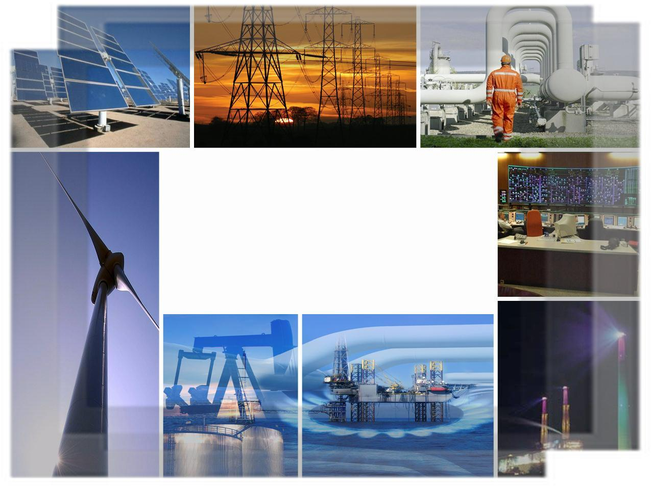

Israel Electric Corporation
Generation and Transmission
Coping with large electrical disturbances in Israel and throughout the World
Reasons & Challenges
Yasha (Yakov) Hain
Senior Executive VP IEC
February 4, 2014

Slide 2
The presentation subjects
Large Power Disturbances Survey (2000-2012)
Reasons and challenges for disturbances
Challenges of renewable energy penetration
Samples of Israeli System disturbances
Israeli system risk management
Summary & Questions

Slide 3
Historical Power Outages
Since 2000
Aug. 14, 2003
The worst US blackout.
Power line problems in the Midwest trigger a cascade of breakdowns that cut power to 55 million people in eight states and Canada, some for more than day
July 12, 2004
Heavy use of air conditioners and other factors are blamed for blackouts affecting at least 7 million people in Greece just a month before the Summer Olympic Games.
November, 2006
A German power company switches off high voltage line over a river to let a cruise ship pass. It triggers outages for 10 million people in Germany, France, Italy and Spain.
Sep. 8, 2011
System disturbance occurred leaded to cascading outages and leaving approximately 5 million people without power. The outages affected parts of Arizona, California, Mexico.
July 31, 2012
3 power grids across half of India fail in what authorities call overdrawing of the system, leaving a record 620 million people without power for raising concerns about ability to supply
demands.
100 Mil
370 Mil
55 Mil
60 Mil
55 Mil
7 Mil
10 Mil
5 Mil
620 Mil
Sep. 28, 2003
A short circuit in power line in Switzerland leads to blackouts affecting 95% of Italy. Some 55 million people are without power for as long as 18 hours.
Aug. 18, 2005
An imbalanced power grid kicks power plants offline in Indonesia leaves almost 100 million people in the dark, many for more than five hours.
Nov.10, 2009
Storms near the Itaipu hydroelectric dam on the Paraguay-Brazil border blamed for outages that cut power to as many as 60 million people in Brazil for couple hours. The Paraguay population of 7 million is also blacked out.
July.30, 2012
India’s northern electricity grid fails for much of the day, leaving 370 million people without power.
Source: news.Nationalpost.com

Slide 4
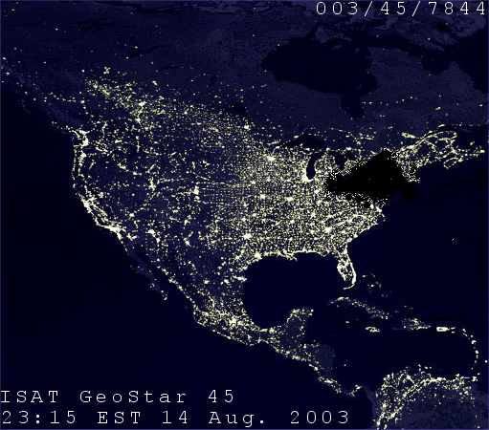
US & Canada Blackout - facts
The largest blackout in north America ever:
45 million in USA, 10 million in Canada were affected
62 000 MW of power outages
508 generating units in 256 power plants shut down
Conventional -66
Combustion including Combine cycle -70
Nuclear -10
Hydro -101 and other -18
Estimated total cost in USA 10.3 billion $,
Canada 2.3 billion $
Time of restoration 50%- 24 hours, 80%-48 hours
the rest up to 5 days
Source: US & Canada Power system Outage task force- Causes of August 14 blackout

Slide 5
Main presentation subjects
Large Power Disturbances Survey (2000-2012)
Reasons and challenges for disturbances
Challenges of renewable energy penetration
Samples of Israeli System disturbances
Israeli system risk management
Summary & Questions

Slide 6
Swiss cheese fault model
US & Canada largest blackout on August 14, 2003
Inadequate tree trimming
345 KV line fault due tree touch, some power plant fault
State estimator confused by line fault and Alarm system fault
Operators inter communication fault
SYSTEM
COLLAPSE
Cascade lines and generations tripping
Notes:
מודל גבינה שוויצרית הינו מודל אשר אומר באם בגבינה ישנם חורים ולקחת ולחתוך את הגבינה לחתיכות סיכוי קלוש שכל החורים במקומות שונים בפרוסות יסתדרו בקו אחד.
זאת אומרת צריך השתלשלות אירועים ונסיבות אשר עלולה לגרום לאירוע כלשהו
בדומה לכך נעשה ניתוח של האירוע בצפון אמריקה.

Slide 7
Direct causes for US blackout
Failure to maintain adequate reactive power support
Failure to ensure operation within secure limits
Inadequate vegetation management
Inadequate Operators training
Failure to identify emergency conditions and
communication with neighboring systems
Inadequate regional-scale visibility over the
power system, dysfunction of EMS/SCADA system
Lack of adequate backup capability of the EMS system
Source: US & Canada Power system Outage task force- Causes of August 14 blackout
Notes:
REACTIVE POWER – לא הייתה בארה"ב דרישה מNERC ליצור הספק ראקטיבי – כי פשוט לא שילמו עבורו. ולכן בסופו של דבר התרחש VOLTAGE COLLAPSE
SECURE LIMITS – המערכת נוהלה ברמות נמוכות מה תקין של מתחים בשל הפסקות מעגלים לעבודות שונות וכי לא נעשה תכנון נכון
VEGETATION MANAGEMENT – מדיניות גיזום עצים לא עבדה טוב ולכן אל כל הגיזום נעשה לקראת שיא קיץ
OPERATORS TRAINING – לא היה מספיק כלל אימון של מפקחים למצבים שונים כולל סימולאטור המדמה את המערכת בשלמותה
EMERGENCY COMMUNICATION - - בשל כשל במערכת STATE ESTIMATOR פיקוח MISO הגוף המפקח על פיקוחים איזורים רבים לא היה מסוגל לזהות תמונה בפועל
כמו כו שאננות של מפקחים בפיקוח FE שמערכת התראות שלו כשלה גרם לחוסר אימון במידע אשר נמסר מפיקוחים סמוכים
POWER SYSTEM VISIBILITY - בשל חוסר במדידות של חלק ממידע אשר קיים בפיקוחים איזורים לא ניתן היה לראות את התמונה המלאה. בנוסף מערכת SCADA נפלה ולא היתה מערכת גיבוי נוספת אשר אמורה להתריע על מצב סיכון , כמו כן תוכנות לחישוב של מצב המערכת וכלל חוסר פיקודים במערכת בעת האירוע בפיקוח FE

Slide 8
Main reasons for large disturbances
Based on 16 large disturbances in the World 2002 - 2011
Total contribution | Secondary | Primary | Root cause | #
3 | 0 | 3 | Primary equipment failure | 1
5 | 1 | 4 | Design and application errors | 2
2 | 1 | 1 | Secondary equipment failure | 3
5 | 1 | 4 | Communication failure | 4
6 | 0 | 6 | Natural phenomena | 5
5 | 0 | 5 | Operator errors | 6
1 | 0 | 1 | Errors in maintenance | 7
0 | 0 | 0 | Security related (sabotage, etc.) | 8
1 | 0 | 1 | Inadequate investment and complexity of system | 9
Source: Cigre, WG 2.21 report, 2012

Slide 9
Lessons Learnt
A part from natural phenomena
the main causes for most events are:
Operators errors
Communication failure (including lack of situation awareness)
Protection relay mis- coordination (design) or operations
Control Center Performance
Nothing suggests that any system control centers
exhibited below expectation performance
To be improved
Situation awareness
Protection system design coordination and verification
Operator training and adherence to established procedures
Source: Cigre, WG 2.21 report, 2012

Slide 10
Main presentation subjects
Large Power Disturbances Survey (2000-2012)
Reasons and challenges for disturbances
Challenges of renewable energy penetration
Samples of Israeli System disturbances
Israeli system risk management
Summary & Questions

Slide 11
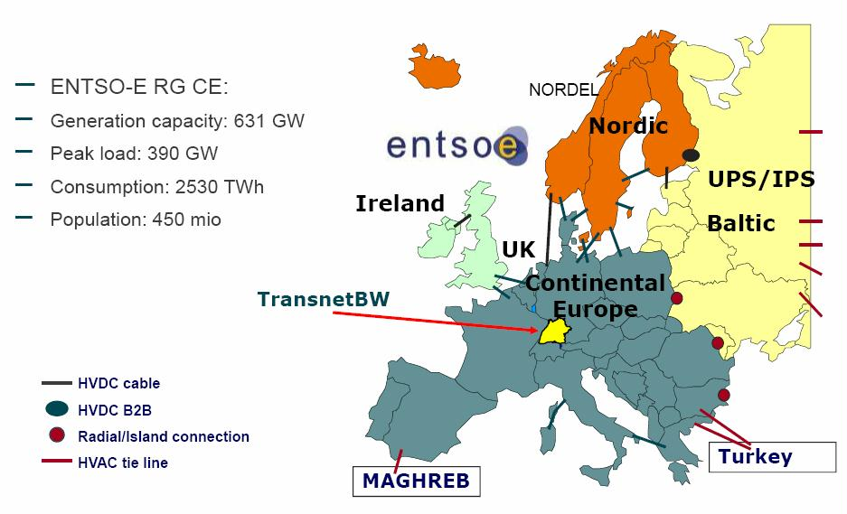
United Europe Grid
Source: Cigre, WG 2.21 report, 2012

Slide 12
Introduction 50.2 Hz problem
In Germany approx. 12.7GW of DG – mostly photovoltaic (PV)
Technical guideline since 2005 applied to DG – Distributed
Generation in low voltage grids :
Disconnection within 200 ms, if f<=47.5 Hz or f>=50.2 Hz
Reconnection after 30 s, if 47.5 Hz< f <50.2 Hz
50.2 Hz was chosen for an easy operation of standby
power by DSO
With several GW of DG in the interconnected system
frequency stability is hampered if 50.2 Hz are exceeded
Frequency stability:
Acceleration time constant is approx. 10s (in future
probably decreasing due to power electronics.
Primary control reserve is 3000 MW
Source: Cigre, WG 2.21 report, 2012

Slide 13
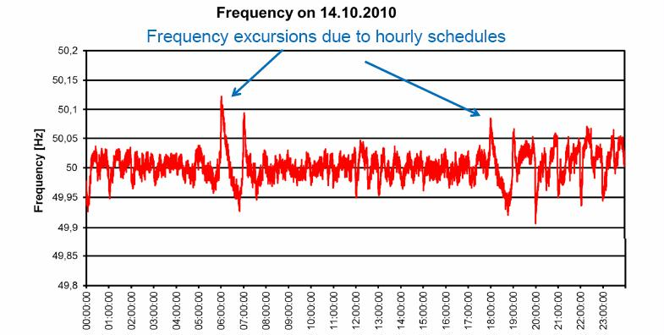
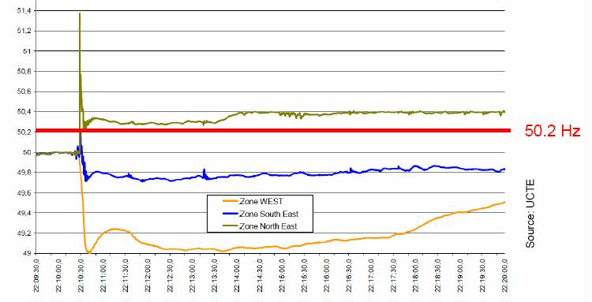
Triggering 50.2 Hz problem
- Frequency measurements during European disturbance 2006 - 50.2 Hz are significantly exceeded
Low probability to exceed 50.2 Hz under normal conditions
Source: Cigre, WG 2.21 report, 2012

Slide 14
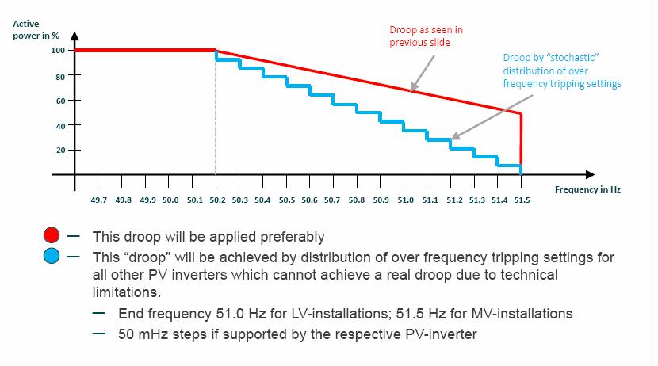
New Grid connections rules
Source: Cigre, WG 2.21 report, 2012

Slide 15
50.2 HZ - Conclusions
DG-infeed has reached a system relevant penetration
and is furthermore growing
An integral approach over all voltage levels of the united
grid is needed
In Germany the “System stability regulation” started
since July 2012 for PV retrofit in:
Cost of 175 million euro
Approx. 9500 MW of installed LV PV
Timeframe – 3 years
Development of grid codes e.g. “Requirements for Grid
Connection Applicable to all Generators”
Studies of system Dynamics with respect to DG
in Continental Europe is needed
Source: Cigre, WG 2.21 report, 2012

Slide 16
Main presentation subjects
Large Power Disturbances Survey (2000-2012)
Reasons and challenges for disturbances
Challenges of renewable energy penetration
Samples of Israeli System disturbances
Israeli system risk management
Summary & Questions

Slide 17
Noble disturbance 31/7/2011
Bar
Noble
Shut down
End of
event
Noble
Is back
22:40
08:45
21:20

Slide 18
Chain of events
Bar
- Coal
- Gas
- Gas oil
- Fuel Oil
Lowest
reserve
4% during 1 HOUR
2135
563
2104
547
2640
1305
1577
1170
4924
4908
4861

Slide 19
Chain of events
Bar
21:28
- Unit Start
21:28
- Load reduction
21:28
- Fuel transfer completion
21:28
- Shut down
2135
563
אשכול 3
547
2104
2640
צפית 2
אשכול 10
1305
אשכול 9+6
1577
1170
רידינג 4
רמת חובב 4
+ דוד
חגית 5
+ דוד
4924
גזר 30
4908
4861
אשכול 8
חגית 20
אשכול 7
חגית 4 + דוד
22:08
22:12
21:25
22:27
22:39
21:28
21:43
22:17
22:39
23:47
21:32
22:40

Slide 20
What might happened?
System capacity
9850 MW
Transmission constraints
9750 MW
Transmission constraints in case of N-1
9550 MW
Power outages
550
550
550
7.5 hours
5 hours
5.5 hours
Explanation
Outages because of generation lack during 3 days up to 250MW
Additional outages because of line overload in Tel Aviv area – 100MW
Additional outages in case of N-1 fault in South to Hadera – 200MW

Slide 21
Hagit PRMS Shutdown
Customers
Lost
20.09.2010
MW
Hz
Power
Outages
Load
Shedding 2
Hagit site
shutdown
Customer damage –
Unsupplied Energy 256 MWh
Up to 1.5 hour customer shortage
Alternative fuel cost 0.8 mil$
Power
Outages
Load Shedding 1
Hagit came
back
POWER OUTAGES
90 MINUTES
Notes:
חשוב לציין כאן שהאירוע לא נגרם עקב תקלה בחח"י אלא עקב טעות אנוש בחברת נתג"ז באחריותה מתקני PRMS
באירוע נפסק אתר חגית בהספק של כ960 MW
האירוע התרחש בפסגת עומס בשעה 14

Slide 22
Main presentation subjects
Large Power Disturbances Survey (2000-2012)
Reasons and challenges for disturbances
Challenges of renewable energy penetration
Samples of Israeli System disturbances
Israeli system risk management
Summary & Questions

Slide 23



Israeli Grid Constraints
Isolated system
Low system reserve
Not enough IPPs coming yet
Generation by fuel - Natural Gas Dependency
A lot of environmental constraints
Large future renewable PV penetration
A lot of players IEC, IPPs, PUA, Gas Authority
and others

Slide 24

System risk and response
Maintenance activities coordination
Supplier disturbances:
Gas quality
Facilities fault
Transporter - INGL :
No pressure regulation ability
One PRMS to Power Plants
Radial pipeline – no redundancy
Disturbance management – a lot of players
IEC alternative fuel generation response
Low grid reserve (5%) – virtual gas storage

Slide 25
Main presentation subjects
Large Power Disturbances Survey (2000-2012)
Reasons and challenges for disturbances
Challenges of renewable energy penetration
Samples of Israeli System disturbances
Israeli system risk management
Summary & Questions

Slide 26
Summary
Power outages happen and utilities
have to be prepared to deal with them
The mean time between large outages
more than 10000 MW is 13 years*
The largest power outage in Israel
happened in 1995 ………………
*California Institute of Technology, “Complexity and Robustness,” 1999. Data from NERC

Slide 27
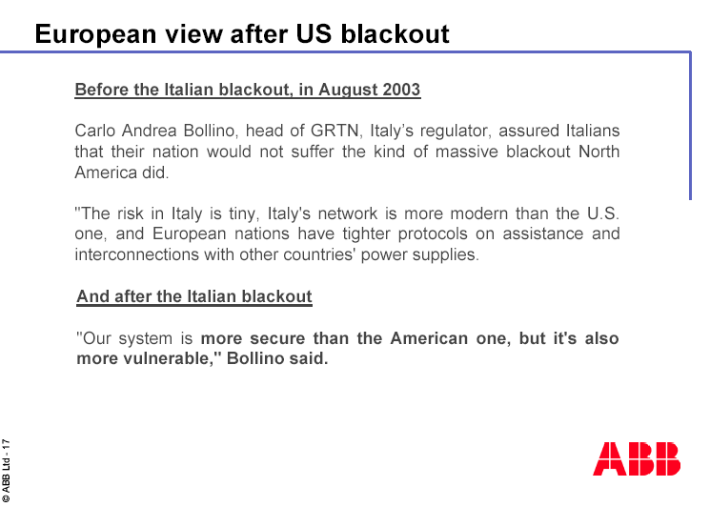
And finally

Slide 28
Questions
Thanks
and
your

