Slide 1
Stability of coupled synchronous generators
Elad Venezian
Under the supervision of Prof. George Weiss

Slide 2
Agenda
TBD: agenda
Schemas for FOM and TICSG
Graphics
Getting ISE and classical model by phasors

Slide 3
Introduction:
~150 years of electricity grid.
The electricity grid become more and more dependent on inverters.
The microgrid concept.
The main power source of the electricity gird is the Synchronous Generator (SG).
This work discuss single generator connected to an infinite bus, and Two Identical Coupled SGs (TICSG).
The frequency stability concept.
TBD schemas of FOM and TICSG.

Slide 4
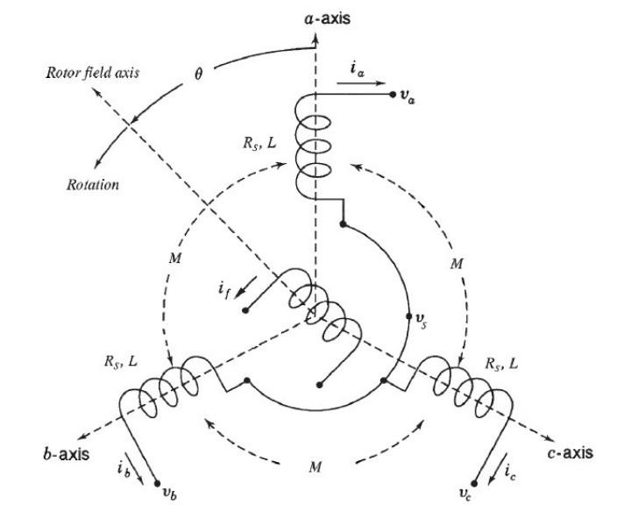
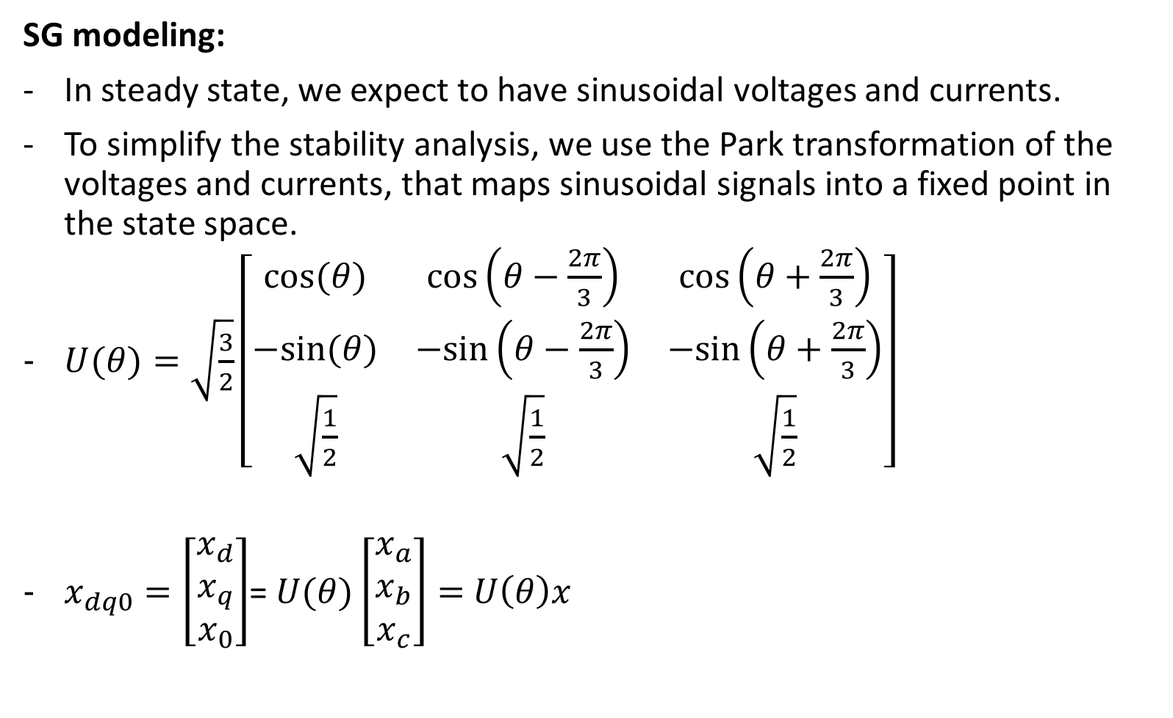
SG modeling:
In steady state, we expect to have sinusoidal voltages and currents.
To simplify the stability analysis, we use the Park transformation of the voltages and currents, that maps sinusoidal signals into a fixed point in the state space.
$U(θ)=\sqrt{\frac{3}{2}}\left[\begin{matrix}cos⁡(θ) & cos⁡\left(θ−\frac{2π}{3}\right) & cos⁡\left(θ+\frac{2π}{3}\right) \\ −sin⁡(θ) & −sin⁡\left(θ−\frac{2π}{3}\right) & −sin⁡\left(θ+\frac{2π}{3}\right) \\ \sqrt{\frac{1}{2}} & \sqrt{\frac{1}{2}} & \sqrt{\frac{1}{2}}\end{matrix}\right]$
$x_{dq0}=\left[\begin{matrix}x_{d} \\ x_{q} \\ x_{0}\end{matrix}\right]$= $U(θ)\left[\begin{matrix}x_{a} \\ x_{b} \\ x_{c}\end{matrix}\right]=$ $U\left(θ\right)x$

Slide 5

SG modeling:
Assuming constant $i_{f}$.
$$\frac{d}{dt}\left[\begin{matrix}L_{s}i_{d} \\ L_{s}i_{q} \\ Jω\end{matrix}\right]=\left[\begin{matrix}−R_{s} & ωL_{s} & 0 \\ −ωL_{s} & {−R}_{s} & −{mi}_{f} \\ 0 & {mi}_{f} & −D_{p}\end{matrix}\right]\left[\begin{matrix}i_{d} \\ i_{q} \\ ω\end{matrix}\right]+\left[\begin{matrix}{−V}_{d} \\ {−V}_{q} \\ T_{m}\end{matrix}\right]$$
This model depends on $θ$.
Prime mover torque is $T_{m}−D_{p}$ $ω$

Slide 6
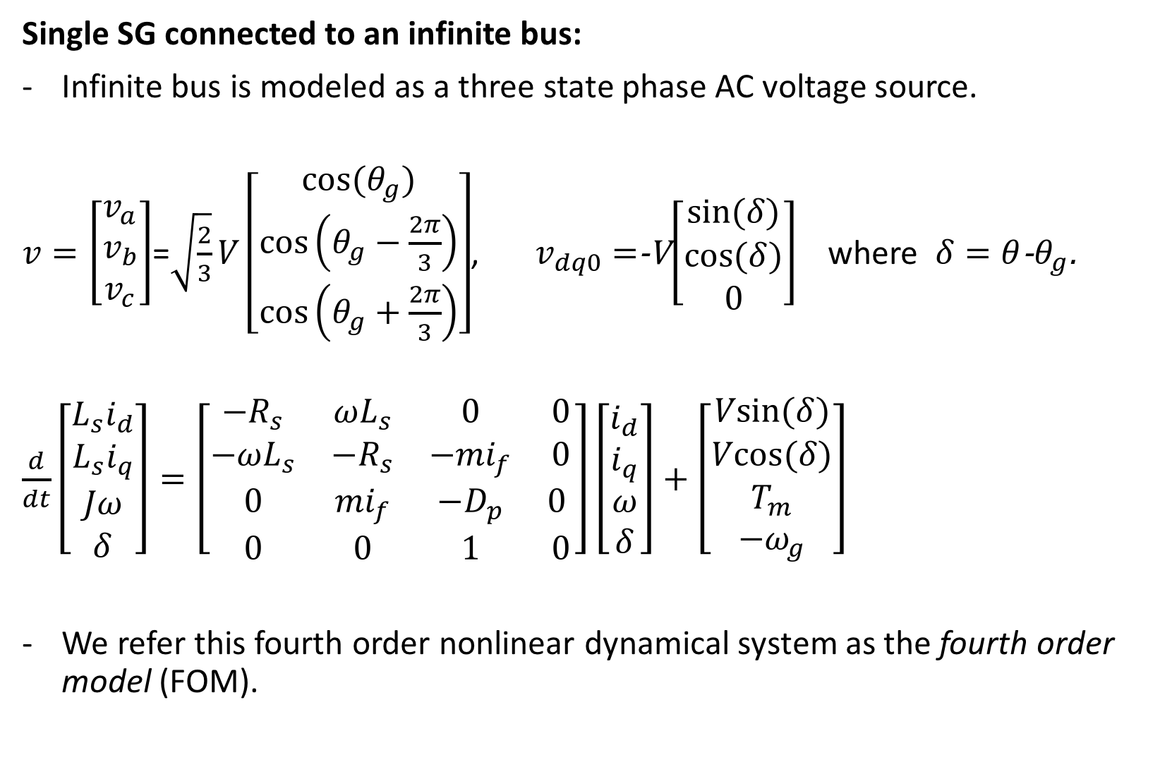
Single SG connected to an infinite bus:
Infinite bus is modeled as a three state phase AC voltage source.
$v=\left[\begin{matrix}v_{a} \\ v_{b} \\ v_{c}\end{matrix}\right]$=$\sqrt{\frac{2}{3}}V\left[\begin{matrix}cos⁡(θ_{g}) \\ cos⁡\left(θ_{g}−\frac{2π}{3}\right) \\ cos⁡\left(θ_{g}+\frac{2π}{3}\right)\end{matrix}\right]$, $v_{dq0}=$-V$\left[\begin{matrix}sin⁡(δ) \\ cos⁡(δ) \\ 0\end{matrix}\right]$ where $δ=θ$-$θ_{g}$.
$\frac{d}{dt}\left[\begin{matrix}L_{s}i_{d} \\ L_{s}i_{q} \\ Jω \\ δ\end{matrix}\right]=\left[\begin{matrix}−R_{s} & ωL_{s} & 0 & 0 \\ −ωL_{s} & {−R}_{s} & −{mi}_{f} & 0 \\ 0 & {mi}_{f} & −D_{p} & 0 \\ 0 & 0 & 1 & 0\end{matrix}\right]\left[\begin{matrix}i_{d} \\ i_{q} \\ ω \\ δ\end{matrix}\right]+\left[\begin{matrix}Vsin⁡(δ) \\ Vcos⁡(δ) \\ T_{m} \\ −ω_{g}\end{matrix}\right]$
We refer this fourth order nonlinear dynamical system as the fourth order model (FOM).

Slide 7
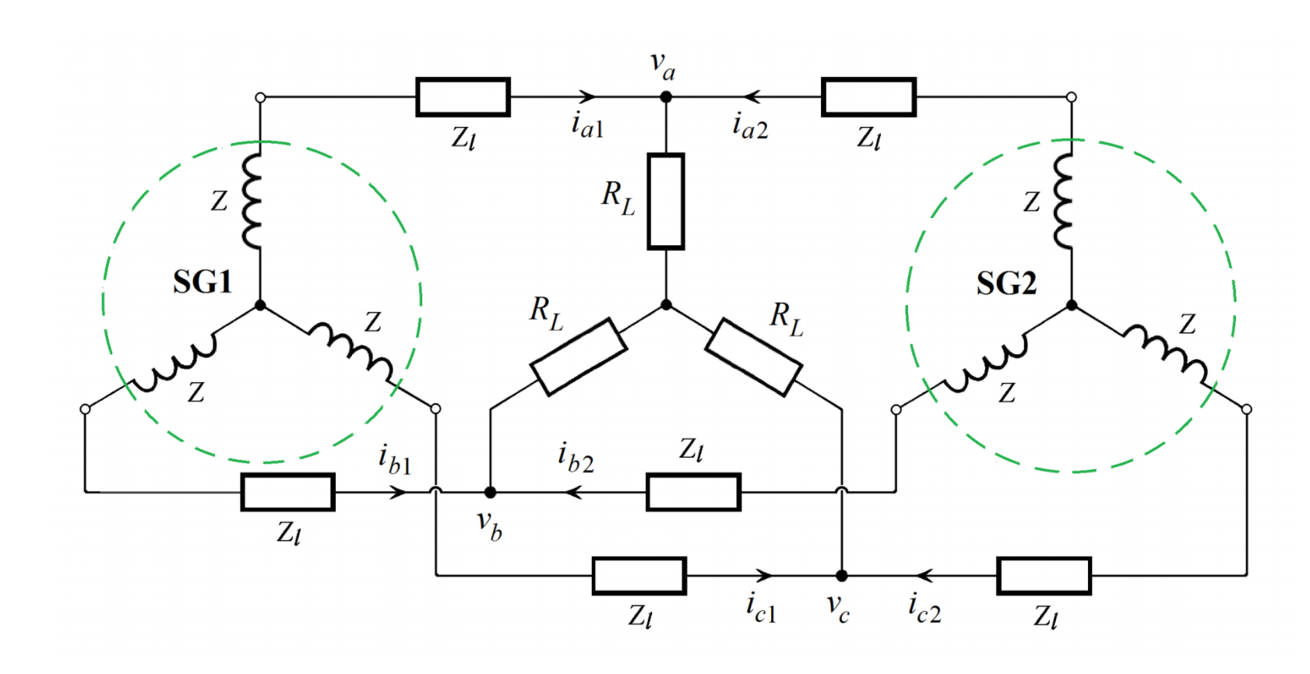

TICSG:
$Z_{l}$ can be added to $R_{s}$ and $L_{s}$.
Note that each SG vectors depends on different $θ$.
$U\left(θ_{1}\right)U^{−1} \left(θ_{2}\right)=\left[\begin{matrix}\cos\left(δ\right) & −\sin\left(δ\right) & 0 \\ \sin\left(δ\right) & \cos\left(δ\right) & 0 \\ 0 & 0 & 1\end{matrix}\right]$,
$x_{dq0\left(θ_{1}\right)}=U\left(θ_{1}\right)U^{−1}x_{dq0\left(θ_{2}\right)}$

Slide 8
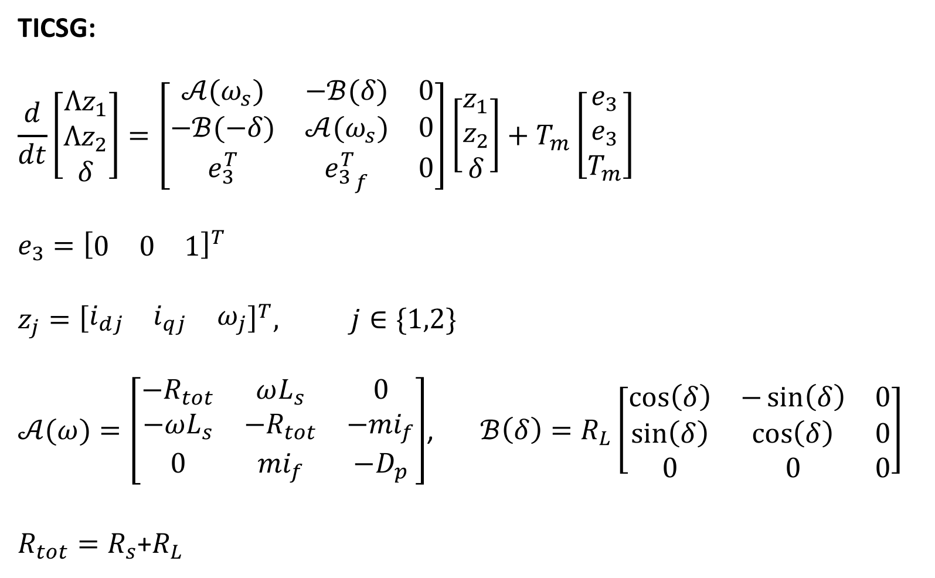
TICSG:
$$\frac{d}{dt}\left[\begin{matrix}Λz_{1} \\ Λz_{2} \\ δ\end{matrix}\right]=\left[\begin{matrix}𝒜(ω_{s}) & −ℬ(δ) & 0 \\ −ℬ(−δ) & 𝒜(ω_{s}) & 0 \\ e_{3}^{T} & {e_{3}^{T}}_{f} & 0\end{matrix}\right]\left[\begin{matrix}z_{1} \\ z_{2} \\ δ\end{matrix}\right]+T_{m}\left[\begin{matrix}e_{3} \\ e_{3} \\ T_{m}\end{matrix}\right]$$
$$e_{3}={\left[\begin{matrix}0 & 0 & 1\end{matrix}\right]}^{T}$$
$$z_{j}={\left[\begin{matrix}i_{dj} & i_{qj} & ω_{j}\end{matrix}\right]}^{T}, j∈\{1,2\}$$
$𝒜(ω)=\left[\begin{matrix}−R_{tot} & ωL_{s} & 0 \\ −ωL_{s} & {−R}_{tot} & −{mi}_{f} \\ 0 & {mi}_{f} & −D_{p}\end{matrix}\right]$, $ℬ\left(δ\right)=R_{L}\left[\begin{matrix}\cos\left(δ\right) & −\sin\left(δ\right) & 0 \\ \sin\left(δ\right) & \cos\left(δ\right) & 0 \\ 0 & 0 & 0\end{matrix}\right]$
$R_{tot}=R_{s}$+$R_{L}$

Slide 9
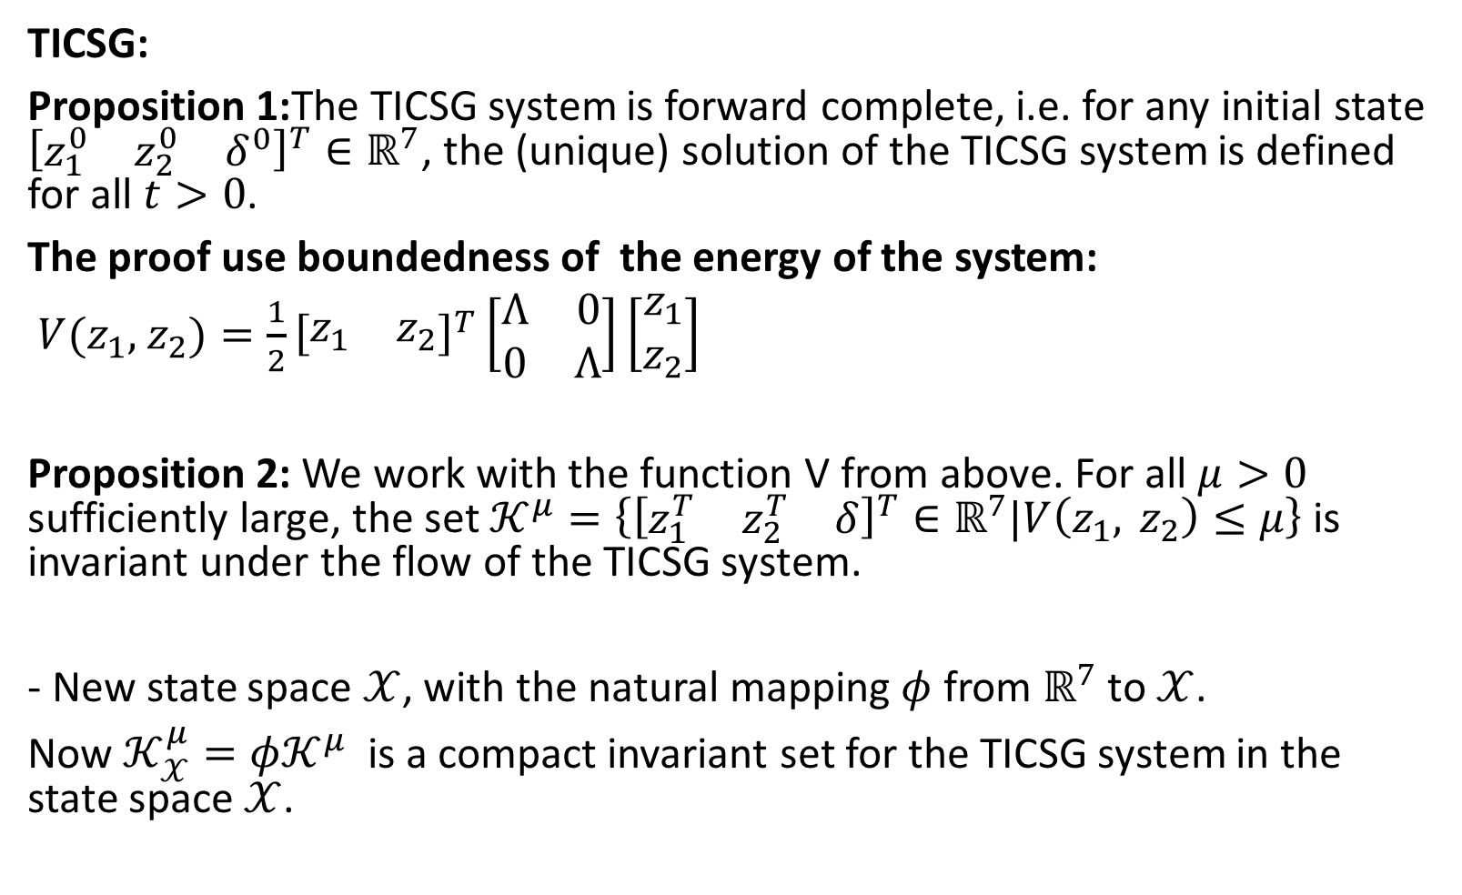
TICSG:
Proposition 1:The TICSG system is forward complete, i.e. for any initial state ${\left[\begin{matrix}z_{1}^{0} & z_{2}^{0} & δ^{0}\end{matrix}\right]}^{T}∈ℝ^{7}$, the (unique) solution of the TICSG system is defined for all $t>0$.
The proof use boundedness of the energy of the system:
$V(z_{1},$ $z_{2})=\frac{1}{2}{\left[\begin{matrix}z_{1} & z_{2}\end{matrix}\right]}^{T}\left[\begin{matrix}Λ & 0 \\ 0 & Λ\end{matrix}\right]\left[\begin{matrix}z_{1} \\ z_{2}\end{matrix}\right]$
Proposition 2: We work with the function V from above. For all $μ>0$ sufficiently large, the set $𝒦^{μ}=\left\{{\left[\begin{matrix}z_{1}^{T} & z_{2}^{T} & δ\end{matrix}\right]}^{T}∈ℝ^{7}\text{|}V\left(z_{1}, z_{2}\right)≤μ\right\}$ is invariant under the flow of the TICSG system.
- New state space $𝒳$, with the natural mapping $φ$ from $ℝ^{7}$ to $𝒳$.
Now $𝒦_{𝒳}^{μ}=φ𝒦^{μ}$ is a compact invariant set for the TICSG system in the state space $𝒳$.

Slide 10
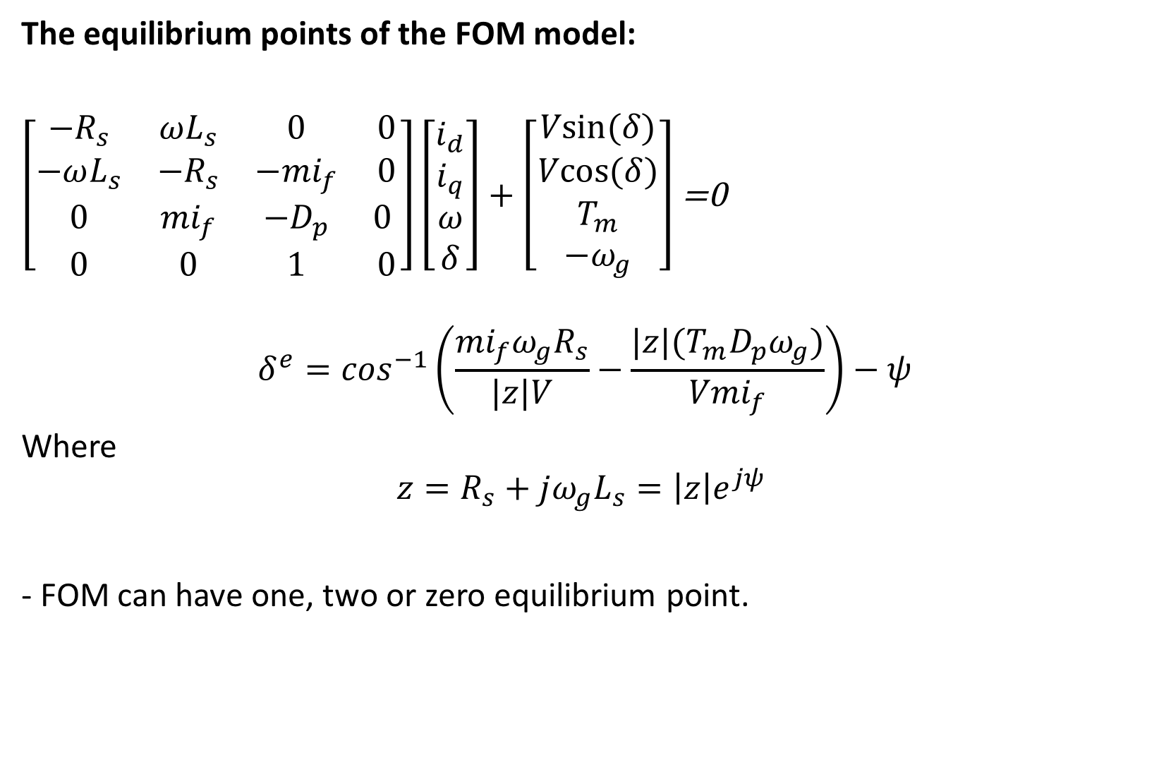
The equilibrium points of the FOM model:
$\left[\begin{matrix}−R_{s} & ωL_{s} & 0 & 0 \\ −ωL_{s} & {−R}_{s} & −{mi}_{f} & 0 \\ 0 & {mi}_{f} & −D_{p} & 0 \\ 0 & 0 & 1 & 0\end{matrix}\right]\left[\begin{matrix}i_{d} \\ i_{q} \\ ω \\ δ\end{matrix}\right]+\left[\begin{matrix}Vsin⁡(δ) \\ Vcos⁡(δ) \\ T_{m} \\ −ω_{g}\end{matrix}\right]$ =0
$$δ^{e}=\cos^{−1}\left(\frac{{mi}_{f}ω_{g}R_{s}}{|z|V}−\frac{|z|(T_{m}D_{p}ω_{g})}{{Vmi}_{f}}\right)−ψ$$
Where
$$z=R_{s}+jω_{g}L_{s}=\left|z\right|e^{jψ }$$
- FOM can have one, two or zero equilibrium point.

Slide 11
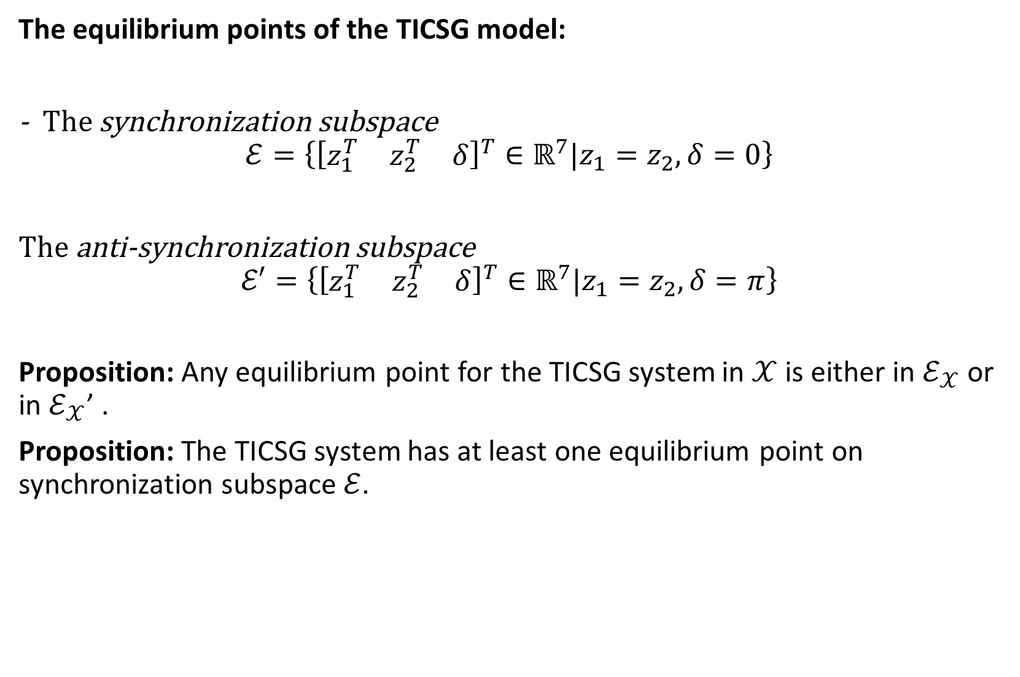
The equilibrium points of the TICSG model:
- The synchronization subspace
$$ℰ=\left\{{\left[\begin{matrix}z_{1}^{T} & z_{2}^{T} & δ\end{matrix}\right]}^{T}∈ℝ^{7}\text{|}z_{1}=z_{2}, δ=0\right\}$$
The anti-synchronization subspace
$$ℰ′=\left\{{\left[\begin{matrix}z_{1}^{T} & z_{2}^{T} & δ\end{matrix}\right]}^{T}∈ℝ^{7}\text{|}z_{1}=z_{2}, δ=π\right\}$$
Proposition: Any equilibrium point for the TICSG system in $𝒳$ is either in $ℰ_{𝒳}$ or in $ℰ_{𝒳}$’ .
Proposition: The TICSG system has at least one equilibrium point on synchronization subspace $ℰ$.

Slide 12
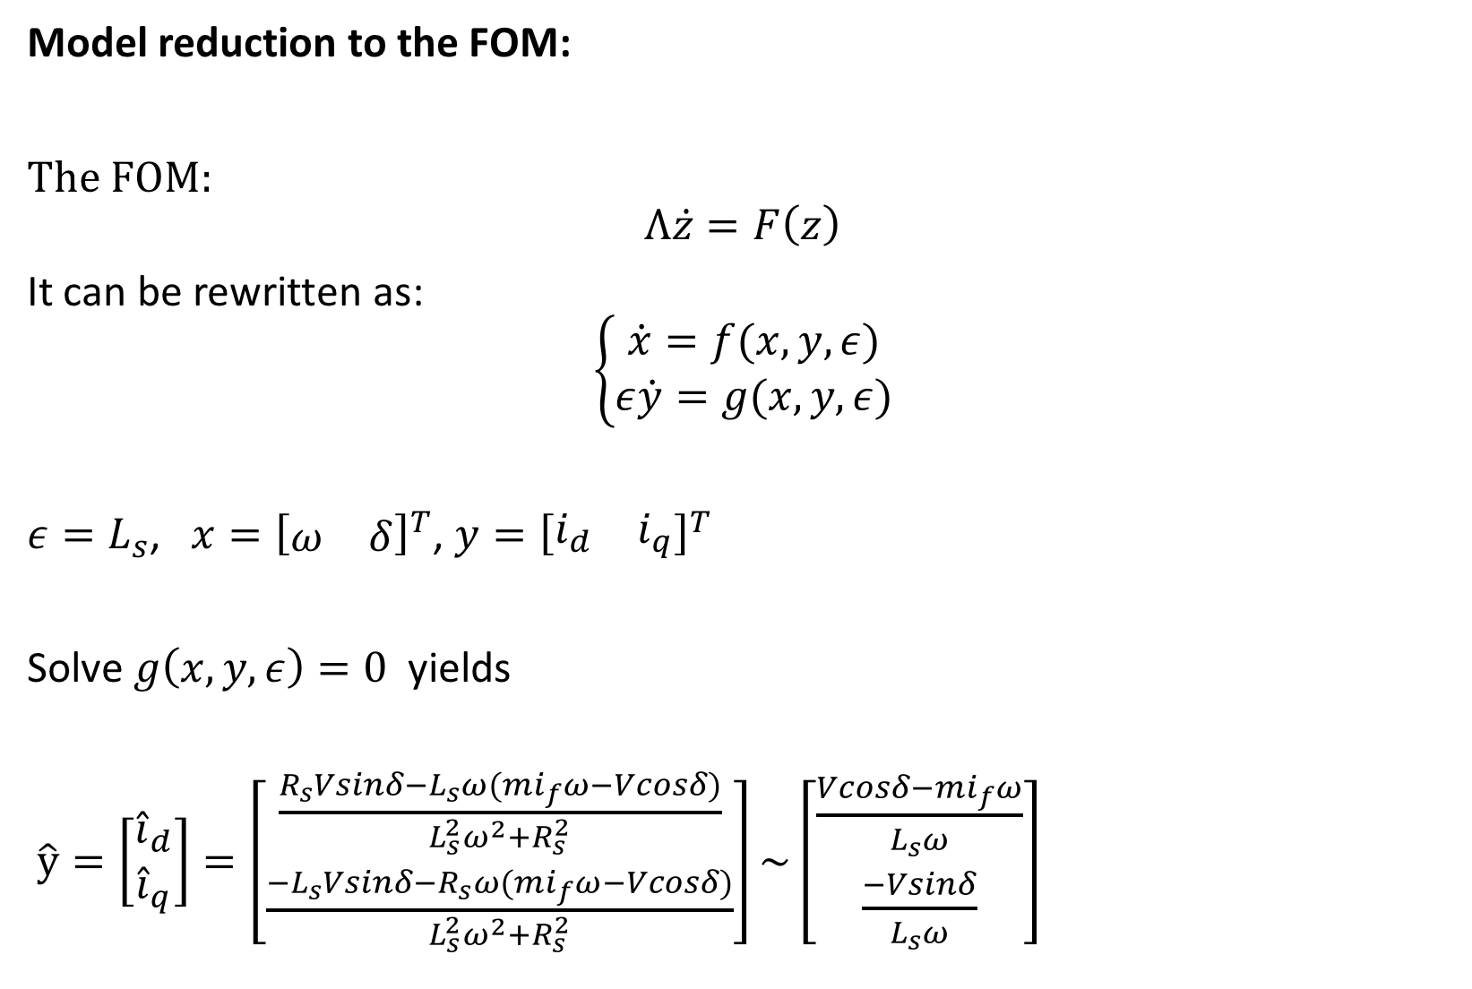
Model reduction to the FOM:
The FOM:
$$Λ\dot{z}=F\left(z\right)$$
It can be rewritten as:
$$\left\{\begin{matrix}\dot{x}=f(x,y,ε) \\ ε\dot{y}=g(x,y,ε)\end{matrix}\right.$$
$ε=L_{s}$, $x={\left[\begin{matrix}ω & δ\end{matrix}\right]}^{T}$, $y={\left[\begin{matrix}i_{d} & i_{q}\end{matrix}\right]}^{T}$
Solve $g\left(x,y,ε\right)=0$ yields
$\hat{y}=\left[\begin{matrix}{\hat{i}}_{d} \\ {\hat{i}}_{q}\end{matrix}\right]=\left[\begin{matrix}\frac{R_{s}Vsinδ−L_{s}ω(mi_{f}ω−Vcosδ)}{L_{s}^{2}ω^{2}+R_{s}^{2}} \\ \frac{{−L}_{s}Vsinδ−R_{s}ω(mi_{f}ω−Vcosδ)}{L_{s}^{2}ω^{2}+R_{s}^{2}}\end{matrix}\right]\sim \left[\begin{matrix}\frac{Vcosδ−mi_{f}ω}{L_{s}ω} \\ \frac{−Vsinδ}{L_{s}ω}\end{matrix}\right]$

Slide 13
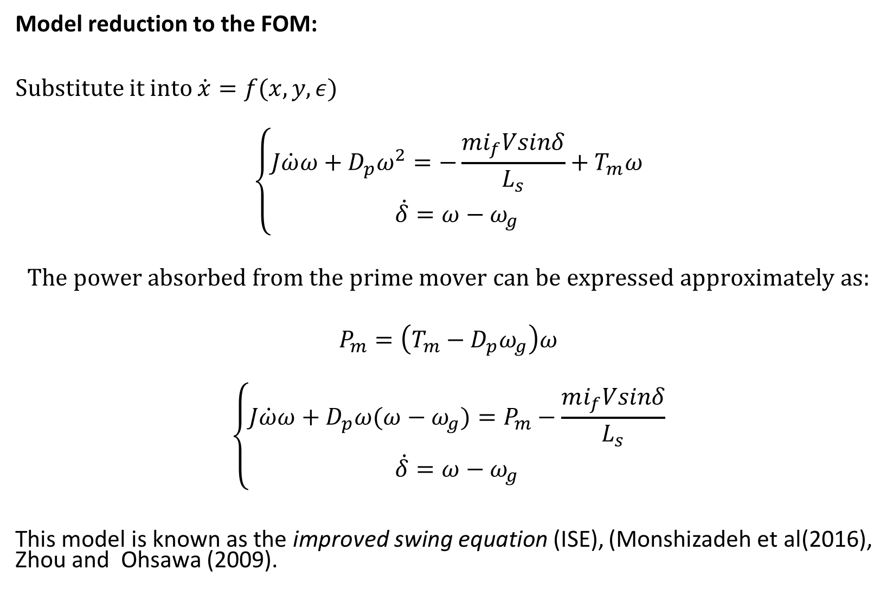
Model reduction to the FOM:
Substitute it into $\dot{x}=f(x,y,ε)$
$$\left\{\begin{matrix}J\dot{ω}ω+D_{p}ω^{2}=−\frac{mi_{f}Vsinδ}{L_{s}}+T_{m}ω \\ \dot{δ}=ω−ω_{g}\end{matrix}\right.$$
$$The power absorbed from the prime mover can be expressed approximately as:$$
$$P_{m}=\left(T_{m}−D_{p}ω_{g}\right)ω$$
$$\left\{\begin{matrix}J\dot{ω}ω+D_{p}ω(ω−ω_{g})=P_{m}−\frac{mi_{f}Vsinδ}{L_{s}} \\ \dot{δ}=ω−ω_{g}\end{matrix}\right.$$
This model is known as the improved swing equation (ISE), (Monshizadeh et al(2016), Zhou and Ohsawa (2009).

Slide 14
Simulations:
5 KW SG

Slide 15
Simulations:
1 MW SG

Slide 16
Simulations:
Non stable example

Slide 17
Simulations:
Different region of attraction

Slide 18

The stability of the TICSG system:
The TICSG system:
$$\tilde{Λ}\left[\begin{matrix}{\dot{z}}_{1} \\ {\dot{z}}_{2} \\ \dot{δ}\end{matrix}\right]=f\left(z_{1},z_{2},δ\right)$$
It can be rewritten as:
$$\dot{e}=F\left(e,x\right), \dot{x}=G\left(e,x\right)$$
$e=\left[\begin{matrix}z_{2}−z_{1} \\ δ\end{matrix}\right]$, $x=z_{1}+z_{2}$

Slide 19
The TICSG e,x model

Slide 20
Stability on the synchronization manifold

Slide 21
George proposition

Slide 22
Bayau definitions

Slide 23
Bayau Theorem

Slide 24
Bayau application

Slide 25
Simulation1

Slide 26
Simulation2

Slide 27
Conclusions

