Slide 1
Stability of coupled synchronous generators

Slide 2
A warning about the use of reduced models of synchronous generators
Elad Venezian and George Weiss
School of EE, Tel Aviv University

Slide 3
Introduction
Approximately 150 years of electricity grid.
The electricity grid is more and more dependent on inverters.
The main power source of the electricity gird is the Synchronous Generator (SG).
The stability concept (in particular, frequency and voltage).
We discuss a single generator connected to an infinite bus. The question is its stability and the region of attraction of the stable equilibrium point.
Reduced model called improved swing equation has been proposed by Zhou and Ohsawa (2009) Monshizadeh et al (2016). We investigate its usefulness for stability analysis.

Slide 4
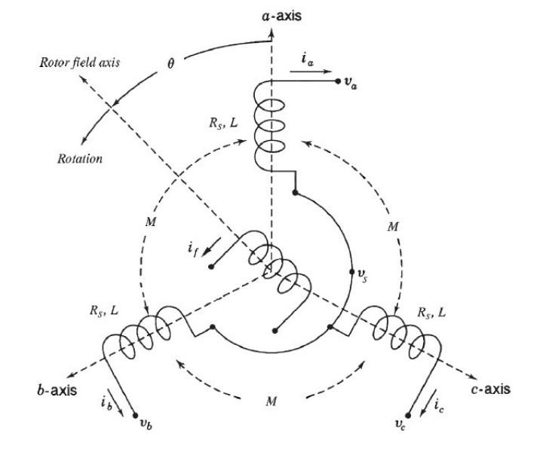
SG modeling

Slide 5
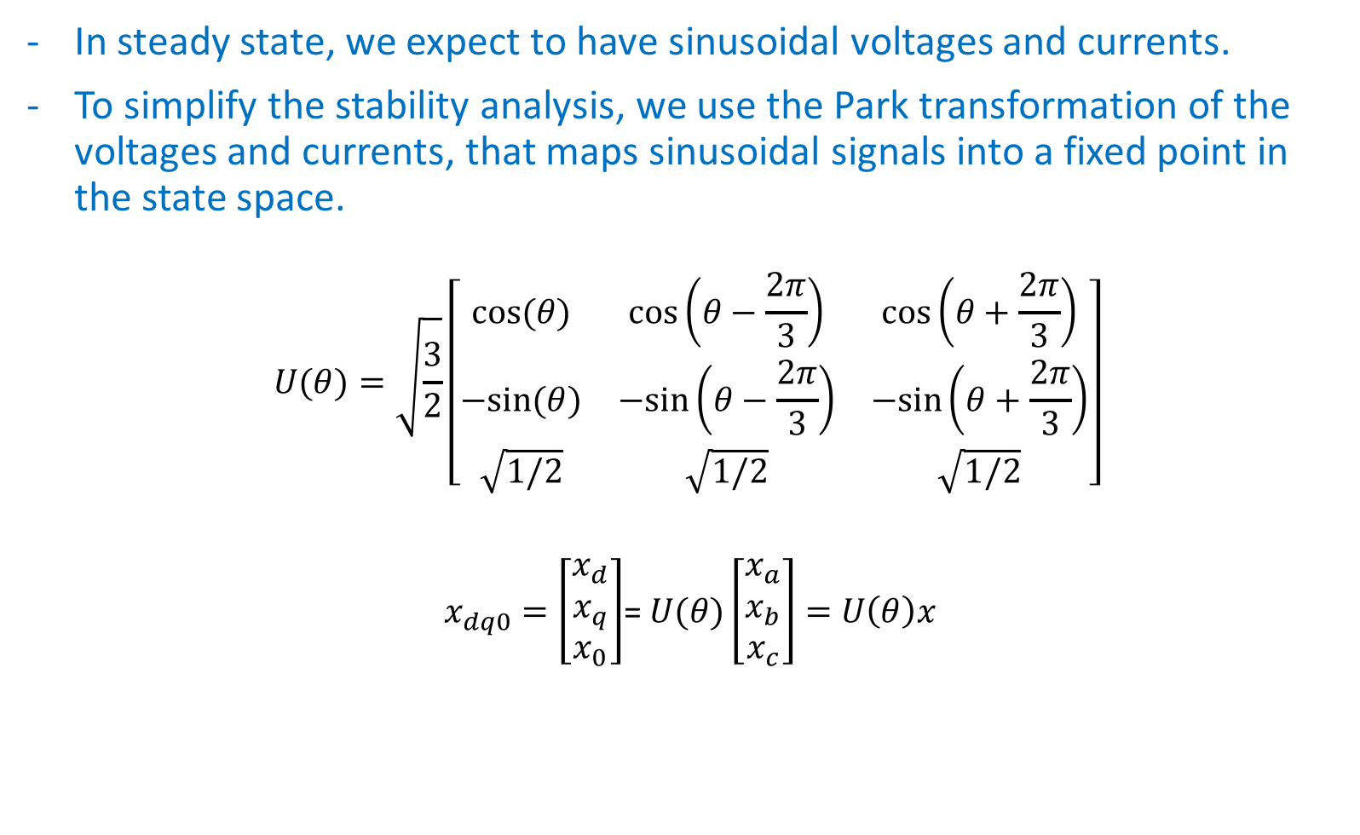
SG modeling
In steady state, we expect to have sinusoidal voltages and currents.
To simplify the stability analysis, we use the Park transformation of the voltages and currents, that maps sinusoidal signals into a fixed point in the state space.
$$U(θ)=\sqrt{\frac{3}{2}}\left[\begin{matrix}cos⁡(θ) & cos⁡\left(θ−\frac{2π}{3}\right) & cos⁡\left(θ+\frac{2π}{3}\right) \\ −sin⁡(θ) & −sin⁡\left(θ−\frac{2π}{3}\right) & −sin⁡\left(θ+\frac{2π}{3}\right) \\ \sqrt{1/2} & \sqrt{1/2} & \sqrt{1/2}\end{matrix}\right]$$
$x_{dq0}=\left[\begin{matrix}x_{d} \\ x_{q} \\ x_{0}\end{matrix}\right]$= $U(θ)\left[\begin{matrix}x_{a} \\ x_{b} \\ x_{c}\end{matrix}\right]=$ $U\left(θ\right)x$

Slide 6
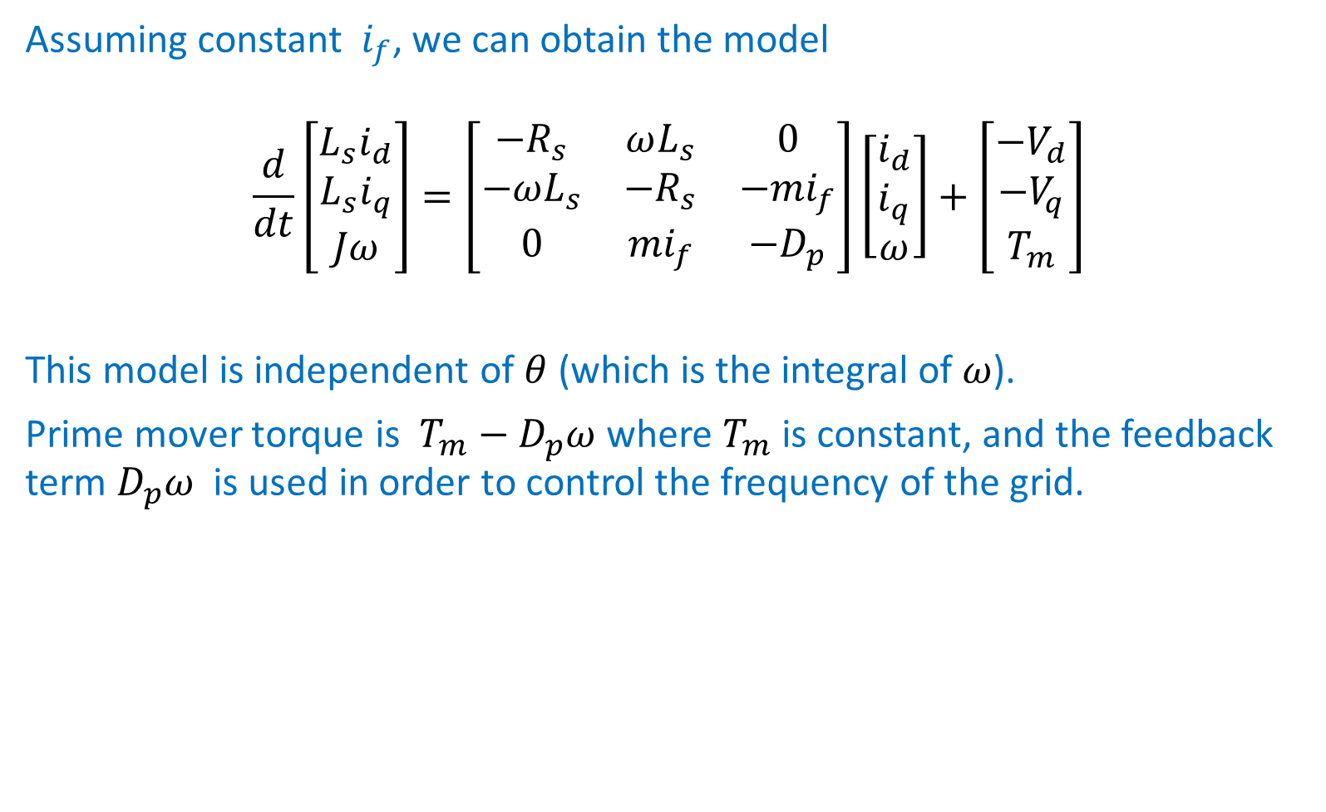
SG modeling
Assuming constant $i_{f}$, we can obtain the model
$$\frac{d}{dt}\left[\begin{matrix}L_{s}i_{d} \\ L_{s}i_{q} \\ Jω\end{matrix}\right]=\left[\begin{matrix}−R_{s} & ωL_{s} & 0 \\ −ωL_{s} & {−R}_{s} & −{mi}_{f} \\ 0 & {mi}_{f} & −D_{p}\end{matrix}\right]\left[\begin{matrix}i_{d} \\ i_{q} \\ ω\end{matrix}\right]+\left[\begin{matrix}{−V}_{d} \\ {−V}_{q} \\ T_{m}\end{matrix}\right]$$
This model is independent of $θ$ (which is the integral of $ω$).
Prime mover torque is $T_{m}−D_{p}ω$ where $T_{m}$ is constant, and the feedback term $D_{p}ω$ is used in order to control the frequency of the grid.

Slide 7
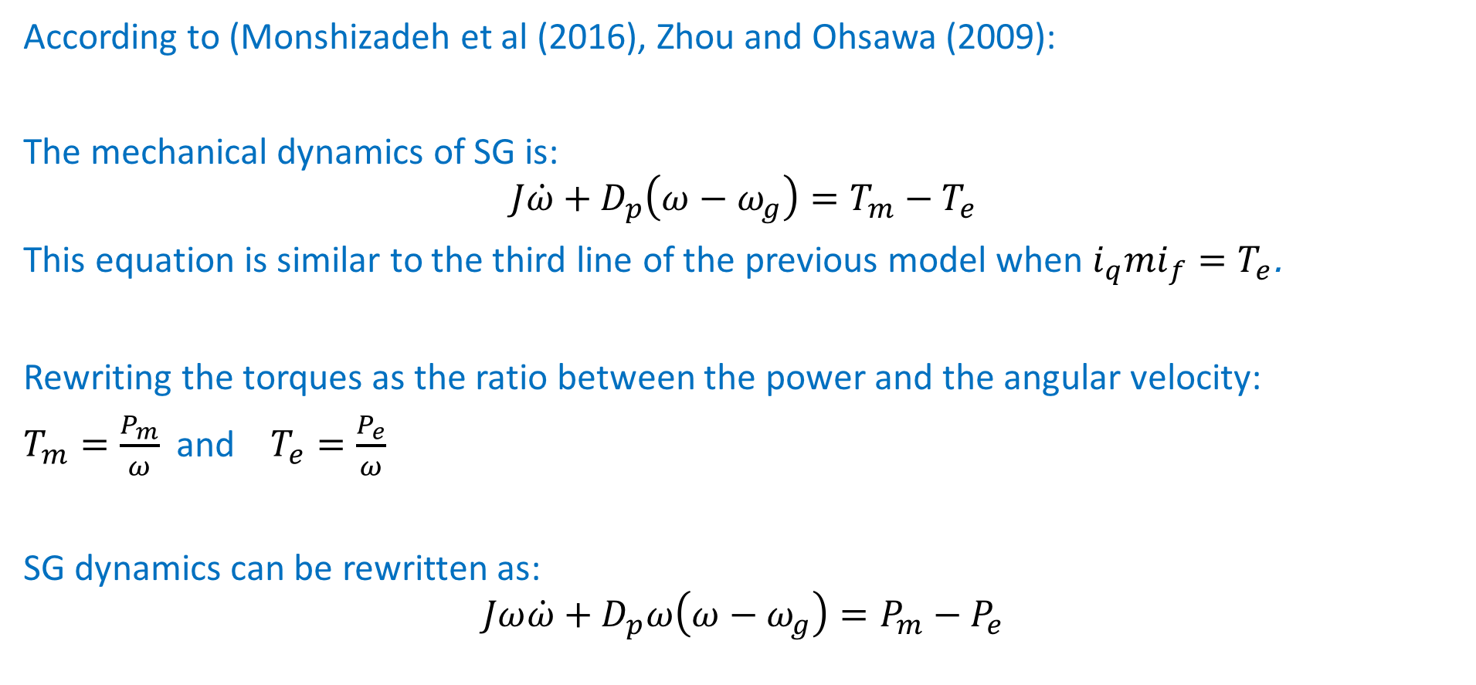
The improved swing equation model
According to (Monshizadeh et al (2016), Zhou and Ohsawa (2009):
The mechanical dynamics of SG is:
$$J\dot{ω}+D_{p}\left(ω−ω_{g}\right)=T_{m}−T_{e}$$
This equation is similar to the third line of the previous model when ${i_{q}mi}_{f}=T_{e}$.
Rewriting the torques as the ratio between the power and the angular velocity:
$T_{m}=\frac{P_{m}}{ω}$ and $T_{e}=\frac{P_{e}}{ω}$
SG dynamics can be rewritten as:
$$Jω\dot{ω}+D_{p}ω\left(ω−ω_{g}\right)=P_{m}−P_{e}$$

Slide 8
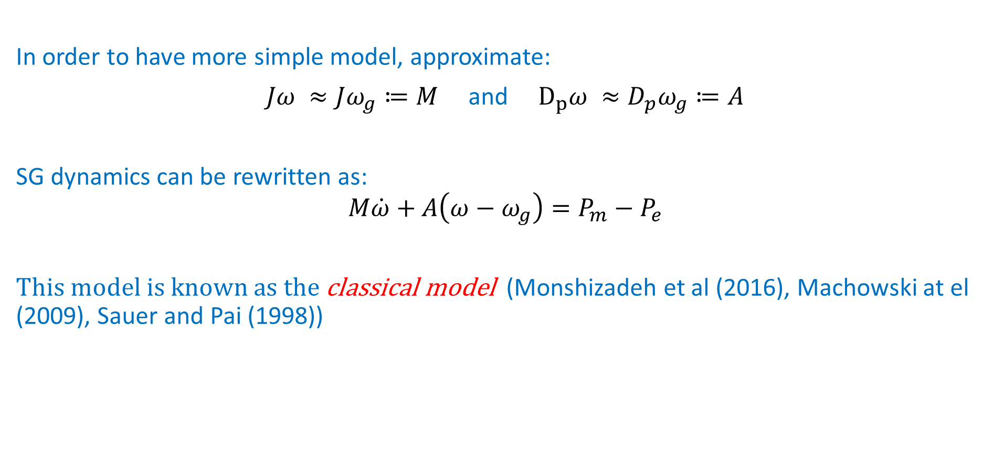
The classical swing equation model
In order to have more simple model, approximate:
$Jω ≈Jω_{g}≔M$ and $D_{p}ω ≈D_{p}ω_{g}≔A$
SG dynamics can be rewritten as:
$$M\dot{ω}+A\left(ω−ω_{g}\right)=P_{m}−P_{e}$$
This model is known as the classical model (Monshizadeh et al (2016), Machowski at el (2009), Sauer and Pai (1998))

Slide 9
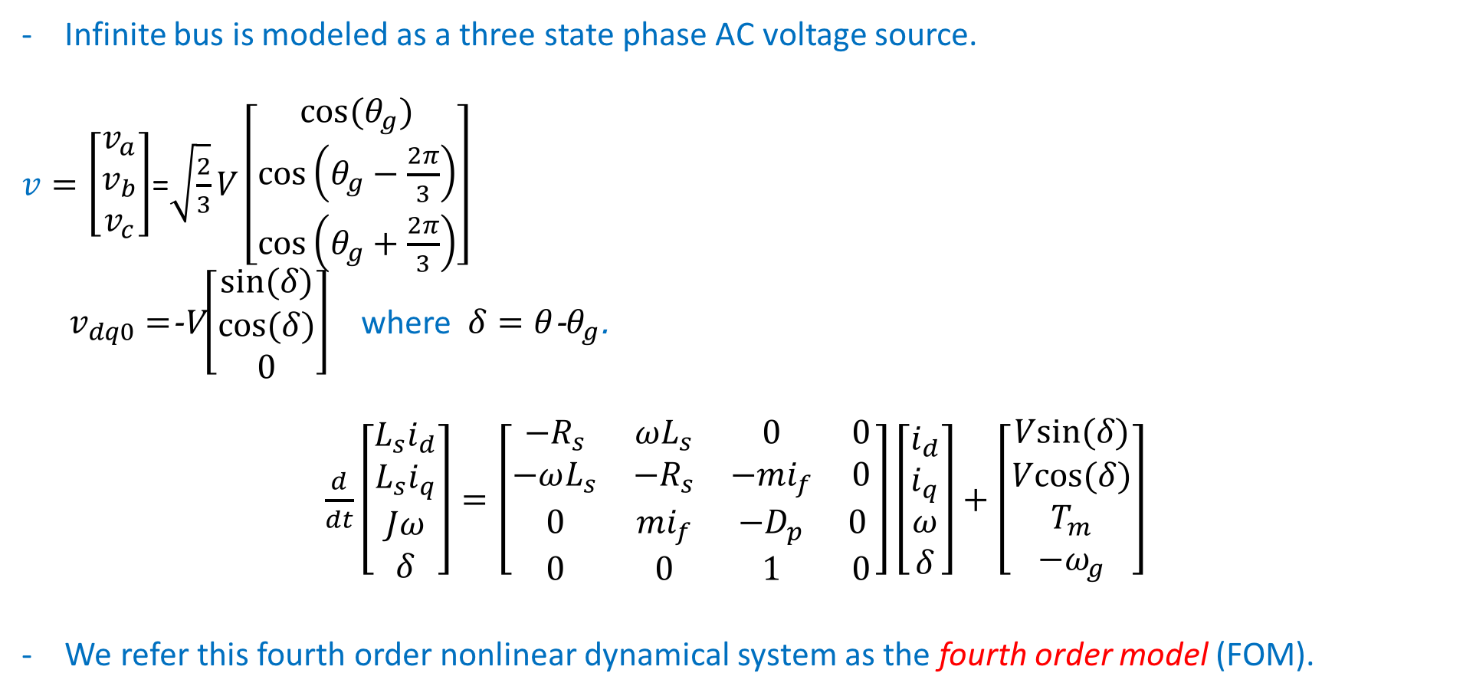
Single SG connected to an infinite bus:
Infinite bus is modeled as a three state phase AC voltage source.
$v=\left[\begin{matrix}v_{a} \\ v_{b} \\ v_{c}\end{matrix}\right]$=$\sqrt{\frac{2}{3}}V\left[\begin{matrix}cos⁡(θ_{g}) \\ cos⁡\left(θ_{g}−\frac{2π}{3}\right) \\ cos⁡\left(θ_{g}+\frac{2π}{3}\right)\end{matrix}\right]$
$v_{dq0}=$-V$\left[\begin{matrix}sin⁡(δ) \\ cos⁡(δ) \\ 0\end{matrix}\right]$ where $δ=θ$-$θ_{g}$.
$\frac{d}{dt}\left[\begin{matrix}L_{s}i_{d} \\ L_{s}i_{q} \\ Jω \\ δ\end{matrix}\right]=\left[\begin{matrix}−R_{s} & ωL_{s} & 0 & 0 \\ −ωL_{s} & {−R}_{s} & −{mi}_{f} & 0 \\ 0 & {mi}_{f} & −D_{p} & 0 \\ 0 & 0 & 1 & 0\end{matrix}\right]\left[\begin{matrix}i_{d} \\ i_{q} \\ ω \\ δ\end{matrix}\right]+\left[\begin{matrix}Vsin⁡(δ) \\ Vcos⁡(δ) \\ T_{m} \\ −ω_{g}\end{matrix}\right]$
We refer this fourth order nonlinear dynamical system as the fourth order model (FOM).

Slide 10
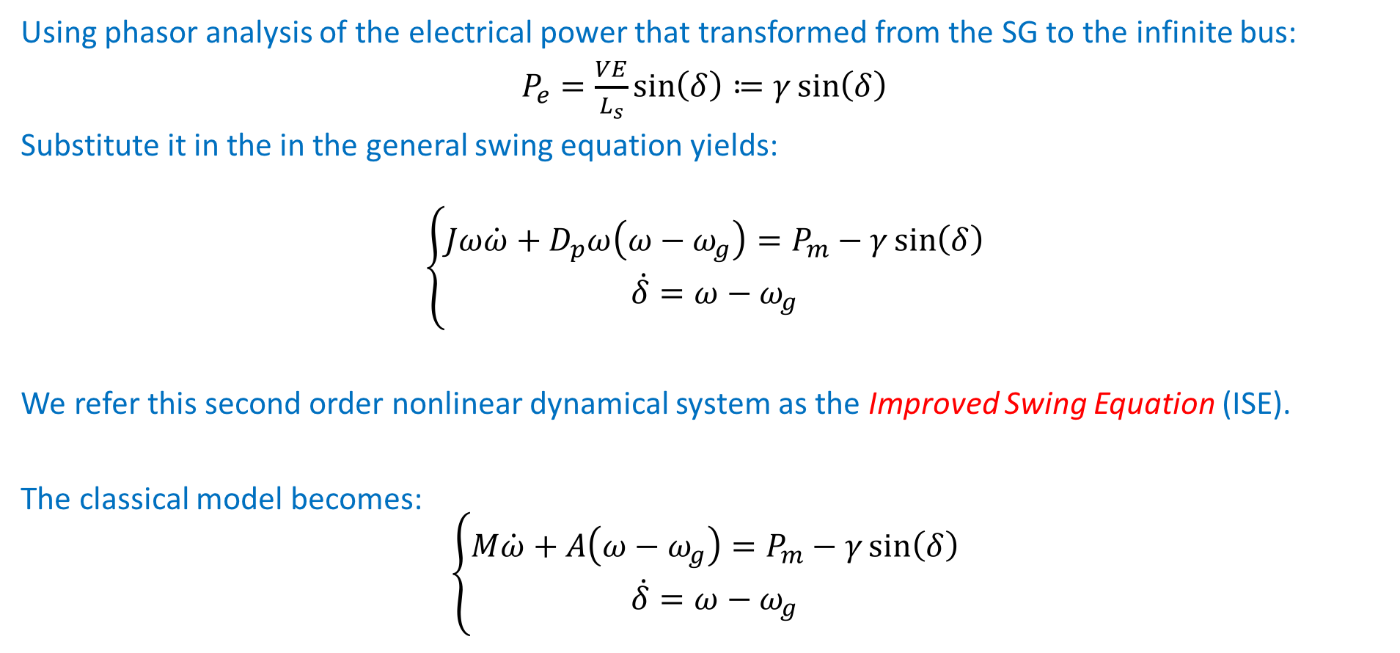
Single SG connected to an infinite bus: (ISE)
Using phasor analysis of the electrical power that transformed from the SG to the infinite bus:
$P_{e}=\frac{VE}{L_{s}}\sin\left(δ\right)≔γ\sin\left(δ\right)$
Substitute it in the in the general swing equation yields:
$$\left\{\begin{matrix}Jω\dot{ω}+D_{p}ω\left(ω−ω_{g}\right)=P_{m}−γ\sin\left(δ\right) \\ \dot{δ}=ω−ω_{g}\end{matrix}\right.$$
We refer this second order nonlinear dynamical system as the Improved Swing Equation (ISE).
The classical model becomes:
$$\left\{\begin{matrix}M\dot{ω}+A\left(ω−ω_{g}\right)=P_{m}−γ\sin\left(δ\right) \\ \dot{δ}=ω−ω_{g}\end{matrix}\right.$$

Slide 11
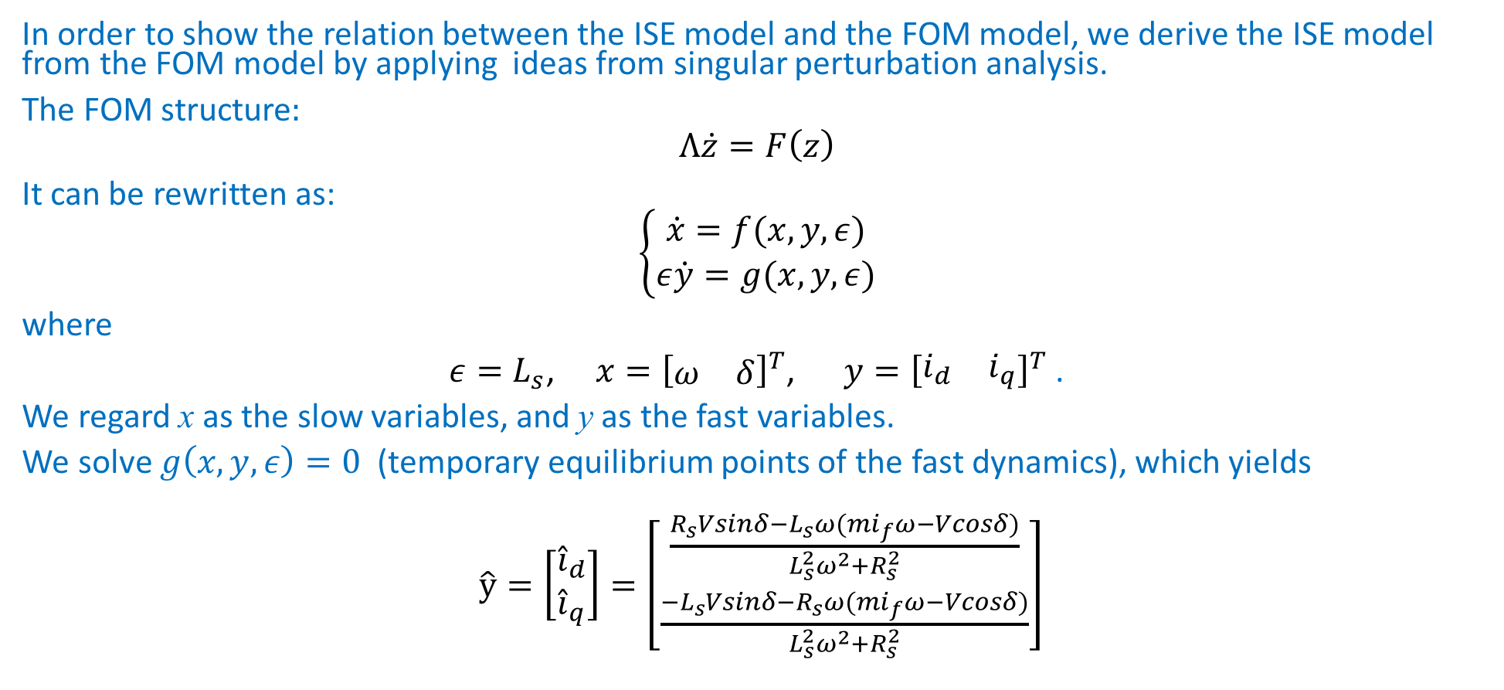
Model reduction
In order to show the relation between the ISE model and the FOM model, we derive the ISE model from the FOM model by applying ideas from singular perturbation analysis.
The FOM structure:
$$Λ\dot{z}=F\left(z\right)$$
It can be rewritten as:
$$\left\{\begin{matrix}\dot{x}=f(x,y,ε) \\ ε\dot{y}=g(x,y,ε)\end{matrix}\right.$$
where
$ε=L_{s}$, $x={\left[\begin{matrix}ω & δ\end{matrix}\right]}^{T}$, $y={\left[\begin{matrix}i_{d} & i_{q}\end{matrix}\right]}^{T}$ .
We regard x as the slow variables, and y as the fast variables.
We solve $g\left(x,y,ε\right)=0$ (temporary equilibrium points of the fast dynamics), which yields
$\hat{y}=\left[\begin{matrix}{\hat{i}}_{d} \\ {\hat{i}}_{q}\end{matrix}\right]=\left[\begin{matrix}\frac{R_{s}Vsinδ−L_{s}ω(mi_{f}ω−Vcosδ)}{L_{s}^{2}ω^{2}+R_{s}^{2}} \\ \frac{{−L}_{s}Vsinδ−R_{s}ω(mi_{f}ω−Vcosδ)}{L_{s}^{2}ω^{2}+R_{s}^{2}}\end{matrix}\right]$

Slide 12

Model reduction
In order to show the relation between the ISE model and the FOM model, we derive the ISE model from the FOM model by applying ideas from singular perturbation analysis.
The FOM structure:
$$Λ\dot{z}=F\left(z\right)$$
It can be rewritten as:
$$\left\{\begin{matrix}\dot{x}=f(x,y,ε) \\ ε\dot{y}=g(x,y,ε)\end{matrix}\right.$$
where
$ε=L_{s}$, $x={\left[\begin{matrix}ω & δ\end{matrix}\right]}^{T}$, $y={\left[\begin{matrix}i_{d} & i_{q}\end{matrix}\right]}^{T}$ .
We regard x as the slow variables, and y as the fast variables.
We solve $g\left(x,y,ε\right)=0$ (temporary equilibrium points of the fast dynamics), which yields
$\hat{y}=\left[\begin{matrix}{\hat{i}}_{d} \\ {\hat{i}}_{q}\end{matrix}\right]=\sim \left[\begin{matrix}\frac{Vcosδ−mi_{f}ω}{L_{s}ω} \\ \frac{−Vsinδ}{L_{s}ω}\end{matrix}\right]$

Slide 13
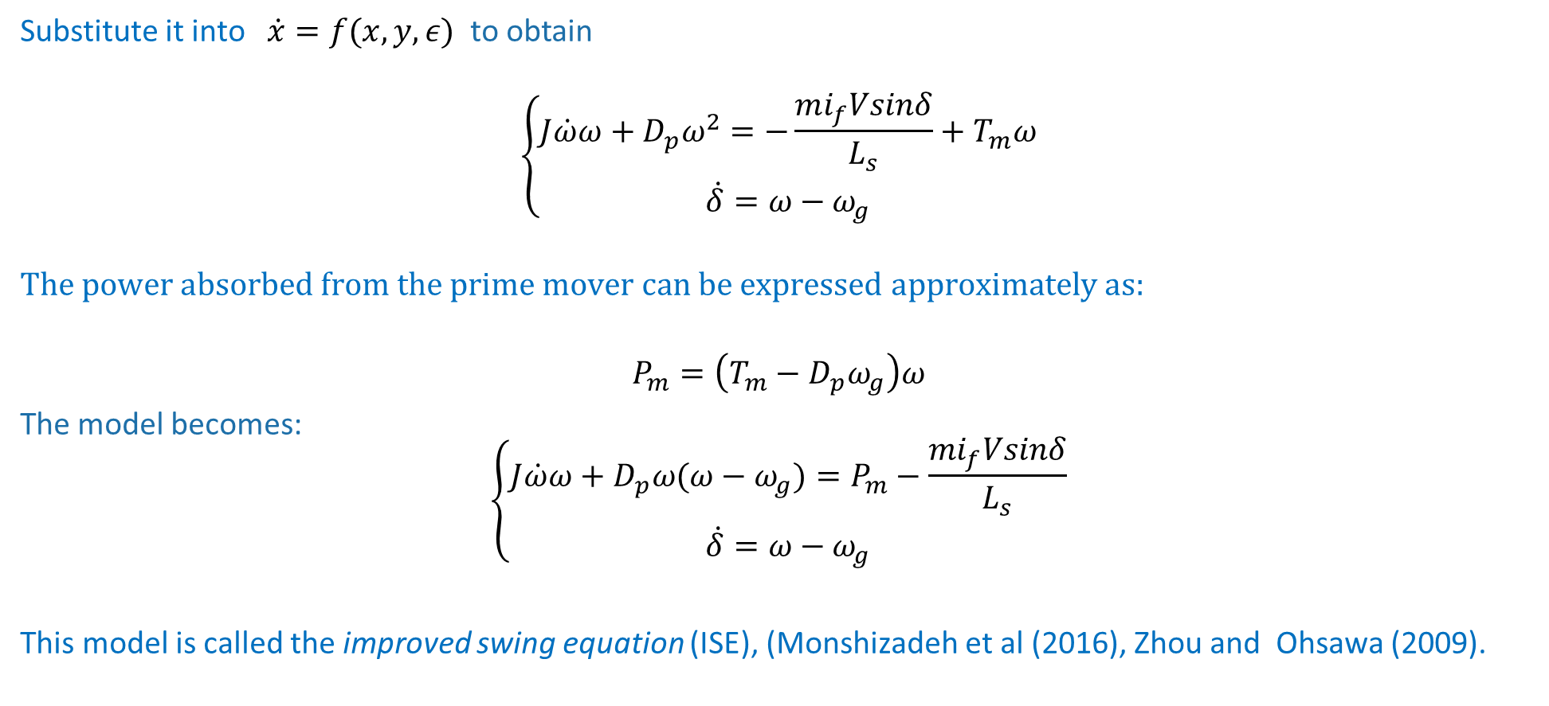
Model reduction
Substitute it into $\dot{x}=f(x,y,ε)$ to obtain
$$\left\{\begin{matrix}J\dot{ω}ω+D_{p}ω^{2}=−\frac{mi_{f}Vsinδ}{L_{s}}+T_{m}ω \\ \dot{δ}=ω−ω_{g}\end{matrix}\right.$$
$$The power absorbed from the prime mover can be expressed approximately as:$$
$$P_{m}=\left(T_{m}−D_{p}ω_{g}\right)ω$$
The model becomes:
$$\left\{\begin{matrix}J\dot{ω}ω+D_{p}ω(ω−ω_{g})=P_{m}−\frac{mi_{f}Vsinδ}{L_{s}} \\ \dot{δ}=ω−ω_{g}\end{matrix}\right.$$
This model is called the improved swing equation (ISE), (Monshizadeh et al (2016), Zhou and Ohsawa (2009).

Slide 14
Simulations
5 KW SG connected to infinite bus
variables with a hat correspond to the reduced model.

Slide 15
Simulations
1 MW SG

Slide 16

Simulations
The FOM is locally stable, (eigenvalues of the Jacobian around the equilibrium point are −11.41±376.9i, −508±837i).
The ISE doesn’t have any equilibrium ($\left|\frac{P_{m}L_{s}}{mi_{f}V}\right|>1$).

Slide 17
Simulations
Different region of attraction
- Initial condition of this simulation is within the region of attraction of the reduced model, but outside the region of attraction of the FOM

Slide 18
Two Identical Coupled SGs (TICSG).

Slide 19
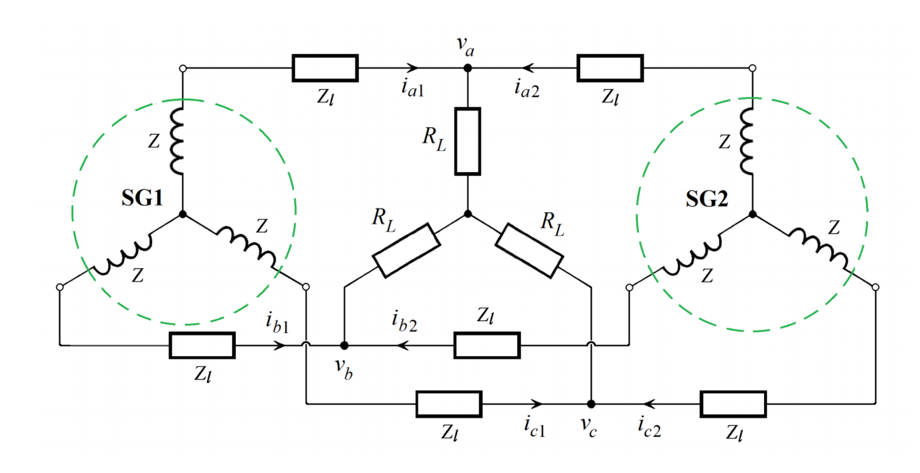

TICSG Modeling:
Two identical SGs connected in parallel through inductive lines, to a resistive load.
Each SG variables depend on different $θ$.
$x_{dq0\left(θ_{1}\right)}=U\left(θ_{1}\right){\left(θ_{2}\right)U}^{−1}x_{dq0\left(θ_{2}\right)}.$
$U\left(θ_{1}\right)U^{−1} \left(θ_{2}\right)=\left[\begin{matrix}\cos\left(δ\right) & −\sin\left(δ\right) & 0 \\ \sin\left(δ\right) & \cos\left(δ\right) & 0 \\ 0 & 0 & 1\end{matrix}\right].$

Slide 20
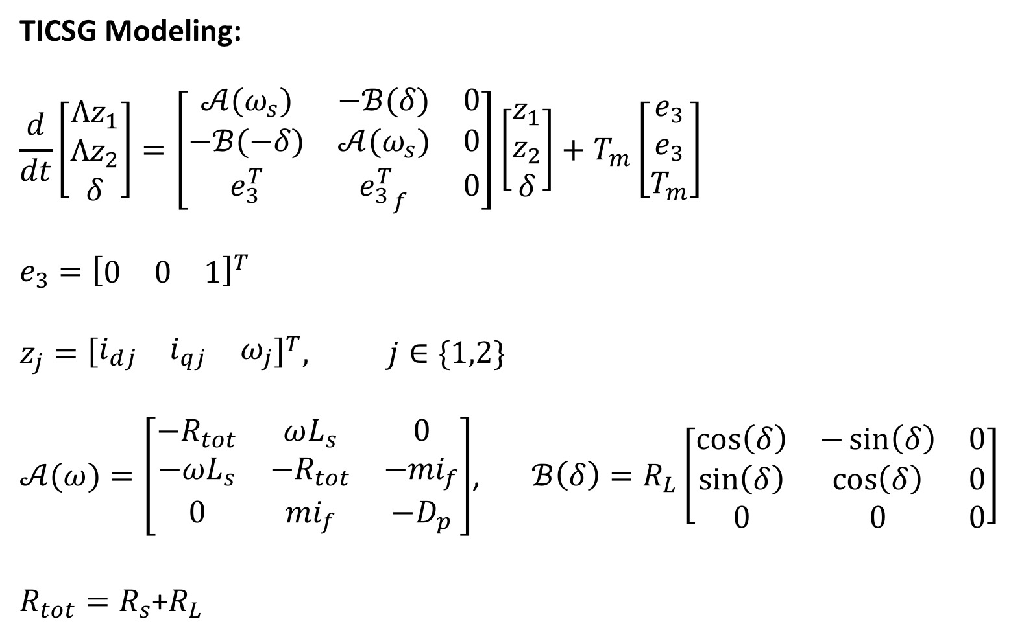
TICSG Modeling:
$$\frac{d}{dt}\left[\begin{matrix}Λz_{1} \\ Λz_{2} \\ δ\end{matrix}\right]=\left[\begin{matrix}𝒜(ω_{s}) & −ℬ(δ) & 0 \\ −ℬ(−δ) & 𝒜(ω_{s}) & 0 \\ e_{3}^{T} & {e_{3}^{T}}_{f} & 0\end{matrix}\right]\left[\begin{matrix}z_{1} \\ z_{2} \\ δ\end{matrix}\right]+T_{m}\left[\begin{matrix}e_{3} \\ e_{3} \\ T_{m}\end{matrix}\right]$$
$$e_{3}={\left[\begin{matrix}0 & 0 & 1\end{matrix}\right]}^{T}$$
$$z_{j}={\left[\begin{matrix}i_{dj} & i_{qj} & ω_{j}\end{matrix}\right]}^{T}, j∈\{1,2\}$$
$𝒜(ω)=\left[\begin{matrix}−R_{tot} & ωL_{s} & 0 \\ −ωL_{s} & {−R}_{tot} & −{mi}_{f} \\ 0 & {mi}_{f} & −D_{p}\end{matrix}\right]$, $ℬ\left(δ\right)=R_{L}\left[\begin{matrix}\cos\left(δ\right) & −\sin\left(δ\right) & 0 \\ \sin\left(δ\right) & \cos\left(δ\right) & 0 \\ 0 & 0 & 0\end{matrix}\right]$
$R_{tot}=R_{s}$+$R_{L}$

Slide 21
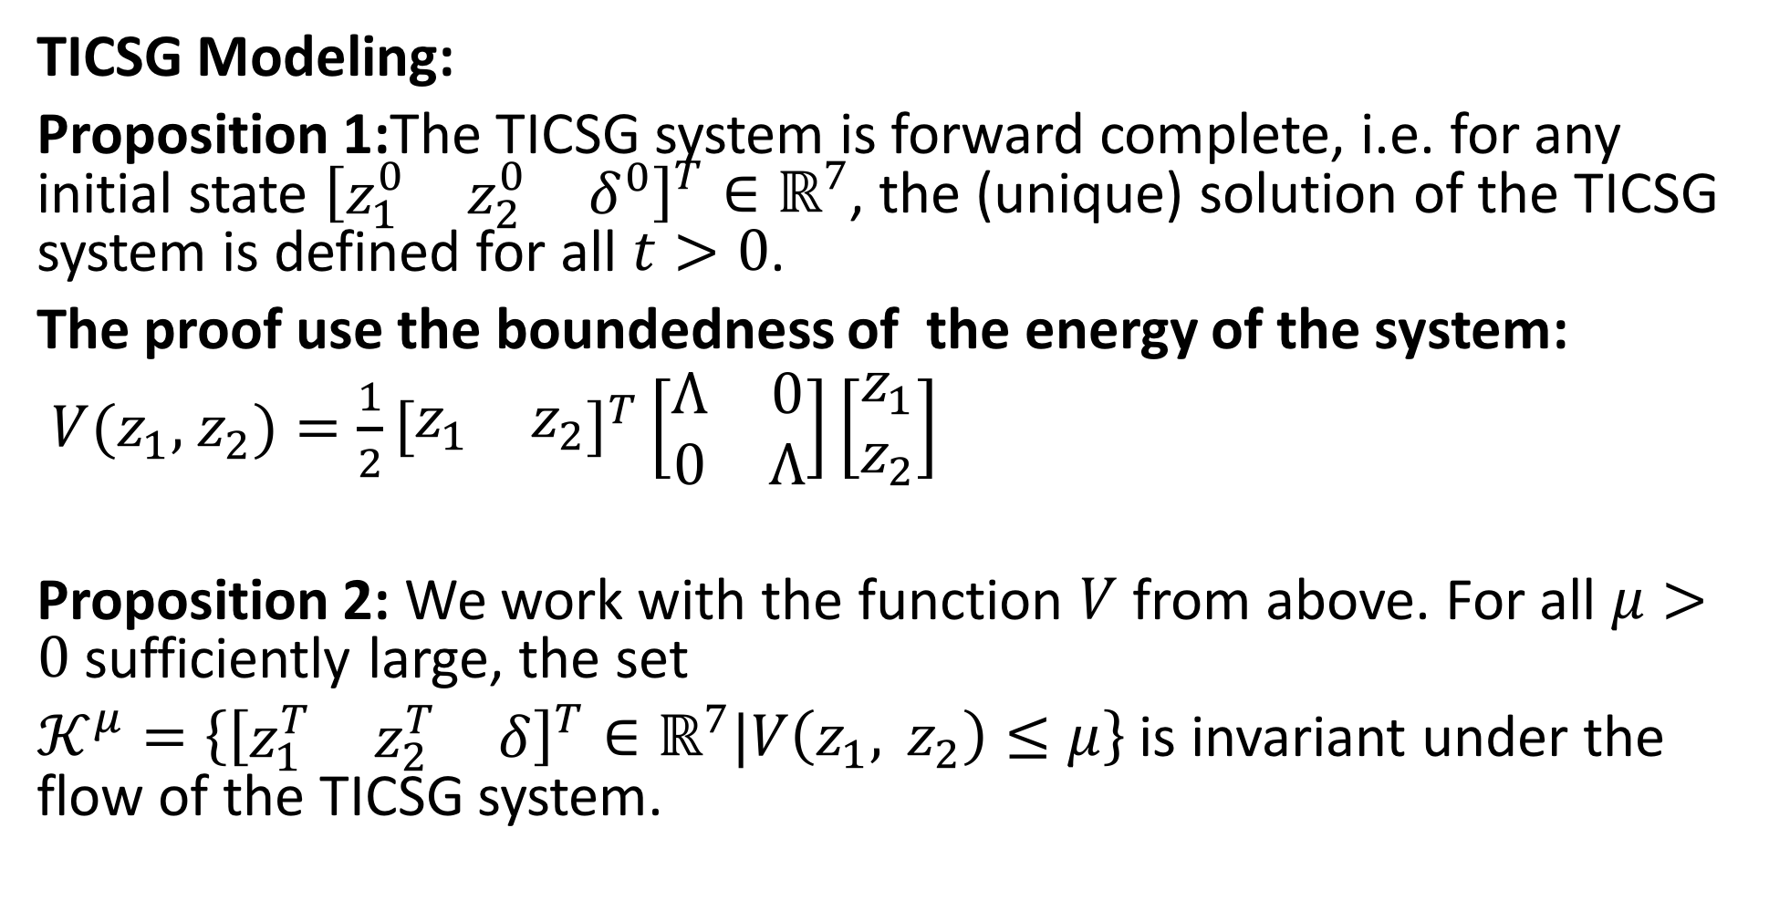
TICSG Modeling:
Proposition 1:The TICSG system is forward complete, i.e. for any initial state ${\left[\begin{matrix}z_{1}^{0} & z_{2}^{0} & δ^{0}\end{matrix}\right]}^{T}∈ℝ^{7}$, the (unique) solution of the TICSG system is defined for all $t>0$.
The proof use the boundedness of the energy of the system:
$V(z_{1},$ $z_{2})=\frac{1}{2}{\left[\begin{matrix}z_{1} & z_{2}\end{matrix}\right]}^{T}\left[\begin{matrix}Λ & 0 \\ 0 & Λ\end{matrix}\right]\left[\begin{matrix}z_{1} \\ z_{2}\end{matrix}\right]$
Proposition 2: We work with the function $V$ from above. For all $μ>0$ sufficiently large, the set
$𝒦^{μ}=\left\{{\left[\begin{matrix}z_{1}^{T} & z_{2}^{T} & δ\end{matrix}\right]}^{T}∈ℝ^{7}\text{|}V\left(z_{1}, z_{2}\right)≤μ\right\}$ is invariant under the flow of the TICSG system.

Slide 22






Sketch of the proof:
$V(z_{1},$ $z_{2})=\frac{1}{2}{\left[\begin{matrix}z_{1} & z_{2}\end{matrix}\right]}^{T}\left[\begin{matrix}Λ & 0 \\ 0 & Λ\end{matrix}\right]\left[\begin{matrix}z_{1} \\ z_{2}\end{matrix}\right]$
$\dot{V}≤E(z_{1},$ $z_{2})=−D_{p}\left(ω_{1}^{2}+ω_{2}^{2}\right)+T_{m}\left(ω_{1}+ω_{2}\right)−w_{min}{\left|\vec{i}\right|}^{2}$
$K_{+}=\left\{(z_{1}, z_{2})\}∈ℝ^{6}\text{|}E \left(z_{1}, z_{2}\right)≥0\right\}$
$μ_{0}=max⁡\{V(z_{1}, z_{2})|\left(z_{1}, z_{2}\right)∈𝒦_{+}\}$
$$μ_{0}$$
$$\dot{V}<0$$
$$K_{+}$$
$${V=μ}_{0}$$
$$V=μ$$

Slide 23
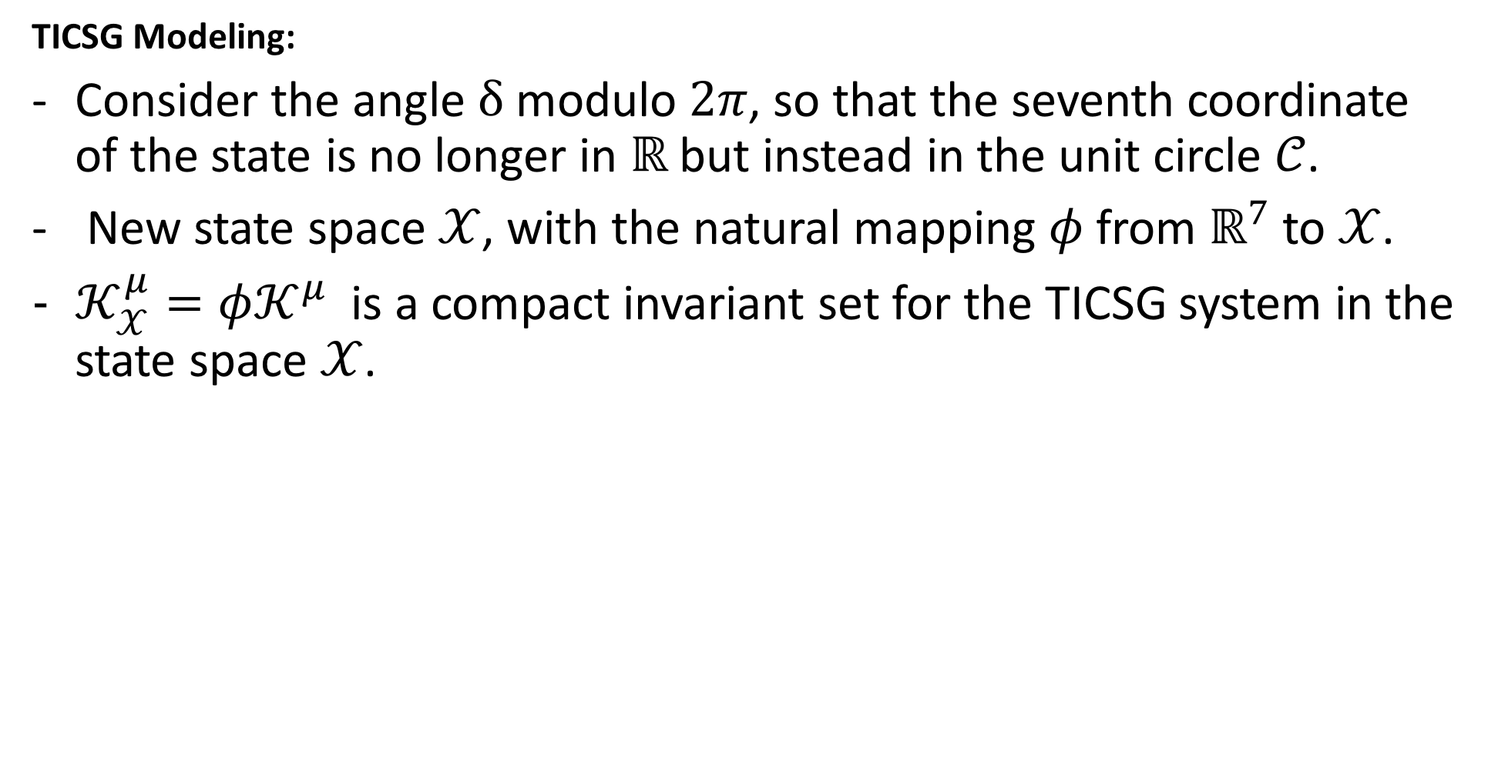
TICSG Modeling:
Consider the angle $δ$ modulo $2π$, so that the seventh coordinate of the state is no longer in $ℝ$but instead in the unit circle $𝒞$.
New state space $𝒳$, with the natural mapping $φ$ from $ℝ^{7}$ to $𝒳$.
$𝒦_{𝒳}^{μ}=φ𝒦^{μ}$ is a compact invariant set for the TICSG system in the state space $𝒳$.

Slide 24
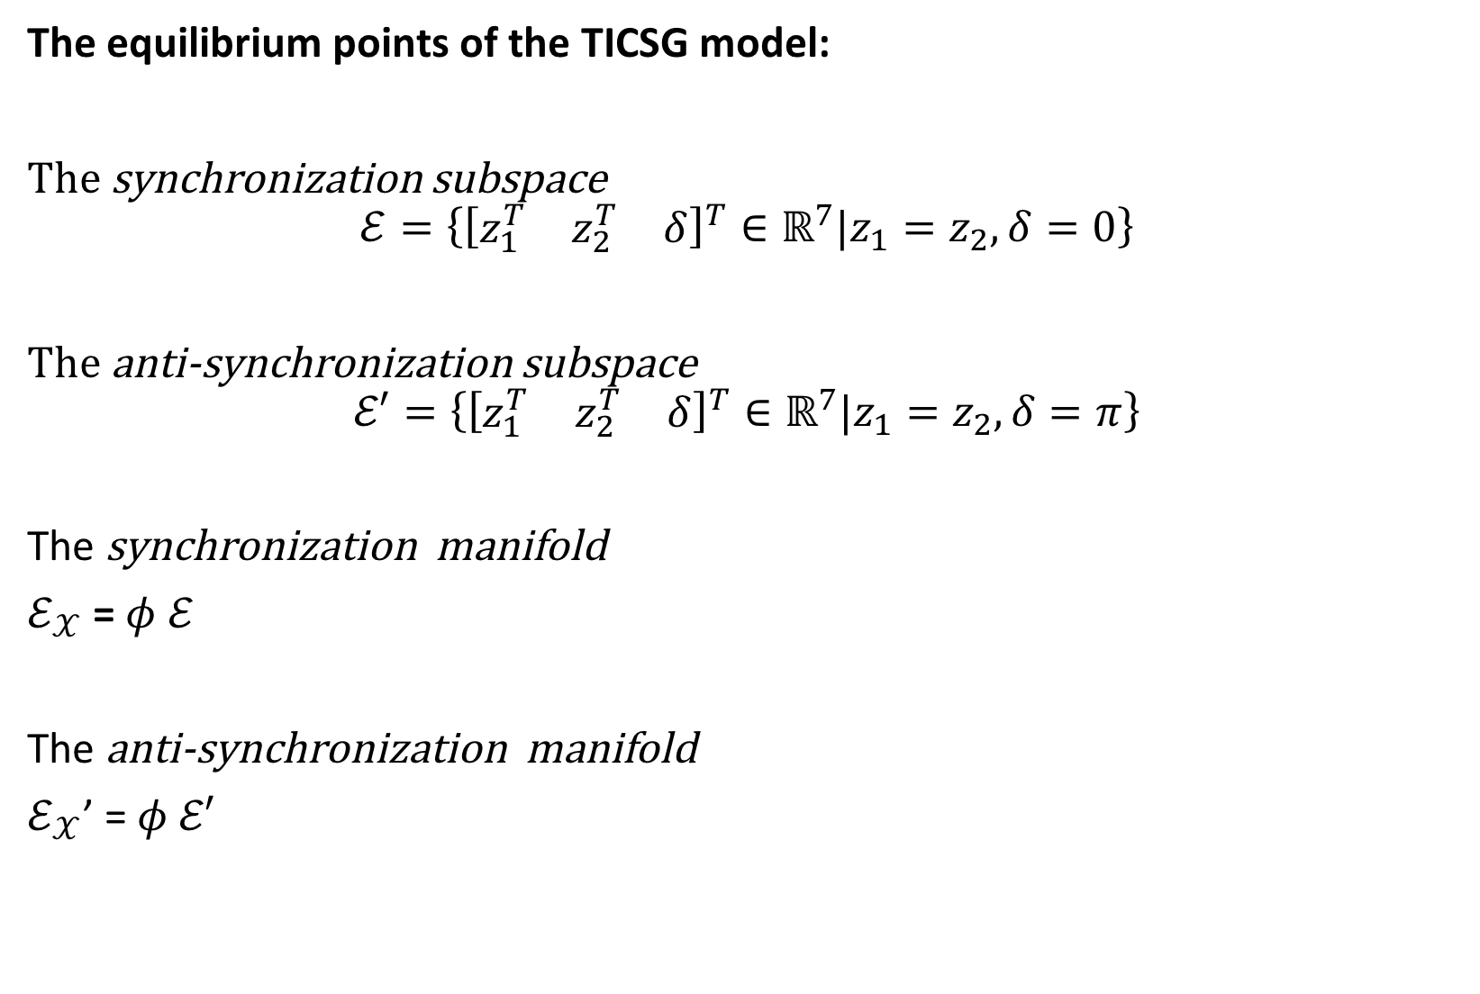
The equilibrium points of the TICSG model:
The synchronization subspace
$$ℰ=\left\{{\left[\begin{matrix}z_{1}^{T} & z_{2}^{T} & δ\end{matrix}\right]}^{T}∈ℝ^{7}\text{|}z_{1}=z_{2}, δ=0\right\}$$
The anti-synchronization subspace
$$ℰ′=\left\{{\left[\begin{matrix}z_{1}^{T} & z_{2}^{T} & δ\end{matrix}\right]}^{T}∈ℝ^{7}\text{|}z_{1}=z_{2}, δ=π\right\}$$
The synchronization manifold
$ℰ_{𝒳}$ = $φ$ $ℰ$
The anti-synchronization manifold
$ℰ_{𝒳}$’ = $φ$ $ℰ′$

Slide 25
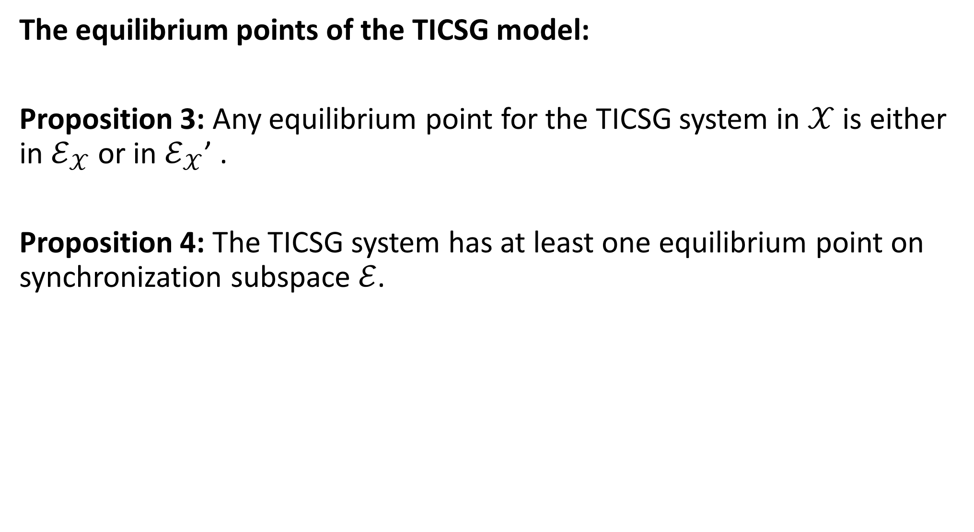
The equilibrium points of the TICSG model:
Proposition 3: Any equilibrium point for the TICSG system in $𝒳$ is either in $ℰ_{𝒳}$ or in $ℰ_{𝒳}$’ .
Proposition 4: The TICSG system has at least one equilibrium point on synchronization subspace $ℰ$.

Slide 26

The stability of the TICSG system:
The TICSG system:
$$\tilde{Λ}\left[\begin{matrix}{\dot{z}}_{1} \\ {\dot{z}}_{2} \\ \dot{δ}\end{matrix}\right]=f\left(z_{1},z_{2},δ\right)$$
It can be rewritten as:
$$\dot{e}=F\left(e,x\right), \dot{x}=G\left(e,x\right)$$
$e=\left[\begin{matrix}z_{2}−z_{1} \\ δ\end{matrix}\right]$ $x=z_{1}+z_{2}$

Slide 27
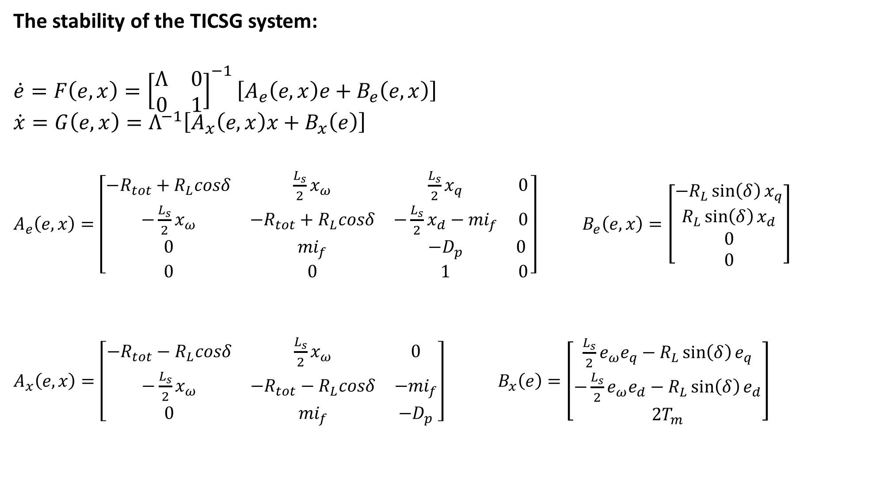
The stability of the TICSG system:
$$\dot{e}=F\left(e,x\right)={\left[\begin{matrix}Λ & 0 \\ 0 & 1\end{matrix}\right]}^{−1}\left[A_{e}\left(e,x\right)e+B_{e}\left(e,x\right)\right]$$
$$\dot{x}=G\left(e,x\right)=Λ^{−1}\left[A_{x}\left(e,x\right)x+B_{x}\left(e\right)\right]$$
$A_{e}\left(e,x\right)=\left[\begin{matrix}−R_{tot}+R_{L}cosδ & \frac{L_{s}}{2}x_{ω} & \frac{L_{s}}{2}x_{q} & 0 \\ −\frac{L_{s}}{2}x_{ω} & −R_{tot}+R_{L}cosδ & −\frac{L_{s}}{2}x_{d}−{mi}_{f} & 0 \\ 0 & {mi}_{f} & −D_{p} & 0 \\ 0 & 0 & 1 & 0\end{matrix}\right]$ $B_{e}\left(e,x\right)=\left[\begin{matrix}−R_{L}\sin\left(δ\right)x_{q} \\ R_{L}\sin\left(δ\right)x_{d} \\ 0 \\ 0\end{matrix}\right]$
$A_{x}\left(e,x\right)=\left[\begin{matrix}−R_{tot}−R_{L}cosδ & \frac{L_{s}}{2}x_{ω} & 0 \\ −\frac{L_{s}}{2}x_{ω} & −R_{tot}−R_{L}cosδ & −{mi}_{f} \\ 0 & {mi}_{f} & −D_{p}\end{matrix}\right]$ $B_{x}\left(e\right)=\left[\begin{matrix}\frac{L_{s}}{2}e_{ω}e_{q}−R_{L}\sin\left(δ\right)e_{q} \\ −\frac{L_{s}}{2}e_{ω}e_{d}−R_{L}\sin\left(δ\right)e_{d} \\ 2T_{m}\end{matrix}\right]$

Slide 28

The stability of the TICSG system:
The synchronization subspace becomes $ℰ=\left\{\left[\begin{matrix}e \\ x\end{matrix}\right]∈ℝ^{7}\text{|}e=0\right\}$.
$F\left(e,x\right)=0$, which shows that $ℰ$ is invariant.

Slide 29
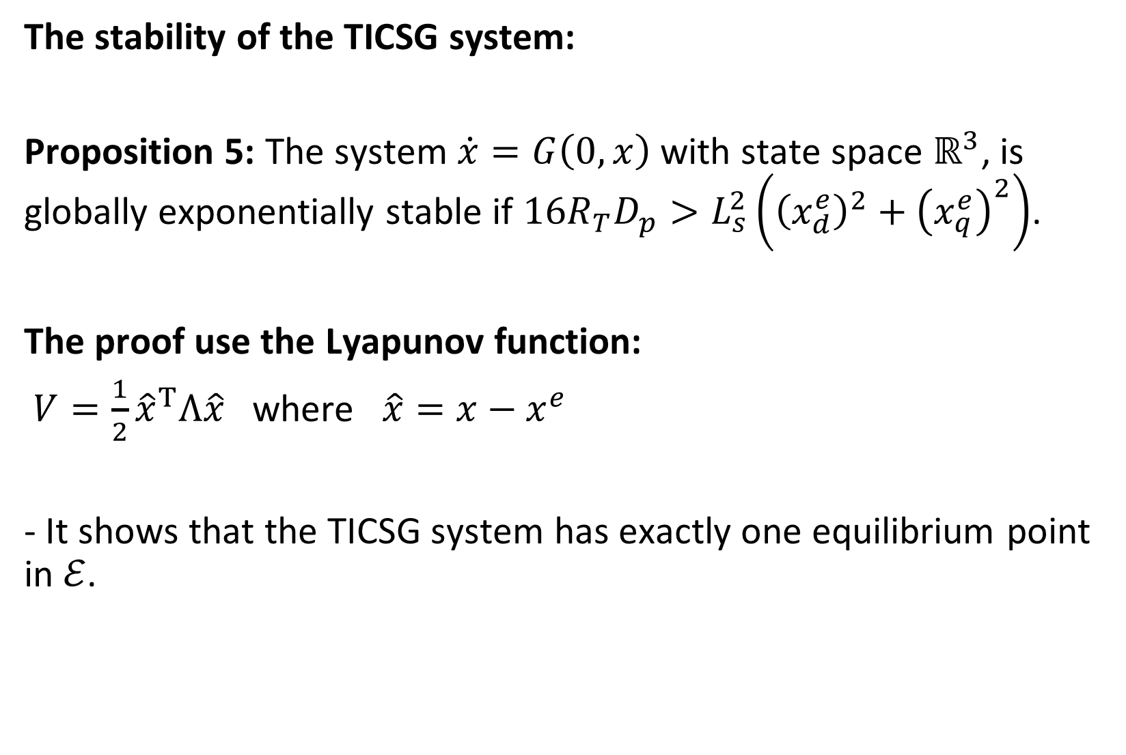
The stability of the TICSG system:
Proposition 5: The system $\dot{x}=G\left(0,x\right)$ with state space $ℝ^{3}$, is globally exponentially stable if $16R_{T}D_{p}>L_{s}^{2}\left({\left(x_{d}^{e}\right)}^{2}+{\left(x_{q}^{e}\right)}^{2}\right)$.
The proof use the Lyapunov function:
$V=\frac{1}{2}{\hat{x}}^{T}Λ\hat{x}$ where $\hat{x}=x−x^{e}$
- It shows that the TICSG system has exactly one equilibrium point in $ℰ$.

Slide 30





The stability of the TICSG system:
$e∈ℝ^{n_{e}}$, $x∈ℝ^{n_{x}}$
$𝒦$- invariant compact subset of $ℝ^{n_{e}}×ℝ^{n_{x}}$.
$$𝒦_{x}=\left\{x∈ℝ^{n_{x}}|\left(0,x\right)∈𝒦\right\}$$
$$e$$
$$𝒦$$
$$x$$
$$𝒦_{x}$$

Slide 31
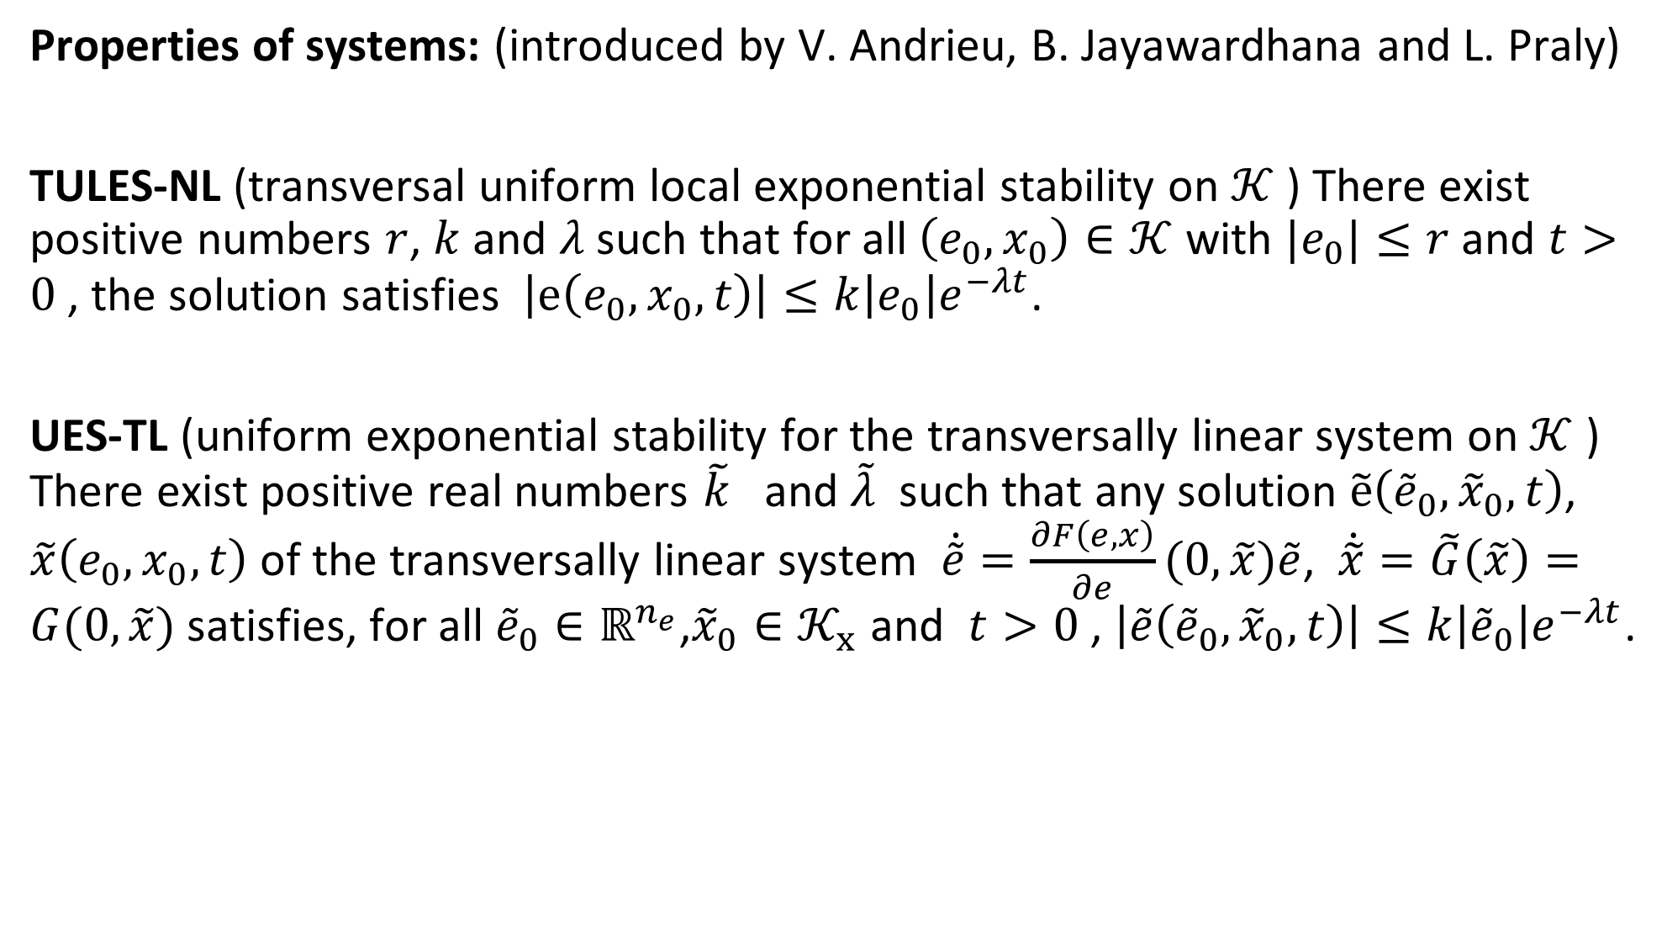
Properties of systems: (introduced by V. Andrieu, B. Jayawardhana and L. Praly)
TULES-NL (transversal uniform local exponential stability on $𝒦$ ) There exist positive numbers $r$, $k$ and $λ$ such that for all $\left(e_{0}, x_{0}\right)∈𝒦$ with ${|e}_{0}|≤r$ and $t>0$, the solution satisfies $\left|e\left(e_{0}, x_{0},t\right)\right|≤k\left|e_{0}\right|e^{−λt}$.
UES-TL (uniform exponential stability for the transversally linear system on $𝒦$ ) There exist positive real numbers $\tilde{k}$ and $\tilde{λ}$ such that any solution $\tilde{e}\left({\tilde{e}}_{0},{\tilde{x}}_{0},t\right)$, $\tilde{x}\left(e_{0}, x_{0},t\right)$ of the transversally linear system $\dot{\tilde{e}}=\frac{∂F\left(e,x\right)}{∂e}(0,\tilde{x})\tilde{e}$, $\dot{\tilde{x}}=\tilde{G}\left(\tilde{x}\right)=G(0,\tilde{x})$ satisfies, for all ${\tilde{e}}_{0}∈ℝ^{n_{e}}$,${\tilde{x}}_{0}∈𝒦_{x}$ and $t>0$, $\left|\tilde{e}\left({\tilde{e}}_{0},{\tilde{x}}_{0},t\right)\right|≤k\left|{\tilde{e}}_{0}\right|e^{−λt}$.

Slide 32
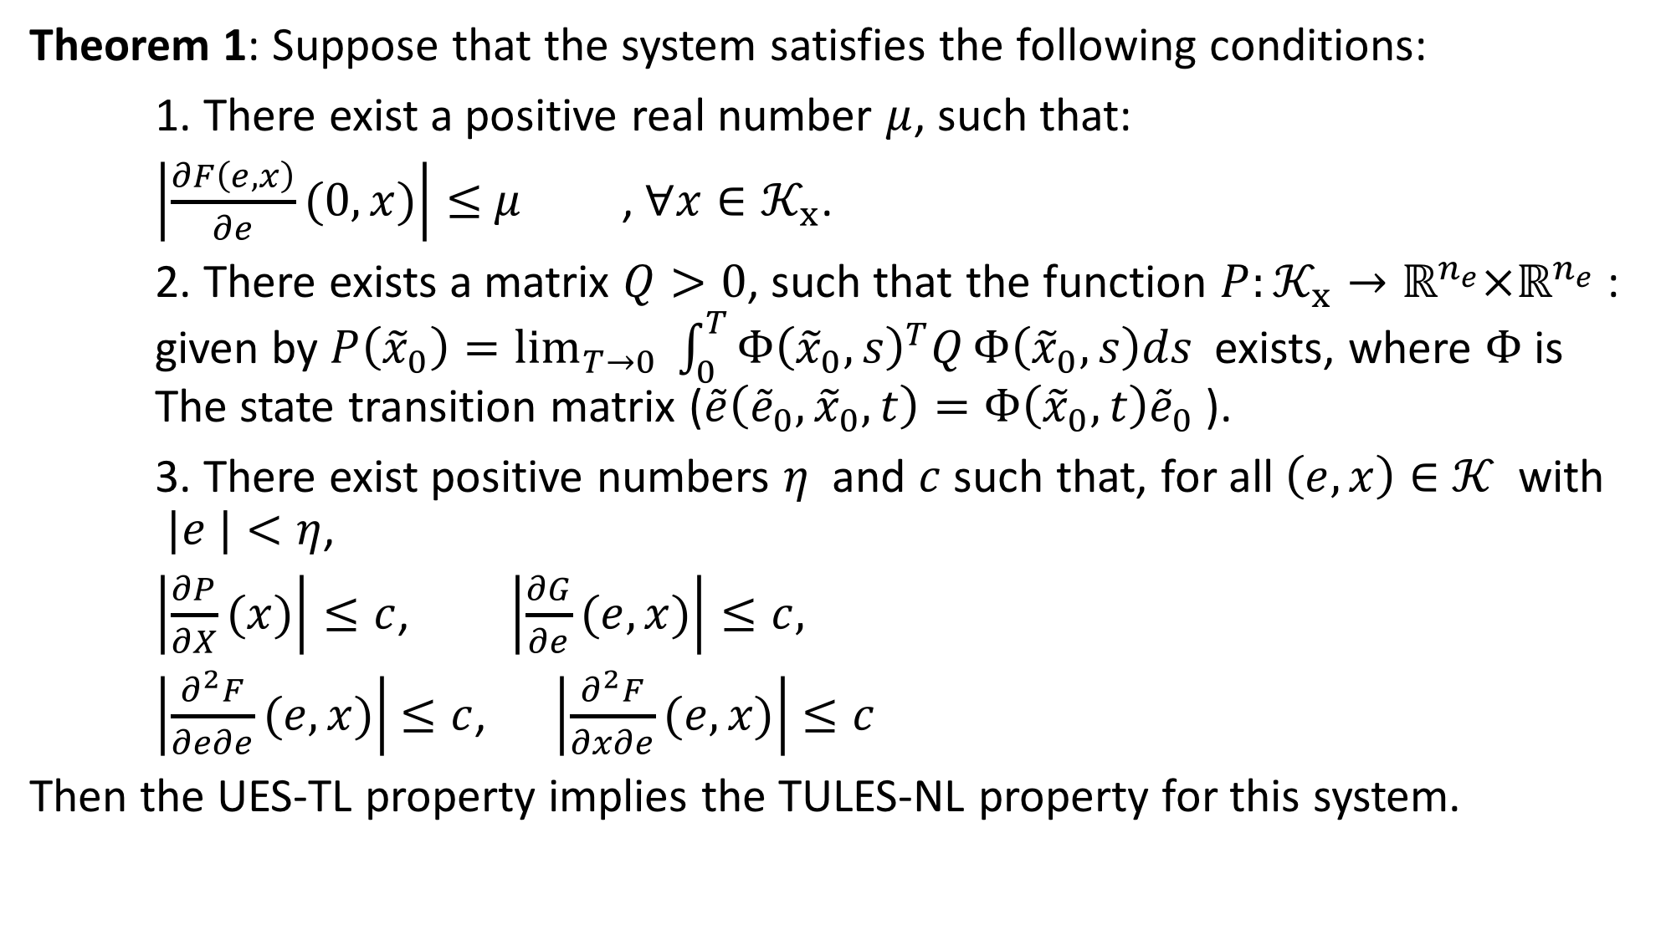
Theorem 1: Suppose that the system satisfies the following conditions:
1. There exist a positive real number $μ$, such that:
$\left|\frac{∂F\left(e,x\right)}{∂e}(0,x)\right|≤$ $μ$ , $∀x∈𝒦_{x}$.
2. There exists a matrix $Q>0$, such that the function $P:𝒦_{x}→ℝ^{n_{e}}×ℝ^{n_{e}}$ : given by $P\left({\tilde{x}}_{0}\right)=\lim_{T→0}{\int_{0}^{T}{Φ{\left({\tilde{x}}_{0},s\right)}^{T}Q}Φ\left({\tilde{x}}_{0},s\right)ds}$exists, where $Φ$ is The state transition matrix ($\tilde{e}\left({\tilde{e}}_{0},{\tilde{x}}_{0},t\right)=Φ\left({\tilde{x}}_{0},t\right){\tilde{e}}_{0}$).
3. There exist positive numbers $η$ and $c$ such that, for all $\left(e,x\right)∈$ $𝒦$ with $|e |<η$,
$\left|\frac{∂P}{∂X}(x)\right|≤c$, $\left|\frac{∂G}{∂e}(e,x)\right|≤c,$
$\left|\frac{∂^{2}F}{∂e∂e}(e,x)\right|$ $≤c$, $\left|\frac{∂^{2}F}{∂x∂e}(e,x)\right|$ $≤c$
Then the UES-TL property implies the TULES-NL property for this system.

Slide 33

Proposition 6: Suppose that system is such that $\dot{\tilde{x}}=\tilde{G}\left(\tilde{x}\right)$ is globally exponentially stable on $𝒦_{x}$, with the equilibrium point ${x^{e}∈𝒦}_{x}$. Moreover, we assume that the matrix $\frac{∂F}{∂e}(0,x^{e})$ is stable (Hurwitz). Then for every compact set $K_{x}$ contained in the interior of $𝒦_{x}$ there exists $ε>0$ such that the set
$$K\left(ε\right)=\left\{\left(e,x\right)∈ℝ^{n_{e}}×ℝ^{n_{x}}| \left|e\right|≤ε,x∈K_{k}\right\}$$
is contained in the region of attraction of the equilibrium point $(0,x^{e})$ of the system.

Slide 34







$$e$$
$$𝒦$$
$$K_{x}$$
$$x^{e}$$
$$x$$
$$𝒦_{x}$$
$$K$$
$$ε$$

Slide 35
Equilibrium point -E_x X E’ E - proposition 1 - proposition 25

Slide 36
Stability - new representation. E -proposition. - only one eq at E K - Bayu theorem - simple theorem (5.2.2) with picture. Applying bauy theorem

Slide 37
Simulations.

