Slide 1





Awazon
Basketball Wilson
Professional basketball from the Wilson company
Basketball Wilson
Professional basketball from the Wilson company
Basketball Wilson
Professional basketball from the Wilson company
Basketball Wilson
Professional basketball from the Wilson company
Yonatan’s shop
Yonatan’s shop
Yonatan’s shop
Yonatan’s shop
60$
60$
60$
60$
Buy me!
Buy me!
Buy me!
Buy me!
Basketball Wilson
Professional basketball from the Wilson company
Basketball Wilson
Professional basketball from the Wilson company
Basketball Wilson
Professional basketball from the Wilson company
Basketball Wilson
Professional basketball from the Wilson company
Yonatan’s shop
Yonatan’s shop
Yonatan’s shop
Yonatan’s shop
60$
60$
60$
60$
Buy me!
Buy me!
Buy me!
Buy me!
Notes:
צפייה בהרשאות קונה:
1.יהיה ניתן לסנן לפי קטגוריה את המוצרים
2.יהיה ניתן לבצע חיפוש חופשי לפי שם ולפי תיאור המוצר

Slide 2
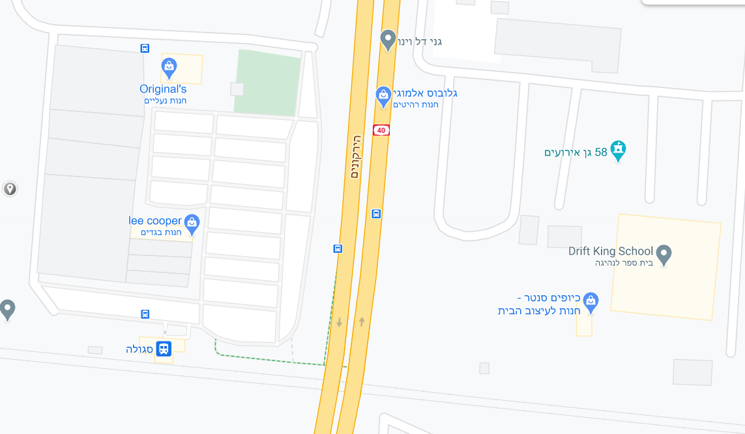

Awazon
Notes:
צפייה בהרשאות קונה:
1.שימוש קלאסי בגוגל מפס שכולל הכל
2.נדקור מיקומים ספצייפים של החנויות שלנו לפי הדיבי

Slide 3

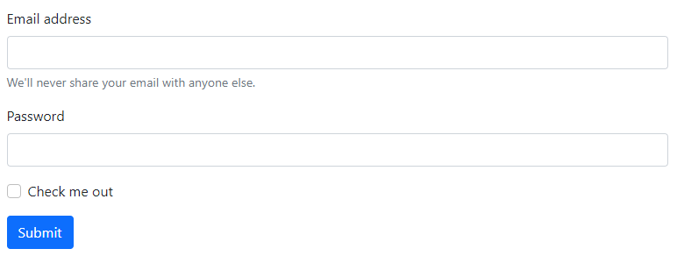

Awazon
Edit product
Basketball Wilson
Professional basketball from the Wilson company
Basketball Wilson
Professional basketball from the Wilson company
Basketball Wilson
Professional basketball from the Wilson company
Basketball Wilson
Professional basketball from the Wilson company
60$
60$
60$
60$
Delete products
Delete products
Delete products
Delete products
Basketball Wilson
Professional basketball from the Wilson company
Basketball Wilson
Professional basketball from the Wilson company
Basketball Wilson
Professional basketball from the Wilson company
Basketball Wilson
Professional basketball from the Wilson company
60$
60$
60$
60$
Delete products
Delete products
Delete products
Delete products
Notes:
צפייה בהרשאות בעל חנות:
Pop up edit product:
כותרת – Edit product
שדות:
Name: text
discription: text
price: number
Photo (optional): upload photo
Buttun: save

Slide 4
Awazon
Create new product
Basketball Wilson
Professional basketball from the Wilson company
Basketball Wilson
Professional basketball from the Wilson company
Basketball Wilson
Professional basketball from the Wilson company
Basketball Wilson
Professional basketball from the Wilson company
60$
60$
60$
60$
Delete products
Delete products
Delete products
Delete products
Basketball Wilson
Professional basketball from the Wilson company
Basketball Wilson
Professional basketball from the Wilson company
Basketball Wilson
Professional basketball from the Wilson company
Basketball Wilson
Professional basketball from the Wilson company
60$
60$
60$
60$
Delete products
Delete products
Delete products
Delete products
Notes:
Pop up new product:
כותרת – Create new product
שדות:
Name: text
discription: text
price: number
Photo (optional): upload photo
Buttun: create!

Slide 5
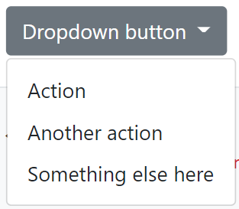


Awazon
אופציה לבחירת חנות – תעדכן את השאילתות להיות לפי הגרפים
Notes:
צפייה בהרשאות מנהל מערכת:
1.דרופ דאון שניתן להחליף חנות ויעדכן את הגרפים
2.גרף 1 כמות מוצרים לפי קטגוריה בחנות
3.גרף 2 כמות הרכישות לפי מוצר בחנות

Slide 6
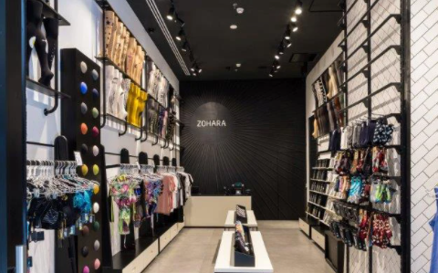
Awazon
Yonatan’s shop
King Salomon 6, Tel Aviv
Yonatan’s shop
King Salomon 6, Tel Aviv
Yonatan’s shop
King Salomon 6, Tel Aviv
Yonatan’s shop
King Salomon 6, Tel Aviv
0546938577
0546938577
0546938577
0546938577
Owner – Yonatan Kliger
Owner – Yonatan Kliger
Owner – Yonatan Kliger
Owner – Yonatan Kliger
Delete store
Delete store
Delete store
Delete store
Yonatan’s shop
King Salomon 6, Tel Aviv
Yonatan’s shop
King Salomon 6, Tel Aviv
Yonatan’s shop
King Salomon 6, Tel Aviv
Yonatan’s shop
King Salomon 6, Tel Aviv
0546938577
0546938577
0546938577
0546938577
Owner – Yonatan Kliger
Owner – Yonatan Kliger
Owner – Yonatan Kliger
Owner – Yonatan Kliger
Delete store
Delete store
Delete store
Delete store
Notes:
צפייה בהרשאות מנהל מערכת:
1.צפייה בחנויות עם יכולת למחיקת חנות
2.יכולת להוסיף חנות עם פופאפ

Slide 7
Awazon
Create new shop
Yonatan’s shop
King Salomon 6, Tel Aviv
Yonatan’s shop
King Salomon 6, Tel Aviv
Yonatan’s shop
King Salomon 6, Tel Aviv
Yonatan’s shop
King Salomon 6, Tel Aviv
0546938577
0546938577
0546938577
0546938577
Owner – Yonatan Kliger
Owner – Yonatan Kliger
Owner – Yonatan Kliger
Owner – Yonatan Kliger
Delete store
Delete store
Delete store
Delete store
Yonatan’s shop
King Salomon 6, Tel Aviv
Yonatan’s shop
King Salomon 6, Tel Aviv
Yonatan’s shop
King Salomon 6, Tel Aviv
Yonatan’s shop
King Salomon 6, Tel Aviv
0546938577
0546938577
0546938577
0546938577
Owner – Yonatan Kliger
Owner – Yonatan Kliger
Owner – Yonatan Kliger
Owner – Yonatan Kliger
Delete store
Delete store
Delete store
Delete store
Notes:
Pop up:
כותרת – Create new shop
שדות:
Name: text
City: text
Address: text
Owner: text
Phone: text
Photo (optional): upload photo

