Slide 1

CAS FEE 2016 – Project 2
Disease Diary

Slide 2
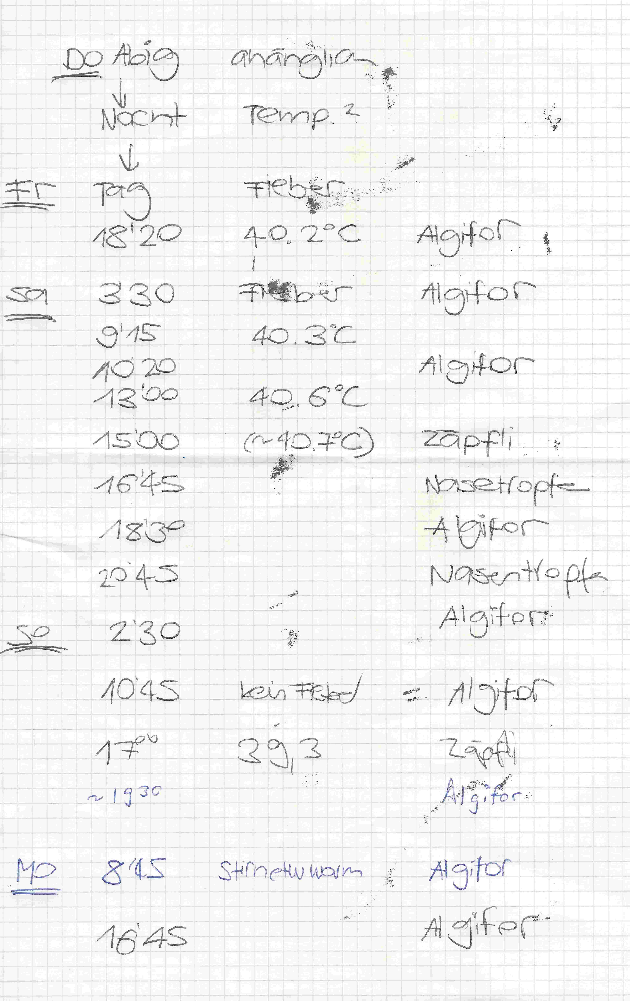
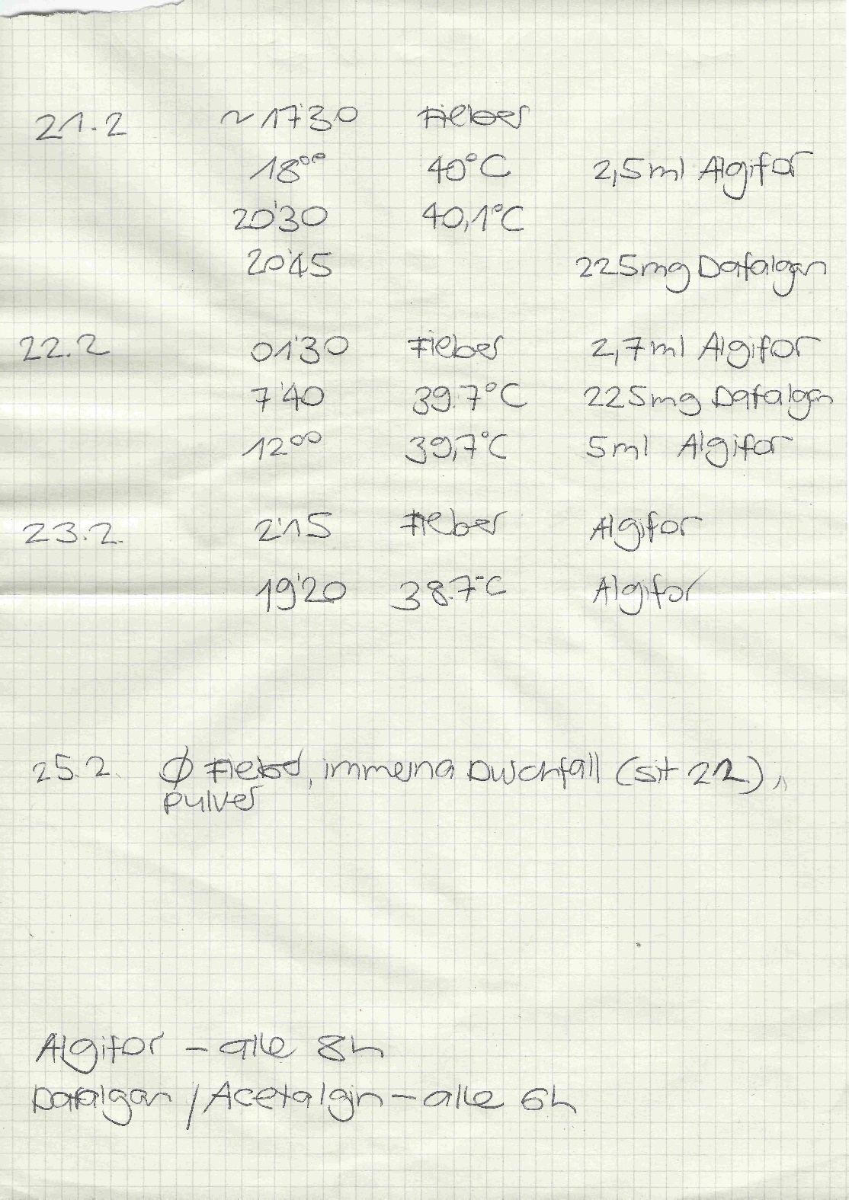
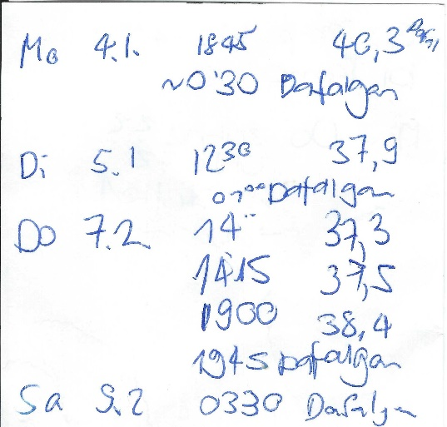
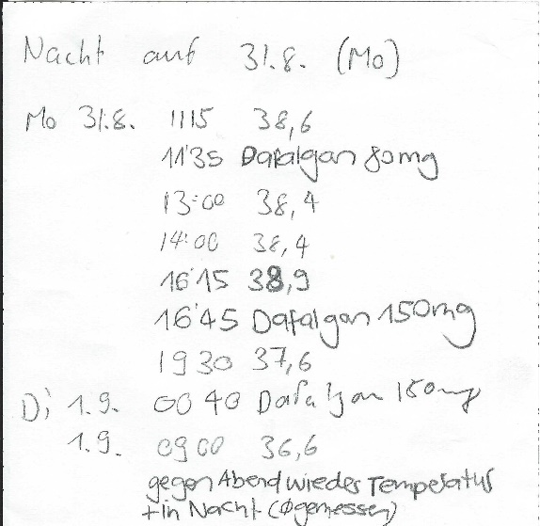
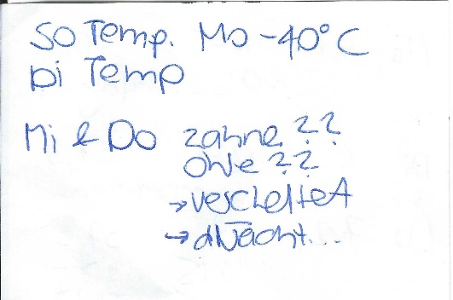
Ausgangslage

Slide 3
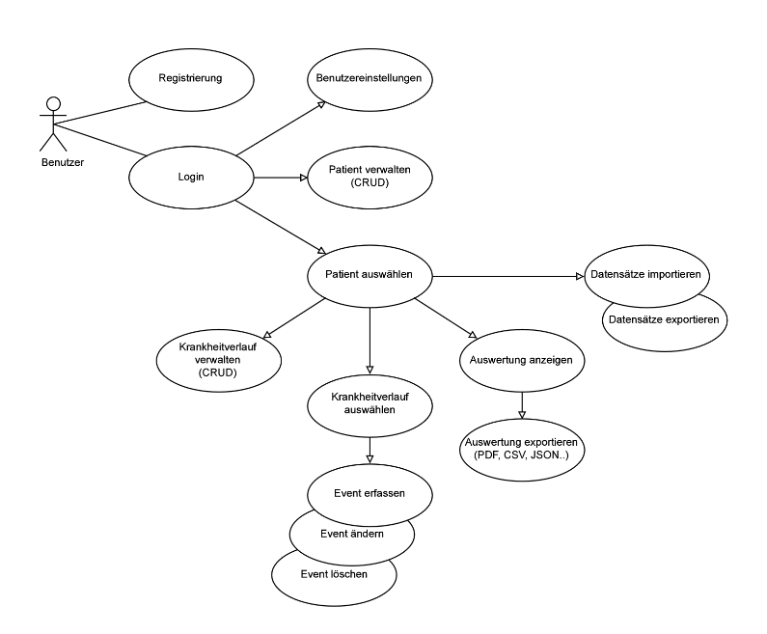
use cases

Slide 4
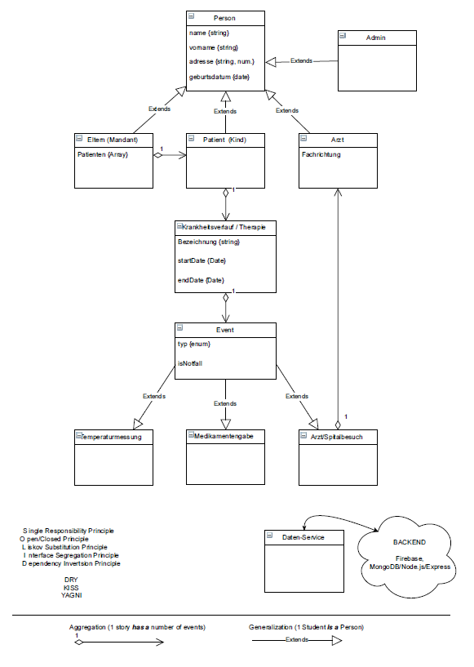
class diagram

Slide 5

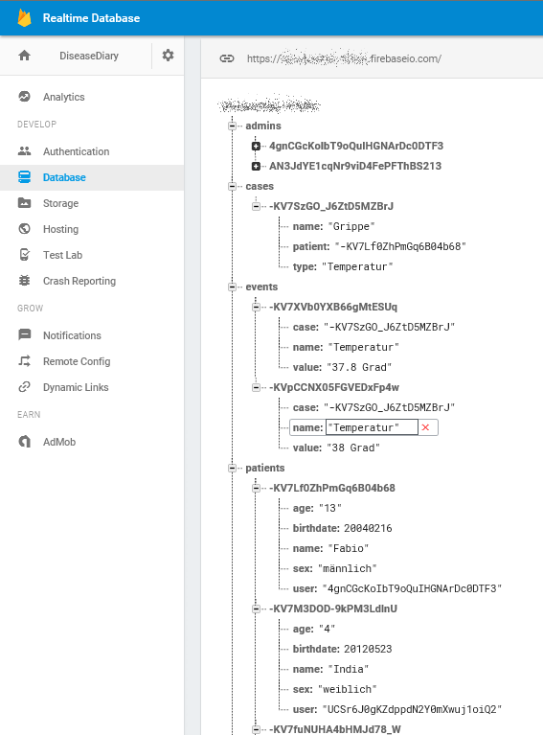
data structure
Backend as a Service von Google
Realtime NoSQL-Database
Authentication: Basic, OAuth
Firebase SDK -> Angularfire2: Realtime Observers and Authentication
Denormalized data structure

Slide 6
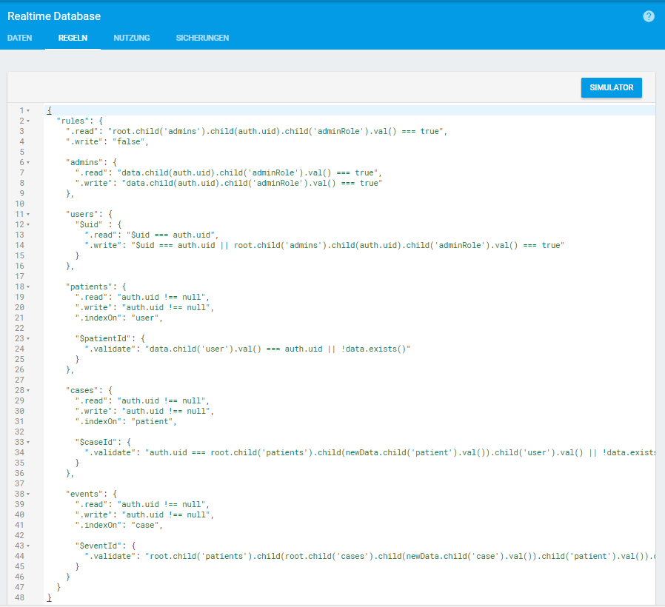
security rules
Rules pro Node
.read / .write
.validate
.indexOn
.read and .write cascade
.validate rules are AND-ed together
Rules are not filters
Predefined Variables:
now, root, auth, data, newData, $var

Slide 7
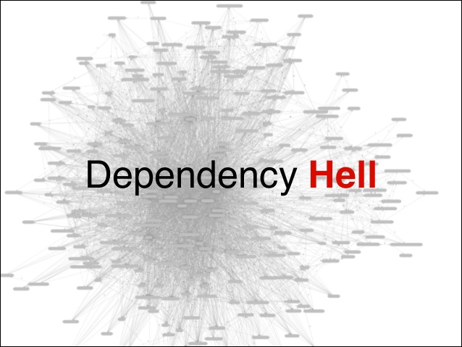

Slide 8
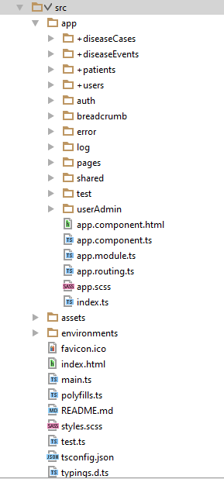
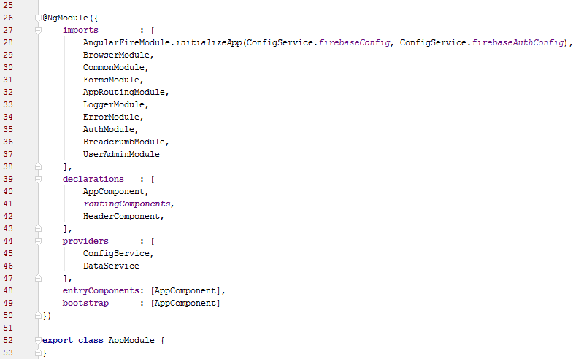
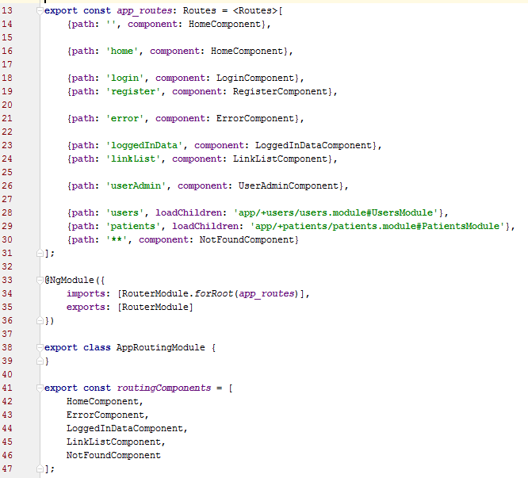

module & router #1
→ lazy loading
source

Slide 9
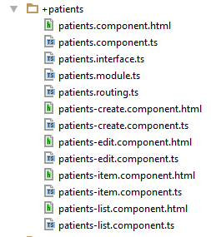
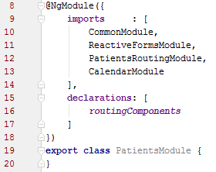
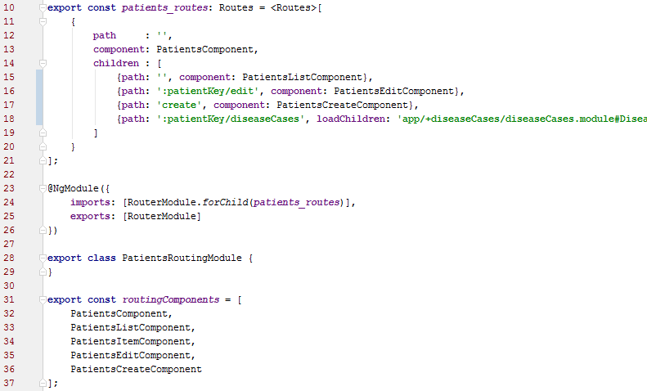
source
module & router #2
→ lazy loading

Slide 10


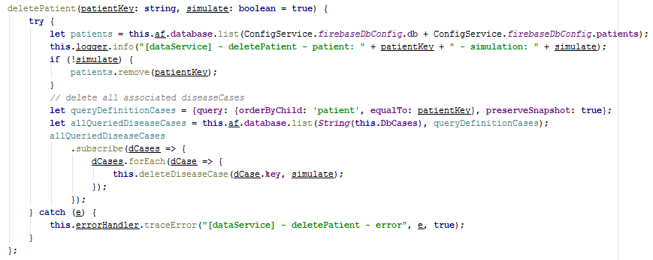
source
angularfire2 →
Firebase List - Observable
Firebase Object - Observable

Slide 11
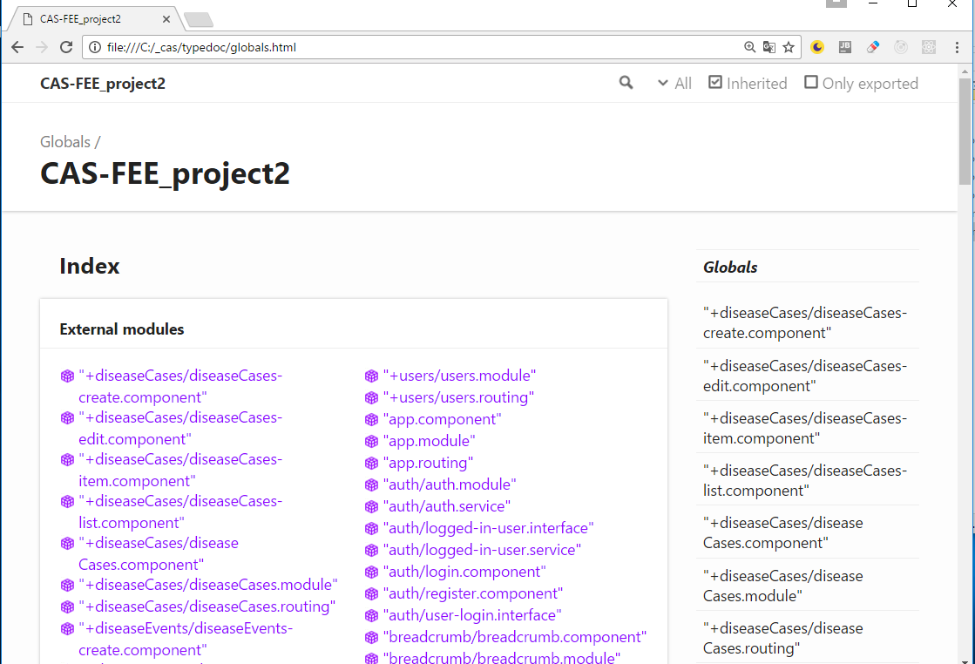

documentation

Slide 12


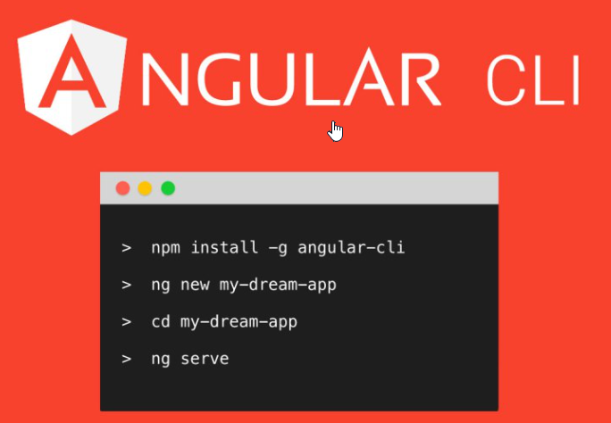




tools & methodology

Slide 13

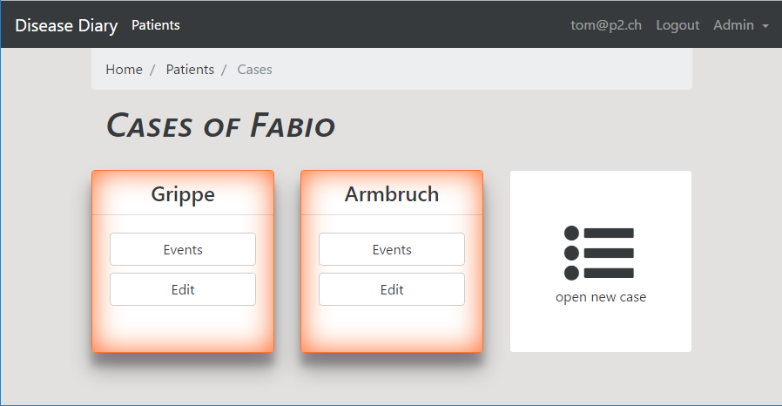
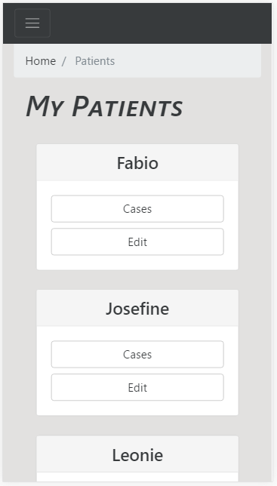
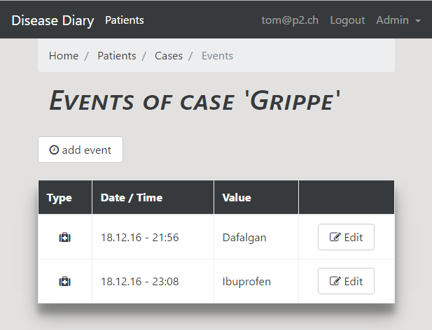
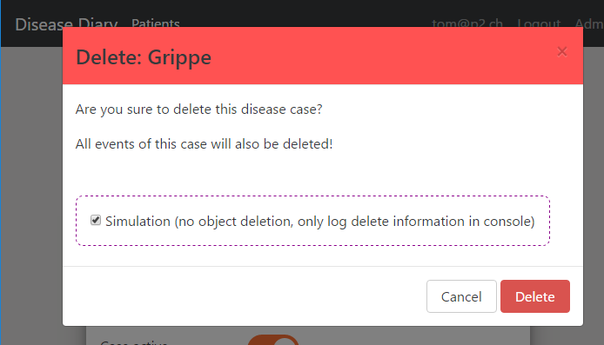
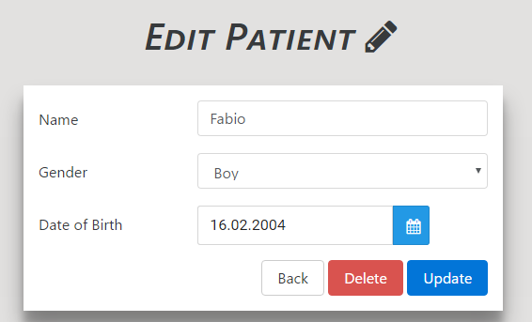
application

Slide 14


Thanks ;-)

