Slide 2
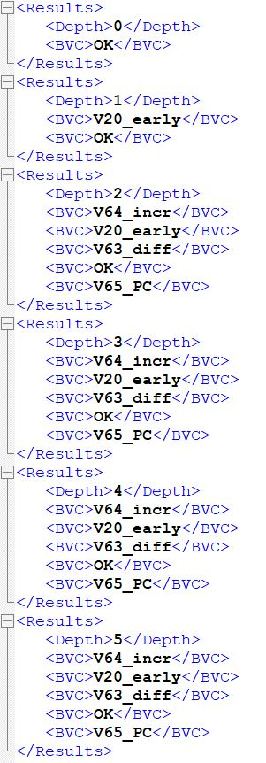
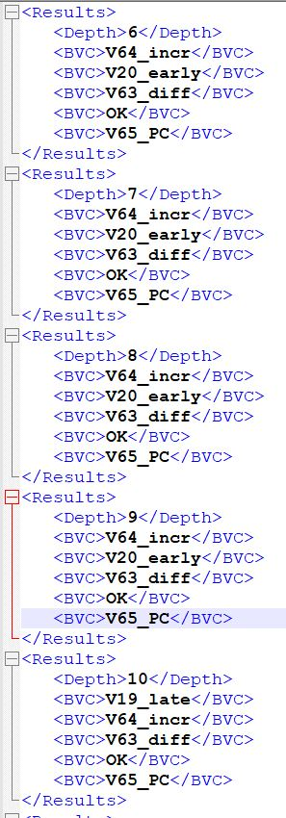
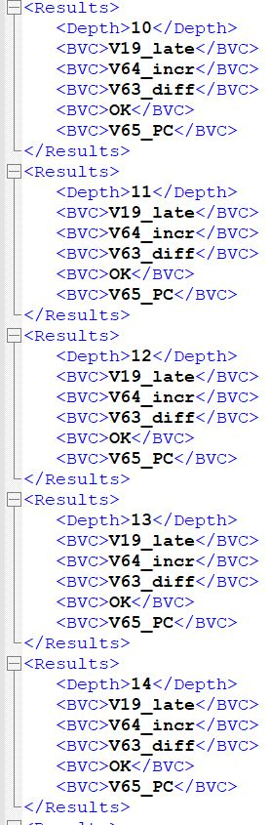

Slide 3
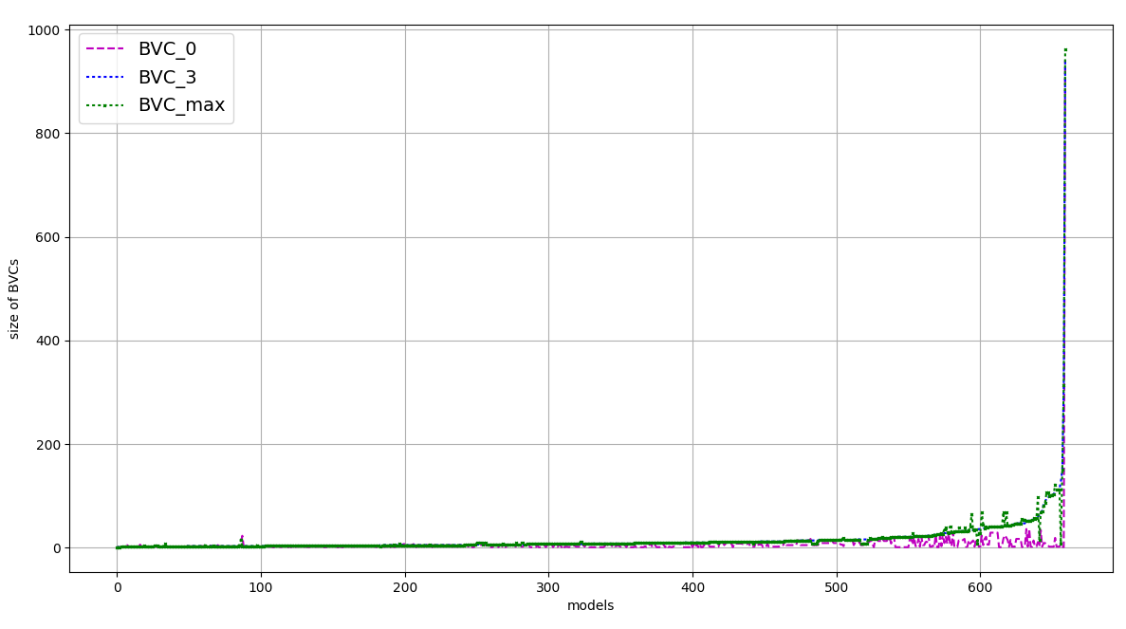
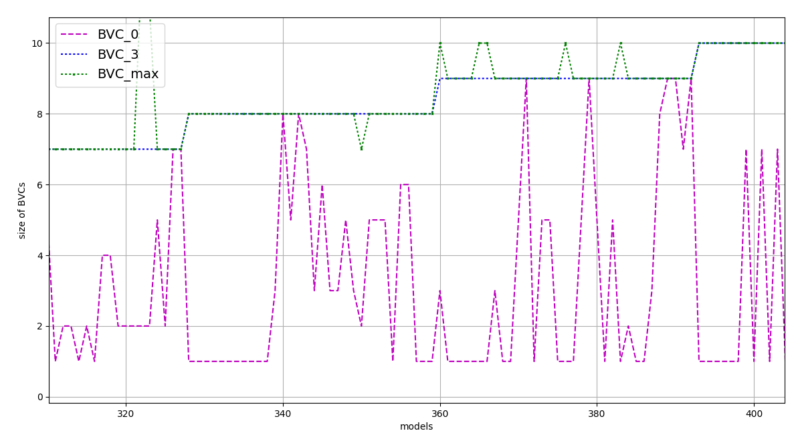
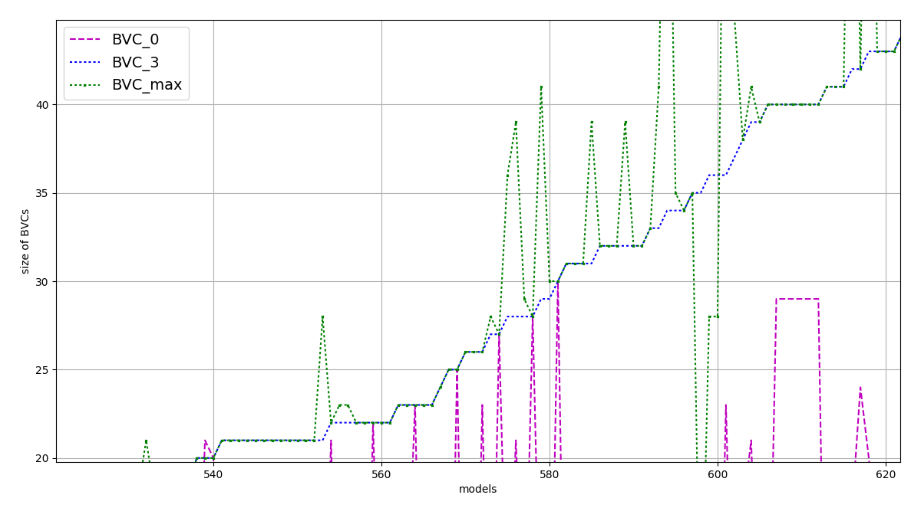
(a)
(b)
(c)

Slide 4
MIVC#2
on_p
p2
MIVC#1
one_below
p1
a2_below
doi_on
a1_below
P

Slide 5
MIVC#2
MIVC#1
below
a2_below
above_hyst
a1_below
doi_on
a1_above
a2_above
d1 d2
P = on_p

Slide 6
node asw (alt1, alt2: int) returns (doi_on: bool);
var
a1_below, a2_below, a1_above, a2_above,
one_below, both_above, on_p : bool;
let
a1_below = (alt1 < THRESHOLD);
a2_below = (alt2 < THRESHOLD);
a1_above = (alt1 >= T_HYST);
a2_above = (alt2 >= T_HYST);
one_below = a1_below or a2_below;
both_above = a1_above and a2_above;
doi_on = if one_below then true
else if both_above then false else (false -> pre(doi_on));
on_p = ((alt1 < THRESHOLD) and (alt2 < THRESHOLD)) => doi_on;
tel;
(1)
(2)
(3)
(4)
(5)
(6)
(7)
(8)

Slide 7
node asw (alt1, alt2: int) returns (doi_on: bool);
(1)
(2)
(3)
(4)
(5)
(6)
(7)
(8)

Slide 8
node asw (alt1, alt2: int; inhibit: bool)
returns (doi_on: bool);
var
a1_below, a2_below, a1_above, a2_above,
below, above_hyst, d1, d2: bool;
let
a1_below = (alt1 < THRESHOLD);
a2_below = (alt2 < THRESHOLD);
a1_above = (alt1 >= T_HYST);
a2_above = (alt2 >= T_HYST);
below = a1_below or a2_below;
above_hyst = a1_above and a2_above;
doi_on = if (below and not inhibit) then true else d1;
d1 = if (inhibit or above_hyst) then false else d2;
d2 = (false -> pre(doi_on));
tel;
(1)
(2)
(3)
(4)
(5)
(6)
(7)
(8)
(9)

Slide 9
1. read (n)
2. i := 1
3. a := 0
4. b := 1
5. while i <= n do
6. a := a + i
7. b := b - i
8. i := i + 1
9. ptint (a)
10. print (b)
1. read (n)
2. i := 1
4. b := 1
5. while i <= n do
7. b := b - i
i := i + 1
10. print (b)
backward slice for p = 10 and V = {b}
3. a := 0
6. a := a + i
9. ptint (a)
forward slice for
p = 3 and V = {a}
(a)
(b)
(c)

Slide 10
#
X
X
#
#
#
#
#
O
X
X
O
X
X
X
X
O
X
MUST element
X
X
MAY element
#
#
X
#
IRRELEVANT element

Slide 11
C
C
D
D
I
J
A
F
G
A
F
G
B
B
H
E
E
R = /\ r ∈ ∆
r1
r2
r3
(a)
(b)

Slide 12
node top( in1 : bool; in2: bool) returns (P : bool);
var
x : int; c1 : bool;
c2 : bool; c3 : bool;
r1 : bool; r2 : bool;
let
x = 0 -> if (c2 and x < 90) then (10 + pre(x))
else (pre(x) - 10);
r1 = in1;
r2 = not in1;
c1 = (r1 or r2) and in2;
c2 = if in2 then false else c1;
c3 = not c2 or c1;
P = (x < 100) or c3;
tel;
(a)
r1
r2
x
P
c3
c2
c1
(b)

Slide 13
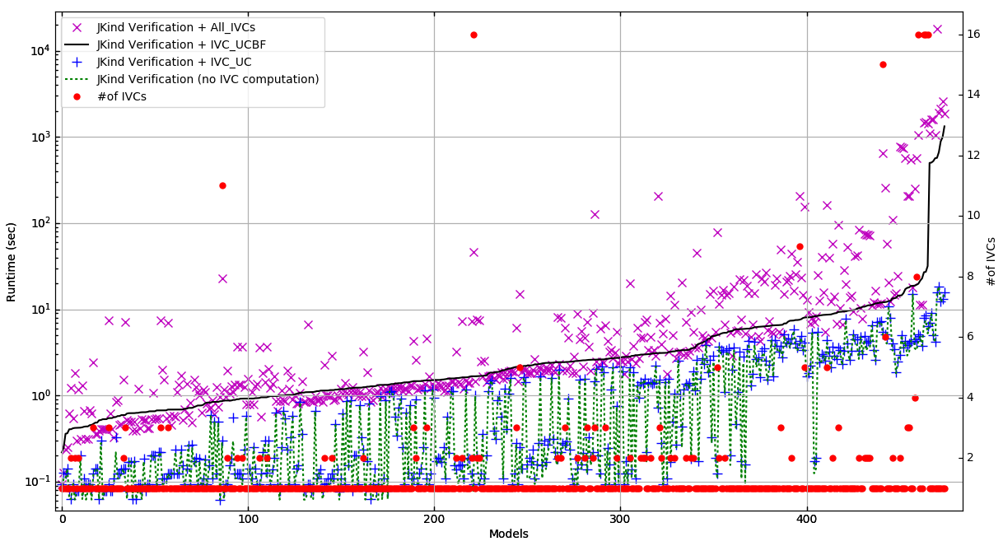
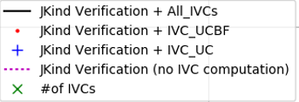
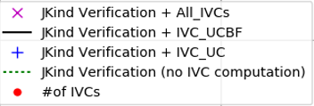
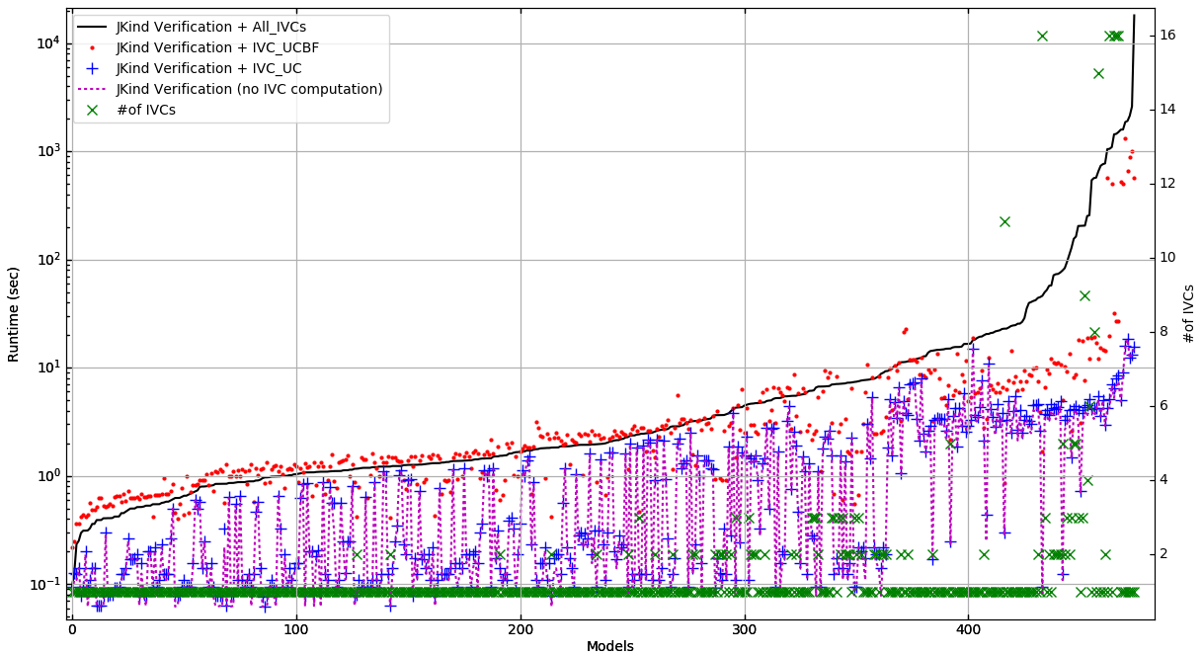
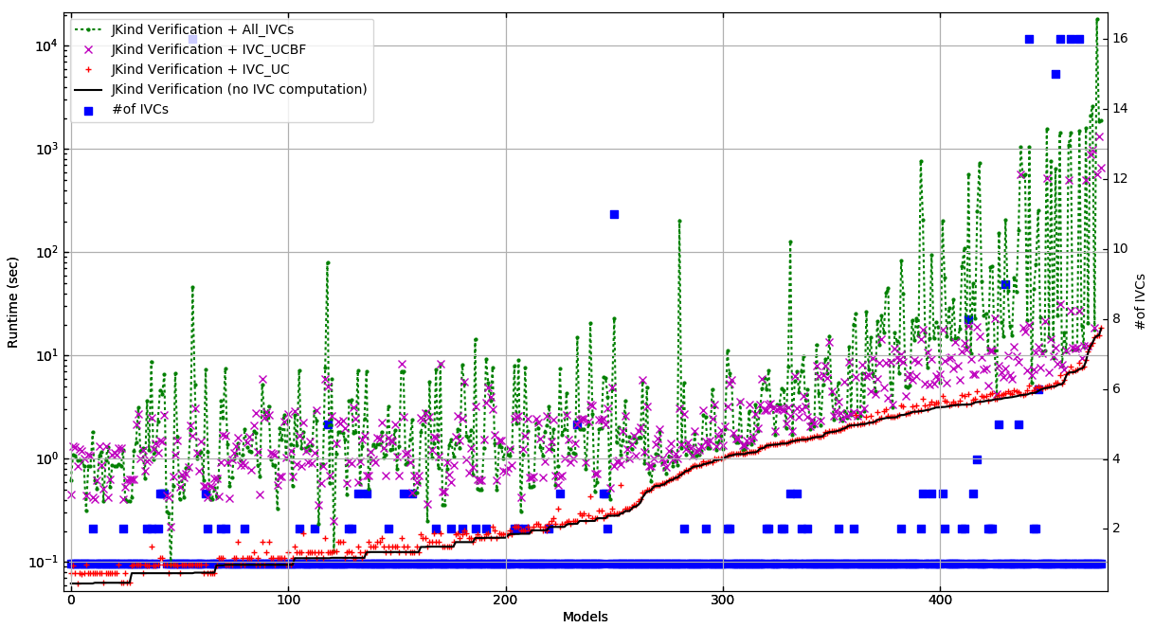
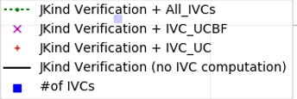
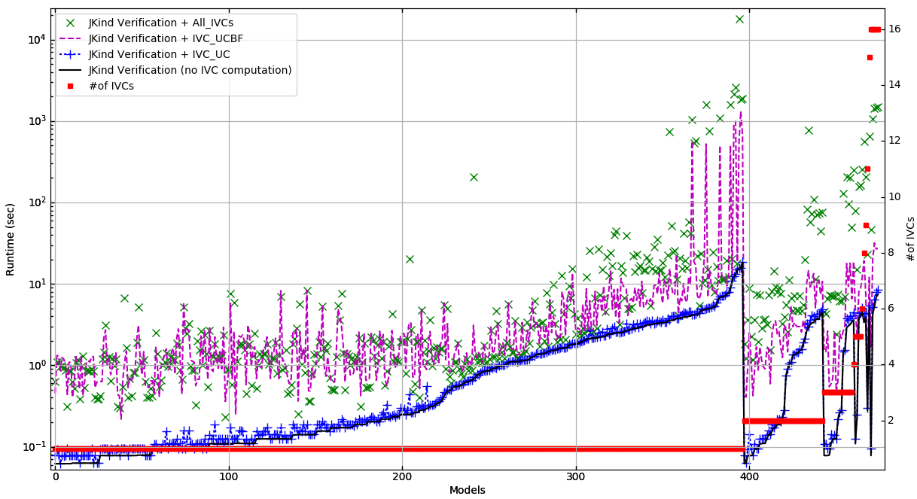
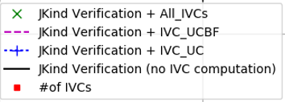
Runtime (sec)
#of IVCs
Models

Slide 14
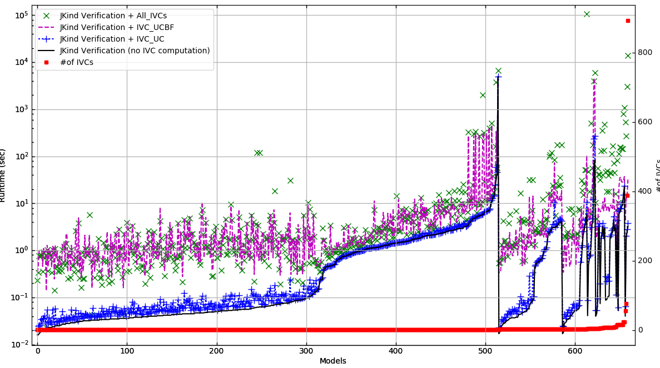
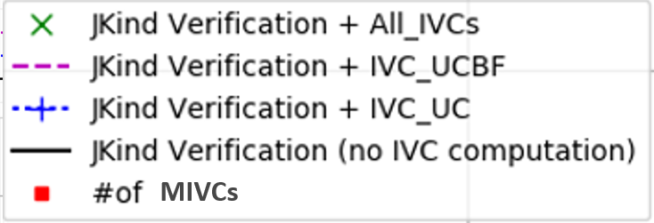
MIVCs
Runtime (sec)
#of MIVCs
Models

Slide 15
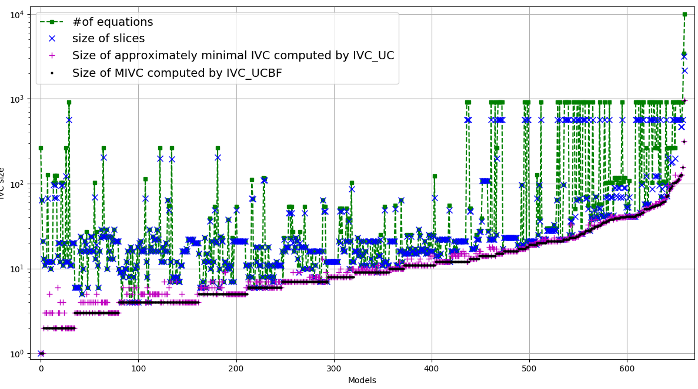
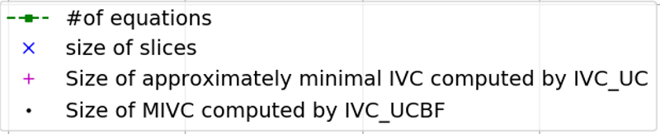
#of elements
Models

Slide 16
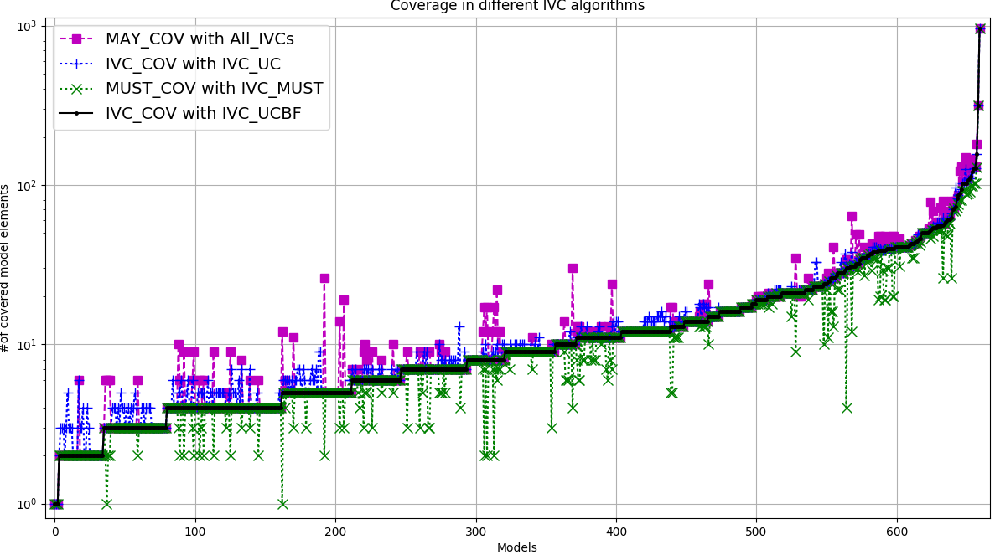
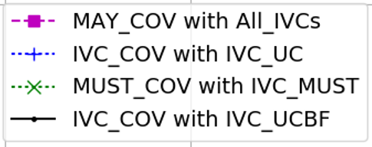
#of covered model elements
Models

Slide 17
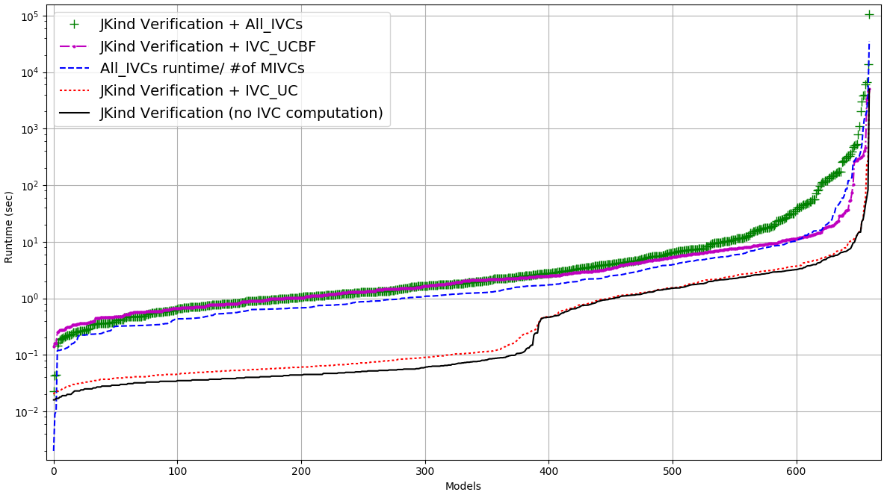
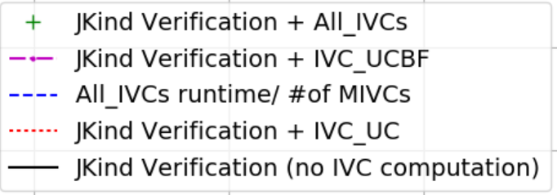
Runtime (sec)
Models

Slide 18
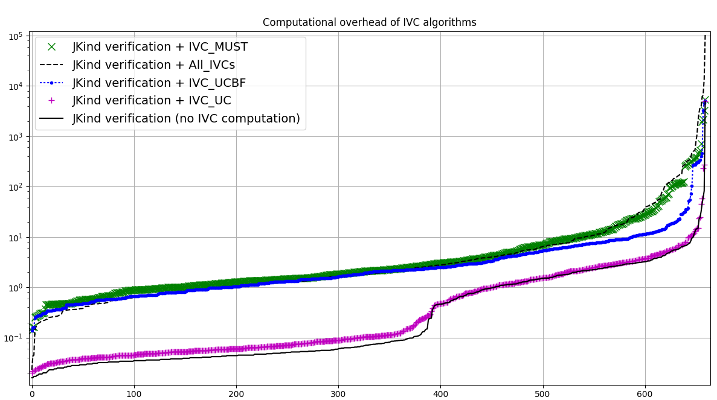
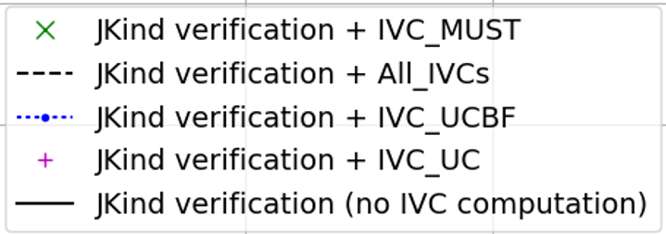
Runtime (sec)
Models

