Slide 1
Complete Traceability for Requirements in Satisfaction Arguments
Murugesan, M. W. Whalen, E. Ghassabani, and M. Heimdahl
Department of Computer Science and Engineering
University of Minnesota

Slide 2
Requirements Traceability
improve change impact assessment
“Ability to describe and follow the life of a requirement, in both forwards and backwards direction”
[O. C. Z. Gotel and C. W. Finkelstein, 1994]
Requirements
Engineering
Acceptance
Test
System
Design
System
Test
improve scope management
assess the quality of the system
Software
Architectural Design
improve test coverage & reduce test cost
Integration
Test
Component
Software Design
Unit Test
creating
assurance arguments
Code
Development
Notes:
ability to describe and follow the life of a requirement, in both forwards and backwards direction (i.e., from its origins, through its development and specification, to its subsequent deployment and use, and through all periods of on-going refinement and iteration in any of these phases).”

Slide 3
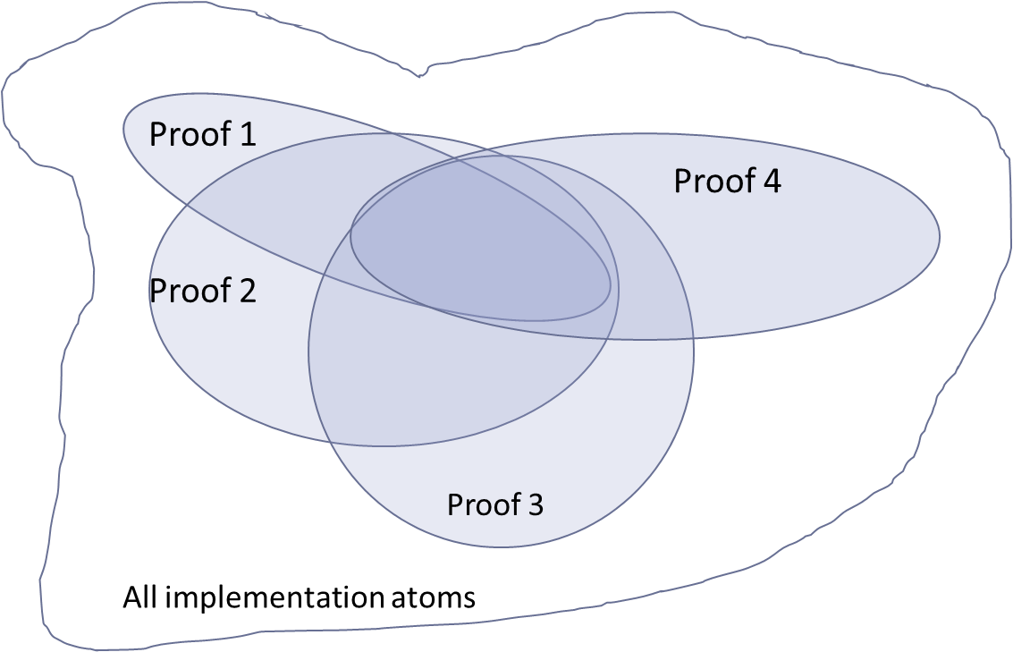
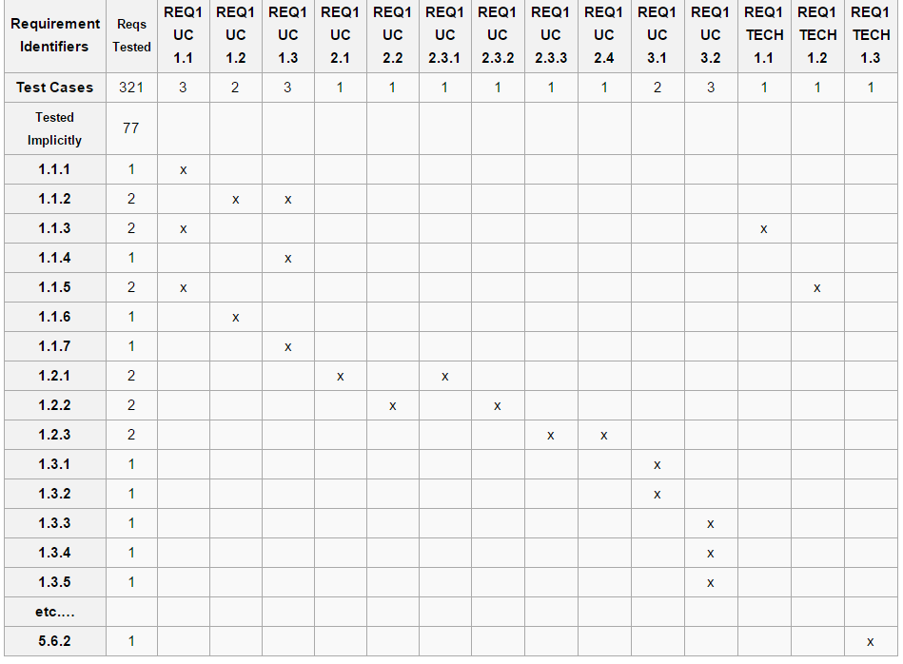
Multiplicity of Trace Relations
We often use a traceability matrix to show trace relationships between artifacts
We assume that there is only one such matrix:
Often, however, there are many equally valid matrices.
We will demonstrate this by talking about satisfaction arguments and proofs.
This observation has important effects on traceability research and regression activities.

Slide 4
Proof Diversity (Graphically)
Proof 1
Proof 4
Proof 2
Proof 3
All implementation atoms

Slide 5
Our Approach
Requirements Satisfaction Traceability
Satisfaction Arguments offer a semantically rich way to establish the trace links from each requirement to the target artifacts (instead of just recording)
a set of support for the given requirement
those parts of the system and environment that were necessary to satisfy the requirements

Slide 6
Set of Support and Trace Links
Argument ≡ a proof in which the requirement is the claim
Model
Elements:
Intermediate Lemmas:
Requirement:

Slide 7
Set of Support and Trace Links
Argument ≡ a proof in which the requirement is the claim
Model
Elements:
Dark green circles define the set of support: model claims necessary for the proof
Intermediate Lemmas:
Requirement:

Slide 8

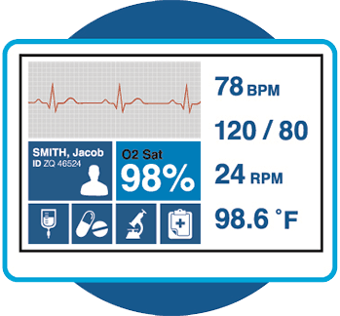
Example
3 artifacts that when working together satisfy the requirement
patient monitoring device
REQ: raise an alarm if the patient’s heart rate is lower
than 40 beats per minute
trace link is established to:
1) a heartbeat sensor
2) a LED
3) an assumption: blinking light is an alarm
implementation artifacts unnecessary for the proof:
body temperature sensor, alarm, blood sugar monitor, help request button, etc.
Notes:
For this slide, please read the motivating example we have in the paper
heartbeat sensor (measures the patient’s heartbeat and reports a hazard if it is lower than 40 beats per minute),
a LED (produces a blinking red light if the sensor reports the hazard), and
an assumption (blinking red light is an alarm and will attract attention)—
. These trace links help identify the components that are impacted by a change in the requirement and vice versa. For instance, if the device is now expected to raise an alarm if the heart rate is lower than 35 per minute (instead of 40), the trace links established helps identify that the sensor functionality needs to be changed to meet the new requirement.

Slide 9
Traceability Building Blocks
Implementation
#
A source artifact (requirement) r ∈ ∆ from which relationships should be established
The target artifacts (implementation elements) S ⊆ Σ to which the source artifact is to be associated
The trace relationship tr that describes the association between the artifacts
#
#
#
#
#
#
#
#
#
#
#
#
#
#
#
#
tr
r
We write S ⊦s r for S ⊆ Σ and r ∈ ∆ when S satisfies requirement r
#
#
#
#

Slide 10
Set of Support
Implementation
#
SOS: a minimal set of target artifacts to construct a proof
SOS maps a requirement to a set of support
#
#
#
#
#
#
#
#
#
#
#
#
SOS (r, S) ≡ S ⊦s r ∧ (¬ ∃ S0 . S0 ⊂ S ∧ S0 ⊦s r)
#
#
#
#
#
#
tr
r
#
#

Slide 11
All Sets of Support
#
there could be many SOS-es for a requirement: all sets of support (ASOS)
ASOS for a requirement is an association to all its sets of support
#
#
#
#
#
#
#
#
#
#
#
ASOS (r) ≡ { S | S ⊆ Σ ∧ (r, S) ∈ SOS }
#
#
#
#
#
The set of ASOS-es for all requirements represents complete traceability
#
#
#
#

Slide 12
Categorizing Design Artifacts
#
#
X
suppose we have a property, r, that can be proved in 3 different ways
#
#
X
#
#
#
O
MUST (r) = ⋂ ASOS (r)
#
#
O
#
#
#
X
X
O
X
#
X
MAY (r) = ( ⋃ ASOS (r)) \ MUST(r)
#
X
#
X
#
X
#
X
#
#
IRR (r) = Σ\ ( ⋃ ASOS (r))
#
#
X
#
X
Notes:
This categorization helps identify the role and relevance of each target artifact in satisfying a requirement. The MUST elements are those target artifacts that are absolutely necessary for the requirement satisfaction. Hence, any change to these elements will most likely impact on each other. On the other hand, MAY elements indicate those target artifacts that satisfy the requirement in one of the possible ways. Any change to just one of these elements will not affect the satisfaction of that requirement. The IRRELEVANT elements are never required to satisfy the requirement, so neither does a change in these artifacts affect the satisfaction of the requirement, nor does a change in the requirement necessitate a change in these elements (at least in terms of satisfaction).

Slide 13
Why should we care?
While there has been a large amount of work in the area of requirements traceability, there are NOT
any definition of what constitutes a “good” set of trace links
any well defined metrics whereby to measure the quality of set of trace links
The existing traceability literature does not discuss multiple alternative satisfaction arguments or sets of trace links for one system design
Complete traceability can assist in tailoring verification and validation in systems.

Slide 14
Implementation
Implemented in a branch of the AGREE/AADL tool suite:
allows a model-based approach to system construction in which compositional proofs are used to automatically establish satisfaction arguments.
The approach uses the JKind model checker:
symbolic model checking using induction-based techniques: IC3/PDR and k-induction.
such tools can often determine whether safety properties hold of complex finite or infinite-state systems.

Slide 15
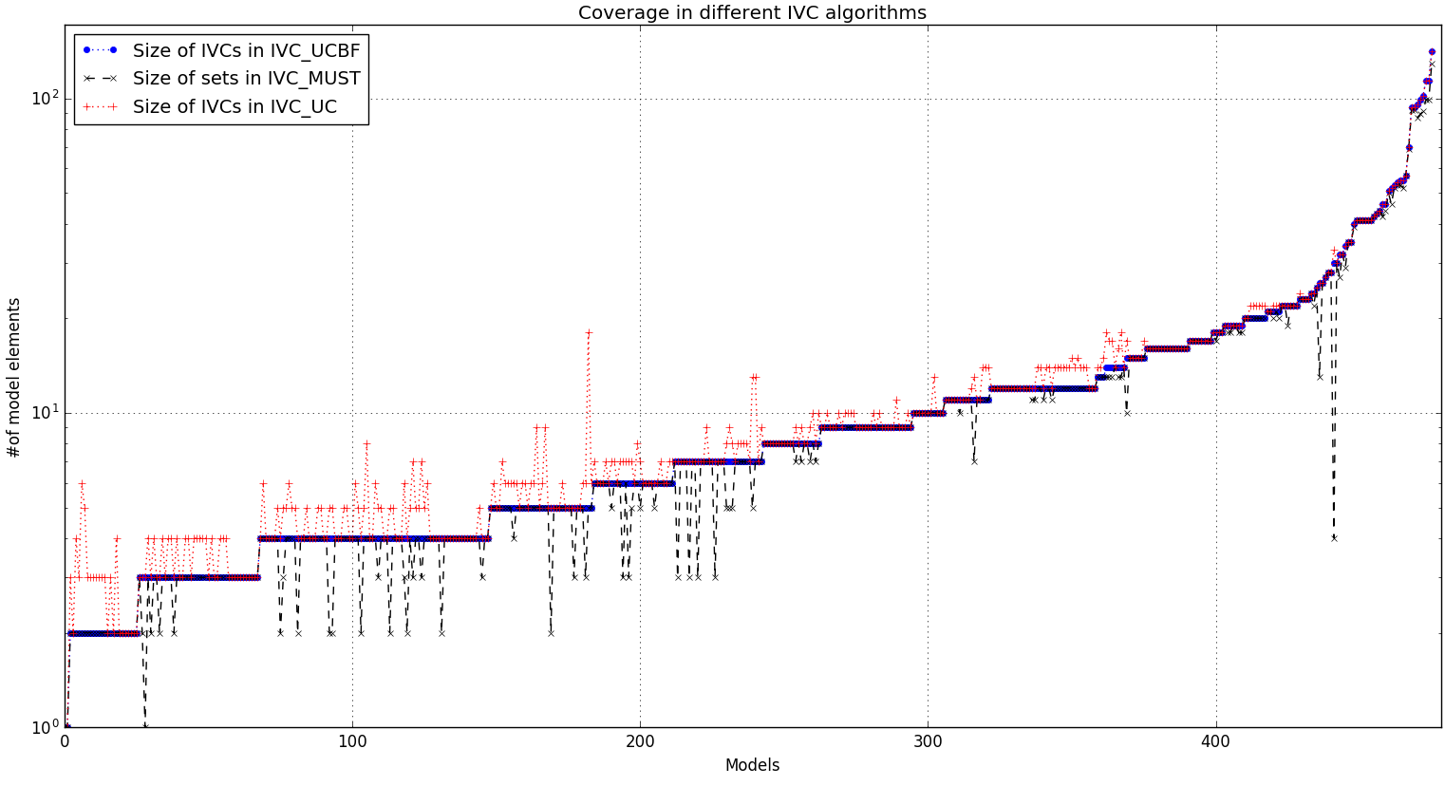
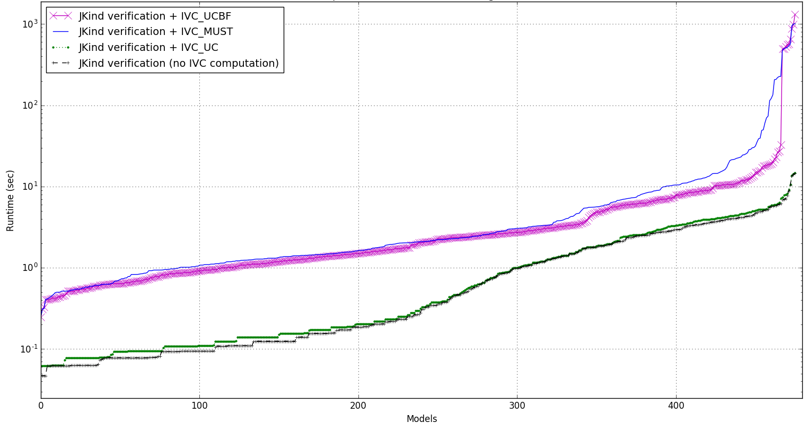
Evaluation
JKind verification + finding SOS (truly minimal ) : IVC_UC
JKind verification + finding must elements of a requirement : IVC_MUST
JKind verification + finding SOS (closely minimal ) : IVC_UCBF
JKind verification

Slide 16
Conclusions & Future work
A theoretical framework that can be used to understand and assess requirements satisfaction traceability
A complete set of trace links
the set that identifies all implementation and environment elements needed to make all satisfaction arguments.
Future work: a computational framework that allows an analyst to reason about the trace links and identify disjoint sets of support to explore the fault tolerant properties of an architectural solution.
Notes:
we define a theoretical framework that can be used to understand and assess requirements satisfaction traceability—the trace links from a requirement to its im- plementation. By defining a requirements satisfaction trace from a requirement to a set of support we have a clear definition of sufficient set of trace links—a set that identifies all implementation and environment elements needed to make one satisfaction argument. Similarly, we can discuss a complete

Slide 17


Thanks for your attention!

