Slide 1
Proof - based Coverage Metrics for Formal Verification
Elaheh Ghassabani, Andrew Gacek, Michael Whalen
University of Minnesota
Rockwell Collins Advanced Technology Center

Slide 2
Coverage
Have we specified enough properties?
specification completeness can be quantified by some coverage metrics
Coverage for property-based formal verification
Existing metrics are usually based on mutation
a mutant is “killed” if one of the properties that is satisfied by the original design is violated by the mutated design
“atomic” changes to the design
Notes:
In fact, the way that coverage is formalized plays a key part in the strength/ effectiveness of a method for the assessment of completeness.
The goal of a coverage metric is usually to assign a numeric score that describes how well properties cover the design.
the set of possible mutations depends on the notation that is
used.

Slide 3
Contribution
A new approach for measuring property completeness based on proof rather than mutation
Coverage metrics based on a set of minimal proofs
Provide algorithm to compute those metrics
Implementation & evaluation

Slide 4
Mutation-based Coverage
Many different kinds of mutations
State-based mutations
flip the value of one of the bits in the state
Logic-based mutations
fix the value of a bit to constant : find stuck-at faults.
Syntactic mutations
remove states in a control flow graph representation of hardware
Notes:
For these designs, State-based mutations flip the value of one of the bits in the state. There are several variations depending on whether the flip is performed on a single state within a Kripke structure [14], or in the description of the signal in the transition relation of the circui
logic-based mutations fix the value of a bit to constant zero or one, and can be used to determine whether
properties can find stuck-at faults.

Slide 5
Notations
Transition system N = (I, T)
T is a conjunction of a collection of terms: T = ⋀j Tj
Net-list N = (V, E, µ),
µ : V → { AND , INV , REG , INP }

Slide 6
Nondeterministic Coverage
Chockler et al., Coverage in interpolation-based model checking, Design Automation Conference (DAC) 2010
System is modeled in terms of a net-list N
mutations of a single vertex: either stuck-at-zero, stuck-at-one, or nondeterministic.

Slide 7
Minimal Proofs
design elements ➔ ⬅ proof
Inductive Validity Core (IVC)
traceability
…
property #1
property #i
…
…
model elements:
IVCs for property #1
IVCs for property #i

Slide 8
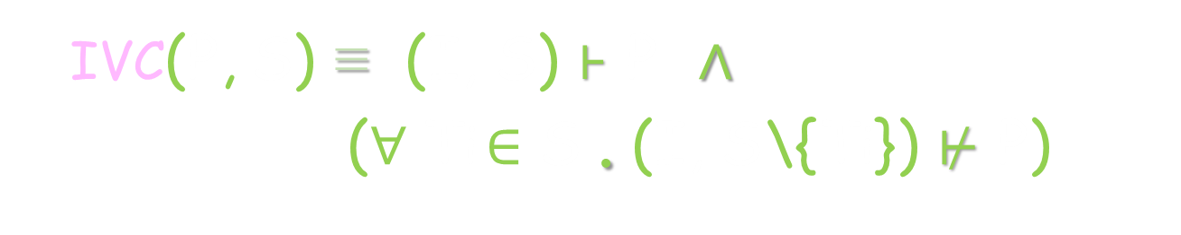
IVC
Given transition system (I, T) & safety property P
S ⊆ T is an IVC set iff (I, S) ⊦ P
S is minimal iff
(¬ ∃ S’ . S’ ⊂ S ∧ (I, S’) ⊦ P
s.t. (I, T) ⊦ P
P
IVC(P, S) ≡ (I, S) ⊦ P ∧
(∀ Ti $∈$ S . (I, S\{Ti}) $⊬$ P)
S
T
Notes:
In order to talk about generalizing a transition system, we assume the transition relation of the system has the structure of a toplevel
conjunction. This assumption gives us a structure that we can easily manipulate as we generalize the system
By further abuse of notation we will identify $T$ with the set of its top-level conjuncts. Thus we will write $x \in T$ to mean that $x$ is a top-level conjunct of $T$. We will write $S \subseteq T$ to mean that all top-level conjuncts of $S$ are top-level
conjuncts of $T$.

Slide 9
All IVCs
There could be many IVCs for a property:
AIVC (P) ≡ { S| S ⊆ T ∧ IVC (P, S) }
P
proof 3
…
model
proof 2
specification
proof 1

Slide 10
Coverage in Formal Verification
Have we specified enough requirements (properties)?
Justifiable notion of coverage:
given a property P = ⋀ pi ∈ ∆ and (P, S) ∈ MIVC, all element in S are covered
We could formalize complementary notions based on MIVC and AIVC
every property covers the elements in every (P, S) ∈ MIVC
given P = ⋀ pi ∈ ∆ , every element in AIVC (P) is covered
property P only covers elements in MUST (P)
…

Slide 11
IVCs?
proof 3
proof 1
h
property P
…
specification
j
proof 2
model

Slide 12
Implementation
Implemented in the JKind model checker:
symbolic model checking using induction-based techniques: IC3/PDR and k-induction.
such tools can often determine whether safety properties hold of complex finite or infinite-state systems.
Integrated in AGREE/AADL tool suite:
allows a model-based approach to system construction in which compositional proofs are used to automatically establish satisfaction arguments.

Slide 13
Research Questions
Goal: Determine quality of our approach and future directions
RQ1: Minimality
RQ2: Performance
RQ3: Diversity
how close to minimal is computed set?
does choice of solving algorithm (PDR, K-induction) matter?
overhead ?
how efficient is it in comparison with the brute force algorithm?
how do different solvers perform on computing IVCs?
how many different minimal IVC sets are there for a proof?
how similar are these IVC sets?

Slide 14
Overhead of different algorithms
Algorithm | min | max | avg | stdev
All_IVCs | 13.642% | 101034.61% | 2544.399% | 7764.159%
Minimization | 0.0% | 3646.154% | 26.560% | 181.579%
IVC_UC | 0.0% | 100.0% | 10.226% | 11.718%
IVC_UCBF | 14.092% | 11124.432% | 882.018% | 1512.071%
IVC_MUST | 13.731% | 10530.769% | 1081.099% | 1613.265%
* Overhead = ( running time of the algorithm )/ ( JKind verification time) x 100

Slide 15
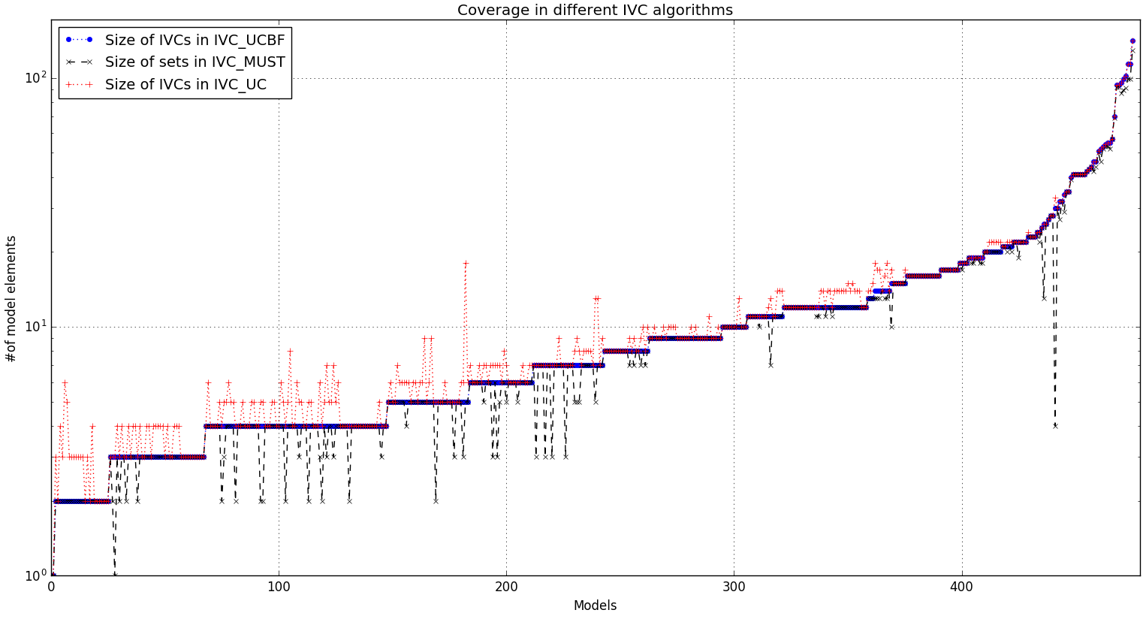
Coverage of different algorithms
IVC sizes | min | max | avg | stdev
IVC_UC | 1 | 141 | 12.741 | 15.986
IVC_UCBF | 1 | 141 | 12.174 | 16.092
IVC_MUST | 1 | 129 | 11.644 | 15.027
Ratio of IVC sizes | min | max | avg | stdev
IVC_UC to IVC_UCBF | 100% | 360% | 110.5% | 23.0%
IVC_MUST to IVC_UCBF | 13.3% | 100% | 95.9% | 12.1%
IVC_UC to IVC_MUST | 100% | 825% | 119.5% | 47.3%

Slide 16

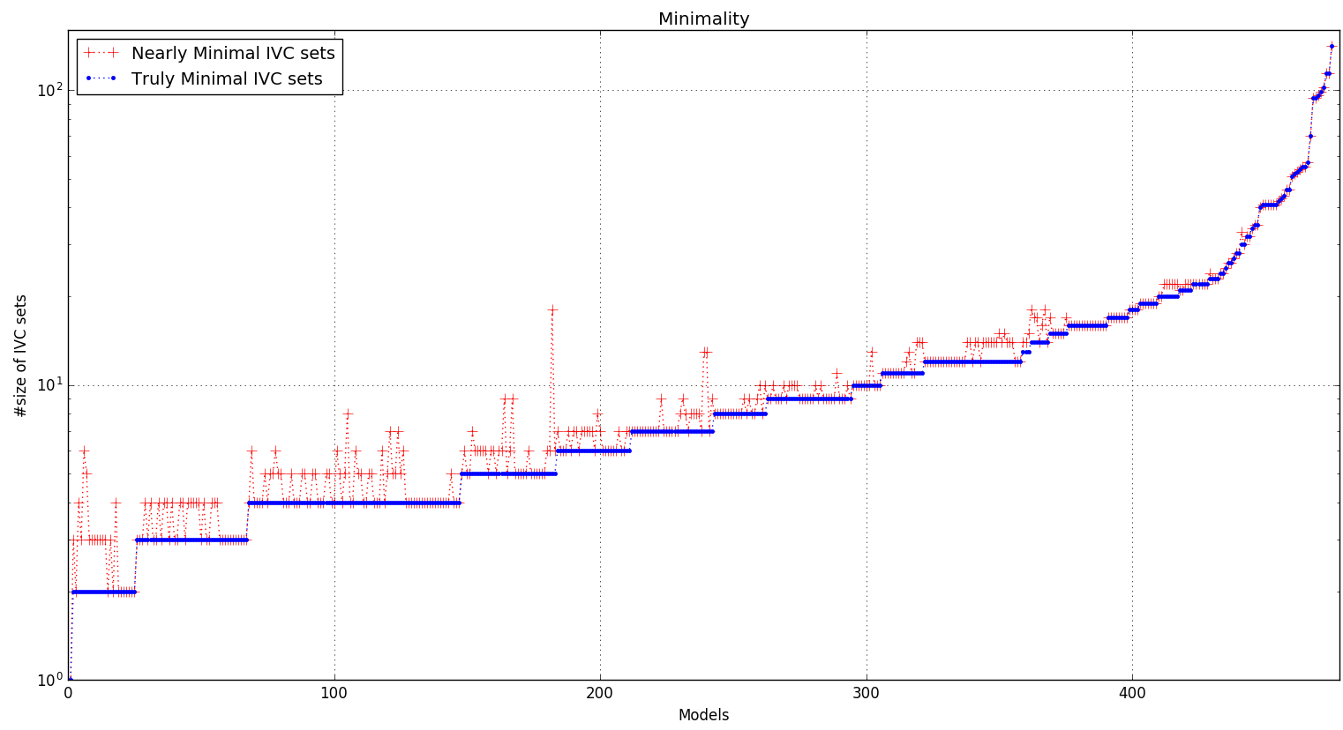
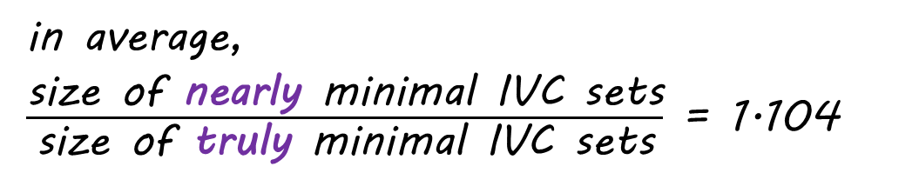
Minimality
in average,
$\frac{\text{size} \text{of} \text{nearly} \text{minimal} \text{IVC} \text{sets}}{\text{size} \text{of} \text{truly} \text{minimal} \text{IVC} \text{sets}}$ = 1.104

Slide 17
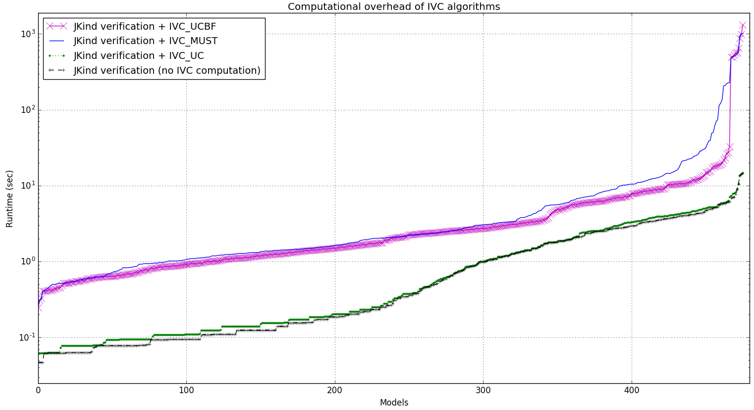
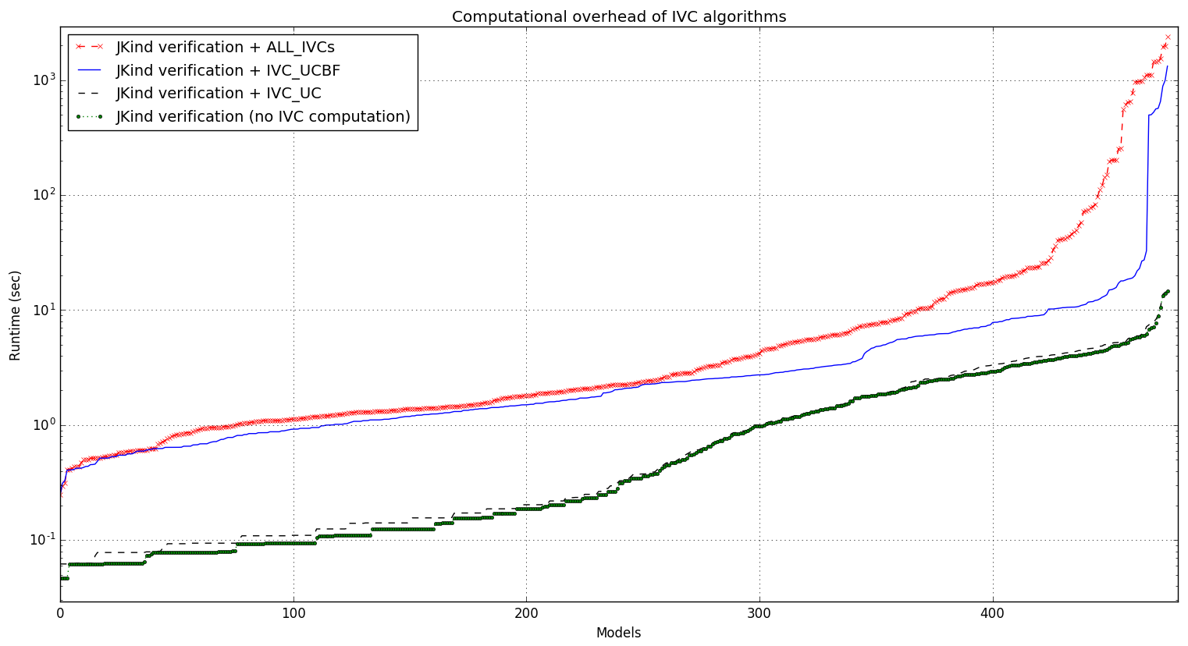
Overhead of different algorithms
Algorithm | min | max | avg | stdev
All_IVCs | 13.642% | 101034.61% | 2544.399% | 7764.159%
Minimization | 0.0% | 3646.154% | 26.560% | 181.579%
IVC_UC | 0.0% | 100.0% | 10.226% | 11.718%
IVC_UCBF | 14.092% | 11124.432% | 882.018% | 1512.071%
IVC_MUST | 13.731% | 10530.769% | 1081.099% | 1613.265%
* Overhead = ( running time of the algorithm )/ ( JKind verification time) x 100

Slide 18
Experiments
Model set:
Valid set: 476 models have valid properties (necessary for IVC computation)
Machine: Intel(R) Core(TM) i5-2430M CPU @ 2.40GHz + 4GB RAM
13 different runs for each model
12 runs for cross product of
Solvers: Z3, Yices, SMTInterpol, MathSAT
Proof Methods: k-induction, PDR, cooperative (both)
1 run for the brute-force algorithm
476 x 13 = 6188 runs in total
Notes:
In this study, we started from a suite of 700 Lustre models developed
as a benchmark suite for [21]. We augmented this suite
with 81 additional models from recent verification projects including
avionics and medical devices [4, 38]. Most of the benchmark
models from [21] are small (10kB or less, with 6-40 equations) and
contain a range of hardware benchmarks and software problems involving
counters. The additional models are much larger: around
80kB with over 300 equations. We added the new benchmarks to
better check the scalability for the tools, especially with respect
to the brute force algorithm. Each benchmark model has a single
property to analyze.
G. Hagen and C. Tinelli. Scaling up the formal verification of
lustre programs with smt-based techniques. In Formal
Methods in Computer-Aided Design, 2008. FMCAD ’08,

Slide 19


Conclusion
improve change impact assessment
Requirements
Engineering
Acceptance
Test
https://github.com/
elaghs/
Working/tree/master/ support/experiments
System
Design
System
Test
improve scope management
assess the quality of the system
Architectural
Design
Integration
Test
http://loonwerks.com/ tools/jkind.html
improve test coverage + reduce test cost
+ test case generation
Component Design
Unit Test
Code
Development
creating assurance arguments

Slide 20
Thank You!
?

Slide 21
Notations
Transition system (I, T)
T is a conjunction of a collection of terms: T = ⋀j Tj

Slide 22
How?
Based on UNSAT Cores in SMT Solvers
(I, T)
NOT property
...
solver
UNSAT cores
prop holds:
UNSAT
prop is violated :
SAT
Notes:
Generalization of work on UNSAT Cores in SMT Solvers for Inductive Proofs
Alloy uses UNSAT Cores for similar purposes
We extend this idea to inductive proofs and this allows additional uses.
Iterated use of UNSAT Core Algorithm
Find satisfying assignment for the Boolean formula
Claims = expressions within the model.
For AGREE, these are any equations or properties defined within the contracts.

Slide 23
Computing IVC Set
For each property:
Reduce invariants and find a minimal set of invariants
Obtain a minimum K by which the property is inductively provable
For the obtained K, compute unsat core with a special IVC query
Unsat core will contain a super-set of IVCs
Minimize unsat core to get a minimal set of IVCs

Slide 24
General Idea
property
…
lemmas (invariants)
…
…
model elements
…
IVCs

Slide 25
Algorithm
get the invariants & mark them
property
get UNSAT cores
minimize the cores
…
mark model elements in TR
lemmas
construct a special query (IVC query)
get UNSAT cores
…
minimize the cores
model
elements
…

Slide 26
Minimality
Is it possible to compute “truly” minimal IVC sets?
YES with a brute force approach, but expensive
Our algorithm is a lot faster than the brute force approach
it yields “nearly” minimal IVC sets.
property
proof paths
…
Using
lemmas 1, i
IVC:
{x, y, z}
Using
lemmas 2, i
IVC:
{y, z}
1
2
i
lemmas
…
m
model elements
…
x
y
z
⊇

Slide 27
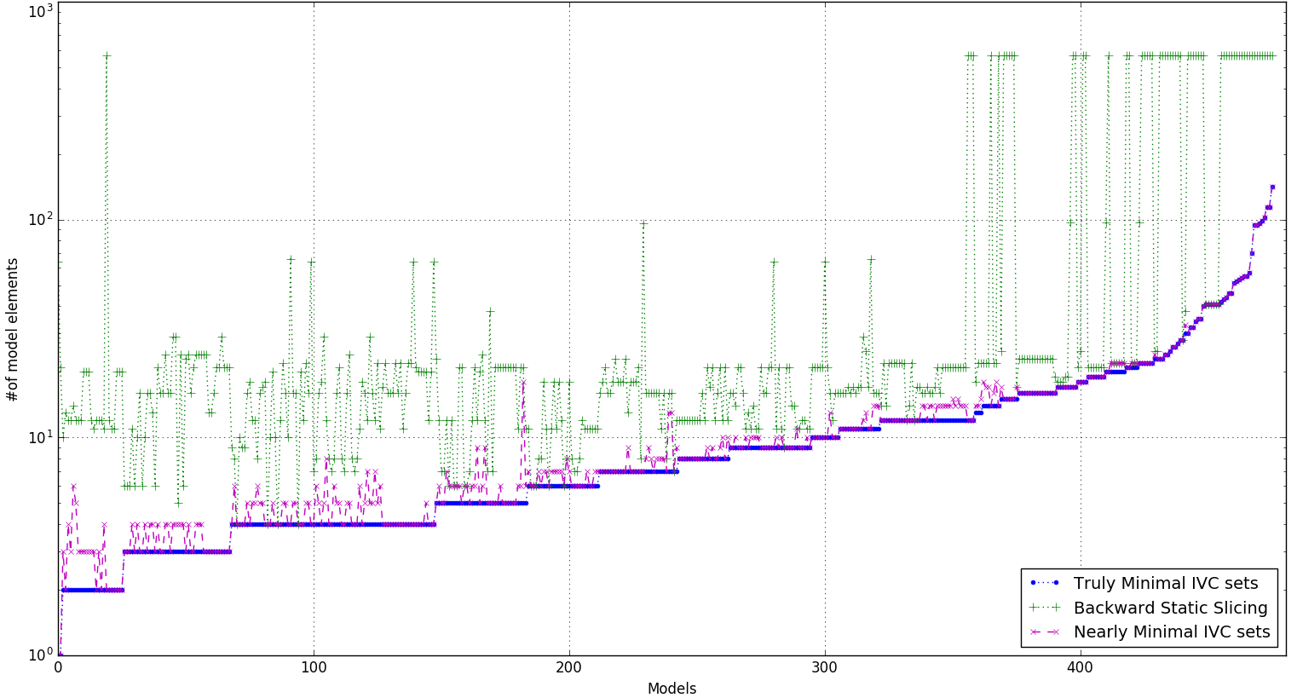
Minimality
Slices are (mean) 406% larger than nearly minimal IVCs

Slide 28
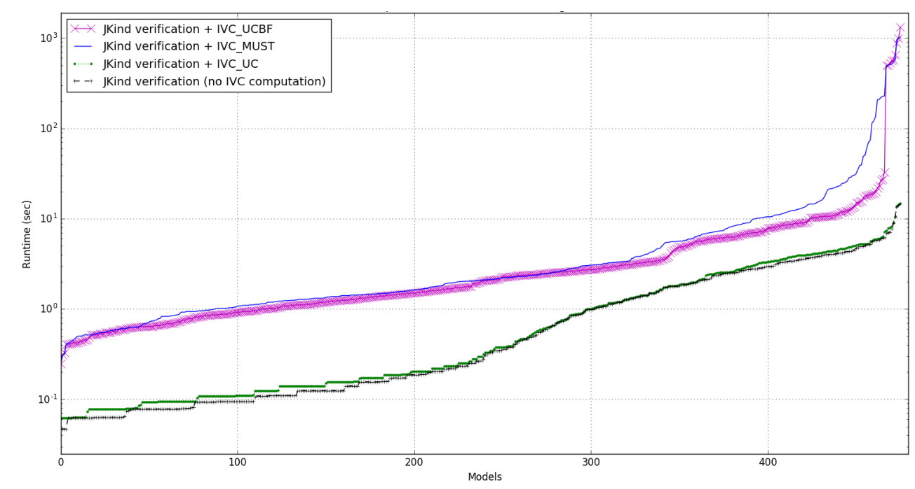

Slide 29
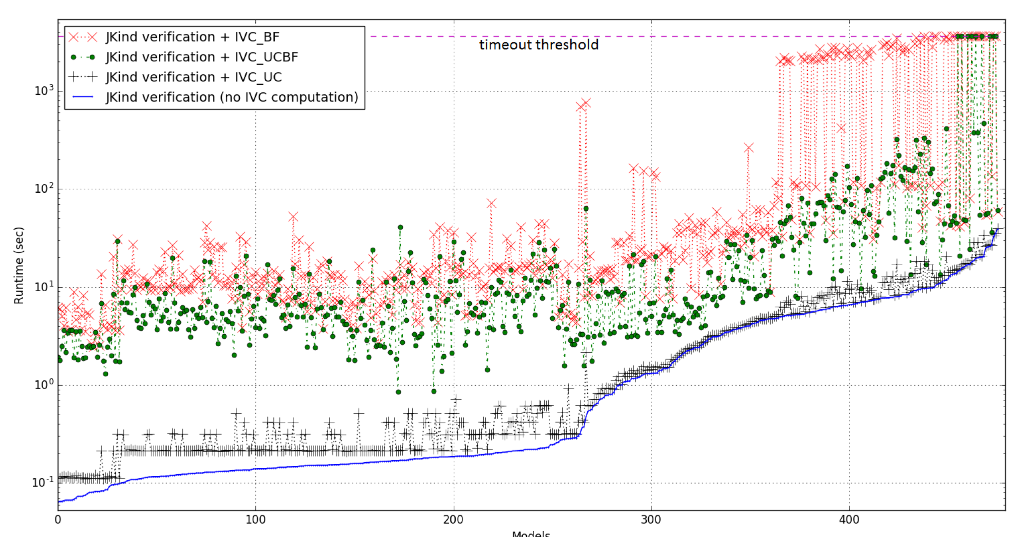
Performance

Slide 30
Practical?! Useful?!
NASA CVFCS on the Quad-redundant flight controller
Rockwell Collins, part of the AFRL SpEAR project
Helicopter architecture proofs in the DARPA HACMS project
NSF Medical device project on the GPCA model
AGREE Symbolic Simulator, Part of DARPA SOSITE project
AGREE/JKind Test-Case Generator
Since Jan, 2016

