Slide 1
Proof - based Coverage Metrics for Formal Verification
Elaheh Ghassabani
Oral Prelim Exam (OPE), Computer Science
University of Minnesota

Slide 2

Why Formal Verification?
derives
are the tests adequate?
requirements
tests
talented developers
Statement coverage
derives
Decision coverage
MCDC (Modified Decision Condition Coverage)
Execute over
implementation
measure adequacy
Notes:
Idea: measure how well your tests cover your code as an approximation of “goodness” of your testing
Statement coverage: Every statement in the code should be executed by some test
Decision coverage: every Boolean expression should take on both true/false values
Modified Decision Condition Coverage (MCDC): every simple Boolean condition should be shown to independently affect the outcome of compound Boolean expressions.
Boundary Value Testing: Every relational operator should be tested at, immediately above, and immediately below the point-of-success.

Slide 3











Problem
o
o
o
o
o
X
o
o
o
o
o
o
o
o
o
o
X
o
System
o
o
o
o
X
o
X
X
o
X
o
X
o
o
o
o
X
…is that it only samples a set of possible behaviors
Even small systems have trillions and trillions of possible states
Notes:
SLOWWWW
Even if we get statement coverage still there are lots of behaviors not covered
Unlike physical systems, (where many engineers gained their experience), most software systems are discontinuous
There is no sound basis for extrapolating from tested to untested cases
So we need to consider all possible states of the system

Slide 4
Model Checking
requirements
real system
semantics
abstraction (modeling)
formalizing
property specification
system model
model checker
error location
satisfied
satisfied
violated +
counterexample
simulation
Notes:
Model checking is an automated technique that, given a finite-state model of a system and a formal property, systematically checks whether this property holds for (a given state in) that model

Slide 5
Coverage
Have we specified enough properties?
No ➔ erroneous behavior may escape verification
Goal: quantifying specification completeness by a coverage metric
The goal of a coverage metric: to assign a numeric score that describes how well properties cover the design
Coverage score
Notes:
The motivation is clear: an erroneous behavior of the design can escape the verification effort if this behavior
is not captured by the specification.

Slide 6
Coverage for Formal Verification
Model checking
all reachable parts of the design are visited!!!
Existing metrics are usually based on mutation
a mutant is “killed” if
one of the properties that is satisfied by the original design
is violated by the mutated design
“atomic” changes to the design
Depending on the modeling formalism used, this may be the value of a gate or signal or an expression within a statement in a program.
State-based mutations
Logic-based mutations
Syntactic mutations
Notes:
In formal verification, as in model checking all reachable parts of the design are visited.
In fact, the way that coverage is formalized plays a key part in the strength/ effectiveness of a method for the assessment of completeness.
the set of possible mutations depends on the notation that is used.
For these designs, State-based mutations flip the value of one of the bits in the state. There are several variations depending on whether the flip is performed on a single state within a Kripke structure [14], or in the description of the signal in the transition relation of the circui
logic-based mutations fix the value of a bit to constant zero or one, and can be used to determine whether
properties can find stuck-at faults.
Remove states in a control flow graph representation of hardware

Slide 7
History
Problems:
expensive
don’t preserve provability
don’t work for infinite systems
Not for SMT-based model checking
finite state systems
explicate-state model checking
impractical and expensive
state-based metric with FSM mutations
Hoskote et al. 1999
Chockler et al. 2001
SAT-based model checking
state-of-the-art, still expensive though
inductive proof method (interpolation)
improved the same idea
Mutation-based notions
Chockler et al. 2003
logic-based metric
Das 2005
evaluation & benchmarking
Claessen 2007
Große et al. 2007
Kupferman et al. 2008
vacuity
Other approaches
Chockler et al. 2010
Proof-based notions
Haedicke et al. 2012
non-deterministic coverage
OUR WORK ☺ 2017
Notes:
In formal verification, as in model checking all reachable parts of the design are visited.
In fact, the way that coverage is formalized plays a key part in the strength/ effectiveness of a method for the assessment of completeness.
the set of possible mutations depends on the notation that is used.
For these designs, State-based mutations flip the value of one of the bits in the state. There are several variations depending on whether the flip is performed on a single state within a Kripke structure [14], or in the description of the signal in the transition relation of the circui
logic-based mutations fix the value of a bit to constant zero or one, and can be used to determine whether
properties can find stuck-at faults.
Remove states in a control flow graph representation of hardware

Slide 8
Contribution
Coverage metrics based on a set of minimal proofs
Allows introducing different metrics
Can be applied early and throughout a development cycle
Proof-preserving
Provide efficient algorithms to compute those metrics
Implementation & evaluation

Slide 9
Transition System
Transition system (I, T) over state space U
I : U → bool T : U × U → bool
T is a conjunction of a collection of terms:
T(u, u’) = T1 (u, u’) ∧ ··· ∧ Tn (u,u’)
T = T1 ∧ ··· ∧ Tn
Abuse of notation: T = {T1 , ··· , Tn}

Slide 10
node asw (alt1, alt2: int; inhibit: bool) returns (doi_on: bool);
var a1_below, a2_below, a1_above, a2_above, below, above_hyst, d1, d2: bool;
let
(1) a1_below = (alt1 < THRESHOLD);
(2) a2_below = (alt2 < THRESHOLD);
(3) a1_above = (alt1 >= T_HYST);
(4) a2_above = (alt2 >= T_HYST);
(5) below = a1_below or a2_below;
(6) above_hyst = a1_above and a2_above;
(7) doi_on = if (below and not inhibit) then true else d1;
(8) d1 = if (inhibit or above_hyst) then false else d2;
d2 = (false -> pre(doi_on));
tel;
T = { a1_below, ··· , d2 }

Slide 11
Safety Property
Reachability for (I,T): the smallest predicate R : U → bool s.t.
∀ u . I(u) ⇒ R(u)
∀ u, u’ . R(u) ∧ T(u, u’) ⇒ R(u’)
Safety property: a state predicate P : U → bool
P holds on (I, T) if ∀ u . R(u) ⇒ P(u)
(I, T) ⊦ P
Notes:
it holds on all reachable states, i.e

Slide 12
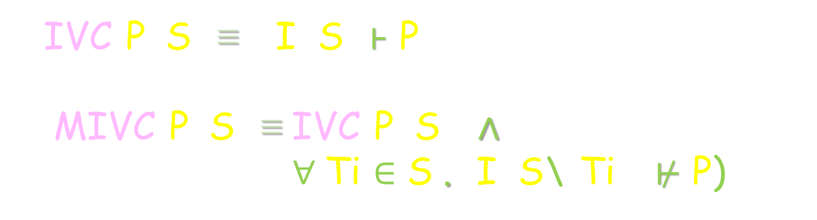
IVC
Given transition system (I, T) & safety property P
S ⊆ T is an IVC iff (I, S) ⊦ P
S is minimal iff
(¬ ∃ S’ . S’ ⊂ S ∧ (I, S’) ⊦ P
s.t. (I, T) ⊦ P
P
IVC(P, S) ≡ (I, S) ⊦ P
MIVC(P, S) ≡ IVC(P, S) ∧
(∀ Ti $∈$ S . (I, S\{Ti}) $⊬$ P)
S
T

Slide 13
Minimal Proofs
design elements ➔ ⬅ proof
Inductive Validity Core (IVC)
traceability
…
property #1
property #i
…
…
model elements:
IVCs for property #1
IVCs for property #i

Slide 14
Minimal Proofs
design elements ➔ ⬅ proof
Inductive Validity Core (IVC)
traceability
…
∧
∧
P ≡
property #1
property #i
…
P
…
…
model elements:
IVCs for P

Slide 15
All MIVCs
There could be many minimal IVCs for a property:
AIVC (P) ≡ { S| S ⊆ T ∧ MIVC (P, S) }
P
proof 3
…
model
proof 2
specification
proof 1

Slide 16
Categorizing Design Artifacts
MUST (P) = ⋂ AIVC (P)
MAY (P) =( ⋃ AIVC (P)) \ MUST(P)
X
P
…
X
X
model
specification
IRR

Slide 17


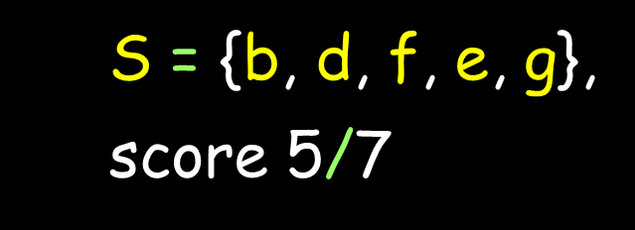
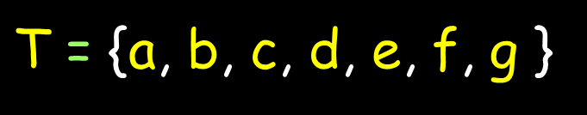
Metric #1
P
MIVC#1
a
c
IVC coverage (IVC-COV):
Given S ∈ AIVC (P),
Ti is covered by P via S iff
Ti ∈ S ∧ MIVC(P, S)
coverage score =$\frac{\text{|}\text{S}\text{|}}{ \text{|}\text{T}\text{|} }$
b
d
e
f
g
MIVC#2
MIVC#3
$\text{T}$ = {a, b, c, d, e, f, g }
$\text{S}$ = {c, b, d}, score 3/7
$\text{S}$ = {b, d, f, e, g},
score 5/7

Slide 18
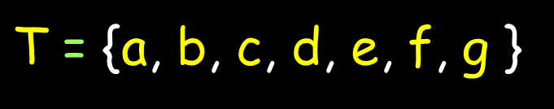
Metric #2
P
MIVC#1
a
MAY-COV:
Given Ti ∈ T is covered by P iff
Ti ∈ MAY-COV (P)
MAY-COV (P) = {Ti | ∃S ∈ AIVC (P) . Ti ∈ S}
b
d
e
c
f
g
MIVC#2
MIVC#3
$\text{T}$ = {a, b, c, d, e, f, g }
MAY-COV (P) = T

Slide 19
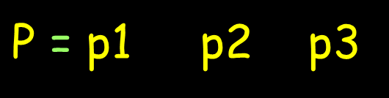

Metric #3
$\text{T}$ = {a, …, j }
S2
S3
∧
∧
a
$\text{P}$ = p1 p2 p3
S1
b
i
j
AIVC (P) = {{S1 U S4},
{S2 U S4}}
c
g
e
d
h
S4
MAY-COV (P) = ⋃ AIVC (P)
f
p1
p2
p3

Slide 20
Metric #3
MODEL-COV:
Given a set of properties ∆ over T, Ti ∈ T is covered iff
Ti ∈ MODEL-COV (T)
MODEL-COV (T) = {Ti | ∃P ∈ ∆, S ∈ AIVC (P) . Ti ∈ S}

Slide 21
Metric #4
MUST-COV:
Given Ti ∈ T is covered by P iff Ti ∈ MUST (P)
P
MIVC#1
a
MUST (P) = {d}
b
c
d
e
MIVC#2
f
g
MIVC#3
Notes:
It doesn’t preserve provability!!!!

Slide 22

Chockler et al. 2010
*
Nondeterministic coverage (NONDET-COV):
Ti ∈ T is covered by P iff Ti ∈ NONDET-COV (P)
NONDET-COV (P) = {Ti | (I, T) ⊦ P ∧ (I, T \ {Ti}) $⊬$ P}
MUST (P)
., * Coverage in interpolation-based model checking, DAC2010

Slide 23
Recap!
We need multiple notions of coverage with different levels of rigor
depending on the context and application
We need multiple notions because not a single one is absolute
The proposed coverage metrics can be ranked in terms of their scores as follows:
NONDET-COV ≤ IVC-COV ≤ MAY-COV ≤ MODEL-COV
Many more proof-based coverage metrics based on the MIVC/AIVC idea can be formalized.
Metrics that make use of AIVC relation are computationally more expensive to compute than IVC-COV
although they might be easier to satisfy (i.e., result in higher coverage scores)
Notes:
Because to some degree the requirements we want in the SW depends on the criticality
In testing, for certain kind of programs statement coverage is enough, and for other programs you have to be really rigorous like with MCDC.
The proposed coverage metrics can be ranked in terms of their scores as follows:
IVC-C OV and N ONDET -C OV * are equivalent when all elements within the model are covered: if all model elements are MUST elements, then there can only be one IVC, and this IVC uses all of the model elements.

Slide 24
Algorithms
IVC_UC
IVC_UCBF
IVC_MUST
IVC_COV
MUST_COV
[Chockler et al. 2010]

Slide 25
How?
Based on UNSAT Cores in SMT Solvers
(I, T)
NOT property
...
solver
UNSAT cores
prop holds:
UNSAT
prop is violated :
SAT
Notes:
Generalization of work on UNSAT Cores in SMT Solvers for Inductive Proofs
Alloy uses UNSAT Cores for similar purposes
We extend this idea to inductive proofs and this allows additional uses.
Iterated use of UNSAT Core Algorithm
Find satisfying assignment for the Boolean formula
Claims = expressions within the model.
For AGREE, these are any equations or properties defined within the contracts.

Slide 26
General Idea
property
…
lemmas (invariants)
…
…
model elements
…
IVCs

Slide 27
IVC_UC Algorithm
get the invariants & mark them
property
get UNSAT cores
minimize the cores
…
mark model elements in TR
lemmas
construct a special query (IVC query)
get UNSAT cores
…
minimize the cores
model
elements
…

Slide 28
Minimality
Is it possible to compute “truly” minimal IVC sets?
YES with a brute force approach, but expensive
Our algorithm is a lot faster than the brute force approach
it yields “nearly” minimal IVC sets.
property
proof paths
…
Using
lemmas 1, i
IVC:
{x, y, z}
Using
lemmas 2, i
IVC:
{y, z}
1
2
i
lemmas
…
m
model elements
…
x
y
z
⊇

Slide 29
Implementation
Implemented in the JKind model checker:
symbolic model checking using induction-based techniques: IC3/PDR and k-induction.
such tools can often determine whether safety properties hold of complex finite or infinite-state systems.

Slide 30
Experiments
Model set:
Valid set: 476 models have valid properties (necessary for IVC computation)
Machine:
Intel(R) i5-4690, 3.50GHz + 16GB RAM

Slide 31
Research Questions
Goal: evaluate both the efficiency and effectiveness of the three described algorithms: IVC_UCBF, IVC_UC, and IVC_MUST
RQ1:
RQ2:
RQ3:
How expensive is the coverage analysis using the IVC_UC, IVC_MUST, and IVC_UCBF algorithms?
How hard are different metrics to satisfy (IVC-COV vs NONDET-COV)?
Minimality?

Slide 32

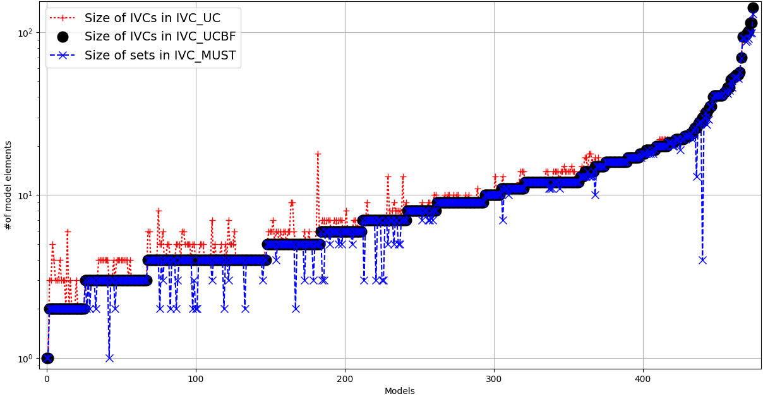
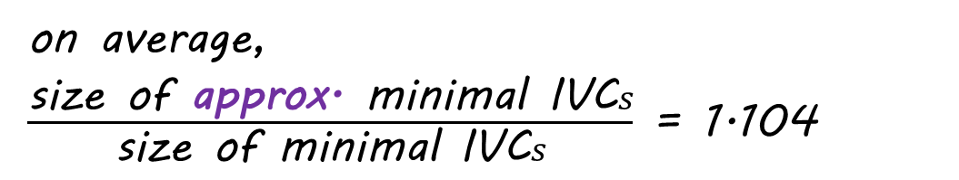
on average,
$\frac{\text{size} \text{of} \text{approx}\text{.} \text{minimal} \text{IVC}s}{\text{size} \text{of} \text{minimal} \text{IVC}s}$ = 1.104

Slide 33
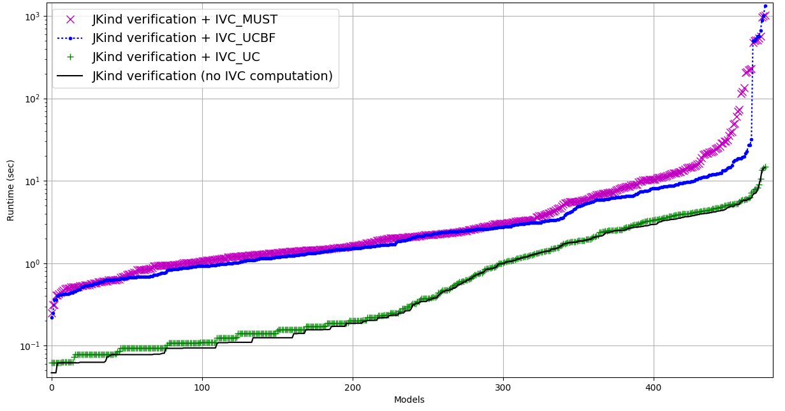

Slide 34
Discussion
node asw (alt1, alt2: int; inhibit: bool) returns (doi_on: bool);
var a1_below, a2_below, a1_above, a2_above, below, above_hyst, d1, d2: bool;
let
(1) a1_below = (alt1 < THRESHOLD);
(2) a2_below = (alt2 < THRESHOLD);
(3) a1_above = (alt1 >= T_HYST);
(4) a2_above = (alt2 >= T_HYST);
(5) below = a1_below or a2_below;
(6) above_hyst = a1_above and a2_above;
(7) doi_on = if (below and not inhibit) then true else d1;
(8) d1 = if (inhibit or above_hyst) then false else d2;
d2 = (false -> pre(doi_on));
tel;
Granularity

Slide 35
Discussion
node asw (alt1, alt2: int; inhibit: bool) returns (doi_on: bool);
var a1_below, a2_below, a1_above, a2_above, below, above_hyst, d1, d2: bool;
let
(1) a1_below =
(2) a2_below =
(3) a1_above = (alt1 >= T_HYST);
(4) a2_above = (alt2 >= T_HYST);
(5) below = (alt1 < THRESHOLD) or (alt2 < THRESHOLD);
(6) above_hyst = a1_above and a2_above;
(7) doi_on = if (below and not inhibit) then true else d1;
(8) d1 = if (inhibit or above_hyst) then false else d2;
d2 = (false -> pre(doi_on));
tel;
Granularity

Slide 36
Discussion
node asw (alt1, alt2: int; inhibit: bool) returns (doi_on: bool);
var a1_below, a2_below, a1_above, a2_above, below, above_hyst, d1, d2: bool;
let
(1) a1_below =
(2) a2_below =
(3) a1_above =
a2_above =
(5) below = (alt1 < THRESHOLD) or (alt2 < THRESHOLD);
(6) above_hyst = (alt1 >= T_HYST) and (alt2 >= T_HYST);
(7) doi_on = if (below and not inhibit) then true else d1;
(8) d1 = if (inhibit or above_hyst) then false else d2;
d2 = (false -> pre(doi_on));
tel;
Granularity

Slide 37
Discussion
node asw (alt1, alt2: int; inhibit: bool) returns (doi_on: bool);
var a1_below, a2_below, a1_above, a2_above, below, above_hyst, d1, d2: bool;
let
(1) a1_below =
(2) a2_below =
(3) a1_above =
a2_above =
(5) below = (alt1 < THRESHOLD) or (alt2 < THRESHOLD);
(6) above_hyst = (alt1 >= T_HYST) and (alt2 >= T_HYST);
(7) doi_on = if (below and not inhibit) then true else d1;
(8) d1 = if (inhibit or above_hyst) then false else d2;
d2 = (false -> pre(doi_on));
tel;
Granularity

Slide 38
Discussion
node asw (alt1, alt2: int; inhibit: bool) returns (doi_on: bool);
var a1_below, a2_below, a1_above, a2_above, below, above_hyst, d1, d2: bool;
let
(1) a1_below =
(2) a2_below =
(3) a1_above =
a2_above =
(5) below =
(6) above_hyst =
(7) doi_on = if (((alt1 < THRESHOLD) or (alt2 < THRESHOLD)) and not inhibit) then true else d1;
(8) d1 = if (inhibit or (alt1 >= T_HYST) and (alt2 >= T_HYST)) then false else d2;
d2 = (false -> pre(doi_on));
tel;
Granularity

Slide 39
Discussion
node asw (alt1, alt2: int; inhibit: bool) returns (doi_on: bool);
var a1_below, a2_below, a1_above, a2_above, below, above_hyst, d1, d2: bool;
let
(1) doi_on = if (((alt1 < THRESHOLD) or (alt2 < THRESHOLD)) and not inhibit) then true
else if (inhibit or (alt1 >= T_HYST) and (alt2 >= T_HYST)) then false else
(false -> pre(doi_on));
tel;
Granularity
Bingo??!!!! 100% coverage!!!!

Slide 40


Conclusion
improve change impact assessment
Requirements
Engineering
Acceptance
Test
https://github.com/
elaghs/
Working/tree/master/ support/experiments
System
Design
System
Test
improve scope management
assess the quality of the system
Architectural
Design
Integration
Test
http://loonwerks.com/ tools/jkind.html
improve test coverage + reduce test cost
+ test case generation
Component Design
Unit Test
Code
Development
creating assurance arguments

Slide 41
Thank You!
?

Slide 42
Structural Coverage Testing
Idea: measure how well your tests cover your code as an approximation of “goodness” of your testing
Examples:
Statement coverage: Every statement in the code should be executed by some test
Decision coverage: every Boolean expression should take on both true/false values
Modified Decision Condition Coverage (MCDC): every simple Boolean condition should be shown to independently affect the outcome of compound Boolean expressions.
Boundary Value Testing: Every relational operator should be tested at, immediately above, and immediately below the point-of-success.
Notes:
Coverage testing is designed to check whether your test suites meet some minimum level of “goodness”. For structural coverage testing, the goodness factor is how well the tests execute the code structures in your program. There are kinds of coverage, some I’ve put here. <Explain>

Slide 43
Computing IVC Set
For each property:
Reduce invariants and find a minimal set of invariants
Obtain a minimum K by which the property is inductively provable
For the obtained K, compute unsat core with a special IVC query
Unsat core will contain a super-set of IVCs
Minimize unsat core to get a minimal set of IVCs

Slide 44
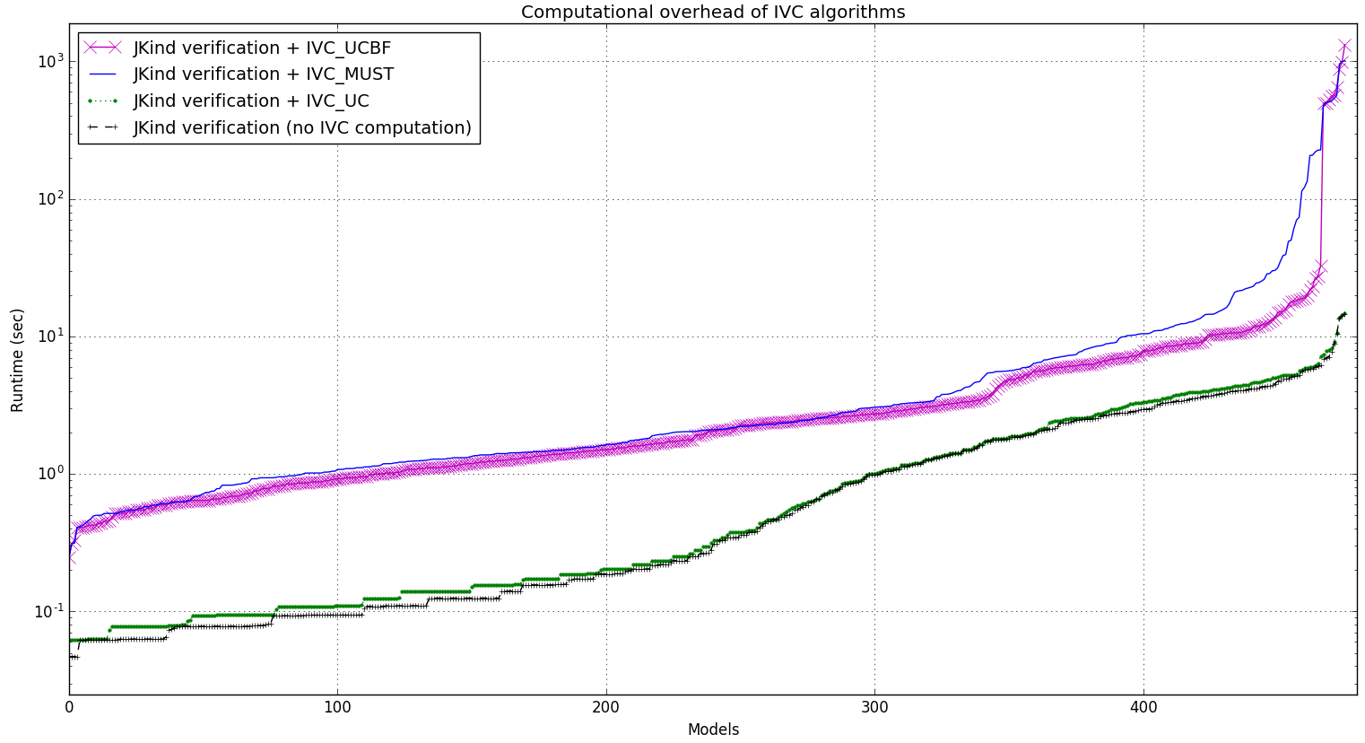
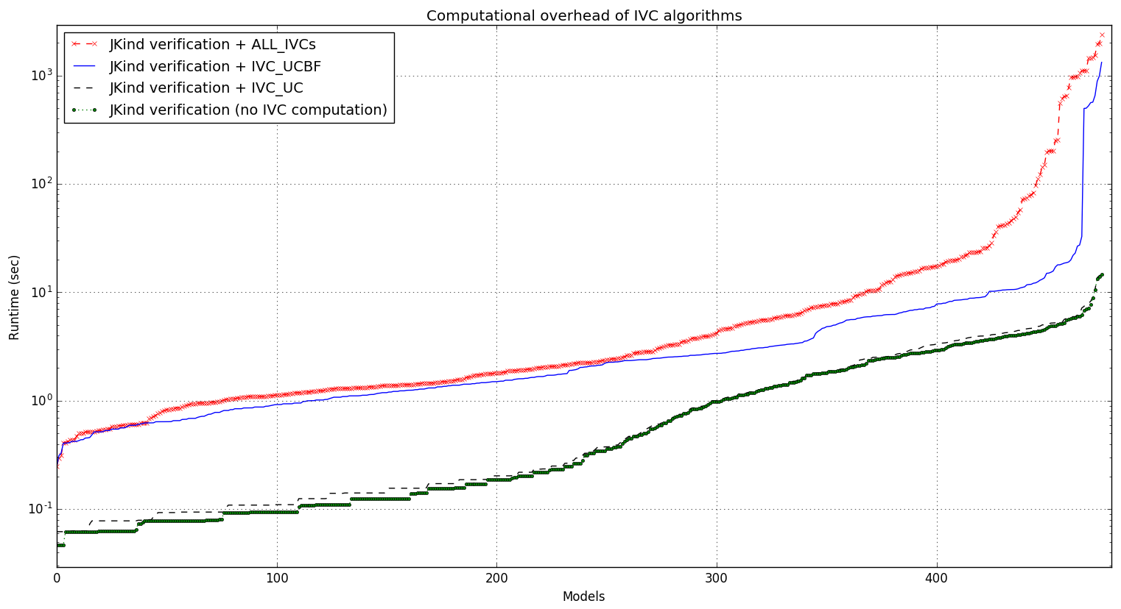
Overhead of different algorithms
Algorithm | min | max | avg | stdev
All_IVCs | 13.642% | 101034.61% | 2544.399% | 7764.159%
Minimization | 0.0% | 3646.154% | 26.560% | 181.579%
IVC_UC | 0.0% | 100.0% | 10.226% | 11.718%
IVC_UCBF | 14.092% | 11124.432% | 882.018% | 1512.071%
IVC_MUST | 13.731% | 10530.769% | 1081.099% | 1613.265%
* Overhead = ( running time of the algorithm )/ ( JKind verification time) x 100

Slide 45
Overhead of different algorithms
Algorithm | min | max | avg | stdev
All_IVCs | 13.642% | 101034.61% | 2544.399% | 7764.159%
IVC_UC | 0.0% | 100.0% | 10.226% | 11.718%
IVC_UCBF | 14.092% | 11124.432% | 882.018% | 1512.071%
IVC_MUST | 13.731% | 10530.769% | 1081.099% | 1613.265%
* Overhead = ( running time of the algorithm )/ ( JKind verification time) x 100

Slide 46
Coverage of different algorithms
IVC sizes | min | max | avg | Stdev
IVC_UC | 1 | 141 | 12.74 | 15.98
IVC_UCBF | 1 | 141 | 12.17 | 16.09
IVC_MUST | 1 | 129 | 11.64 | 15.02
Ratio of IVC sizes | min | max | avg | stdev
IVC_UC to IVC_UCBF | 100% | 360% | 110.5% | 23.0%
IVC_MUST to IVC_UCBF | 13.3% | 100% | 95.9% | 12.1%
IVC_UC to IVC_MUST | 100% | 825% | 119.5% | 47.3%

Slide 47
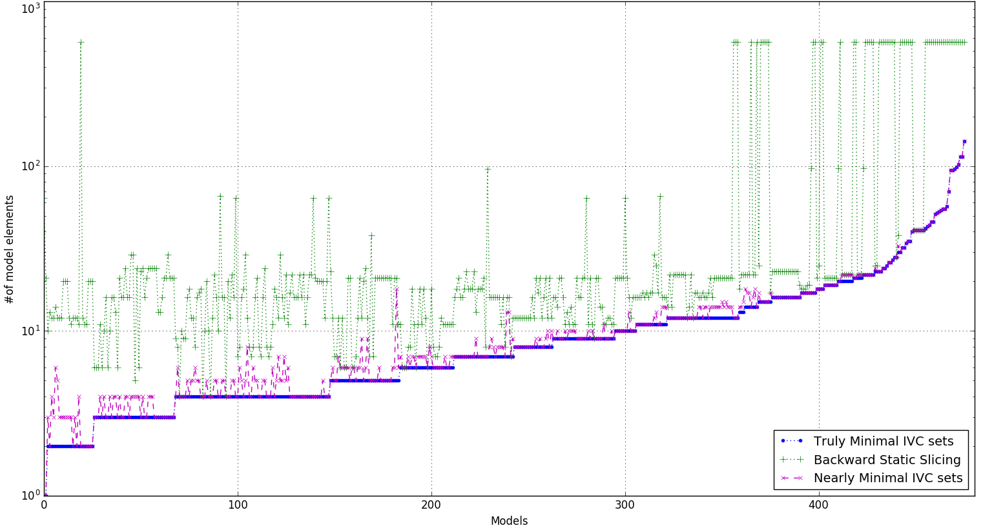
Minimality
Slices are (mean) 406% larger than nearly minimal IVCs

Slide 48
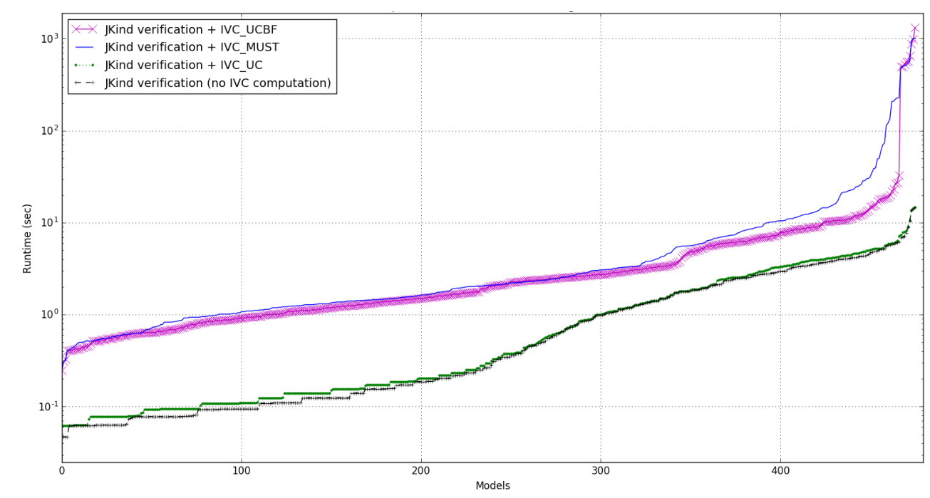

Slide 49
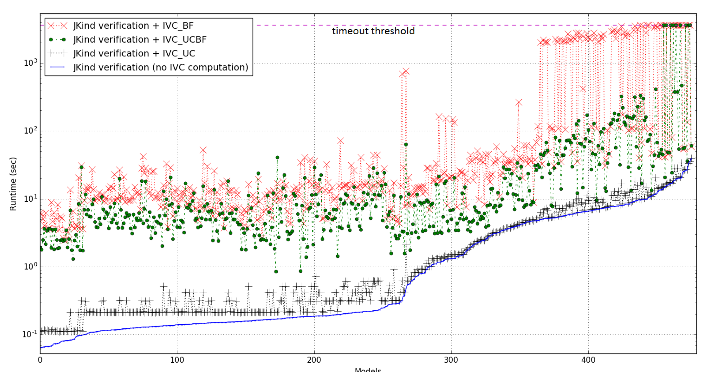
Performance

Slide 50
Practical?! Useful?!
NASA CVFCS on the Quad-redundant flight controller
Rockwell Collins, part of the AFRL SpEAR project
Helicopter architecture proofs in the DARPA HACMS project
NSF Medical device project on the GPCA model
AGREE Symbolic Simulator, Part of DARPA SOSITE project
AGREE/JKind Test-Case Generator
Since Jan, 2016

