Slide 1
INFORMATION TECHNOLOGY
Hardware and Software

Slide 2
Learning Outcomes
Define hardware and software
Describe the hardware categories
Describe the computers categories by size
Define the two types of software
Describe the role of the operating system and utility software
Compare the uses of vertical and horizontal market software
List the common input, output, storage, and telecommunication devices

Slide 3
Hardware and Software: The Basics
IT is any computer-based tool that:
  People use to work with information
  Support the information and information-processing needs of an organization
Hardware – physical aspects of computers, telecommunications, and other information technology devices
  Example: Keyboard, monitor
Software -a general term for the various kinds of programs used to operate computers and related devices
  Example: Microsoft Excel

Slide 4
Six Categories of Hardware
Input Device
Output device
Storage device
Central processing unit (CPU)
Telecommunications device
Connecting device

Slide 5
Two main types of software
Application software - software used to solve specific problems or perform specific tasks
System software - handles tasks specific to technology management and coordinates the interaction of all technology devices
  Operating system software - supports the application software and manages how the hardware devices work together
  Utility software - provides additional functionality to the operating system

Slide 6
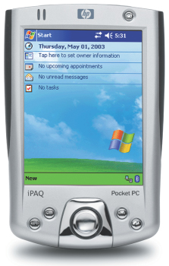
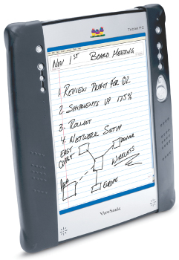
Computer Categories
Personal digital assistant (PDA):
a small hand-held computer that performs simple tasks
Notebook computer:
a fully functional computer designed to be carried around
Tablet computer:
a pen-based computer that provides the screen capabilities of a PDA with the functional capabilities of a notebook

Slide 7
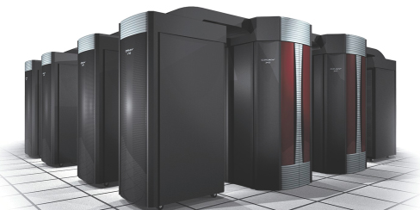
Computer Categories (continued)
Desktop computer
Minicomputer - designed to meet the computing needs of several people simultaneously in a small to medium-size business environment
Mainframe computer - designed to meet the computing needs of hundreds of people in a large business environment
Supercomputers - the fastest, most powerful, and most expensive type of computer

Slide 8
Software
Software contains the instructions that the hardware executes to perform an information processing task
Without the aid of software, the computer hardware is useless
Two categories of software
  Application
  System

Slide 9
Application Software
Application software is used for specific information processing needs, including:
  Payroll
  Customer relationship management
  Project management
  Training
  Word processing and many others

Slide 10
Application Software (continued)
Personal productivity software :
used to perform personal tasks such as writing a memo, creating a graph, or creating a slide presentation
Examples:
  Microsoft Word
  Microsoft Excel
  Internet Explorer
  Quicken

Slide 11
Application Software (continued)
Vertical market software :
application software that is unique to a particular industry
  Patient-scheduling software
  Nursing allocation software
Horizontal market software :
general enough to be suitable for use in a variety of industries
  Inventory management software
  Payroll software

Slide 12
System Software
System software controls how the various technology tools work together along with the application software
Operating System controls application software and manages how the hardware devices work together
  Example: Microsoft Windows XP Home,
  Mac OS, Linux
Utility
  Uninstaller software, spyware software

Slide 13
Data Representation
Binary digit (bit)
  the smallest unit of information that a computer can process
ASCII (American Standard Code for Information Interchange)
  the coding system that most personal computers use to represent, process, and store information
Byte
  a group of eight bits to represent a character

Slide 14
Common Input Devices
Input device is a tool used to capture information and commands
Examples include:
  Keyboard
  Point-of-sale (POS)
  Microphone
  Mouse
  Pointing stick
  Touch pad
  Touch screen
  Bar code reader
  Optical mark recognition (OMR)
  Scanner

Slide 15
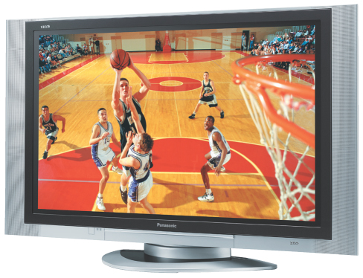
Common Output Devices
Output device is equipment used to see, hear, or otherwise accept the results of information processing
Monitors
  Cathode-ray tubes (CRTs)
  Flat-panel displays
  Liquid crystal display (LCD) monitors
  Gas plasma displays
Pixels - the dots that make up an image on the computer screen

Slide 16
Common Output Devices (continued)
Printers
  Inkjet printers - make images by forcing ink droplets through nozzles
  Laser printers - form images using an electrostatic process, the same way a photocopier works
  Multifunction printers - scan, copy, and fax, as well as print

Slide 17
Common Storage Devices
High-capacity floppy disk
Hard disk
CD-ROM (compact disc - read-only memory)
CD-R (compact disc-recordable)
CD-RW (compact disc-rewritable)
DVD-ROM
DVD-R
DVD-RW or DVD+RW
Flash memory device
Memory card

Slide 18
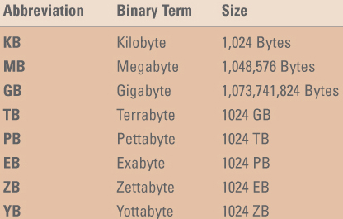

Slide 19
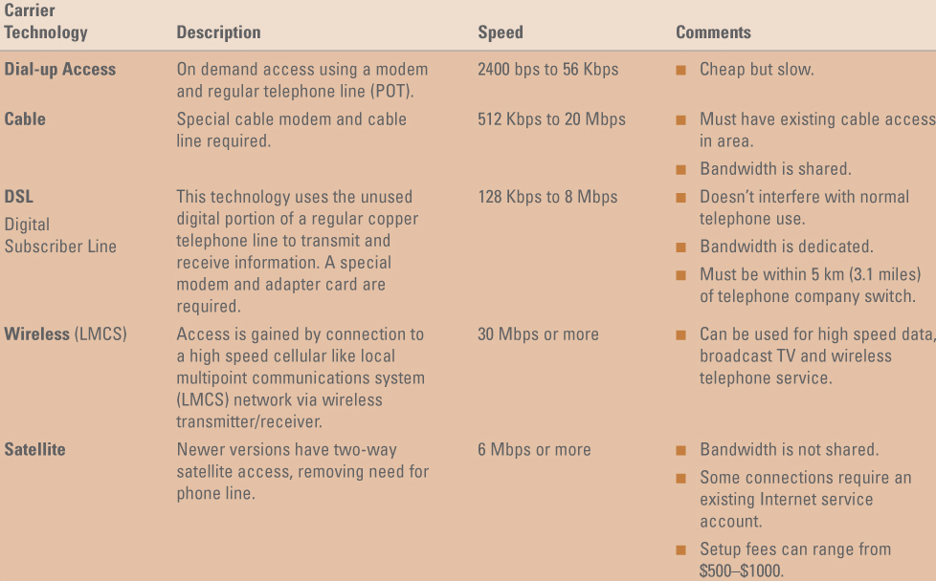
Telecommunication Devices

Slide 20
Communication Software
Connectivity software
  enables a computer to “dial up” or connect to another computer
Web browser software
  enables a computer to surf the Web
E-mail software
  enables electronic communication with other people by sending and receiving e-mail

Slide 21
Wireless Connection
Infrared also called IR or IrDA (infrared data association) - uses red light to send and receive information
Bluetooth - standard for transmitting information in the form of short range radio waves over distances of up to 30 feet and is used for purposes such as wirelessly connecting a cell phone or a PDA to a computer
WiFi (wireless fidelity) - standard for transmitting information in the form of radio waves over distances up to about 300 feet

Slide 22
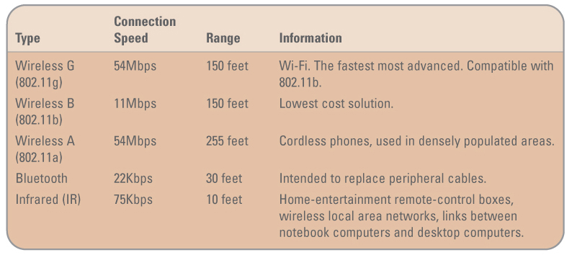
Wireless Connection (continued)

Slide 23
Connecting Devices
Connecting devices enable the hardware to communicate with each other
  A parallel connector is used to plug a printer into a system box
  Parallel connector interfaces with a parallel port that is connected to an expansion card

Slide 24
Buses, Expansion Slots, Expansion Cards; Ports, Connectors
Expansion bus - moves information from the CPU and RAM to all of the other hardware devices
Expansion slot - a long skinny socket on the motherboard into which an expansion card is inserted
Expansion card - a circuit board that is inserted into an expansion slot
Ports - simply the plug-ins found on the outside of the system box into which a connector is plugged into
Popular connectors include:
  USB (universal serial bus)
  Serial connector
  Parallel connector

Slide 25
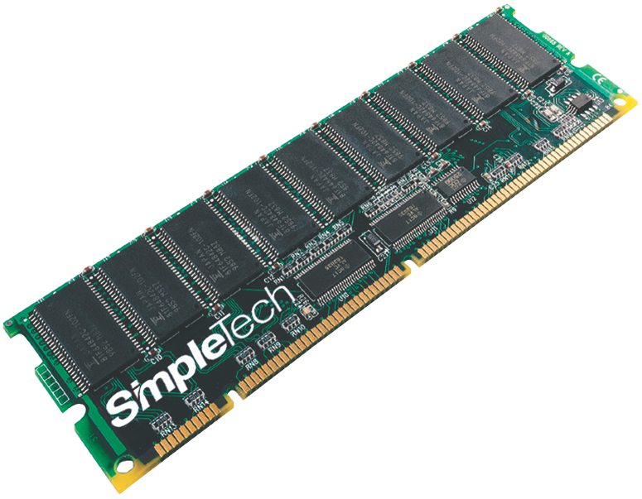
Random Access Memory (RAM)
RAM - temporary storage that holds the current information, the application software currently being used, and the operating system software
RIMM
DIMM
SIMM

Slide 26
Central Processing Unit (CPU)
CPU - the actual hardware that interprets and executes the program instructions and coordinates how all the other hardware devices work together.
  Control unit - interprets software instructions and tells the other hardware devices what to do, based on the software instructions
  Arithmetic/logic unit (ALU) - performs all arithmetic operations and all logic operations
CPU Speed
  Megahertz (MHz) - the number of millions of CPU cycles per second
  Gigahertz (GHz) - the number of billions of CPU cycles per second

