Slide 2
IVC#2
alarm
p2
IVC#1
below
p1
a2_below
doi_on
a1_below
P

Slide 3
node asw(alt1, alt2: int; stat1, stat2 : bool)
returns (alarm: bool; doi_on: bool);
var
a1_below, a2_below, below, p1, p2 : bool;
let
a1_below = stat1 and (alt1 < THRESHOLD);
a2_below = stat2 and (alt2 < THRESHOLD);
below = a1_below or a2_below;
alarm = not stat1 and not stat2;
doi_on = if alarm then pre(doi_on) else below
p1 = a1_below => doi_on;
p2 = a2_below => doi_on;
tel;
(1)
(2)
(3)
(4)
(5)
(6)
(7)

Slide 4
#
X
X
#
#
#
#
#
O
X
X
O
X
X
X
X
O
X
MUST element
X
X
MAY element
#
#
X
#
IRRELEVANT element

Slide 5
C
C
D
D
I
J
A
F
G
A
F
G
B
B
H
E
E
R = /\ r ∈ ∆
r1
r2
r3
(a)
(b)

Slide 6
node top( in1 : bool; in2: bool) returns (P : bool);
var
x : int; c1 : bool;
c2 : bool; c3 : bool;
r1 : bool; r2 : bool;
let
x = 0 -> if (c2 and x < 90) then (10 + pre(x))
else (pre(x) - 10);
r1 = in1;
r2 = not in1;
c1 = (r1 or r2) and in2;
c2 = if in2 then false else c1;
c3 = not c2 or c1;
P = (x < 100) or c3;
tel;
(a)
r1
r2
x
P
c3
c2
c1
(b)

Slide 7
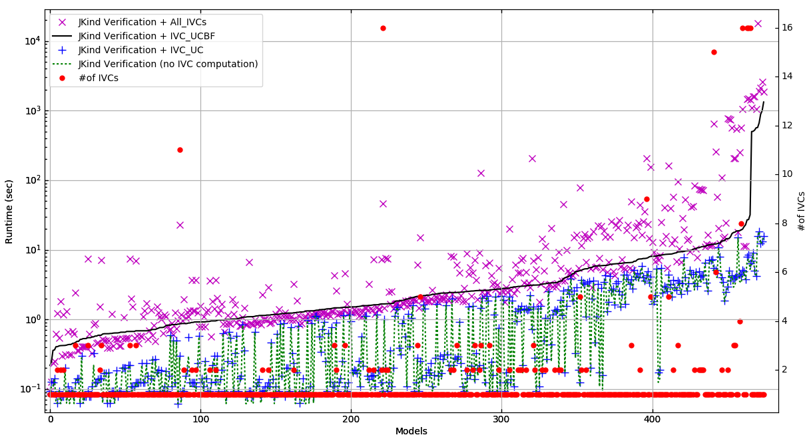
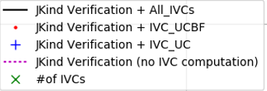
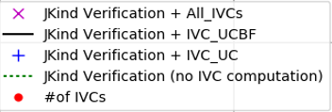
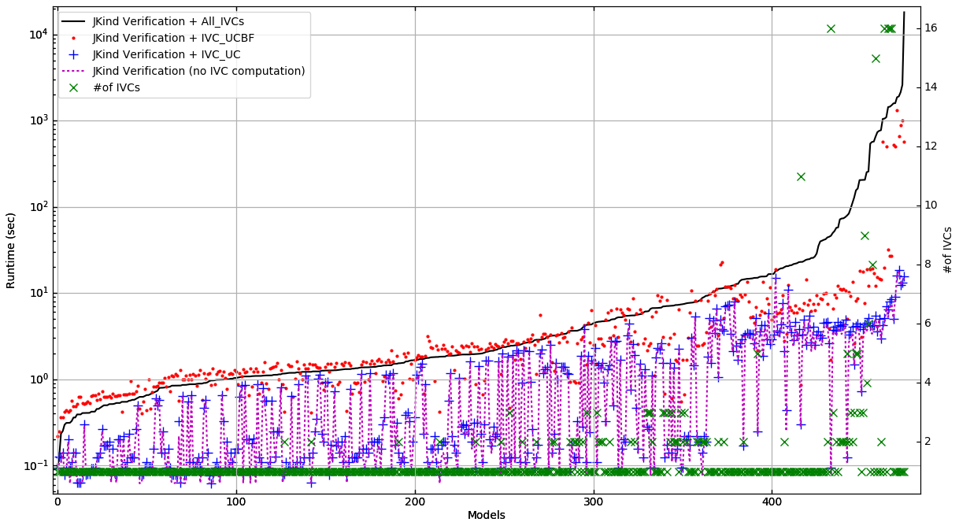
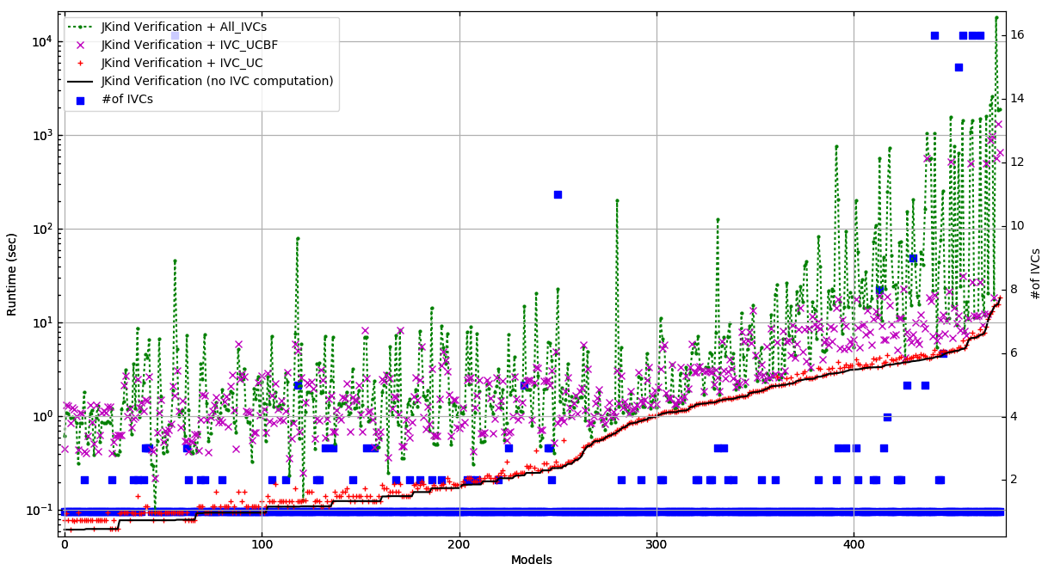
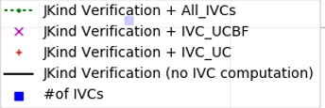
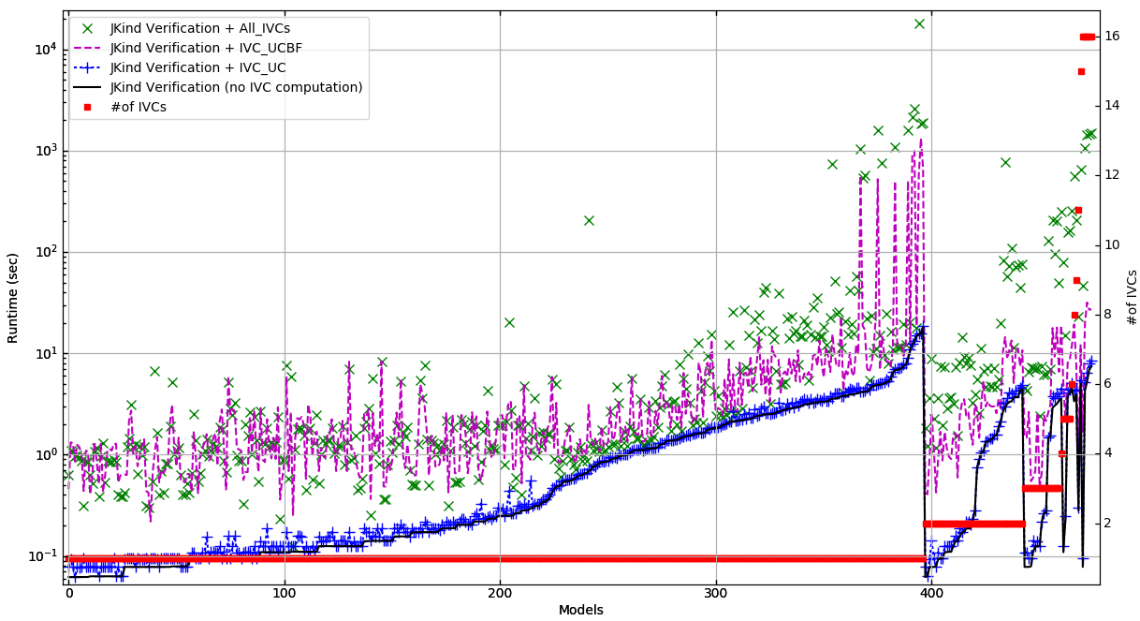
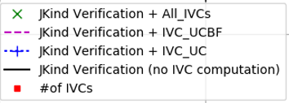
Runtime (sec)
#of IVCs
Models

Slide 8
Runtime (sec)
#of IVCs
Models

Slide 9
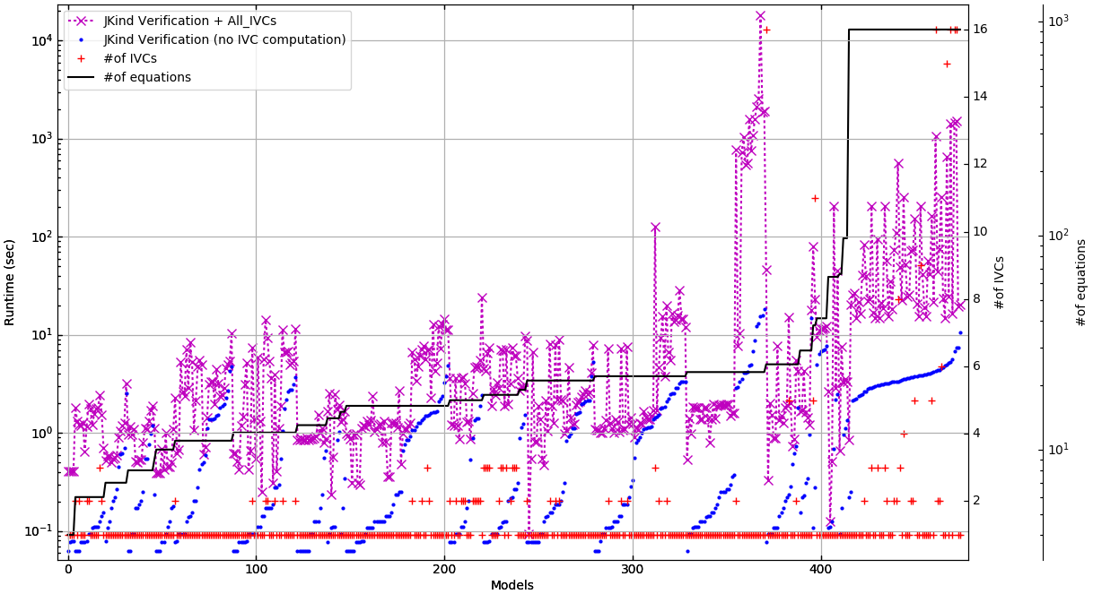
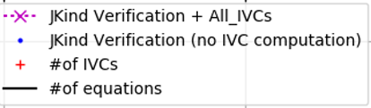
Runtime (sec)
#of IVCs
#of Equations
Models

Slide 10
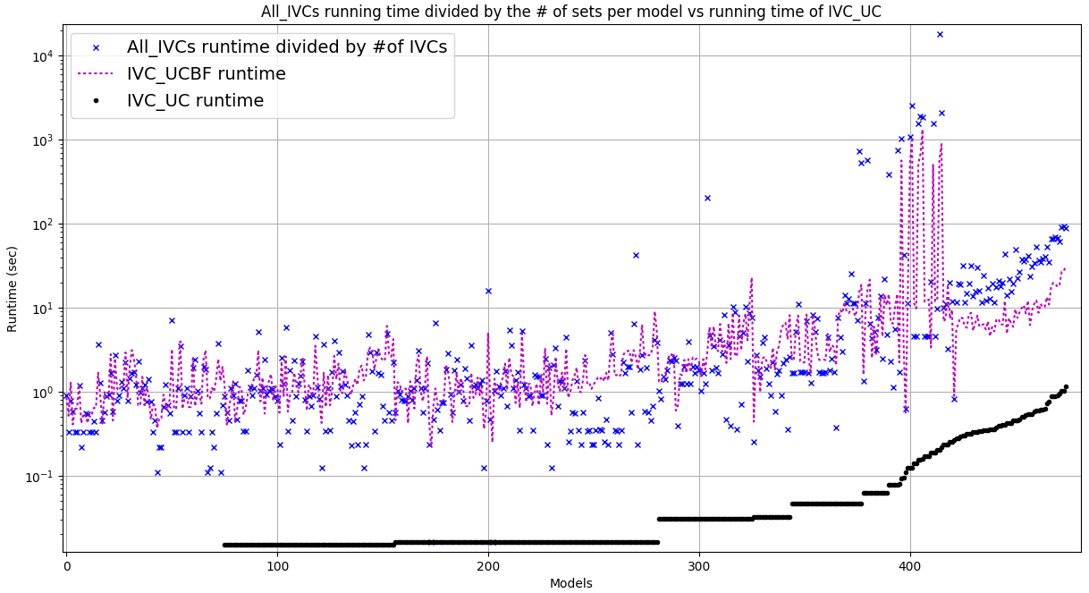
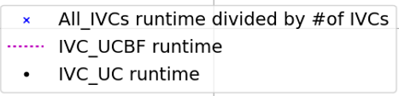
Runtime (sec)
Models

Slide 11
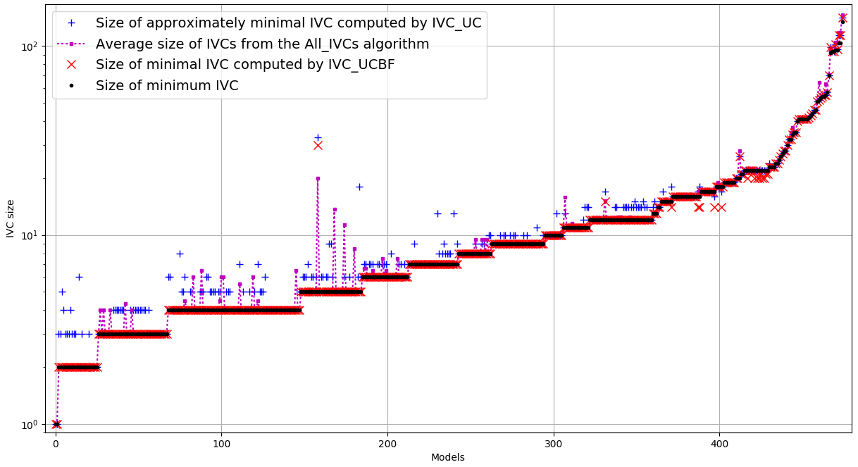
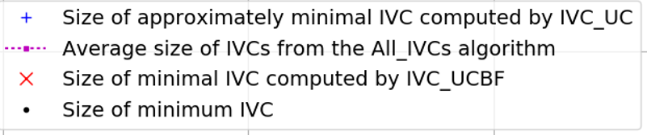
IVC size
Models

Slide 12
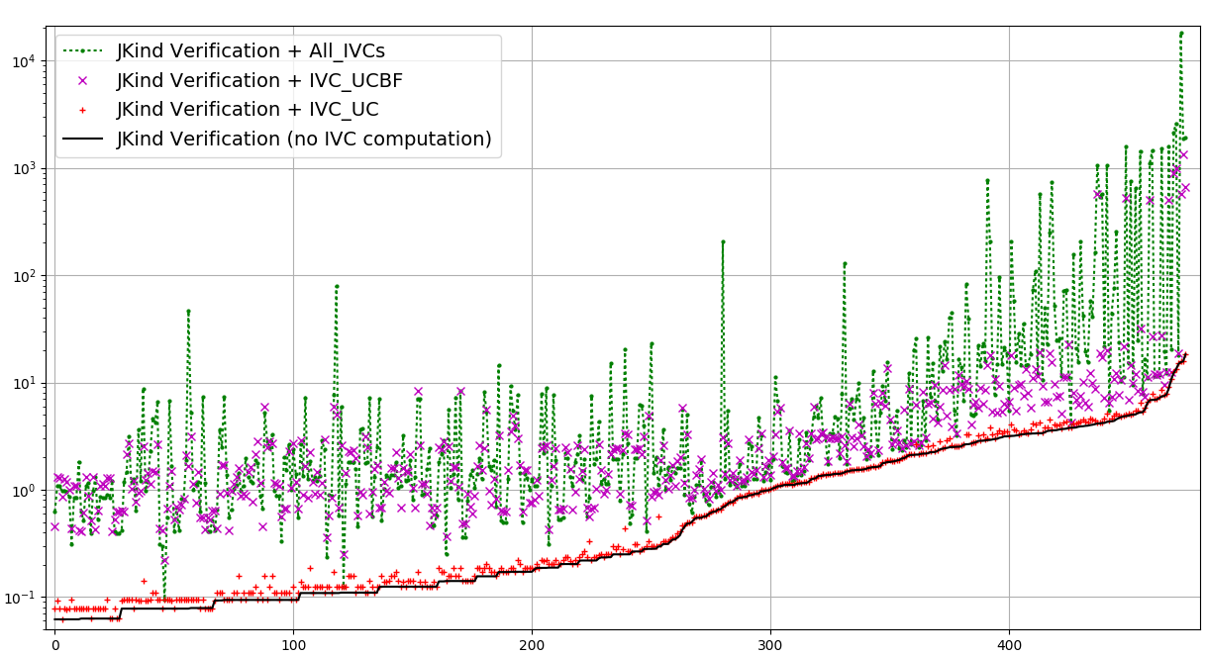
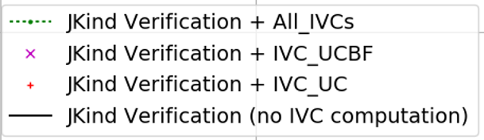
Runtime (sec)
Models

Slide 13
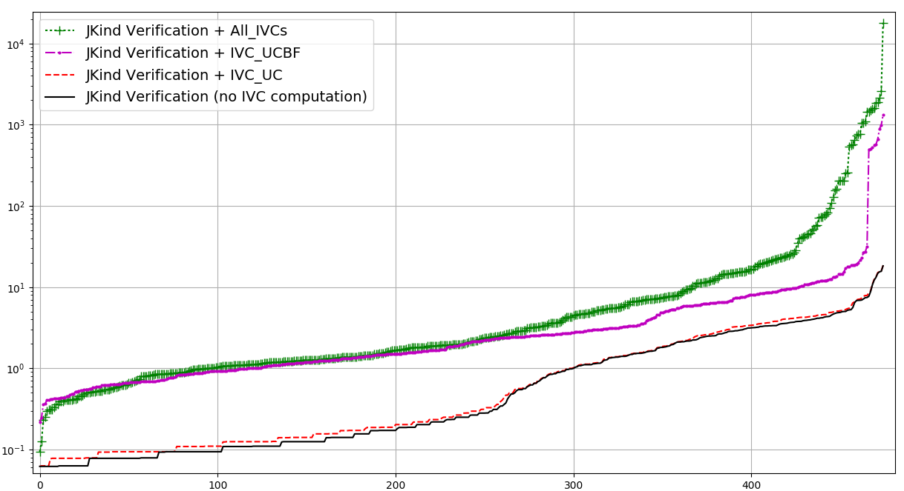
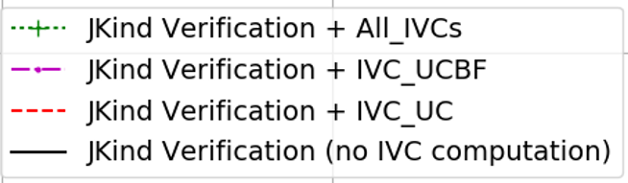
Runtime (sec)
Models

Slide 14
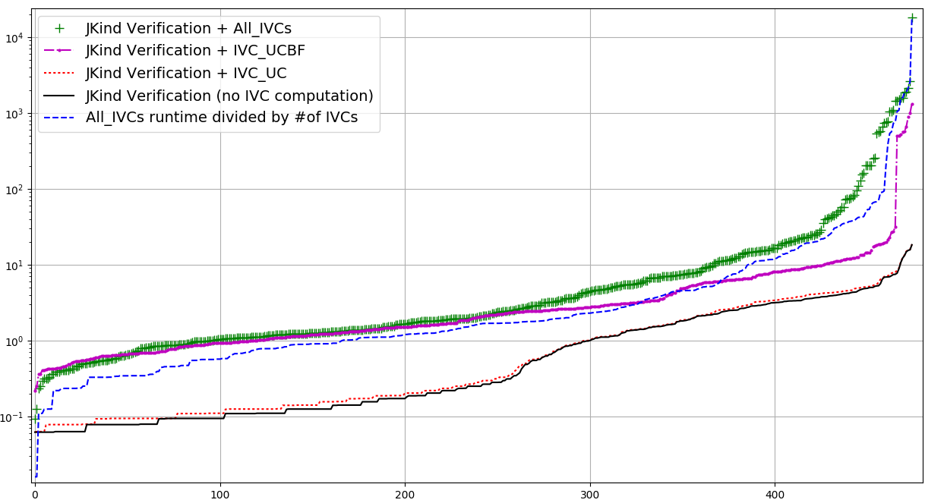
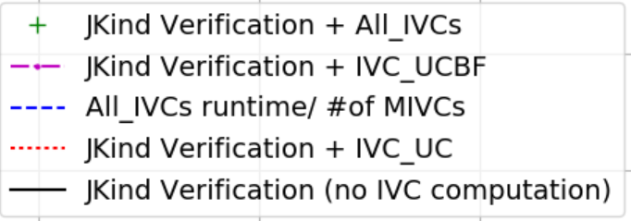
Runtime (sec)
Models

