Slide 1
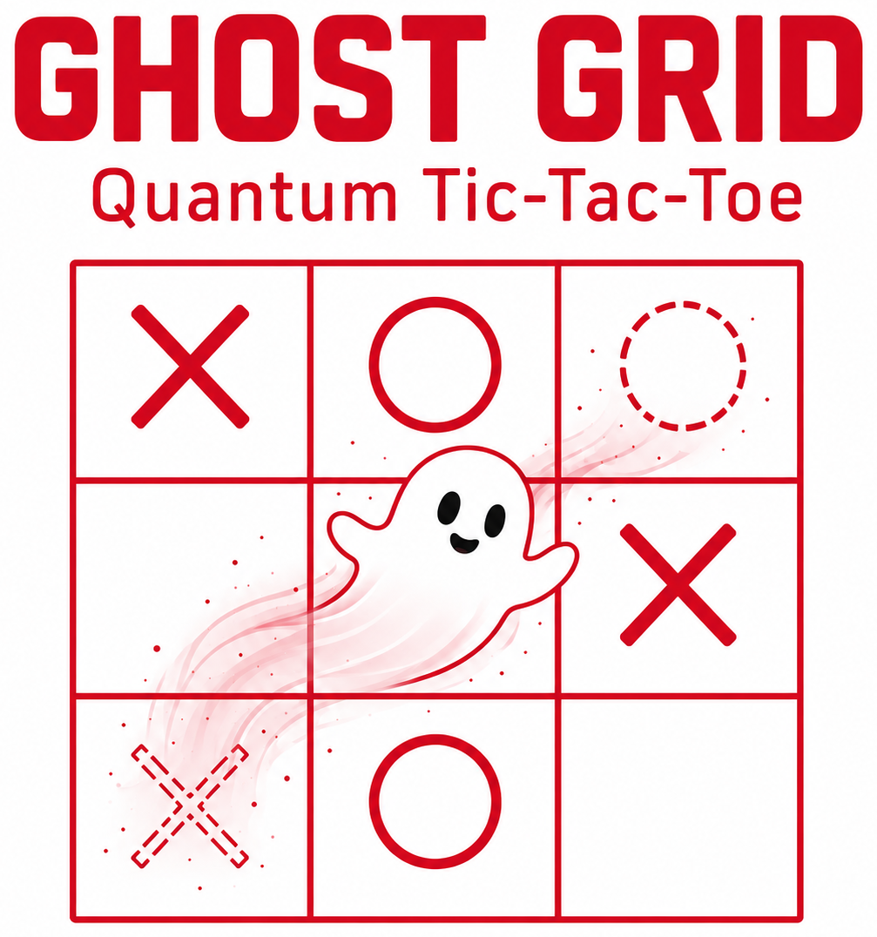
Superposition
Tic-Tac-Toe
A quantum game for two players
Adapted from Allan Goff, American Journal of Physics 74 (2006)
Notes:
Before class, open Superposition_Only_TicTacToe_Offline.html in a browser. The game runs without internet. Click Full screen to project it.

Slide 2
Superposition: two places until measured
Tiny quantum objects, like electrons, follow their own rules.
Before a measurement, an electron can seem to be in two places at once.
Measuring finds it in one place.
No one can predict which place.
Before measuring
X
1 · A
X
1 · B
Measure: roll a die
After measuring
X
GHOST GRID · Superposition Tic-Tac-Toe
2 / 7
Notes:
In the game, a die stands in for the random result of a measurement.

Slide 3
Quantum computers use qubits
A regular computer bit is either 0 or 1.
A quantum bit, or qubit, can be in a superposition of 0 and 1.
A precise laser or microwave pulse puts a qubit into superposition.
Heat and noise ruin a superposition, so qubits need shielding.
With enough qubits, some problems could be solved much faster.
Three ways to build a qubit
Trapped ion
+
One charged atom floats in a trap. Lasers control it.
Superconducting circuit
×
A tiny circuit is kept colder than outer space. Microwaves control it.
Photon
A photon is a particle of light. The way it wiggles stores 0 or 1.
GHOST GRID · Superposition Tic-Tac-Toe
3 / 7
Notes:
Google and IBM build qubits from superconducting circuits. IonQ and Quantinuum use trapped ions. A common myth says a quantum computer tries every answer at once. It does not. It uses superposition and interference to make right answers more likely.

Slide 4
Entanglement links two particles
Particles become entangled when they interact or are created together.
Entangled particles share one quantum state, even far apart.
In a simple pair, if one shows 0, the other shows 0 too.
Each result is random, so entanglement cannot send messages faster than light.
Quantum computers entangle qubits so they can work together.
How scientists make entangled photons
A
Laser
Crystal
B
One photon can split into two entangled photons.
Measure both photons
A: 0
B: 0
or
A: 1
B: 1
The results match. Which one you get is random.
GHOST GRID · Superposition Tic-Tac-Toe
4 / 7
Notes:
Einstein doubted entanglement and called it “spooky action at a distance.” Goff named the game’s spooky marks after that phrase. The 2022 Nobel Prize in Physics honored experiments with entangled photons. It went to Alain Aspect, John Clauser, and Anton Zeilinger. In the game, two pairs that share a square act a little like an entangled pair.

Slide 5
On your turn, pick one kind of move
Classical move
Superposition move
Put one real X or O in a square that is completely empty.
Put a matching pair of spooky marks in two squares, A and B.
X
5
3
7
O
2 · A
O
2 · B
A square can hold up to two spooky marks.
A real mark locks its square.
Placing stops when every square has at least one mark.
GHOST GRID · Superposition Tic-Tac-Toe
5 / 7
Notes:
On screen, choose Classical or Superposition above the playing pad. Then click a square or press a key from 1 to 9. Each pair gets its own color and move number.

Slide 6
Measure your own pairs with a die
Measure when every square has a mark.
Take turns. Measure only your own pairs.
Pick one of your pairs and roll the die.
Odd keeps A. Even keeps B.
The kept mark becomes real. The other mark disappears.
1
5
Before
X
1 · A
X
1 · B
Roll: 4
1
X
5
After
4 is even, so B stays in square 5.
Shared squares: two pairs cannot both stay in one square. If a kept mark lands there, the other pair becomes real in its other square.
GHOST GRID · Superposition Tic-Tac-Toe
6 / 7
Notes:
On screen, click one of your spooky marks, then click Roll die. The game makes any forced moves and lists them after the roll. If a player has no pairs left, the other player keeps measuring. Squares that empty out open again for the next round.

Slide 7
Win after all pairs are measured
Three real marks in a row wins.
Spooky marks do not count.
A row for both players is a draw.
A full board with no row is a draw.
Otherwise, place and measure again.
1
2
3
X
1 · A
X
3 · B
X
5 · A
4
5
6
7
8
9
Not a win yet.
All three X marks are spooky.
Talk about it
Why do three spooky marks in a row not count as a win?
Two pairs share a square. What does measuring one tell you about the other?
GHOST GRID · Superposition Tic-Tac-Toe
7 / 7
Notes:
Spooky marks are not real until they are measured. That is why a row of spooky marks does not win. Measurement decides which marks become real.

