Slide 1




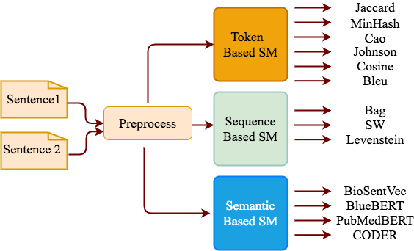
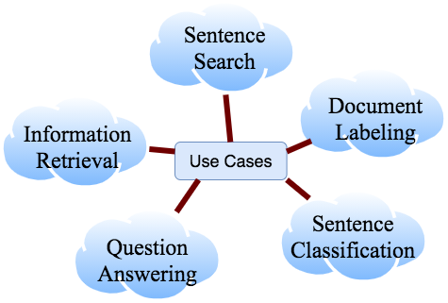
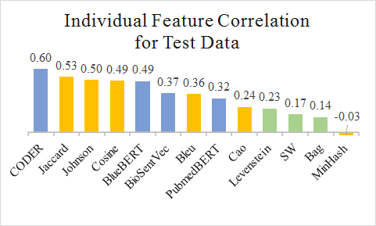
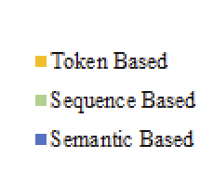
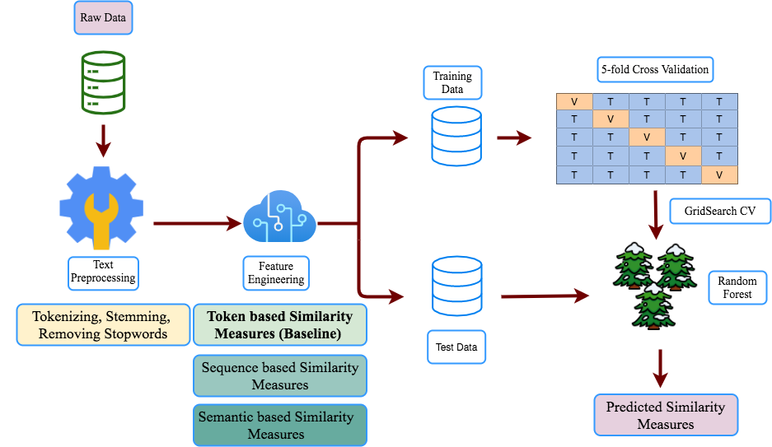
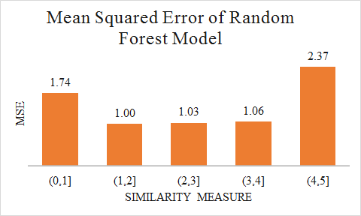
Natural Language Processing to Capture Sentence Similarity
for Electronic Health Records
Elaheh Aghaarabi^{1,2}, Qingyu Chen² and Zhiyong Lu²
elaheh.aghaarabbi@nih.gov, qingyu.chen@nih.gov, luzh@ncbi.nlm.nih.gov
¹Towson University, ² National Center for Biotechnology Information, National Library of Medicine, National Institutes of Health
Introduction
A crucial task in textual applications
Poor performance of general domain approaches for clinical text
Goal:
A baseline model to predict textual similarity measures (SM) for clinical text
Adding more SMs to the baseline model to improve performance
Results
SMs (Features):
Conclusion
Token-based SMs (baseline) correlation with the gold standard scores ➔ 0.73 in the validation and 0.59 in the test data
Adding sequence-based SMs ➔ ~3% performance improvement
Adding semantic-based SMs ➔ ~6% performance improvement
Significant performance improvement ➔ Semantic SMs (transformer-based methods and sentence-embedding models)
Highest error of Random Forest model in the lowest and highest similar sentence pairs
Model:
6 token-based SMs (baseline)
3 sequence-based SMs
4 semantic-based SMs
Pearson correlation of individual SMs with the gold standard similarity score
Figure 1. Sentence Similarity Use Cases
Figure 3. SM Categories
Table 1. Model Prediction Correlation with the Different Sets of SMs
Model | Number of SMs | Validation Set | Test Set
Token SM (Baseline) | 6 | 0.73 | 0.59
Token + Seq SM | 9 | 0.75 | 0.62
Token + Seq + Semantic SM | 13 | 0.81 | 0.68
Figure 4. Feature Importance
Future Work
Including more varieties of similarity-based features
Performing transfer learning by using more sentence pairs with the general domain text
Evaluating generalization ability of the model by using other clinical text
Method
Data:
Training data ➔ 1640 sentence pairs with the gold standard score
Test data ➔ 412 sentence pairs
Baseline Model:
A Random Forest model trained on the token-based SMs
Evaluation Metric:
Pearson correlation to evaluate the model prediction correlation with the gold standard score
Discussion
Error Analysis:
Mean Squared Error (MSE)
Five subcategories of expert-defined similarity regions
Acknowledgement
This research is supported by the Graduate Data Science Summer Program and the Intramural Research Program of the National Library of Medicine, NIH
Reference
[1] Chen, Q., Du, J., Kim, S., Wilbur, W.J. and Lu, Z., 2020. Deep learning with sentence embeddings pre-trained on biomedical corpora improves the performance of finding similar sentences in electronic medical records. BMC medical informatics and decision making, 20(1), pp.1-10
Figure 2. Model Pipeline to Capture Sentence Pair Similarity
Figure 5. Mean Squared Error for Different Similarity Regions

