Slide 1
Sugar Tax Policy
COMP6235 - Food and Health
Team 2

Slide 2
The Sugar Tax Policy
The chancellor has announced a new sugar tax on the soft drinks industry will be introduced in the UK, with implementation expected in April 2018^{[1]}.
The news from BBC gave us the idea to raise this issue. Several questions come:
Why is the Sugar Tax Policy relevant?
Is Sugar Tax targeting the right demography?
What is the relationship between target product and obesity?
Can Sugar Tax reduce obesity?
[1] "Sugar Tax: How Will It Work? - BBC News". BBC News. N.p., 2016. Web. 1 Nov. 2016.
Notes:
Ada takes the introduction

Slide 3
Datasets
Consumption (gov.uk - family food datasets)
Household and Eating out consumption of soft drinks (2000-2014)
Specification for Caloric and Non-Caloric soft drinks
Household and Eating out expenses on soft drinks (1992 - 2014)
Regional HouseHold and Eating Out consumption of soft drinks (2001-2014)
Health (data.gov.uk - NHS [National Health Service] )
Regional and historical data about obesity diagnosis (2006 - 2014)
Historical data about obesity by gender (2004 - 2014)
Historical data about obesity by age (2004 - 2014)
Notes:
Gerard takes datasets

Slide 4
Data science pipeline
RStudio
Data Collection
Cleaning
Analyzing
Product Development
MongoDB Excel Notepad++ SublimeText
Python with Flask framework Bootstrap + Material Design MongoDB (with Pymongo Nginx
Leaflet Chartist.js
Report /
Visualising
Notes:
Chidi takes the pipeline: for visualising,regional health data was joined consumption data by region for the heat maps using leaflet

Slide 5
Technical aspects
Regression:
Analyse data to build a linear regression for UK regions obesity and sugar consumption
Correlation:
Obese demographics and sugar consumption
Obese demographics and soft drinks consumption
Obese demographics and low calories soft drinks consumption
Notes:
Chidi takes the technical aspects

Slide 6
Results
Data fact 1:
(-) Negative relation between eating sugar and obesity.
(-) Negative relation between drinking soft drink (in general) with obesity.
Data fact 2:
(+) Very strong positive relation between drinking low calories soft drink and obesity.
(+) Even stronger positive relation between obese people by the age of 16-24 and consuming low calories soft drink.
Notes:
Lingga takes results

Slide 7
Conclusions
Although people are getting more and more obese, there is negative relation between sugar consumption and obesity.
However, there is strong positive relation between increase in consumption of low calorie drinks and obesity.
Are there any other factors, e.g. artificial sweeteners like aspartame, that might be overlooked? [2]
So, although the Sugar Tax Policy has aimed the right age groups, the product group it is targeting is already low in calories, and the desired outcome on slowing the obesity growth is questionable.
There has been already trend of people reducing sugar intake and drinking more lower than higher calorie drinks
[2] "The Truth About Aspartame - Live Well - NHS Choices". Nhs.uk. N.p., 2016. Web. 11 Jan. 2017.
Notes:
Lingga takes results

Slide 8
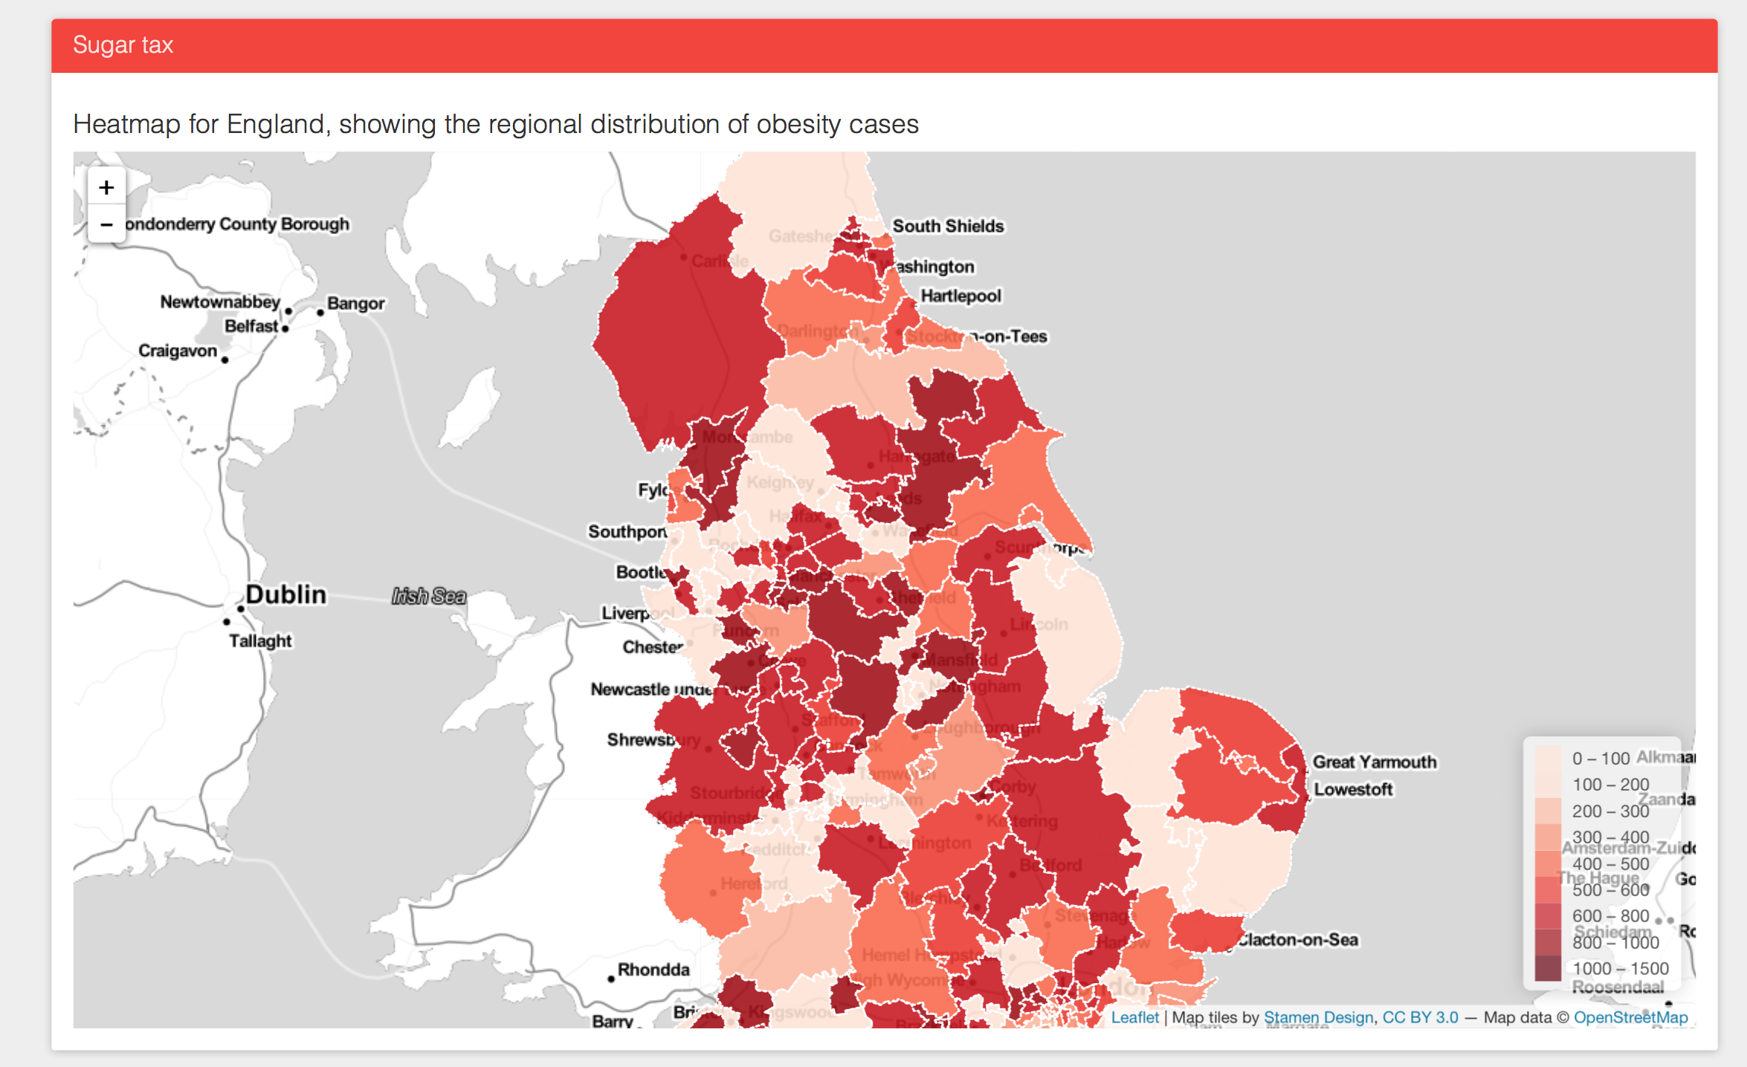
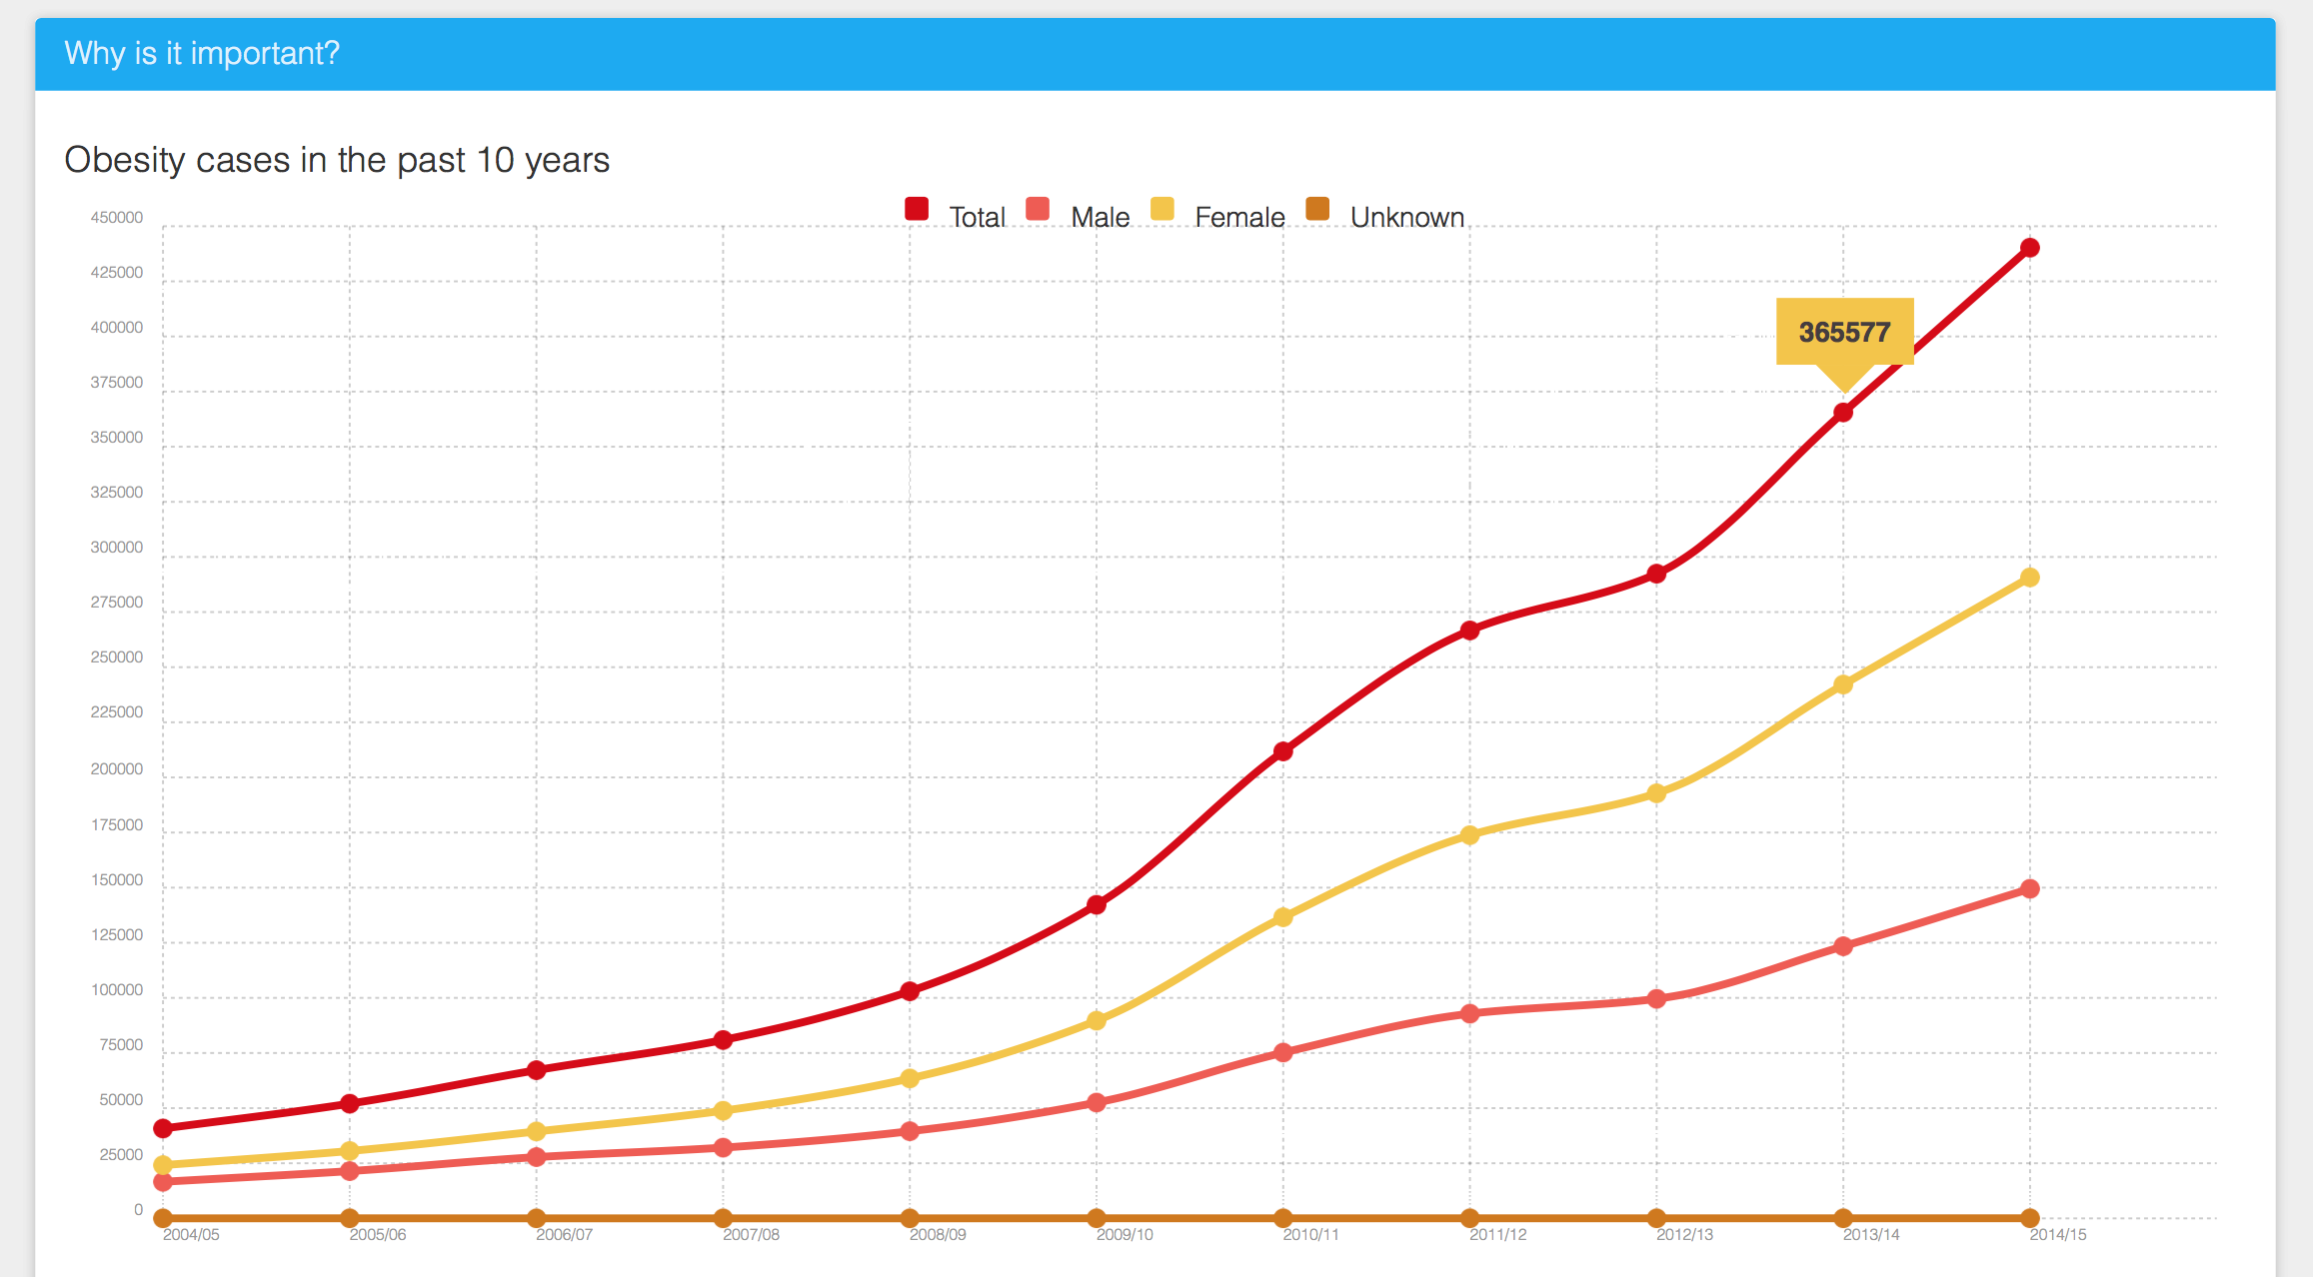
Product
Website
Charts
Interactive map
Results of the analysis
Notes:
Ahmet takes the product demo

