Slide 1
Areas of Manchester to target for emissions reductions From Fossil Fueled VEhicles
Data Science Capstone Project

Slide 2
Areas of Manchester to target for emissions reductions from Fossil Fueled VEhicles
Three ways to reduce emissions from fossil fueled vehicles:
Low emissions zones to restrict/deter polluting vehicles via additional tariffs,
Public electric vehicle (EV) charging points to encourage transition of low emissions vehicles,
Incentives/subsidies for electric vehicle car sharing schemes to set up and operate in the area.
We’re looking for the areas with the most to gain. The factors that influence the ‘level of gain’ are:
Respiratory Disease Deaths – reducing number of fossil fuel powered cars will reduce private vehicle tailpipe emissions, reducing the air pollution that augments respiratory health problems.
COPD Admissions – reducing number of fossil fuel powered cars will reduce private vehicle tailpipe emissions, reducing the air pollution that augments COPD (Chronic Obstructive Pulmonary Disease).
Accidents – reducing number of vehicles on the roads can reduce the number of accidents.
Factors that will influence EV (private or car sharing) uptake include:
Distance to station – an assumption in this project is that the further a ward (i.e. a type of district in Manchester) is from a station the more likely the locals are to use private transport. Therefore these areas can benefit from EV charging and car sharing schemes.

Slide 3
Who wants to know?
The answer to this question ‘which areas of Manchester should be targeted for emissions reductions from fossil fuelled vehicles’, may be of interest to:
Policy makers and or Local Authorities - to set targets and incentives for three ideas laid out on the previous slide,
Community interest groups - to campaign for the rollout of local charging points.

Slide 4
Data acquisition and cleaning
CSV of Manchester wards by latitude and longitude, Source: https://www.doogal.co.uk/UKPostcodes.php?Search=M (June, 2020)
Of the 47 fields available in the CSV the 5 fields were selected for use these were all fully populated
Accidents, Health and Population data by Manchester ward, Source: https://dashboards.instantatlas.com/viewer/report?appid=962615537fc24dda8a0a29dc86bd4e37 (June, 2020)
Geojson file of wards of Source: https://martinjc.github.io/UK-GeoJSON/json/eng/wards_by_lad/E08000003.json (June, 2020)
Foursquare supermarket venue search (June, 2020)
Had to clear rows with a mention of Money or Car from the results of the ‘supermarket’ search
The solar potential identified for Manchester in Source: Google Environmental Insights Explorer (June, 2020) https://insights.sustainability.google/places/ChIJ2_UmUkxNekgRqmv-BDgUvtk/download

Slide 5
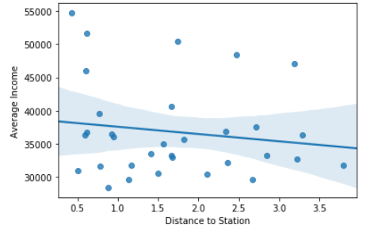
Data exploration & Visualisation
Is there a relationship between Distance to Station and Average Income of a ward?
Scatter plot of Distance to Station and Average Income shows slight negative correlation, -0.149.
It is thought that houses close to amenities (like a station) cost more so those with higher incomes can better afford these.
Wards appearing on the top right hand corner of this graph are hypothesised to be the best candidate locations for chargepoint installations.

Slide 6
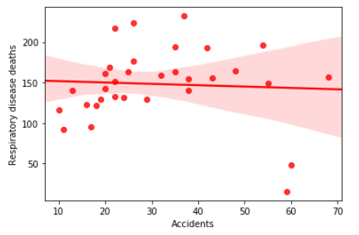
Data exploration & Visualisation
Is there a relationship between Respiratory Disease Deaths and Road Accidents in a ward?
Scatter plot suggests no correlation.
There are many influencing factors that cause accidents that are not related to the number of vehicles in an area (and respiratory diseases are also caused by factors other than vehicle air pollution).

Slide 7
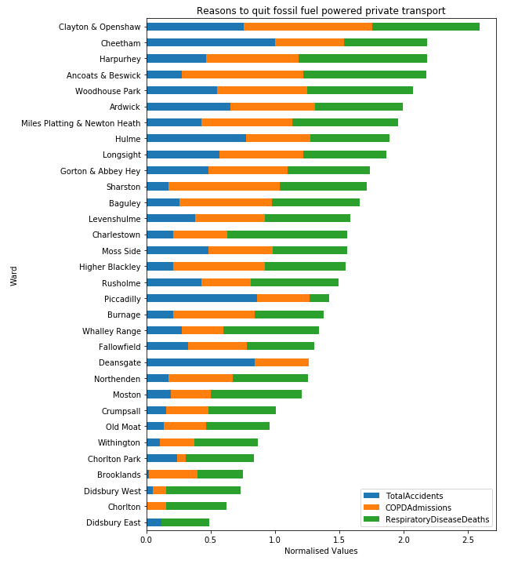
Data Analysis
The three key features that would influence the ‘level of gain’ for targeting fossil fuel vehicle reduction are normalised and stacked in this horizontal bar chart which shows the totals in descending order.

Slide 8
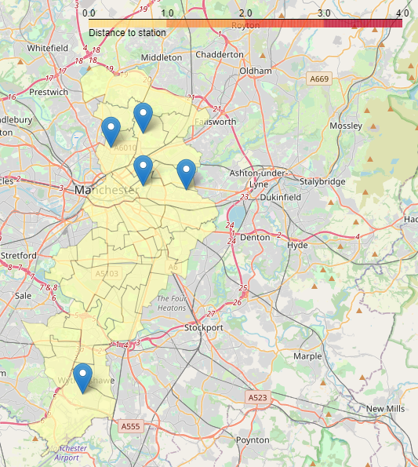
Data visualisation
Choropleth map to show the distance to the station.
Markers show the top 5 wards with the worst total cases of respiratory disease deaths, COPD admissions and accidents.
They markers contain the ward names in a ‘pop over’.

Slide 9
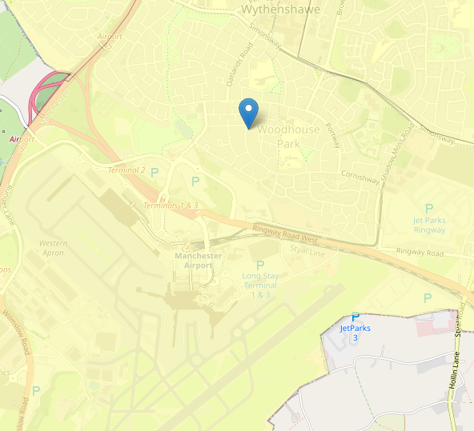
Data visualisation
One of the five wards appears to be a long way outside the city centre. Upon zooming in we see that it is close to Manchester International Airport so it seems likely that this is the cause of the air pollution leading to Woodhouse Park being in the top 5 wards.

Slide 10
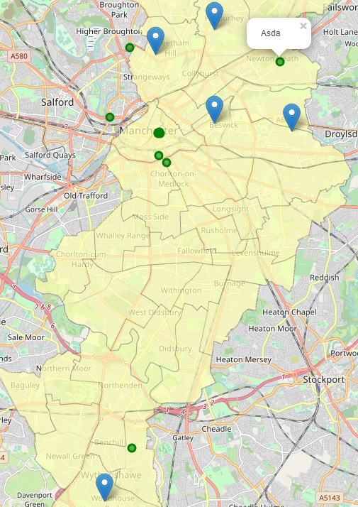
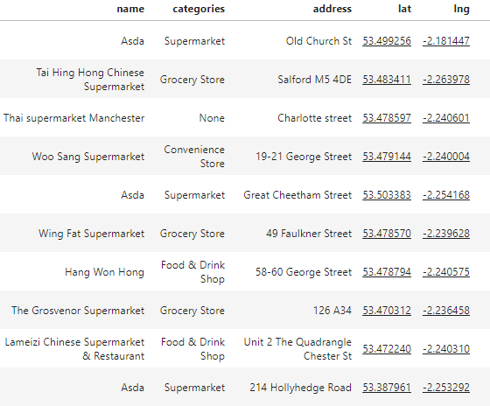
Data visualisation
To make the visualisation more useful. The Foursquare API is used to identify supermarkets within 2km of the centre of the top 5 wards. (Inlay here shows dataframes with the identified supermarkets).
Supermarkets are frequented by most households on average weekly (even in lockdown). Hence their car parks would make ideal locations for EV chargepoints or car share scheme bases.

Slide 11
Conclusions and Recommendations
It is recommended that: Clayton & Openshaw, Cheetham, Harpurhyey, Ancoats & Beswick, Woodhouse Park be targeted for ways to reduce air pollution.
To reduce pollution from emissions from fossil fuelled private vehicles, the supermarkets identified within the vicinity of the top 5 wards could be explored as places for electric vehicle chargepoints and/or EV car sharing schemes.

