Slide 1
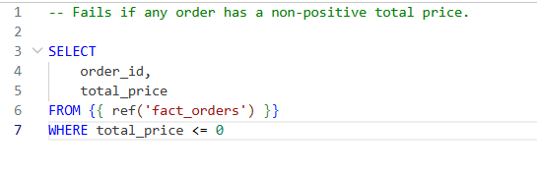
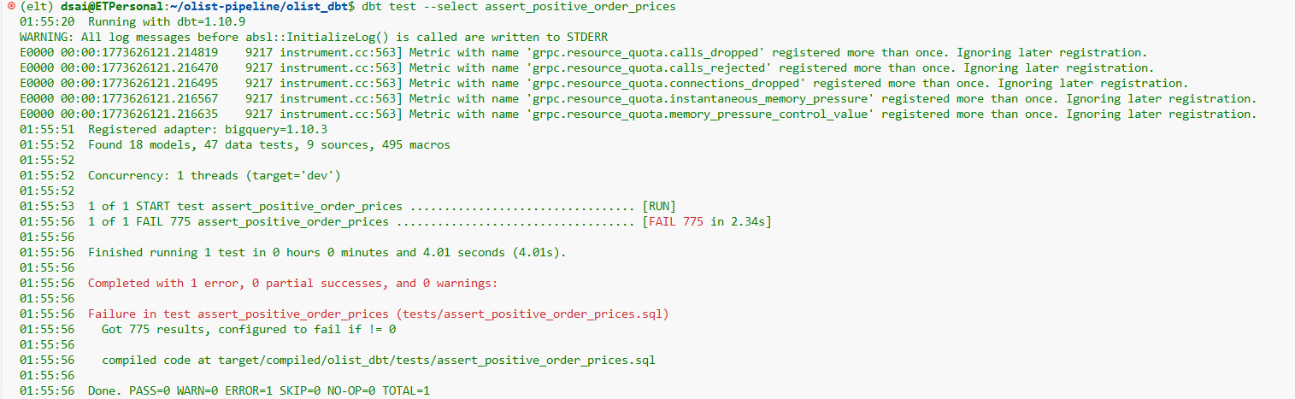
SQL
Test
Our pipeline detected 775 orders with zero total value and 9 payments with zero or negative value — these represent data quality issues in the source data that would need to be addressed before business reporting

Slide 2
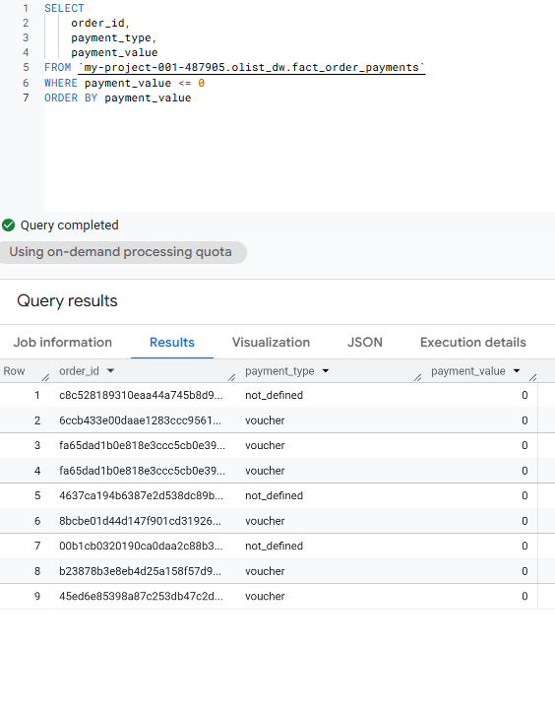
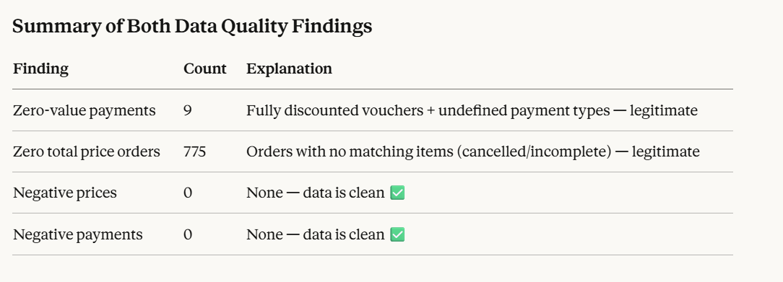
Our pipeline detected 9 zero-value payments: 6 fully discounted vouchers and 3 unclassified payments. These are valid edge cases in the source data, not pipeline errors

Slide 3
Data Quality Findings
Finding 1 — Zero-Value Payments (9 records)
Detected by: assert_positive_payment_values singular test
What was found: 9 payment records with a payment_value of 0, consisting of 6 voucher payments and 3 payments with an undefined payment type.
Root cause: Voucher payments with a value of 0 represent fully discounted orders where the customer paid nothing out of pocket. The 3 not_defined records indicate incomplete payment type data in the source system.
Conclusion: These are legitimate edge cases in the source data, not pipeline errors. No fix required.
Finding 2 — Zero Total Price Orders (775 records)
Detected by: assert_positive_order_prices singular test
What was found: 775 orders with a total_price of 0.
Root cause: These orders exist in the orders table but have no matching items in the order items table. They are orders that were created but never completed — likely cancelled or abandoned before any products were added. The pipeline's coalesce(..., 0) logic correctly defaulted their price to 0 rather than losing the records.
Conclusion: These are incomplete orders from the source system. Individual item prices were verified separately and confirmed to be all positive and clean.

Slide 4
Finding 3 — No Negative Values (0 records)
Detected by: Both singular tests
What was found: Zero records with negative prices or negative payment values across the entire dataset.
Conclusion: No anomalous negative values exist in the pipeline. Data is clean. ✅

Slide 5
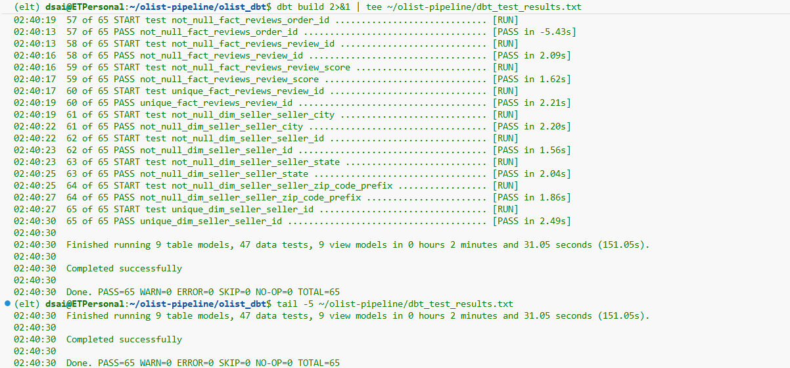
Dbt test results

Slide 6
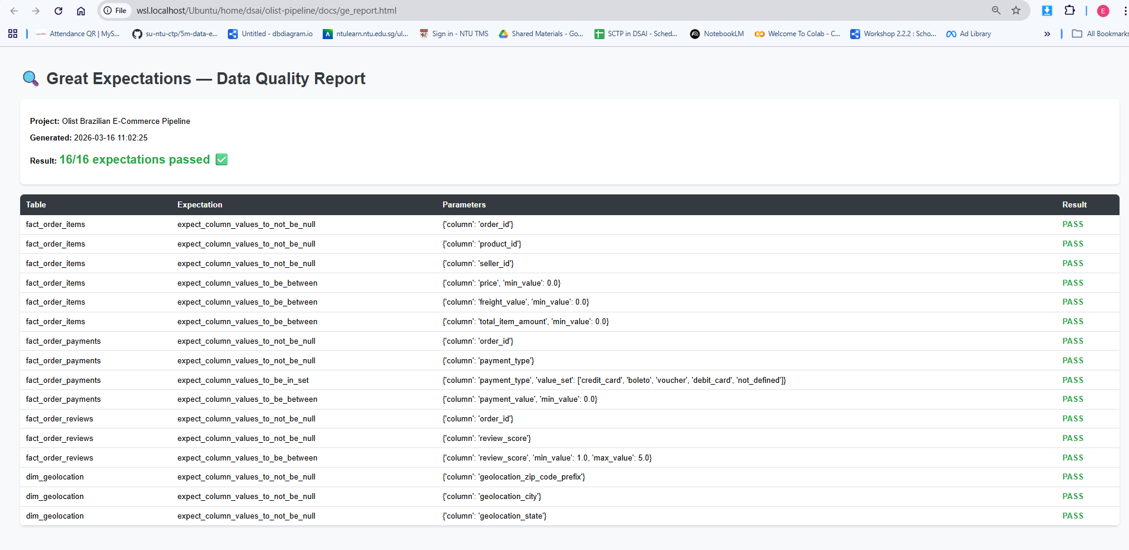

Slide 7
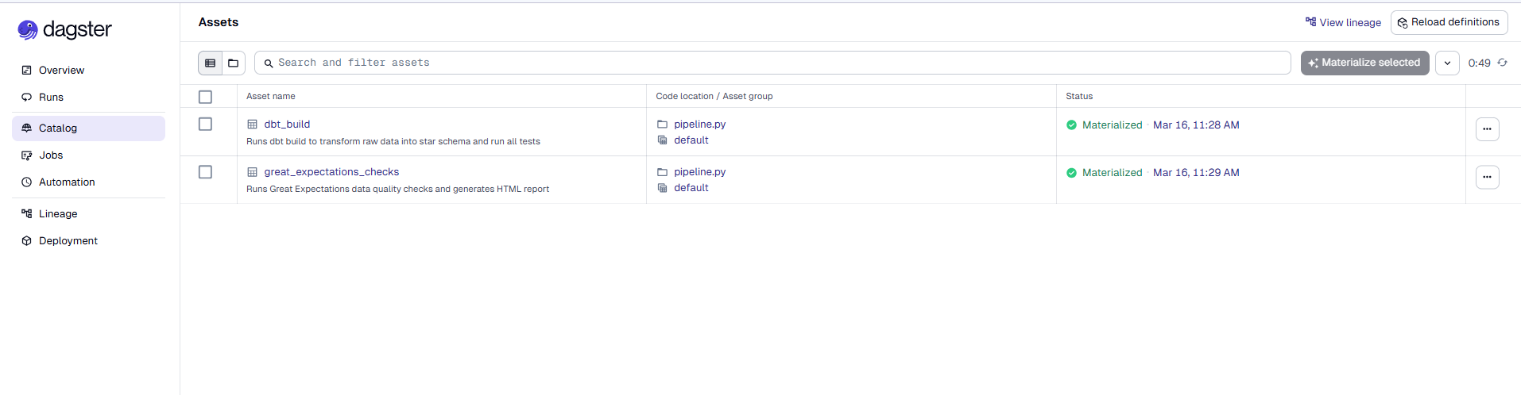
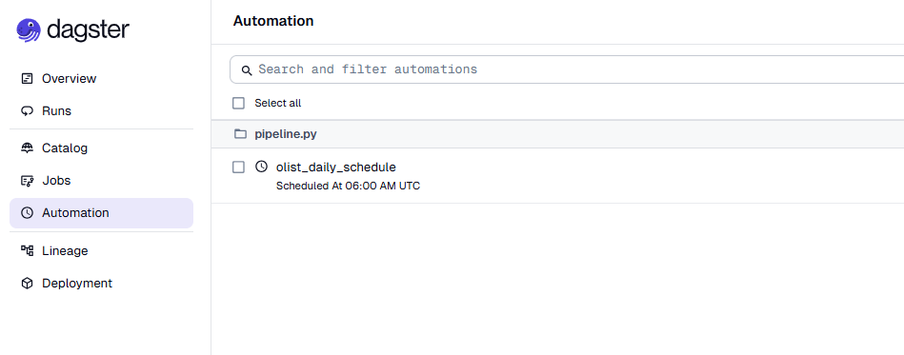

Slide 8
