Slide 1
Testing Debris Disk Dynamics
Investigating the Effects of Planetesimal Size on Long Term Debris Disk Evolution
Elaine Nieves · University of Atacama · Supervisor: Dr. Marco Muñoz Gutiérrez · SOCHIAS 2026
Notes:
15 minutes: ~3.5 min intro, 3.5 min stirring, 5.5 min simulations, 2 min planet + summary. Fill in name, affiliation, venue.

Slide 2
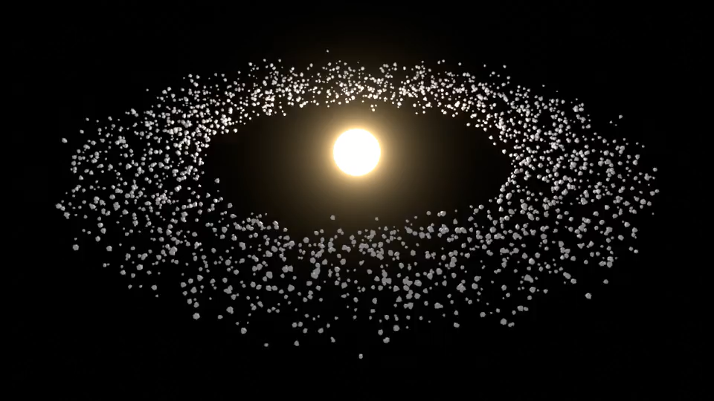
What is a debris disk?
A belt of rock and ice left over from planet formation
Primoirdial dust should vanish in about a Myr, so the dust we observe must be resupplied
Source of the Dust: collisions between planetesimals we cannot see
2
Notes:
Say what the animation shows before it plays (what the dots are, what is being stirred). Planetesimals collide, break apart, make dust; we only see the dust. Dust is removed by radiation pressure and Poynting-Robertson drag, so it must be continuously replenished.

Slide 3
Why debris disks matter
A fossil record
Planet signposts
Our own system
Belt size, mass and structure record how planetesimals formed
Gaps, warps and sharp edges can point to planets we cannot see
Analogs of the Kuiper belt, and the dust around habitable-zone planets
3
Notes:
Check which system your 100 AU belt is modeled on (HD 216435?) and name it here if useful. Resolved with ALMA, HST, JWST.

Slide 4
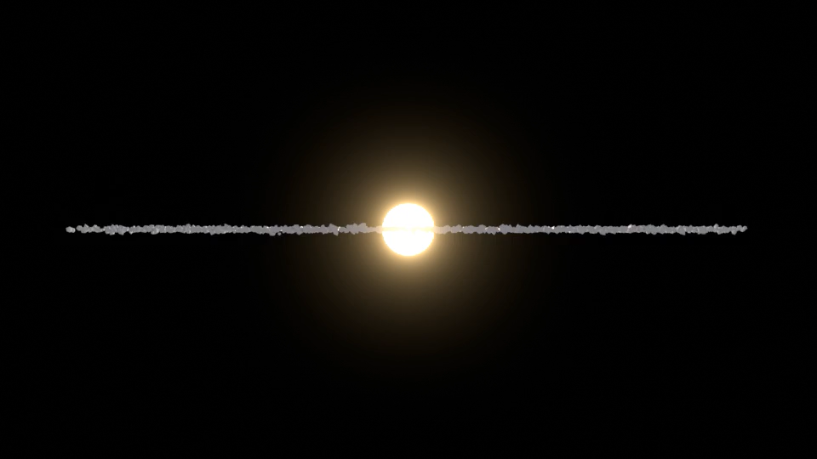
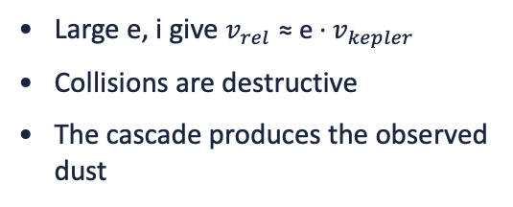
The puzzle: collisions need stirring
Cold disk
Stirred disk
e ≈ 0, i ≈ 0
Low relative speeds
Collisions are gentle: bodies stick, little dust
Large e, i give $v_{rel}$ ≈ e · $v_{kepler}$
Collisions are destructive
The cascade produces the observed dust
What stirred the disk, and when?
4
Notes:
Primordial disks are dynamically cold. Something has to excite eccentricities and inclinations, and the answer sets when the collisional cascade turns on.

Slide 5
Two main ways to stir a disk
Self-stirring
Planet stirring
Largest planetesimals excite the rest
No planet required
Stirring front moves outward through the disk
Secular and resonant forcing
Acts on a secular timescale
Can also sculpt gaps and edges
5
Notes:
Setup for the end of the talk: today I test self-stirring; next I add a planet. A stellar flyby is a third option; one sentence if asked.

Slide 6
Mixed stirring: both at once
+
=
Self-stirring
Planet stirring
Mixed stirring
Large planetesimals excite the belt
Secular and resonant forcing
Both act on the same disk
What could change the stirring rate?
Planet-to-disk mass ratio
Planet–disk distance
Mass distribution
Which one dominates the excitation?
How strongly planet forcing reaches the belt
Size slope q and stirrer mass set the self-stirring strength
Goal: unite them and see how the stirring rate changes
14
Notes:
Mixed stirring = a planet and self-gravitating planetesimals acting together. Compare e_rms(t) against the self-stirring-only runs while varying: planet/disk mass ratio, planet-disk distance, mass distribution (slope q, stirrer mass). Add any further factors you had in mind (e.g. planet eccentricity) here; your message cut off after 'mass distributions'. If short on time, cut this slide or merge it into the previous one.

Slide 7

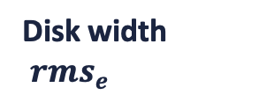

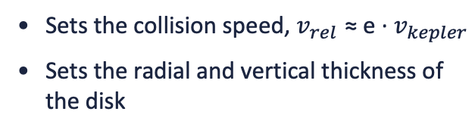
Quantifying stirring
Why $e_{rms}$ matters
RMS eccentricity
e_{rms} ∝ t^{p}
Sets the collision speed, $v_{rel}$ ≈ e · $v_{kepler}$
Sets the radial and vertical thickness of the disk
Expected growth: p ≈ 1/4
(Krivov & Booth 2018)
Disk width
${rms}_{e}$
Quantifies stirring as a whole
Disk thickness ${rms}_{i}$
Vertical scale height in edge-on systems
6
Notes:
Define e_rms and C_e here (fill in your definition from the Krivov & Booth comparison). Inclination dispersion works the same way.

Slide 8
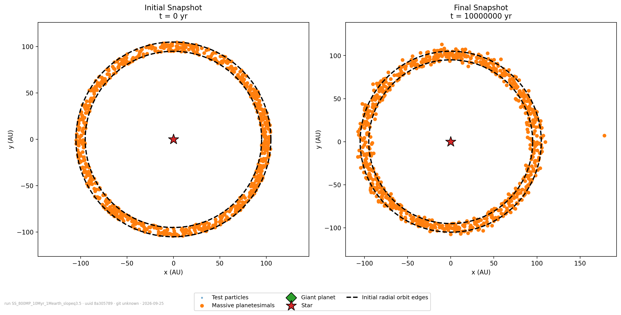
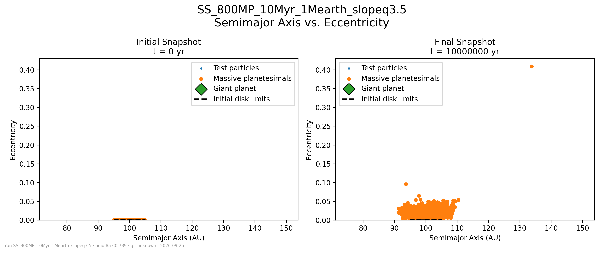
Simulation setup
800
100 AU
1–10 M⊕
q = 3.5
massive planetesimals
belt, 95–105 AU wide
total belt mass
size-distribution slope
REBOUND + Mercurius, full mutual gravity among massive bodies. Initial e, i ≈ 3×10⁻⁵.
8
Notes:
Left panel is the cold disk at t = 0; right is the same belt after 10 Myr. Also varied: q = 2.5, 4.5, uniform masses, and a Lorentzian a-distribution in the newest runs. Test particles feel gravity but do not stir.

Slide 9
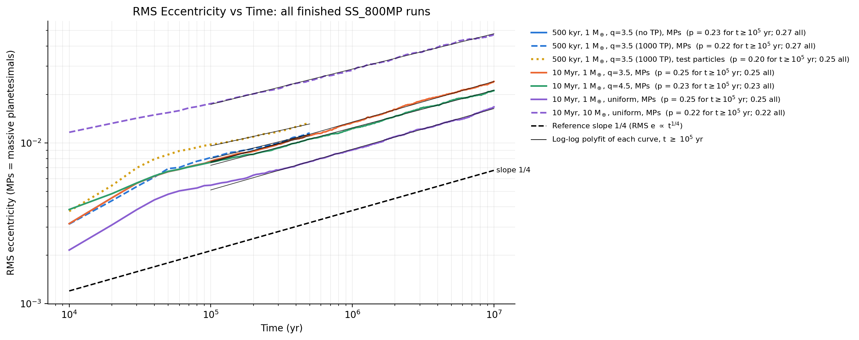
RMS eccentricity grows as a power law
p ≈ 0.20–0.25 in every run, close to the 1/4 reference slope
10
Notes:
Fits are log-log degree-1 polyfits for t >= 1e5 yr (calibration/rms_e_all_runs_fits.md). The 1 Earth-mass q=3.5 run gives p = 0.25 over 10 Myr. State whether this agrees with Krivov & Booth.

Slide 10
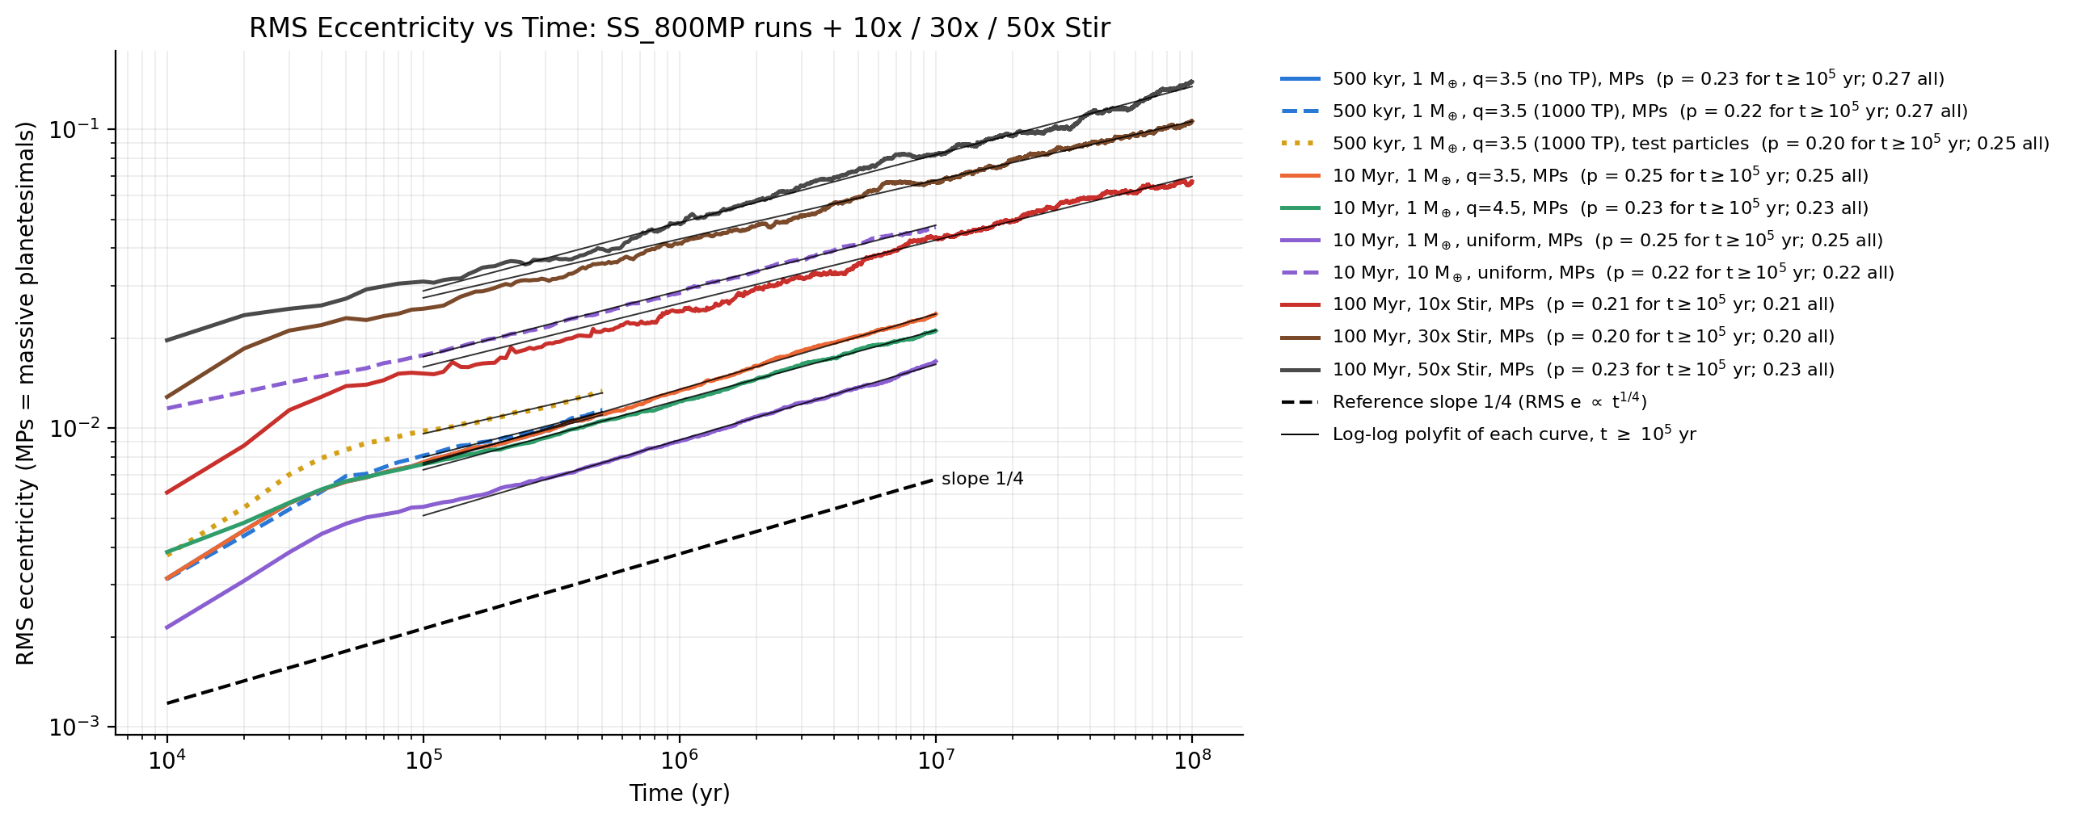
What changes the amplitude
×10
≈0.07 → 0.15
p barely moves
10× the belt mass (1 to 10 M⊕, uniform)
e_rms at 100 Myr, 10× to 50× stirrers
0.20–0.25 for every mass model
11
Notes:
Amplitude A (e = A t^p): 2.8e-4 for 1 Earth mass uniform vs 1.4e-3 for 10 Earth masses uniform. Stirrer runs are 100 Myr; the 50x run reaches about 0.15, 10x about 0.07. Check wording on test particles (p about 0.20 vs 0.22 for massive bodies) if you mention them.

Slide 11
Next: add a giant planet
1
Does a planet stir faster than self-stirring
2
Does it truncate or warp the belt, adding structure that e_rms misses?
planet
3
Can width, thickness and edge sharpness tell the two apart?
belt
13
Notes:
The code already supports a giant planet (a-e and a-i figures mark it). Fill in the planned planet parameters and when to expect results.

Slide 12
Summary
1
Debris disks make dust only if stirred, and stirring tells us how planets formed
2
Self-stirring in N-body runs gives RMS e growing as t^¼ (p ≈ 0.20–0.25), robust across mass models
3
Next: add a giant planet and compare the signatures
Questions?
15
Notes:
Backup figures if asked: a-e evolution, survival fraction, Rayleigh outlier cut (outputs/<run>/figures).

Slide 13
A reproducible pipeline
YAML config
Run on lab machine
Report and figures
Frozen copy plus git commit and environment saved with each run
Dispatched over SSH, phone notification when done
Provenance stamp on every figure
Any figure ties back to the exact code and config that made it
9
Notes:
Optional slide; cut first if short on time. One sentence is enough.

Slide 14


How we measure stirring
Disk width gives ${rms}_{e}$
Quantifies stirring as a whole
Vertical scale height in edge-on systems
Disk thickness gives ${rms}_{i}$
Dust brightness vs. age
Collisional decay depends on relative speed
We see the dust and infer the planetesimals, so simulations bridge the gap
7
Notes:
Caveat: observations see dust, not the planetesimals doing the stirring. This is where N-body simulations help.

Slide 15
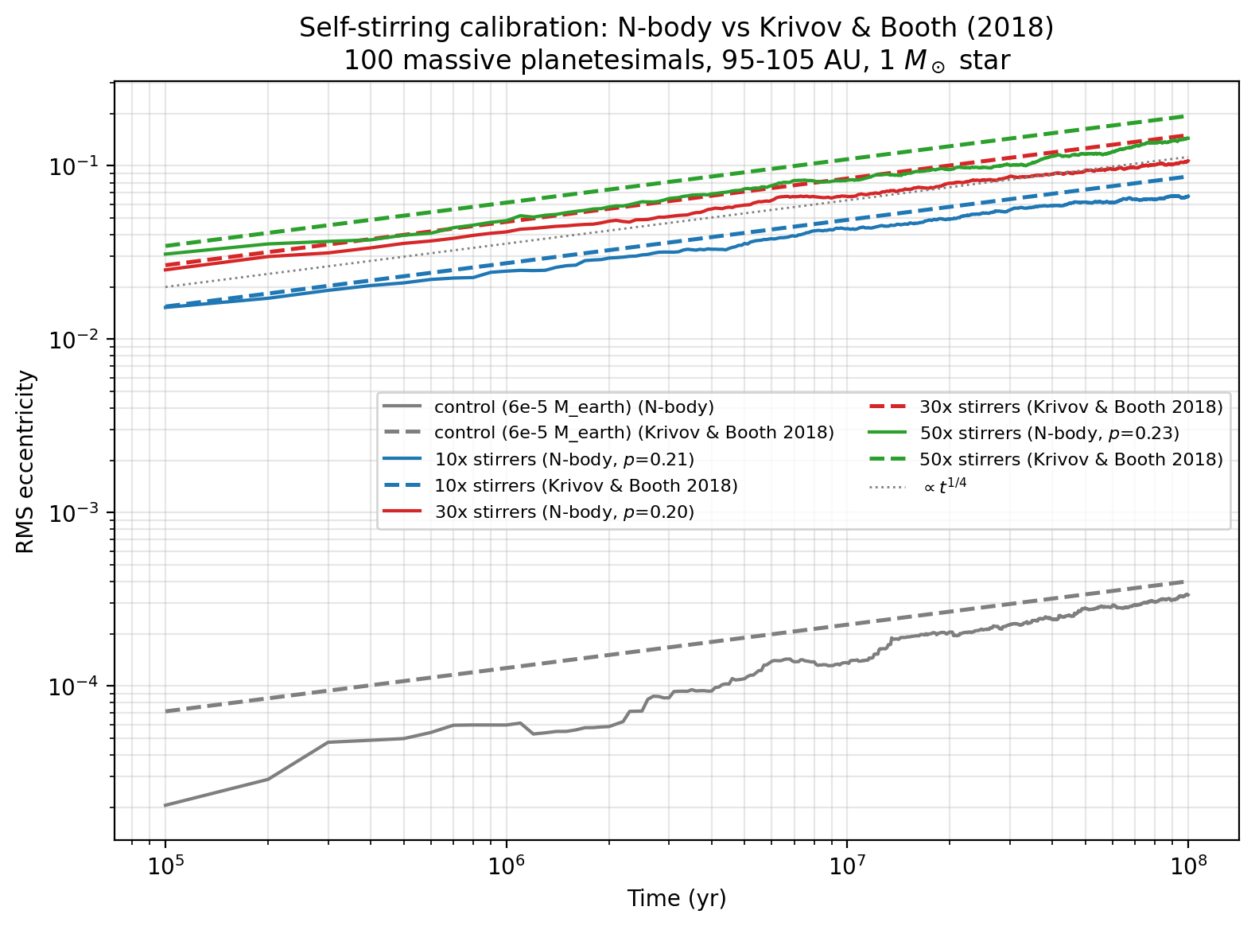
Calibration against Krivov & Booth
100 massive planetesimals, 95–105 AU, 100 Myr, solar-mass star
N-body (solid) vs analytic model (dashed) for 10×, 30×, 50× stirrers
Same growth rate: p = 0.20–0.23 vs 1/4
N-body sits slightly below the analytic curve at late times
[fill: what this implies for the setup]
12
Notes:
Optional; cut if short on time. Fill in the takeaway: the setup reproduces the published growth rate, with a modest amplitude offset.

Slide 16
Calibration against Krivov & Booth
100 massive planetesimals, 95–105 AU, 100 Myr, solar-mass star
N-body (solid) vs analytic model (dashed) for 10×, 30×, 50× stirrers
Same growth rate: p = 0.20–0.23 vs 1/4
N-body sits slightly below the analytic curve at late times
[fill: what this implies for the setup]
12
Notes:
Optional; cut if short on time. Fill in the takeaway: the setup reproduces the published growth rate, with a modest amplitude offset.

