Slide 1

Reasoning About Group Polarization:
From Semantic Games to Sequent Systems
Robert Freiman, Carlos Olarte, Elaine Pimentel and Christian G. Fermüller
LIPN - Université Sorbonne Paris Nord.
LPAR-25
Mauritius

Slide 2
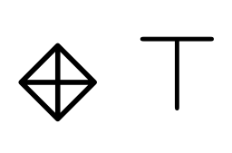
Agreement and disagreement relations
+
I have a friend (+): there exists a R+ successor.

Slide 3
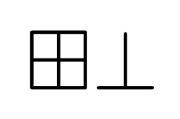
Agreement and disagreement relations
-
-
I don’t have friends (duality)

Slide 4


Agreement and disagreement relations
Bob
-
+
Alice
I’m friend of Alice
and enemy of Bob.

Slide 5
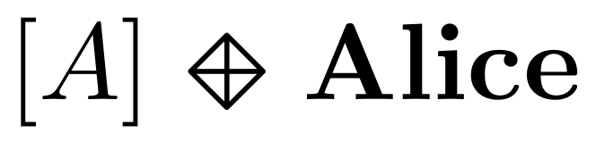

Agreement and disagreement relations
Everybody is friend of Alice (global modality)
+
+
+
+
Alice

Slide 6



PNL Logic
holds for agent a whenever 𝜙 holds for some a’s enemy.
holds for agent a whenever 𝜙 holds for some a’s friend.
holds whenever 𝜙 holds for all agents

Slide 7

PNL Logic
holds for agent a whenever 𝜙 holds for some a’s enemy.
holds for agent a whenever 𝜙 holds for some a’s friend.
holds whenever 𝜙 holds for all agents
a R⁺ b: agent a agrees with (is a friend of) agent b
a R⁻ b: agent a disagrees with (is an enemy of) agent b
R⁺ is reflexive
R⁺ and R⁻ are symmetric.
These relations do not overlap

Slide 8
PNL Logic
holds for agent a whenever 𝜙 holds for some a’s enemy.
holds for agent a whenever 𝜙 holds for some a’s friend.
holds whenever 𝜙 holds for all agents
a R⁺ b: agent a agrees with (is a friend of) agent b
a R⁻ b: agent a disagrees with (is an enemy of) agent b
R⁺ is reflexive
R⁺ and R⁻ are symmetric.
These relations do not overlap
Optional axiom: collectively connectedness

Slide 9
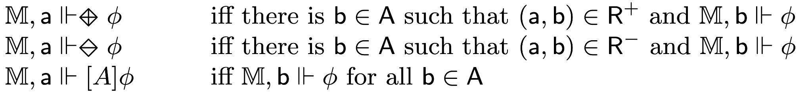
PNL Logic
holds for agent a whenever 𝜙 holds for some a’s enemy.
holds for agent a whenever 𝜙 holds for some a’s friend.
holds whenever 𝜙 holds for all agents
a R⁺ b: agent a agrees with (is a friend of) agent b
a R⁻ b: agent a disagrees with (is an enemy of) agent b

Slide 10
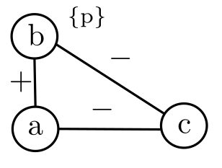


Semantic Game (truth in a model)
Proponent
F is true over 𝕄
Opponent
F is false over 𝕄
Model 𝕄
PNL
Semantic Game

Slide 11
Provability Game (validity)
Playing over all models
Proponent
F is true
Opponent
F is false
PNL
Semantic Game
Provability Game

Slide 12
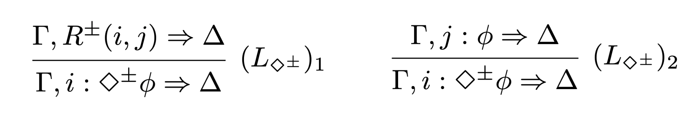
Analytic calculus
F is provable
F is not provable
PNL
Semantic Game
Provability Game
Sequent
Calculus

Slide 13
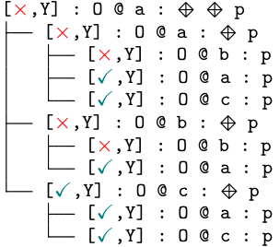

Our Contributions
Towards automation:
Intended meaning
Dynamics
Satisfiability
Semantic Game
Disjunctive states
Conditions for finiteness
Validity
Automatic procedures
Provability Game
Cut-free
Axioms as rules
Modular (different axioms)
Sequent Calculus

Slide 14
Semantic Game for PNL
Satisfiability : Played over a PNL model

Slide 15
Semantic Game for PNL
Satisfiability : Played over a PNL model
Players claim the truth of a formula

Slide 16


Semantic Game for PNL
Satisfiability : Played over a PNL model
Players claim the truth of a formula
Game states:
My and Your choices and strategies
P: Proponent
O: Opponent

Slide 17
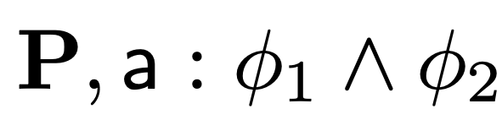
Semantic Game
Conjunction

Slide 18
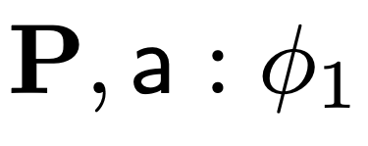
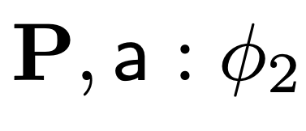
Semantic Game
Conjunction
YOU

Slide 19
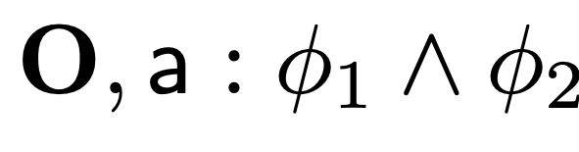
Semantic Game
Conjunction

Slide 20
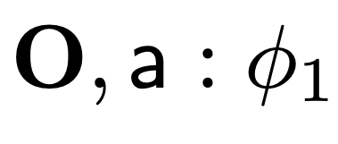
Semantic Game
Conjunction
ME

Slide 21
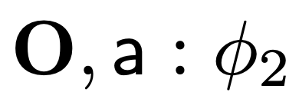
Semantic Game
Conjunction
ME

Slide 22
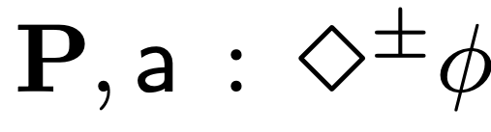
Semantic Game
Diamond

Slide 23
Semantic Game
Diamond
No a-successor, then you win

Slide 24
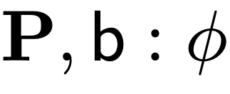
Semantic Game
Diamond
ME

Slide 25
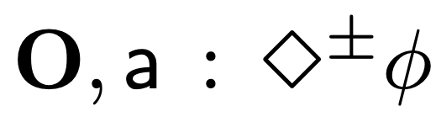
Semantic Game
Diamond

Slide 26
Semantic Game
Diamond
No a-successor, then I win!

Slide 27
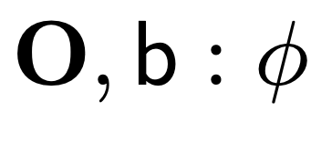
Semantic Game
Diamond
YOU

Slide 28
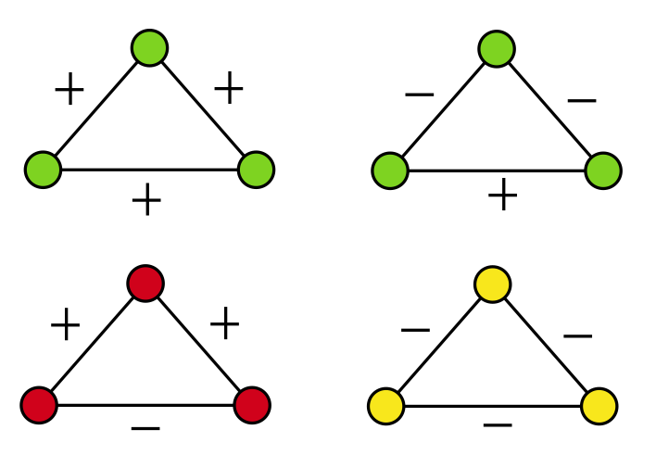
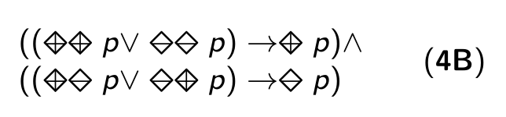
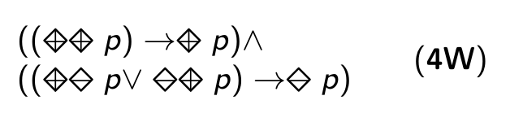
An example: Balance (stable configurations)

Slide 29

An example: Balance (stable configurations)
From scitechdaily.com

Slide 30
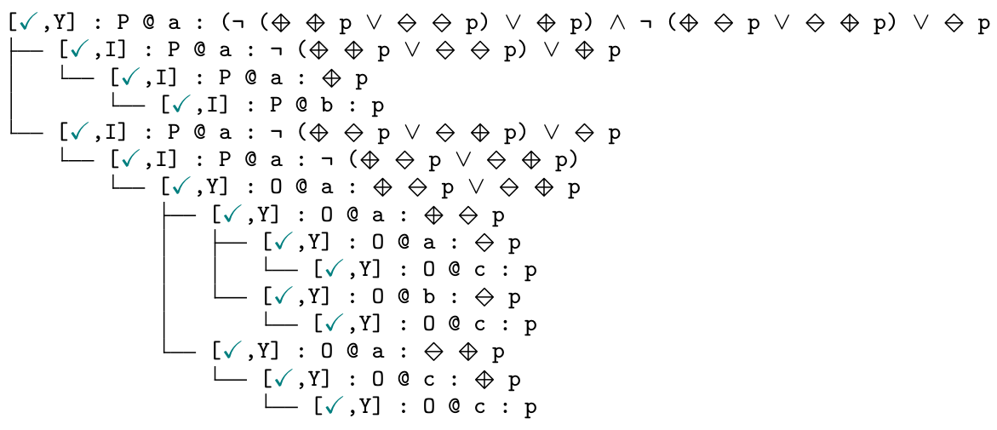
Dynamics: playing the game

Slide 31
Dynamics: playing the game

Slide 32
Dynamics: playing the game

Slide 33
Dynamics: playing the game

Slide 34
Dynamics: playing the game

Slide 35
Dynamics: playing the game

Slide 36
Dynamics: playing the game
I win!

Slide 37
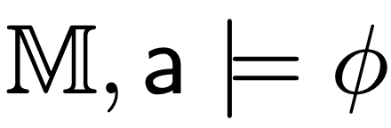
Semantic Game G_{𝕄}
Theorem 1.
I have a winning strategy in 𝕄 for
iff

Slide 38
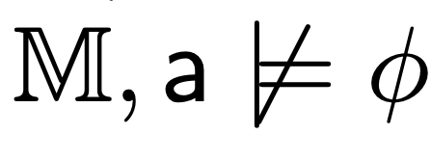
Semantic Game G_{𝕄}
Theorem 1.
I have a winning strategy in 𝕄 for
iff
2. You have a winning strategy in 𝕄 for
iff

Slide 39

What about validity?
There is no a uniform strategy for winning the game

Slide 40
What about validity?
There is no a uniform strategy for winning the game
Validity/disjunctive game:
Multiset of game states.

Slide 41

What about validity?
There is no a uniform strategy for winning the game
Validity/disjunctive game:
Multiset of game states.
The ability to duplicate states.

Slide 42


What about validity?
There is no a uniform strategy for winning the game
Validity/disjunctive game:
Multiset of game states.
The ability to duplicate states.
,
{
}

Slide 43

What about validity?
There is no a uniform strategy for winning the game
Validity/disjunctive game:
Multiset of game states.
The ability to duplicate states.
The model is relevant “only” in elementary states.
,
{
}
,
{
}

Slide 44
Disjunctive games
Disjunctive game DG(P, i : 𝜙) can be thought of as
Me and You

Slide 45
Disjunctive games
Disjunctive game DG(P, i : 𝜙) can be thought of as
Me and You
playing all semantic games G(P, i : 𝜙)

Slide 46
Disjunctive games
Disjunctive game DG(P, i : 𝜙) can be thought of as
Me and You
playing all semantic games G(P, i : 𝜙)
over all PNL-models 𝕄

Slide 47
Disjunctive games
Disjunctive game DG(P, i : 𝜙) can be thought of as
Me and You
playing all semantic games G(P, i : 𝜙)
over all PNL-models 𝕄
Winning condition: I win (and you lose) if for every PNL model there is an elementary game state where I win the semantics game.

Slide 48
Adequacy
Theorem 2
I have a winning strategy for the disjunctive game DG(F) iff F is valid.

Slide 49
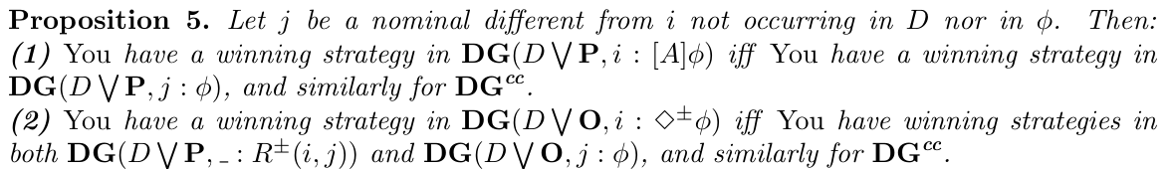
From strategies to proofs (EP stopped here)
Infinitely many possibilities:
Your best strategy: Pick a fresh nominal!

Slide 50
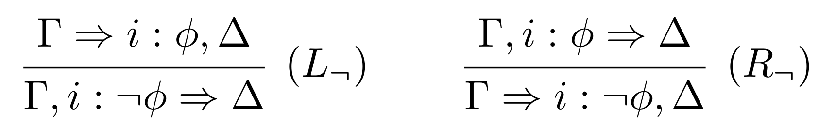
A proof system
Left/Right Opponent/Proponent

Slide 51
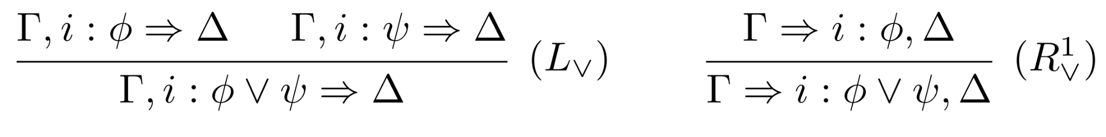
A proof system
Your choices: branches
My choices: decision

Slide 52
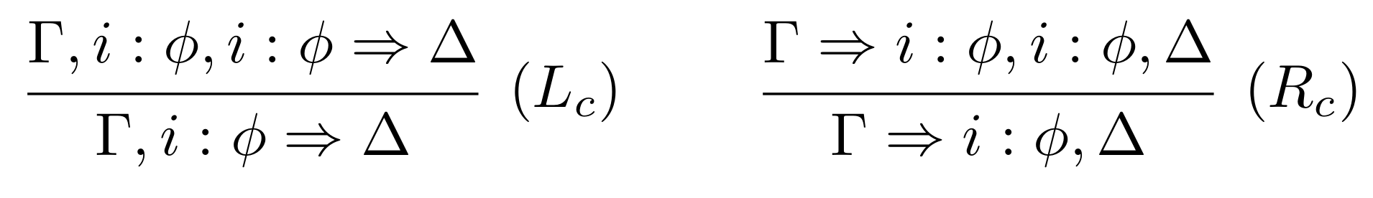
A proof system
Disjunctive games: contraction

Slide 53
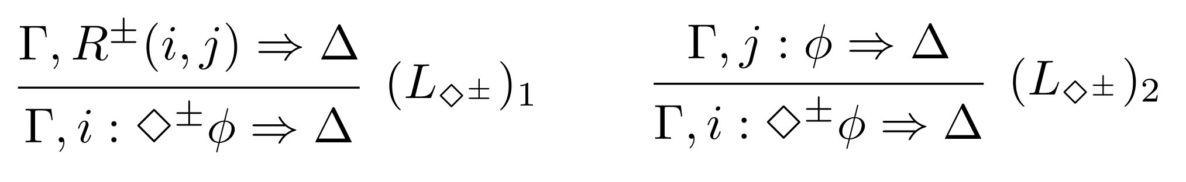
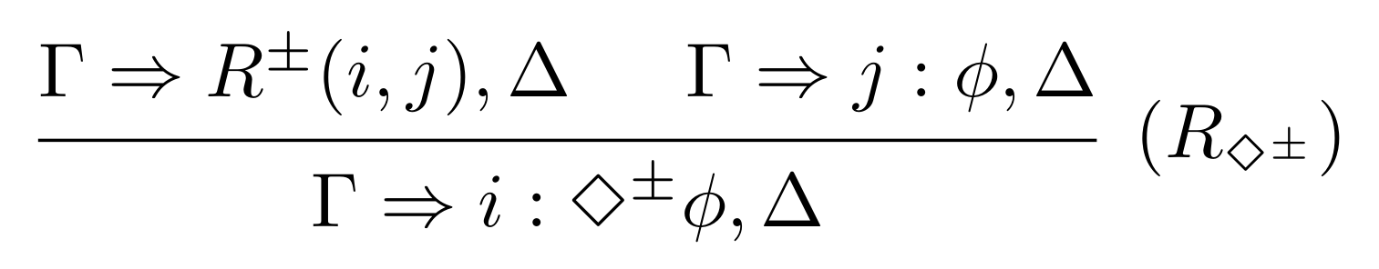
A proof system
Fresh nominals (your best strategy)

Slide 54
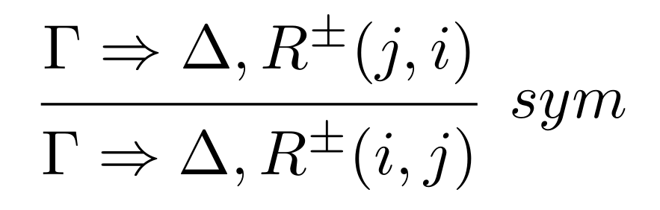
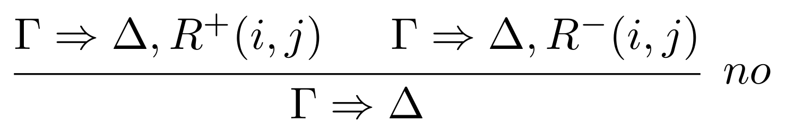
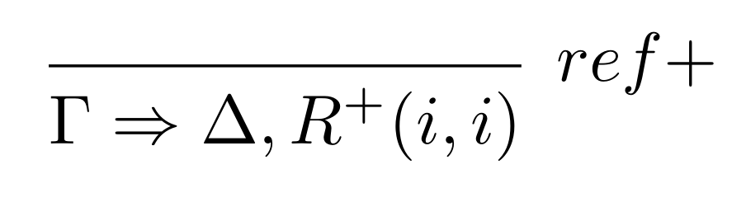
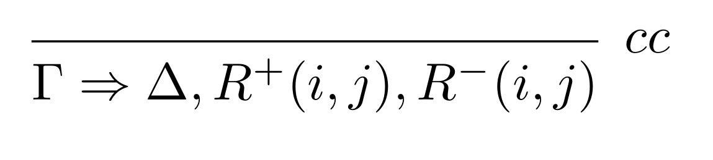
A proof system
Frame axioms: Relational Rules

Slide 55

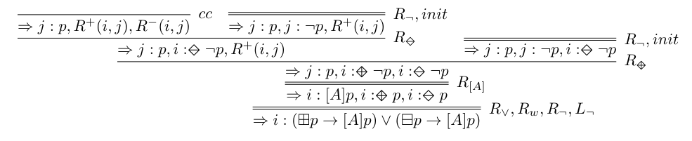
A proof system: Example
Collective connectedness

Slide 56

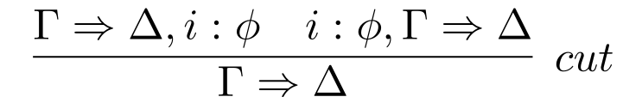
A proof system
Theorem 3
I have a winning strategy for the disjunctive game DG( ) iff
is provable in DS.
Theorem 4
The following rule is admissible

Slide 57
Dynamics
(Globally) adding new positive or negative links
(Locally) changing the polarity of one link
Extended PNL
Semantic Game
Provability Game
Sequent
Calculus

Slide 58


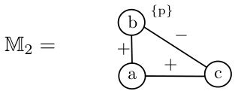
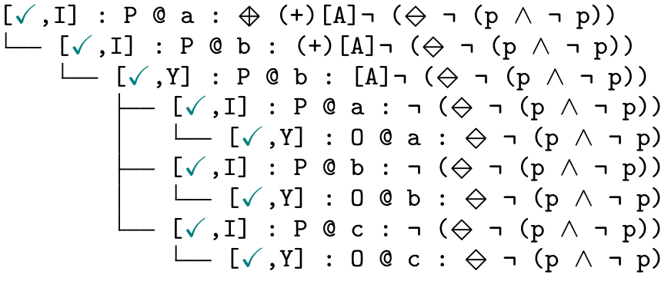
Example: reconciliation

Slide 59
Conclusion
Semantic game: concrete scenarios and meaning.
Disjunctive game: validity.
A method for obtaining cut-free sequent system from the game.
Frame properties as sequent rules.
Perspectives
Relaxing symmetry.
Games with budget (limiting the changes).
More on automation (strategies and focusing).

Slide 60




Thanks!
SGR project PROMUEVA (Minciencias)
NATO Science for Peace and Security Programme project SymSafe
European Union’s Horizon 2020 (Mosaic)

