Slide 1
Shunting-Yard Algorithms
Elaine Lee
4/2/2013

Slide 2

Shunting Yard
A shunting yard is a railroad yard found at some freight train stations, used to separate railroad cars on to one of several tracks.

Slide 3
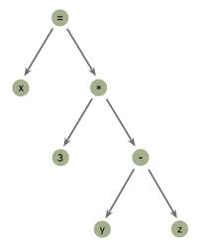

Shunting-Yard Algorithm
Invented by Edsger Dijkstra (Fig. 1)
A method for parsing mathematical expressions specified in infix notation. e.g. 3 + 5
It can be used to produce output in:
    Reverse Polish notation (RPN) a.k.a. postfix notation.
        e.g. 5 3 +
    An abstract syntax tree (AST):
Figure 1:
Edsger Dijkstra, a mightily-bearded computer scientist.

Slide 4
Why Do We Want to Change Notation?
Postfix notation is often used in stack-based and concatenative programming languages. It is also common in dataflow and pipeline-based systems, including Unix pipelines.
Abstract syntax trees are a data structure widely used in compilers, due to their property of representing the structure of program code.
Brackets are unnecessary: the user enters calculations in the order that is required, letting the automatic stack store intermediate results on the fly for later use. Likewise, there is no requirement for the precedence rules required in infix notation.
No equals key is required to force computation to occur.

Slide 5
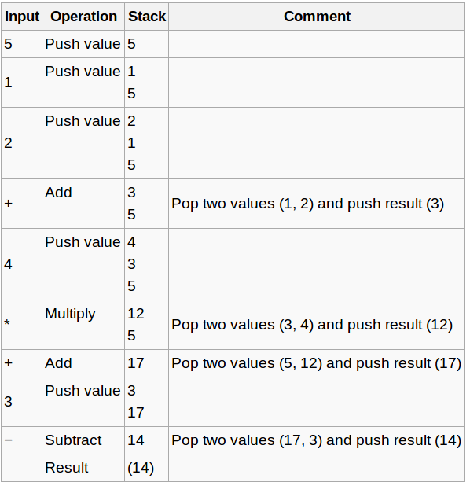
Postfix Evaluation Example
Infix expression: 5 + ((1 + 2) * 4) − 3
Postfix expression: 5 1 2 + 4 * + 3 -
When a computation is finished, its result remains as the top (and only) value in the stack; in this case, 14.

Slide 6


Shunting-Yard Algorithm
Tokenize:
split the input string containing the expression into tokens.
The only token supported are numbers and operators (+, -, *, /) and parentheses.
Set operator Precedence:
use a hash to store the operator precedences. The unary - operator is called -u to distinguish it from the binary operator with the same name.
Right-associative operators must be treated specially. In this example, we only have one (the unary -), and store it in another hash.

Slide 7
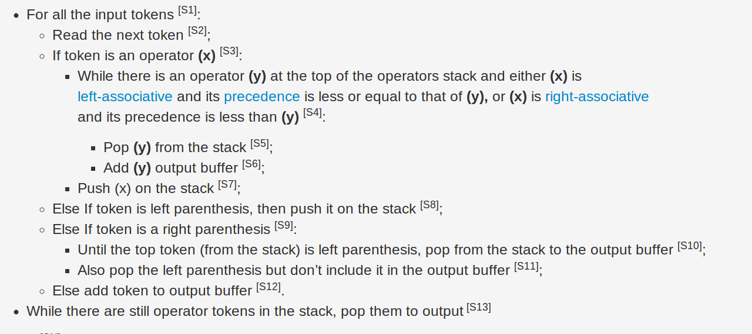
Shunting-Yard Algorithm
Parsing pseudocode:

Slide 8
References
http://en.wikipedia.org/wiki/Shunting_yard_algorithm
http://andreinc.net/2010/10/05/converting-infix-to-rpn-shunting-yard-algorithm/
Dijkstra's Original description of the Shunting yard algorithm

Slide 10
Shunting-Yard Algorithm
Parsing pseudocode - old:
While there are tokens to be read:
Read a token
If the token is a number:
Add token to the result stack
If the token is a left parenthesis:
Push token onto operators stack
If the token is a right parenthesis:
While the token at the top of the stack is not a left parenthesis:
Pop token from operator stack and push it onto the result stack
Pop the left parenthesis, but do not put it onto the result stack
If the token is an operator:
While the operator at the top of the operators stack has higher or equal precedence:
Pop operator off operators stack and push it onto the result stack
Push read in token onto operators stack
While the operators stack is not empty:
Pop operator and push it onto the result stack

Slide 11
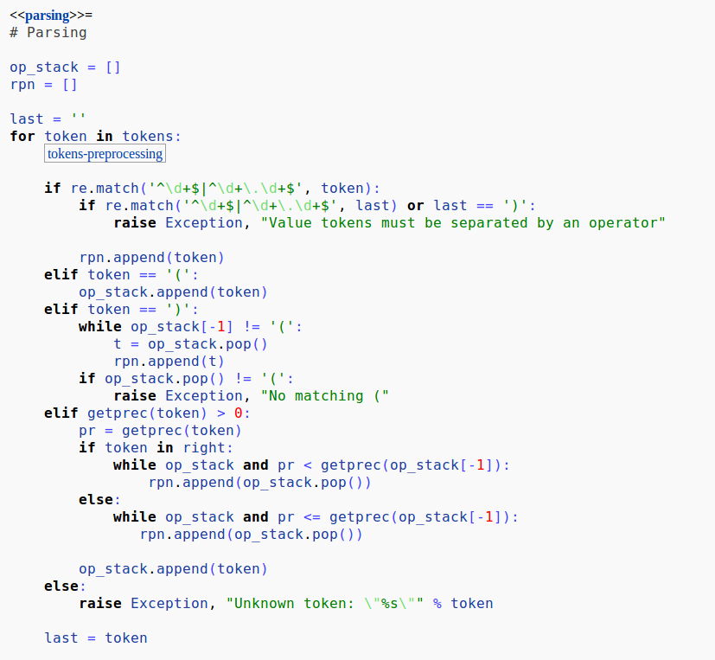
SYA: Python Example

