Slide 1


K.RAMAKRISHNAN COLLEGE OF TECHNOLOGY
(AUTONOMOUS), TRICHY.
ELECTRICITY BILLING SYSTEM
PRESENTED
ELAIYANILA.S
2303811710422037
SUPERVISOR
Mr. M. Saravanan, M.E.,
AP/CSE.

Slide 2
PRESENTATION OVERVIEW
Objective
Project Introduction
Problem Statement
Methodologies (Programming concepts relevant to problem statement)
Architecture of the proposed system
List of Modules
Merits
Results and Discussion
Queries

Slide 3
OBJECTIVE
The objective of the Electricity Billing System code is to provide a user-friendly graphical interface for calculating electricity bills based on the number of units consumed.
The system follows a tiered pricing structure, where the cost per unit varies depending on the amount of electricity used, with rates of Rs. 5 for the first 100 units, Rs. 7 for the next 100 units, Rs. 10 for the subsequent 100 units, and Rs. 12 for units exceeding 300.

Slide 4
PROJECT INTRODUCTION
The ElectricityBillingSystemSwing is a simple Java application that provides an interactive platform for calculating electricity bills. Utilizing Java Swing for the graphical user interface, the program prompts users to enter their personal information, including their customer name, ID, and the number of units of electricity consumed.
In addition to the bill, thesystem calculates an 18% Goods and Services Tax (GST) and displays both the GST amount and the total amount after including GST.

Slide 5
PROBLEM STATEMENT
The problem is to develop a Java-based Electricity Billing System using the Swing GUI framework, which allows users to calculate their electricity bill based on the number of units consumed. The system should allow the user to input their Customer Name, Customer ID, and Units Consumed.
The results should be displayed in labels. The system should also include error handling to ensure only valid inputs are accepted (e.g., non-numeric values should trigger an error message). The overall objective is to provide an easy-to-use application for calculating electricity bills with clear, accurate results.

Slide 6
METHODOLOGIES
Input Handling:
GUI Components: The user interface is designed using Java Swing to create a clean
and simple form for input and output. Components like JTextField are used for entering thencustomer's name, ID, and units consumed, while JLabel is used to display the results.
Calculation Logic:
      Rs. 5 per unit for the first 100 units.
      Rs. 7 per unit for the next 100 units.
      Rs. 10 per unit for the next 100 units.
      Rs. 12 per unit for units above 300
      .

Slide 7
METHODOLOGIES
Event-Driven Programming:
When the button is clicked, the input values are retrieved, the calculations are performed, and the results are displayed on the GUI.
Program Flow:
  Main Method: The program starts by setting up the JFrame (main window) and adding all the components (input fields, buttons, labels) to the panel.
  Action Listener: When the user clicks the "Calculate Bill" button, the program processes the input data, calculates the bill, and updates the labels with the results.
  Visibility: The JFrame is made visible at the end, allowing the user to interact with the application.
2/7/20

Slide 8
ARCHITECTURE OF THE PROPOSED SYSTEM
User interface
Application logic
Data layer
Interaction flow

Slide 9
LIST OF MODULES
Bill Calculation:
The Bill Calculation Module handles the core logic for calculating the electricity bill based on the units consumed by the customer. The system follows a tiered pricing structure, applying different rates depending on the amount of electricity consumed.
User Interface :
The User Interface (UI) Module is responsible for creating the graphical layout through which users interact with the application. Using Java's Swing library, the module sets up a main window (JFrame) and organizes components like labels, text fields, and buttons inside a panel (JPanel).
GST Calculation:
The GST Calculation Module handles the calculation of Goods and Services Tax (GST), which is typically applied to the electricity bill at a rate of 18%. Once the basic bill is calculated, this module computes the GST amount by multiplying the bill by the GST percentage (18%). The total amount to be paid by the customer is then calculated by adding the GST to the original bill.

Slide 10
LIST OF MODULES
GST Calculation:
The GST Calculation Module handles the calculation of Goods and Services Tax (GST), which is typically applied to the electricity bill at a rate of 18%. Once the basic bill is calculated, this module computes the GST amount by multiplying the bill by the GST percentage (18%).
Error Handling :
The Error Handling Module ensures the robustness of the system by managing potential errors, particularly when users input invalid data. For example, if the user enters non-numeric characters for the units consumed, the program catches the resulting NumberFormatException and displays an error message to the user.
2/7/20

Slide 11
MERITS
User-Friendly Interface
Efficient Bill Calculation
Automatic GST Calculation
Real-Time Results
Clear Presentation of Results
Scalability

Slide 12
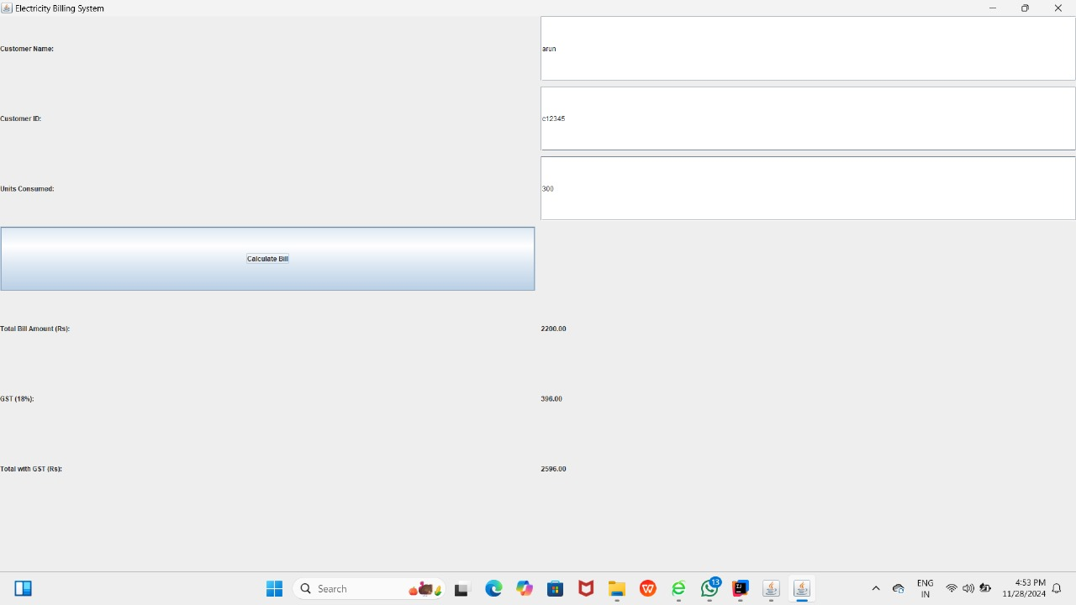
RESULTS AND DISCUSSION

Slide 13
QUERIES ?

