Slide 1

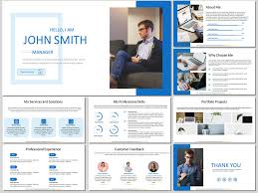
Digital Portfolio
Name :
NM ID :
Register No :
Department :
College :
University :
Elakkiya R
asbrubd2428k0024
2428k0024
BSc CS (AI&DS)
Shree Venkateshwara Arts and Science College,Gobi
Bharathiar University

Slide 2

AGENDA
Problem Statement
Project Overview
Target Audience
Tools and Technologies
Portfolio Design and Layout
Features and Functionalities
Challenges and Solutions
Conclusion

Slide 3
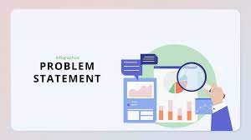
PROBLEM STATEMENT
In today’s competitive environment, traditional resumes are no longer sufficient to create a strong impression. They are static, lack interactivity, and fail to provide a complete view of an individual’s capabilities. Recruiters often find it difficult to visualize projects or understand technical skills in depth. To overcome these challenges, there is a growing need for a professional digital identity that is interactive, visually appealing, and easily accessible.

Slide 4
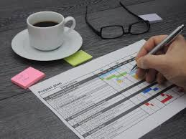
PROJECT OVERVIEW
This project focuses on the design and development of a personal portfolio website that serves as a digital resume, showcasing education, skills, and projects in a structured manner. Built using HTML, CSS, and JavaScript, it ensures responsiveness and an attractive design. The portfolio includes About Me, Education, Skills, Projects, and Contact sections, with a navigation bar for smooth movement. A contact form is integrated so visitors can reach out directly, making the portfolio a reflection of my technical knowledge, creativity, and professionalism.

Slide 5

TARGET AUDIENCE
The primary end users of the portfolio website include recruiters and hiring managers, who can quickly assess my qualifications, skills, and projects. Peers and students may also find it inspiring to build their own digital presence. In addition, mentors and collaborators can connect for project opportunities, while the general audience can explore my work and learning journey. The portfolio is thus designed to cater to multiple stakeholders with simplicity and clarity.

Slide 6

TOOLS AND TECHNOLOGIES
The portfolio was developed using HTML, CSS, and JavaScript for frontend design and interactivity. Imgbb was used to host images and media, ensuring lightweight pages and smooth loading. Development and testing were done on CodePen for quick prototyping and validation. For deployment, platforms like GitHub Pages or Netlify are considered to make the portfolio globally accessible. Together, these tools ensured easy maintenance, responsiveness, and a visually consistent design.

Slide 7
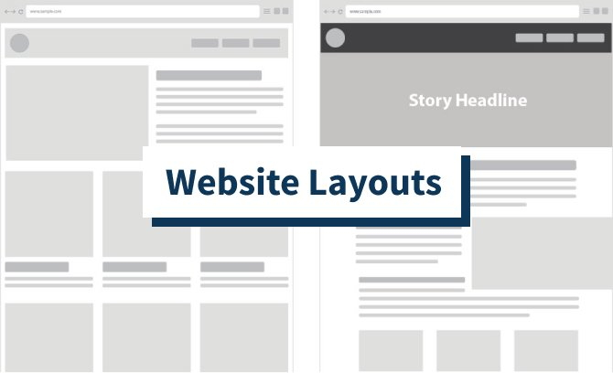
PORTFOLIO DESIGN AND LAYOUT
The portfolio is structured into five sections. The About Me page introduces my background, passions, and interests. The Education page highlights my academic details in a card-style design. The Skills page lists technical skills (HTML, CSS, JavaScript, Python, Java) and soft skills like communication and teamwork. The Projects page showcases completed works with short descriptions and technologies used. Finally, the Contact page includes a form for visitors to submit their details and message. The layout maintains clarity, balance, and a professional look with consistent styling.

Slide 8
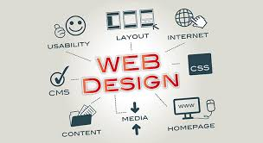
FEATURES AND FUNCTIONALITIES
Clean Multi-Page Layout – Separate sections for About, Education, Skills, Projects,and Contact.
Easy Navigation – Top navigation bar for smooth movement across all pages.
Responsive Styling – Optimized to work on desktops, tablets, and mobiles.
Project Highlights – Showcases completed projects with brief descriptions and technologies used.
Interactive Contact Form – Lets visitors share their name, email, and message to connect directly.
Consistent Visual Design – Card-style layouts, balanced spacing, and simple backgrounds for a professional look.
Skill Presentation – Technical and soft skills neatly listed for quick readability.

Slide 9
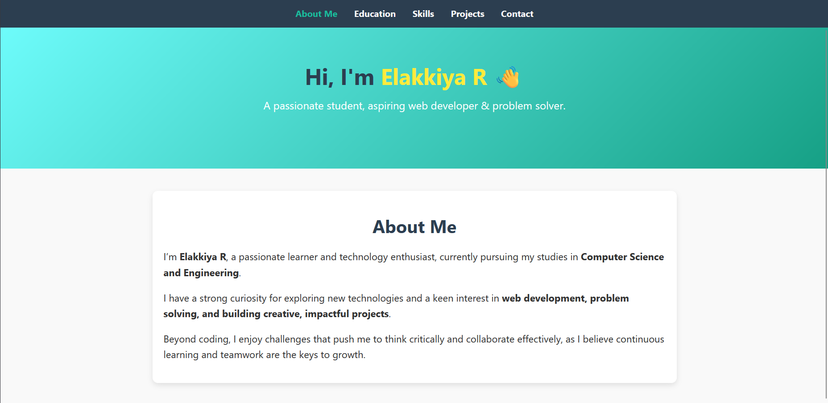
RESULT AND SCREENSHOTS
About Me

Slide 10
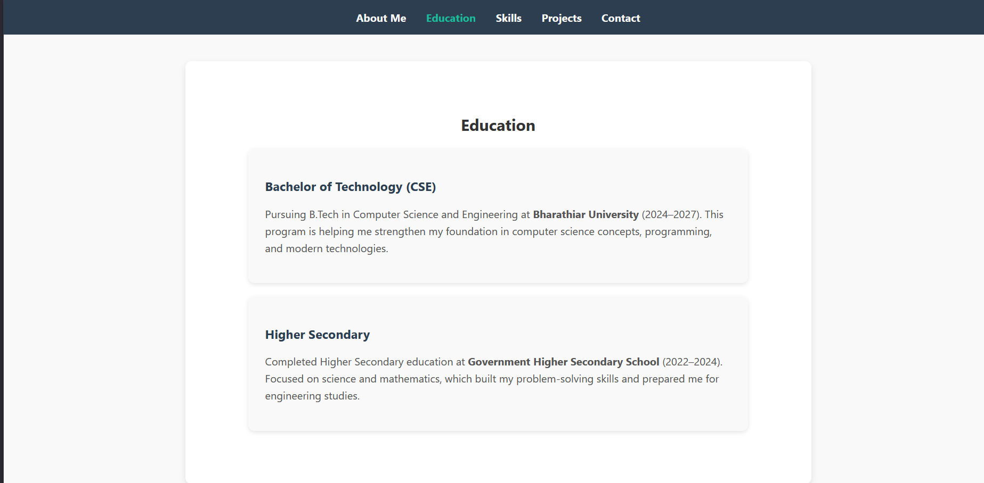
RESULT AND SCREENSHOTS
Education

Slide 11
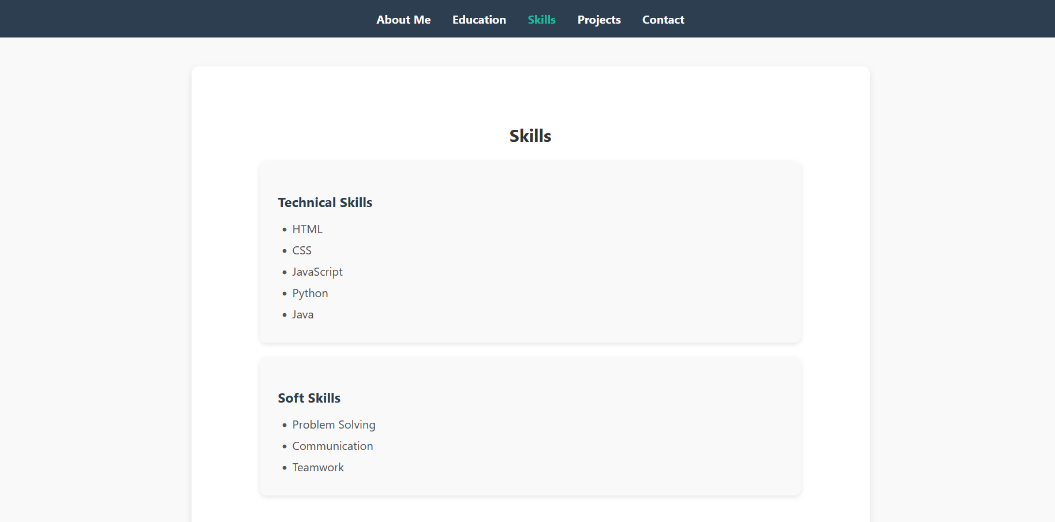
RESULT AND SCREENSHOTS
Skills

Slide 12
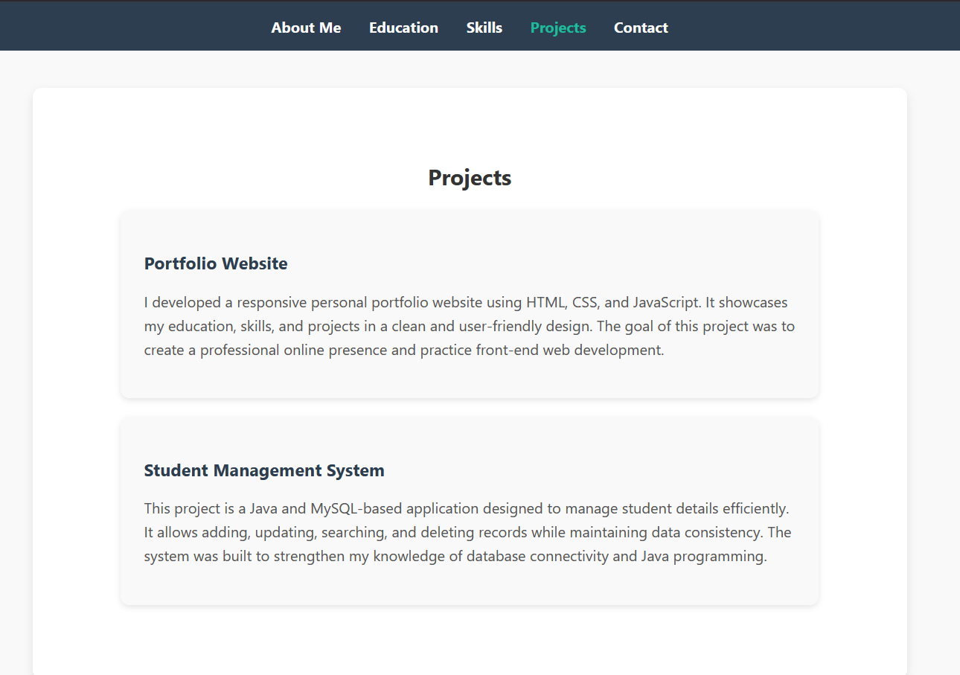
RESULT AND SCREENSHOTS
Projects

Slide 13
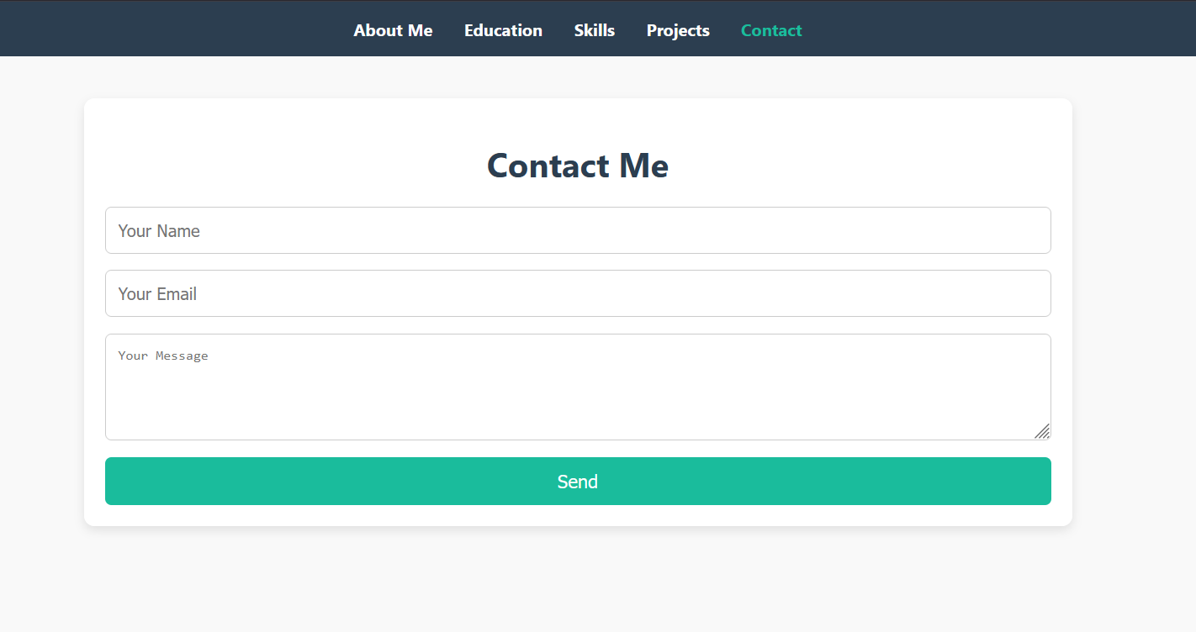
RESULT AND SCREENSHOTS
Contact me

Slide 14

CONCLUSION
The personal portfolio website acts as a professional digital identity, bringing together education, skills, and projects in an organized and visually appealing way. Unlike traditional resumes, it offers recruiters a more engaging experience and better insight into my capabilities. It also demonstrates my ability to apply web development concepts in practice. Overall, the portfolio enhances my visibility, supports career growth, and lays a foundation for future digital platforms.

Slide 15

GITHUB LINK
https://github.com/elakkiyaelakkiyar007-lang/Personal-portfolio-.git

