Slide 1
Comprehensive Exploratory Data Analysis (EDA) Report For
Global Electronics
Enhancing Customer Satisfaction, Optimizing Operations, and Driving Business Growth
Prepared by: ELAKKIYA.P

Slide 2
Introduction
Overview of Global Electronics
Company Profile: Global Electronics is a prominent retailer specializing in consumer electronics with a global reach. The company aims to deliver top-notch products and exceptional customer service.
Mission: To provide high-quality electronics and innovative solutions, enhancing customer experiences through advanced technology.
Market Presence: Global Electronics operates through a vast network of physical stores and online platforms, serving a diverse international customer base.
Objective of the Analysis
Primary Goal: Conduct a thorough Exploratory Data Analysis (EDA) to derive actionable insights from the company's datasets.
Key Objectives:
Enhance marketing strategies by analyzing customer behavior and demographics.
Optimize inventory management based on product performance and sales data.
Improve sales forecasting with historical data and trend analysis.
Inform product development and store expansion decisions using detailed performance metrics.

Slide 3
Scope of Data
Datasets Included:
Stores Data: Information on store locations and operational details.
Products Data: Details about products and their categories.
Sales Data: Transaction records and sales information.
Exchange Rates Data: Impact of currency fluctuations on international sales.
Customers Data: Customer demographics and details.
Data Coverage: The analysis includes comprehensive data from multiple regions, product categories, and time periods to provide a detailed understanding of business operations and customer interactions.

Slide 4
Data Cleaning Steps
Handling Missing Values:
Identification: Check for missing or null values across all datasets.
Approach:
Imputation: Fill missing values with appropriate substitutes (e.g., mean, median, mode) or use interpolation for continuous variables.
Removal: Exclude rows or columns with excessive missing values if imputation is not feasible.
Consistency: Ensure that missing values are handled consistently across related datasets.
Data Type Conversion:
Date Fields: Convert date fields to a standardized datetime format for consistency (e.g., Order Date, Open Date, Date in exchange rates).
Numerical Fields: Ensure that numerical values (e.g., Unit Cost USD, Unit Price USD, Exchange) are in the correct numeric format for calculations.
Categorical Fields: Convert categorical variables (e.g., Country, Brand, Currency Code) to consistent text or categorical types.

Slide 5
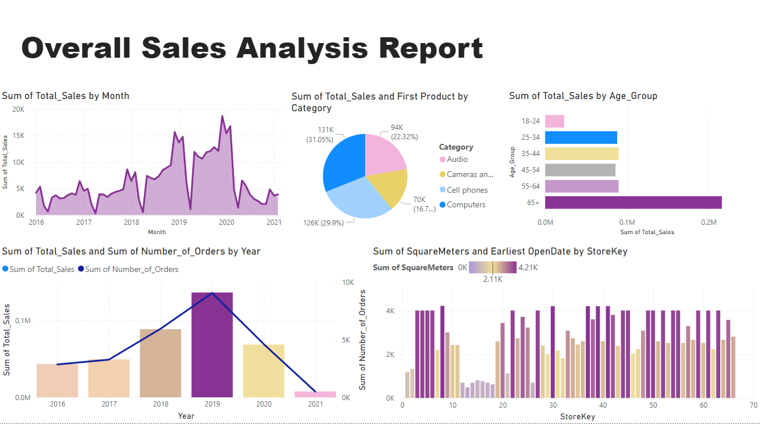

Slide 6
Overall Analysis
Sum of Total Sales by Month :
Seasonal Trends: The area chart shows fluctuations in sales over time, with noticeable peaks and troughs. For example, there is a significant spike in sales around mid-2019 and early 2020. These peaks could correspond to successful marketing campaigns, holiday seasons, or new product launches.
Actionable Recommendation: Focus marketing efforts and inventory stockpiling around these peak periods to maximize sales. Analyze what specific factors contributed to these peaks and replicate successful strategies.
Sum of Total Sales and First Product by Category :
Category Contribution: The pie chart indicates the distribution of sales among different product categories.
For instance:
Audio: 29.99%
Cameras and Accessories: 31.05%
Cell Phones: 22.32%
Computers: 16.7%
Actionable Recommendation: Given that Cameras and Accessories and Audio categories are the top contributors to sales, consider investing more in these categories. This could include expanding the product range, improving marketing strategies, or offering promotions.

Slide 7
Overall Analysis
Sum of Total Sales by Age Group:
Age Group Preferences: The stacked bar chart shows sales distribution across different age groups. Notably, the 65+ age group is the highest contributor to sales.
Actionable Recommendation: Tailor marketing campaigns and product offerings to cater more to the 65+ age group. Consider introducing products that appeal to older customers and ensure that marketing messages resonate with this demographic.
Sum of Total Sales and Sum of Number of Orders by Year:
Yearly Performance: The line and stacked column chart reveals trends in both total sales and the number of orders over the years. For example, there was a peak in total sales and number of orders in 2019, followed by a decline.
Actionable Recommendation: Investigate the reasons behind the peak in 2019 to understand what drove the high sales and order numbers. Conversely, analyze the factors contributing to the decline in subsequent years and develop strategies to counteract these issues.
Sum of Square Meters and Earliest Open Date by Store Key :
Store Performance: The clustered column chart shows the relationship between store size (in square meters) and their sales performance. Stores with larger square meters and earlier open dates tend to have higher sales.
Actionable Recommendation: For future store openings, consider larger store sizes as they seem to perform better. Additionally, invest in older stores to maintain their high performance, possibly through renovations or increased marketing efforts.

Slide 8
visualization
Visualization in data analysis involves creating graphical representations of data to uncover insights and communicate findings effectively.
Here’s a detailed information about the sales data and use visualizations for various types of data insights.

Slide 9
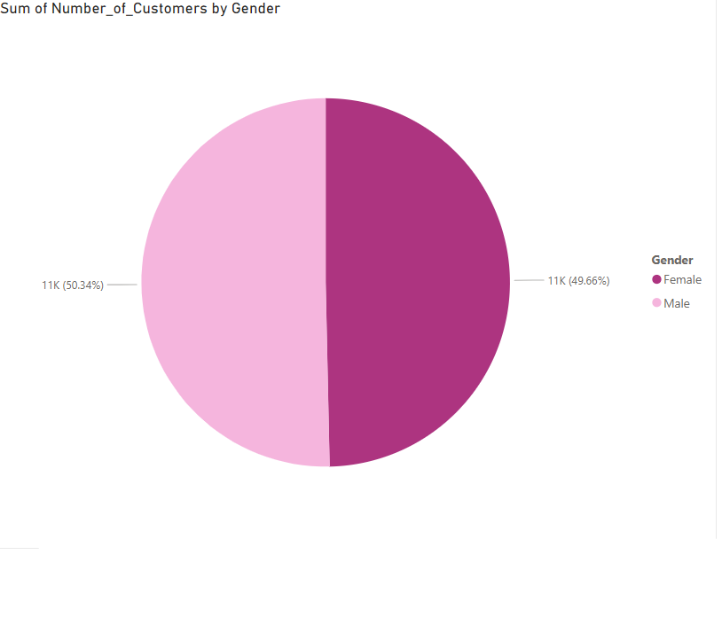
Distribution by gender

Slide 10
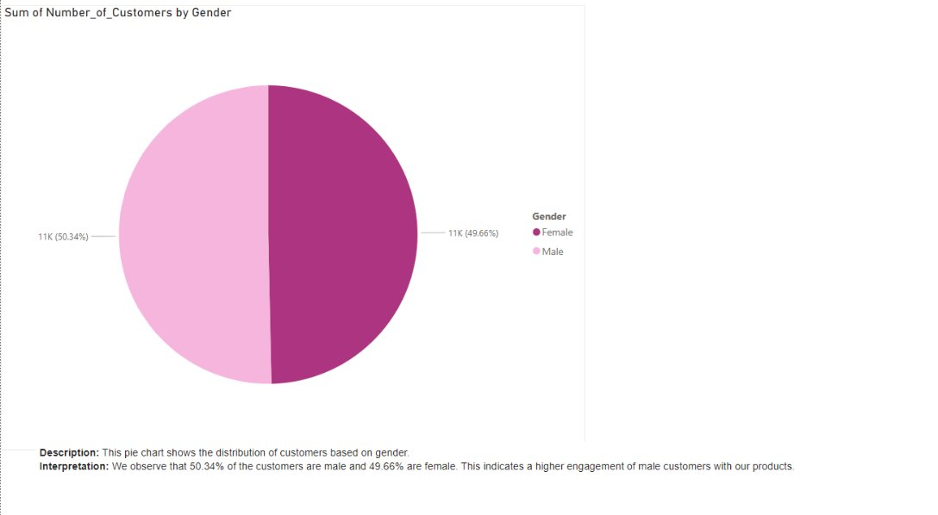
Distribution by gender
Visualization:
Pie Chart: Shows the distribution of customers based on gender.
Interpretation:
Male Customers: 50.34%
Female Customers: 49.66%
Insight:
Gender Balance: The nearly equal distribution of male and female customers (50.34% male vs. 49.66% female) suggests that the engagement with your products is fairly balanced between genders. However, the slight edge in the percentage of male customers indicates a marginally higher engagement among male customers.

Slide 11
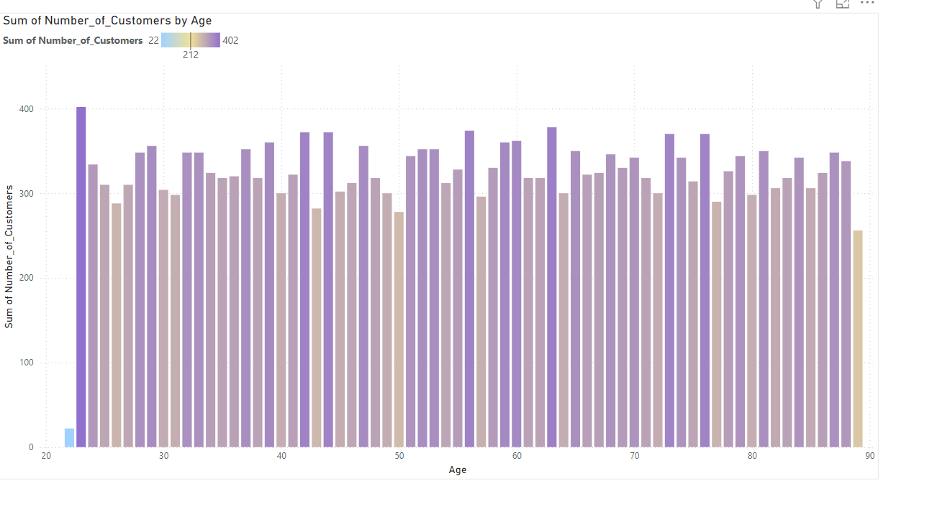
Distribution by age

Slide 12
Distribution by age
Description: This clustered column chart shows the sum of total sales for each age group over the given period.
Interpretation: We observe varying sales volumes across different age groups. Key observations include:
Dominant Age Group: The 25-34 age group shows the highest sales volume, indicating that young adults are the primary customers driving sales. This suggests that products and marketing strategies targeting this demographic are particularly effective.
Significant Contributions: The 35-44 and 45-54 age groups also show substantial sales volumes, suggesting that middle-aged customers are a significant part of the customer base.
Emerging Age Group: The 18-24 age group, while not the highest, still shows notable engagement, indicating potential growth as this demographic matures.
Strategic Insights: Understanding sales distribution by age group can help in tailoring marketing strategies, product offerings, and customer engagement efforts. For example, focusing on digital marketing strategies for younger age groups and personalized experiences for older age groups can maximize engagement and sales.

Slide 13
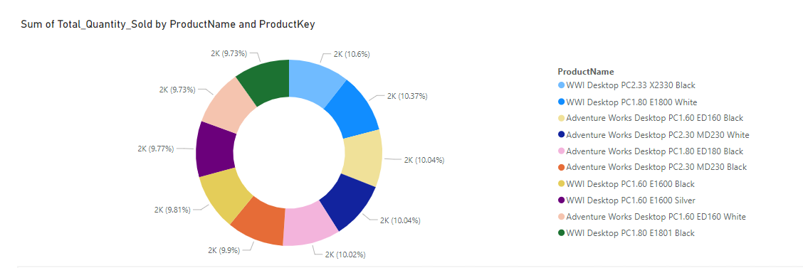
Top 10 Products By Sales

Slide 14
Top 10 Products By Sales
Description: A donut chart is a variation of a pie chart with a blank center, which allows for additional information to be displayed in the middle. In this case, the donut chart visualizes the average sales price by product category. Each segment of the donut represents a different product category, with the size of each segment corresponding to the proportion of the average sales price for that category relative to the total average sales price.
Top Seller: The WWI Desktop PC2.33 X2330 Black is the best-selling product, with the highest quantity sold (2200 units). This suggests that this particular model or color is highly favored among customers.
Brand Comparison WWI: Out of the top 10 products, 6 are from the WWI brand. This indicates a strong preference or higher market penetration of WWI products in your data set.
Adventure Works: 4 of the top 10 products are from Adventure Works. This brand also has a significant presence but slightly less dominant than WWI.
Color Preferences: Black is the most popular color, appearing in 7 of the top 10 products. White and Silver are less popular, with White appearing in 3 products and Silver in 1.
Product Specifications: It seems that there are variations in model specifications (e.g., 1.60, 1.80, 2.30 GHz) but the data doesn't show a clear correlation between the specifications and sales volume beyond color preferences.
Potential Actions Inventory and Marketing: Focus on stocking and promoting the top-selling products, especially the most popular color and model.
Brand Strategies: If you’re managing these brands, consider strategies to boost the sales of Adventure Works products or explore why WWI products are more popular.
Customer Preferences: Further analysis could investigate why black is preferred, or if specific features in the top-selling models contribute to their popularity.

Slide 15
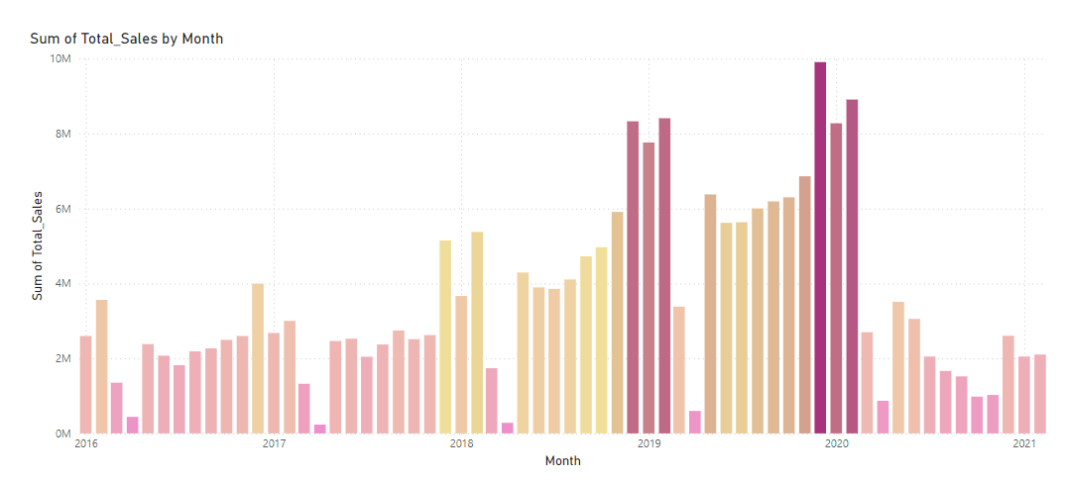
Sales By Month And Year

Slide 16
Sales By Month And Year
Description: This line and stacked column chart shows the sum of total sales for each month over the given period.
Interpretation: We observe fluctuations in sales volume throughout the year.
Key observations include:
High Sales Periods: December shows a significant increase in sales, likely due to the holiday season.
Low Sales Periods: Sales dip slightly during the summer months (Jan to March), which could be due to lower customer engagement during this period.
Consistent Growth: There is a general trend of increasing sales from June to Sep, indicating a period of steady growth.
This data is essential for understanding seasonal trends and planning inventory and marketing strategies accordingly.

Slide 17
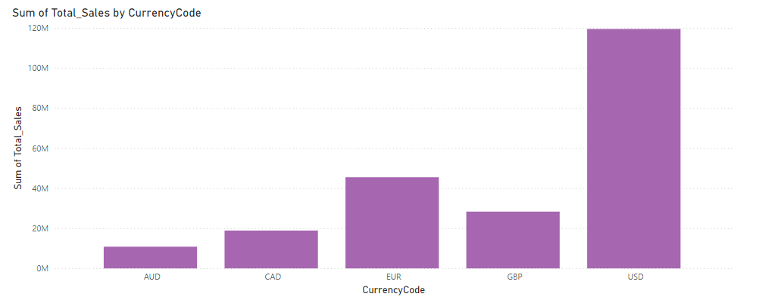
Total Sales By Currency

Slide 18
Total Sales By Currency
Description: This bar chart shows the sum of total sales for each currency used in transactions over the given period.
Interpretation: We observe varying sales volumes across different currencies. Key observations include:
Dominant Currency: USD (United States Dollar) shows the highest sales volume, indicating that a majority of our transactions are conducted in this currency. This suggests that our primary market might be in regions where USD is the standard currency.
Moderate Sales Currencies: EUR (Euro) and GBP (British Pound) also show significant sales volumes, suggesting strong customer engagement in Europe.
Low Sales Currencies: Other currencies, such as AUD (Australian Dollar),and CAD (Canadian dollar) have lower sales volumes. This might indicate smaller customer bases or fewer transactions in regions using these currencies.
Strategic Insights: Understanding the distribution of sales by currency can help in tailoring marketing strategies, managing currency risks, and making informed decisions about regional market focus and expansion.

Slide 19
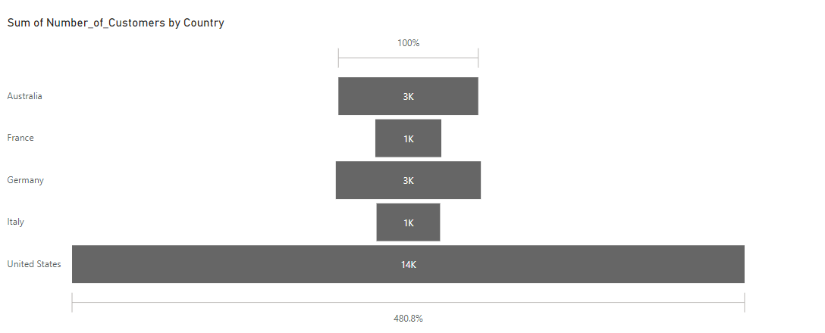
Location Distribution

Slide 20
Location Distribution
Description: This funnel chart shows the sum of total sales for each country over the given period.
Interpretation: We observe different sales volumes across various countries. Key observations include:
Leading Country: The United States shows the highest sales volume, indicating a strong customer base and market presence in this region.
Significant Markets: Other countries such as Germany and Australia, also show substantial sales volumes, suggesting strong market engagement in these regions.
Emerging Markets: Countries with lower sales volumes, like France and Italy, might represent emerging markets with potential for growth.
Strategic Insights: Understanding sales distribution by country can help in tailoring marketing strategies, optimizing inventory management, and making informed decisions about regional market focus and expansion. For example, increasing marketing efforts in high-performing countries and exploring growth opportunities in emerging markets

Slide 21
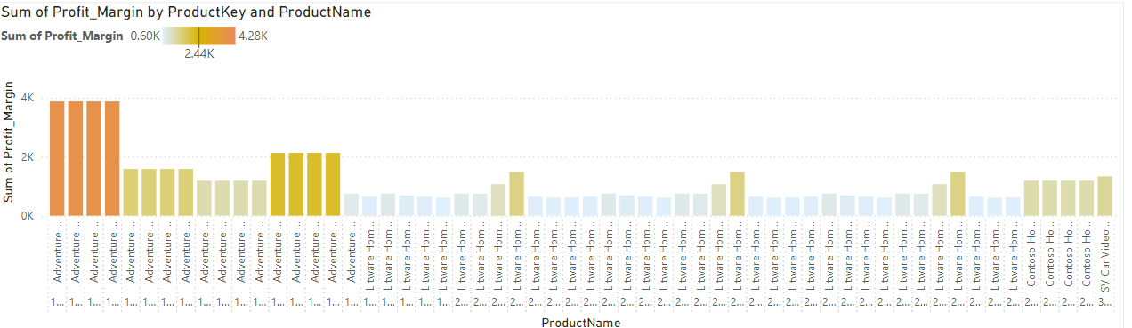
Profit Margin By Products

Slide 22
Profit Margin By Products
Description: The clustered column chart displays the sum of profit margins for various products in the dataset. Each bar represents a product, identified by its Product Key and ProductName, with the height of the bar indicating the total profit margin. Different colors are used to differentiate between product categories or specific products.
Interpretation: High-Profit Products: The chart reveals that products such as 'Adventure Works' and 'Cyril Overn' have significantly higher profit margins compared to others. These products contribute substantially to overall profitability and are key drivers of profit.
Moderate-Profit Products: Products like 'Aaron Lee' and 'Francisco Ramírez' have moderate profit margins, indicating a balanced cost-to-sales ratio. These products perform well but are not as profitable as the top performers.
Low-Profit Products: Products such as 'Maxi Pérez' and 'Siriu McLeary' show relatively lower profit margins. These products may have higher costs or lower sales prices, resulting in lower profitability.
Color Coding Insight: The use of different colors helps to quickly identify different categories or groups of products. For instance, all 'Adventure Works' products are shown in orange, making it easy to see that this category has consistently high profit margins.

Slide 23

Profit Margin By Products
Strategic Recommendations: Enhance High-Profit Products: Focus marketing efforts and resources on high-profit products like 'Adventure Works' and 'Cyril Overn' to maximize sales and profitability.
Optimize Moderate-Profit Products: Evaluate the pricing strategies and cost structures of moderate-profit products to find opportunities for improvement.
Improve or Discontinue Low-Profit Products: Analyze the reasons behind the lower profit margins of products like 'Maxi Pérez' and 'Siriu McLeary'. Consider cost reduction strategies, price adjustments, or even discontinuing products that consistently underperform.
By leveraging these insights, businesses can make informed decisions to optimize their product portfolio, improve profitability, and develop targeted strategies for different product categories.

Slide 24
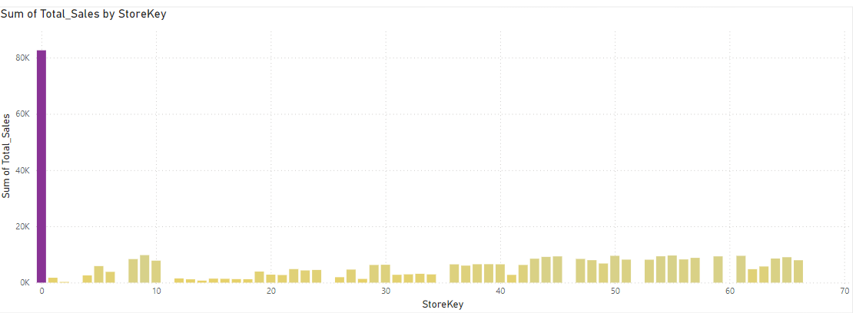
Total Sales By Stores

Slide 25
Total Sales By Stores
Description: This line and stacked column chart visualizes total sales by store. Each bar represents a store, identified by its Store Key on the X-axis, and the height of the bar indicates the total sales for that store on the Y-axis.
Interpretation: Top-Performing Stores: The chart highlights which stores have the highest total sales. Stores with the tallest bars have the highest sales figures, indicating strong performance.
Underperforming Stores: Stores with shorter bars have lower total sales, signaling potential areas for improvement.
Sales Distribution: The chart provides a clear view of how sales are distributed across different stores, allowing for easy comparison.
Strategic Insights: Focus on High-Performing Stores: Invest in marketing and inventory for stores with high sales to further boost their performance.
Support Underperforming Stores: Identify and address the factors contributing to lower sales in underperforming stores.
Balanced Strategy: Ensure that resources are allocated effectively to maintain a balanced sales distribution across all stores.
By using this chart, businesses can gain valuable insights into store performance and make data-driven decisions to optimize sales strategies.

Slide 26
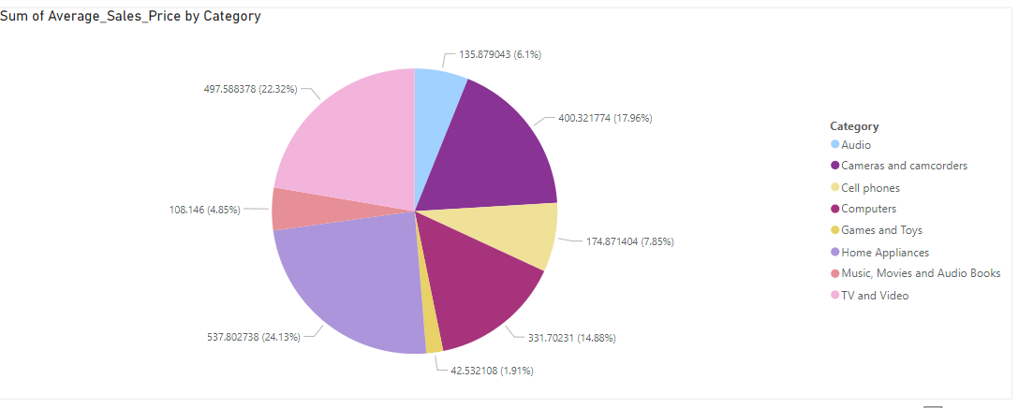
Average Sales Price By Product

Slide 27
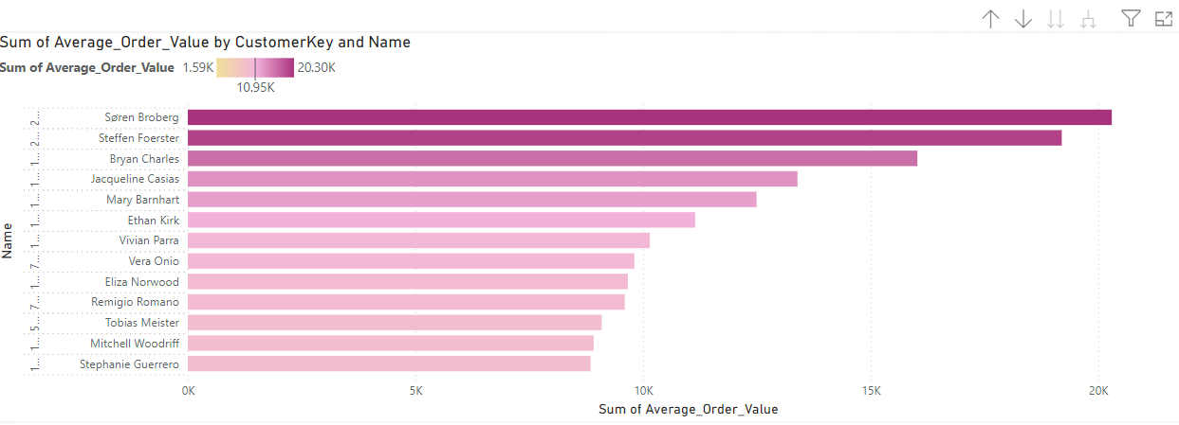
Average Order Value By Customer

Slide 28
Average Order Value By Customer
Description: This horizontal bar chart displays the "Sum of Average Order Value by Customer Key and Name." Each bar represents a customer, identified by their name and unique customer key, and the length of the bar indicates the total of their average order values.
Interpretation: Top Customer Spend: The chart reveals that Soren Bro berg has the highest average order value sum, making them the top spender among the customers listed. This is followed closely by Steffen Forster and Bryan Charles.
High-Value Customers: The top five customers, including Soren Bro berg, Steffen Forster, Bryan Charles, Jacqueline Casias, and Mary Barnhart, significantly contribute to the sales with high average order values.
Customer Engagement: Customers with higher average order values likely have a higher level of engagement or purchase more expensive products.
Diverse Spending Patterns: There is a noticeable range in the sum of average order values, indicating diverse spending behaviors among different customers.
Strategic Focus: Focusing on maintaining and enhancing relationships with top spenders like Soren Bro berg and Steffen Forster can be strategically beneficial. Additionally, understanding the reasons behind the lower spending patterns of other customers could help in developing targeted marketing strategies to increase their order values.

Slide 29
Average Sales By Products
Description: This pie chart visualizes the average sales price by product category. Each segment represents a product category, with the size of the slice indicating the proportion of the average sales price for that category relative to the total average sales price
Strategic Insights:
Premium Focus: Categories such as Home Appliances and TV and Video should be the focus for premium marketing strategies, given their higher average sales prices.
Balanced Pricing Strategy: For mid-range categories like Computers and Cell phones, a balanced approach to pricing and promotions could help in capturing a broad customer base.
Volume Strategy for Low-Price Categories: Categories like Audio, Music, Movies and Audio Books, and Games and Toys might benefit from volume sales strategies due to their lower average prices. Bundling and discount promotions could be effective.
By analyzing the average sales price by product category, businesses can tailor their marketing and sales strategies to target different segments effectively, optimizing revenue across all categories.

Slide 30
Recommendations
Marketing Strategies: Based on customer and sales analysis
Inventory Management: Recommendations based on product and sales analysis
Sales Forecasting: Insights for better forecasting
Product Development: Based on product and customer feedback
Store Operations: Recommendations for expansion and optimization

Slide 31
Overall Insights
Leverage Peak Sales Periods: Utilize insights from sales spikes to plan marketing and inventory strategies around these periods.
Focus on Top Product Categories: Prioritize the top-performing product categories (Cameras and Accessories, Audio) in marketing and inventory management.
Target High-Performing Demographics: Enhance marketing efforts towards the 65+ age group, which shows higher engagement.
Address Declining Trends: Investigate and address the reasons behind sales declines in recent years to reverse the trend.
Optimize Store Operations: Focus on larger stores and consider expanding them or opening new large stores. Invest in older, high-performing stores to sustain their success.
These insights can guide strategic decisions to enhance customer satisfaction, optimize operations, and drive overall business growth.

Slide 32
Thank You

