Slide 1
PageModel class && Model Binding

Slide 2
PageModel class

Slide 3
PageModel class.
It has the same name as the display template and ends with .cs extension.
It is the model for the display template. It derives from the PageModel class.
It contains Properties and Handler methods.

Slide 4
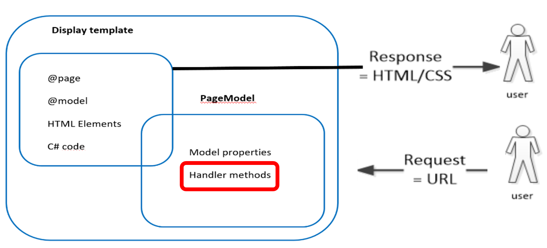
Handler methods && naming convention
When a Razor Page receives a request, a single handler method is selected to run, based on the incoming request ( Get or Post).

Slide 5
How is a handler method selected ?
Handler methods are matched via a naming convention:
On{verb}[Async]
{verb} is the HTTP method : Get , Post, Delete , Put.
[async] is optional.
When a Razor Page receives a request, a single handler method is selected to run:
If the incoming request is a Get request the OnGet handler method is selected.
If the incoming request is a Post request the OnPost handler method is selected.
Important :
For HTML forms, it's very common to have an OnGet handler method that displays the initial empty form ( for example when creating objects), and an OnPost handler method that handles the POST back from the client .

Slide 6
OnGet && OnPost
The OnGet or OnGetAsync ( asynchronous behavior) method is selected for GET requests.
The OnPost or OnPostAsync ( asynchronous behavior) method is selected for POST requests.

Slide 7
When is the OnGet method called ?
Get Request
When navigating to a page, its OnGet handler method is invoked
With a form using the Get method (i.e implementing search, filtering…..etc. ), the OnGet method of the page is invoked.

Slide 8
When is the OnPost method called ?
Post Request
When submitting a form the OnPost method of the same page is invoked.
NB : As we will see in Tag Helpers chapter:
You can define the page that will handle the form data.
You can even define your handler method that will handle the form data (Maybe becuase OnPost is used for another purpose)

Slide 9
ModelBinding

Slide 10
Model Binding in Razor Pages is the process that takes values from HTTP requests and maps them as:
PageModel properties
Handler method parameters ( route data)

Slide 11
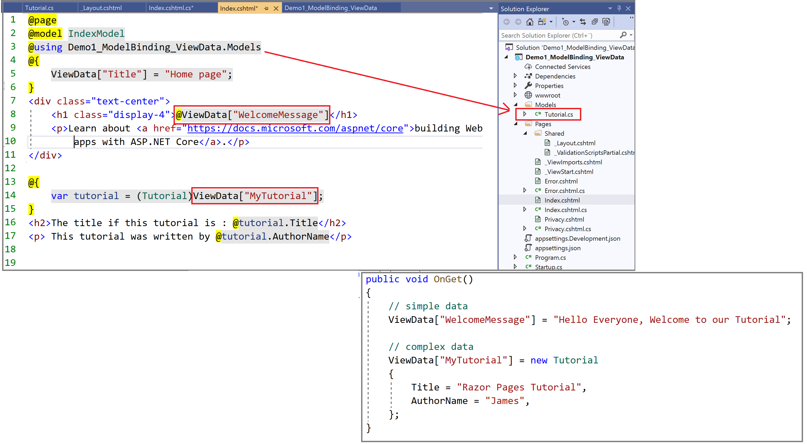
Binding from Get request using ViewData.
Binding
Binding

Slide 12
Issues
Sustainable for small forms.
However , for large forms, the assignment code can become very tedious.
Error prone :
No code-completion or Intellisense support for string indices.
High risk for mistakes: ViewData[“WelcomeMessage"]

Slide 13
Download and run Demo1_ModelBinding_ViewData 1. Let us play with the demo 2. What is the issue with using ViewData.

Slide 14
Binding complex models ?
Using ViewData
Create and bind a single property of the model type
NB: You can also bind every property. However this procedure is tedious.

Slide 15
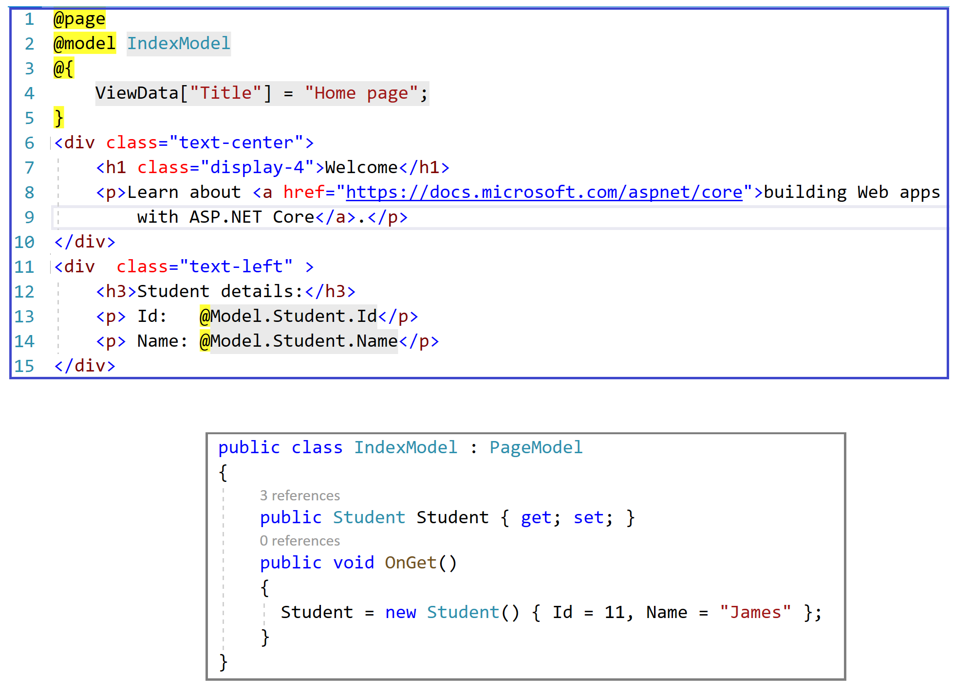
Binding simple objects from Get request using properties

Slide 16
1. Download Demo2_ModelBinding_SimpleObject 2. Run the application. 3. Let us play with the demo : instead of binding the Student property, try to bing each property 4. Instead of using a simple Student object , try to use a collection( list or dictionary) of students. HINT: Use foreach loop to diplay the list
Demo2_ModelBinding_SimpleObject

Slide 17
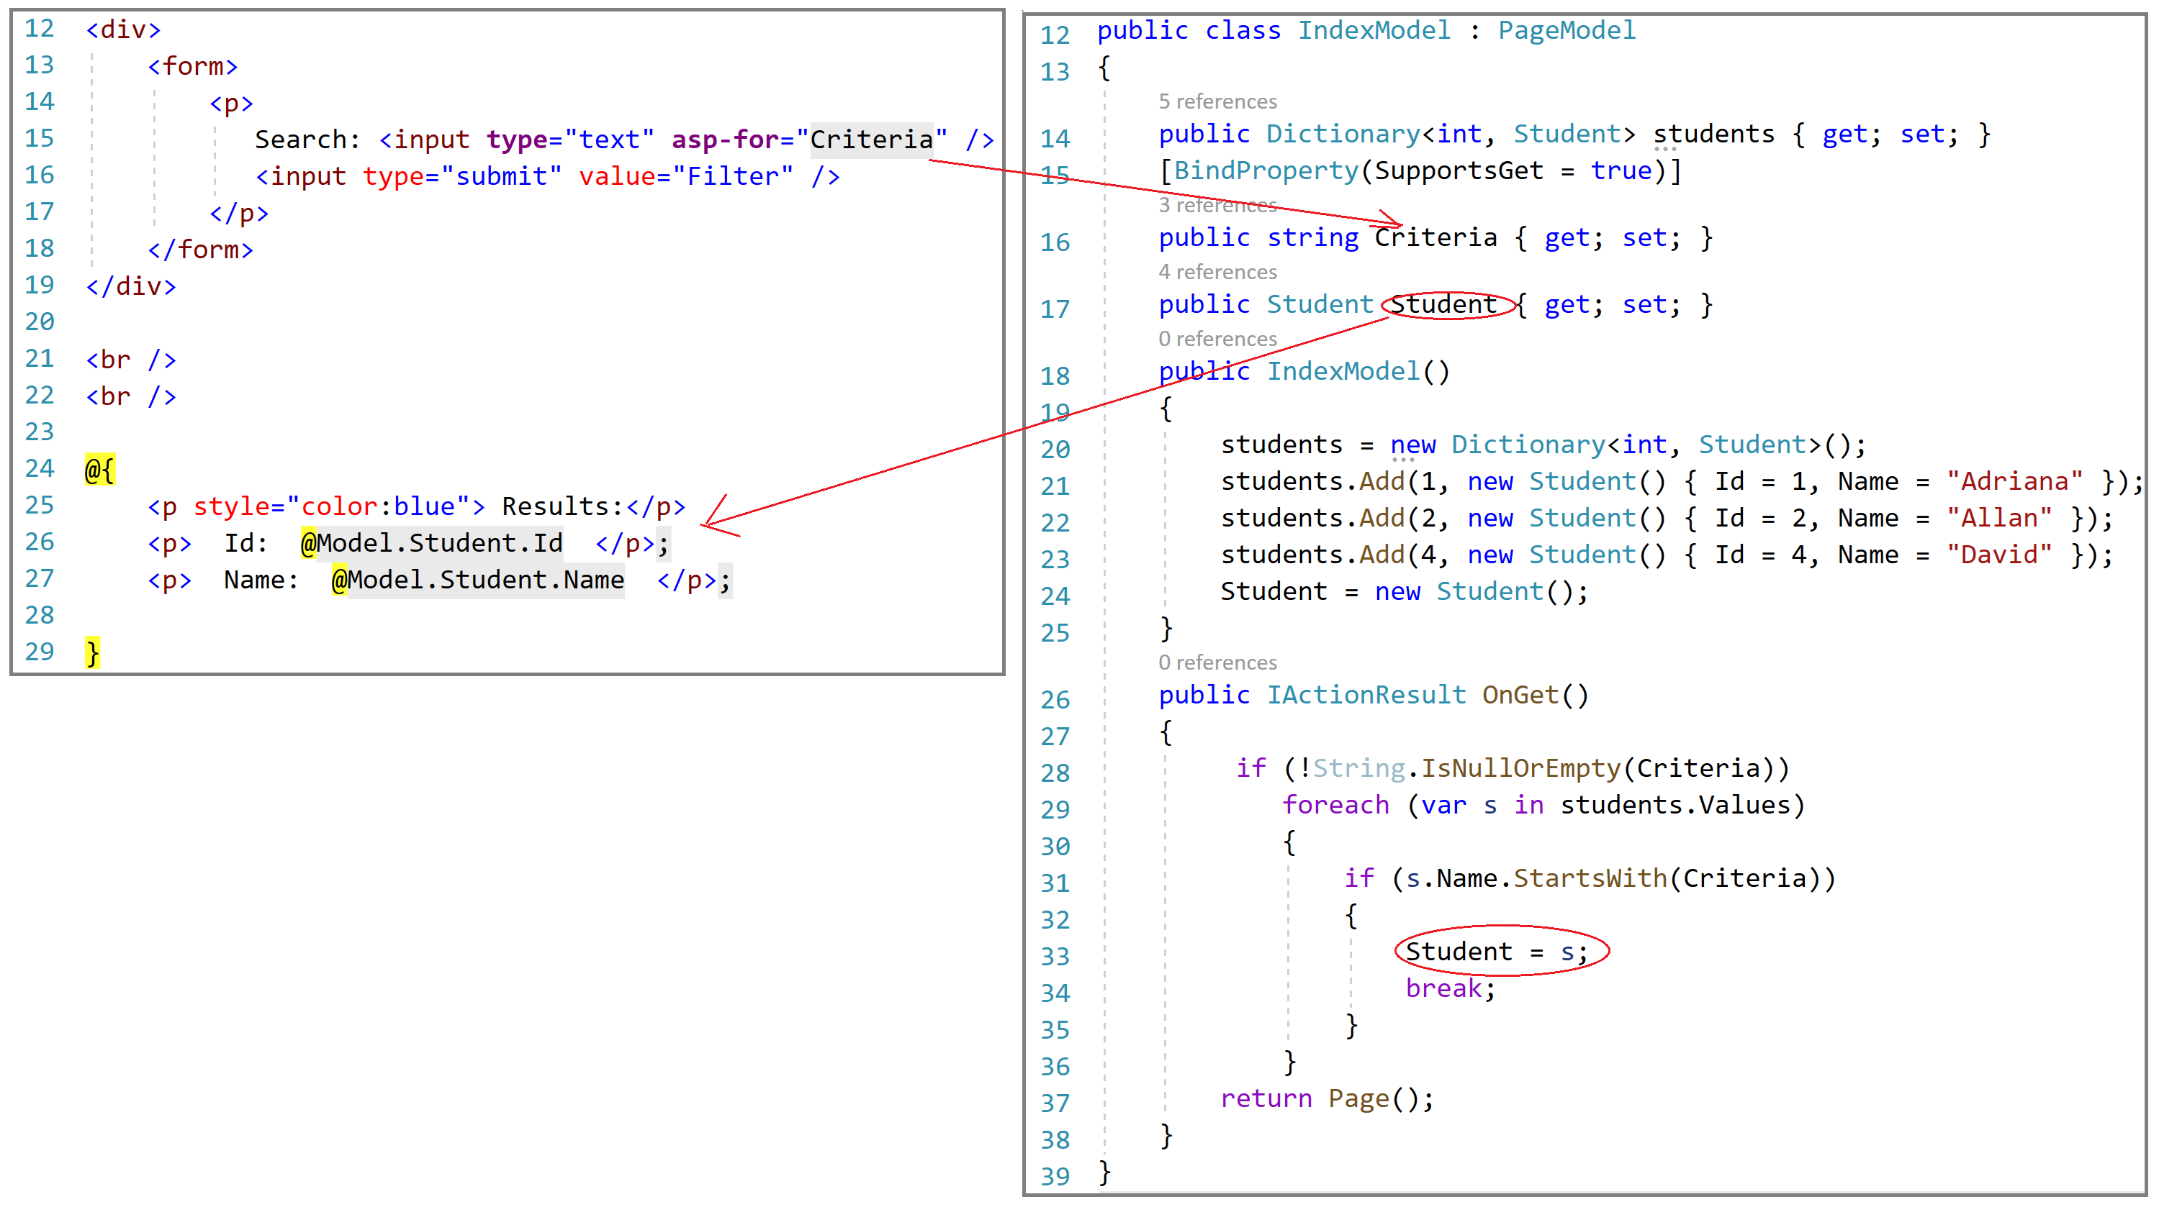
Binding from Get request - searching / filtering

Slide 18
Download and run Demo4_ModelBinding_Search
Try to enter a search criteria and test the application
Try to test the application with no criteria at all.

Slide 19
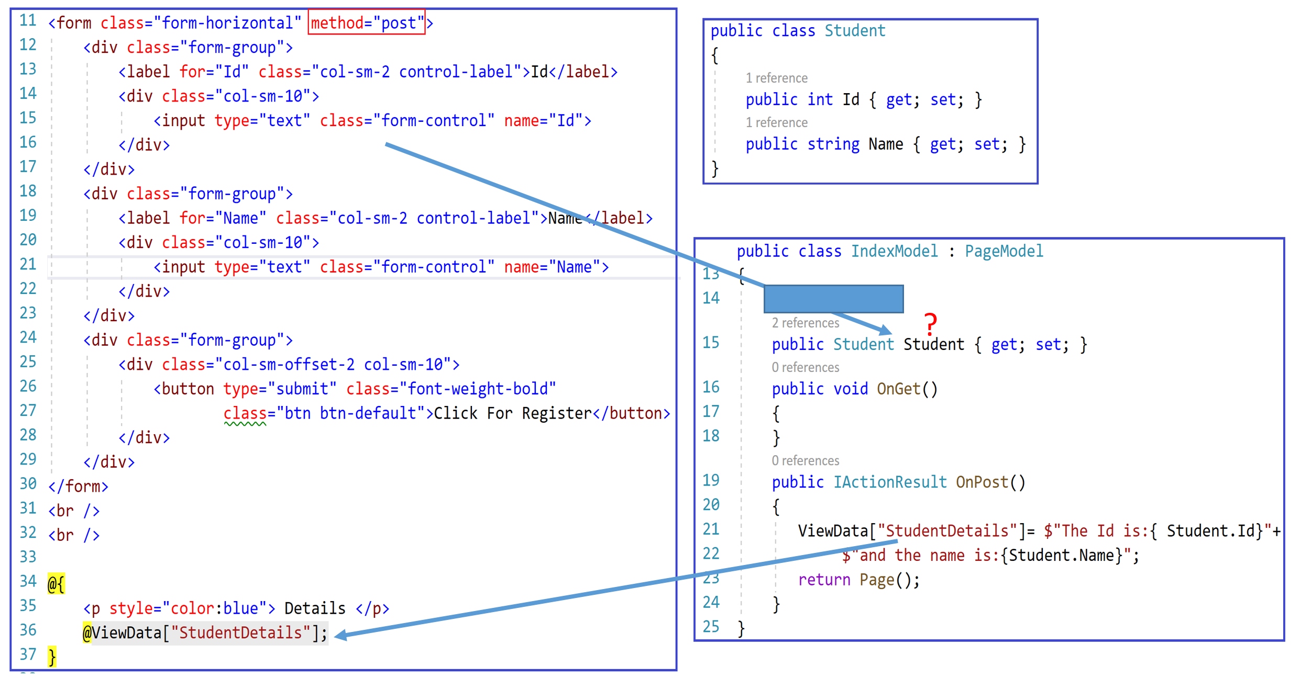
Binding simple objects from Post request using properties

Slide 20
Download and run Demo3_ModelBinding_SimpleObject_Post
Download and run the demo.
It is not working. Why?
Try to fix the problem ( work with a partner).

Slide 21
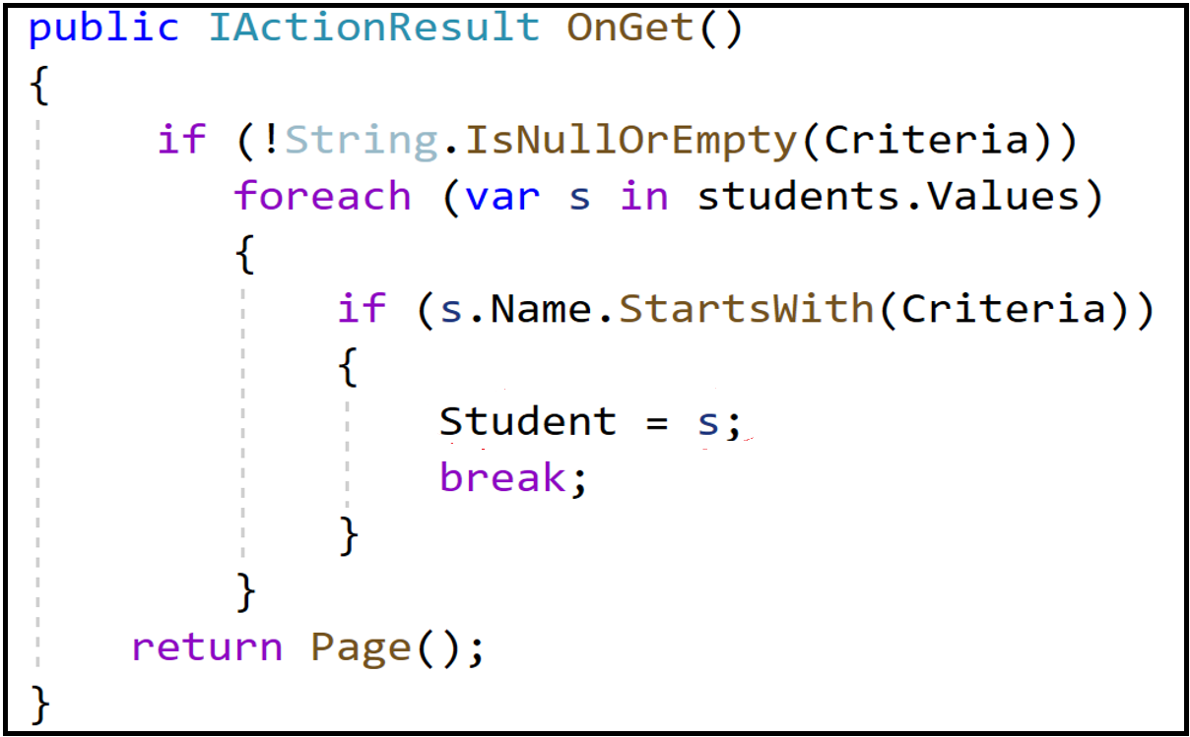
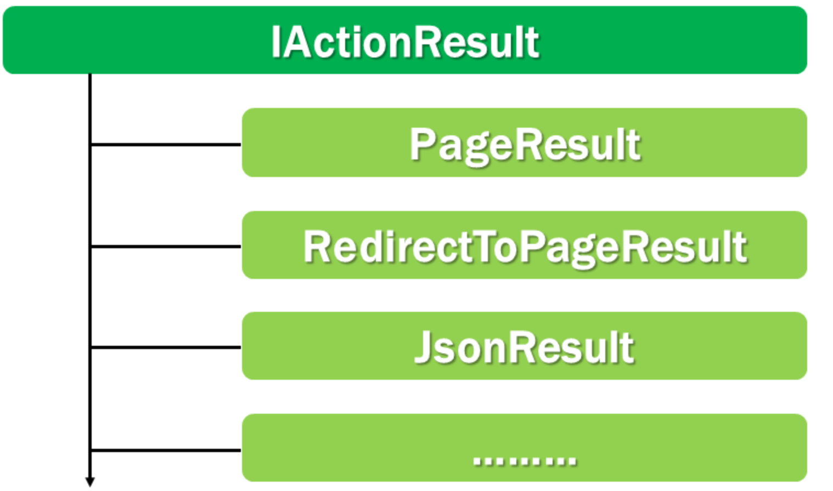
Re-rendering the same page.
This is done by the Page() method.
Page() method returns PageResult which also implements IActionResult interface
IActionResult interface
Re-directing to another page
This is done using RedirectToPage(“ “) method that returns RedirectToPageResult which also implements IActionResult interface
Re-directing to another action
This is done using RedirectToAction(“ “) method that returns RedirectToActionResult which also implements IActionResult interface
Changing the return type of OnGet() action from void to IActionResult allows us to return different result types that implement IActionResult interface. The same for OnPost().

