Slide 1
Routing

Slide 2
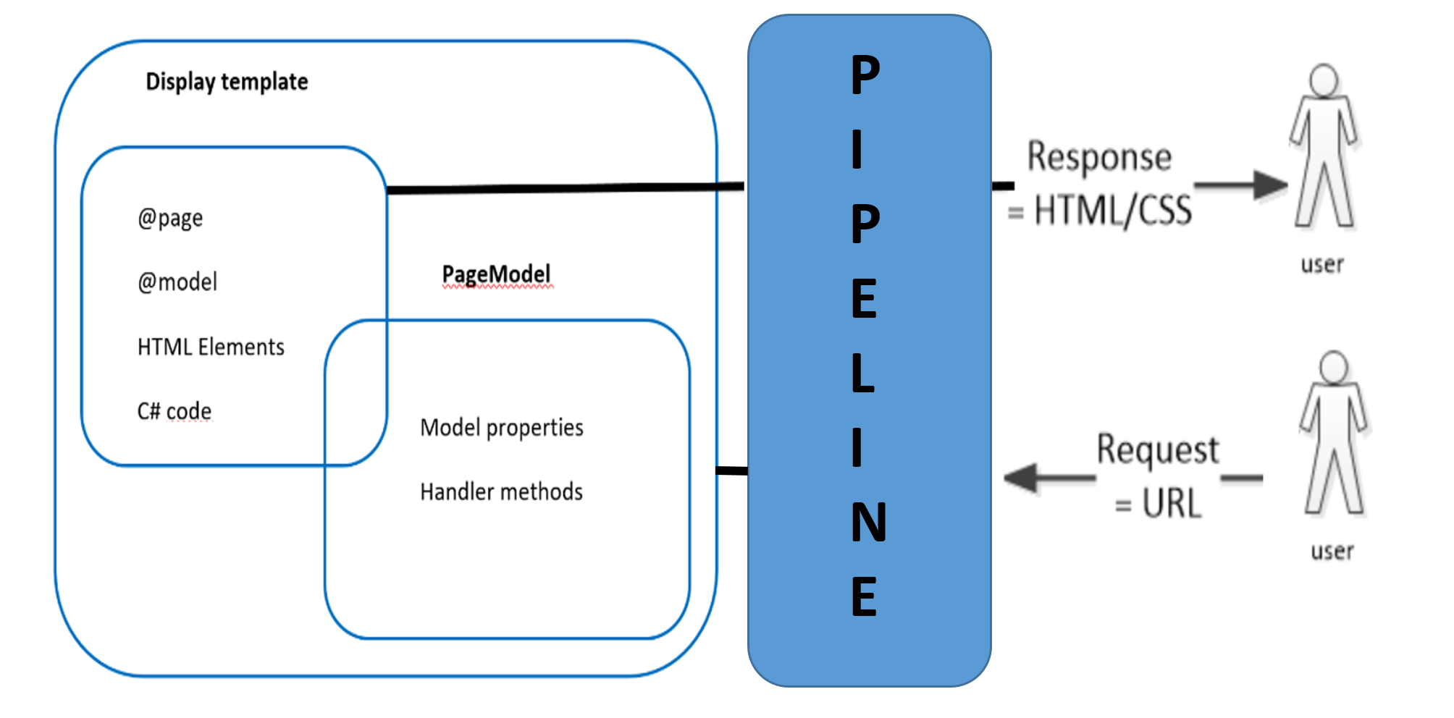
Middleware
P
I
P
E
L
I
N
E

Slide 3
Middleware in Razor Pages
Where should the request be directed or routed to?
Should details of the request be logged?
Should the application simply return the content of a file?
Should it compress the response?

Slide 4
Middleware in Razor Pages (cont…)
What should happen if an exception is encountered while the request is being processed?
Is the person making the request actually allowed to access the resource they have requested?
Answer: Separate components called Middlewares are taking care of all these concerns. They form the request pipeline.

Slide 5
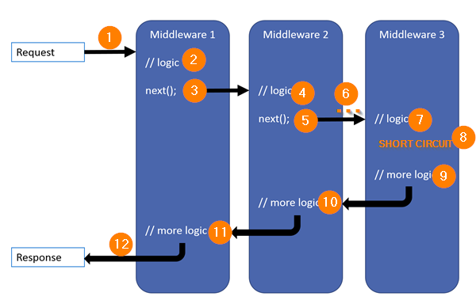
ASP.NET Core Pipeline
A middleware can either terminate the pipeline execution and return a response or it can pass control on to the next middleware.

Slide 6
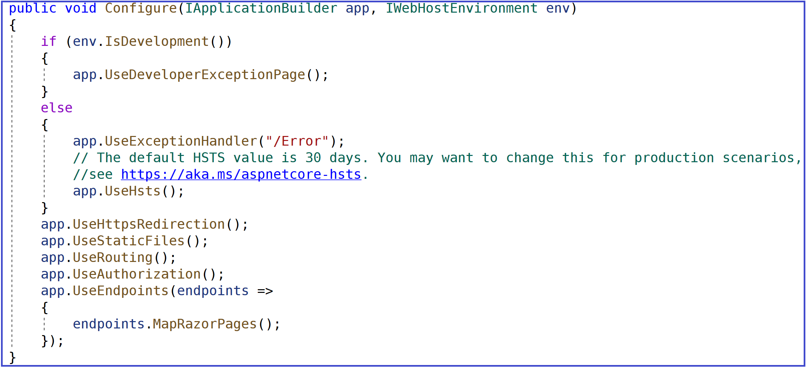
ASP.NET Core Pipeline
A middleware should be registered in the Configure method of the Startup class ( i.e app.UseRouting() )

Slide 7
Routing with Razor Pages
Where should the request be directed or routed to?
By default, Routing is based on matching URLs to file paths.
The folder Pages is by default the root Razor Pages folder
The Index Razor page is considered the default page in any folder or any subfolder having an Index page.

Slide 8
How to change the root folder for Razor Pages ? Use configuration
Option1
public void ConfigureServices(IServiceCollection services)
{
services.AddRazorPages().AddRazorPagesOptions (options => {
options.RootDirectory = "/Content";});
}
Option 2
public void ConfigureServices(IServiceCollection services)
{
services.AddRazorPages().WithRazorPagesRoot("/Content");
}

Slide 9
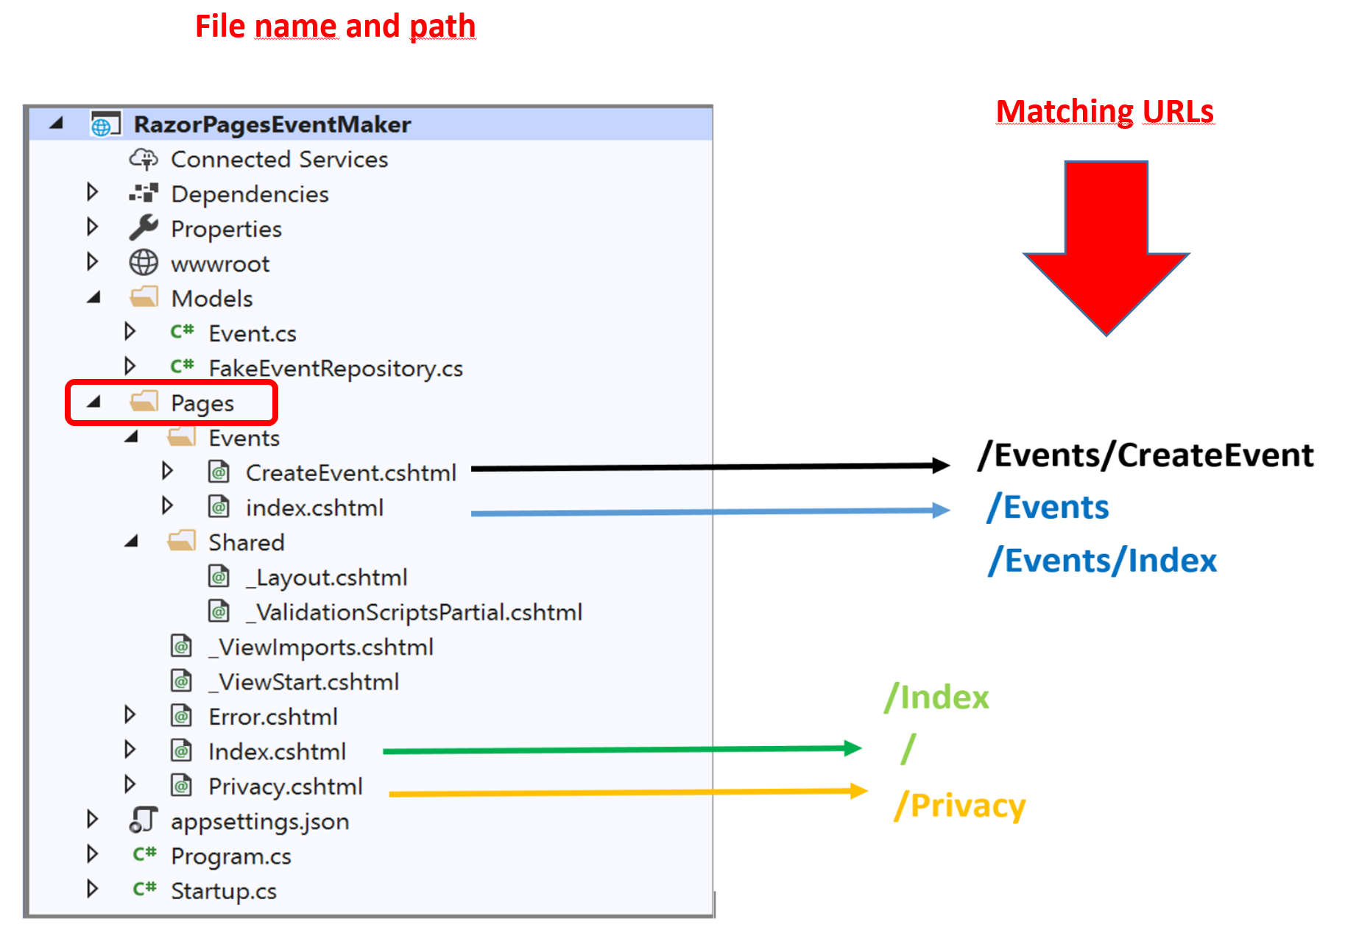
Routing with Razor Pages
If you create a Razor Page in your app at /Pages/Events/CreateEvent.cshtml, it
would be exposed at the URL: /Events/CreateEvent.

Slide 10
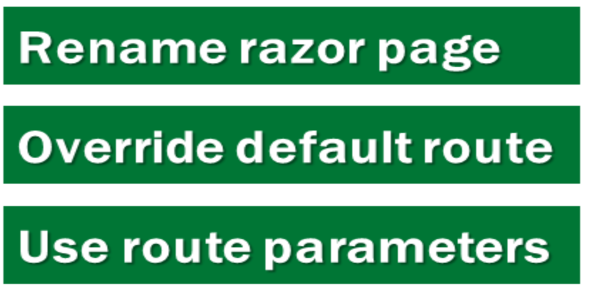
AmbiguousMatchException
If a single URL matches multiple razor pages , asp.net core throws AmbigousMatchException
Solution:

Slide 11
Custom routes
Provide a route template in the @page directive
@page "/customroute/customized/{id}"
This page would be exposed at : /customroute/customized/id
Example: /customroute/customized/123.
NB: The id value can be bound to a PageModel property using model binding( route binding).

Slide 12
Demo1
In this demo we are going to :
Download and run demo1_routing
Explore the code ( model binding …etc)
In the top menu, we add a link to the GetAll_Create page.
Append an Edit link to each item from the list

Slide 13
Passing data from a page to another page

Slide 14

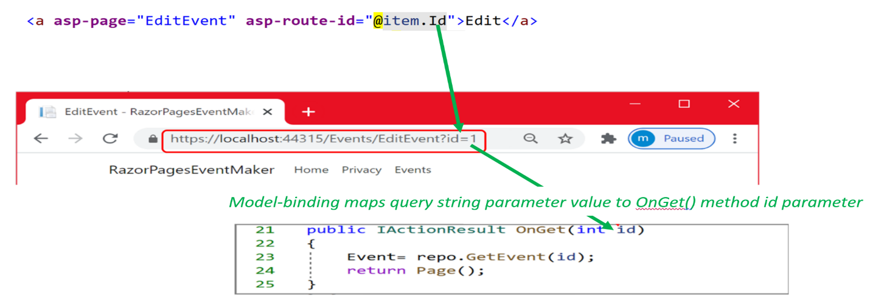

Slide 15
Demo2
In this demo we are going to :
Implement Edit specific student using QueryString

Slide 16
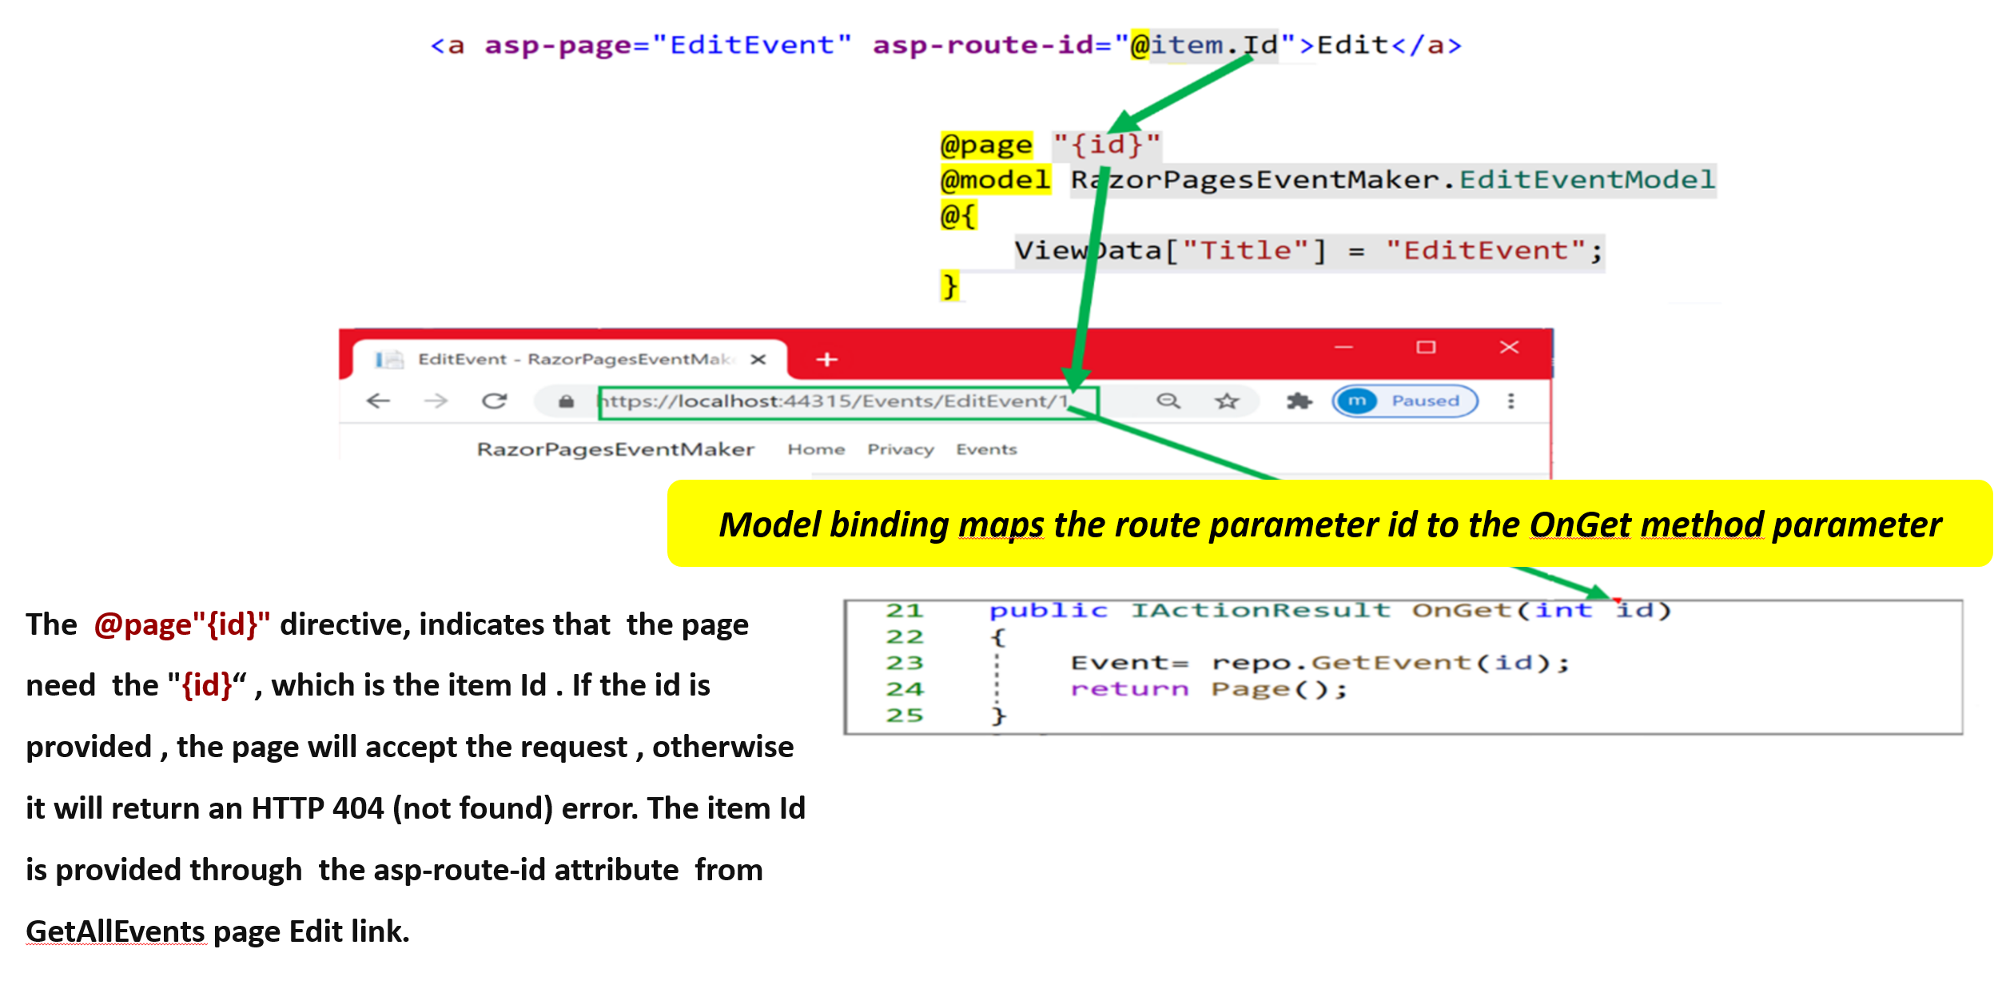
Route parameters

Slide 17
Demo3
In this demo we are going to :
Implement Edit specific student using Route parameter

Slide 18
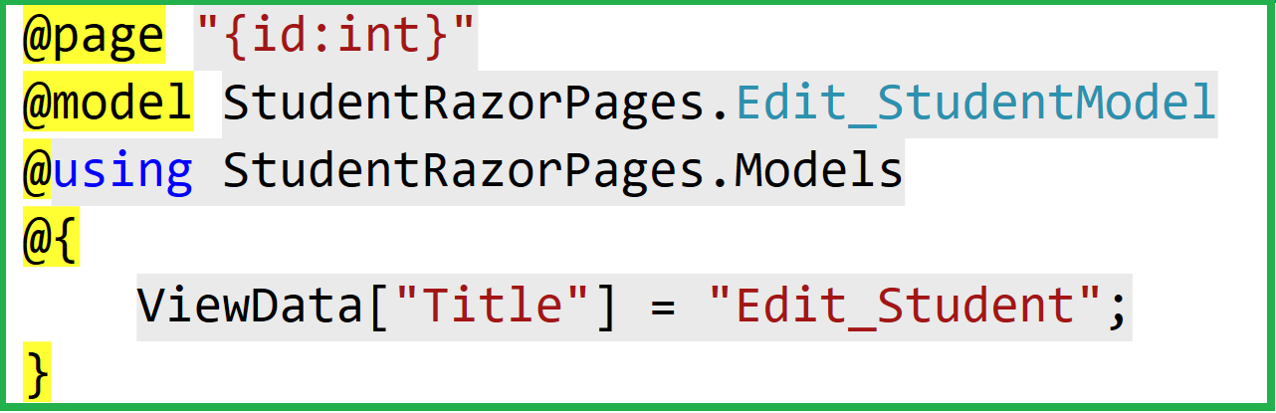
Some Route Constraints
Constraint | Example | Use
int | ”{id:int}” | Only integer values
Other Support
Decimal Float bool
Double Long DateTime
guid

Slide 19
Route Constraints for numbers and ranges
Constraint | Example | Use
min(value) | ”{id:min(1)}” | Integer value must be at least 1
max(value) | ”{id:max(100)}” | Integer value must not be more than 100
range(min,max) | ”{id:range(1,100)}” | Integer value must be between 1 and 100 (inclusive)
Constraint | Example
Regex(expression) | String must match the pattern specified by the regular expression

Slide 20
Demo4
In this demo we are going to :
Add some Constraint on the Edit student page

