Slide 1
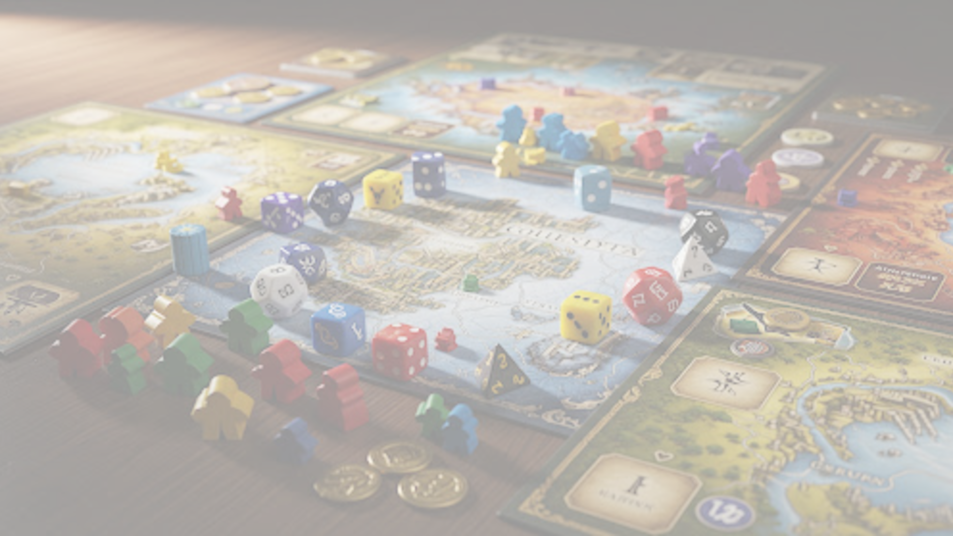


Capstone: Board Game Design Analysis
CAPSTONE PROJECT 2026
PRESENTED BY ERIC LAM

Slide 2


Problem & Motivation
lightbulb
analytics
The Intent
To provide insight for boardgame designers and publishers, offering inspiration and strategic guidance for new game design ideas.
The Approach
Predicting boardgame ratings by analyzing core game mechanics and themes to identify the drivers of player success.
BOARD GAME DESIGN ANALYSIS | 2026
ERIC LAM

Slide 3
Data & Methodology
storage
list_alt
Kaggle Dataset
Source: BoardGameGeek Reviews
games_detailed_info2025.csv (~27k rows)
Feature Engineering
Analyzing ~28 core attributes
Focused on complex mechanic combinations
psychology
Modeling Objective
Predicting board game ratings based on player-favored mechanics:
Board game Mechanics as primary input vectors
Average Rating as the target variable for regression
BOARD GAME DESIGN ANALYSIS | 2026
ERIC LAM

Slide 4
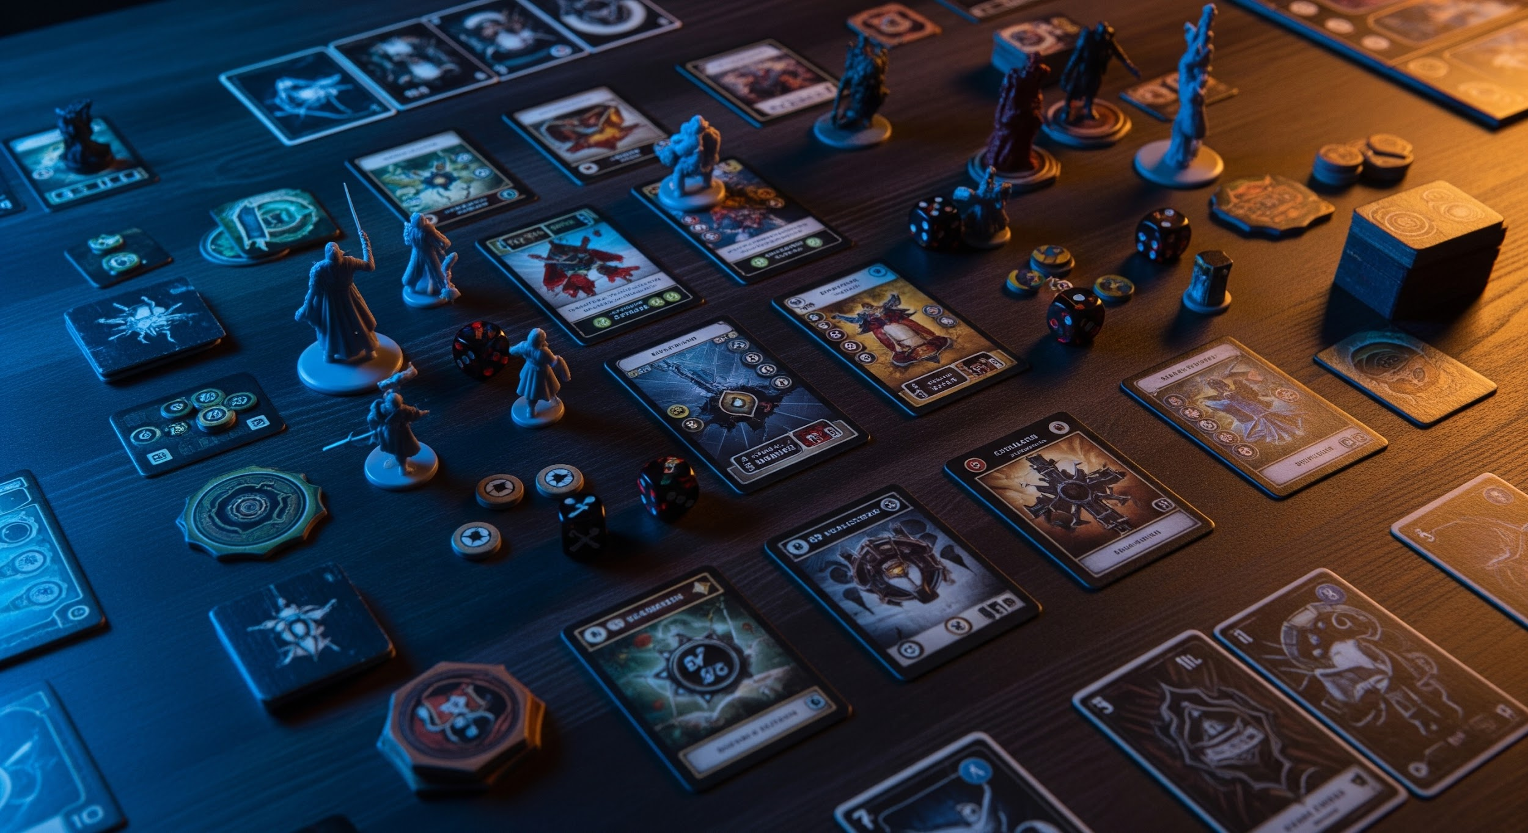
Model Architecture & Results
hub
balance
DeepNet DNN
MLP with Batch Normalization & Dropout layers. Structure: 512 512 256 128 1.
Robust Optimization
Implemented HuberLoss to ensure the model remains robust against outliers in game ratings.
insights
Test Set Results & Summary
MAE: ~0.33 | RMSE: ~0.48 | R: ~0.72
The model successfully captures complex interactions between game mechanics and categories to predict overall player reception.
BOARD GAME DESIGN ANALYSIS | 2026
ERIC LAM

Slide 5
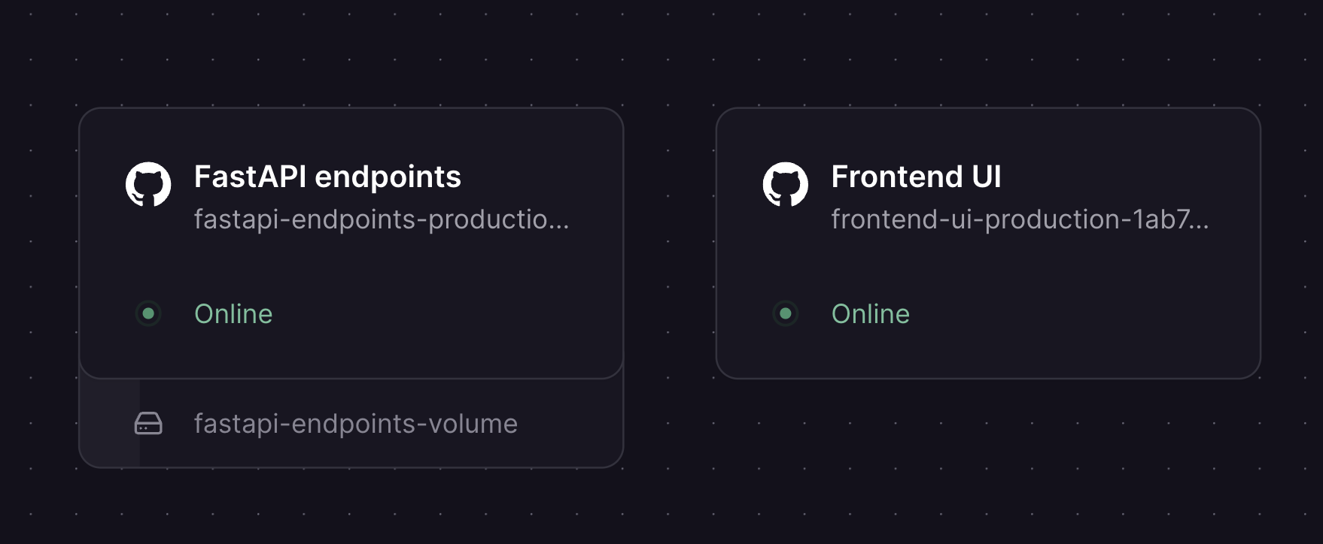
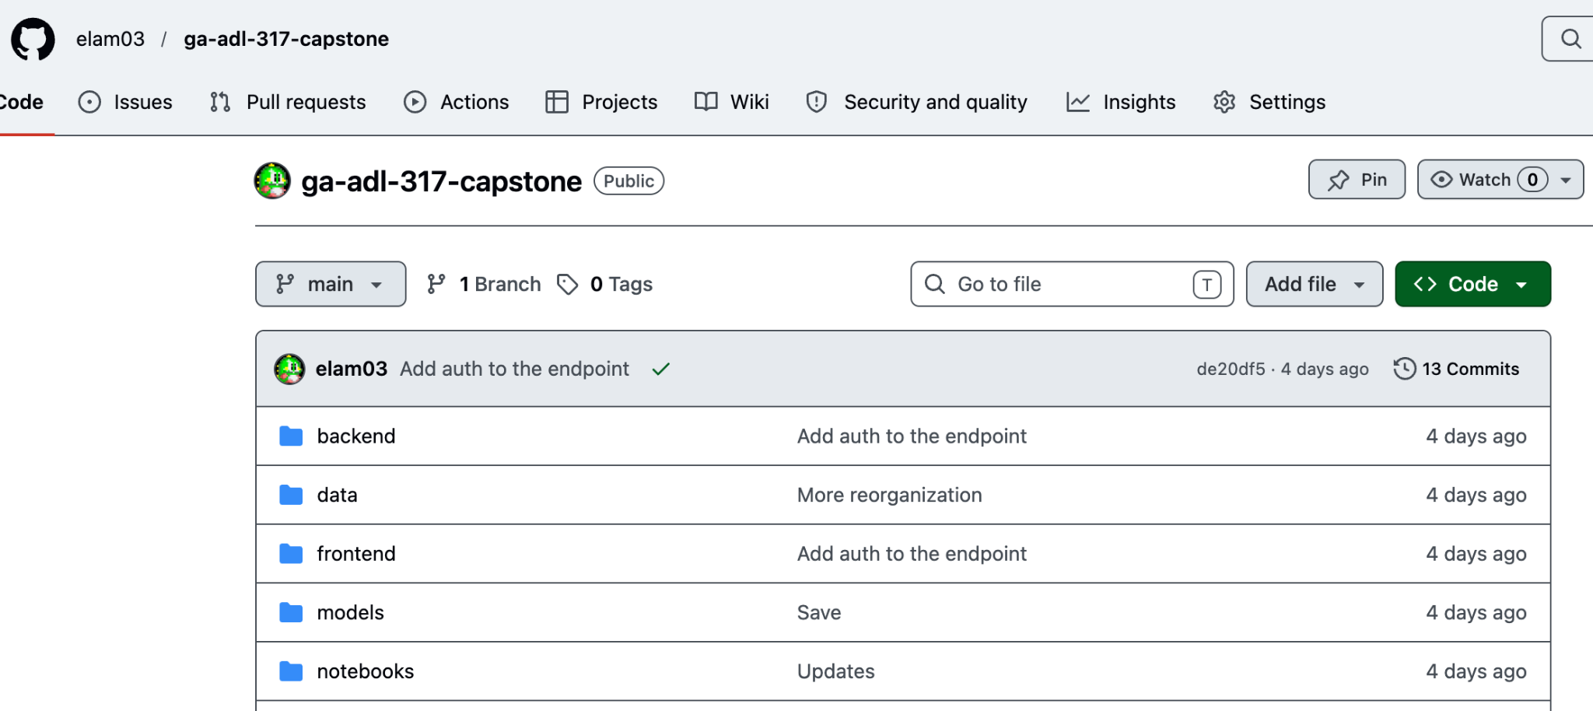
Deployment
Public Github Repo
Link
Deployed to Railway
Link
e
BOARD GAME DESIGN ANALYSIS | 2026
ERIC LAM

Slide 6
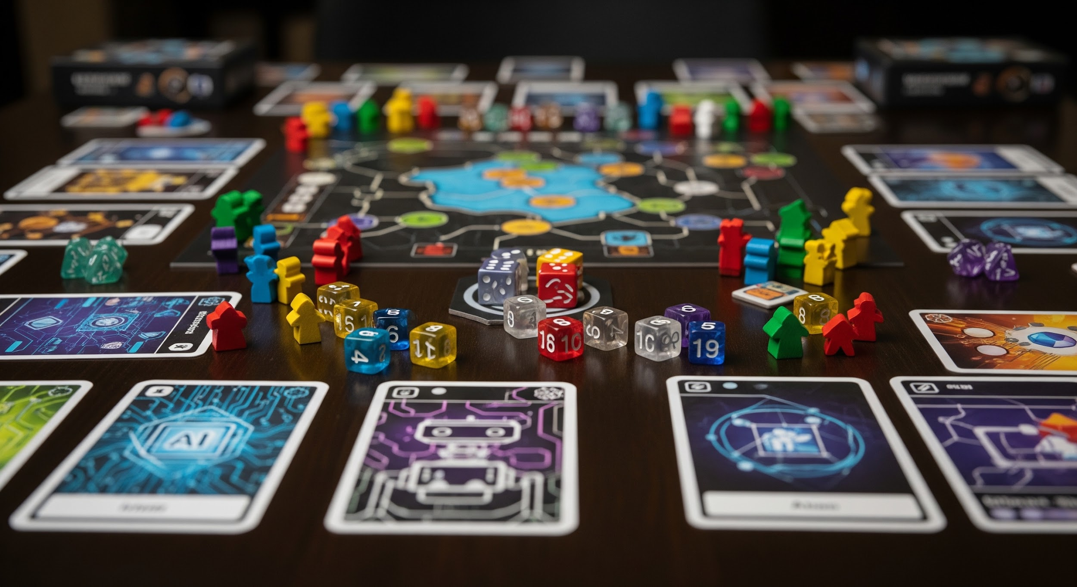
RAG Integration
search
database
Semantic Search Engine
Implemented Retrieval-Augmented Generation (RAG) using ChromaDB and LangChain.
Vector Database Seeding
Populated using `name` and `description` fields to enable nuanced game discovery.
api
Backend API Infrastructure
FastAPI server exposing core service endpoints:
`/rag/prepare`: Database initialization with test mode
`/rag/search`: Real-time semantic query processing
BOARD GAME DESIGN ANALYSIS | 2026
ERIC LAM

Slide 7
Challenges & Learnings
construction
cloud_done
Feature Engineering
Successfully parsed and one-hot encoded high-cardinality features (83 categories, 191 mechanics) using `MultiLabelBinarizer`.
Deployment
Navigated containerized deployment to Railway, overcoming "Mixed Content" errors and TypeScript iteration build errors.
psychology
Model Tuning
Learned that a deeper architecture with Batch Normalization was necessary to significantly improve performance over the initial baseline network.
BOARD GAME DESIGN ANALYSIS | 2026
ERIC LAM

Slide 8
Ethical & Responsible AI Reflection
error_outline
verified_user
Data Bias
Training data reflects historical tastes of Kaggle/BGG users, potentially penalizing niche or innovative designs.
Responsible Use
Intended as an inspiration tool, not a judge, to promote diverse and inclusive game creation approaches.
BOARD GAME DESIGN ANALYSIS | 2026
ERIC LAM

Slide 9

Future Improvements
auto_awesome
Multimodal LLM Analysis
Utilize LLMs to analyze box art and extract mechanics directly from rulebook PDFs.
visibility
Personalized Recommendations
Incorporate collaborative filtering to offer custom board game suggestions.
BOARD GAME DESIGN ANALYSIS | 2026
ERIC LAM

Slide 10
Q & A
error_ouline
Thank you!
BOARD GAME DESIGN ANALYSIS | 2026
ERIC LAM

