Slide 1




MicroPay
Hackathon 2026
OPEN PAYMENTS

Slide 2
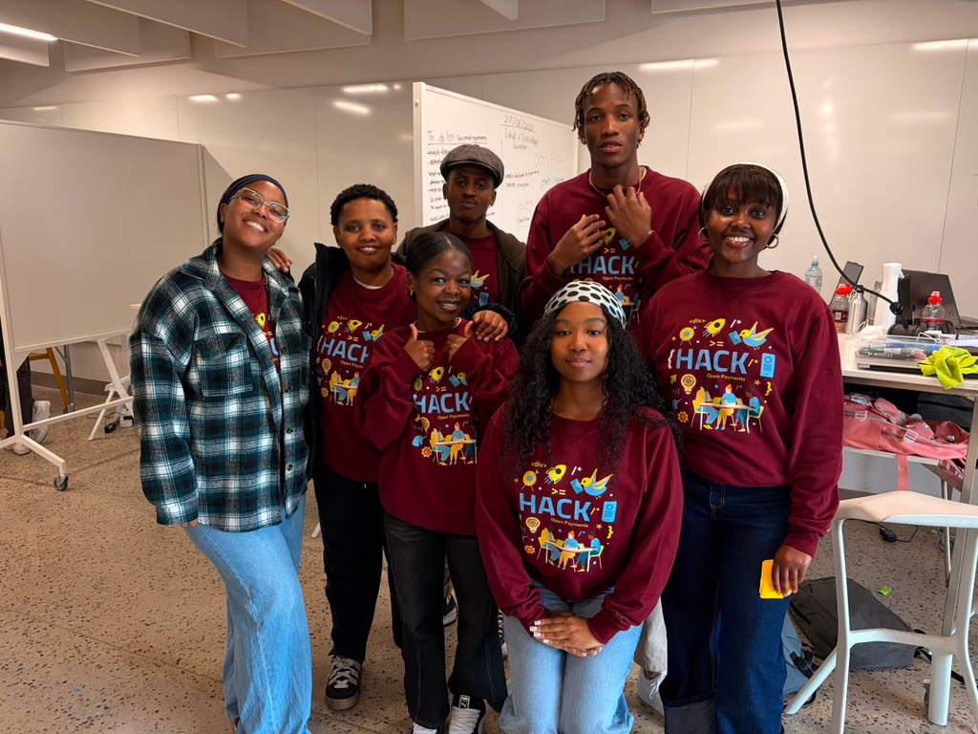


Meet the team
DataFlow
Omphile Ramotsho
Esona Ratazayo
Khanya Khosana
Buhle Mntuyedwa
Sinazo Mabiza
Qhamkile Mkhize
Elam Mandulo
#ILPHacks
@interledger #OpenPayments

Slide 3
Problem statement
Problem
Prepaid mobile users lose money on unused data because bundles expire.
Why
To stop users from paying for data they never consume.
Aim
To enable pay-as-you-use micropayments via Open Payments, where users are billed in real-time per MB with no expiry.
#ILPHacks
@interledger #OpenPayments

Slide 4
Solution
Why Unique?
Pay-per-MB – Only pay for what you use.
No expiry – Balance never disappears.
Interledger backbone – Real-time, secure micropayments.
User-first – Transparent pricing + spending limits.
#ILPHacks
@interledger #OpenPayments

Slide 5
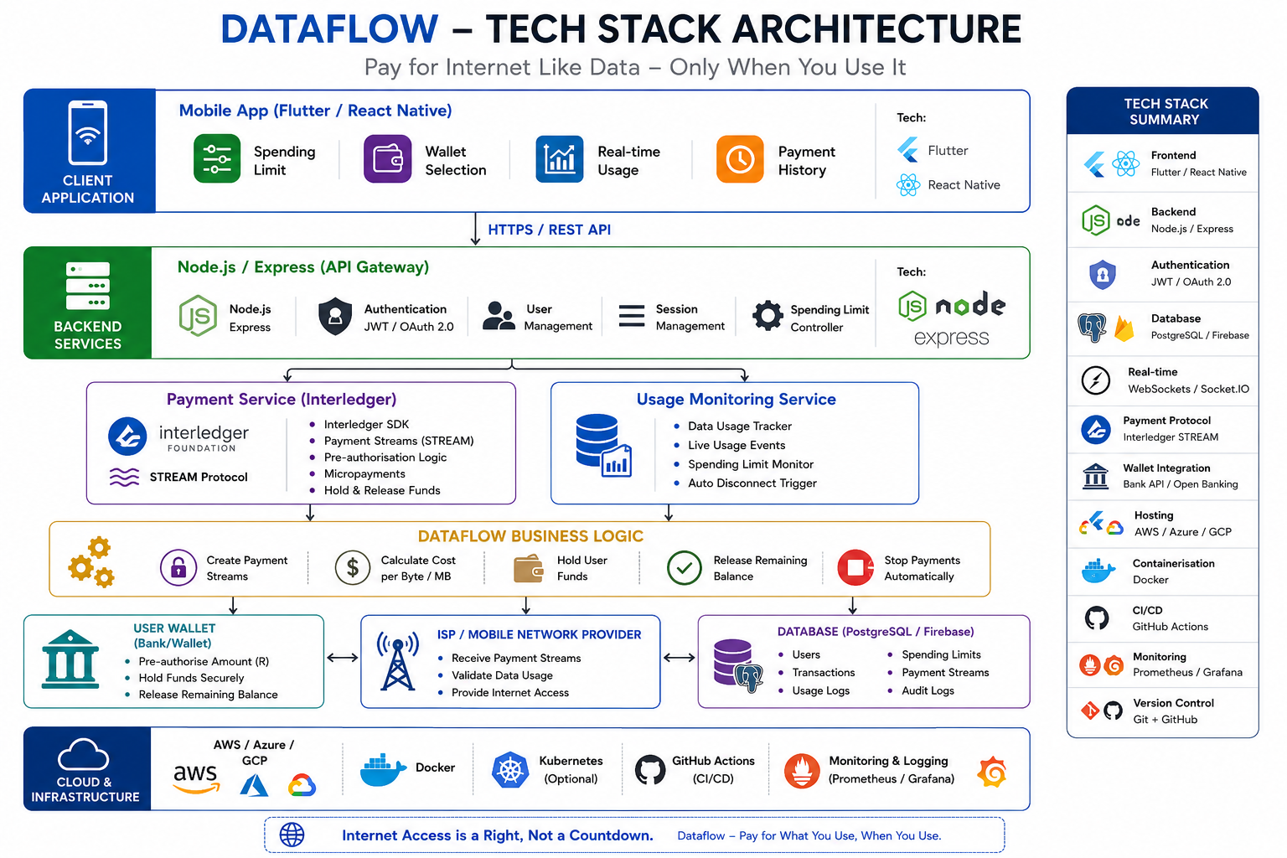
#ILPHacks
@interledger #OpenPayments

Slide 6
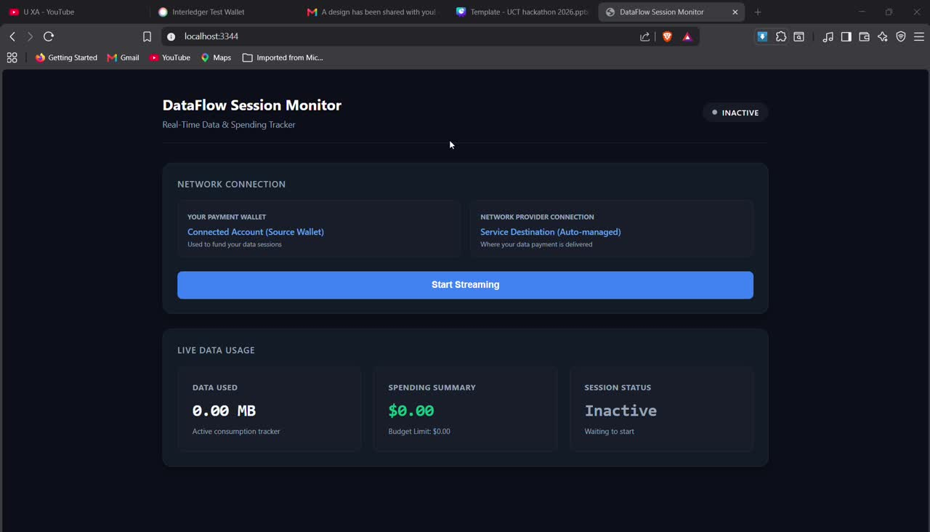
#ILPHacks
@interledger #OpenPayments

Slide 7
Feasibility & Business Engine
Micropayments – Interledger makes per-MB billing viable.
0.5% sustainability fee – Built-in protocol margin funds operations.
B2B white-label licensing – Telecoms pay to access new, price-sensitive markets.
#ILPHacks
@interledger #OpenPayments

Slide 8
Conclusion
Next step: Pilot live per-MB billing with one local ISP and a closed user group.
Vision: Replace expired data bundles with a fair, pay-per-use utility.
Impact: Internet access that's affordable, transparent, and wastes nothing.
#ILPHacks
@interledger #OpenPayments

Slide 9
Thank you.
#UWC #UCT #ILP # DataFlow
#ILPHacks
@interledger #OpenPayments

