Slide 1
Guideline Layer for ETA Prediction in Smart Transportation
Based on Resource Awareness
Proof of Concept — Implementation & Results Interpretation
Elango K (23AI016) · Gokul C (23AI018) · Kavitha K (23AI027)
Dept. of Artificial Intelligence and Data Science
Nandha Engineering College (Autonomous), Erode, Tamil Nadu, India
Notes:
Welcome. This deck walks through the Guideline Layer we proposed in our IEEE paper, the local proof-of-concept implementation, and what the results mean. Goal: show that resource profiling can run alongside any ETA model without touching it.

Slide 2
The Problem: Accurate ETA Models That Can't Ship
Motivation · Paper Section V (Research Gaps)
• Deep learning (LSTM, GRU, Transformers) achieves strong ETA accuracy — R² ≈ 0.93, MAE ≈ 18.5 s [1]
• But the literature reports accuracy metrics almost exclusively:
  MAE / RMSE / R² — CPU load, RAM, battery drain and bandwidth are rarely reported [1],[2],[3],[16]
  Models that win benchmarks fail on real constrained devices (smartphones, ESP32-class hardware)
• Resource Profiling Gap — the focus of our research (Paper Section V)
• Question we answer: can a system enforce resource-aware design WITHOUT rewriting the prediction model?
Accuracy — reported everywhere
Resource cost — rarely reported ✗
Notes:
Accuracy is a necessary but not sufficient condition for deployment. Every survey we read reports MAE/RMSE/R2; almost none report the compute footprint. That gap is what the Guideline Layer addresses.

Slide 3
Proposed Solution — The Guideline Layer
A modular, model-agnostic addition · Paper Section VI-A
1 · Monitoring Engine
observe CPU / RAM /
battery / bandwidth
data (GPS, traffic, weather)
2 · Threshold Checker
compare vs benchmarks
(CPU ≤ 30% …)
compare
ETA Prediction Model
(LSTM / GRU / XGBoost)
— unchanged —
observe
escalate
profiled every inference cycle
4 · Logging Module
lightweight records +
periodic cloud sync
3 · Warning System
alert + remediation hint
(prune / quantize)
log
The layer is NOT a model — it runs alongside the predictor, so any ETA model can be profiled without modification.
Notes:
Four modules form a closed loop: observe, compare, escalate, log. The ETA model in the middle is never touched. This is the paper's core design claim, and the demo verifies it with three different models.

Slide 4
The Four Profiling Benchmarks
Paper Section VI-D — practical starting points, not hard rules
RAM ≤ 500 MB
CPU ≤ 30%
Battery ≤ 20% / hr
Bandwidth ≤ 1 MB / min
Fits smartphones and embedded
devices without crashes
Keeps the device responsive,
headroom for other apps
A full working day on
battery power
Usable on poor connections,
lower cloud costs
Thresholds are tunable per device class — a smartphone may be RAM-hungry, a rural fleet bandwidth-constrained.
Notes:
These four numbers come straight from the paper. They are calibration starting points; the implementation makes every one of them a config value, so each device class gets its own policy.

Slide 5
From Paper to Code — One Command End-to-End
python run_experiment.py → data · train · simulate · analyze · report
Paper module | Implementation | Role in the PoC
Monitoring Engine | guideline_layer/monitoring.py | Samples CPU/RAM/battery/bandwidth per inference cycle
Threshold Checker | guideline_layer/thresholds.py | Compares usage against the four benchmarks
Warning System | guideline_layer/warnings.py | Alerts with remediation hints, cooldown + escalation
Logging Module | guideline_layer/logging_module.py | JSONL records + periodic sync to simulated fleet cloud
Closed loop (Fig. 2) | guideline_layer/layer.py | Observe → compare → escalate → log
• Three pluggable ETA models: linear (traditional ML) · gradient_boosting (XGBoost-class) · mlp (deep stand-in for LSTM/GRU)
• Every model simulated with the Guideline Layer ON and OFF → overhead measured
• Full run ≈ 30 s on a laptop, fully reproducible (seed 42)
Notes:
The code mirrors the paper's architecture module for module. Three models of increasing complexity run through the same layer, so we can show it is genuinely model-agnostic.

Slide 6
Experimental Setup
Synthetic data — deterministic and reproducible
• Synthetic urban corridor: 18 stops, 30 days × 16 trips/day
• ≈ 8,600 stop-observations; train/test split by trip (no leakage)
• Ground truth from a physics-based model: distance / speed, modulated by
  time-of-day traffic (peak hours), weather (clear / rain / fog), stop dwell
• At every stop the model predicts remaining time to the terminal (the ETA)
• Three models spanning the accuracy–resource trade-off:
  linear — traditional ML baseline
  gradient_boosting — XGBoost-class (paper ref [12]: MAE ≈ 16 s in Phnom Penh)
  mlp — deep-model stand-in for the LSTM/GRU class
• Guideline Layer ON and OFF for each model → measures the layer's own cost
Notes:
We cannot use a real city's GPS feed in a self-contained PoC, so the data generator builds a plausible corridor with realistic traffic and weather effects. The model interface (fit/predict) is identical to what real data would use.

Slide 7
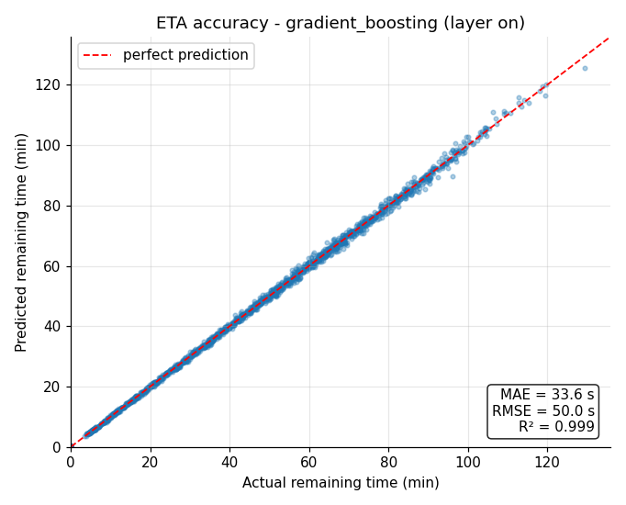
Results 1 — ETA Accuracy: Prediction Quality Is Preserved
Layer ON vs OFF identical (the layer never touches the model)
Model | MAE (s) | RMSE (s) | R²
linear (traditional ML) | 194.4 | 263.1 | 0.9766
gradient_boosting (XGBoost-class) | 33.6 | 50.0 | 0.9992
mlp (deep-model stand-in) | 34.8 | 45.0 | 0.9993
• Lightweight model matches the deep model:
  MAE 33.6 s vs 34.8 s — 1.2 s apart
• Consistent with ref [12]: XGBoost beat heavier models in Phnom Penh
• Traditional linear regression is not expressive enough for ETA (MAE 194 s)
• ⇒ accuracy alone cannot justify the deep model
Notes:
The headline: gradient boosting and the deep network are within ~1 s of each other on MAE. So on this data, the deep model buys almost nothing in accuracy — its real cost shows up next, in resources. That is exactly why profiling matters.

Slide 8
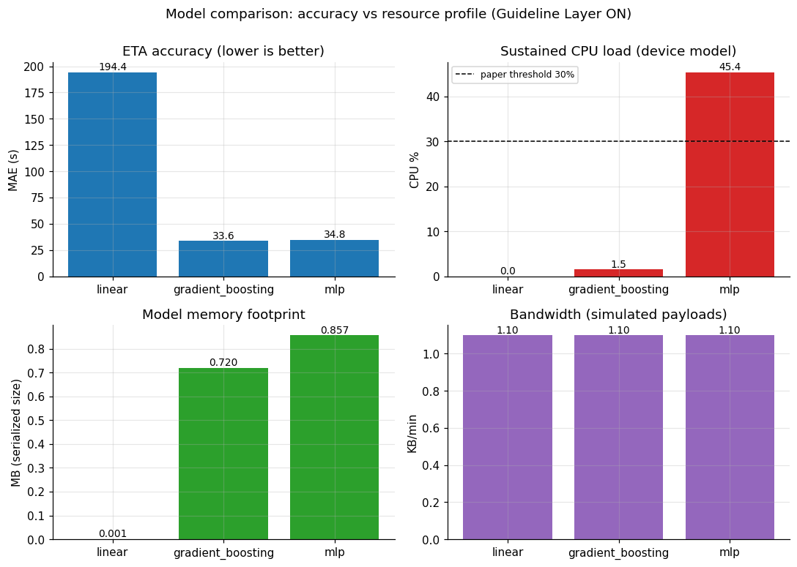
Results 2 — Resource Profiles: Where the Deep Model Pays
Monitoring Engine output, averaged over 1,728 inference cycles per model
• mlp sustains 45.4% CPU — BREACHES the 30% ceiling
• gradient_boosting uses 1.5% — well within limits
  ≈ 97% less sustained CPU for the same accuracy
• RAM: every model fits the 500 MB budget (largest 0.86 MB)
• Bandwidth: ~1.1 KB/min — edge-style payloads, batched cloud sync
• Battery: mlp drains ≈ 13%/hr vs ≈ 3%/hr for the light models
Notes:
This is the layer's key output: a resource report next to every ETA. The deep model violates the CPU threshold; the lightweight model does not, at equal accuracy. The monitoring data makes the trade-off visible instead of guessed.

Slide 9
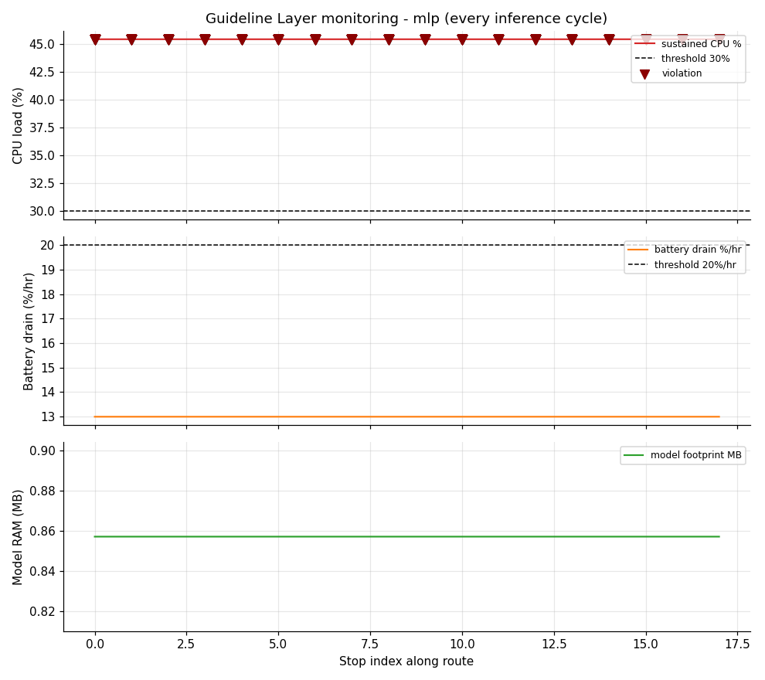
Results 3 — The Closed Loop in Action
Threshold Checker → Warning System, every inference cycle
• CPU load monitored at every stop along the route
• Red triangles: each detected threshold breach
• 1,728 violations for mlp → 432 alerts (cooldown de-duplicates)
• Alerts carry remediation hints, not just symptoms
{"metric": "cpu_percent", "value": 45.4, "limit": 30.0,
"severity": "warning", "count": 1,
"hint": "CPU sustained load too high — consider pruning
the model, reducing inference frequency, or
switching to a lighter architecture"}
Logging Module: JSONL per cycle + periodic cloud sync
Notes:
Zoom into one model's trip: CPU is sampled each stop, every breach is a red triangle. Alerts are de-duplicated by a 120 s cooldown (hence 1,728 violations become 432 alerts) and escalate to critical if they persist. The hint tells the operator WHAT to do — prune, reduce frequency, or swap the model.

Slide 10
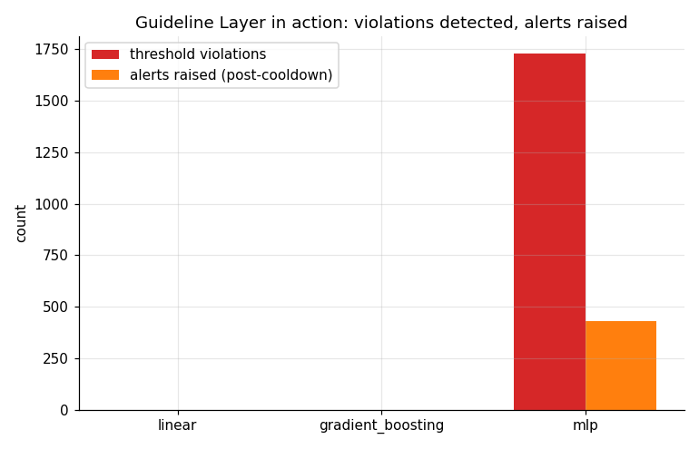
Results 4 — Violations & Alerts by Model
Only the deep model breaches the policy
• linear: 0 violations — 0 alerts
• gradient_boosting: 0 violations — 0 alerts
• mlp: 1,728 violations → 432 alerts
  every inference breaches the CPU policy
  cooldown + escalation keep alerts actionable
• The policy is enforced continuously — a one-off profile could never catch per-cycle drift
Notes:
The layer separates 'within policy' from 'breaching policy' cleanly. Only the deep model triggers alerts, and each alert is actionable. This is the governance the paper argues the field lacks.

Slide 11
Results 5 — The Layer Costs Almost Nothing
Wall-time with the layer ON vs OFF (1728 inferences per model)
Model | Layer ON (s) | Layer OFF (s) | Δ
linear | 1.3 | 0.7 | within noise
gradient_boosting | 8.9 | 10.1 | within noise
mlp | 2.3 | 1.2 | within noise
• The layer samples OS counters and appends small JSONL records
• It never touches the prediction path — overhead is negligible and dominated by run-to-run noise
• Supports the paper's central claim: resource-aware design WITHOUT changing the underlying model
Notes:
Wall time ON vs OFF is within noise for every model — the differences shown are run-to-run variance, not the layer. The layer's work is a few microseconds of counter sampling per cycle plus a tiny log append.

Slide 12
What This Means — Interpreting the Results
The point of the PoC in four bullets
Accuracy ≠ Deployability
The deep model matches the light model (MAE 34.8 s vs 33.6 s) yet uses ~30× the CPU. Accuracy alone cannot choose a model.
Profiling Makes Trade-offs Visible
The layer attaches a resource report to every ETA — the missing column in the literature's tables.
Policy, Enforced Continuously
Per-inference threshold checks catch drift that one-off profiling misses; alerts name the remedy (prune / quantize / swap).
Truly Additive
Runs beside any model, costs ~nothing, changes nothing — the deployment story the paper promises.
Notes:
Four takeaways map the numbers back to the paper's claims: accuracy is not deployability; profiling makes the trade-off visible; enforcement is continuous; and the layer is additive by construction.

Slide 13
Limitations — Stated Honestly
What this PoC is and is not
• Synthetic data: plausible route / traffic / weather model, not real observations (data/make_data.py)
• Device model: CPU & battery are modelled for embedded-class hardware (MACs-based calibration, see guideline_layer/config.py);
  raw laptop measurements are logged in every inference record
• The paper's ~35% saving figure is a literature comparison — this PoC demonstrates the mechanism, not a reproduction
• Next step: real GTFS/GPS data + real hardware (ESP32 / Raspberry Pi) → measured numbers replace modelled ones
Credibility rule: label every modelled number as modelled — the raw measurements are always one file away.
Notes:
We pre-empt the obvious objection: the CPU/battery figures are modelled for the paper's target device class. The honest framing is 'mechanism demonstrated on synthetic data'; measured numbers come in the next phase with real hardware.

Slide 14
Roadmap — From PoC to Full Final-Year Project
Paper Section VIII (Future Work), phased
1 · Real data
GTFS / GPS feed replaces the synthetic generator — model interface unchanged
2 · Real deep model
PyTorch LSTM / GRU in the registry, MACs estimator extended
3 · Real hardware
Profile on ESP32 / Raspberry Pi; calibrate config.py with measured values
4 · Remediation loop
Implement quantization / pruning the Warning System suggests; re-run to show resources drop
5 · Fleet scale
Federated learning on the logging module's periodic cloud sync (paper future work)
Notes:
Each phase has a clear deliverable and reuses the same pipeline, so progress is incremental and demoable at every step.

Slide 15
Thank You — Questions?
Guideline Layer for ETA Prediction in Smart Transportation — Based on Resource Awareness
elangokandhasamy284@gmail.com · Dept. of AI & DS, Nandha Engineering College
Notes:
Invite questions. Anticipated: 'is the CPU number made up?' — raw measurements are real and logged; the sustained % is a transparent model for embedded hardware. 'Does it slow things down?' — overhead is within noise. 'Why is the deep model not more accurate?' — see ref [12]; its cost is resources, which is the point.

