Slide 1
The Crazy Six presents Field Day

Slide 2
Game Idea
Main player is a participant in a research study about genetic mutations
Each level tests a different ability that was developed from the genetic mutation

Slide 3
Similar Games
Portal
Core Fighter 2
http://www.anchorcast.net/corefighter/

Slide 4
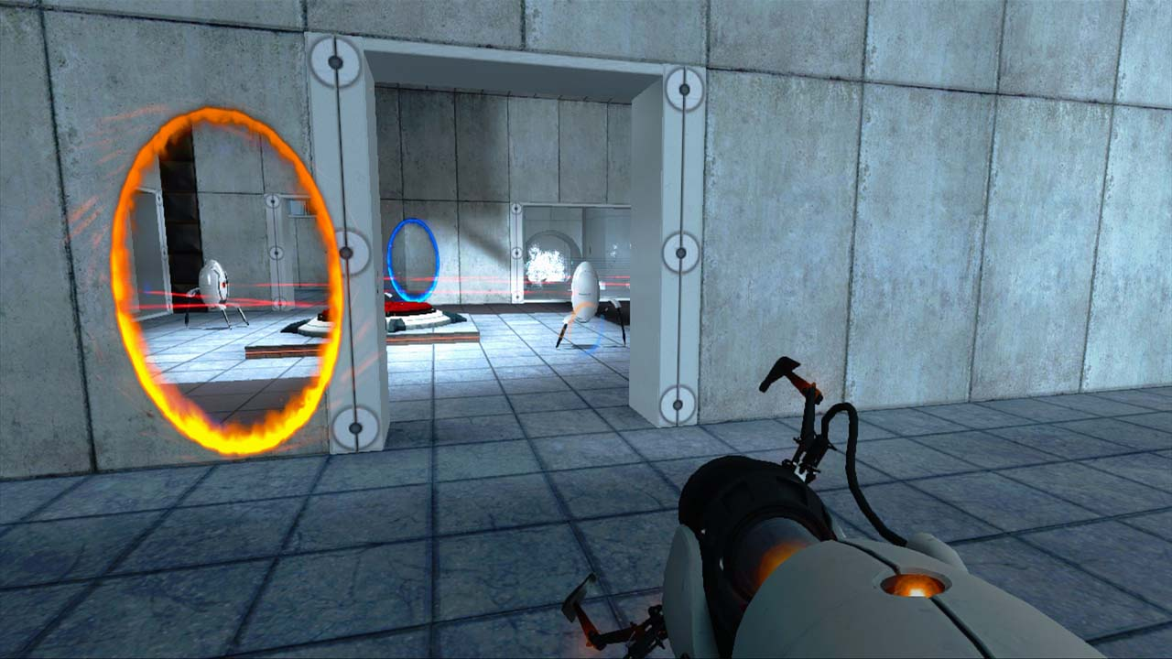

Slide 5
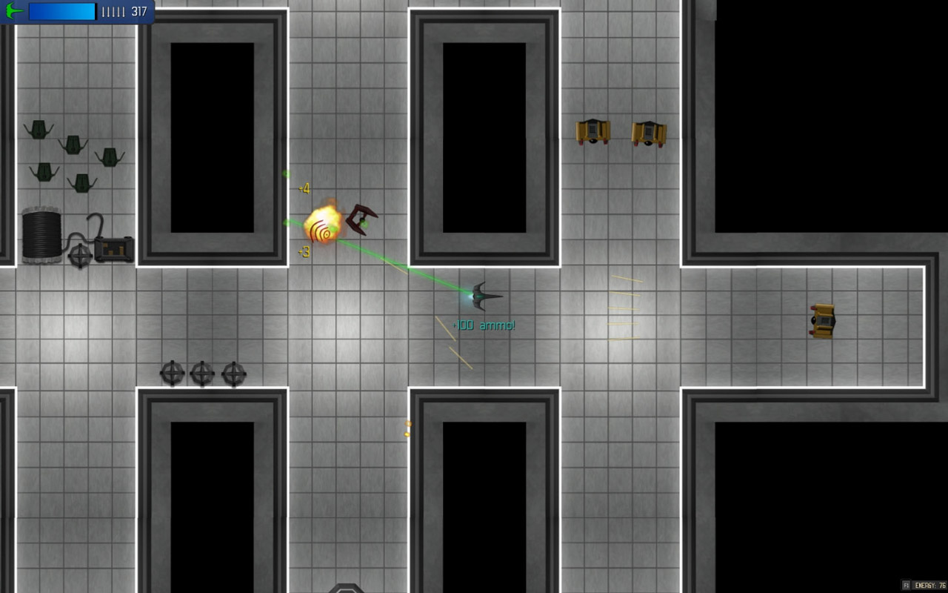

Slide 6
Demo
Action Tiles
Cut Scenes
Maze
Level Editor

Slide 7
Things to Add
Enable active attack on zombies
Traverse back to previous levels
Add more story elements
Voiceovers
Cut Scenes

Slide 8
Questions?

