Slide 1
The Crazy Six presents Field Day

Slide 2
Game Idea
Main player is a participant in a research study about genetic mutations
Each level tests a different ability that was developed from the genetic mutation

Slide 3
Similar Games
Portal
Core Fighter 2
http://www.anchorcast.net/corefighter/

Slide 4
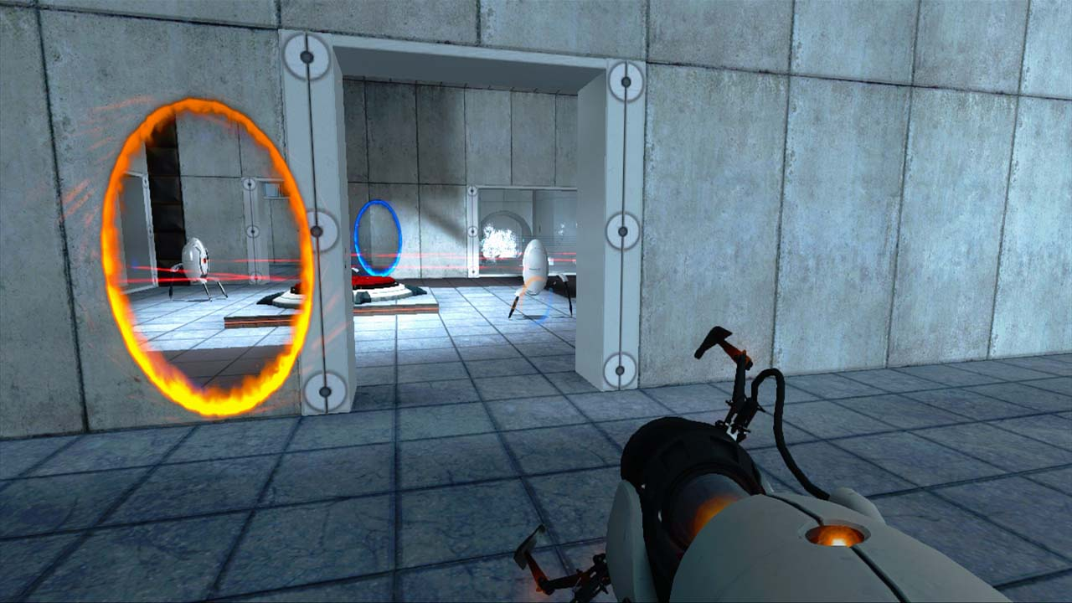

Slide 5
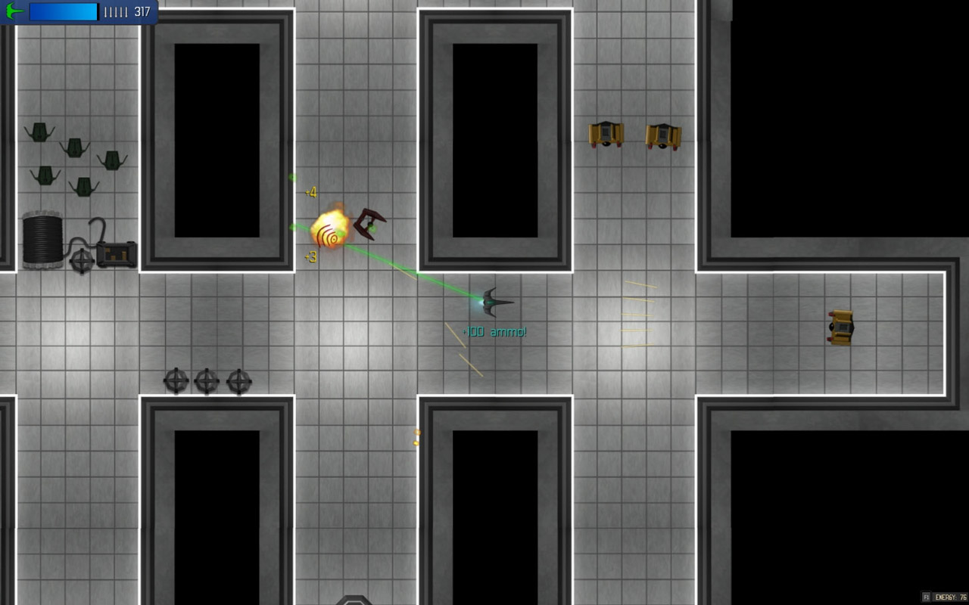

Slide 6
Demo
Level Editor
Cut Scenes
Turret Lever
Maze

Slide 7
3 Things to Add
Enable active attack on zombies
Traverse back to previous levels
Add more story elements
Voiceovers
Cut Scenes

