Slide 1
The Crazy Six presents Field Day
Notes:
Introduce everybody pretty quickly

Slide 2
Game Idea
Main player is a participant in a research study about genetic mutations
Each level tests a different ability that was developed from the genetic mutation

Slide 3
Similar Games
Portal
Core Fighter 2
http://www.anchorcast.net/corefighter/
Notes:
Portal: influenced story - lab environment and getting tested if you can best the level
Core Fighter 2: found recently - graphically similar – we plan on adding lighting effects similar to the ones in the screenshot

Slide 4
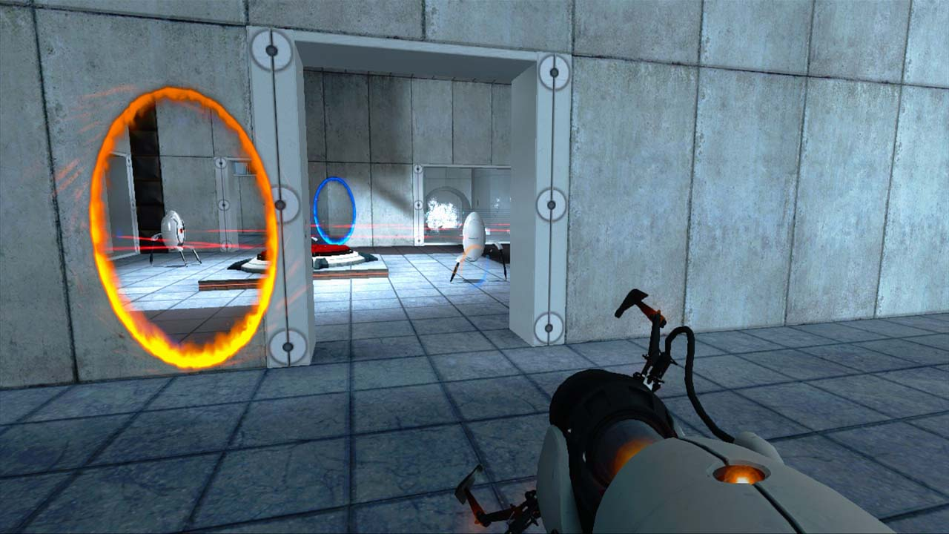

Slide 5
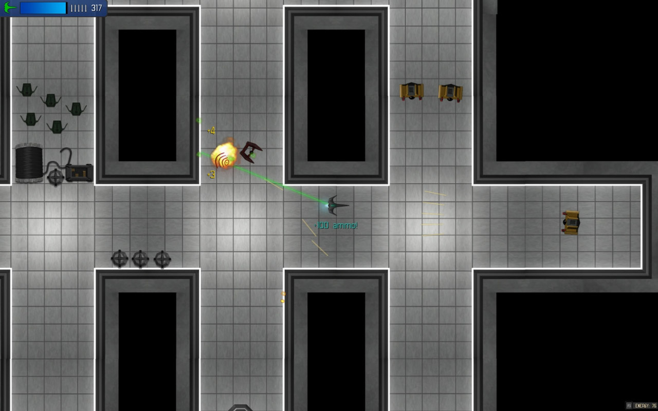
Notes:
Core Fighter 2: graphically similar

Slide 6
Demo
Action Tiles
Cut Scenes
Maze
Level Editor

Slide 7
Things to Add
Enable active attack on zombies
Traverse back to previous levels
Add more story elements
Voiceovers
Cut Scenes
Notes:
Traversing back: code is nearly there – level changes will already persist (items picked up, levers switched stay switched)
We are going to add more music/sound fx

Slide 8
Questions?

