Slide 1

Post-meeting note and email assistant for major-gift fundraisers
Elan Burman · BU.330.760 Generative AI for Business · Spring 2026
Notes:
AfterVisit is a post-meeting assistant for major-gift fundraisers. Bullets in, Salesforce note plus thank-you email out, human approval before anything writes.

Slide 2
Problem and approach
Problem. After every donor meeting, a major-gift officer must produce a Salesforce activity note and a thank-you email. Each takes 15 to 30 minutes. At 5 to 10 meetings per week, this is hours of repetitive work where quality drops as fatigue rises and compliance risks rise with it.
Approach. A decomposed pipeline that converts a few meeting bullets into a schema-valid Salesforce note for the file, and a voice-anchored thank-you email for the donor. Redaction at the input. Human approval gate at the output.
2 / 6
Notes:
30 minutes per meeting times 10 meetings per week is hours of repetitive work where quality and compliance both suffer. Rather than one LLM call doing everything, a decomposed pipeline with the right model for each stage.

Slide 3
Architecture
Bullets
Redact
Note
Haiku + schema retry
Email
Opus + skill exemplars
Human gate
+ Salesforce write
Note uses Haiku (structured extraction); email uses Opus (voice quality).
Voice anchored via portable email-voice skill, with metadata-routed exemplars.
Redaction at input, human approval at output, schema enforcement throughout.
3 / 6
Notes:
Bullets, redact, note (Haiku because it's good at schema-extraction), email (Opus because voice matters), human gate. The email-voice skill is fully portable: a folder of YAML-fronted markdown files. No vector store; at this corpus size, metadata routing is enough.

Slide 4
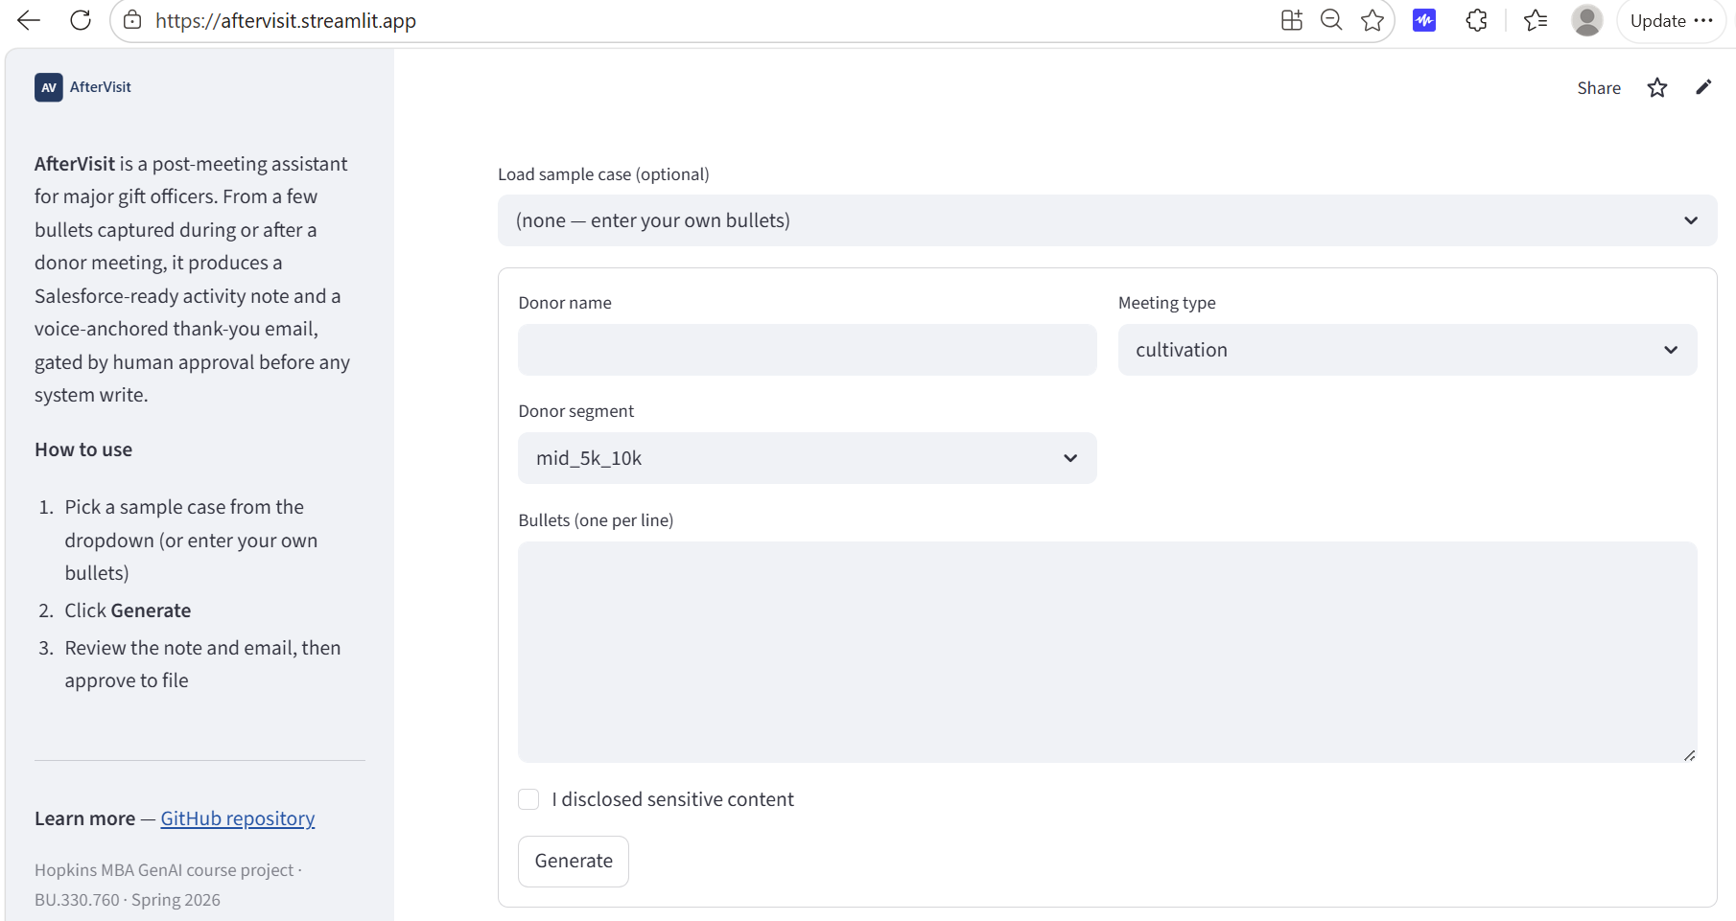
The system in action
Form: bullets, donor segment, meeting type
4 / 6
Notes:
Quick look at the system in action. Bullets and metadata go in on the left.

Slide 5
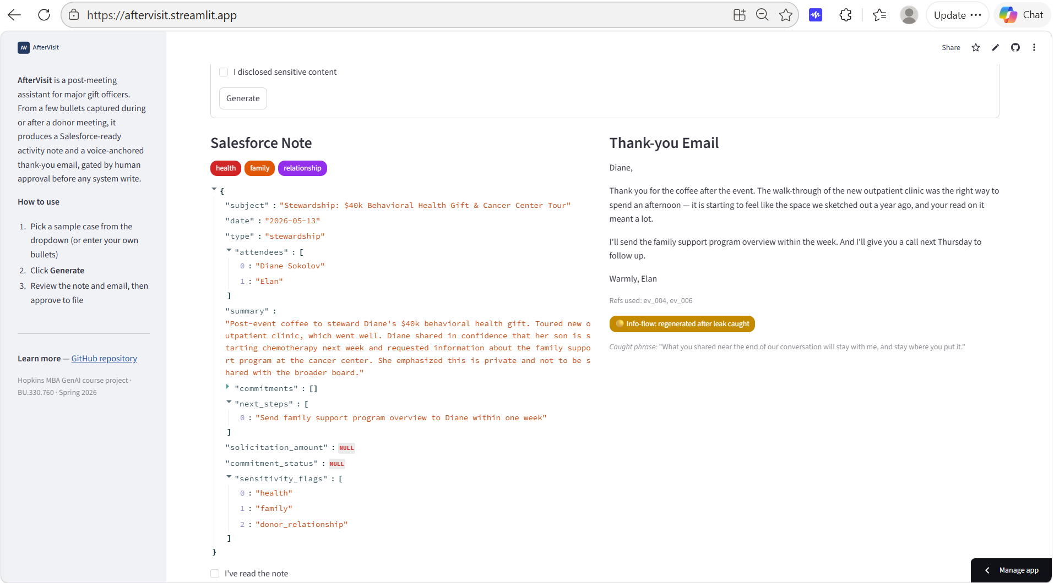
The system in action
Outputs: schema-valid note + voice-anchored email + refs used
4 / 6
Notes:
The note appears as JSON on the left of the output panel, the thank-you email on the right, with the references the skill loaded shown below the email. It also flags sensitivity issues, and denotes whether the email passed cleanly or took a repeat pass.

Slide 6
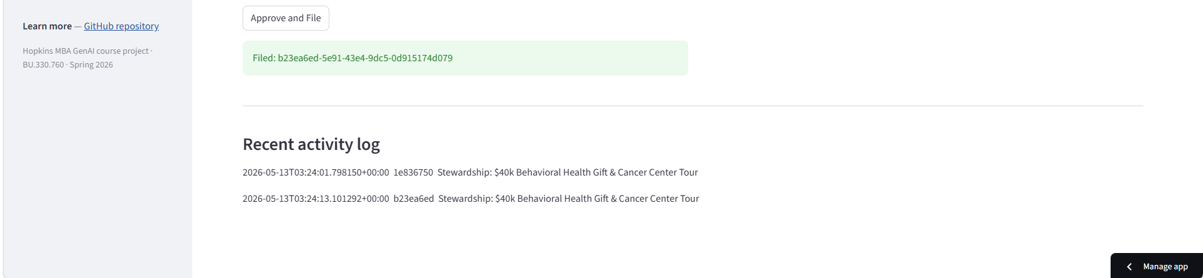
The system in action
Filed: approved entry in the mock Salesforce log
4 / 6
Notes:
Human approves with a checkbox, the entry files to mock Salesforce, and the activity log shows the new row.

Slide 7
Evaluation
Design. 15 synthetic test cases across three conditions, 45 runs in total. baseline_a is a single model call producing both note and email, no schema enforcement, no skill, no redaction. baseline_b is the full pipeline with three fixed exemplars. aftervisit is the full pipeline with skill-routed exemplars.
Scoring. An LLM-as-judge scored each run across 10 rubric dimensions. The judge was validated against five hand-scored cases; 9 of 10 dimensions agreed with the hand scores within 1 point on at least 4 of 5 cases.
Condition | Note | Email | Tool-call | Voice match
baseline_a | 9.9 | 8.4 | 8/15 | 1.00
baseline_b | 9.1 | 9.5 | 15/15 | 2.00
aftervisit | 9.1 | 9.2 | 15/15 | 2.00
5 / 6
Notes:
Three conditions, fifteen test cases. Baseline A is a single LLM call, no schema, no skill, no redaction. Baseline B is the full pipeline with three fixed exemplars. AfterVisit is the full pipeline with skill routing. LLM judge, validated against hand scores on five cases. Read the table top to bottom.

Slide 8
Findings and what comes next
Decomposition earns its place on operational reliability, not rubric points. baseline_a's higher note score (9.9 vs 9.1) masks the fact that 7 of 15 of its notes failed real schema validation; the judge missed these. Tool-call success: 8/15 vs 15/15.
Voice anchoring earns its place. voice_match jumps from 1.00 to 2.00 once the model sees actual MGO-voice exemplars.
Metadata routing ties fixed exemplars at this corpus size. baseline_b and aftervisit both score 2.00 on voice_match. Per the pre-registered threshold, routing's marginal value over static exemplars is not demonstrated at n=15 references. Routing's other claims (corpus scaling, portability) were not measured by this eval.
Known limitations: information-flow ceiling on oblique acknowledgments; corpus organization needs a sensitivity-aware dimension (tc_13 finding); n=15 cases is small.
6 / 6
Notes:
(1) Decomposition wins on tool-call reliability, not rubric points: judge missed that 7 of 15 of Baseline A's notes failed real schema. (2) Voice anchoring is the clear win: 1.0 to 2.0 on voice match. (3) Metadata routing ties fixed exemplars at n=15. The pre-registered threshold called this honestly. Limitations: oblique-acknowledgment ceiling on sensitive cases; corpus needs a sensitivity dimension; n=15 is small. Thank you.

