Slide 1

Exploratory Data Analysis
<Cab Project>
<21.06.2022>
Submitted by : Safi Cengiz
Submitted date : 21.06.2022

Slide 2

Agenda
Executive Summary
Problem Statement
Approach
EDA
EDA Summary
Recommendations

Slide 3
Executive Summary
Private investment company XYZ in the United States has plans to grow their presence in the taxicab industry.
They need to acquire some data that can provide them with insights into the current cab investment market.Using the data analytics, they need to determine which company they should invest in so that they can achieve the greatest possible profit.
The purpose of this project is to offer pertinent recommendations that will assist Cab Investments in making decisions that are in line with their Go-to-Market (G2M) strategy.

Slide 4
Problem Statement
Putting money into the taxi industry could be smart choice, but they need to figure out which specific company to put their money into first.
Due to the intense level of competition that currently exists in the taxi industry, prior to investing money in the sector, it is essential to make careful observations and conduct thorough market research.
It is essential to collect sufficient data from a variety of sources, properly analyse the data, compare the offerings of various competitors, determine the factors that affect the market, comprehend the characteristics that promote the business, and finally select the appropriate company.

Slide 5
Approach
Collect data
Analyze the data
Detect outliers
Combine datasets
Detect correlations
Analyze patterns
Provide insights
Create model for predict profit by features
Tools used – Python, Pycaret, Numpy, Pandas

Slide 6

Exploratory Data Analysis
Datasets used:
Cab_Data.csv – Details of transaction for pink and yellow cab companies
Customer_ID.csv – Mapping table that contains a unique identifier which links the customer’s demographic details
Transaction_ID.csv – Mapping table that contains transaction to customer mapping and payment mode
City.csv – List of USA cities, their population and number of cab users
This Photo by Unknown Author is licensed under CC BY-ND

Slide 7
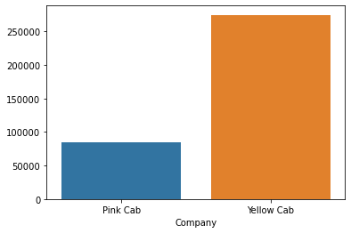
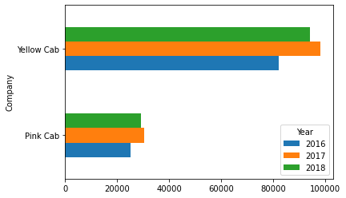
Pink cab and yellow cab distribution rates as general .
Exploratory Data Analysis
Pink cab and yellow cab distribution rates by years.

Slide 8
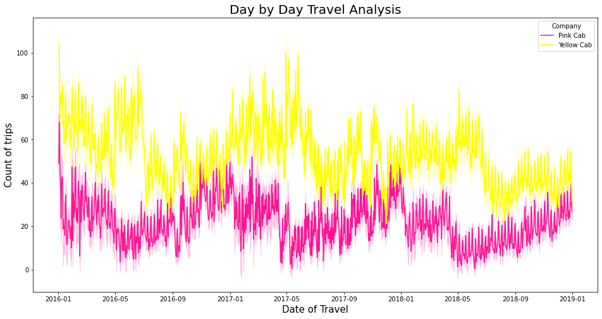
Date of Travel Analysis
The seasonality of trips is revealed by an overall analysis of the data based on the passage of time. There is a consistent pattern that repeats itself every year.
Beginning in January and continuing through December, the total number of trips taken has been steadily climbing throughout the year. This recurring pattern occurs every year.

Slide 9
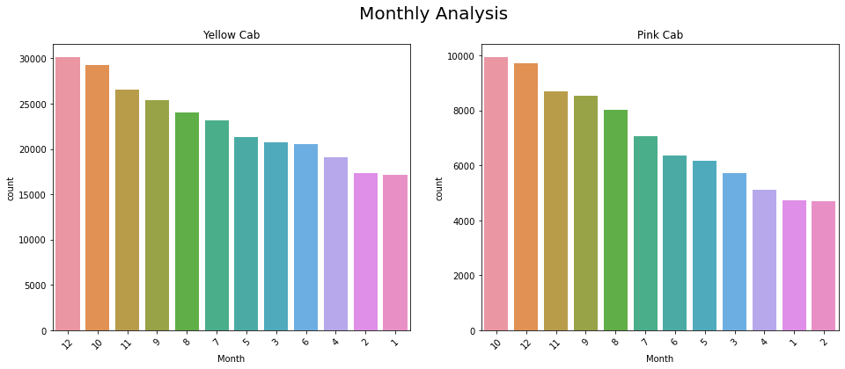
Monthly: Date of Travel Analysis
The highest total number of trips for both cabs was recorded in the months of December and October.
The lowest numbers are recorded in February and January.

Slide 10
Profit Analysis
Yellow cab has much more revenue than pink cab.

Slide 11
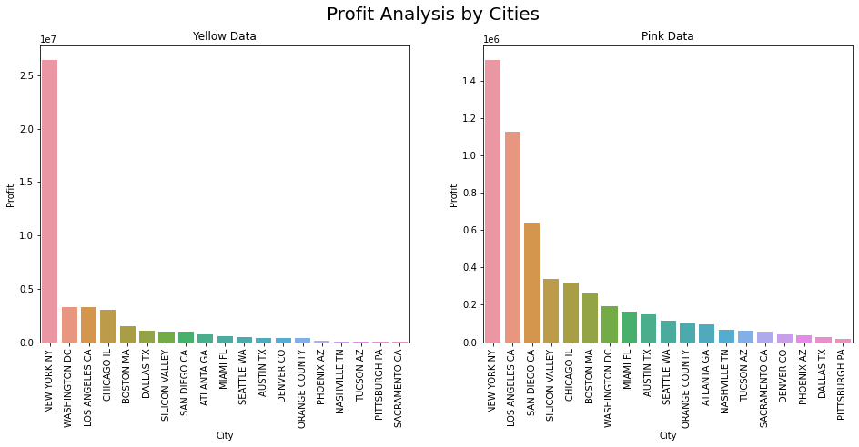
Profit Analysis:City
Yellow cab is more profitable for investors, but if we desire invest certain cities, people in some cities prefer Pink cab more.

Slide 12
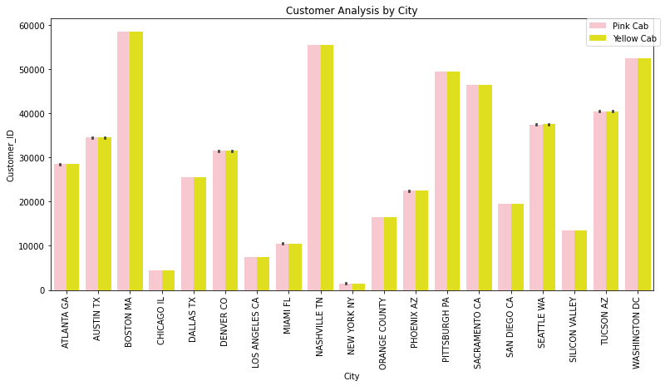
Profit Analysis:City

Slide 13
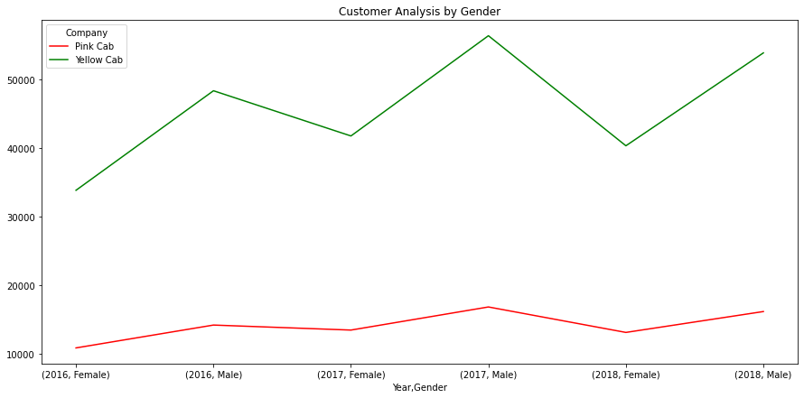
Customer Analysis: Gender
Male using more cab then females in general but, its obvious different in yellow cab while in pink cab its not that much different.

Slide 14
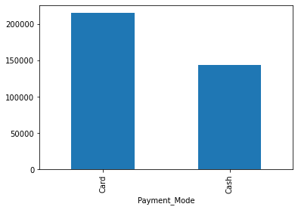
Customer Analysis: Payment
Card payment definitely support as infrastructure, Because customers prefer credit card more often than cash.

Slide 15
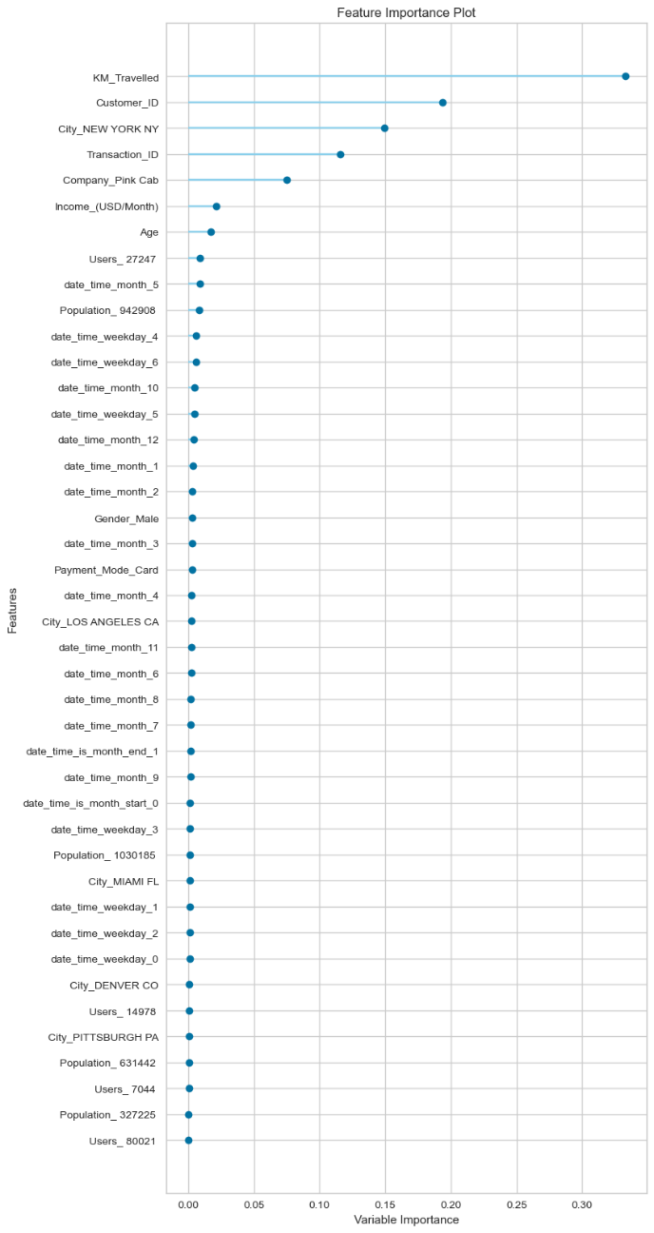
Modelling Feature importance
We’ll modelling for predict profit with other features.

Slide 16
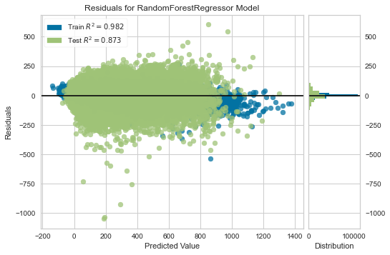
Modelling : Best Model
Best model for predicting profit is Random Forest Regressor. 0.87 fitted for test dataset.

Slide 17
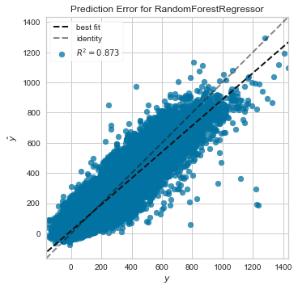
Modelling : Best Model
0.87 fitted for test dataset. This graph shows how fit model on dataset. If nodes on lines, it means it fitted very well . Far dots means outliers.

Slide 18
EDA Summary
Seasonality and year makes different trends
Profit Analysis
gender, city analysis
Payment methods
We predicted profit with model, while we removed 'ProfitPercentage','Year','Month','Price_Charged','Cost_of_Trip’ these features.

Slide 19
Recommendations
Yellow Cab is the superior option for financial commitments.In the analysis conducted on a daily, monthly, and yearly basis, it has a greater number of customers and trips.
Yellow cabs are becoming increasingly popular in every city in the world.The profit generated by yellow cabs is higher than those generated by pink cabs.

Slide 20
Thank You

