Slide 1
Stroke Risk Prediction
Using EDA & Machine Learning Model

Slide 2
About the Dataset
70000 rows, 18 columns (+1 column added later)
15 columns were binary values of symptoms (1 = present, 0 = not present)
No missing data
Columns: [age, chest pain, shortness of breath, irregular heartbeat, fatigue & weakness, dizziness, swelling, pain in neck/jaw/shoulder/back, excessive sweating, persistent cough, nausea/vomiting, high blood pressure, chest discomfort, cold hand/feet, snoring/sleep apnea, anxiety, stroke risk (%), at risk (binary), # of symptoms]

Slide 3
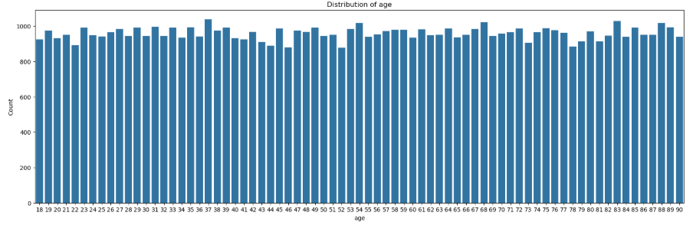
EDA – histograms

Slide 4
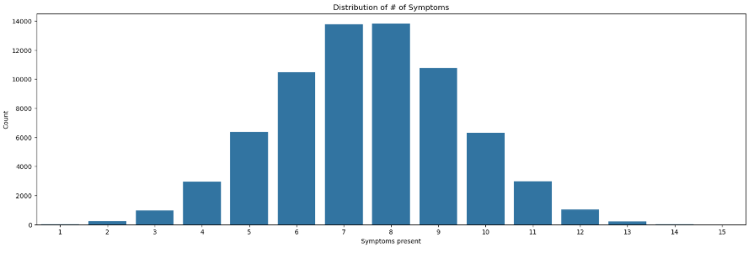
EDA – histograms

Slide 5
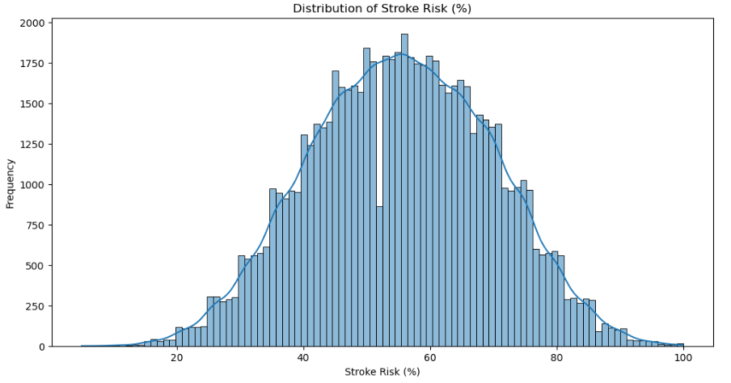
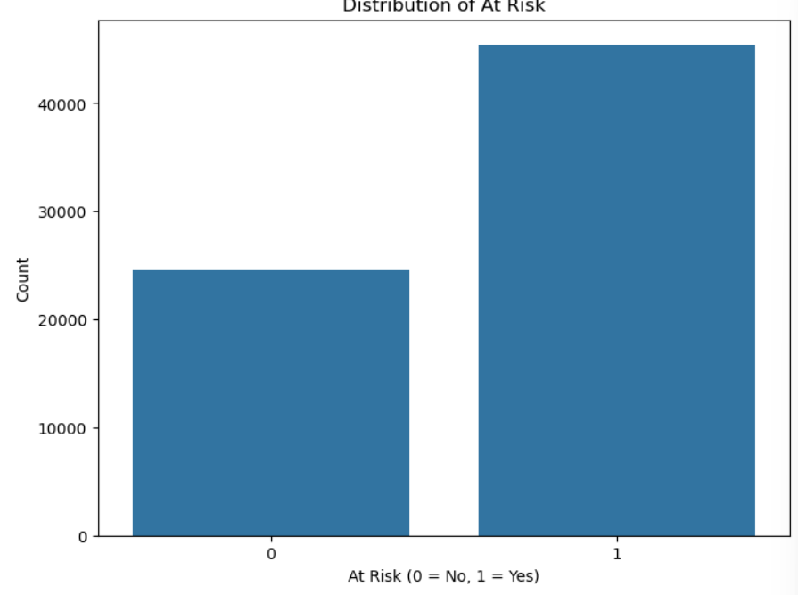
EDA – histograms

Slide 6
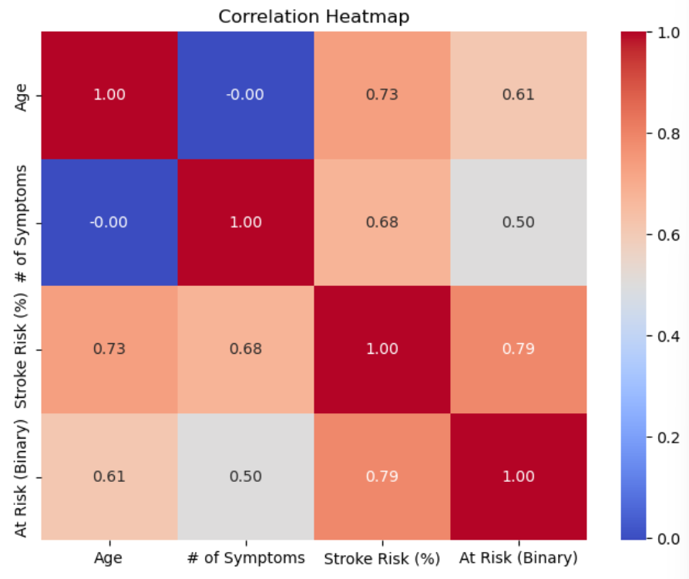
EDA – heat map

Slide 7
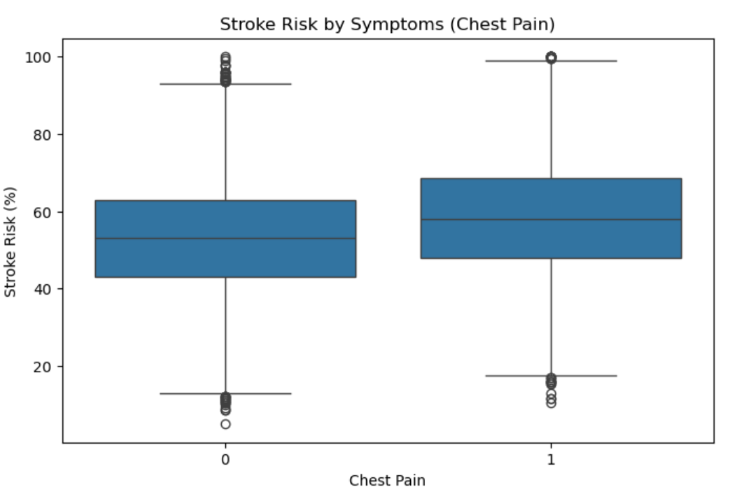
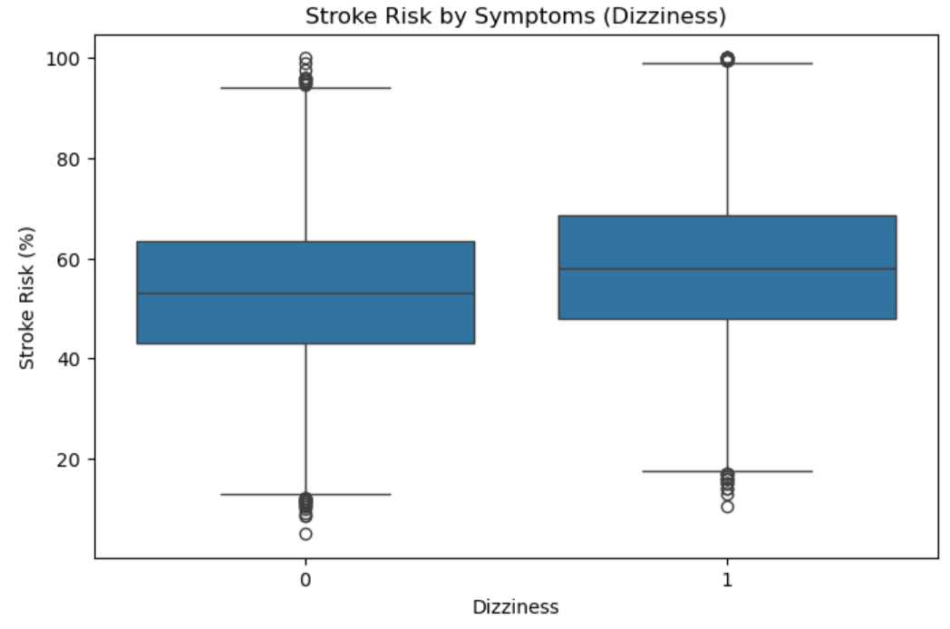
EDA – box plots

Slide 8
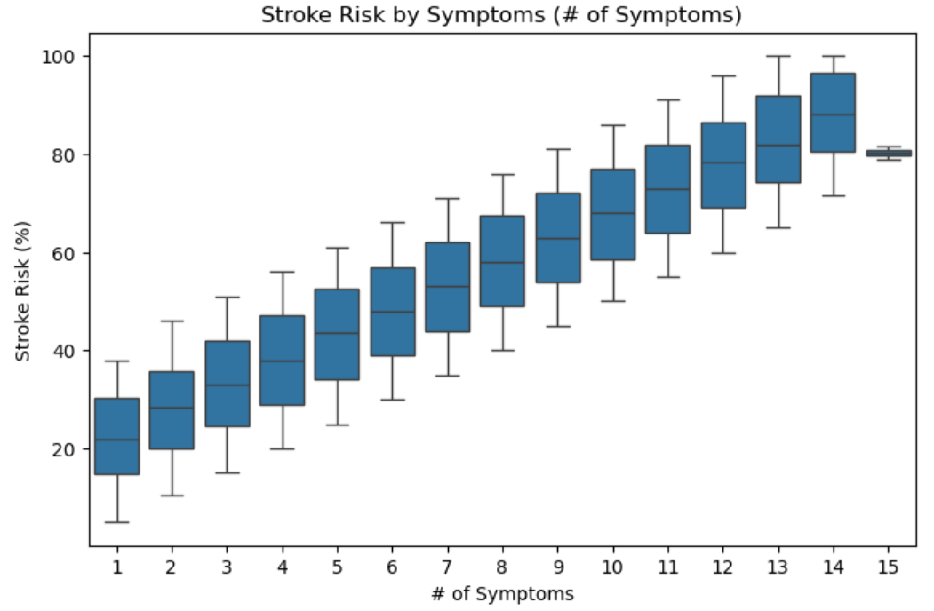
EDA - boxplots

Slide 9
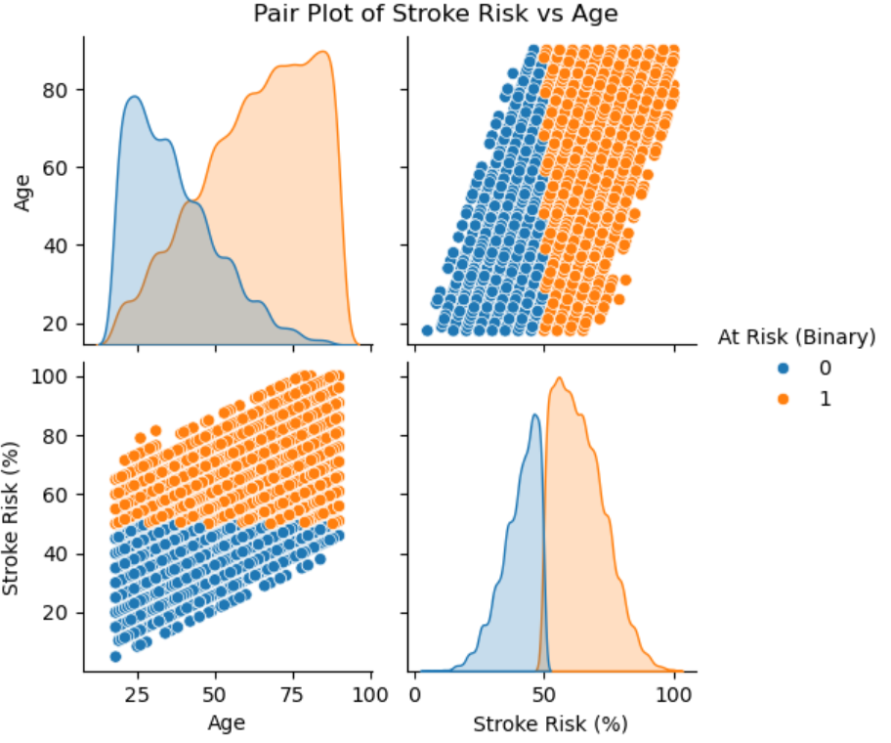
EDA – pair plot

Slide 10
Regression Models
Model 1: uses all data, 80/20 train/test split
Model 2: uses all data, 70/30 train/test split
Model 3: uses age & cardiovascular/neurological symptoms only, 80/20 split
Model 4: uses age & cardiovascular/neurological symptoms only, 70/30 split
Selected symptoms: ['Chest Pain', 'Irregular Heartbeat', 'Fatigue & Weakness', 'Dizziness', 'High Blood Pressure', 'Chest Discomfort (Activity)', 'Anxiety/Feeling of Doom']

Slide 11
Regression Model results
Model 1:
Mean squared error 7.212163808644858e-05
Root mean squared error 0.008492445942509648
R square 0.9999996485993495
Model 2:
Mean squared error 4.8791215880574506e-05
Root mean squared error 0.006985070928814861
R square 0.9999997616331122
Model 3:
Mean squared error 48.810700807936094
Root mean squared error 6.9864655447469355
R square 0.7621780027634335
Model 4:
Mean squared error 49.599389343884184
Root mean squared error 7.04268339085921
R square 0.7576848238163447

Slide 12
Limitations & Improvements for the Future
Health-related data does not tend to be linear
First, look at data of people who have already had strokes and what their combination of symptoms were
Also look at whether or not a person has had a stroke in the past

Slide 13
Conclusion
Age & stroke risk % have a strong positive correlation
The more symptoms a person has at one time drastically increases their risk of having a stroke
Just looking at cardiovascular & neurological symptoms does not provide accurate insight into stroke risk

