Slide 1


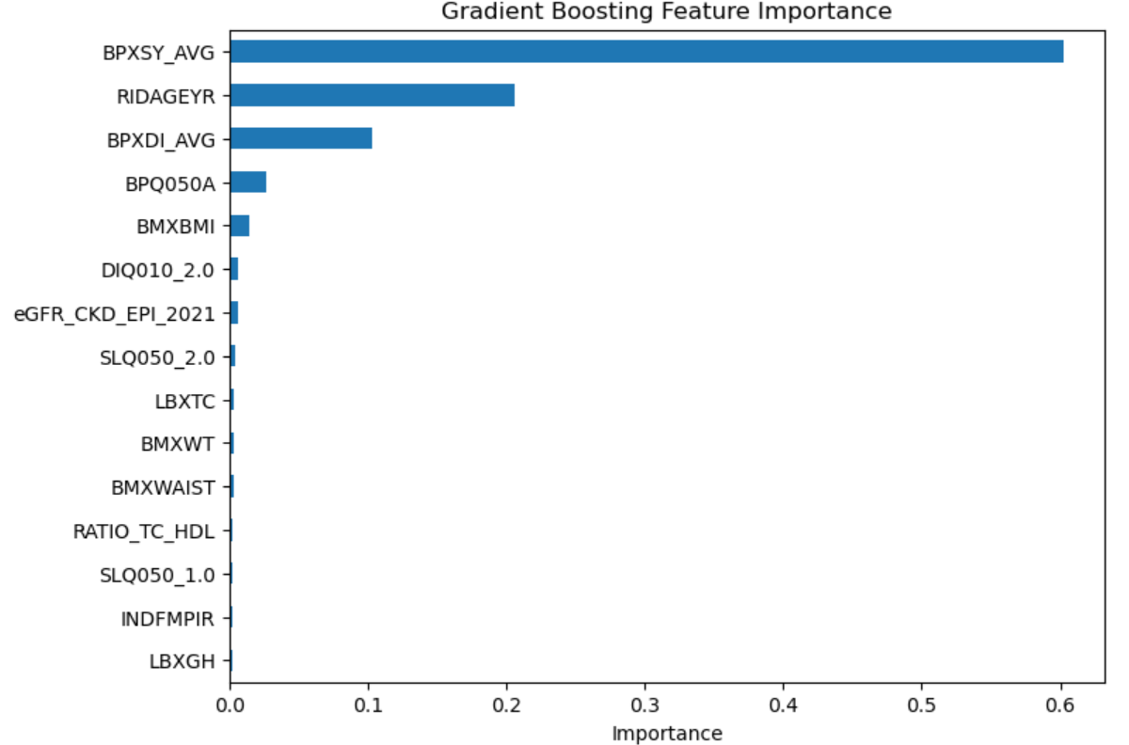
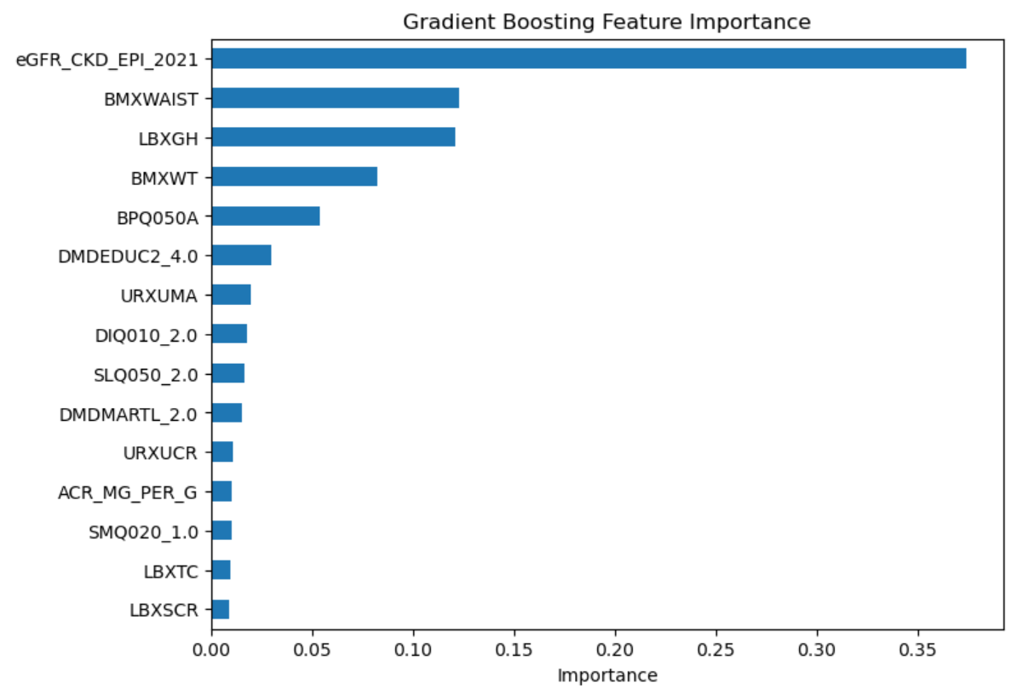
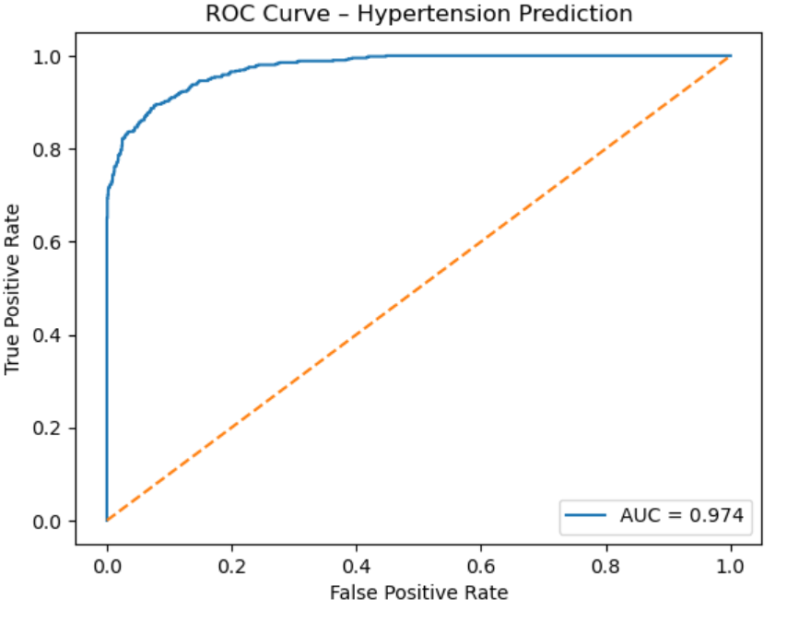

Predicting Cardiometabolic Risk Using Machine Learning
Ellie Landoch
Bellarmine University Data Science Program
Advisor: Dr. Andrew Karem
Abstract
Methods
Results
This project uses machine learning models to predict hypertension risk using demographic, lifestyle, and clinical health data from the NHANES dataset. Logistic regression, random forest, and gradient boosting models were developed and compared. Model performance was evaluated using accuracy, precision, recall, F1 score, and ROC curves. Gradient boosting showed the strongest performance. Results show that while blood pressure is a strong predictor, models still perform well without it, indicating that other health factors also contribute to risk prediction.
Data Preprocessing
Removed variables with large amounts of missing data
Standardized numeric variables
Train/test split (80/20)
Models
Logistic Regression – baseline statistical model
Random Forest Classifier – ensemble of decision trees
Gradient Boosting – sequential learning model
Model Performance:
Metric | Score
Accuracy | 0.93
Precision | 0.92
Recall | 0.83
F1 Score | 0.87
Best performance achieved using Gradient Boosting with BP variables.
Introduction
Model Evaluation
Key Findings
Gradient Boosting achieved the highest performance among the models tested (Accuracy = 0.93, AUC = 0.98)
Removing blood pressure variables reduced model performance
Models still performed well without BP (AUC ≈ 0.93)
Other factors (age, kidney function, lifestyle) also contribute to risk prediction
Top Predictors:
Systolic/Diastolic blood pressure
Age
BMI & Weight
Kidney function indicators
Sleep disorder indicators
Cholesterol
Waist circumference
Glycohemoglobin
Poverty income ratio
Education level
Cardiovascular disease is one of the leading causes of death worldwide.
Early detection of risk factors allows for preventative treatment and improved patient outcomes.
Machine learning models can identify patterns in health data that help predict disease risk.
Predictive models can help healthcare providers identify individuals at higher risk and support preventative treatment strategies.
Performance metrics used:
Accuracy – overall correctness of predictions
Precision – how often positive predictions are correct
Recall – how well the model identifies true positives
F1 Score – balance between precision and recall
ROC Curve (AUC) – ability to distinguish between risk vs no risk
These metrics measure how accurately the model identifies individuals with and without hypertension risk.
Gradient Boosting feature importance identifying the strongest predictors of hypertension risk.
Objectives
Identify predictors of hypertension using demographic, lifestyle, and clinical health data
Develop predictive models using machine learning techniques
Evaluate model performance using classification metrics
Understand how health factors contribute to cardiovascular risk
Dataset
Gradient Boosting feature importance excluding systolic/diastolic blood pressure and age.
NHANES Cardiometabolic Dataset
Collected by the CDC
~10,000 U.S. adults
Demographic, lifestyle, and clinical variables
Includes blood pressure, BMI, cholesterol, smoking behavior, kidney function indicators, etc.
Conclusion
Future Work
ROC curve showing the model’s ability to distinguish between individuals with and without hypertension risk.
Machine learning models were effective in predicting hypertension risk using health and lifestyle data. Gradient boosting produced the strongest performance across all metrics.
While blood pressure was a key predictor, model performance remained high even when it was removed, showing that other variables such as age, kidney function, and lifestyle factors also play an important role.
These results suggest that predictive models can help identify at-risk individuals even when complete clinical data is not available.
This approach demonstrates the potential of early risk detection and helps guide preventative healthcare strategies.
Test additional machine learning models
Improve feature selection and preprocessing
Apply models in clinical screening tools
Expand analysis to predict additional cardiovascular outcomes
Explore use in early detection for at-risk populations
Model | Variables | Accuracy | AUC
Logistic Regression | With BP | 0.89 | 0.96
Random Forest | With BP | 0.92 | 0.97
Gradient Boosting | With BP | 0.93 | 0.98
Random Forest | Without BP | 0.84 | 0.92
Gradient Boosting | Without BP | 0.86 | 0.93
Contact Information
Ellie Landoch
elandoch@bellarmine.edu
Bellarmine University Data Science Program
Model performance decreased when blood pressure variables were removed, highlighting the importance of feature selection and data availability in predictive modeling.
References
Centers for Disease Control and Prevention (CDC). National Health and Nutrition Examination Survey (NHANES). https://www.cdc.gov/nchs/nhanes/
Kaggle. NHANES Cardiometabolic Dataset. https://www.kaggle.com/
DataCamp. Random Forest Classifier in Python. https://www.datacamp.com/tutorial/random-forests-classifier-python
Data36. Random Forest in Python. https://data36.com/random-forest-in-python/
DataCamp. Guide to the Gradient Boosting Algorithm. https://www.datacamp.com/tutorial/guide-to-the-gradient-boosting-algorithm
Stack Overflow. How to Plot ROC Curve in Python. https://stackoverflow.com/questions/25009284/how-to-plot-roc-curve-in-python

